Slide 1
Search for ^{283,284,285}Fl
decay chains
Krzysztof P. Rykaczewski
Physics Division, Oak Ridge National Laboratory
for the Russia - US - Poland collaboration
JINR:
V.K. Utyonkov, Yu.S.Tsyganov, A.N. Polyakov, A.A.Voinov,
Yu.Ts. Oganessian, F.Sh. Abdullin, S.N. Dmitriev, M.G. Itkis,
A.V. Sabelnikov, R.N. Sagaidak, I.V. Shirokovsky,
M.V. Shumeiko, V.G. Subbotin, A.M. Sukhov,
and G.K. Vostokin
ORNL:
N. T. Brewer, K. Miernik*, J. B. Roberto, K. P. Rykaczewski
*now University of Warsaw
UTK/ORNL: R. K. Grzywacz
Vanderbilt: J. H. Hamilton
LLNL: R. A. Henderson and M. A. Stoyer
ARIS 2014, Tokyo, June 2014

Slide 2
120
119
118 |  |  |  |  |  |  |  |  |  |  |  |  |  |  |  |  |  |  |  |  |  | ²⁹⁴118 0.7 ms
117 |  |  |  |  |  |  |  |  |  |  |  |  |  |  |  |  |  |  |  |  |  | ²⁹³117 20 ms | ²⁹⁴117 50 ms
116 |  |  |  |  |  |  |  |  |  |  |  |  |  |  |  |  |  |  |  | ²⁹⁰Lv 8 ms | ²⁹¹Lv 6.3 ms | ²⁹²Lv 12 ms | ²⁹³Lv 60 ms
115 |  |  |  |  |  |  |  |  |  |  |  |  |  |  |  |  |  | ²⁸⁷115 40 ms | ²⁸⁸115 0.16 s | ²⁸⁹115 0.3 s | ²⁹⁰115 0.8 s
114 |  |  |  |  |  |  |  |  |  |  |  |  |  |  |  |  | ²⁸⁵Fl 0.12 s | ²⁸⁶Fl 0.12 s | ²⁸⁷Fl 0.51 s | ²⁸⁸Fl 0.6 s | ²⁸⁹Fl 2 s
113 |  |  |  |  |  |  |  |  |  |  | ²⁷⁸113 1.4 ms |  |  |  | ²⁸²113 70 ms | ²⁸³113 90 ms | ²⁸⁴113 0.9 s | ²⁸⁵113 4 s | ²⁸⁶113 8 s
112 |  |  |  |  |  |  |  |  |  |  | ²⁷⁷Cn 0.69 ms |  |  |  | ²⁸¹Cn 97 ms | ²⁸²Cn 0.8 ms | ²⁸³Cn 4.0 s | ²⁸⁴Cn 90 ms | ²⁸⁵Cn 30 s
111 |  |  |  |  |  |  | ²⁷²Rg 3.8 ms |  | ²⁷⁴Rg 13 ms |  |  |  | ²⁷⁸Rg 4 ms | ²⁷⁹Rg 0.12 s | ²⁸⁰Rg 4.8 s | ²⁸¹Rg 17 s | ²⁸²Rg 2 m
110 |  |  |  |  | ²⁶⁹Ds 0.18 ms | ²⁷⁰Ds 0.1 ms | ²⁷¹Ds 163 ms |  | ²⁷³Ds 0.17 ms |  |  |  | ²⁷⁷Ds 5.7 ms |  | ²⁷⁹Ds 0.2 ms |  | ²⁸¹Ds 14 s
109 |  |  | ²⁶⁶Mt 1.7 ms |  | ²⁶⁸Mt 21 ms |  | ²⁷⁰Mt 0.48 s |  |  |  | ²⁷⁴Mt 0.4 s | ²⁷⁵Mt 25 ms | ²⁷⁶Mt 0.65 s | ²⁷⁷Mt 5 ms | ²⁷⁸Mt 5 s
108 |  | ²⁶⁴Hs 0.46 s | ²⁶⁵Hs 2.0 ms | ²⁶⁶Hs 2.3 ms | ²⁶⁷Hs 52 ms |  | ²⁶⁹Hs 9.7 s | ²⁷⁰Hs 3.6 s | ²⁷¹Hs 4 s |  | ²⁷³Hs 0.26 s |  | ²⁷⁵Hs 0.16 s |  | ²⁷⁷Hs 3 ms
107 | ²⁶²Bh 102 ms |  | ²⁶⁴Bh 440 ms |  | ²⁶⁶Bh 2.1 s | ²⁶⁷Bh 17 s |  |  | ²⁷⁰Bh 60 s | ²⁷¹Bh 1.7 s | ²⁷²Bh 11 s |  | ²⁷⁴Bh 40 s
106 | ²⁶¹Sg 0.23 s | ²⁶²Sg 8 ms | ²⁶³Sg 0.9 s |  | ²⁶⁵Sg 13 s | ²⁶⁶Sg 21 s | ²⁶⁷Sg 2 m |  | ²⁶⁹Sg 2.2 m |  | ²⁷¹Sg 2.4 m
105 | ²⁶⁰Db 1.5 s | ²⁶¹Db 1.8 s | ²⁶²Db 39 s | ²⁶³Db 27 s |  |  | ²⁶⁶Db 22 m | ²⁶⁷Db 80 m | ²⁶⁸Db 30 h |  | ²⁷⁰Db 1 h
104 | ²⁵⁹Rf 3 s | ²⁶⁰Rf 21 ms | ²⁶¹Rf 5.3 s | ²⁶²Rf 2.1 s | ²⁶³Rf 11 m |  | ²⁶⁵Rf 105 s |  | ²⁶⁷Rf 2.3 h
103 | ²⁵⁸Lr 3.9 s | ²⁵⁹Lr 6.3 ms | ²⁶⁰Lr 3 m | ²⁶¹Lr 39 m | ²⁶²Lr 3.8 h |  |  |  | ²⁶⁶Lr 10 h
102 | ²⁵⁷No 24.5 s | ²⁵⁸No 1.2 ms | ¹⁵⁹No 58 m | ²⁶⁰No 108ms |  | ²⁶²No 5 ms
Z/N | 155 | 156 | 157 | 158 | 159 | 160 | 161 | 162 | 163 | 164 | 165 | 167 | 168 | 169 | 170 | 171 | 172 | 173 | 174 | 175 | 176 | 177 | 178 | 179 | 180
⁴⁸Ca+actinides
Hot Fusion Island
of over 50 nuclei
~1 pb
~20 fb
²⁸⁴Fl
0.4 ms
~10 pb
Nuclear Mainland
Fission is terminating
the decay chains
at the Island

Slide 3
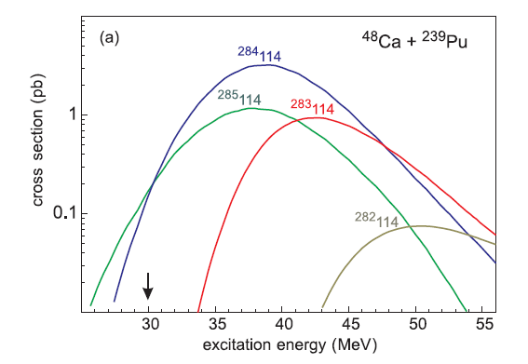
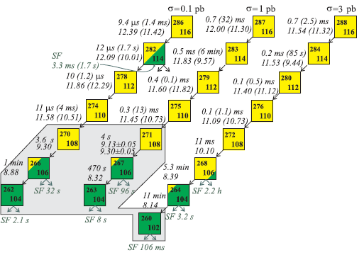
Zagrebaev, Karpov, Greiner; PR C85, 014608, 2012
Cross section values
σ ~ 1 – 3 picobarn
E*~38 MeV maximizes σ(²⁸⁴Fl)
Kowal 2014: E_{α}~11.5 MeV
Muntian 2003: E_{α}~11.5 MeV, 0.2 ms
Moeller 1997: E_{α}~ 9.4 MeV, 85 s
very rich decay properties
were predicted by Zagrebaev et al

Slide 4
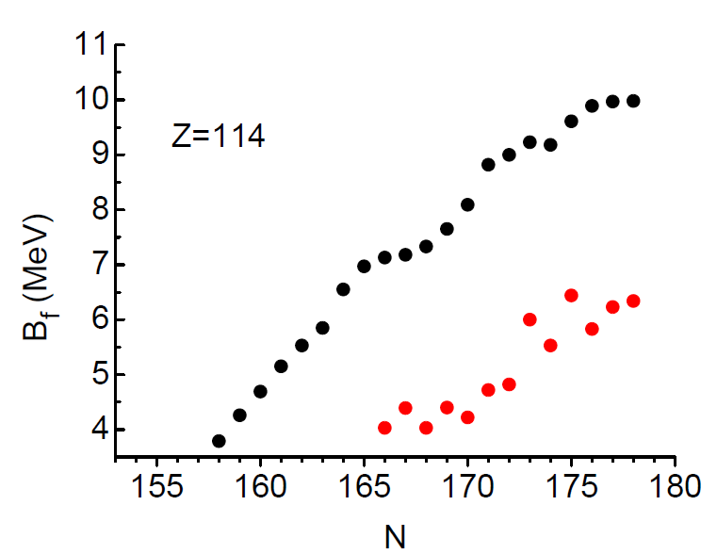
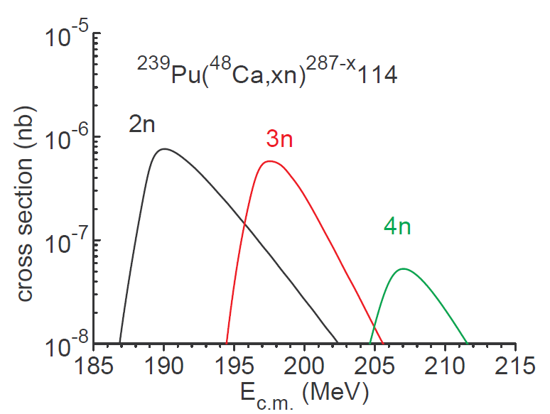
Krystyna Wilczyńska et al., PR C86, 2012 got 1000 times lower cross sections
using fission barriers values B_{f} from M. Kowal et al in cross-section calculations
Moeller et al., PR C79, 2009
Kowal et al
PR C 82, 2010
EXP
note the ~ 0.7 MeV drop in B_{f} value between ²⁸⁵Fl and ²⁸⁴Fl
K. Wilczyńska: ~ 300 keV difference in Bf value corresponds to
about an order of magnitude change in calculated cross-section value

Slide 5
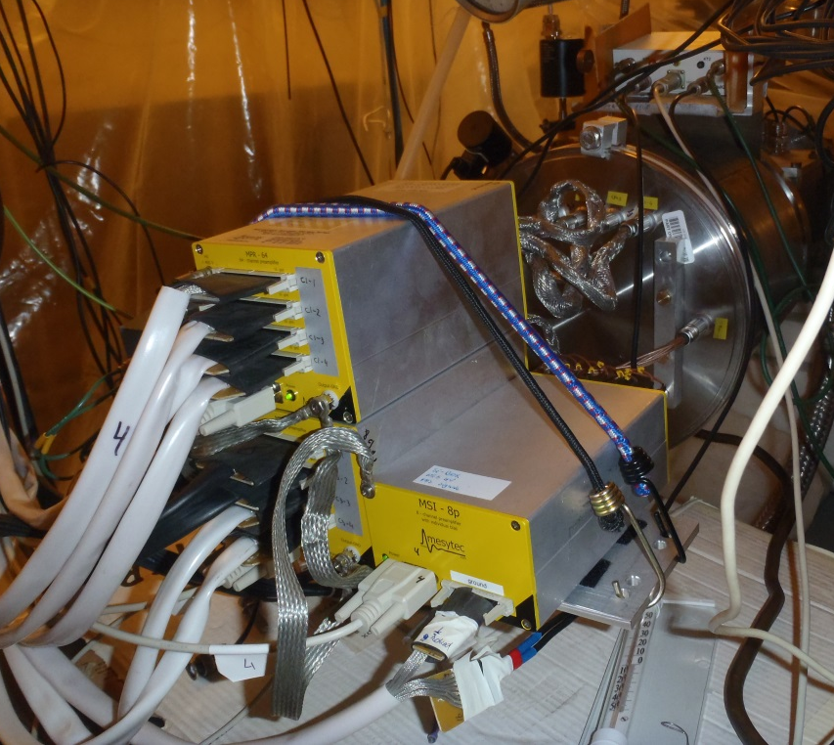
Connecting Hot Fusion Island with Nuclear Mainland
search for new Z=114 Flerovium isotopes and their decay products
4n 3n 2n ²⁴⁰Pu+⁴⁸Ca
4n 3n 2n ²³⁹Pu+⁴⁸Ca
new detectors and preamps
at the focal plane of DGFRS
²⁴⁰Pu material from Oak Ridge
delivered to Dubna on 27thDec. 2013
(after 1 year of paperwork)
Vladimir Utyonkov’s estimations

Slide 6
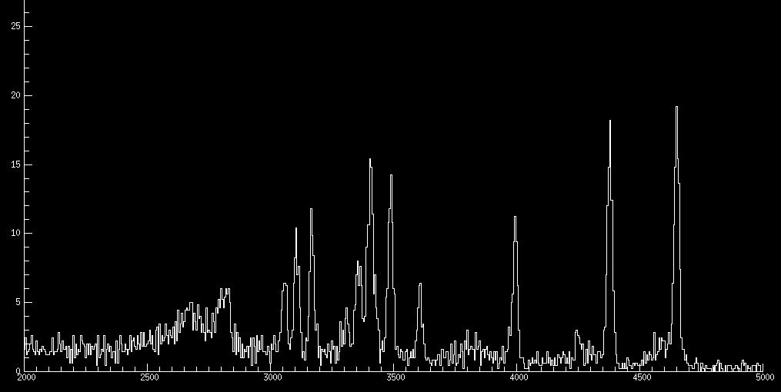
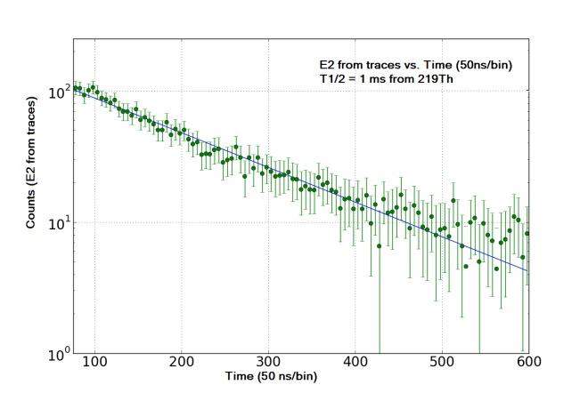
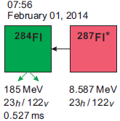
ORNL-UTK multi-detector and digital data acquisition system operating at the Dubna Gas Filled Recoil Separator (DGFRS)
standard mode
217Th
9.3 MeV
α-emitters including
1 μs activity of ²¹⁹Th
studied at the DGFRS
during ⁴⁸Ca+^{nat}Yb run
Nov.-Dec. 2013
219Th
T_{1/2}=1 μs
215Ra
8.7 MeV
trace mode
pile-up’s only
216Th
7.9 MeV
energy of α-particles
Evidence for fast SF-decay
of new super heavy isotope ²⁸⁴Fl.
Event observed consistently in analog and digital ACQs
(V. Utyonkov, N. Brewer).
Low cross section of about 0.3 pb and short SF lifetime indicate a large drop in fission barriers.

Slide 7
VALID implantation – fast SF decay event (random origin < 10⁻⁷, V. K. Utyonkov)
previous good “recoil” (E>5 MeV, valid TOF) implanted in the same pixel 7.6 hours earlier
high DSSD pixilation helps !
Assignment of the event:
²⁸⁴Fl or, e.g., ^{240m}Am SF 0.9 ms isomer from +1p transfer on ²³⁹Pu?
If it is ²⁸⁴Fl: σ~0.3 pb (10 times below Zagrebayev,100 times above Wilczynska σ_{cal})
Relatively large SF energy points to higher-Z nucleus (Z=114 Fl vs Z=95 Am)

Slide 8
No other events indicating the presence of SF isomers in Am and Pu isotopes
around mass 239 were identified.
We need more events to determine better the half-life to show that new SF-activity does not match known SF-isomer next to ²³⁹Pu, hence it could interpreted as ²⁸⁴Fl SF.
Experiment with ²⁴⁰Pu target and ⁴⁸Ca, 4n channel → ²⁸⁴Fl, 3n channel → ²⁸⁵Fl
(experimental campaign started at the DGFRS, Dubna)
Identification of ²⁹²118 →²⁸⁸116 →²⁸⁴Fl (SF) α–α–SF decay chain would confirm our assignment
²⁴⁸Cm(⁴⁴Ca, 4n) ²⁸⁸116 at Dubna SHE factory
²⁴⁹Cf (⁴⁸Ca, 5n) ²⁹²118 during one year long campaign with mixed-Cf target (time allocated)

Slide 9
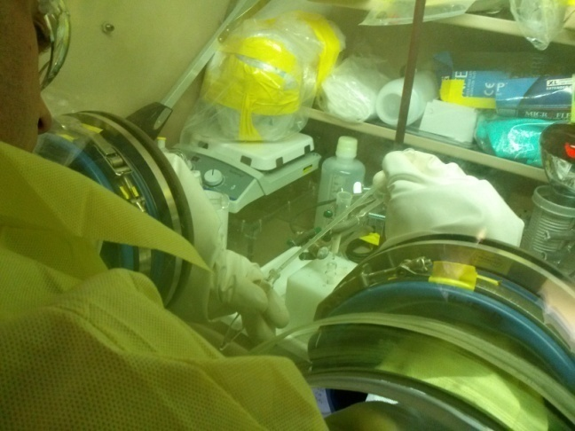
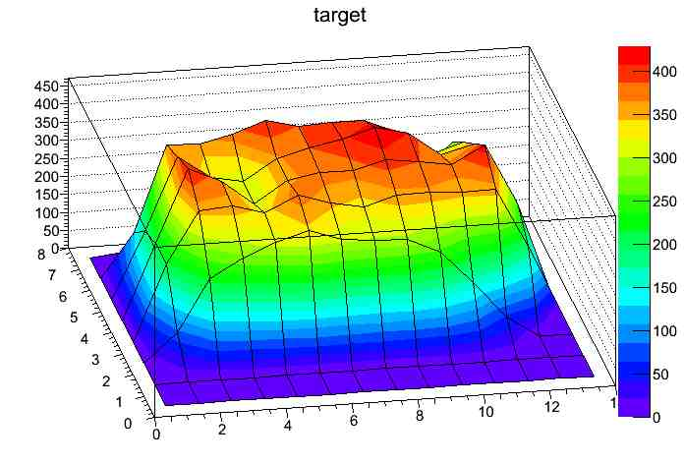
Mixed-Cf target ORNL 2013-2014
Radiochemical Engineering Development Center REDC at HFIR-ORNL
~ 40 years old Cf-sources processed at REDC to obtain mixed-Cf material
²⁴⁹Cf (351 y) ²⁵⁰Cf (13 y) ²⁵¹Cf (898 y) ²⁵²Cf (2.65 y)
7.6 mg 2.5 mg 5.7 mg 0.007 mg
48.1% 15.6% 30.3% 0.04%
~ 3* 10⁷ n/s, unshielded dose in 6” ~ 1 rem/hour
polyethylene shield reduces the radiation dose below 0.1 rem/hour
work on mixed-Cf
at ORNL’s REDC
8 out of 12 target sectors
ready in May 2014
Radiographic image
of Sm test target
The heaviest atomic nuclei: ⁴⁸Ca+²⁵¹Cf→²⁹⁵118 (4n) and ²⁹⁶118 (3n)

Slide 10
Summary
Program of “connecting Island to Mainland” started at the DGFRS
New detection system implemented and tested at the DGFRS, parallel digital and analog data acquisition, high DSSD segmentation, sensitivity to sub-μs half-lives (R. Grzywacz).
The reaction between ²³⁹Pu and ⁴⁸Ca was studied at the DGFRS. At ~ 1.3•10¹⁹ beam dose one candidate event for SF activity of ²⁸⁴Fl detected. If it is ²⁸⁴Fl, than σ ~ 0.3 pb,
Experimental campaign restarted at the DGFRS on 27th May
Long experiment with mixed-Cf target (^{249,250,251}Cf) + ⁴⁸Ca is planned to be started after Cf target sectors from Oak Ridge reach Dubna. 8 out of 12 target sectors ready in May 2014, 0.33 mg/cm²
Dubna’s “SHE Factory” is getting built (~ 2017)

