Slide 1


Mirror Symmetry
Isospin breaking in
Coulomb energy differences
Silvia M. Lenzi
Dipartimento di Fisica e Astronomia“Galileo Galilei”
Università di Padova and INFN
Silvia Lenzi
University of Padova and INFN

Slide 2
Neutron-proton exchange symmetry
Charge symmetry : V_{pp} = V_{nn}
Charge independence: (V_{pp} + V_{nn})/2= V_{np}
Deviations are small
MeV
T=1
T=0 and T=1
T=1
MeV
5
5
4
4⁺
4⁺
4
4⁺
3
3
2
2
1
2⁺
2⁺
2⁺
1
0
0⁺
0⁺
0⁺
0.693
1⁺
0
3⁺

Slide 3
Differences in analogue excited states
Z
N=Z
Mirror Energy Differences (MED)
N
Test the charge symmetry of the interaction
Triplet Energy Differences (TED)
Test the charge independency of the interaction

Slide 4
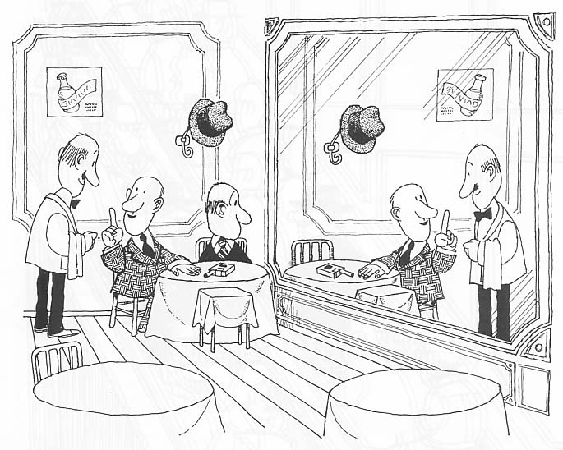
Mirror symmetry is (slightly) broken
Isospin symmetry breakdown, mainly due to the Coulomb field, manifests when comparing mirror nuclei. This constitutes an efficient observatory for a direct insight into nuclear structure properties.

Slide 5

Measuring MED and TED
Can we reproduce such small energy differences?
What can we learn from them?
They contain a richness of information
about spin-dependent structural phenomena
We measure nuclear structure features:
How the nucleus generates its angular momentum
Evolution of radii (deformation) along a rotational band
Learn about the configuration of the states
Isospin non-conserving terms of the interaction

Slide 6
Coulomb effects
V_{CM} Multipole Coulomb energy:
Between valence
protons only
radial effect:
radius changes with J
V_{Cm} Monopole Coulomb energy
L² term to account for shell effects
change the
single-particle
energies
electromagnetic LS term

Slide 7
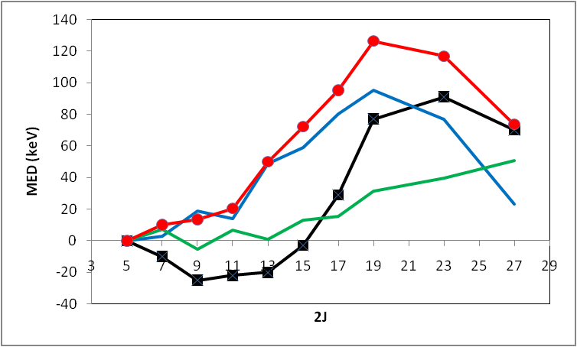
Are Coulomb corrections enough?
V_{CM}+V_{Cm}
VCM
Exp
VCm
Another isospin symmetry breaking (ISB) term is needed
and it has to be big!

Slide 8
Looking for an empirical interaction
In the single f_{7/2} shell, an interaction V can be defined by two-body matrix elements written in the proton-neutron formalism :
We can recast them in terms of isoscalar, isovector and isotensor contributions
ππ πν νν
Mirrors
We assume that the configurations
of these states are pure (f_{7/2})²
Isovector
Triplet
Isotensor

Slide 9
Looking for an empirical interaction
From the yrast spectra of the T=1 triplet ⁴²Ti, ⁴²Sc, ⁴²Ca we deduce the interaction
 | J=0 | J=2 | J=4 | J=6
V_{C} | 81 | 24 | 6 | -11
MED-V_{C} | 5 | 93 | 5 | -48
TED-V_{C} | 117 | 81 | 3 | -42
Calculated
estimate V_{B} ⁽¹⁾
estimate V_{B} ⁽²⁾
Simple ansatz for the application to
nuclei in the pf shell:
J=2 anomally
A. P. Zuker et al., PRL 89, 142502 (2002)

Slide 10
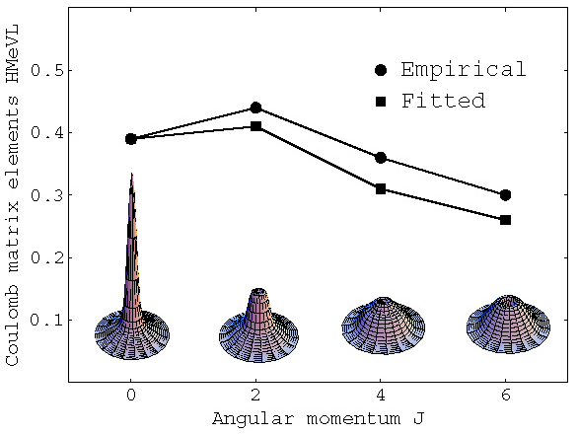
The “J=2 anomaly”
Is this just a Coulomb two-body effect?
Spatial correlation probability for two nucleons in f_{7/2}
Calculation (using Harmonic Oscillator w.f)
Two possibilities:
Increase the J=2 term
Decrease the J=0 term
We choose 1) but there is not much difference
Coulomb matrix elements (MeV)
Angular momentum J

Slide 11
Calculating MED and TED
We rely on isospin-conserving shell model wave functions and obtain the
energy differences in first order perturbation theory as sum of expectation values of the Coulomb (V_{C}) and isospin-breaking (V_{B}) interactions

Slide 12
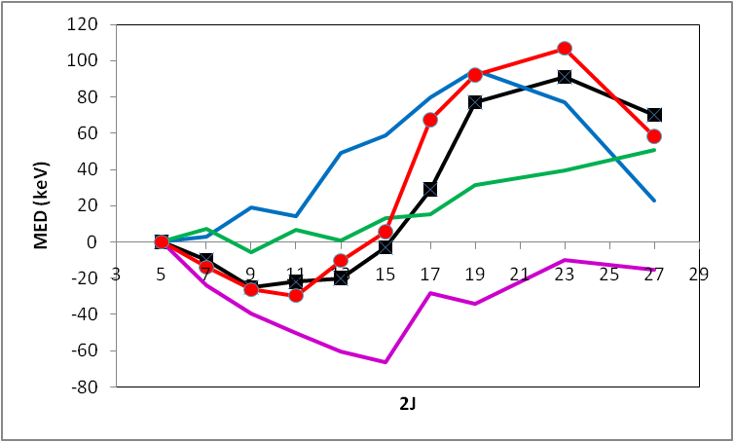
Calculating the MED with SM
Theo
VCM: gives information on the nucleon alignment or recoupling
⁴⁹Mn-⁴⁹Cr
V_{CM}
Exp
VCm: gives information on changes in the nuclear radius
V_{Cm}
Important contribution from the ISB VB term:
of the same order as the Coulomb contributions
V_{B}
M.A. Bentley and SML,
Prog. Part. Nucl. Phys. 59,
497-561 (2007)
A. P. Zuker et al., PRL 89, 142502 (2002)

Slide 13
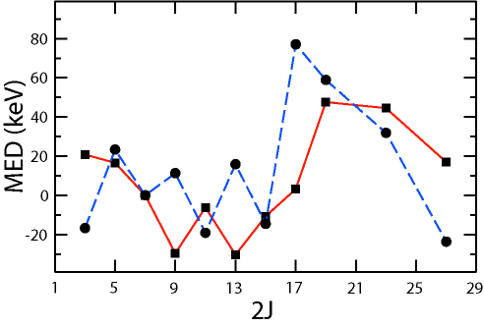
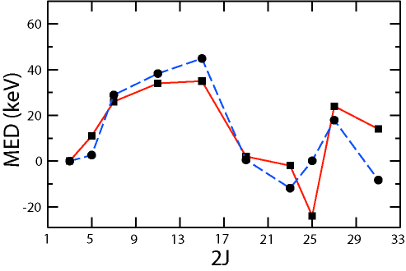

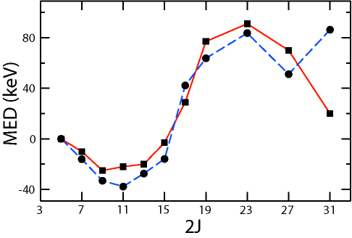
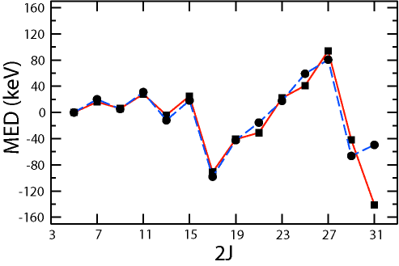
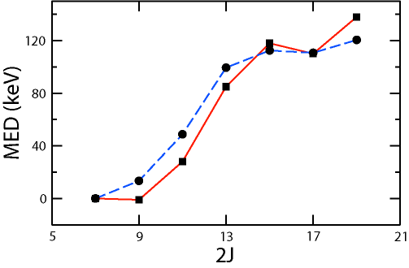
MED in T=1/2 states
Very good quantitative description of data without free parameters
A = 45
A = 47
A = 49
A = 51
A = 53
M.A. Bentley and SML,
Prog. Part. Nucl. Phys. 59,
497-561 (2007)

Slide 14
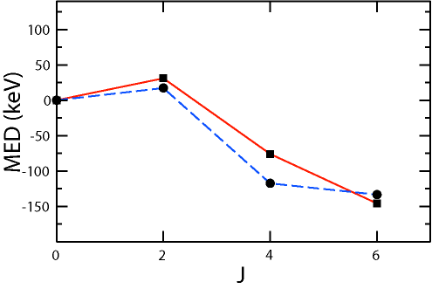
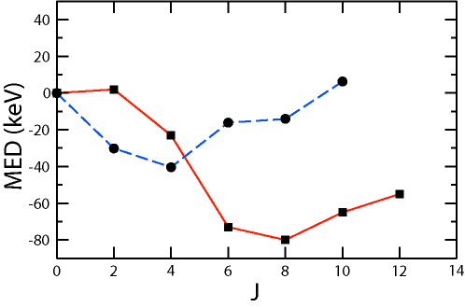
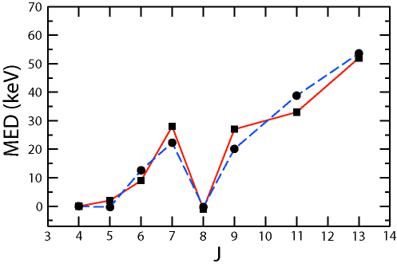
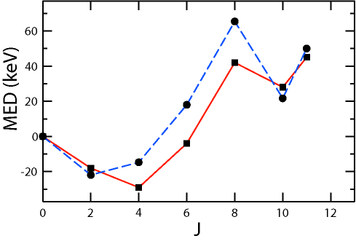
MED in T=1 states
A = 42
A = 46
A = 48
A = 50
A = 54
M.A. Bentley and SML,
Prog. Part. Nucl. Phys. 59,
497-561 (2007)
Same parameterization
for the whole f_{7/2} shell!

Slide 15
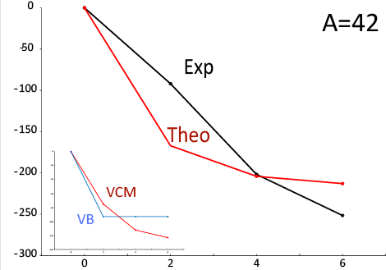
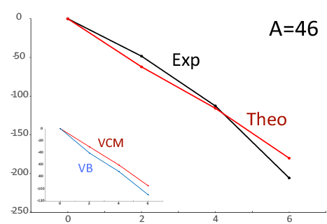
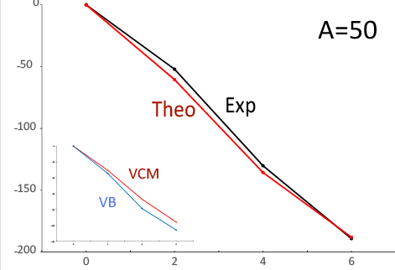
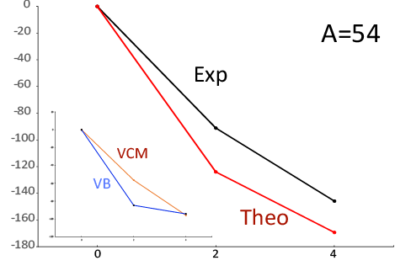
TED in the f_{7/2}shell
TED (keV)
TED (keV)
TED (keV)
TED (keV)
Only multipole effects are relevant.
The ISB term VB is of the same magnitude of the Multipole Coulomb term

Slide 16
Some questions arise…
What happens farther from stability
or at larger T in the f_{7/2} shell?
The same prescription applies (poster by T. Henry)
Can we understand the origin of this term?
Work in progress
Is the ISB term confined to the f_{7/2} shell
or is a general feature?
If so the same prescription should work!

Slide 17
Looking for a systematic ISB term
Necessary conditions for such studies:
good and enough available data
good shell model description of the structure
Ideal case: the sd shell
But…few data at high spin and
no indications of “J=2 anomaly” in A=18

Slide 18
A systematic analysis
of MED and TED
in the sd shell

Slide 19
The method
We apply the same method as in the f_{7/2} shell
However, here the three orbitals, d_{5/2}, s_{1/2} and d_{3/2} play an important role
VCr (radial term): looks at changes in occupation of the s_{1/2}

Slide 20
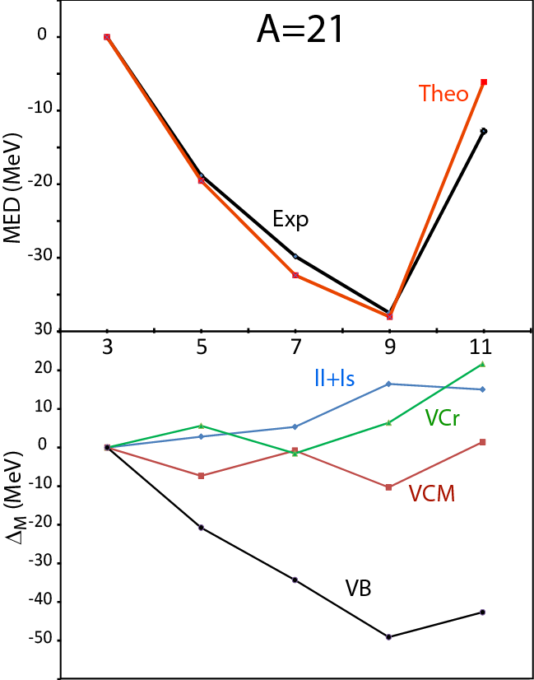
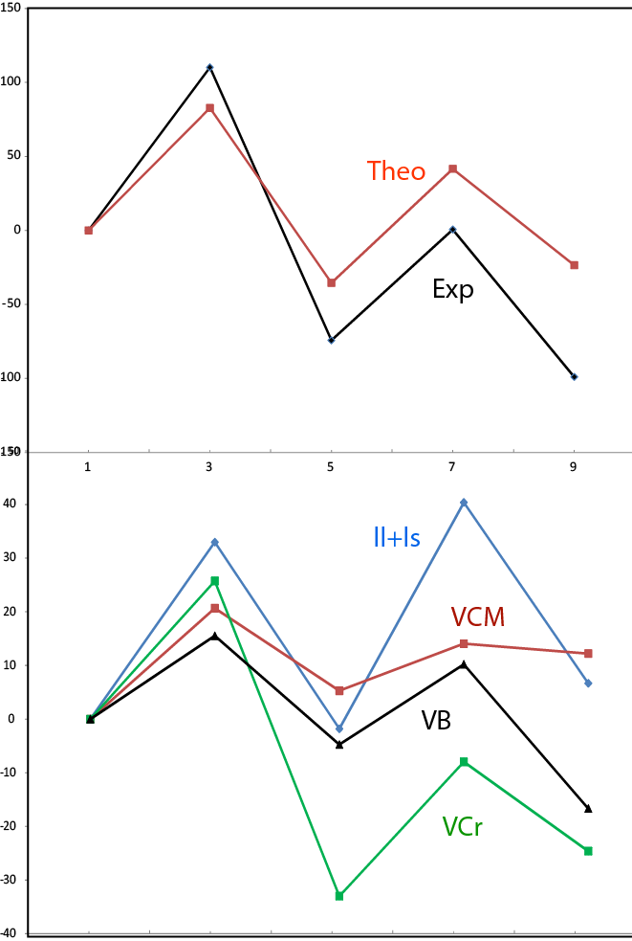
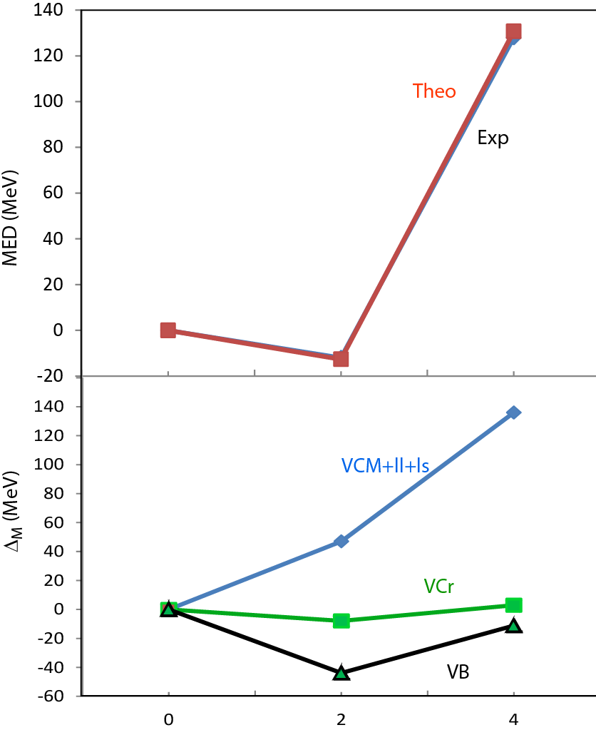
MED: different contributions
A=29
T=1/2
T=1/2
A=26
T=1

Slide 21
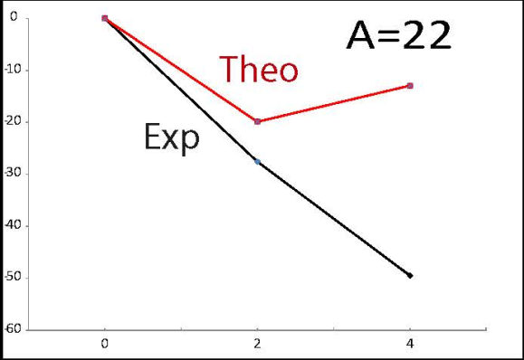
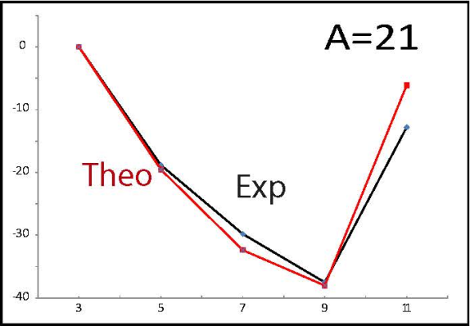
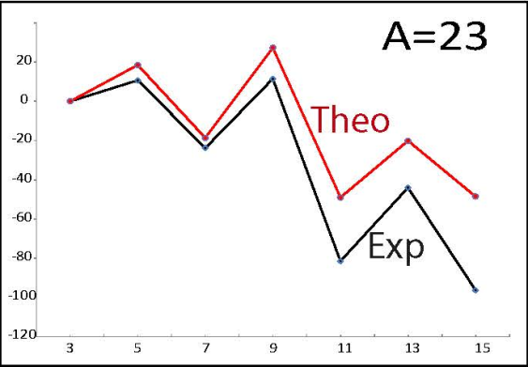
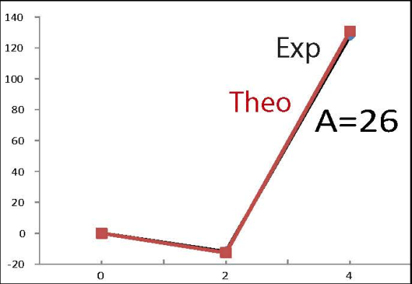
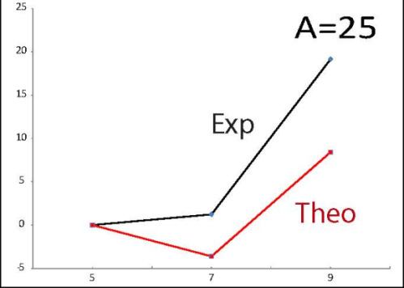
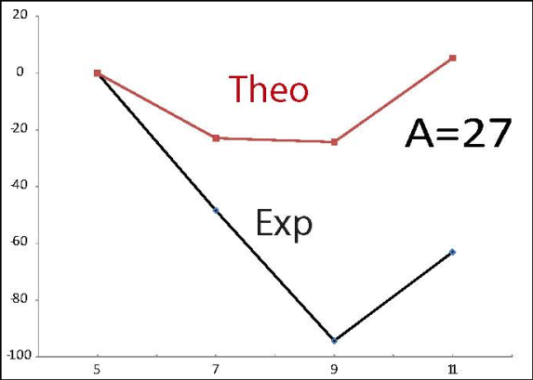
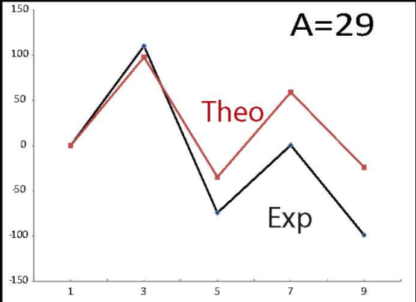
MED in the sd shell
MED (keV)

Slide 22
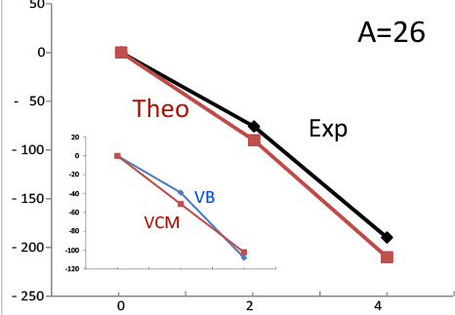
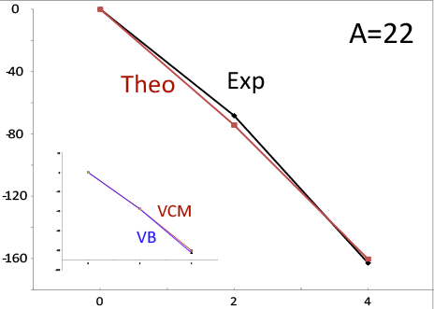
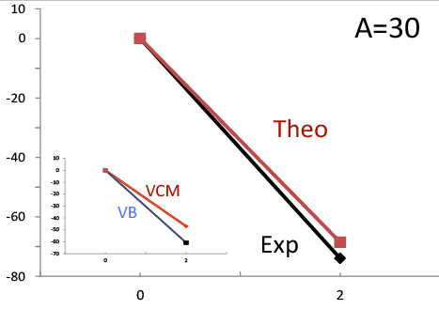
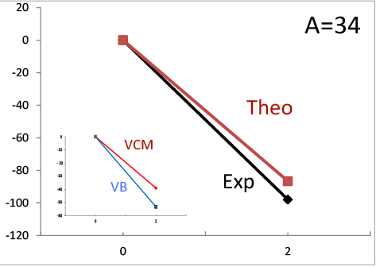
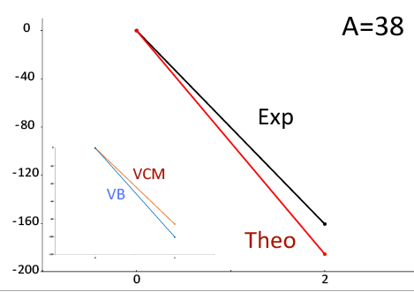
TED in the sd shell
TED (keV)
The prescription applies successfully also in the sd shell!

Slide 23
MED and TED in the upper pf shell

Slide 24
The method
We apply the same method as in the f_{7/2} shell
However, here the three orbitals, p_{3/2}, f_{5/2} and p_{1/2} play an important role
VCr (radial term): looks at changes in occupation of both p orbits

Slide 25
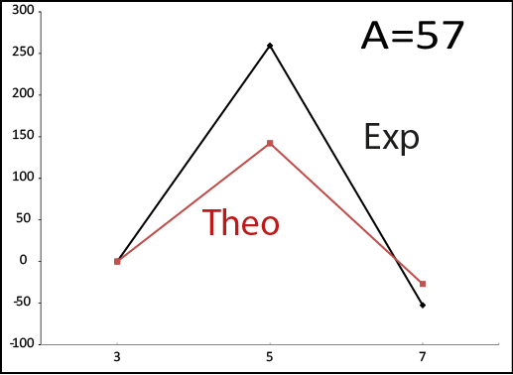
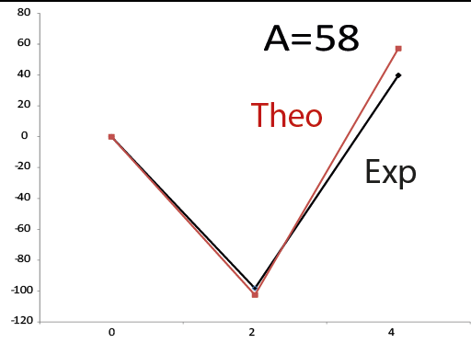
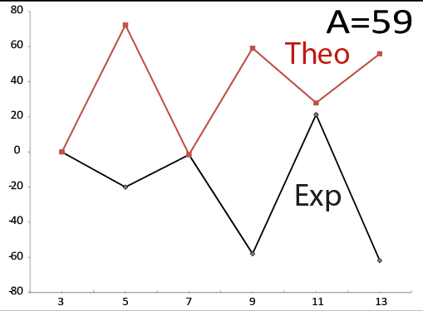
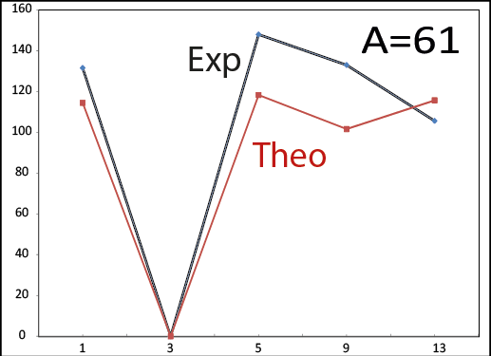
MED in the upper pf shell
MED (keV)

Slide 26
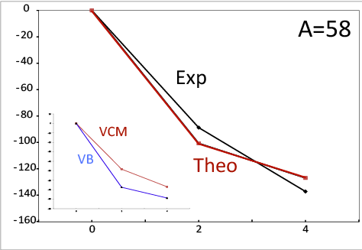
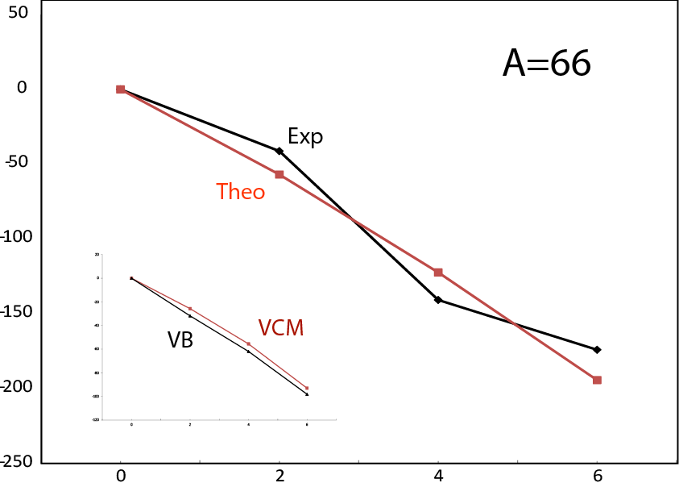
TED in the upper pf and fpg shells

Slide 27

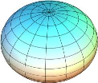
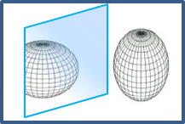
N~Z nuclei in the A~68-84 region
Around N=Z quadrupole correlations are dominant.
Prolate and oblate shapes coexist.
The fpg space is not able to reproduce this behaviour, the fpgds space is needed.
s_{1/2}
d_{5/2}
g_{9/2}
MED are sensitive to shape changes and therefore a full calculation is needed,
which is not always achievable with large scale SM calculations
quasi
SU3
40
f_{5/2}
p
pseudo
SU3
A.P. Zuker, A. Poves, F. Nowacki and SML, arXiv:1404.0224
Experimentally may be not clear if what we measure are energy differences between analogue states, as ISB effects may exchange the order of nearby states of the same J

Slide 28
Conclusions
Z
N=Z
Proton-rich N~Z nuclei present several interesting properties and phenomena that can give information on specific terms of the nuclear interaction.
N
The investigation of MED and TED allows to have an insight on nuclear structural properties and their evolution as a function of angular momentum such as: alignments, changes of deformation, particular s.p. configurations.
The need of including an additional ISB term VB in MED and TED shows up all along the N=Z line from the sd to the upper fp shell,
therefore revealing as a general feature.

Slide 29
In collaboration with
Mike Bentley
Rita Lau
Andres Zuker

