Slide 1
In-beam γ-ray spectroscopy of very neutron-rich N = 32 and 34 nuclei
Advances in Radioactive Isotope Science, Tokyo, Japan. June 1–6, 2014.
D. Steppenbeck,¹ S. Takeuchi,² N. Aoi,³ H. Baba,² N. Fukuda,² S. Go,¹
P. Doornenbal,² M. Honma,⁴ J. Lee,² K. Matsui,⁵ M. Matsushita,¹ S. Michimasa,¹
T. Motobayashi,² D. Nishimura,⁶ T. Otsuka,^{1,5} H. Sakurai,^{2,5} Y. Shiga,⁶ N. Shimizu,¹
P.-A. Söderström,² T. Sumikama,⁷ H. Suzuki,² R. Taniuchi,⁵ Y. Utsuno,⁸
J. J. Valiente-Dobón,⁹ H. Wang^{2,10} and K. Yoneda²
¹Center for Nuclear Study, University of Tokyo, 2-1, Hirosawa, Wako, Saitama 351-0198, Japan
²RIKEN Nishina Center, 2-1, Hirosawa, Wako, Saitama 351-0198, Japan
³Research Center for Nuclear Physics, Osaka University, Osaka 567-0047, Japan
⁴Center for Mathematical Sciences, University of Aizu, Aizu-Wakamatsu, Fukushima 965-8580, Japan
⁵Department of Physics, University of Tokyo, Bunkyo, Tokyo 113-0033, Japan
⁶Department of Physics, Tokyo University of Science, Tokyo 278-0022, Japan
⁷Department of Physics, Tohoku University, Aramaki, Aoba, Sendai 980-8754, Japan
⁸Japan Atomic Energy Agency, Tokai, Ibaraki 319-1195, Japan
⁹Legnaro National Laboratory, Legnaro 35020, Italy
¹⁰Department of Physics, Beijing University, Beijing 100871, People’s Republic of China
1

Slide 2
Spectroscopy of exotic N = 32, 34 isotopes: Outline
General scientific motivation for experimental studies of exotic isotopes around the N = 32 and 34 regions.
In-beam γ-ray spectroscopy at the RIBF facility: Some details relevant to the present work.
Results: In-beam γ-ray spectroscopy of ^{54,53}Ca and new results for ⁵⁰Ar and ⁵⁵Sc from the same experiment. Significance of the N = 32 and 34 subshell closures far from stability.
Shell-model predictions: Successes and developments.
2

Slide 3
Mechanism: Evolution of nuclear shell structure
Neutron-rich fp shell bounded by Z = 20–28 and N = 28–40
Attractive interaction between the πf_{7/2} and νf_{5/2} orbitals is important; responsible for characteristics of nuclear shell evolution in this mass region [1]
[1] e.g., T. Otsuka et al., Phys. Rev. Lett. 95 (2005) 232502
As protons are removed from the πf_{7/2} orbital (from Ni to Ca) the strength of the π–ν interaction weakens, causing the νf_{5/2} orbital to shift up in energy relative to the νp_{1/2} and νp_{3/2} spin-orbit partner orbitals
Development of subshell closures at N = 32 and 34?
3

Slide 4
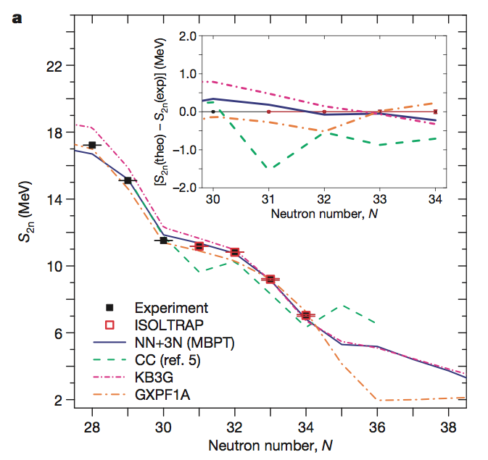
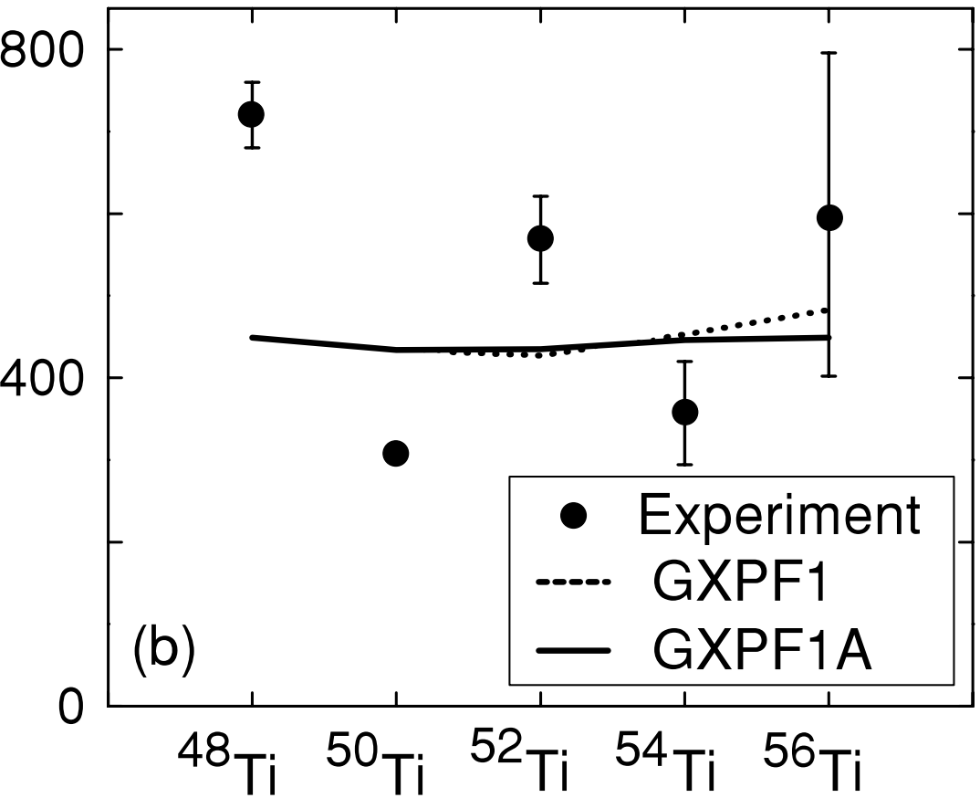
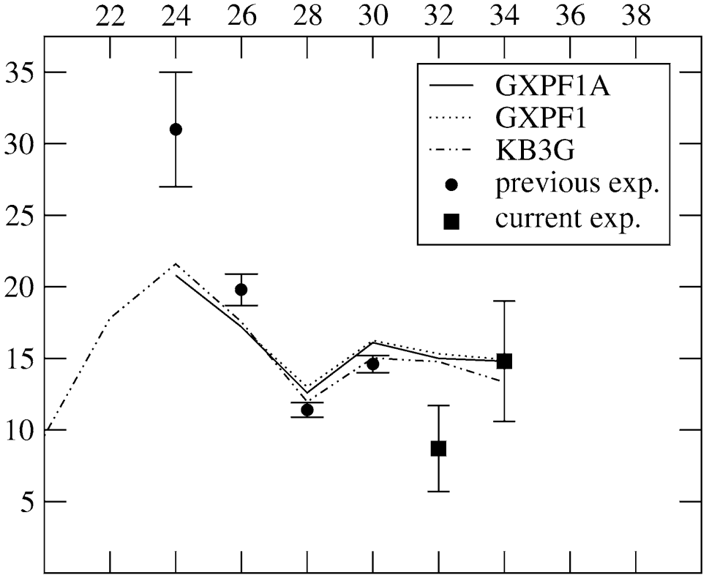
Motivation: The story so far…
Onset of N = 32 subshell gaps observed in ⁵²Ca [2,3], ⁵⁴Ti [4,5] and ⁵⁶Cr [6,7] from systematics of E(2⁺) and B(E2) transition rates
[2] A. Huck et al., Phys. Rev. C 31 (1985) 2226
[3] A. Gade et al., Phys. Rev. C 74 (2006) 021302(R)
[4] R. V. F. Janssens et al., Phys. Lett. B 546 (2002) 55
[5] D.-C. Dinca et al., Phys. Rev. C 71 (2005) 041302(R)
[6] J. I. Prisciandaro et al., Phys. Lett. B 510 (2001) 17
[7] A. Bürger et al., Phys. Lett. B 622 (2005) 29
[8] S. N. Liddick et al., Phys. Rev. Lett. 92 (2004) 072502
More recently, confirmation of N = 32 subshell closure in Ca isotopes from high-precision mass measurements with MR-TOF method, and also evidence discussed in the K isotopes as well (S. Kreim talk on Tuesday)
F. Wienholtz et al., Nature (London) 498 (2013) 346
Left: First 2⁺ energies
Below: B(E2) rates
N = 34
N = 32
Expt.
₂₂Ti
No significant N = 34 subshell gap in ⁵⁶Ti [5,8] or ⁵⁸Cr [6,7], but there is a development in ⁵⁴Ca [10] (see later slide)
[8] S.N. Liddick et al., Phys. Rev. Lett. 92 (2004) 072502
[9] S. Zhu et al., Phys. Rev. C 74 (2006) 064315
[10] D.S. et al., Nature (London) 502 (2013) 207
₂₄Cr
4

Slide 5
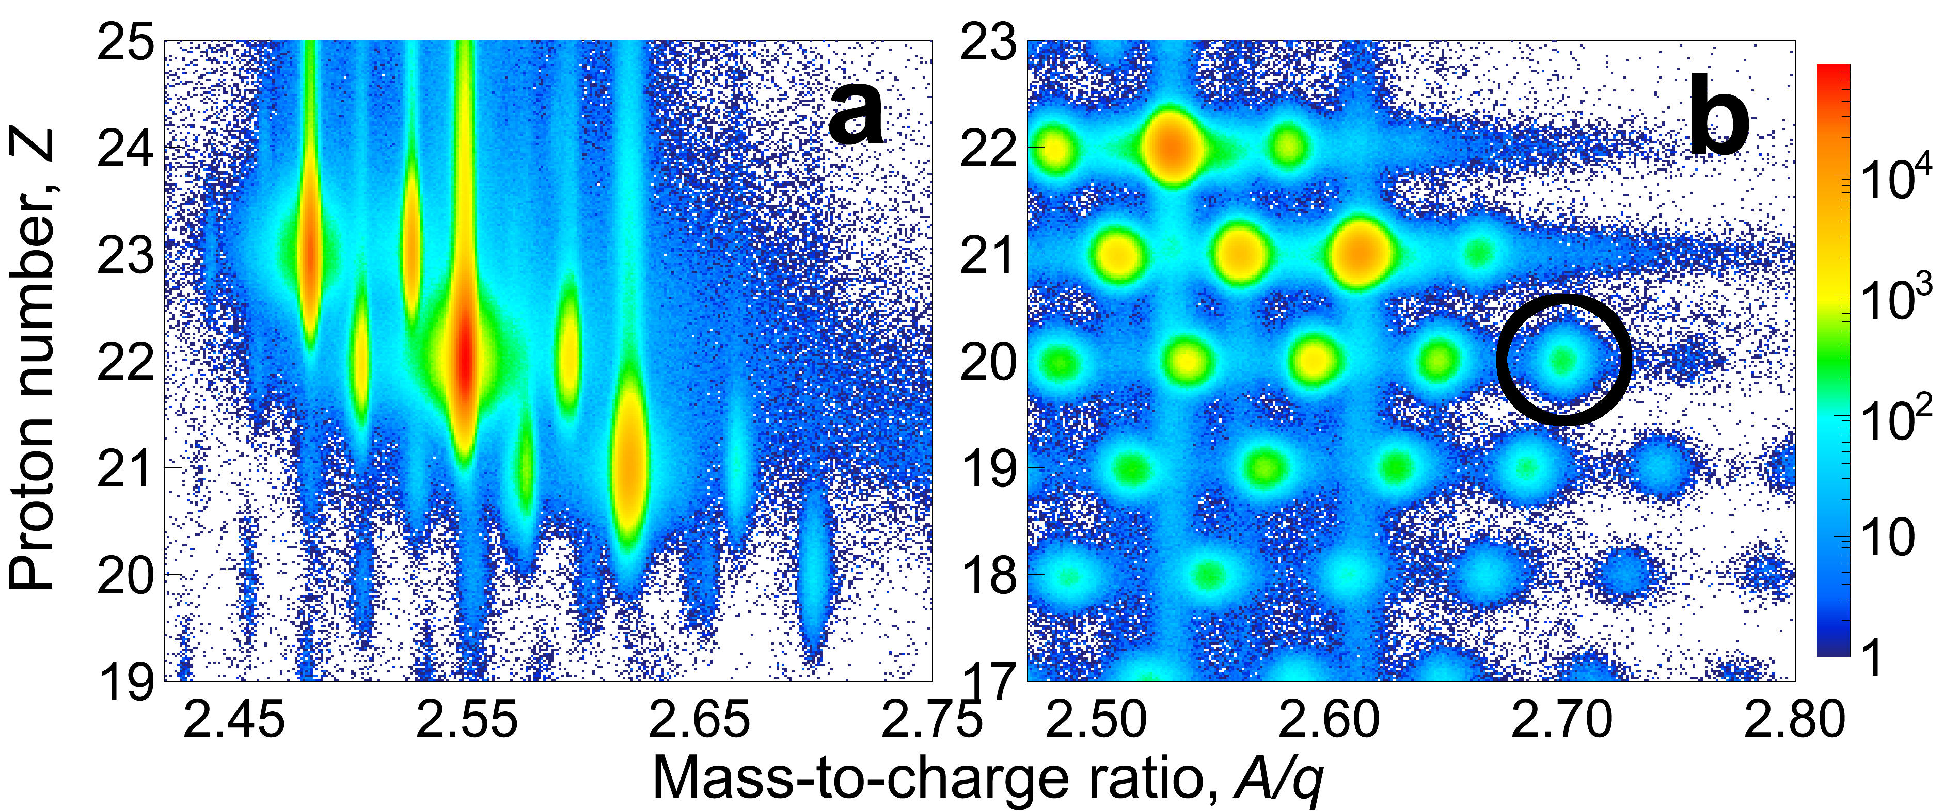
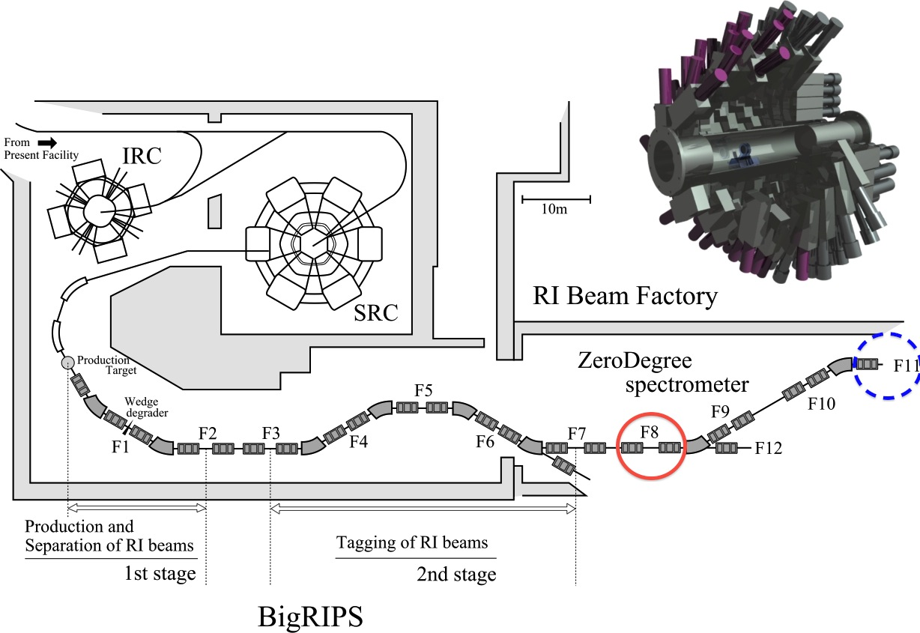
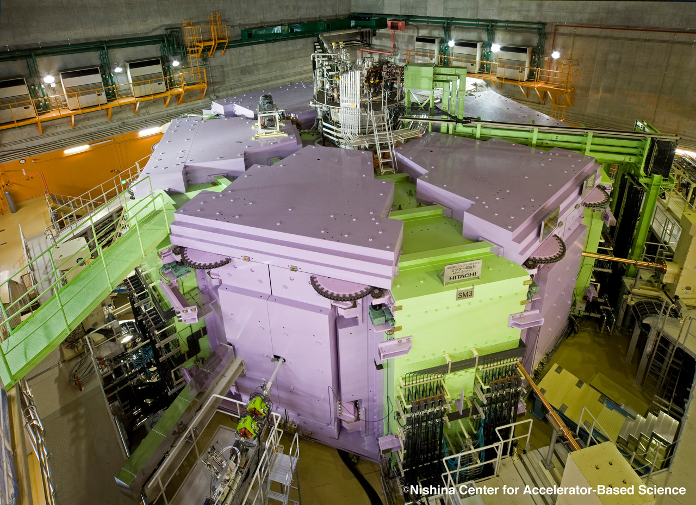
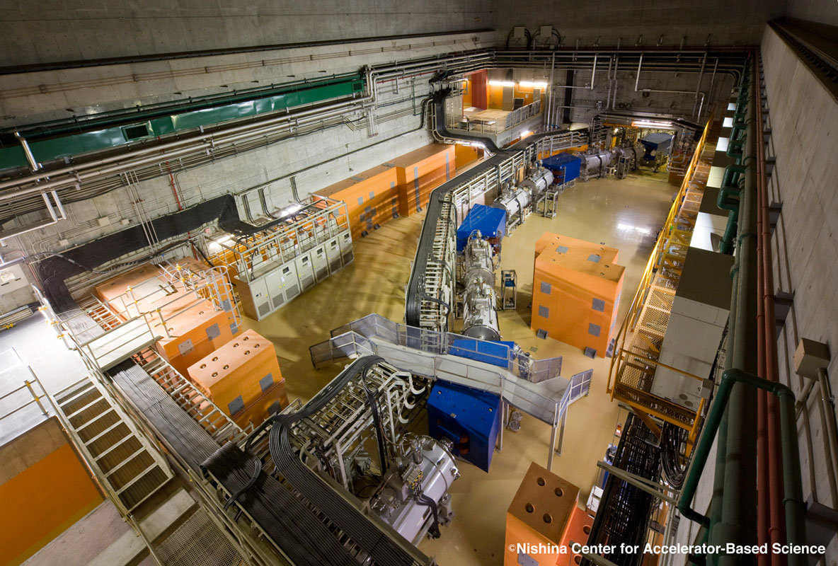
Experiment at RIBF: Brief outline
Particle identification: Bρ–TOF–ΔE measurements
First ⁷⁰Zn experiment at RIBF (July 2012)
60 pnA typical @ 345 MeV/u (Max I_{beam} ~ 100 pnA)
DALI2 [NaI(Tl) array]
⁵⁷V
⁵⁵Sc
⁵⁶Ti
186
detectors
⁵⁴Ca
⁵⁵Sc
⁵⁴Ca
⁵⁰Ar
F0: 10-mm^{t} Be
production target
(⁷⁰Zn fragmentation)
Typical BigRIPS rates
⁵⁵Sc ~ 12 pps/pnA (~ 5%)
⁵⁶Ti ~ 125 pps/pnA (~ 57%)
Data were accumulated for
~ 40 hours over 3 days
Coincidence events
⁹Be(⁵⁵Sc,⁵⁴Ca+γ^{n})X
~ 1.4×10⁴ events
⁹Be(⁵⁶Ti,⁵⁴Ca+γ^{n})X
~ 9.1×10³ events
ZeroDegree
tuned for ⁵⁴Ca
BigRIPS separator
optimised for ⁵⁵Sc,
⁵⁶Ti within acceptance
F8: 10-mm^{t} Be
reaction target
5
(Discussed by N. Aoi yesterday)

Slide 6
Results: In-beam γ-ray spectroscopy of ^{54,53}Ca_{34,33}
Level schemes constructed from measurements of γ-ray relative intensities and γγ coincidences [panels (b) and (d)]. Spin-parity assignments from nuclear theory and systematics.
Concluded that the magnitude of the N = 34 subshell closure (νp_{1/2}–νf_{5/2} SPO gap) in ⁵⁴Ca is similar to the N = 32 subshell closure in ⁵²Ca (νp_{3/2}–νp_{1/2} SPO gap).
6
Notes:
Statistical errors:
1184 +/- 22 (stat) keV
1656 +/- 14 (stat) keV
2043 +/- 7 keV
Systematic errors:
~ 0.7% calibration/gaindrift
~ 0.5% lifetime (30 ps)

Slide 7
New results
In-beam ray spectroscopy of ⁵⁵Sc₃₄
In-beam ray spectroscopy of ⁵⁰Ar₃₂
7

Slide 8
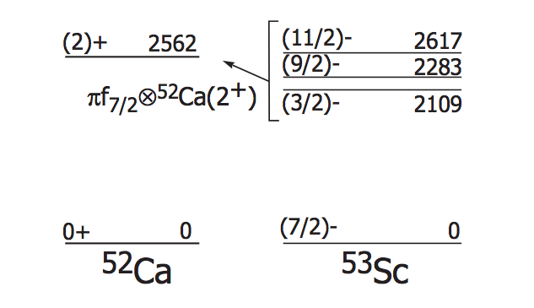
Results: In-beam γ-ray spectroscopy of ⁵⁵Sc₃₄
Motivation: Sizable N = 34 subshell gap in Ca that disappears with only two protons in the πf_{7/2} SPO (Ti isotopes). Natural to investigate the situation intermediate to these cases, ⁵⁵Sc, which contains one proton in the πf_{7/2} SPO:
1629
7/2–
Preliminary
Be(⁵⁵Sc,⁵⁵Sc+γ)
(M_{γ} = 1 only)
1543(14)
1628
5/2–
1566
1/2–
707(7) keV
707(7)
589
3/2–
1543(14) keV
0
0
7/2–
Exp.
GXPF1Br
First 3/2⁻ state is of interest because it is sensitive to the neutron shell gap at the Fermi surface:
(Introduced by
Y. Utsuno on Tuesday)
While the energies of the 2⁺ state in ⁵²Ca and the 3/2⁻ state in ⁵³Sc are similar, indicating a rather robust N = 32 subshell closure, the first 3/2⁻ state in ⁵⁵Sc (707 keV) lies much lower than the 2⁺ in ⁵⁴Ca (2043 keV), suggesting a rapid weakening of the N = 34 subshell gap even with only one proton in the f_{7/2} SPO
Preliminary
Be(⁵⁶Ti,⁵⁵Sc+γ)
(M_{γ} = 1 only)
8
H. Crawford et al., Phys. Rev. C 82 (2010) 014311, and references therein
Notes:
Statistical errors:
1184 +/- 22 (stat) keV
1656 +/- 14 (stat) keV
2043 +/- 7 keV
Systematic errors:
~ 0.7% calibration/gaindrift
~ 0.5% lifetime (30 ps)

Slide 9
New results
In-beam ray spectroscopy of ⁵⁵Sc₃₄
In-beam ray spectroscopy of ⁵⁰Ar₃₂
9

Slide 10
Results: In-beam γ-ray spectroscopy of ⁵⁰Ar₃₂
1.58-MeV transition rather weak, but:
Peak width is comparable to the GEANT4 simulated value
Efficiency-corrected relative intensity (~30%) is similar to 4⁺ -> 2⁺ transition in other cases
Supported by shell-model calculations
E_{γ} = 1050(11) keV
I_{γ} = 100(12)
1.18(2) MeV
⁴⁸Ar
1.58(4) MeV
E_{γ} = 1725(22) keV
I_{γ} = 29(6)
E(2⁺) systematics indicate bump at N = 32, similar to the Cr, Ti and Ca isotopic chains, which is naïvely suggestive of a sizable subshell gap
Plausible, since the νp_{3/2}–νp_{1/2} SPO energy gap is responsible and does not change drastically with Z
Sum of the
Be(⁵⁴Ca,⁵⁰Ar+γ)X,
Be(⁵⁵Sc,⁵⁰Ar+γ)X,
and Be(⁵⁶Ti,⁵⁰Ar+γ)X
reaction channels
1.18(2)- and 1.58(4)-MeV γ rays tentatively assigned as the yrast 2⁺ -> 0⁺ and 4⁺ -> 2⁺ transitions, respectively
SM: full sd shell for protons, full fp shell for neutrons, modified SDPF-MU Hamiltonian (recent experimental data for K and Ca isotopes)
Y. Utsuno et al., Phys. Rev. C 86 (2012) 051301(R)
J. Papuga et al., Phys. Rev. Lett. 110 (2013) 172503
D.S. et al., Nature (London) 502 (2013) 207
Indeed, the SM calculations indicate the presence of a sizable N = 32 subshell gap in Ar isotopes, which is comparible (~2.3 MeV) to the N = 32 gaps in Ca and Ti isotopes (~2.4 and ~2.5 MeV, respectively) (νp_{3/2}–νp_{1/2} spin-orbit partners)
Energies consistent with previous studies of ⁴⁸Ar, which assigned the 1050(11)- and 1725(22)-keV transitions as the 2⁺ -> 0⁺ and 4⁺ -> 2⁺ transitions, respectively
S. Bhattacharyya et al., Phys. Rev. Lett. 101 (2008) 032501
A. Gade et al., Phys. Rev. Lett. 102 (2009) 182502
10
Notes:
Statistical errors:
1184 +/- 22 (stat) keV
1656 +/- 14 (stat) keV
2043 +/- 7 keV
Systematic errors:
~ 0.7% calibration/gaindrift
~ 0.5% lifetime (30 ps)

Slide 11
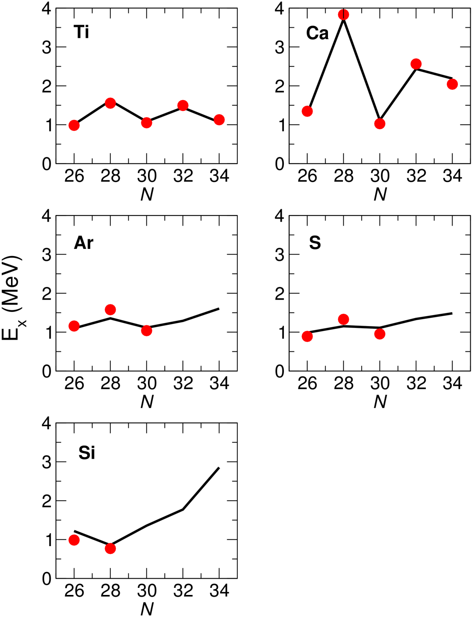
2⁺ levels: comparison between π(pf) and π(sd)
Outlook: Y. Utsuno calculations
π(pf)
π(sd)
11
doubly magic

Slide 12
Spectroscopy of exotic N = 32, 34 isotopes: Summary
Performed in-beam γ-ray spectroscopy with an high-intensity ⁷⁰Zn beam at the RIBF to investigate the strength of the N = 32 and 34 subshell gaps in Ca, Sc and Ar isotopes
Strong candidate for the first 2⁺ state in ⁵⁴Ca at 2043(19) keV, giving first direct evidence for a significant subshell closure at N = 34
Energy of first 3/2⁻ state in ⁵⁵Sc suggests a rapid quenching of the N = 34 subshell gap, even with only one proton in the πf_{7/2} orbital
Low-lying structure of ⁵⁰Ar was also investigated, suggesting a persistant N = 32 subshell closure below Ca (owing to νp_{3/2}–νp_{1/2} S.O. splitting)
12

Slide 13








Thank you for your attention
D. Steppenbeck,¹ S. Takeuchi,² N. Aoi,³ H. Baba,² N. Fukuda,² S. Go,¹
P. Doornenbal,² M. Honma,⁴ J. Lee,² K. Matsui,⁵ M. Matsushita,¹ S. Michimasa,¹
T. Motobayashi,² D. Nishimura,⁶ T. Otsuka,^{1,5} H. Sakurai,^{2,5} Y. Shiga,⁶ N. Shimizu,¹
P.-A. Söderström,² T. Sumikama,⁷ H. Suzuki,² R. Taniuchi,⁵ Y. Utsuno,⁸
J. J. Valiente-Dobón,⁹ H. Wang^{2,10} and K. Yoneda²
¹Center for Nuclear Study, University of Tokyo, 2-1, Hirosawa, Wako, Saitama 351-0198, Japan
²RIKEN Nishina Center, 2-1, Hirosawa, Wako, Saitama 351-0198, Japan
³Research Center for Nuclear Physics, Osaka University, Osaka 567-0047, Japan
⁴Center for Mathematical Sciences, University of Aizu, Aizu-Wakamatsu, Fukushima 965-8580, Japan
⁵Department of Physics, University of Tokyo, Bunkyo, Tokyo 113-0033, Japan
⁶Department of Physics, Tokyo University of Science, Tokyo 278-0022, Japan
⁷Department of Physics, Tohoku University, Aramaki, Aoba, Sendai 980-8754, Japan
⁸Japan Atomic Energy Agency, Tokai, Ibaraki 319-1195, Japan
⁹Legnaro National Laboratory, Legnaro 35020, Italy
¹⁰Department of Physics, Beijing University, Beijing 100871, People’s Republic of China

