Slide 1
Status of the Rare Isotope Science Project
Advances in Radioactive Isotope Science 2014
Yong-Kyun KIM (ykkim@ibs.re.kr)
on behalf of RISP/IBS

Slide 2
Brief History
Rare Isotope Science Project(RISP) launched (2011.12)
1st RISP Workshop on Accelerator Systems (2012.5)
1st Technical Advisory Committee (2012.5)
Baseline Design Summary (2012.6)
International Advisory Committee (2012.7)
KoPAS(Particle Accelerator School) (2012.12)
2nd RISP Workshop on Accelerator Systems (2013.5)
2nd TAC (2013.5)
Technical Design Report (2013.6)
3rd IAC (2013.8)
1st Program Advisory Committee (2013.10)
Construction Plan & Budget Approved (2014. 5)

Slide 3
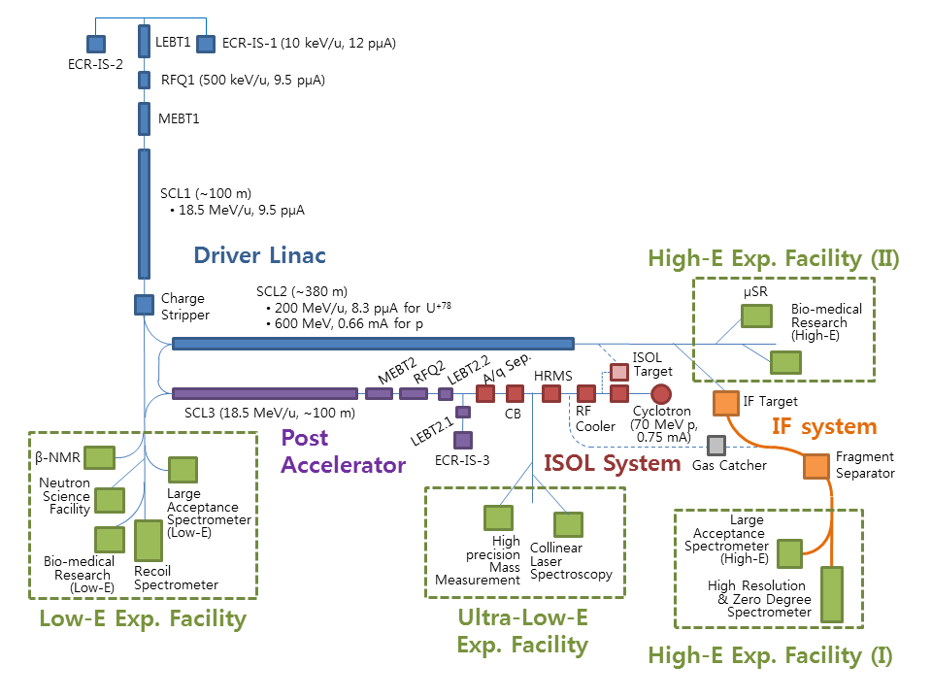
RAON : RISP Accelerator Complex
High intensity RI beams by ISOL & IF
ISOL : direct fission of ²³⁸U by p 70MeV
IF by 200MeV/u, 8.3pμA ²³⁸U
High quality neutron-rich RI beams
¹³²Sn with up to ~250MeV/u, up to 10⁸ pps
More exotic RI beams by ISOL+IF

Slide 4
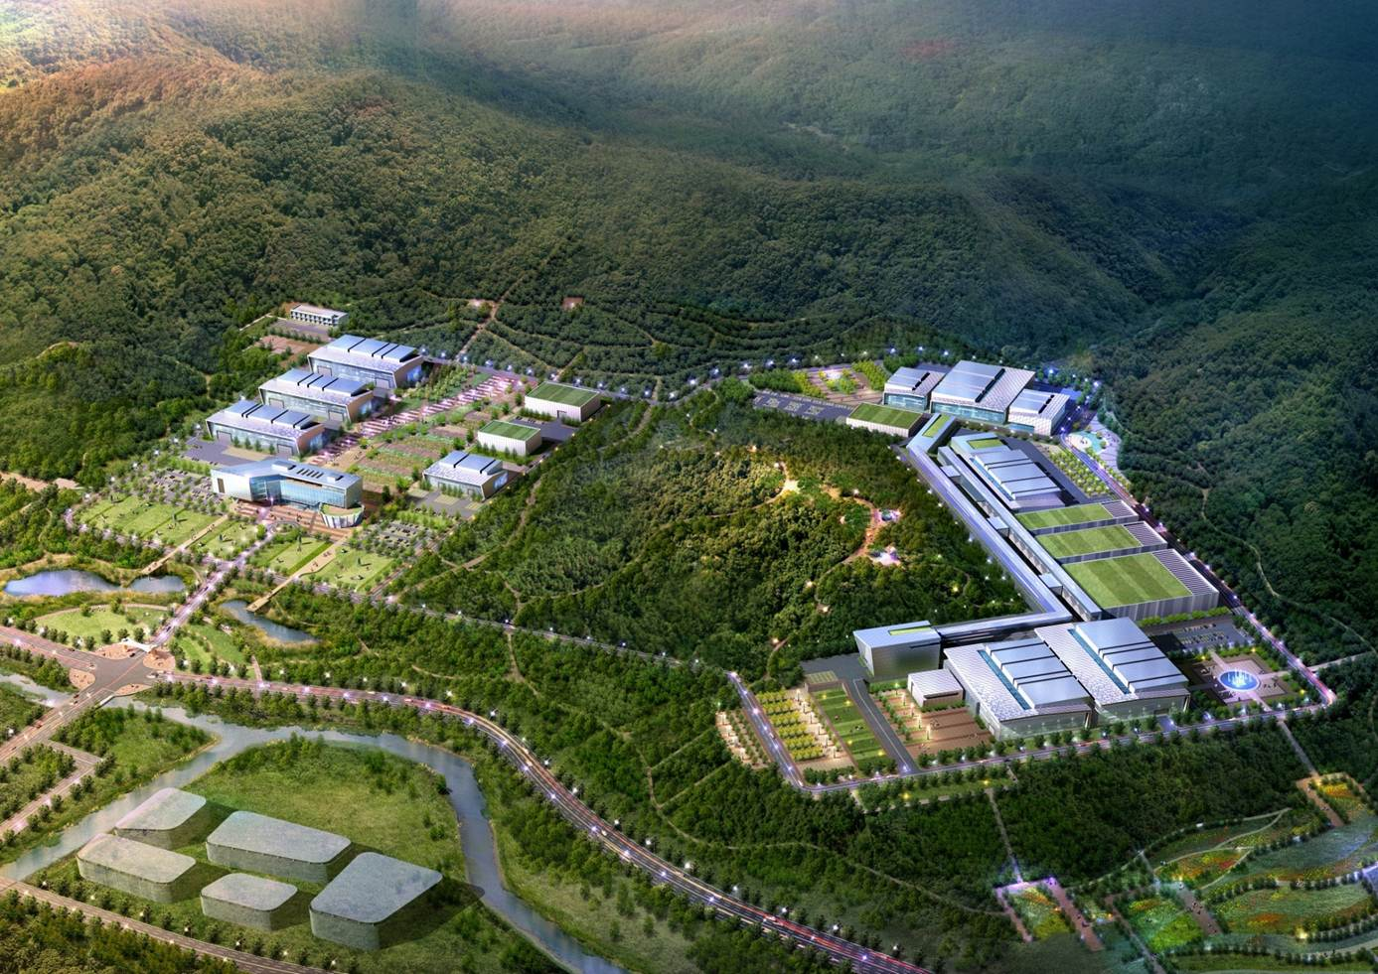
Bird’s eye view of RAON Facility
Location
Completion
1st beam
1st RI beam from ISOL
1st RI beam from IF
: Daejeon, Korea
: 2020 Feb
: 2018 Q1 from SCL1
: 2019 Q4
: 2020 Q2
Supply/Test/Office Bldg
Exp. Halls
IF Target
Driver
SC Linac
Post
Accelerator
Preserved Forest Area
Injector
Main Control
Center
Exp. Halls

Slide 5
Major Milestones
 | 2012 |  |  |  | 2013 |  |  |  | 2014 |  |  |  | 2015 |  |  |  | 2016 |  |  |  | 2017 |  |  |  | 2018 |  |  |  | 2019 |  |  |  | 2020
Rare Isotope Science Project
CD: Conceptual Design
TD: Technical Design
1
2
3
4
1
2
3
4
1
2
3
4
1
2
3
4
1
2
3
4
1
2
3
4
1
2
3
4
1
2
3
4
1
2
3
4
Day-1 exp.
at RS
1st RI beam from ISOL
CD
We are here!!
Building Construction
TD
Accelerator Fabrication
Prototyping
Experimental System Fabrication
Baseline
Design
Summary
Technical
Design
Report
Installation, Commissioning &
Experiments
Main Component
Production Start
Installation
Start
2011.12 ~ 2014.03
2014.04 ~ 2017.02
2017.03 ~ 2020.02
Engineering Design
Prototypes
Subsystems
Test & Evaluation
Main Systems
Installation
Commissioning
Day-1 Experiment
Project Launched, Conceptual Design Report
Baseline Design Summary
Technical Design Report

Slide 6
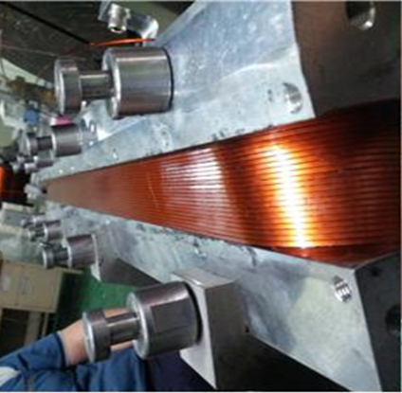
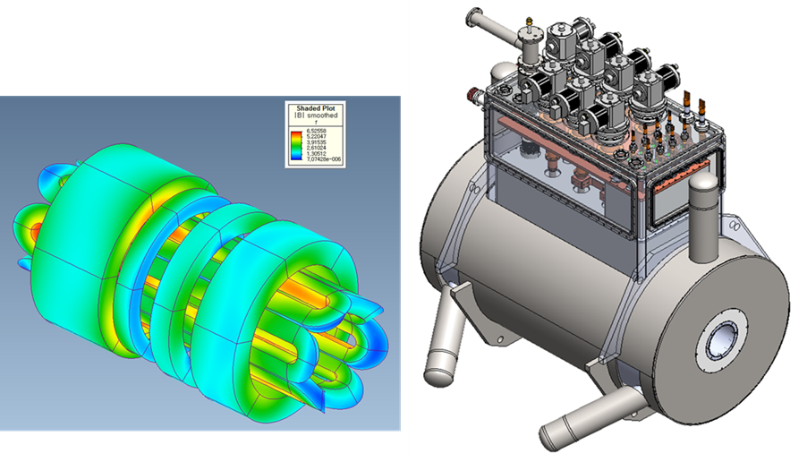
28 GHz ECR Ion Source
Superconducting sextupole and solenoid prototypes were tested and achieved > 30% margin.
Plasma chamber completed.
Sextupole fabrication was completed and intermediate test results are good.
Solenoids are being fabricated.
Preparing for beam test in late 2014.
[Magnet drawing]
B_{inj}= 3.5 T, B_{ext}= 2.2 T,
B_{r}= 2 B_{ecr} , B_{min}= 0.7 T
Six 4K cryocoolers,
One single stage cryocooler

Slide 7
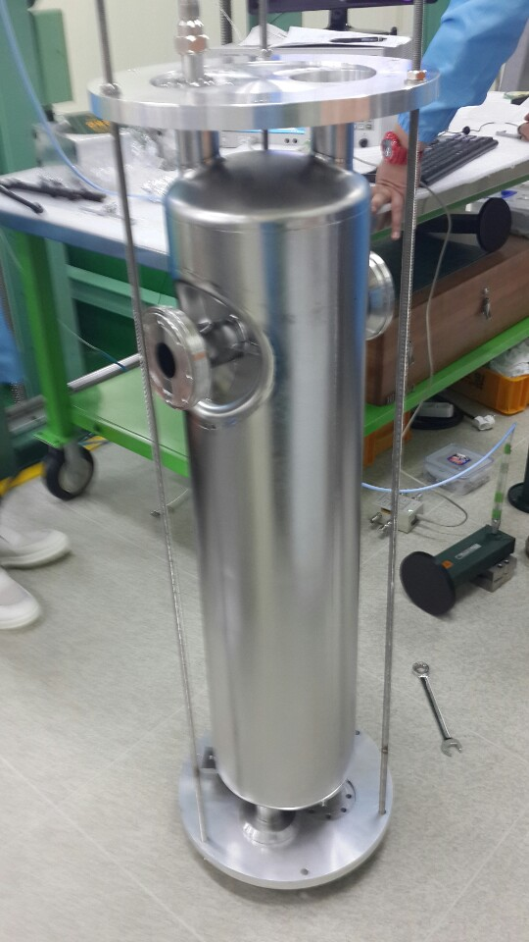
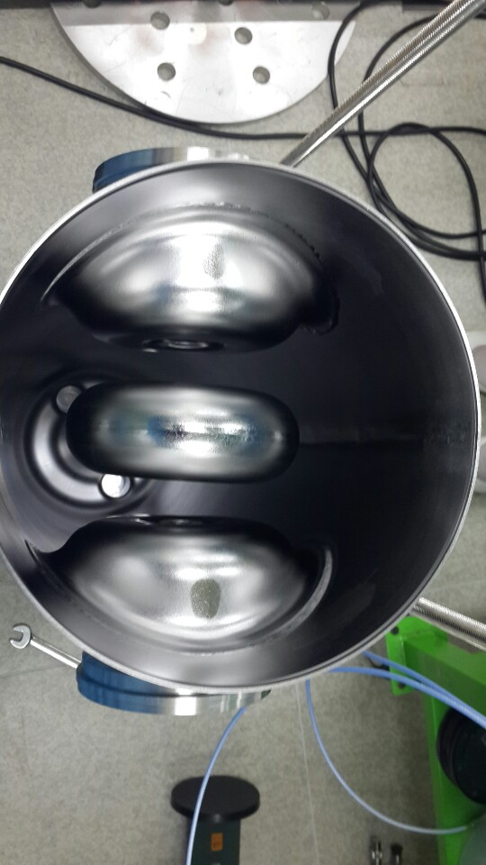
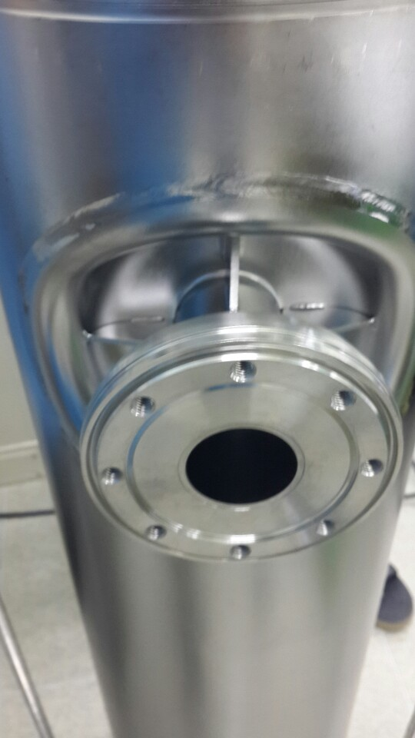
Prototype Niobium QWR cavity

Slide 8
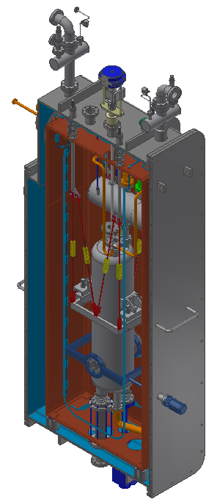
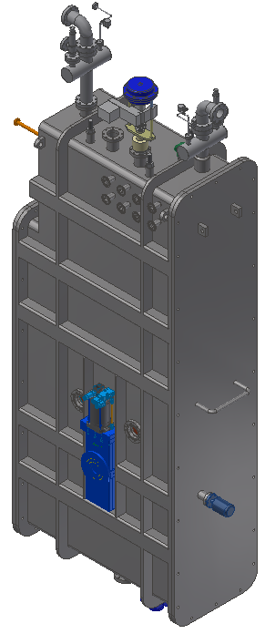
QWR Cryomodule
Cryogenic valve
(DN8)
Safety valve(4.5K)
Level gauge(2ea)
(Relief, Solenoid, Rapture, Pressure)
Reservoir
Feed-through
Safety valve
Module line
(32pin connector)
(Relief, Solenoid, Rapture, Pressure)
Chamber
Magnetic shield
Gate valve
View port
(DN63)
(CF 2.75”)
Thermal shield
Dummy Tuner
Support part
Dummy Tuner motor
Dummy Cavity
Dummy Coupler

Slide 9
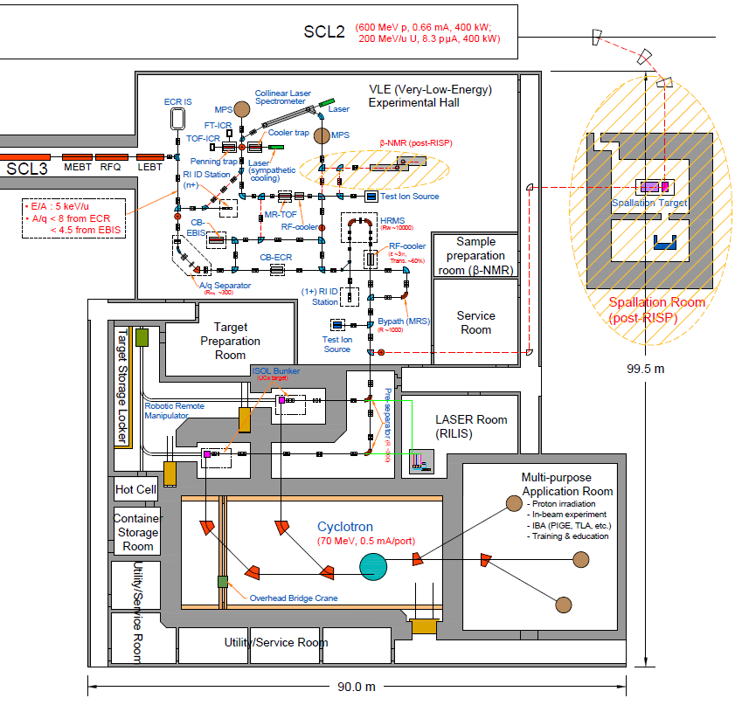
ISOL system
System | Development Goal
① Proton Driver | Cyclotron (70 MeV, 1 mA)
②Target- Ion Source | Fission Target (10 kW & 35 kW) 1.6x10¹³~1.2x10¹⁴ f/s 2.2x10⁹~1.6x10¹⁰ ¹³²Sn/s Ion Sources SIS, RILIS, FEBIAD
③ RF-cooler | CW and Pulsed Beam current : up to 1 μA Emittance : ~ 3 π, ΔE/E < 5x10⁻⁵ ε_{trans.}> 60 % (CW)
④ HRMS | R_{w}~10,000 D > 34 cm/%
⑤ Charge Breeder | EBIS (ECR) efficiency : 4~30% (1~18%) A/q : 2~4 (4~8) E spread (eV/q) : ~50 (1~10) E/A : 5 keV/u
⑥ A/q Selector | R_{A/q} ~300 E+B combination
⑦ Re-accel. | Super-conducting LINAC (0.5~18.5A MeV)
⑦
④
⑤
③
⑥
②
②
①

Slide 10
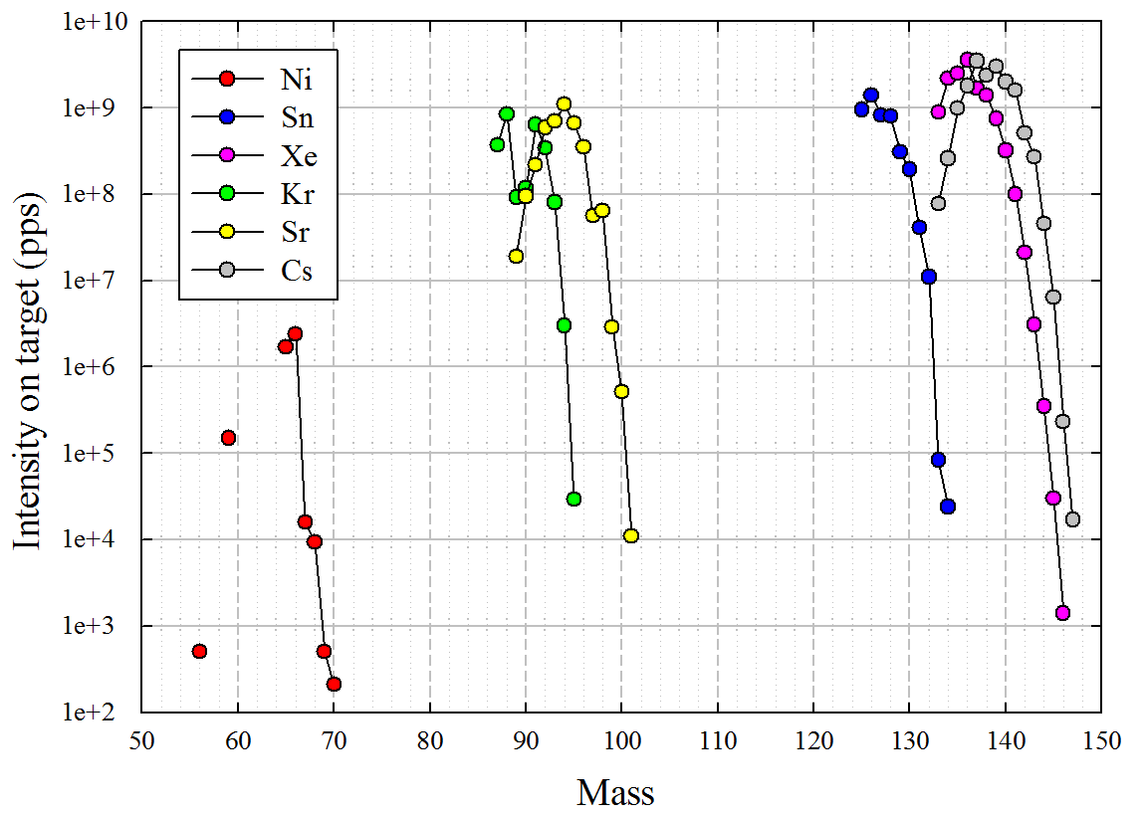
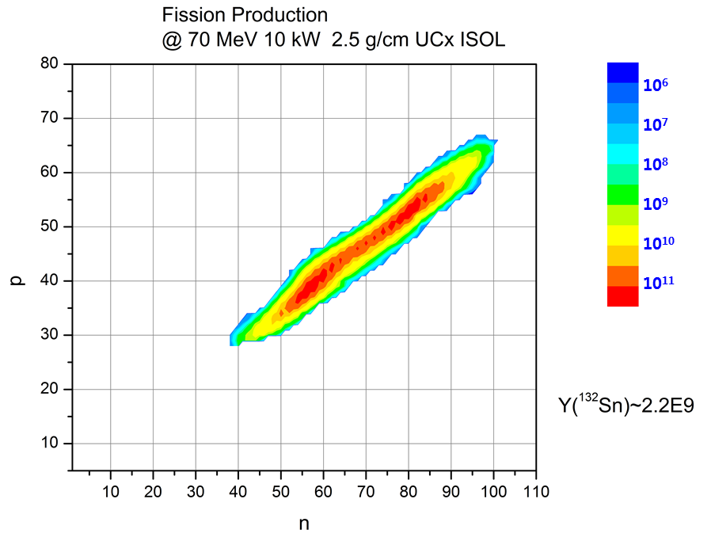
RI Yield estimation
p + UCx → n-rich isotopes (80 < A< 160) by fission reaction
Fission rate (10 kW) : 1.6x10¹³ f/s
Expected lab. intensities (10 kW target)
Production yield (10 kW ISOL target)
Y(¹³²Sn)~2.2E9
n-rich isotopes (80 < A< 160)
Isotope | Half-life | Science | Lab. Yield (pps)
⁶⁶Ni | 2.28 d | Pigmy dipole res. | 4x10⁵
⁶⁸Ni | 21 s | Symmetry energy | 5x10⁶
¹³²Sn | 39.7 s | r-process, PDR | 1x10⁷
¹³⁰⁻¹³⁵Sn | 0.5 s ~ 3.7 min | Fine structure, mass measurement | 10⁴~10⁸
¹⁴⁰Xe | 13.6 s | Symmetry energy | 3x10⁸
¹⁴⁴Xe | 0.4 s | Symmetry energy | 1x10⁵

Slide 11
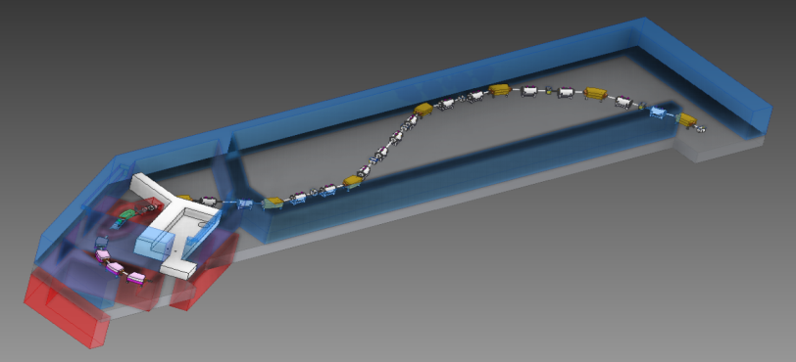
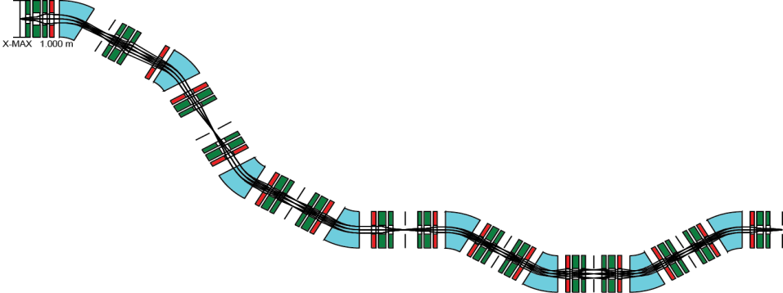
In-Flight separator
The layout of an in-flight separator
The first-order optics of in-flight separator
F1
F2
F3
F4
F5
F6
F7
F8
F9
HTS Dipole and Quadrupole Magnets
Max. magnetic rigidity: ~10 Tm
Momentum acceptance: ± 3%
Angular acceptance :
±40 mrad (H) ± 50 mrad (V)
Focal plane
Achromatic: F2, F4, F5, F7 Dispersive: F1, F3, F6, F8 Doubly achromatic: F9
Momentum resolving power pre-separator: 1140 at F1 2280 at F3 Main separator: 2600 at F6 2600 at F8
Main separator
Target
Pre-separator
LTS Dipole Magnets
Triplets of LTS quadrupole Magnets
Comparison of main separator configurations
C-bend layout of main separator
Using LISE++
Primary beam(1 sigma): ( X, A, Y, B, L, D )
= ( 0.167 mm, 1 mrad, 0.167 mm, 1 mrad, 0 mm, 0.07%)
Target thickness: 30 % of the stopping range of primary beam energy
in target material
Slit width: achromatic focus: FWTM
dispersive focus: Fully open (momentum acceptance 6%)
F1
F2
F4
F5
F6
F0
F3
1st degrader @ F3
2nd degrader @ F5
Momentum resolving power
2600 @ F5
2600 @ F6
F7
F0
F8
Primary beam | Degrader setting | Fragment | Shape | Yield | Purity | Trans.
²³⁸U, 200MeV/u | 1.57 mm @F3 0.70 mm @F5 | ¹³²Sn | C-bend | 7.59E+05 | 0.02% | 1.35%
 | 1.57 mm @F3 0.70 mm @F6 |  | Concave | 1.13E+06 | 0.15% | 2.00%
²⁰⁸Pb, 210MeV/u | 0.70 mm @F3 0.60 mm @F5 | ²⁰⁵Pt | C-bend | 1.00E+03 | 0.01% | 41.80%
 | 0.70 mm @F3 0.60 mm @F6 |  | Concave | 1.00E+03 | 0.02% | 41.60%
¹⁸⁶W, 210 MeV/u | 0.80 mm @F3 0.30 mm @ F5 | ¹⁸⁰Yb | C-bend | 1.50E+06 | 3.66% | 38.20%
 | 0.80 mm @F3 0.30 mm @F6 |  | Concave | 8.13E+06 | 15.90% | 20.80%
F1
Concave layout of main separator
F2
F3
F4
F8
F5
F6
F7
1st degrader @ F3
2nd degrader @ F6
Momentum resolving power 3750 @ F6
poster PS1-C0005

Slide 12
Experimental Facilities at RAON
Field | Facility | Exp. hall | Characteristics | Remark
Pure science | Recoil spectrometer – KOBRA | Low E | High resolution, Large acceptance function, RIBs production with in-flight method | Mass resolution; ~ 200 Large acceptance; ~ 80 msr
 | Large acceptance Spectrometer – LAMPS(L&H) | Low & High E (I) | High efficiency for charged particle, n, and γ | TPC ; 3π sr, Neutron wall, Si-CsI array, dipole spectrometer
 | High resolution Spectrometer | High E (I) | High resolution, Precise scattering Measurement to the focal plan, Rotatable | Momentum resolution ; 1.5x10⁴
 | Zero-degree Spectrometer | High E (I) | Charge and mass separation, Good mass resolution | Momentum resolution ; 1200~ 4100
 | High precession mass measurement system | Ultra low E | Penning trap, Multi-reflection Time of flight | Mass resolution ; 10⁻⁵~ 10⁻⁸
 | Collinear laser Spectroscopy | Ultra low E | High Resolution Laser Spectroscopy System | Spectral resolution ; ≤ 100 MHz
Applied science | β-NMR/μ-SR | Low / High E (II) | High intensity ⁸Li & muon production | ⁸Li & muon > 10⁸ pps
 | Bio-medical facility | Low & High E (II) | Irradiation system for stable & radio ion beam | Uniformity ; < 5%
 | Neutron science Facility | Low E | Fast neutron generation & measurement system of fission cross section | Uncertainty ; < a few %

Slide 13
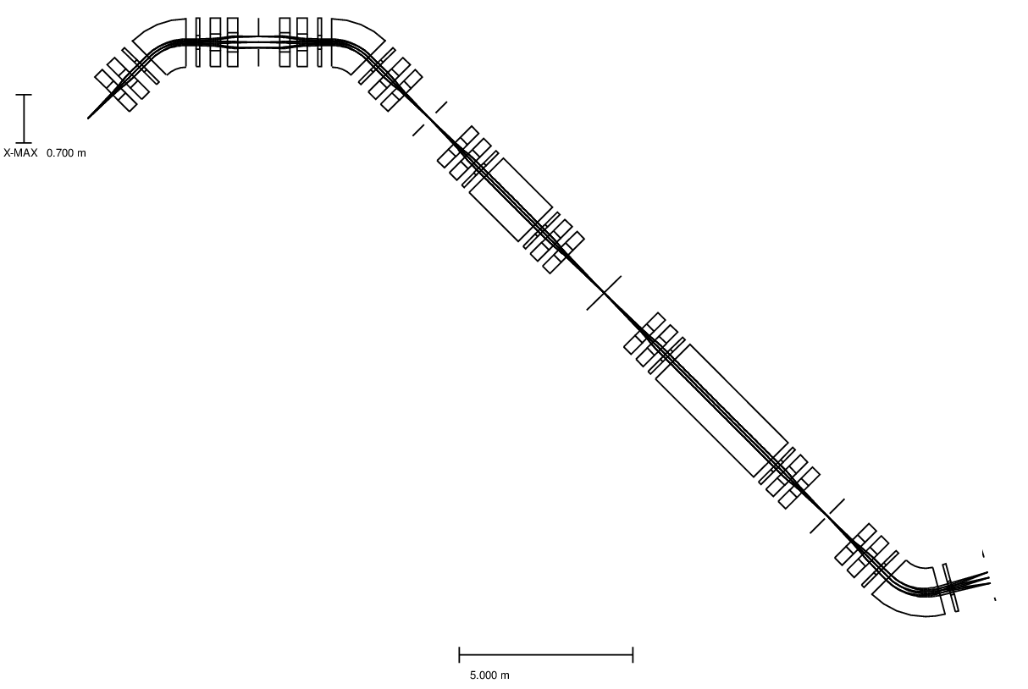
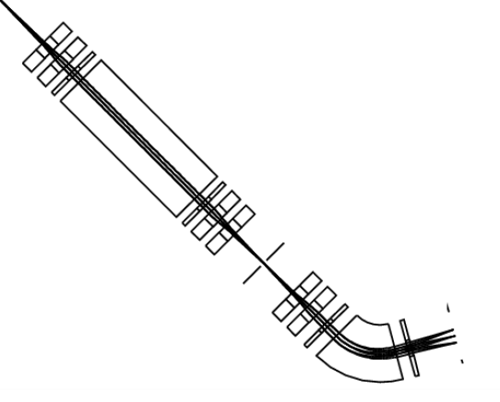
KOBRA (KOrea Broad acceptance Recoil spectrometer and Apparatus)
Experimental facility for nuclear structure and nuclear astrophysics studies
with low-energy stable and rare isotope beams
Physics program
F1
- Astrophysically important nuclear reactions
F0
- Rare event study
F2
WF1
- Structure of exotic nuclei
SI & RI beams from acc.
- Properties of exotic nuclei
- Symmetry energy etc
Versatile two-stage device
RI beams production (stage1)
F3
Commissioning
: Q2 in 2018 !
- low energy in-flight method
WF2
- Quasi Projectile Fragmentation
- Polarized RI beam (beam swinger)
F4
High performance spectrometer (stage2)
F5
- Rotatable
- Large acceptance (>50mSr) by movable Q magnets just after F3
- High momentum resolution (p/Δp ~ 10,000) by dispersion matching

Slide 14
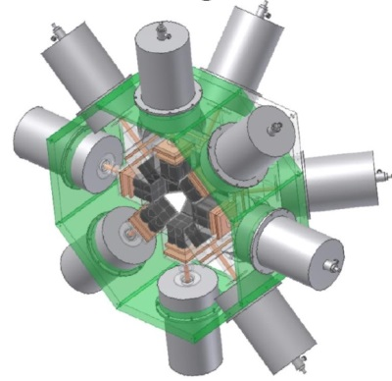
Associate equipment at KOBRA
Technical design work is under way
(poster PS1-C024 & PS2-C005)
Current Manpower : 11 (8 staffs + 3 students)
Collaboration : 11 institutes
KOBRA debut at ARIS 2017 & 2020 !!
F1
F0
F2
SI & RI beams from acc.
· RI Production target
- cryogenic gas target
- solid target for QPF
· Reaction target
- for (p,γ) & (α,γ) reactions
1.5~2.0 m
F3
· Focal plane detection system
· Si-array
· Gamma-array
· Active target
· Gas-jet target (JENSA)
· High power solid target
· Gas target
· Polarized H/He target
F4
F5
Super Clover with ACS
: x 6
: will be ready from May, 2015
· Beam tracking detectors at F1~F5
· Mass measurement system after F5

Slide 15
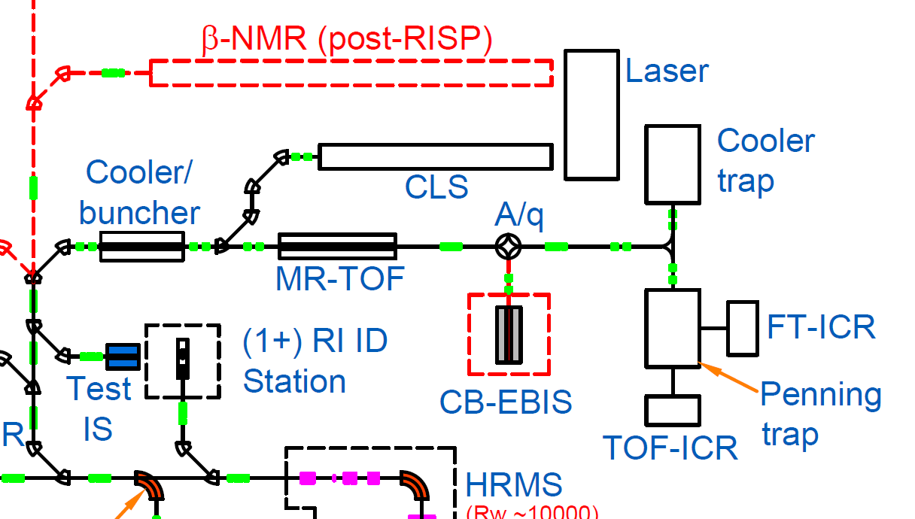
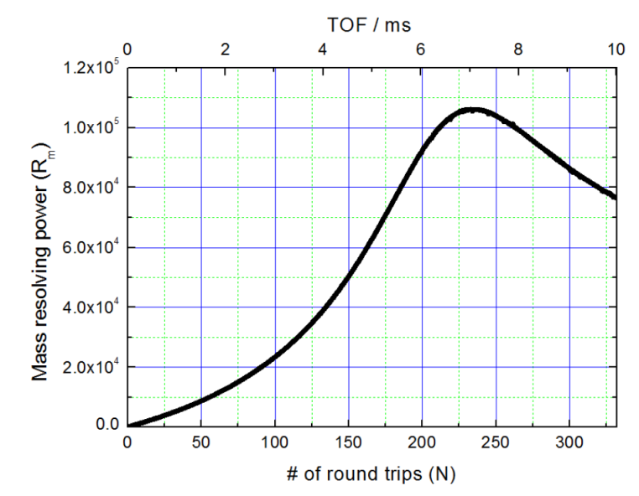
High Precision Mass Measurement System
Construction Plan
1st stage (~2018): MR-TOF
2nd stage: Penning trap with singly charged ions
3rd stage: Penning trap with highly charged ions
(Sympathetic cooler)
Specifications of the MR-TOF-MS
Test IS
Resolving Power: >10⁵
Measurement time: <10 ms
(cooling time: ~2 ms, total TOF: ~7 ms)
→ Mass measurement & Isobar separation for Penning trap
c
To SCL3
From ISOL (20-50 keV)
Layout of the ultra-low energy experiment facility
T=7 ms
R >1x10⁵
L
M₁ … M₅
Drawing of the MR-TOF-MS
Optimal electrode voltages (for the ions with A=132 and Q=1)
Electrode | L | M₁ | M₂ | M₃ | M₄ | M₅
Voltage [V] | -3383.3 | -1456.3 | -220.9 | 1439.1 | 1902.1 | 2748.6
Resolving power (R) vs. # of turns (N)
* optimized by Nelder-Mead method
Poster: PS1-C023 (J.W. Yoon)

Slide 16
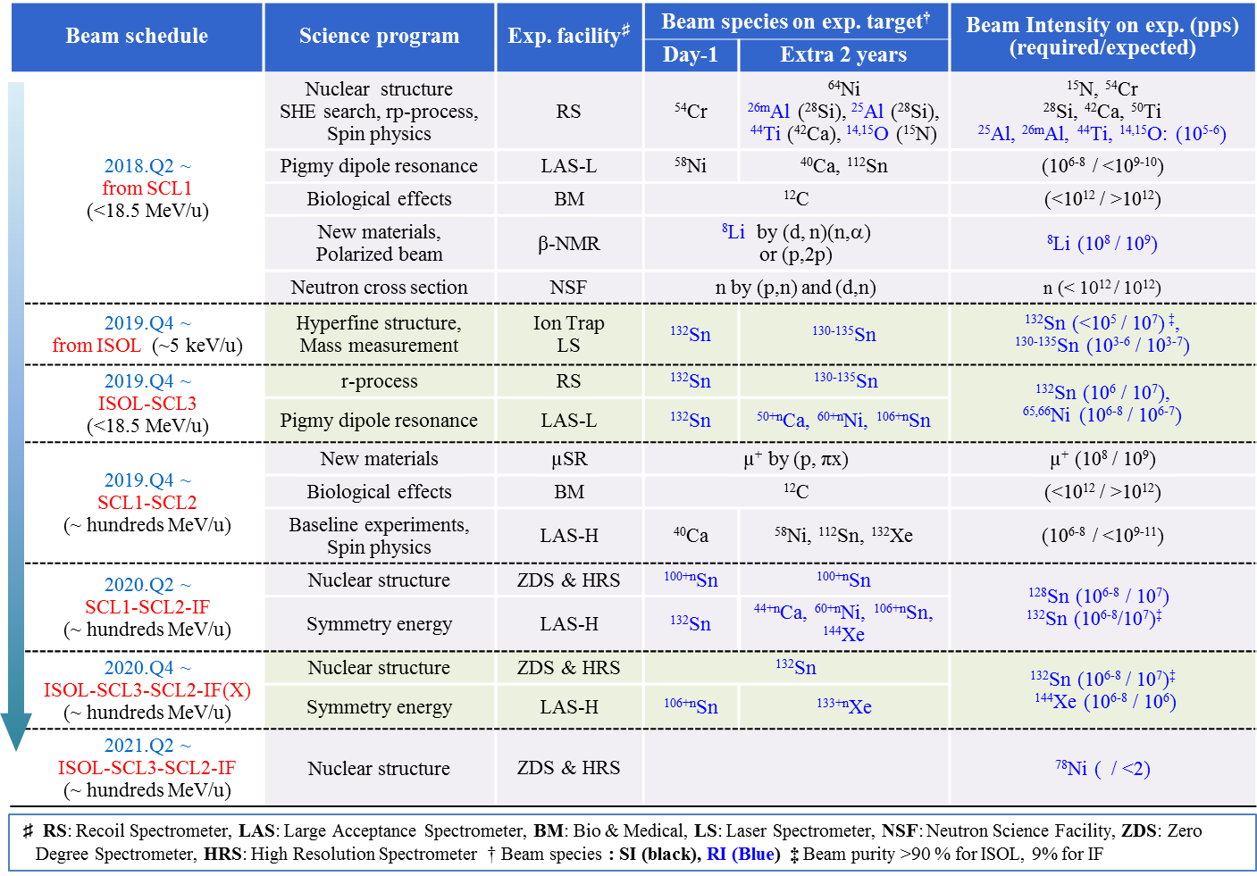
Science Program with Beam Schedule

Slide 17
Summary
RAON is the first large scale RI accelerator facility for nuclear science in Korea.
Integration of independent ISOL & IF systems is one of the distinct feature of RAON.
Prototyping of major parts has been conducted since 2013.
Experimental systems are being developed in parallel.
KOBRA is the first experimental system at RAON, which is a recoil spectrometer for nuclear structure and nuclear astrophysics studies.
MR-TOF system will be developed as a high precision mass measurement system by 2018.
We welcome collaborations with RI scientists.

Slide 18
Thank you for attention !

