Slide 1
Research of Superheavy Elements at RIKEN - Present Status and Perspective -
Kosuke Morita
Department of Physics, Kyushu University /
Superheavy Element Research Group, RIKEN Nishina Center
2nd Conference on Advances in Redioactive Isotope Science, ARIS2014

Slide 2
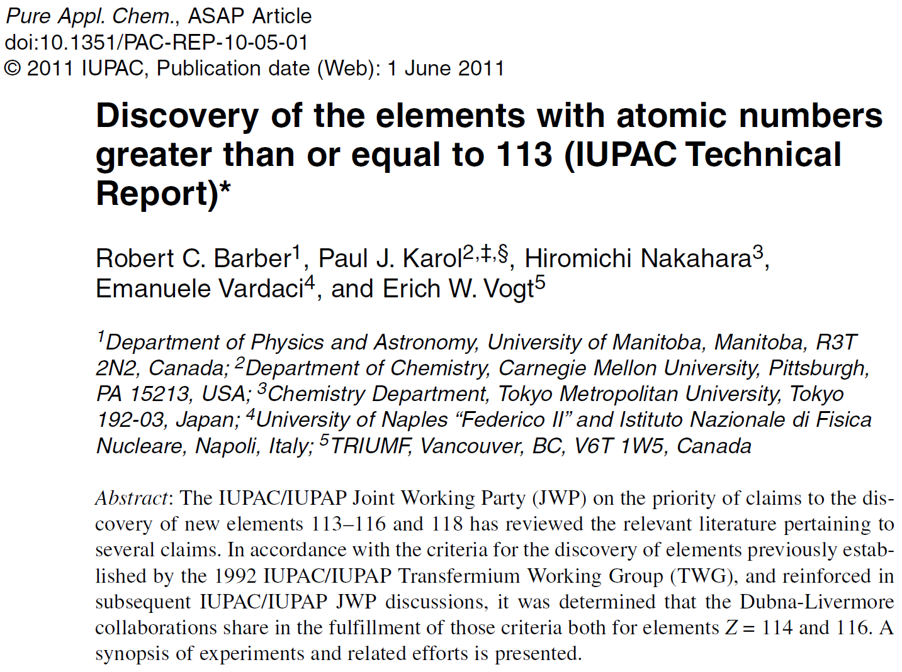
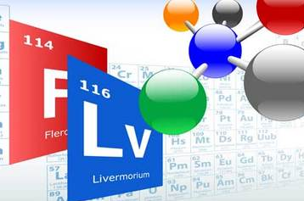
1st ARIS Conference 2011
The Periodic Table has been evolving!

Slide 3
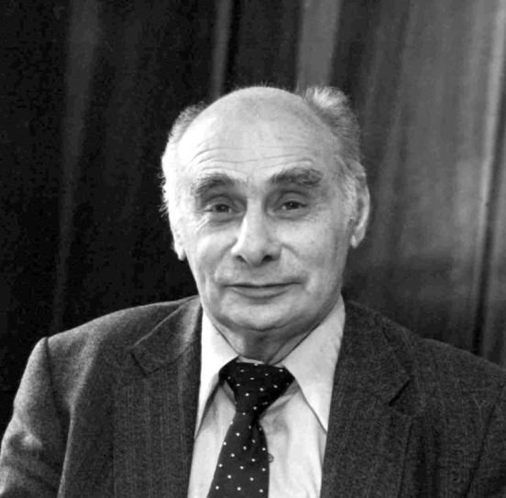
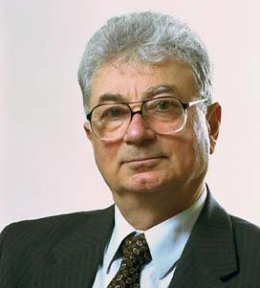
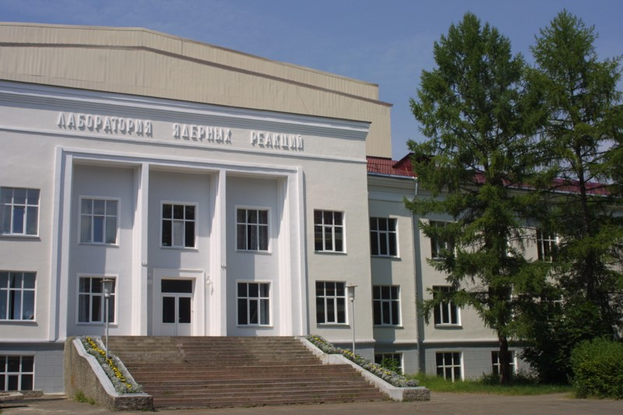
Flerov Laboratory of
Nuclear Reaction
Joint Institute for
Nuclear Research
Dubna, Moscow region
Georgi Nikolaevich Flerov
1913-1990
Yuri Tsolakovich Oganessian
‘flerovium (Fl)’ for element 114
‘livermorium (Lv)’ for element 116

Slide 4
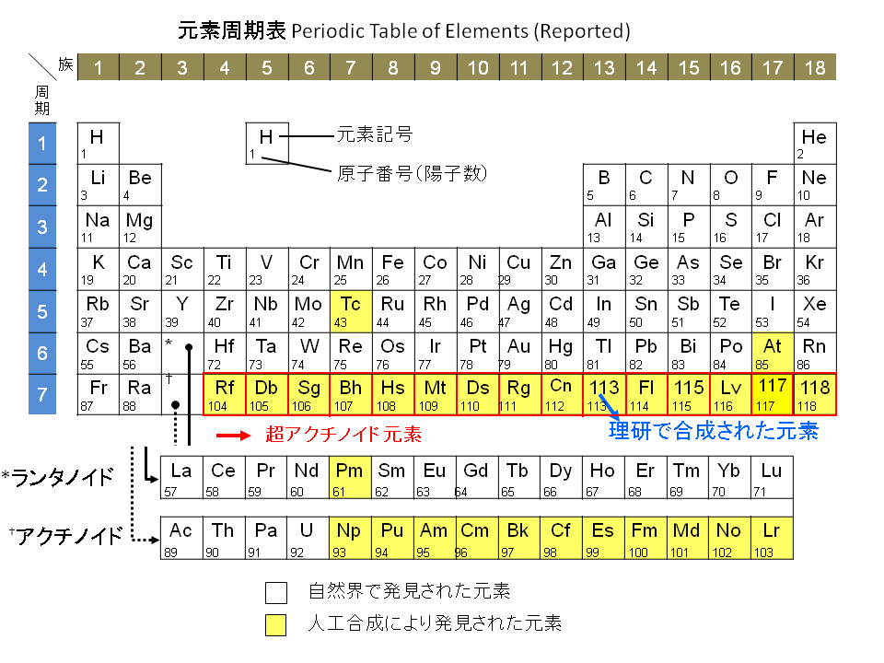

Slide 5
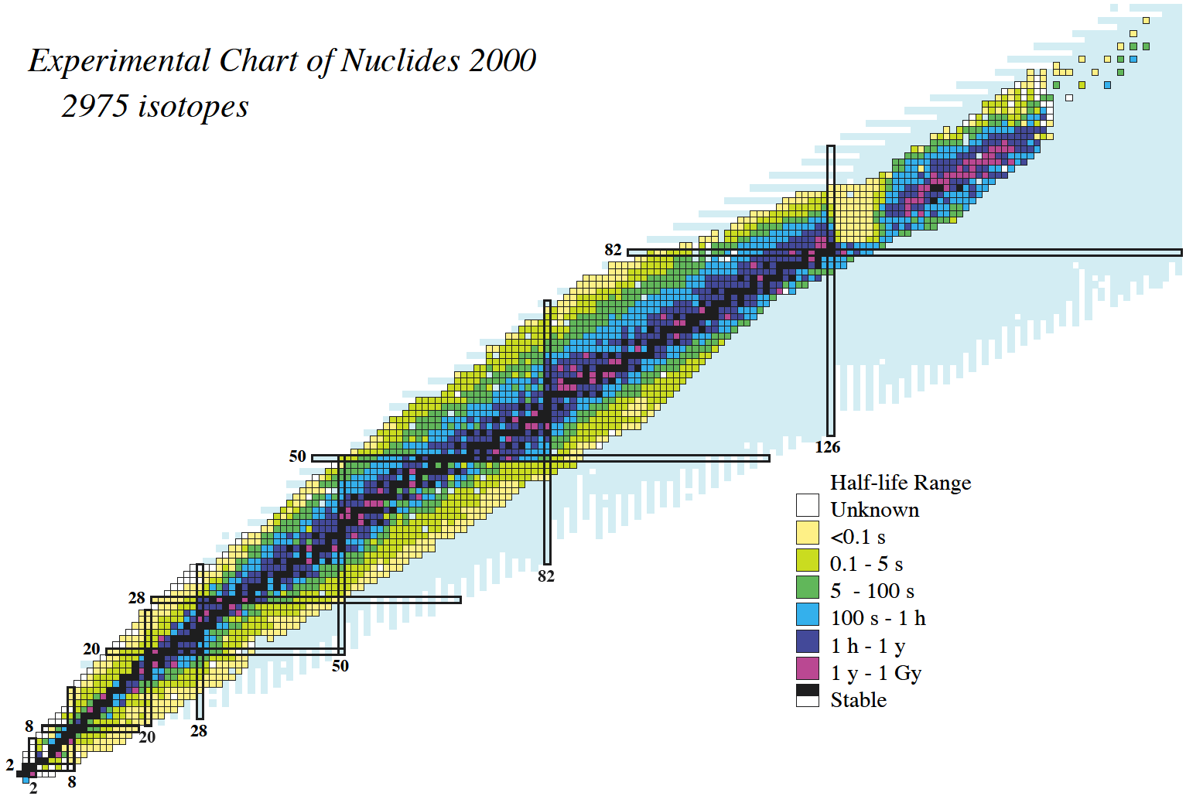
Region of interest
120?
114?
new nuclides: ～40/year
new element: ～0.3/year
184
Z
N

Slide 6
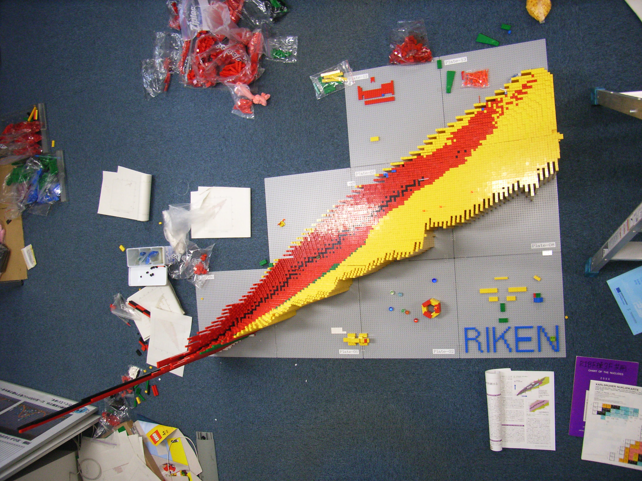

Slide 7
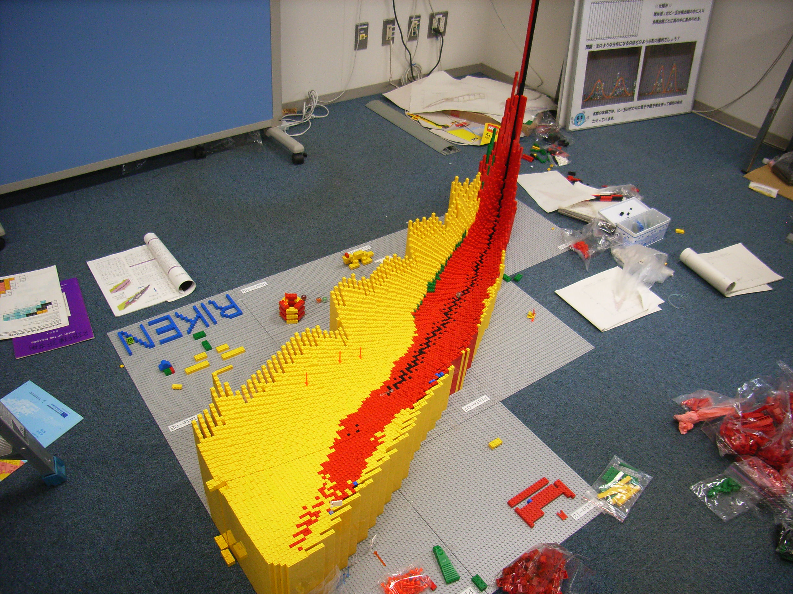

Slide 8
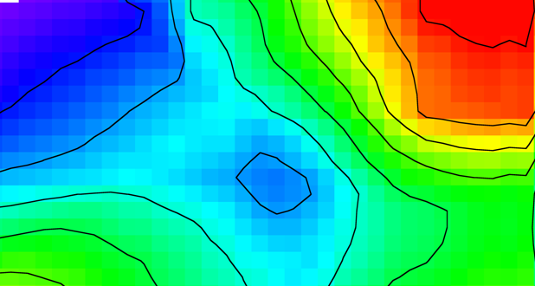
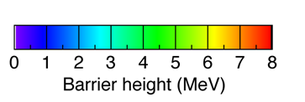
one end of nuclear chart ’84－’94
120
119
118
117
116
115
114
SHE
113
112
Rg
Ds
Mt
266
Hs
264
265
Bh
261
262
Sg
259
260
261
263
Db
258
260
261
262
257
258
259
260
261
262
Rf
262
162
184
A
α-decay
A
Spontaneous fission
A
β⁺ or EC decay

Slide 9
one end of nuclear chart 2010
one end of nuclear chart 2009
120
119
118
294
117
293
294
116
290
291
292
293
115
287
288
289
290
114
286
287
288
289
290
SHE
113
278
283
284
285
286
112
277
282
283
284
285
286
Rg
272
274
279
280
281
282
Ds
269
270
271
273
279
281
282
Mt
266
268
270
275
276
278
Hs
263
264
265
266
267
269
270
271
275
278
Bh
261
262
264
265
266
267
271
272
274
Sg
259
260
261
262
263
264
265
266
271
Db
258
259
260
261
262
263
267
268
270
257
258
259
260
261
262
263
267
268
Rf
261
262
162
184
A
α-decay
A
Spontaneous fission
A
β⁺ or EC decay

Slide 10
113
278
283
284
112
277
282
283
284
285
286
Rg
272
274
280
272
279
269
271
273
279
Ds
270
271
273
281
282
Mt
268
270
266
268
275
276
cold fusion reaction
265
269
Hs
264
265
266
267
269
270
271
275
278
269
261
262
264
Bh
264
265
266
271
272
Sg
261
262
263
265
266
258
259
260
261
263
265
271
260
262
Db
255
256
257
258
259
260
261
262
263
267
268
⁴⁸Ca induced reactions
253
257
258
259
261
262
Rf
254
255
256
257
259
260
261
267
268
252
253
254
255
256
257
258
259
260
Lr
256
261
262
250
251
252
253
253
252
253
254
255
256
257
258
254
253
262
No
255
259
260
247
248
250
252
253
249
250
251
254
255
256
257
Md
251
252
258
259
260
244
245
246
248
249
252
253
257
258
244
246
247
250
251
254
255
256
259
Fm
247
248
257
Es
245
246
247
248
249
250
251
252
253
254
255
256
Cf
244
245
246
247
248
249
250
251
252
253
254
255
hot fusion reaction
Bk
243
244
245
246
247
248
249
250
251
Cm
242
243
244
245
246
247
248
249
250
251
Am
241
242
243
244
245
246
247
Pu
240
241
242
243
244
245
246
247
Np
239
240
241
242
243
244
neutron capture + β-decay
U
238
239
240
242
150
162

Slide 11
Main Limitations of Various Approaches to SHE
Reaction Mode | Proj. (Aproj) | Limitation | Heaviest Nuclide |  | comment
 |  |  | (Z) | (N)
multiple n-capture | n | SF* of Fm isotopes | 100 | 157 | maybe possible in nature (r-process)
hot fusion (HI,xn);x=3-6 Ucn≥40 MeV | ≤34 &48 | small survival prob. (Γ_{n}/Γ_{f} very small) | 118 | 177 | N-rich beam often improves. (cf. ⁴⁸Ca;warm fusion)
cold fusion (HI,xn);x=1,2 Ucn ≤20 MeV | 50-70 | small fusion prob. (dynamical hindrance of fusion?) | 113 | 165
transfer reaction | ≤22 | lack of target heavier than ²⁵⁴Es** | 103 | 159
*SF: spontaneous fission. cf. T_{1/2} of ²⁵⁸Fm₁₅₈ ≈ 400 μs.
**²⁵⁴Es(Z=99): T_{1/2} ≈ 276 day

Slide 12
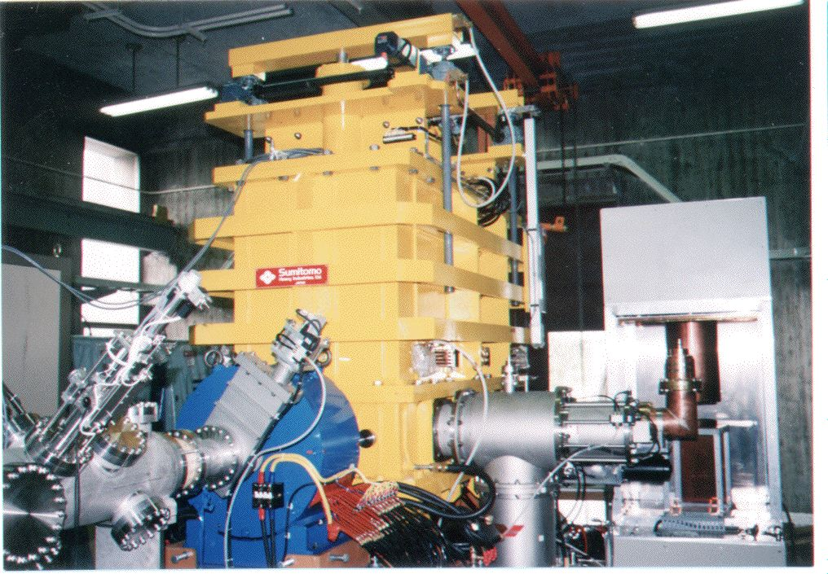
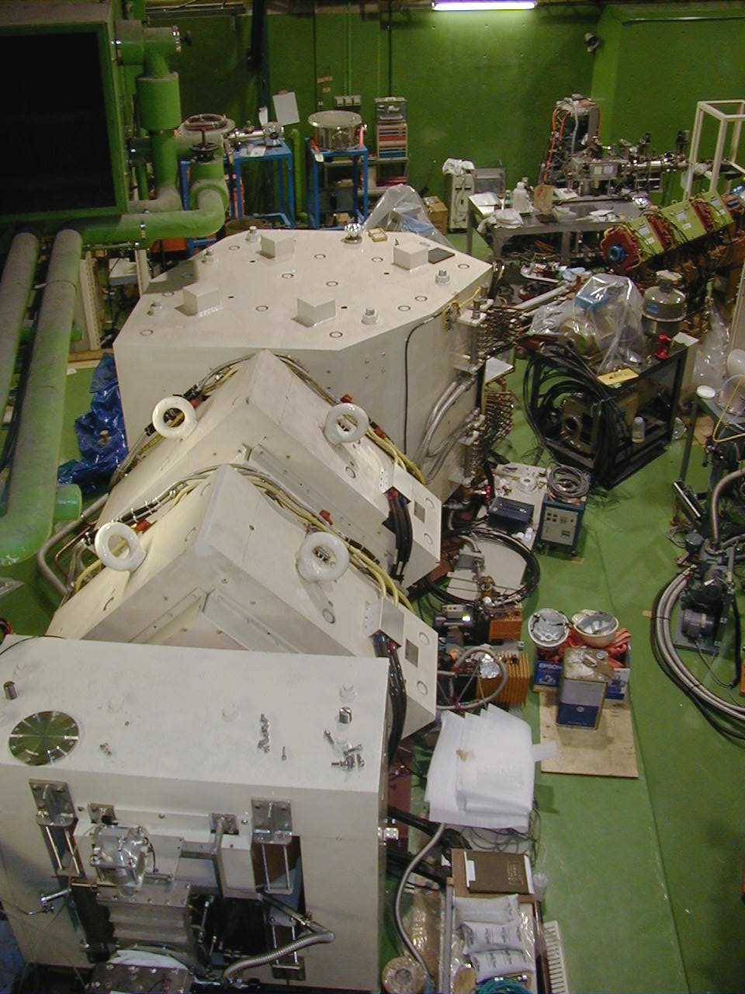
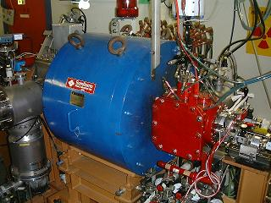
実験方法
核反応
分離装置(separator)
select the nuclei of our
interest from the unwanted
then transport to the
detector chamber
incident ion beam
（粒子の流れ）
GARIS
標的（金属薄膜）
加速器
検出器(detectors)
accelerate ions using electric field
information of energies or positions
of incoming ions and their decay
particles are transform to electric
signal
RFQ-Linac
イオン源
remove electrons from neutral atoms
理研original
18GHz ECR ion-source

Slide 13
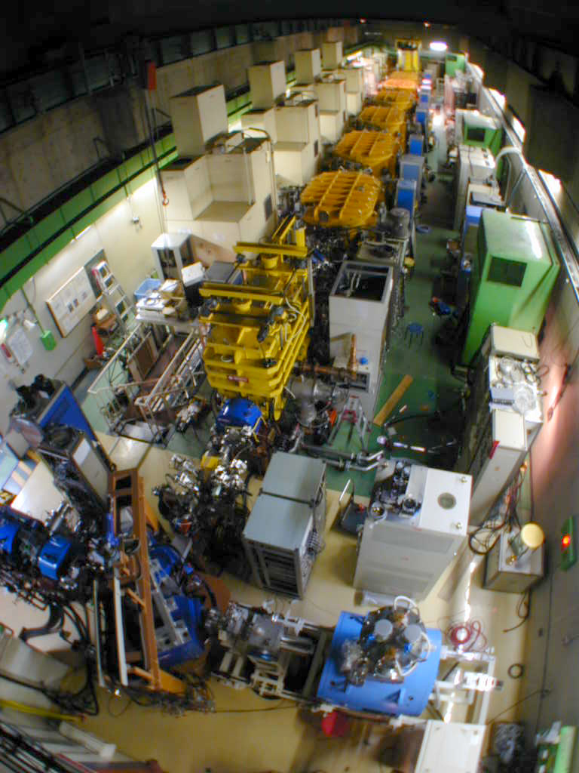
RIKEN Linear Accelerator
RILAC
From ₁H to ₉₂U
Up tp 5.8 AMeV

Slide 14
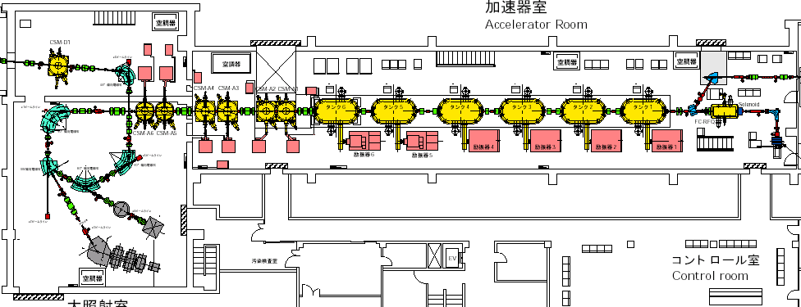
Linear Accelerator Facility
CSM Acc. Tanks
RILAC Acc. Tanks
RFQ-Linac
Beam Energy Monitor
18GHz ECR Ion Source
GARIS
Notes:
Three years ago, Linear accelerator was upgraded and maximum energy was Increased up to 6 A MEV.
Because this maximum energy is enough for production of super heavy element,
The GARIS was re-installed here from Ring Cyclotoron facility.
This is our apparatus GARIS.
Energy of the beam from the acc. were monitored by two method.
One is a B rho of this 90 bending magnet and the other is TOF of this section.
The accuracy of the energy of the beam was pulse minus 0.2 %.

Slide 15
RIKEN Gas-filled Recoil Separator GARIS
D1
Bending angle | 45 degree
Pole gap | 150 mm
Radius of central ray | 1200 mm
Maximum field | 1.54 T
Q1, Q2
Pole length | 500 mm
Bore radius | 150 mm
Maximum field gradient | 5.2 T/m
D2
Bending angle | 10 degree
Pole gap | 160 mm
Pole length | 400 mm
Maximum Field | 1.04 T
beam
Differential pumping section
Rotating Target
r | 150 mm
ω | 2000 rpm
D1 Q1 Q2 D2
Magnification | X | -0.76
 | Y | -1.99
Dispersion |  | 0.97 cm/%
Total length |  | 5760 mm
Acceptance | Δθ | ±68 mrad
 | Δφ | ±57 mrad
 | ΔΩ | 12.2 msr

Slide 16
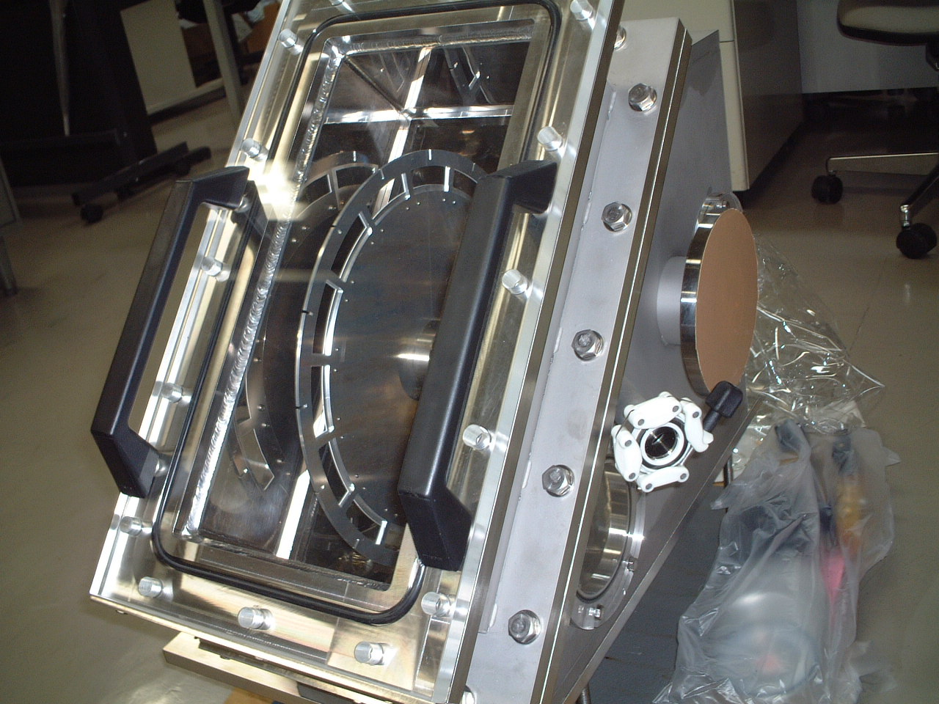
Rotating Target
New Rotating Target φ = 300 mm, ω = 3000 rpm
cf. old one φ = 125 mm, ω = 1000 rpm

Slide 17
Focak plane detectors
PSD + SSD
TOF (MCP)
ions

Slide 18
Reactions studied at GARIS
²⁷²111
14 chains
²⁷⁷112
2 chains
116
115
176
²⁷¹Ds
14 chains
114
113
²⁶⁵Hs
10 chains
112
111
Ds
Mt
170
Hs
Bh
Sg
Db
Rf
162
Lr
α
No
SF
Md
β+ or EC
Fm
β-
Es
Cf
152
Notes:
This is the one end of the nuclear chart.
In order to identify the isotopes definitely, RIKEN SHE group decided to select the reaction that decay chain connected to the known nuclei.
We succeeded to observe these decay chains.
108, 110, 111, 112

Slide 19
Reactions studied by GARIS
²⁷²111
14 chains
²⁷⁸113
116
115
176
²⁷¹Ds
14 chains
114
113
²⁶⁵Hs
10 chains
112
111
Ds
Mt
170
Hs
²⁷⁷112
2 chains
Bh
Sg
Db
Rf
162
Lr
α
No
SF
Md
β+ or EC
Fm
β-
Es
New !
Cf
152
Notes:
The observed chain is locating here.

Slide 20
20
²⁷²Ds
10
4
²⁷³111
2
σ (pb)
²⁷⁸112
Calculated threshold of fission
after 1n emission
1
0.5
Masses of Beams & Targets
Audi & Wapstra, Nucl. Phys A565, 1 (1993)
Masses of Compound Nuclei
Myers & Swiatecki, Nucl. Phys. A601, 141 (1996)
0.3
²⁷⁹113
0.2
0.1
5
10
15
20
Ex of C.N. (MeV)

Slide 21
B + T + Ecm
S_{n}
Second chance fission
sreshold
Ex(CN)
(A – n) + n
S_{n}
B_{f}
saddle point
A
Deformation
saddle point
Deformation
Ecm
Energy diagram of 1n emission
B + T

Slide 22
²⁵²Md ← ²⁵⁶Lr ← ²⁶⁰Db ← ²⁶⁴Bh ← ²⁶⁸Mt ← ²⁷²111
α５
α４
α３
α２
α１
5
τ=5.5ms
5
α1
α１
α１
0
0
5
5
α2
τ=30ms
α２
α２
0
0
Counts / 100 keV
5
5
Counts / bin
τ=1.3s
α3
α３
α３
0
0
5
5
α４
α4
α４
α4
τ=2.2s
τ=27s
0
0
5
5
α5
α5
τ=27s
α５
α５
0
0
100μs
10ms
1s
100s
10000s
8
9
10
11
12
Tdecay
(sec)
E
α
/ MeV
Journal of Physical Society of Japan (JPSJ) Vol. 73, (2004) 1738 - 1744
Notes:
Let me show the result of the decay time distribution and distribution of alpha energy.
The energy distribution is wider than the destribution of Ds, because odd odd particles decay chain.

Slide 23
 | GSI |  | RIKEN |  |  | FLNR
ref. | 1 | 2 | 3 | 4 | present | 5 | 6
²⁷⁷112 | 11.45 | 11.17 | 11.09±.07 | 11.32±.04 | 11.07±.07
 | 0.28 ms | 1.41 ms | 1.10 ms | 1.22 ms | 0.37 ms
²⁷³Ds | 11.08 | 11.20 | 11.14±.04 | 11.15±.07 | 11.03±.07 | 11.35
 | 0.11 ms | 0.31 ms | 0.52 ms | 0.04 ms | 0.373 ms | 0.39 ms
²⁶⁹Hs | 9.23 | 9.18 | 9.17ｃ | 9.25±.07 | 9.14±.04
 | 19.7 s | 22.0 s | 14.2 s | 0.27 s | 36.01 s
²⁶⁵Sg | 4.60 | 0.20 | 8.71±.04 | 8.70±.04 | 8.66±.07 | 8.63
 | 74.0 s | 18.8 s | 23.0 s | 79.9 s | 13.84 s | 158 s
²⁶¹Rf | 8.52 | 153 | 197 | 156 | 176 |  | 8.30±0.06
 | 4.70 s | 14.5 s | 2.97 s | 8.30 s | 3.73 s |  | 54⁺⁸₋₄ s
²⁵⁷No | 8.34 |  |  |  |  | 8.22 | 8.24, 8.34
 | 15.0 s |  |  |  |  | 384 s | 17 s
ref.
1 | Hofmann S. et al., Z. Phys. A354, 229 (1996) | ²⁰⁸Pb + ⁷⁰Zn → ²⁷⁷112 + n
2 | Hofmann S. and Münzenberg G., Rev. Mod. Phys. 72, 733 (2000) | ²⁰⁸Pb + ⁷⁰Zn → ²⁷⁷112 + n
3,4 | J. Phys. Soc. Jpn., Vol. 76, No. 4, p.043201(2007) | ²⁰⁸Pb + ⁷⁰Zn → ²⁷⁷112 + n
 | present | ²⁰⁸Pb + ⁷⁰Zn → ²⁷⁷112 + n
5 | Lazarev Yu. A. et al., Phys. Rev. C54, 620 (1996) | ²⁴⁴Pu + ³⁴S → ²⁷³Ds + 5n
6 | Lazarev Yu. A. et al., Phys. Rev. C62, 064307(2000) | ²⁴⁴Pu + ²²Ne → ²⁶¹Rf + 5n

Slide 24
N=165
²⁷⁷112 τ = 1.0 ms
N=163
²⁷³Ds τ = 0.24 ms
RIKEN
N=161
GSI
²⁶⁹Hs τ = 14 s
RIKEN present
N=159
²⁶⁵Sg τ = 32 s
N=157
²⁶¹Rf τ = 7.6 s
10μs
1ms
0.1s
10s
1000s
T_decay/s

Slide 25
²⁰⁹Bi + ⁷⁰Zn → ²⁷⁸113 + n
36.75 MeV
30.33 mm
36.47 MeV
30.08 mm
²⁷⁸113
CN
²⁷⁸113
CN
初観測の崩壊チェーン
α
α
11.68 MeV
344 μs
30.49 mm
11.52 MeV
4.93 ms
30.16 mm
2004年7月23日 18:55
²⁷⁴111
²⁷⁴111
α
α
11.15 MeV
9.260 ms
30.40 mm
11.31 MeV
34.3 ms
29.61 mm
²⁷⁰Mt
²⁷⁰Mt
α
α
10.03 MeV
7.163 ms
29.79 mm
2.32 MeV (escape)
1.63 s
29.45 mm
²⁶⁶Bh
²⁶⁶Bh
α
α
9.08 MeV
2.469 s
30.91 mm
9.77 MeV
1.31 s
29.65 mm
2度目に観測された崩壊チェーン
²⁶²Db
²⁶²Db
2005年4月2日 2:18
204.05 MeV
40.9 s
30.25 mm
192.32 MeV
0.787 s
30.47 mm
s.f.
s.f.

Slide 26
How much time did we run?
²⁶⁵Hs(Z=108) 3 d（10）
²⁷¹Ds(Z=110) 40d（14）
²⁷²Rg(Z=111) 50d（14）
²⁷⁷112 29d+60d（3）
²⁷⁸113 97d（1）
93d（1）
300d（0）!!!
Difficult to fuse！

Slide 27
Cold fusion cross section
²⁰⁸Pb,²⁰⁹Bi＋HI
1μb
100nb
RIKEN
10nb
1nb
100pb
10pb
1pb
0.1pb
100
102
104
106
108
110
112
114
Atomic number
Notes:
Now, let me summarize my talk.
Since the series of experiments started using a combination of RILAC and GARIS, we observed these events.
Our results confirmed the GSI results of 110 111 112 .
And we newly observed 278113 and its daughter neuclei.
That is all of my talk.
Thank you very much for your attention.
---

Slide 29
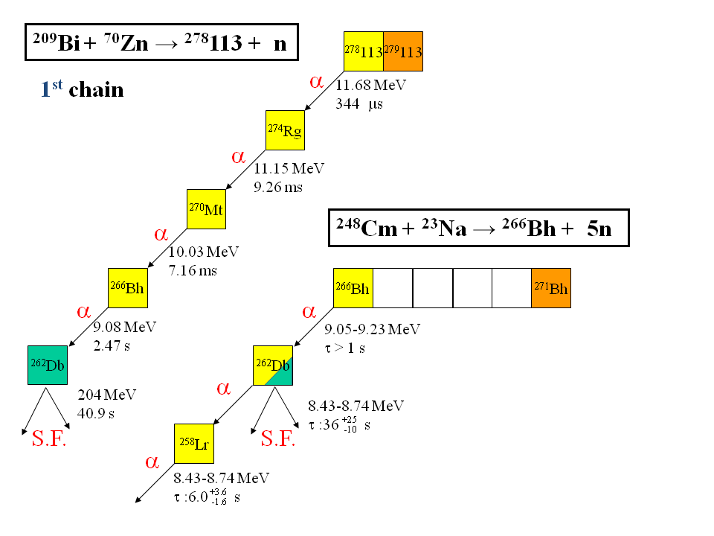

Slide 30
3個目の113番元素を観測
2012年8月12日
²⁷⁸113
CN
α₁
• 連続するα壊変を6回観測
• 既知核²⁶⁶Bh，²⁶²Db，²⁵⁸Lrに到達
⇒ 2004年，2005年の合成を確認
11.82 MeV
667 μs
²⁷⁴Rg
α₂
10.65 MeV
9.97 ms
²⁷⁰Mt
α₃
10.26 MeV
444 ms
²⁶⁶Bh
既知の核種
²⁶⁶Bh
0.6 s
α₄
α 9.29
9.39 MeV
5.26 s
²⁶²Db
8.67
8.53
8.45
²⁶²Db
34 s
α (34%)
α₅
8.63 MeV
126 s
α
8.654
8.621
8.595
8.565
²⁵⁸Lr
²⁵⁸Lr
3.9 s
SF (64%)
α₆
8.66 MeV
3.78 s
²⁵⁴Md
²⁵⁴Md
Wilk et al., PRL 85, 2697 (2000).
Table of Isotopes, 8th ed. (1996).

Slide 31
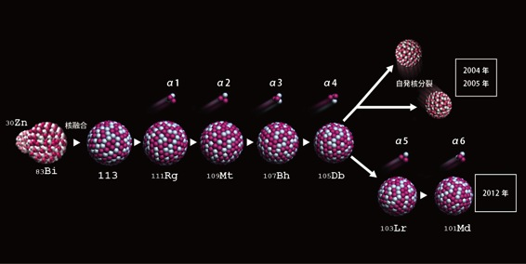

Slide 32
観測された崩壊のまとめ
²⁰⁹Bi + ⁷⁰Zn → n
2nd event Apr. 2 2005
3rd event Aug. 12 2012
1st event Jul. 23 2004
²⁷⁸113
113
112 |  |  |  |  |  |  |  |  |  |  |  |  |  | ²⁷⁷Cn
111 |  |  |  |  |  |  |  |  |  | ²⁷²Rg
110 |  |  |  |  |  |  |  | ²⁶⁹Ds | ²⁷⁰Ds | ²⁷¹Ds |  | ²⁷³Ds
109 |  |  |  |  |  | ²⁶⁶Mt |  | ²⁶⁸Mt
108 |  |  |  | ²⁶³Hs |  | ²⁶⁵Hs | ²⁶⁶Hs | ²⁶⁷Hs |  | ²⁶⁹Hs | ²⁷⁰Hs | ²⁷¹Hs
107 |  |  | ²⁶¹Bh | ²⁶²Bh |  | ²⁶⁴Bh |  | ²⁶⁶Bh | ²⁶⁷Bh
106 | ²⁵⁸Sg | ²⁵⁹Sg |  | ²⁶¹Sg |  | ²⁶³Sg
105 |  |  | ²⁵⁹Db | ²⁶⁰Db
104 | ²⁵⁶Rf |  |  |  | ²⁶⁰Rf | ²⁶¹Rf | ²⁶²Rf
103 | ²⁵⁵Lr |  | ²⁵⁷Lr | ²⁵⁸Lr | ²⁵⁹Lr | ²⁶⁰Lr | ²⁶¹Lr | ²⁶²Lr
102 |  |  | ²⁵⁶No |  | ²⁵⁸No |  | ²⁶⁰No |  | ²⁶²No
101 | ²⁵³Md | ²⁵⁴Md |  |  |  |  | ²⁵⁹Md | ²⁶⁰Md
100 | ²⁵²Fm |  | ²⁵⁴Fm | ²⁵⁵Fm |  | ²⁵⁷Fm | ²⁵⁸Fm | ²⁵⁹Fm
99 | ²⁵¹Es |  | ²⁵³Es |  |  | ²⁵⁶Es | ²⁵⁷Es
98 | ²⁵⁰Cf | ²⁵¹Cf | ²⁵²Cf | ²⁵³Cf | ²⁵⁴Cf | ²⁵⁵Cf | ²⁵⁶Cf
α
²⁷⁸113
α
既知核種
²⁷⁴Rg
α
²⁷⁴Rg
α
²⁷⁰Mt
α
²⁷⁰Mt
α
²⁶⁴Hs
²⁶⁶Bh
α
²⁶⁶Bh
α
²⁶⁰Sg
²⁶²Sg
²⁶⁵Sg
²⁶⁶Sg
²⁵⁷Db
²⁶¹Db
²⁶²Db
²⁶³Db
²⁶²Db
²⁵⁸Db
²⁶²Db
α
SF
²⁵⁷Rf
²⁵⁸Rf
²⁵⁹Rf
²⁶³Rf
²⁵⁶Lr
²⁵⁸Lr
α
²⁵⁴No
²⁵⁵No
²⁵⁷No
²⁵⁹No
²⁵⁴Md
²⁵⁵Md
²⁵⁶Md
²⁵⁷Md
²⁵⁸Md
²⁵³Fm
²⁵⁴Fm
²⁵⁶Fm
α
²⁵²Es
²⁵⁴ES
²⁵⁵Es
²⁵⁰Cf

Slide 33
²⁴⁹Bk + ⁴⁸Ca → 4n
118
117 |  |  |  |  |  |  |  |  |  |  |  |  |  |  | ²⁹³117 | ²⁹⁴117
116
115 |  |  |  |  |  |  |  |  |  |  | ²⁸⁷115 | ²⁸⁸115 | ²⁸⁹115 | ²⁹⁰115
114
113 |  |  |  |  |  |  |  | ²⁸²113 | ²⁸³113 | ²⁸⁴113 | ²⁸⁵113 | ²⁸⁶113
 |  |  |  |  |  |  |  |  |  | ²⁸³Cn
 |  |  |  |  |  | ²⁷⁸Rg | ²⁷⁹Rg | ²⁸⁰Rg | ²⁸¹Rg | ²⁸²Rg
 |  |  |  | ²⁷⁴Mt | ²⁷⁵Mt | ²⁷⁶Mt |  | ²⁷⁸Mt
 |  | ²⁷⁰Bh | ²⁷¹Bh | ²⁷²Bh |  | ²⁷⁴Bh
²⁶⁶Db | ²⁶⁷Db | ²⁶⁸Db |  | ²⁷⁰Db
 |  |  |  |  |  |  |  |  |  |  |  |  |  |  | ²⁹⁴118
 |  |  |  |  |  |  |  |  |  |  |  |  | ²⁹⁰Lv | ²⁹¹Lv
 |  |  |  |  |  |  |  |  |  |  | ²⁸⁶Fl | ²⁸⁷Fl
 |  |  |  |  |  |  |  |  | ²⁸²Cn
 |  |  |  |  |  | ²⁷⁵Hs
 |  | ²⁶⁷Rf
α
²⁹³117
CN
²⁰⁹Bi + ⁷⁰Zn → n
²⁸⁹115
α
²⁸⁹115
CN
α
3rd event Aug. 12 2012
²⁷⁸113
113
112 |  |  |  |  |  |  |  |  |  |  |  |  |  | ²⁷⁷Cn
111 |  |  |  |  |  |  |  |  |  | ²⁷²Rg
110 |  |  |  |  |  |  |  | ²⁶⁹Ds | ²⁷⁰Ds | ²⁷¹Ds |  | ²⁷³Ds
109 |  |  |  |  |  | ²⁶⁶Mt |  | ²⁶⁸Mt
108 |  |  |  | ²⁶³Hs |  | ²⁶⁵Hs | ²⁶⁶Hs | ²⁶⁷Hs |  | ²⁶⁹Hs | ²⁷⁰Hs | ²⁷¹Hs
107 |  |  | ²⁶¹Bh | ²⁶²Bh |  | ²⁶⁴Bh |  | ²⁶⁶Bh | ²⁶⁷Bh
106 | ²⁵⁸Sg | ²⁵⁹Sg |  | ²⁶¹Sg |  | ²⁶³Sg
105 |  |  | ²⁵⁹Db | ²⁶⁰Db
104 | ²⁵⁶Rf |  |  |  | ²⁶⁰Rf | ²⁶¹Rf | ²⁶²Rf
103 | ²⁵⁵Lr |  | ²⁵⁷Lr | ²⁵⁸Lr | ²⁵⁹Lr | ²⁶⁰Lr | ²⁶¹Lr | ²⁶²Lr
102 |  |  | ²⁵⁶No |  | ²⁵⁸No |  | ²⁶⁰No |  | ²⁶²No
101 | ²⁵³Md | ²⁵⁴Md |  |  |  |  | ²⁵⁹Md | ²⁶⁰Md
100 | ²⁵²Fm |  | ²⁵⁴Fm | ²⁵⁵Fm |  | ²⁵⁷Fm | ²⁵⁸Fm | ²⁵⁹Fm
99 | ²⁵¹Es |  | ²⁵³Es |  |  | ²⁵⁶Es | ²⁵⁷Es
98 | ²⁵⁰Cf | ²⁵¹Cf | ²⁵²Cf | ²⁵³Cf | ²⁵⁴Cf | ²⁵⁵Cf | ²⁵⁶Cf
²⁷⁸113
²⁸⁵113
α
CN
α
²⁸⁵113
α
²⁴³Am + ⁴⁸Ca → 2n
既知核種
²⁷⁴Rg
²⁷⁴Rg
²⁸¹Rg
α
²⁸¹Rg
SF
²⁷⁹Ds
SF
²⁷⁰Mt
α
²⁷⁰Mt
²⁶⁴Hs
²⁶⁶Bh
α
²⁶⁶Bh
FLNR/LLNR/GSI/LBNL
Actinide-based, ⁴⁸Ca induced
Hot fusion reactions
²⁶⁰Sg
²⁶²Sg
²⁶⁵Sg
²⁶⁶Sg
²⁷¹Sg
²⁵⁷Db
²⁶¹Db
²⁶²Db
²⁶³Db
²⁶²Db
²⁵⁸Db
²⁶²Db
α
²⁵⁷Rf
²⁵⁸Rf
²⁵⁹Rf
²⁶³Rf
²⁵⁶Lr
²⁵⁸Lr
α
²⁵⁴No
²⁵⁵No
²⁵⁷No
²⁵⁹No
²⁵⁴Md
²⁵⁵Md
²⁵⁶Md
²⁵⁷Md
²⁵⁸Md
²⁵³Fm
²⁵⁴Fm
²⁵⁶Fm
α
²⁵²Es
²⁵⁴ES
²⁵⁵Es
²⁵⁰Cf

Slide 34
ビームタイムのまとめ
ビームタイム |  | 照射時間 | 照射量/和 | 観測事象の数
年 | 月/日 | [日数] | [×10¹⁹]
2003 | 9/5 - 12/29 | 57.9 | 1.24/1.24 | 0
2004 | 7/8 - 8/2 | 21.9 | 0.51/1.75 | 1
2005 | 1/20 - 1/23 | 3.0 | 0.07/1.82 | 0
2005 | 3/20 - 4/22 | 27.1 | 0.71/2.53 | 1
2005 | 5/19 - 5/21 | 2.0 | 0.05/2.58 | 0
2005 | 8/7 - 8/25 | 16.1 | 0.45/3.03 | 0
2005 | 9/7 - 10/20 | 39.0 | 1.17/4.20 | 0
2005 | 11/25 - 12/15 | 19.5 | 0.63/4.83 | 0
2006 | 3/14 - 5/15 | 54.2 | 1.37/6.20 | 0
2008 | 1/9 - 3/31 | 70.9 | 2.28/8.48 | 0
2010 | 9/7 - 10/18 | 30.9 | 0.52/9.00 | 0
2011 | 1/22 - 5/22 | 89.8 | 2.01/11.01 | 0
2011 | 12/2 - 12/19 | 14.4 | 0.33/11.34 | 0
2012 | 1/15 - 2/9 | 25.0 | 0.56/11.90 | 0
2012 | 3/13 - 4/17 | 33.7 | 0.79/12.69 | 0
2012 | 6/12 - 7/2 | 15.7 | 0.25/12.94 | 0
2012 | 7/14 - 8/18 | 32.0 | 0.57/13.51 | 1
Total |  | 553 | 13.51 | 3

Slide 35
Elm. 113
RIKEN K. Morita, K. Morimoto, D. Kaji, H. Haba, K. Okeki, Y. Kudo,
Y. Wakabayashi, A. Yoneda, A. Yoshida, T. Onishi, Y. Kasamatsu,
H. Hasebe, M. Huang, T. Ichikawa, R. Kanungo, K. Katori
Tokyo U. of
Physics T. Sumita, K. Tanaka
Saitama U. T. Yamaguci, T. Akiyama, R. Sakai, S. Yamaki
Niigata U. H. Kudo, S. Goto, M. Murakami, H. murayama, Y. Kariya
IMP Lanzhou H.-S. Xu ，T. Huang
U. Tokyo E. Ideguchi
Tohoku U. T. Suda, H. Kikunaga
JAEA N. Sato, H. Koura, S. Mitsuoka
Yamagata U. F. Tokanai, T. Moriya, K. Mayama, M. Takeyama, S. Namai,
A. Mashiko
U. Tsukuba A. Ozawa, K. Sueki
高能物理研究所 Y.-L. Zhao
Journal of the Physical Society of Japan, 73 (2004) 1593 – 1596.
Journal of the Physical Society of Japan, 76 (2007) 045001.
Journal of the Physical Society of Japan, 81 (2012) 103201.

Slide 36
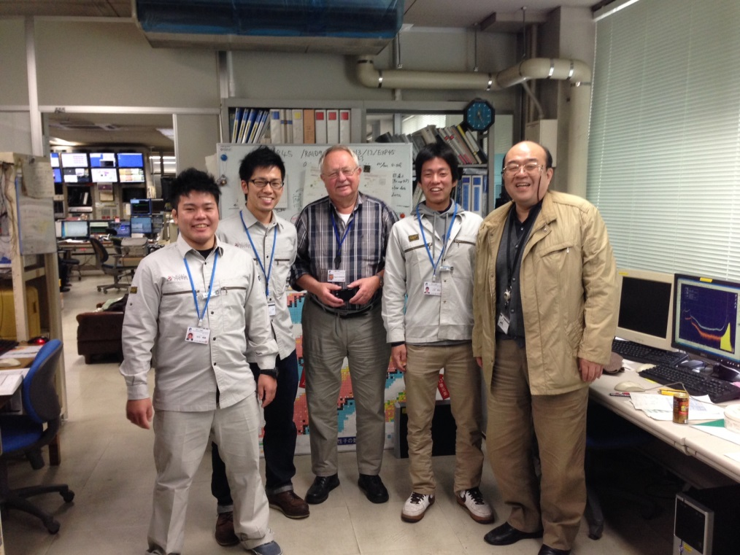
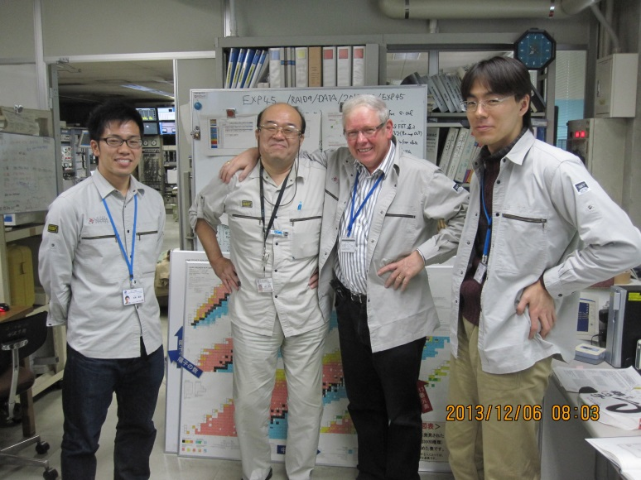
²⁴⁸Cm + ⁴⁸Ca → ²⁹⁶Lv* Experiment at RIKEN GARIS
Dec. 1 － 12, 2013
RIKEN K. Morimoto, D. Kaji, H. Haba, Y. Wakabayashi, M. Huang, J. Kanaya,
A. Yoneda, A. Yoshida, K. Katori
Tokyo U. Sci. K. Tanaka(M2)
Yamagata U. M. Takeyema(D3), F. Tokanai, T. Yoshida
Saitama U. S. Yamaki(D1), T. Yamaguchi
Niigata U. M. Murakami(D3)
IMP Lanzhou Z. Gan, L. Ma
GSI H. Geissel, S. Hofmann, Y. Maurer, S. Heinz
Kyushu U. K. Morita, K. Fujita, Y. Narikiyo(M2), T. Tanaka(M1), S. Yamamoto

Slide 37
GSI/SHIP
3n (²⁹³Lv) 2 events
4n (²⁹²Lv) 4 events
RIKEN/GARIS
Date In 2013 | Time /days | D(Ti) /mgcm⁻² | D(Cm) /mgcm⁻² | E(RILAC) MeV | Elab /MeV (b – c – e) | Ip /pμA | Dose /10¹⁸
2/12 – 12/12 | 10 | 0.90 | 0.265 | 262.0 | 251.0 - 250.0 - 249.0 | 800 | 4.3
3n (²⁹³Lv) 2 events
4n (²⁹²Lv) 3 events

Slide 38
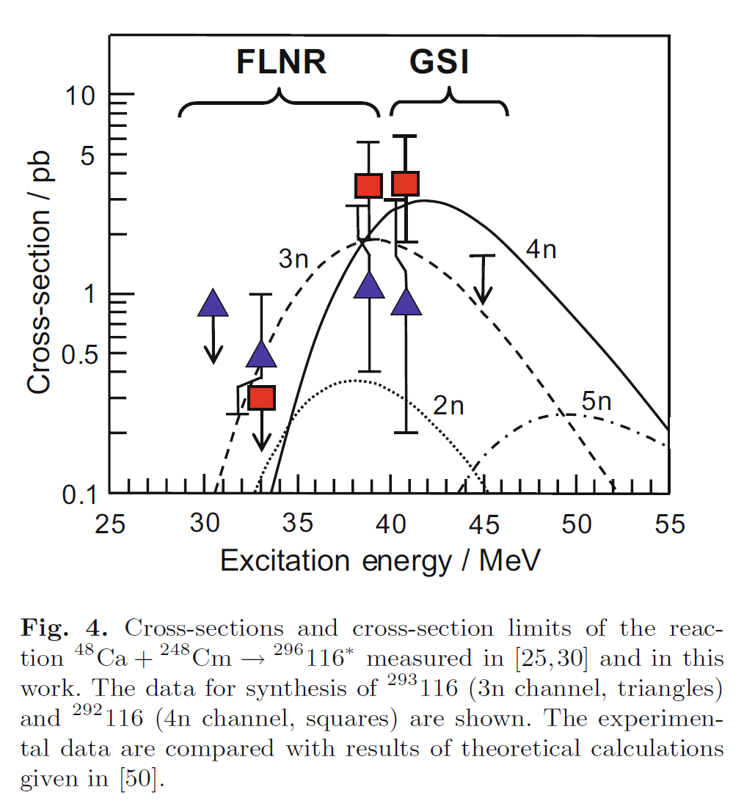
Present results
σ(3n) : 2.1^{+2.9}_{-1.4} pb
σ(4n) : 3.1^{+3.0}_{-1.7} pb
RIKEN

Slide 39
²⁹³Lv
²⁹³Lv
10.47 MeV
253 ms
7.76 MeV (measured by only SSD)
32 ms
²⁸⁹Fl
²⁸⁹Fl
²⁹²Lv
²⁹²Lv
²⁹²Lv
9.89 MeV
3.97 s
9.72 MeV
666 ms
10.79 MeV
32 ms
2.77 MeV (esc.)
2.0 ms
10.66 MeV
4.1 ms
²⁸⁵Cn
²⁸⁵Cn
²⁸⁸Fl
²⁸⁸Fl
²⁸⁸Fl
2.46 MeV (esc.)
7.76 s
1.46 MeV (esc.)
7.56 s
9.89 MeV
548 ms
9.99 MeV
243 ms
0.83 MeV (esc.)
9 ms
²⁸¹Ds
²⁸¹Ds
²⁸⁴Cn
²⁸⁴Cn
²⁸⁴Cn
195 MeV
18.9 s
221 MeV
4.63 s
232 MeV
65 ms
182 MeV
832 ms
9.09 MeV
282 ms
preliminary
new
²⁸⁰Ds
163 MeV
9.3 ms

Slide 40
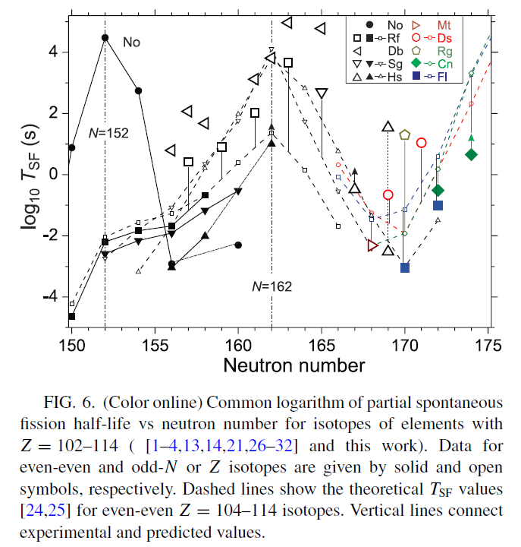
²⁸⁰Ds
T_{1/2}=13⁺⁶⁴₋₆ ms
preliminary
Yu. Ts. Oganessian et al.
PHYS. REV. C 87, 054621 (2013)

Slide 41
one end of nuclear chart 2014
one end of nuclear chart 2010
120
119
118
294
117
293
294
116
290
291
292
293
115
287
288
289
290
114
285
286
287
288
289
SHE
113
278
282
283
284
285
286
112
277
281
283
284
285
282
284
Rg
272
274
278
279
280
281
282
Ds
269
270
271
273
277
279
280
281
Mt
266
268
270
274
275
276
278
Hs
263
264
265
266
267
269
270
271
273
275
277
Bh
261
262
264
265
266
267
270
271
272
274
Sg
259
260
261
262
263
264
265
266
269
271
Db
258
259
260
261
262
263
266
267
268
270
257
258
259
260
261
262
263
265
Rf
261
262
267
162
184
A
α-decay
A
Spontaneous fission
A
β⁺ or EC decay

Slide 42
Summary
An isotope of the 113th element, ²⁷⁸113, was produced in the
²⁰⁹Bi + ⁷⁰Zn → ²⁷⁸113 + n reaction, and unambiguously identified
via genetic correlation, connected to the well known nuclides.
²⁹³Lv and ²⁹²Lv were produced in the ²⁴⁸Cm + ⁴⁸Ca → ²⁹⁶Lv* reaction
What’s Next (New Element Search) ?
²⁹⁴118
²⁹⁵118
²⁹³117
²⁹⁴117
²⁹⁰Lv
²⁹¹Lv
²⁹²Lv
²⁹³Lv
²⁹⁴Lv
N = 174 175 176 177 178

Slide 43
Systematic study of the actinide based ⁵⁰Ti -induced reactions.
²⁴⁸Cm + ⁵⁰Ti → ²⁹⁸118₁₈₀* scheduled in September 2014
cf. ²⁴⁹Cf + ⁴⁸Ca → ²⁹⁷118₁₇₉*
Future ?
²⁴⁸Cm + ⁵⁴Cr → ³⁰²120₁₈₂*
Study of new reaction mechanism (non-complete fusion) to produce
SHE such as multi-nucleon transfer, or deep inelastic reaction of
²⁴⁸Cm + ²³⁸U?
Breakthrough is needed!
Spectroscopic studies of the isotopes of the heaviest element.
Chemistry of superheavy Element.
Mass measurement of SHE with MR-TOF (Wada-san’s group).

Slide 44
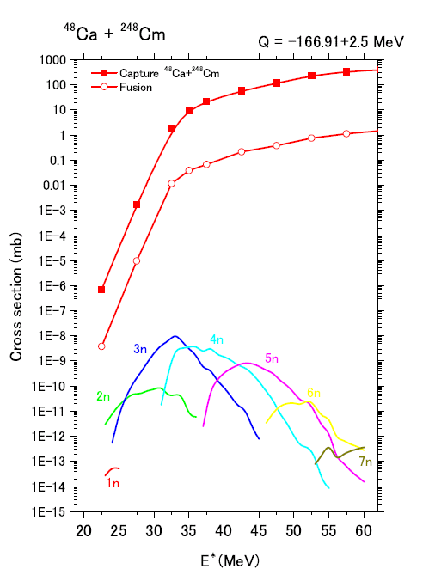
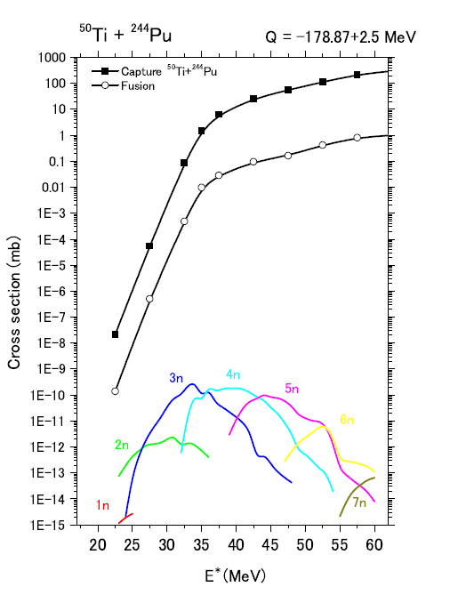
Aritomo & Hagino

Slide 45
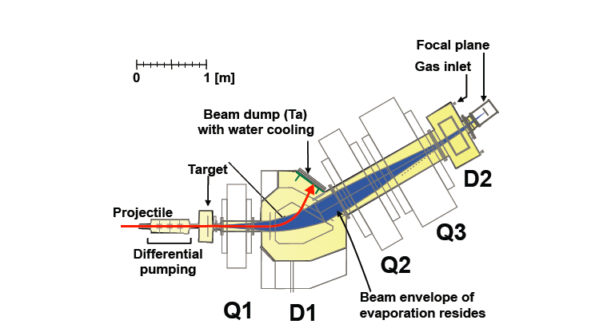
GARIS-II
High Transmission & Low Background
Higher Bρ
D. Kaji et al.

Slide 46
Thank you very much for your kind attention.

Slide 47
²⁶²Db(Z = 105):
b_{α}/b_{SF} = 67%/33%.
T_{1/2} = 34 ± 4 s
8.450 ± 0.020 MeV (75%),
8.530 ± 0.020 MeV (16%),
8.670 ± 0.020 MeV (9%)
α₅
E_{α} = 8.63 ± 0.06 MeV
= 126 s (present)
τ = 56 ⁺⁷⁷ ₋₂₁ s → T_{1/2} = 39 ⁺⁵³ _{–14} s (three events)
²⁵⁸Lr(Z = 103):
b_{α} = 97.5%.
T_{1/2} = 3.92^{+0.35}_{–0.42} s
8.565 ± 0.025 MeV (20%),
8.595 ± 0.010 MeV (46%),
8.621 ± 0.010 MeV (25%),
8.654 ± 0.010 MeV (9%)
α₆
E_{α} = 8.66 ± 0.06 MeV
= 3.78 s
→ T_{1/2} = 2.6 ⁺¹² _{-1.1} s (one events)
²⁵⁴Md/ ^{254m}Md(Z = 101):
b_{EC} = 100%/ 100%,
T_{1/2} = 10 ± 3 / 28 ± 8 min
no signal :
E(X-ray of ²⁵⁴Fm)_{max} = 142 keV
Energy threshold of PSD = 800 keV
²⁵⁴Fm(Z = 100):
b_{α} = 99.94%,
T_{1/2} = 3.240 ± 0.002 h
6.898 ± 0.003 MeV (0.0066%),
7.050 ± 0.002 MeV (0.82%),
7.150 ± 0.002 MeV (14.2%),
7.192 ± 0.002 MeV (84.9%).
α₇₋₁
E_{α} = 7.26 ± 0.07 MeV
= 3.96 h P_{acc} = 0.43
α₇₋₂
E_{α} = 7.18 ± 0.06 MeV
= 6.42 h P_{acc} = 0.70
²⁵⁰Cf (Z=98):
b_{α} = 99.92%
T_{1/2} = 13.08 y

Slide 48
木村健二郎博士は1954年3月のビキニ水爆実験（第五福竜丸が被爆、乗組員の久保山愛吉氏が同年9月死亡）の降灰の分析を委嘱され降灰中に²³⁷Uと¹⁰³Ruなどの核種を確認。
これらの核は戦前仁科博士らと理研で発見した核種であり、図らずもビキニ降灰の中に再会して感慨無量であったと述懐している。
多量の²³⁷Uの検出は、爆発実験に用いた爆弾が3F(Fission-Fusion-Fission)爆弾であることを看破しアメリカを驚かせた。

Slide 49
Reactions studied at GARIS
²⁷²111
14 chains
²⁷⁷112
2 chains
116
115
176
²⁷¹Ds
14 chains
114
113
²⁶⁵Hs
10 chains
112
111
Ds
Mt
170
Hs
Bh
Sg
Db
Rf
162
Lr
α
No
SF
Md
β+ or EC
Fm
β-
Es
Cf
152
Notes:
This is the one end of the nuclear chart.
In order to identify the isotopes definitely, RIKEN SHE group decided to select the reaction that decay chain connected to the known nuclei.
We succeeded to observe these decay chains.
108, 110, 111, 112

Slide 50
Reactions studied by GARIS
²⁷²111
14 chains
²⁷⁸113
116
115
176
²⁷¹Ds
14 chains
114
113
²⁶⁵Hs
10 chains
112
111
Ds
Mt
170
Hs
²⁷⁷112
2 chains
Bh
Sg
Db
Rf
162
Lr
α
No
SF
Md
β+ or EC
Fm
β-
Es
New !
Cf
152
Notes:
The observed chain is locating here.

Slide 51
－1000 V
－1000 V
0 V
0 V
－2000 V
－2000 V
イオンの軌道
E
電子の軌道
+2000 V
半導体検出器
T₁
T₂
2次電子増幅型検出器
+2200 V
L
T=T₂－T₁
V=L/T
E=(1/2)mV²
速度VとエネルギーEの測定値から質量mがわかる

Slide 52
逆バイアス
位置感応型半導体検出器
+ -
高速のイオンが物質中を通過すると、
物質原子から電子がはぎ取られて、
入射したイオンのエネルギーに比例
した数の陽イオンと電子が発生する。
+ -
+ -
+ -
+ 正孔
- 電子
空乏層

Slide 53
位置感応型半導体検出器
+ -
+ -
+ -
～30ミクロン
空乏層

Slide 54
1660 | 元素の定義、定性分析 | ボイル | 英
1859 | 原子スペクトル分析法 | ブンゼン、キルヒホッフ | 独
1869 | 元素周期律 | メンデレーエフ | 露
1895 | X線の発見 | レントゲン | 独
1896 | ウラン放射能の発見 | ベクレル | 仏
1897 | 電子の発見 | トムソン | 英
1908 | 43番ニッポニウムの発見 | 小川正孝 | 日
1911 | 原子核の発見 | ラザフォード | 豪
1913 | 原子番号の確立（特性X線） | モーズレ― | 英
1913 | 原子構造の解明 | ボーア | 丁
1922 | 原子構造の解明によりノーベル賞 | ボーア | 丁
1923 | Ｘ線解析によるハフニウムの発見 | ヘベシー、コスター | 洪、蘭
1925 | 43番マスリウム、75番レニウムの発見 | ノダック、タッケ、 | 独
1932 | 中性子の発見 | チャドウィック | 英
1932 | 加速器の発明 | コッククロフト、ウォルトン、ローレンス、他
1937 | 43番テクネチウムの発見 | セグレ | 伊
1938 | 核分裂の発見 | ハーン、シュトラウスマン、マイトナー
1942 | 最初の原子炉 | フェルミ | 伊
1945 | 最初の原子爆弾 |  | 米
1952 | 最初の水爆 |  | 米
1962 | ピッチブレンド中からTc-99を発見 | 黒田和夫 | 米（日）

Slide 55
⁷⁰Zn ions (beam)
4x10⁻¹³ cm
原子核 nucleus
²⁰⁹Bi atoms (target)

Slide 56
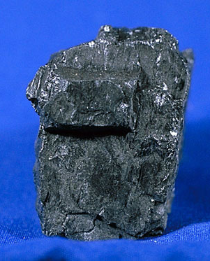
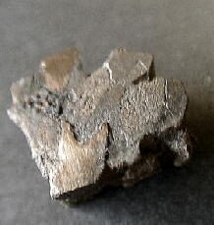
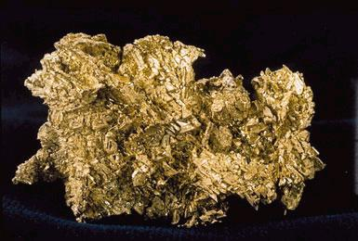
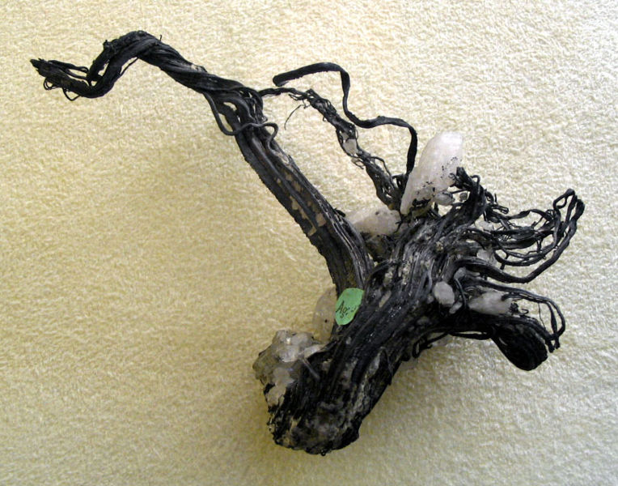
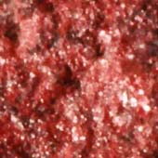
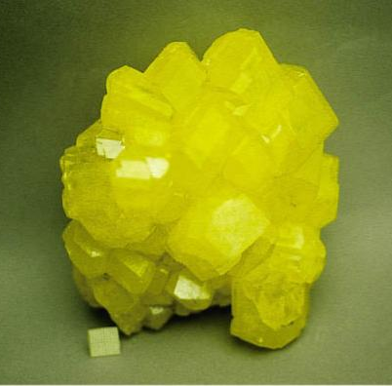
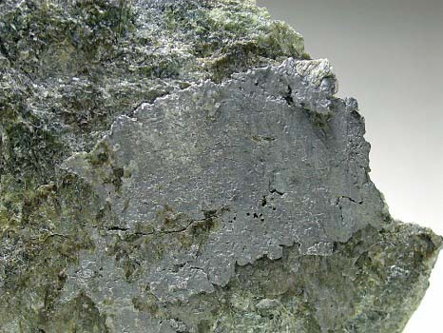
石炭（C）
鉄隕石（Fe）
自然金（Au）
自然銀（Ag）
自然銅（Cu）
自然水銀と辰砂（Hg）
イオウ（S）
自然鉛（Pb）
自然白金（Pt）

Slide 57
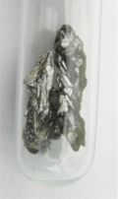
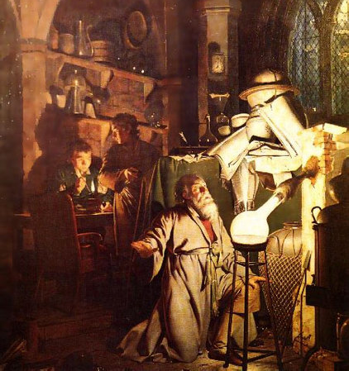
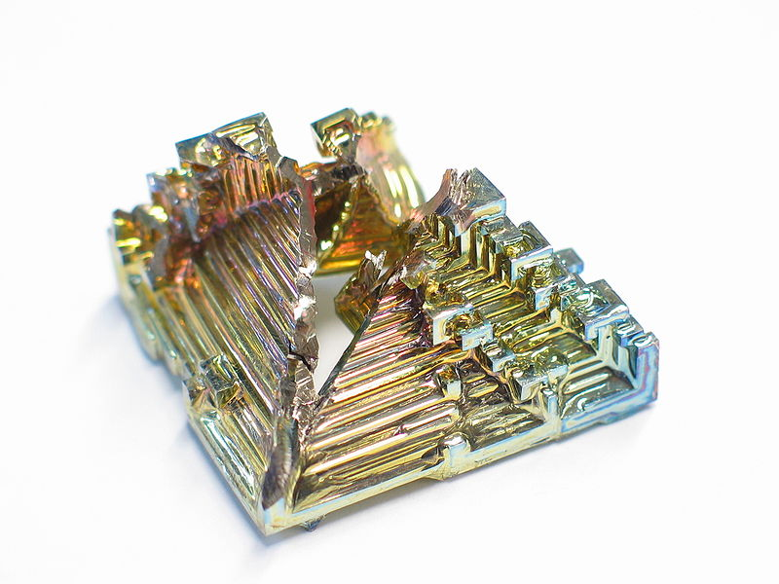
亜鉛（Zn）
アンチモン（Sb）
ヒ素（As）
ビスマス（Bi）
錬金術師らが活躍した時代（江戸時代）までに発見された元素

