Slide 1
Toward a fundamental understanding of nuclear reactions and exotic nuclei
Advances in Radioactive Isotope Science
Tokyo, June 1-6, 2014
S. Quaglioni

Slide 2
Light exotic nuclei offer an exciting opportunity to test our understanding of the interactions among nucleons
But this is not an easy goal …
Challenging for experiment
  Short half lives or unbound
  Minute production cross sections
Challenging for theory
  Low (multi-)particle emission thresholds or unbound
  Bound, resonant and scattering states may be strongly coupled
Need advanced experimental techniques and
ab initio nuclear theory including the continuum

Slide 3
To develop such an ab initio nuclear theory we:
1) Start with accurate nuclear forces (and currents)
NN force
NNN force
NNNN force
Two- plus three-nucleon (NN+3N) forces from chiral effective field theory (EFT)
  NN potential at N³LO (by Entem & Machleidt)
  3N force at N²LO (in the local form by Navratil)
  Guided by quantum chormodynamics (QCD)
  Entirely constrained in the 2- and 3-nucleon systems
Q⁰
LO
Q²
NLO
Q³
N²LO
Q⁴
N³LO
+ ...
+ ...
+ ...
Worked out by Van Kolck, Keiser, Meissner, Epelbaum, Machleidt, ...

Slide 4
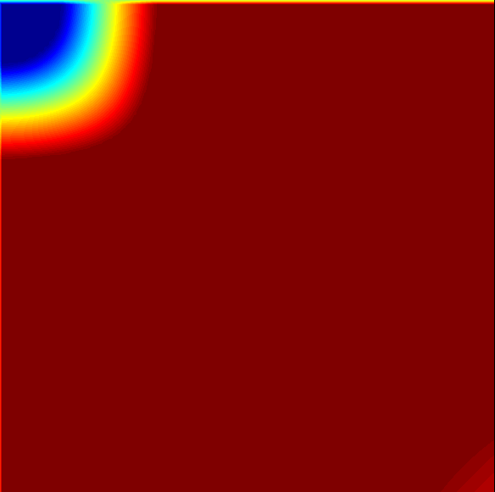
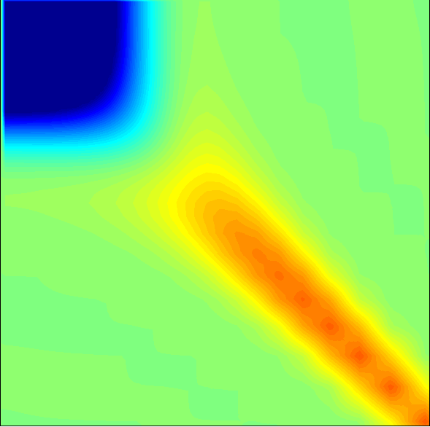
2) ‘Soften’ the interactions using unitary transformations
Similarity Renormalization Group (SRG) method
Phys. Rev. Lett. 103, 082501 (2009)
Unitary transformations
Flow parameter
SRG
NN+3N
Bare
NN+3N
Decouples low and
high momenta
Induces 3-body (&
higher-body) forces
λ = 20 fm⁻¹
λ = 2 fm⁻¹
For the lightest nuclei SRG-evolved NN+3N forces allow to obtain
unitarily equivalent results in much smaller model spaces

Slide 5





3) Solve the many-body problem using a unified approach to nuclear bound and continuum states
Ab initio no-core shell model (NCSM) …
  Bound states, narrow resonances
  Clusters’ structure, short range
… with resonating-group method (RGM)
  Bound & scattering states, reactions
  Dynamics between clusters, long range
Most efficient: ab initio no-core shell model with continuum (NCSMC)
NCSM eigenstates
NCSM/RGM channel states
Unknowns

Slide 6


Discrete and continuous variational amplitudes are determined by solving the coupled NCSMC equations
Scattering matrix (and observables) from matching solutions to known asymptotic with microscopic R-matrix on Lagrange mesh

Slide 7
⁷He: An ideal system to showcase new achievements made possible by the ab initio NCSM with continuum
⁷He is unbound – cannot be reasonably described with NCSM
⁶He core polarization important
  n+⁶He NCSM/RGM calc. with more than few ⁶He states difficult!
NCSMC calculation:
  SRG-N³LO NN with λ = 2.02 fm⁻¹
  N_{max}= 12, ħΩ = 16 MeV
  Up to 3 ⁶He and 4 ⁷He states
n+⁶He Ground State Resonance
Convergence with number of ⁶He eigenstates
⁷He states compensate for
missing higher ⁶He excitations
S. Baroni, P. Navratil, and S. Quaglioni, Phys. Rev. Lett. 110, 022505 (2013); Phys. Rev. C 87, 034326 (2013)

Slide 8
⁷He: An ideal system to showcase new achievements made possible by the ab initio NCSM with continuum
NCSMC yields 3/2⁻ g.s. and 5/2⁻ resonances close to experiment
Is there a low-lying 1/2⁻ state?
n+⁶He Low-Lying Continuum
?
Expt.
Results obtained with NCSMC approach
Low-lying 1/2⁻ state not
supported by our calculation
S. Baroni, P. Navratil, and S. Quaglioni, Phys. Rev. Lett. 110, 022505 (2013); Phys. Rev. C 87, 034326 (2013)

Slide 9
Are 3N forces necessary to achieve a complete picture?The unbound ⁵He nucleus is an excellent testing ground
⁵He resonances sensitive to strength of spin-orbit force
SRG-evolved chiral NN+3N with λ = 2.0 fm⁻¹
  Both Induced and initial 3N forces are included
NCSMC calculation:
  N_{max} = 13 model space
  Up to 14 ⁵He and 7 ⁴He states
  Excellent convergence
n+⁴He Scattering Phase Shifts
NCSMC
+
Convergence with number of ⁴He eigenstates
G. Hupin, S. Quaglioni, and P. Navratil, in preparation

Slide 10
Are 3N forces necessary to achieve a complete picture?The unbound ⁵He nucleus is an excellent testing ground
Are the ⁵He states really needed to accurately describe the n+⁴He continuum?
NCSM/RGM calculation:
  N_{max} = 13 model space
  Up to first 7 states of ⁴He
  Not sufficient!
n+⁴He Scattering Phase Shifts
NCSM/RGM
⁴He core polarization is non
negligible. ⁵He states essential
to describe resonances
Convergence with number of ⁴He eigenstates
G. Hupin, J. Langhammer, P. Navratil, S. Quaglioni, A. Calci, And R. Roth, Phys. Rev. C 88, 054622 (2013)

Slide 11
Are 3N forces necessary to achieve a complete picture?The unbound ⁵He nucleus is an excellent testing ground
3N force enhances 1/2⁻ ←→ 3/2⁻ splitting; essential at low energies!
Elastic scattering of neutrons on ⁴He
NN+3N
NN (with ind. terms)
NN+NNN
x
Expt.
NCSMC
G. Hupin, S. Quaglioni, and P. Navratil, in preparation

Slide 12
⁹Be: Does the 3N force deteriorate the description of the low-lying spectrum? No, need to include the continuum!
  ⁹Be vs. ⁹Be+n-⁸Be(0⁺,2⁺) calculations: preliminary N_{max}=10 results
NN
NN+3N
NN+3N
NN
NN
NN+3N
NN+3N
NN
Expt.
Expt.
E
E
n+⁸Be
n+⁸Be
J. Langhammer, P. Navratil, R. Roth et al., in progress

Slide 13
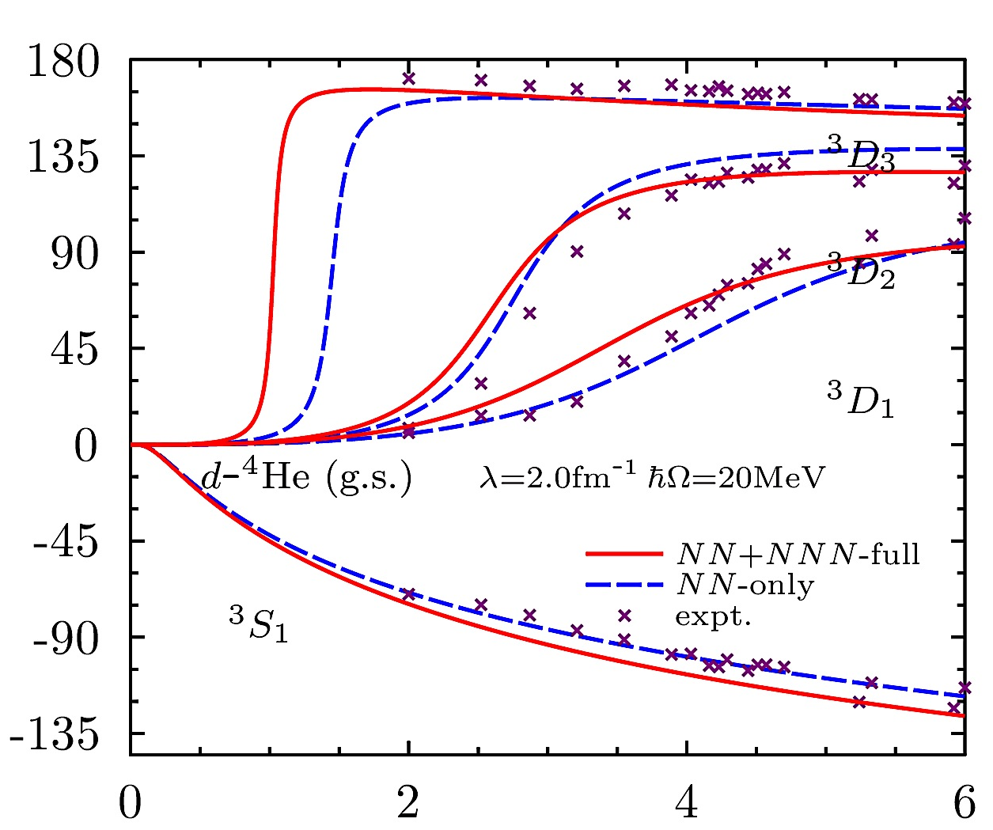
What about scattering with composite projectiles?
d+⁴He→d+⁴He with & without inclusion of: ⁶Li states / 3N forces
preliminary
preliminary
NN-only
λ = 2.0 fm⁻¹
(d+⁴He) + ⁶Li
(d,N) transfer and deuterium scattering on p-shell nuclei underway
G. Hupin, S. Quaglioni, and P. Navratil, in progress

Slide 14
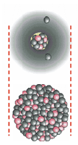
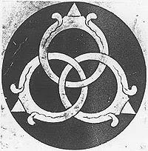


We want to describe also systems for which the lowest threshold for particle decay is of the 3-body nature
Borromean halo nuclei
  ⁶He (= ⁴He + n + n )
  ⁶Be (= α + p + p )
  ¹¹Li (= ⁹Li + n + n )
  ¹⁴Be (= ¹²Be + n + n )
  …
Constituents do not bind in pairs!
¹¹Li
²⁰⁸Pb
Probability
density
of ⁶He g.s.
Probability
density
of ⁶He g.s.
n
⁴He-neutrons separation (fm)
n
⁴He
S. Quaglioni, C. Romero-Redondo, and P. Navratil,
Phys. Rev. C 88, 034320 (2013)
neutron’s separation (fm)

Slide 15
Experimental picture for the excited states of ⁶He
Recent expt. @SPIRAL, GANIL: PLB 718 (2012) 441
⁸He(p,³H)
Soft dipole
mode?

Slide 16
Can we gain insight from an ab initio calculation?
Need to treat 3-cluster continuum: ⁴He(g.s.)+n+n
C. Romero-Redondo, S. Quaglioni, and P. Navratil, arXiv:1404.1960

Slide 17
Can we gain insight from an ab initio calculation?
Need to treat 3-cluster continuum: ⁴He(g.s.)+n+n
Scattering phase shifts
Energy spectrum of states
new
Present results do not support a
three-body soft-dipole resonance
C. Romero-Redondo, S. Quaglioni, and P. Navratil, arXiv:1404.1960

Slide 18
The ab initio description of light dripline nuclei with QCD-guided NN+3N forces is now becoming possible
The NCSMC is an efficient ab initio theory including the continuum
  NCSM eigenstates → short- to medium-range A-body structure
  NCSM/RGM cluster states → scattering physics of the system
New developments
  3N force in nucleon- and
  deuterium-nucleus scattering
  Three clusters in the continuum
  Many I have not presented
  → see J. Dohet-Eraly, PS2-B010
Even more exciting work ahead!
G. Hupin, S. Quaglioni, and P. Navratil, in preparation

Slide 19
Extras

Slide 20
Breakup threshold influences s-wave continuum

Slide 21
Microscopic three-cluster problem
Starts from:
Projects onto the channel basis:
3-body
channels
Hamiltonian kernel
Norm or Overlap kernel

Slide 22
This can be turned into a set of coupled-channels Schrödinger equations for the hyperradial motion
y
Hyperspherical Harmonic (HH)
functions form a natural basis:
Then, with orthogonalization and projection over :
x

Slide 23
These equations can be solved using R-matrix theory
Internal region
(ρ ≤ a)
External region
(ρ > a)
Expansion on a basis
Bound state asymptotic behavior
Scattering state asymptotic behavior

Slide 24
Results for ⁶He ground state
6-body diagonalization vs ⁴He(g.s)+n+n calculation
NCSM 6-body diagonalization
NCSM/RGM ⁴He(g.s.)+n+n
Differences between NCSM 6-body and NCSM/RGM ⁴He(g.s.)+n+n results due to core polarization
Contrary to NCSM, NCSM/RGM wave function has appropriate asymptotic behavior

Slide 25
Other convergence tests
HH expansion

Slide 26
Other convergence tests
Extended-size HO expansion
  Sizable effects only when neutrons are in ¹S₀ partial wave (strong attraction)

Slide 27
Started with NCSM/RGM approach & gradually built up capability to describe fusion reactions with NN force
Astrophysical S-factors
³H(d,n)⁴He astrophysical S-factor
Fusion reactions important to solar astrophysics, Big Bang nucleosynthesis, fusion research, atomic physics
Good convergence with harmonic oscillator (HO) basis size (N_{max})
Slower convergence with number of clusters’ eigenstates
PLB 704, 379 (2011)
PRL 108, 042503 (2012)
Still required for a fundamental
description are also:
3N forces
three-body dynamics
Electron
screening

Slide 28
We started with nucleon-nucleus collisions …
PRL 107, 122502 (2011)
The elastic n-³H cross section for 14 MeV neutrons, important for understanding how the fuel is assembled in an implosion at NIF, was not known precisely enough
n+³H→n+³H cross section
n
Corrected
for target
breakup
n (14 MeV)
³H
³H
³H
d
⁴He
E_{n}=14 MeV
We delivered evaluated data for fusion diagnostic at NIF with required 5% uncertainty.
  Ab initio theory reduces uncertainty due to conflicting data (•,,, ,)

Slide 29
Similarity Renormalization Group evolution of operators*
Root-mean-square radius and total dipole strength
⁴He
³H
*M.D. Schuster, S. Quaglioni, C.W. Johnson, E.D. Jurgenson, and P. Navratil, in preparation

Slide 30
Latest Publications

