Slide 1
ARIS2014
The Rare RI Ring Facility at RIKEN RI Beam Factory
M. Wakasugi, and Rare RI Ring Collaborators
RIKEN, Nishina Center, Japan

Slide 2
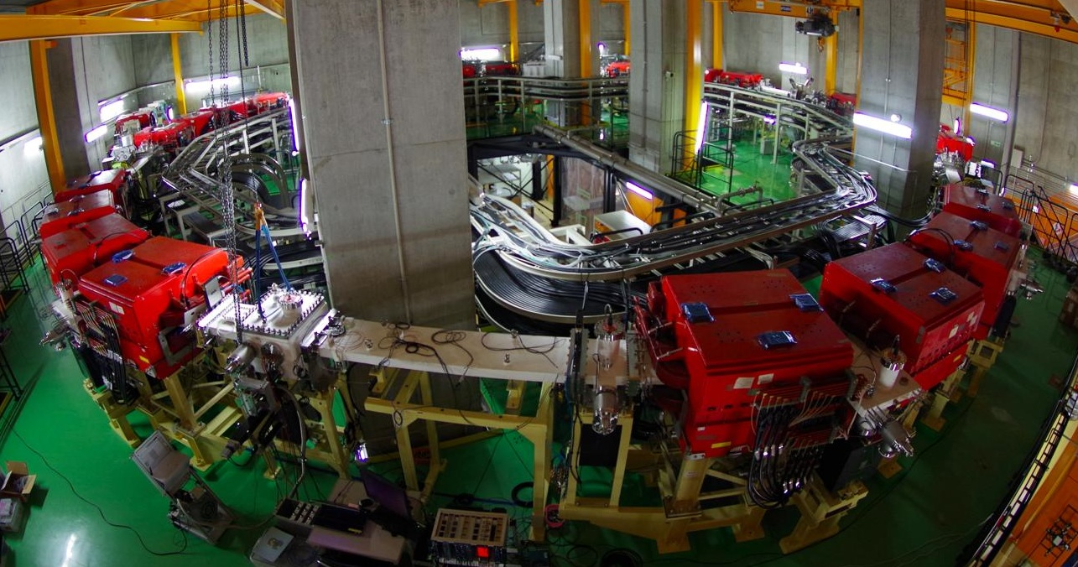
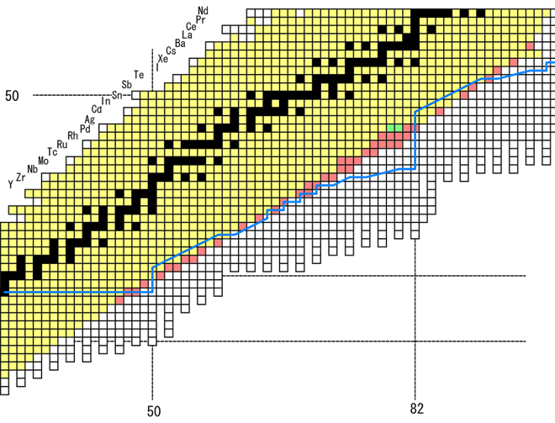
Rare RI Ring (R3)
Heavy-ion storage ring dedicated to mass measurement
based on Isochronous Mass Spectrometry
R-process

Slide 3
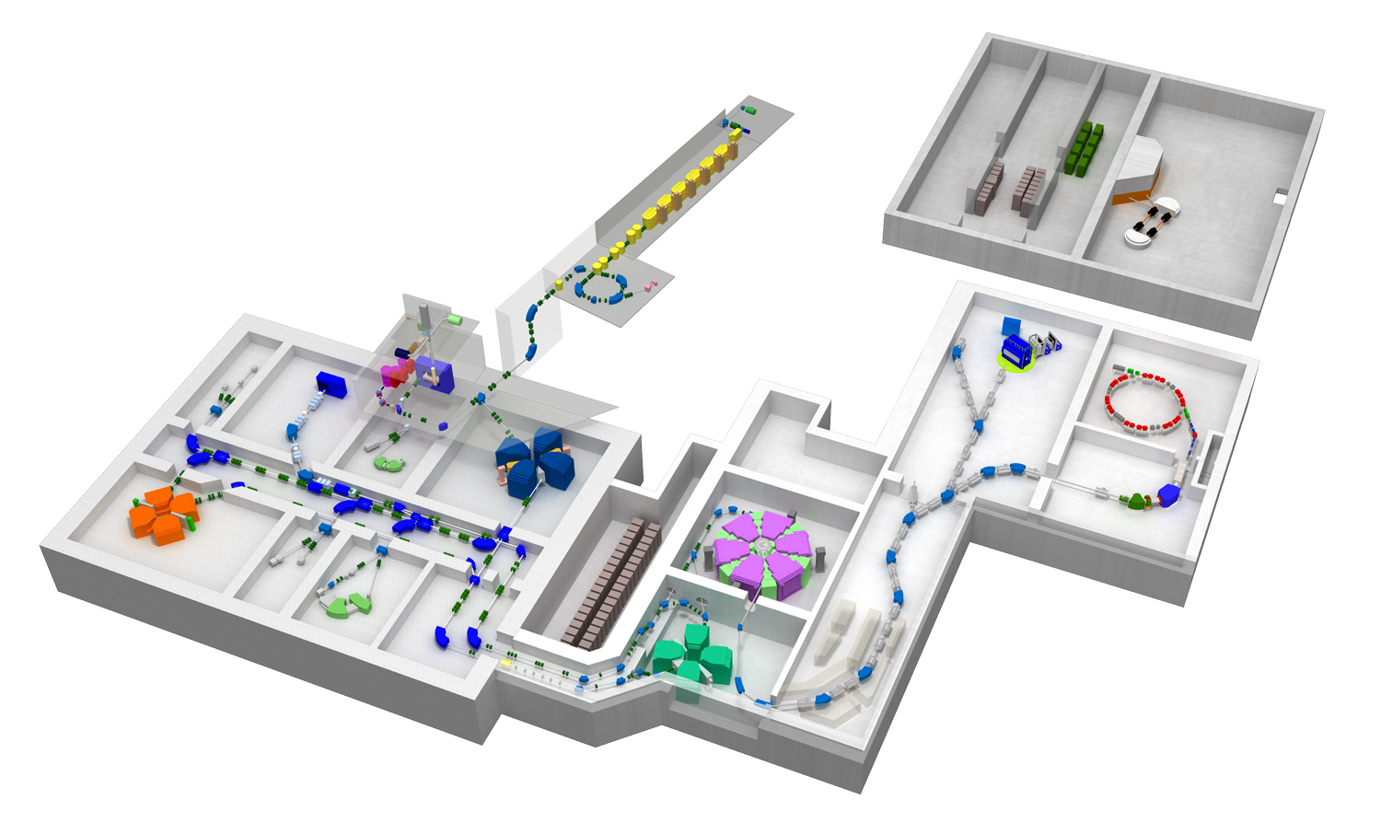
Location of R3 in the RIKEN RI Beam Factory
ECR
Rilac
SCRIT
CSM
GARIS
Rilac2
AVF
SAMURAI
Rare RI Ring
ZeroDegree
RIPS
RRC
SRC
SHARAQ
fRC
BigRIPS
IRC
F3: PID & Trigger
F0: Target

Slide 4
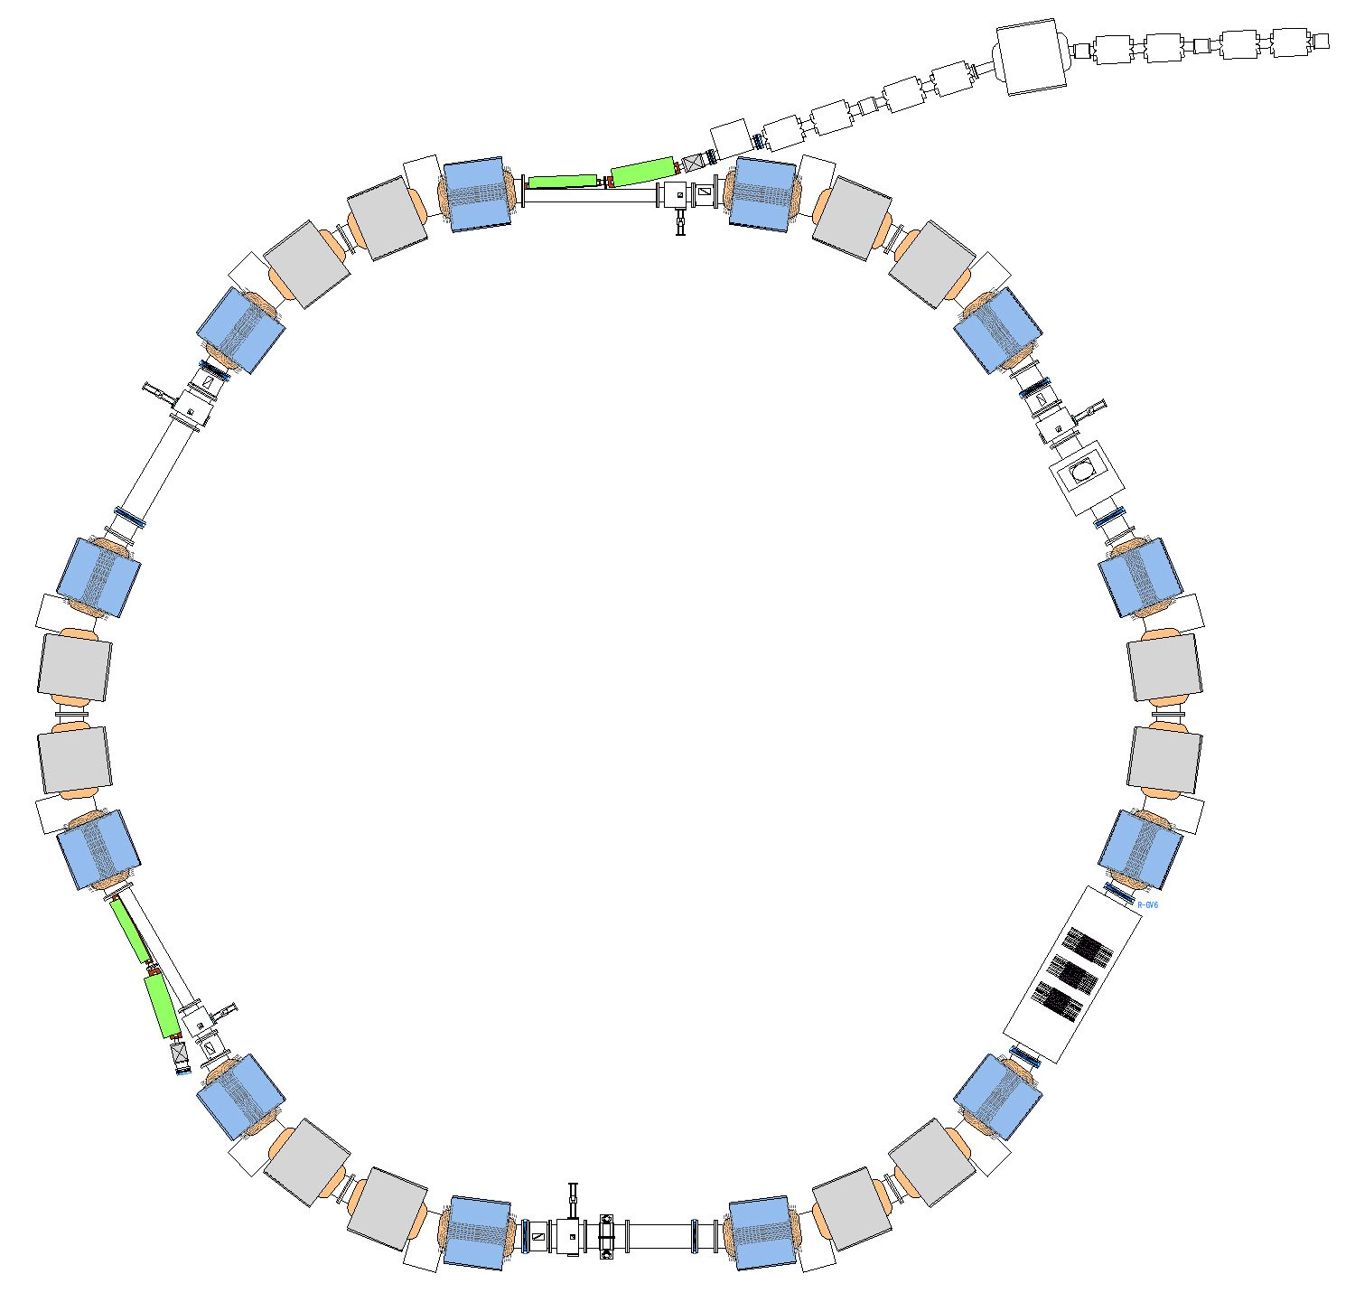
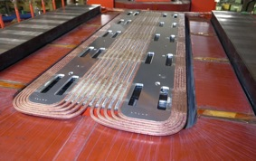
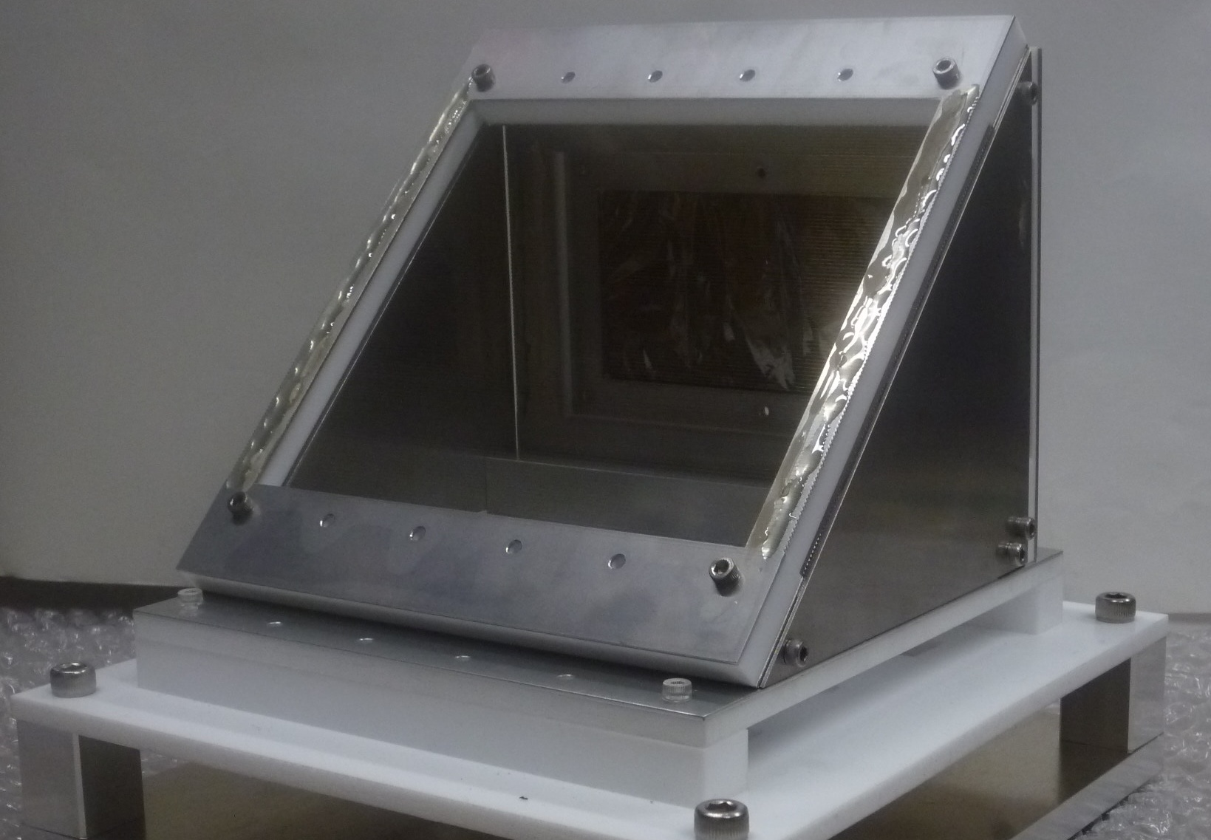
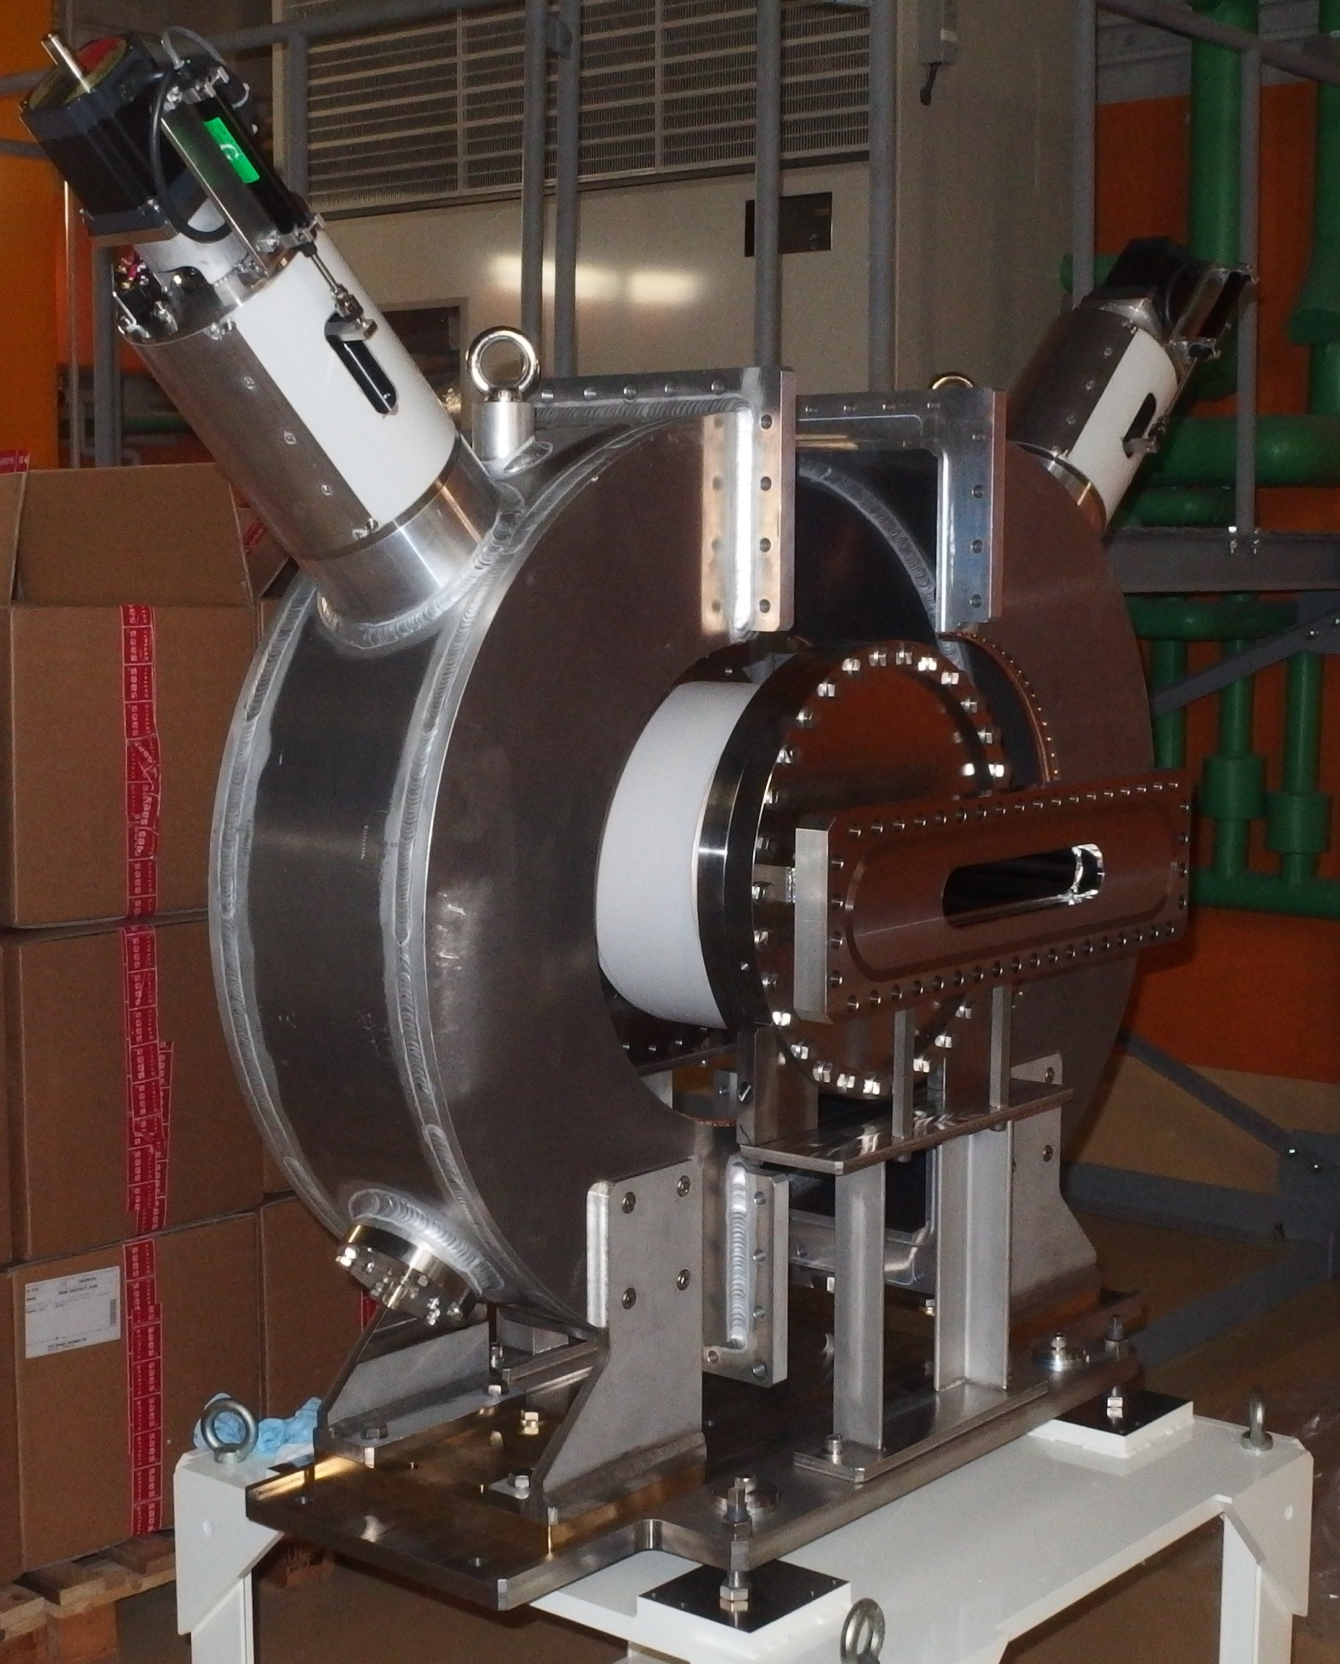
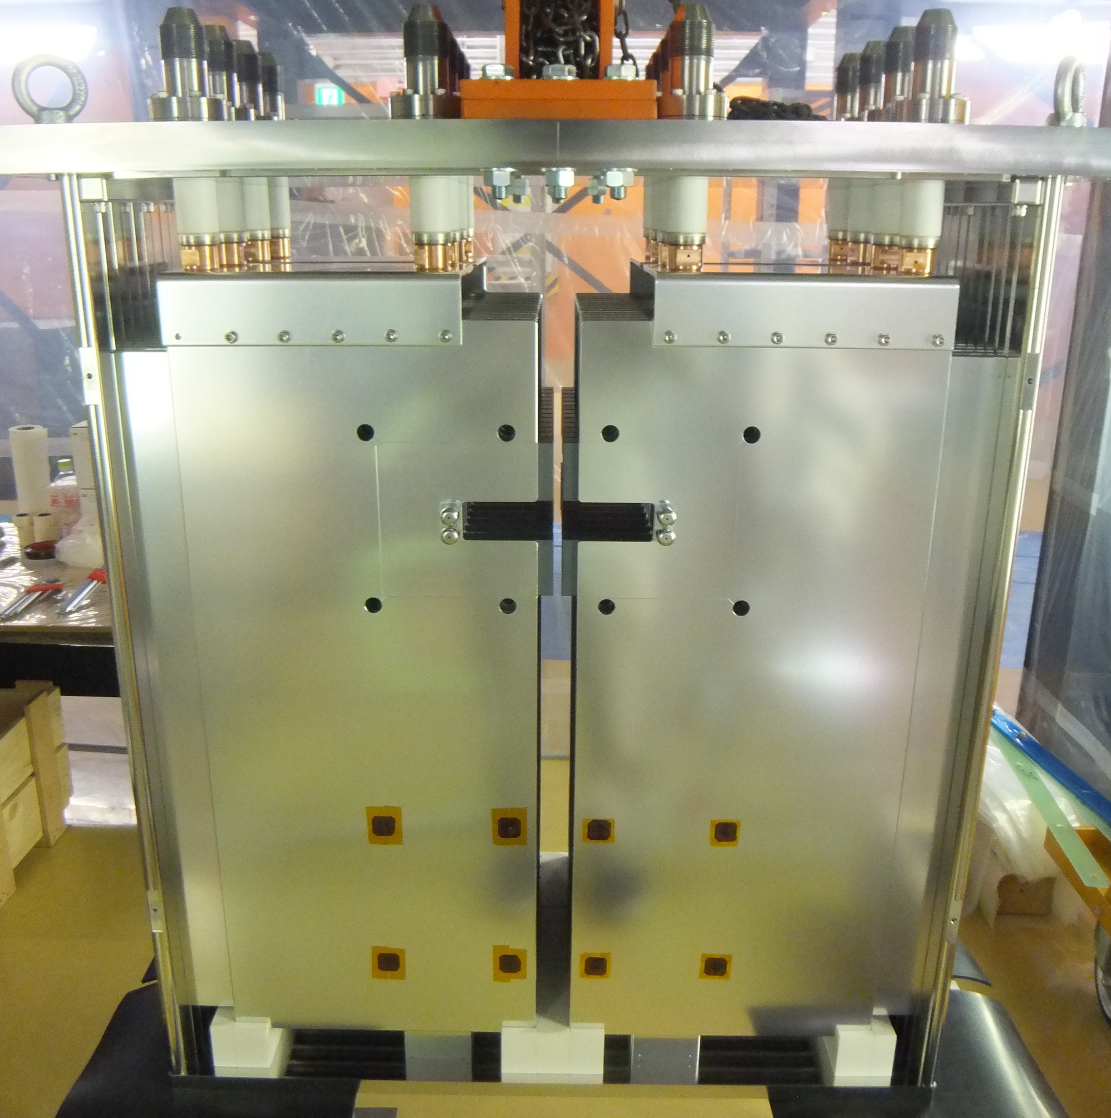
R3: Cyclotron-like Lattice Structure
Injection septum magnets
(Start)
Injection beam line
Hexagonal-Symmetry
Weak-Focusing Lattice Structure
Circumference : 60.3m
Sector magnets
wirh 10 trim coils
C-Foil timing detector
1/6 Optics
Sector magnets
Extraction
septum magnets
Fast-response
Kicker magnets
Tunes: 1.21 / 0.84
Acceptance :
Momentum ΔP/P=±0.5%
Transverse 20π / 10π mm mrad
(Stop
and PID)
Cavity-type
Schottky pickup

Slide 5
Isochronous Mass Spectrometry at R3
Unknown mass m₁ is measured relative to precisely-known reference mass m₀
Two particles with the same momentum have the same flight pass length in the ring
T₁ correction factor
Three values T₀, T₁, and β₁ are measured
To make T₀ and T_{1corr} values independent of momentum,
highly tuned isochronism in a wide range of momentum is required.

Slide 6
Uncertainty of m₁
desired accuracy : δm₁/m₁ ~10⁻⁶
k~10⁻²
Well-known
Reference Mass
~ 10⁻⁶
TOF (T₀, T₁)
Measurement
~ 10⁻⁶
T ~ 700μs (2000turns)
δT ~ 100ps
β₁ Measurement
~ 10⁻⁴
Isochronism of ~10⁻⁶ is required during measurement

Slide 7
How to Measure Masses at R3
T_{0,} T₁ measurement
From Start to Stop
PID
Stop
2000 turns
accumulation
(~0.7ms)
β₁ measurement
From F3 to Start
Start
Precision isochronous field

Slide 8
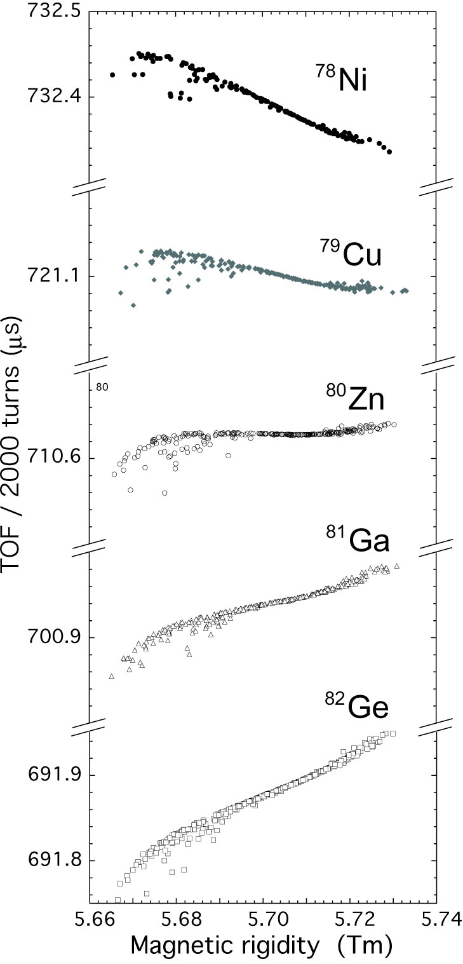
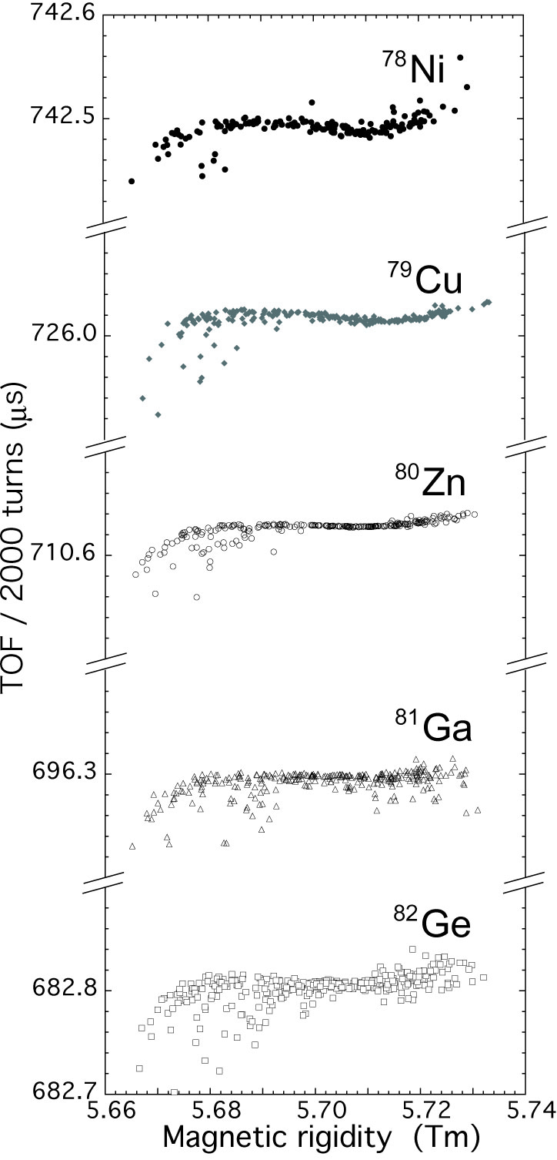
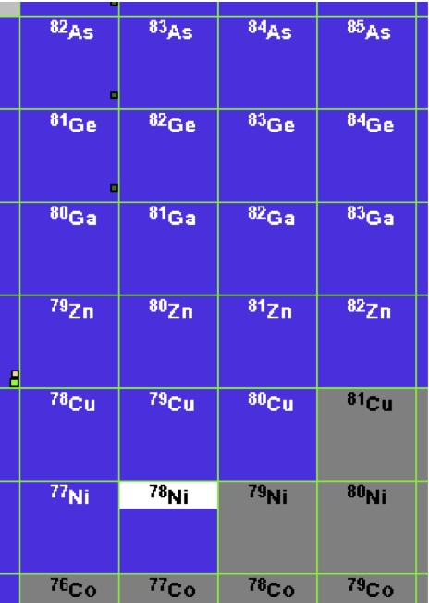
Simulations of ⁷⁸Ni Mass Measurements at R3
○ Many RIs are accepted in the
given machine condition.
○ Isochronism in R3 is tuned for
^{８0}Zn.
○ Some of them are references
for mass determination.
T₁
T_{1corr}
⁷⁸Ni
⁷⁸Ni
T₁ correction
⁸⁰Zn
⁸⁰Zn
⁸²Ge
⁸¹Ga
⁸⁰Zn
⁷⁹Cu
⁷⁸Ni
mass references
Δp/p ±0.5%

Slide 9
Simulations of ⁷⁸Ni Mass Measurements at R3 II
Reference ⁸⁰Zn
Rare RI ⁷⁸Ni
δΔm
Relation between Mass and
corrected revolution time
Mass
references
Δm (m₁-m₀)
T₀
T_{1corr}

Slide 10
Status of R3 Construction
Short History
1st. Phase (2002~2011)
Design study
R&D study
Ring design was finalized in 2011
2nd. Phase (2012~2013)
Construction budget was approved
Construction was started
Infrastructures, Magnets, Power Supplies,
Control system, Vacuum system, etc.
Each device was tested
3rd. Phase (2014~ )
α-particle transport test
Commissioning using 250MeV p-beam
Upgrading to 6Tm machine
Construction of field-stabilization system
Improving detector system
We are here
Major Featuers
○ Forming precision isochronous field in 1% momentum range
○ Individual Injection Scheme

Slide 11
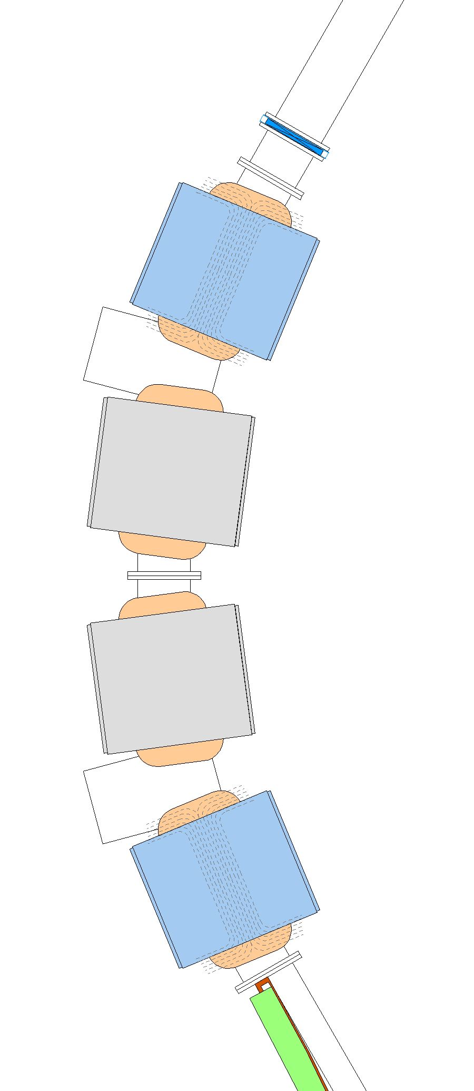
Isochronous Field Formed by 10 Trim Coils
Re-use of TARN-II Magnets
Laminated sector mag.
15 deg. bending
25 turns coils/pole
with correction coils
3000 A max. current
Arc Section
w/o trim coil
±60mm
good field region
Added Trim Coils
w/ 10 trim coils
Δp/p=±0.5% &
ε_{x}=20πmmmrad

Slide 12
Individual Injection Scheme
for the effective use of Rare RIs unpredictably produced
Trigger transmission
~ 430 ns
Requirements for Kicker
○ Fast Response < 500 ns
Trigger input
→ Field Activation
○ Being ready to be
activated at any time
Kicker
PS
R3
Beam flight time
~ 950 ns

Slide 13
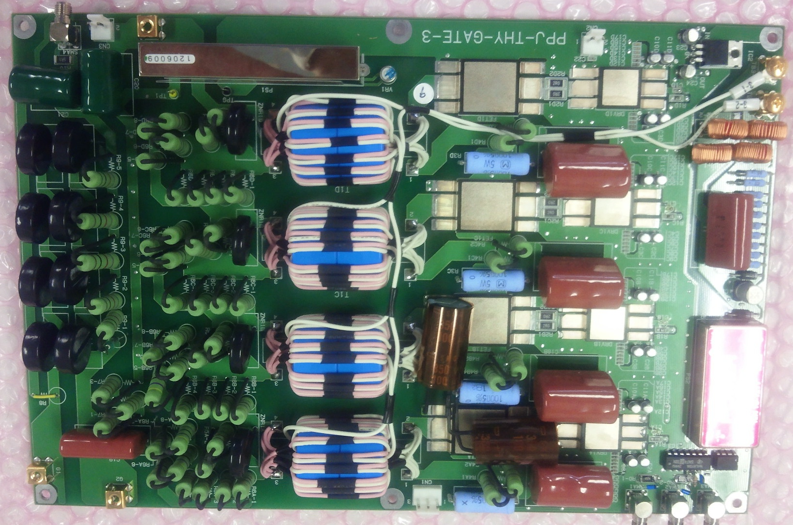
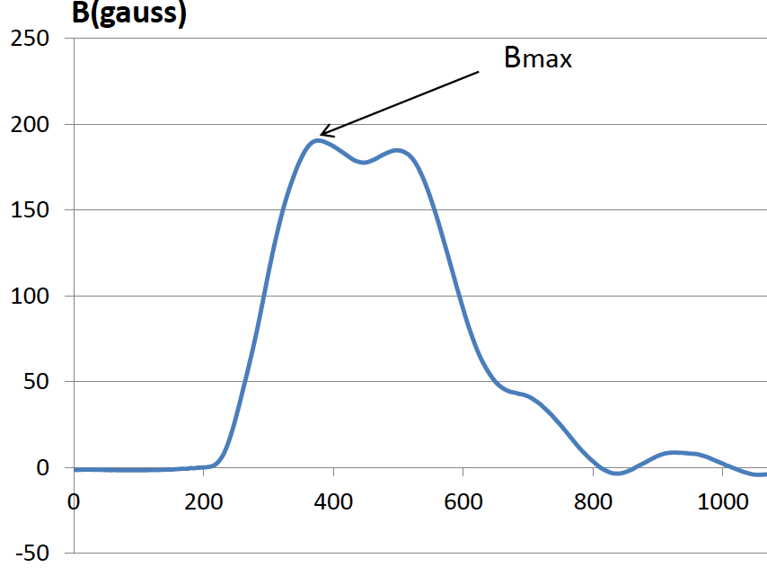
Fast-Response Kicker
Kicker PS
Charger (75kV)
PFN
Number of kicker 6
Number of cell 13
Impedance 12.5Ω
Capacitance 240pF/cell
Inductance 75nH/cell
Maximum current 3000A/35kV
Magnetic field 0.094T
Kick angle 12.8mrad
Thyratron
Trigger in
150ns
Grid-Pulse circuit
105ns
Output
<400ns
Magnetic field (G)
<270ns
Trigger
Distributed constant type
kicker magnets
Time (μs)

Slide 14
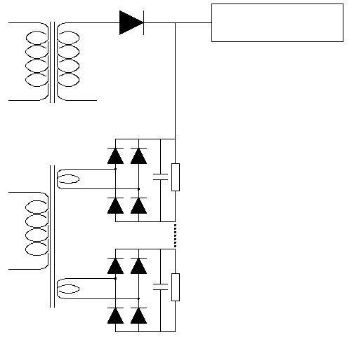
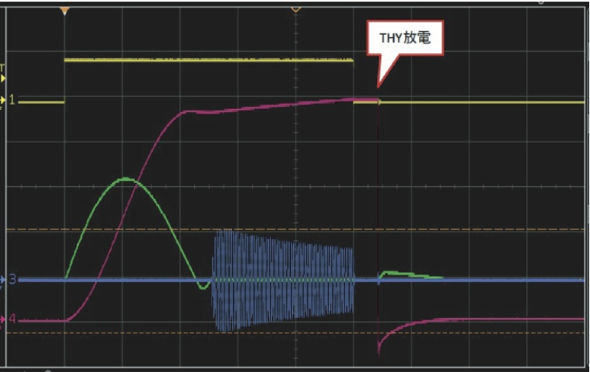
Quick re-charging and Full-Time Charging
Hybrid Charging System
to make kicker PS ready for discharge at any time
Wave form of PFN Charging
Main Charger
Half sinusoidal
90% charging
PFN
Discharge
PFN charging voltage
100%
90%
Sub Charger
500kHz
resonance
+10% charging
keep 100±1%
Main charger
Sub-charger
90%
Charging time 100μs

Slide 15
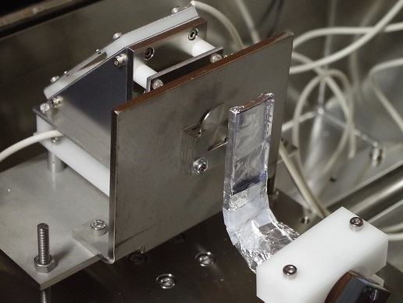
Beam Circulation test using α-particles
TOF Spectrum for 1 revolution
foil detector
(Start)
T_{rev} = 4635.80 (6) ns
α-source
Scintillator
(Stop)
Trim field(dB/dr)/B₀ = 0.205
at line width minimum (rms 1.7ns)

Slide 16
Summary
R3 aiming at precision mass measurement is now partially under
construction at RIKEN RIBF.
R3 has a cyclotron based lattice structure for providing
isochronous magnetic field in a wide range of momentum.
Individual injection scheme was established by developing an
ultra-fast response kicker system.
R3 is ready for commissioning experiment, and hopefully mass
measurement will be started in next year.

Slide 18
Commissioning Experiment using 250MeV p-Beam
p-primary 1-μs pulsed beam
( including 13 micro bunches )
○ Basic Data Acquisition for Ring Operation and Bug-Hunting
○ Ring Operation Sequence Test
Injection ⇨ Accumulation ⇨ Extraction
○ Detector Test
C-Foil Timing Detector and Schottky Pickup
○ Isochronous Tuning Test

Slide 19
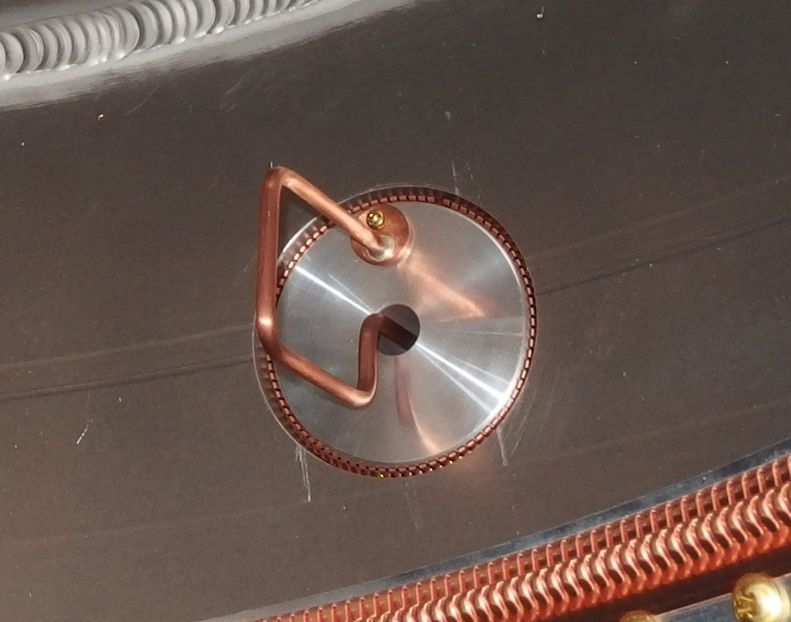
Highly-Sensitive Beam Diagnostic Devices I
Cavity type Schottky pick-up
Tuners
Resonance frequency 171MHz (TM₀₁₀)
Harmonic number 57
Tuning range ±0.5MHz
Q₀ value 9000(measured)
Shunt impedance 430kΩ (measured)
Gap 40mm
Ceramic tube 290mmΦ, 10mm thickness
expected spectrum for
1000 p-particles in ring
Ceramic tube
Single particle (q>20)
circulation is detectable
L-Coupler

Slide 20
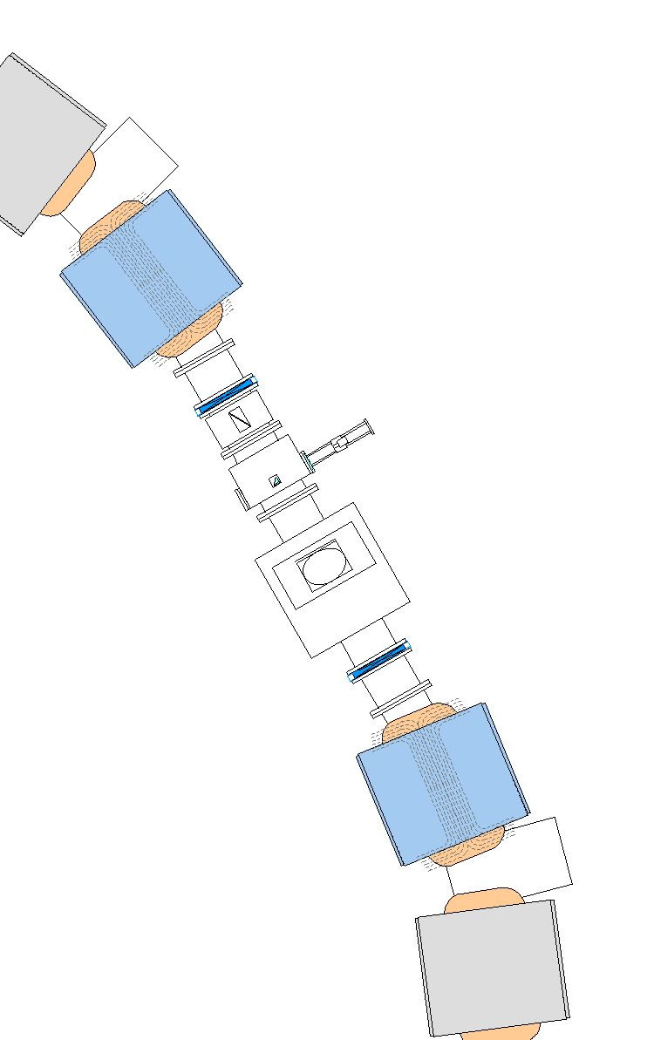
Highly-Sensitive Beam Diagnostic Devices II
monitor for first ~1000-turns circulation
C-Foil Timing Monitor
Test with ⁸⁴Kr 200MeV/u
Time resolution 340ps
60μg/cm² C foil
MCP secondary electron detector
Window size : 100×50 mm²
Position sensitivity : less than 10mm
Efficiency : 75 %

Slide 21
First confirmation of α-particle one-revolution
Momentum distribution of α-particles
5/6
6/6
Δp/p~6.5%
1/6

Slide 22
Tuning of Isochronism in α-particle test
Spectral resolution is limited
by current TOF detector
characteristics
Expected optimum value
(dB/dr)/B₀ = 0.205

