Slide 1

SUNFLOWER
Spectroscopy of Unstable Nuclei
with Fast and sLOW beam Experiments
at RIBF
― In-beam Gamma-ray Spectroscopy with Fast
Exotic Beams at RIBF
AOI Nori (RCNP, Osaka Univ.)
for SUNFLOWER collaboration

Slide 2
PS1-A004 Single-neutron Knockout Reaction from 30Ne
Hongna Liu (RIKEN)
PS1-A021 Persistence of N=50 Shell Closure in the Vicinity of 78Ni
Studied by In-beam Gamma-ray Spectroscopy
Yoshiaki Shiga (Rikkyo Univ.)
PS1-A021 ~⁷⁸Ni Y. Shiga
PS1-A024 Collectivity in the Neutron-rich Pd Isotopes toward N = 82
He Wang (RIKEN)
PS1-A024 ¹²²⁻¹²⁶Pd H. Wang
PS2-A029 Level Structure of 35Mg Following One-neutron Knockout
Satoru Momiyama (Tokyo)
PS2-A029 ³⁵Mg S. Momiyama (Tokyo)
Alexandre Obertelli (CEA Saclay / RIKEN)
Physics Program with MINOS at RIBF
MINOS A. Obertelli
David Steppenbeck (CNS, Univ. of Tokyo)
In-Beam Gamma-Ray Spectroscopy of
Very Neutron-Rich N=32 and 34 Nuclei
⁵⁴Ca D. Steppenbeck
Anna Corsi (CEA Saclay)
Shell Evolution towards 100Sn
^{10x}Sn A. Corsi

Slide 3
SUNFLOWER experiments
2008 DayOne / ⁴⁸Ca
³²Ne H. Scheit, P. Doornenbal PRL103(2009)032501, CPL29(2012)102301
^{31,33}Na H. Scheit, P. Doornenbal PRC81(2010)041305
2010 ⁴⁸Ca
~⁴²Si S. Takeuchi, M. Matsushita PRL 109(2012)182501
^{36,38}Mg P. Doornenbal, H. Scheit PRL 111(2013)212502
²⁹F P. Doornenbal
~Al, P D. Steppenbeck
³³Mg D. Bazin
⁴⁰Mg test P. Fallon, H.L.Crawford PRC89(2014)041303
³¹Ne, ²²C T. Nakamura PRL103(2009)262501, PRL112(2014) 142501
N. Kobayashi PRC86(2012)054604
2011 ²³⁸U
    ⁷⁸Ni K. Yoneda
    ~¹³²Sn H. Wang, NA PRC88(2013)054318
    PTEP2014:023D02 , CPL30(2013) 042501
2012 ¹²⁴Xe / ⁷⁰Zn
    ^{10x}Sn A. Obertelli, P. Doornenbal
    ⁵⁴Ca D. Steppenbeck, S. Takeuchi Nature 502(2013)207
    2013 ²³⁸U
    ⁷⁴Ni G. de Angelis
    2014 ²³⁸U
    ¹³⁶Sn H. Wang, NA
    SEASTAR P. Doornenbal, A. Obertelli

Slide 4
SUNFLOWER experiments
2008 DayOne / ⁴⁸Ca
³²Ne H. Scheit, P. Doornenbal PRL103(2009)032501, CPL29(2012)102301
^{31,33}Na H. Scheit, P. Doornenbal PRC81(2010)041305
2010 ⁴⁸Ca
~⁴²Si S. Takeuchi, M. Matsushita PRL 109(2012)182501
^{36,38}Mg P. Doornenbal, H. Scheit PRL 111(2012)212502
²⁹F P. Doornenbal
~Al, P D. Steppenbeck
³³Mg D. Bazin
⁴⁰Mg test P. Fallon, H.L.Crawford PRC89(2014)041303
³¹Ne, ²²C T. Nakamura PRL103(2009)262501, PRL112(2014) 142501
N. Kobayashi PRC86(2012)054604
2011 ²³⁸U
    ⁷⁸Ni K. Yoneda
    ~¹³²Sn H. Wang, NA PRC88(2013)054318
    PTEP2014:023D02 , CPL30(2013) 042501
2012 ¹²⁴Xe / ⁷⁰Zn
    ^{10x}Sn A. Obertelli, P. Doornenbal
    ⁵⁴Ca D. Steppenbeck, S. Takeuchi Nature 502(2013)207
    2013 ²³⁸U
    ⁷⁴Ni G. de Angelis
    2014 ²³⁸U
    ¹³⁶Sn H. Wang, NA
    SEASTAR P. Doornenbal, A. Obertelli
²⁹F = ²⁸O + p
Pd isotopes close to N = 82
Pd isotopes close to N = 50
⁵⁴Ca at N=34

Slide 5
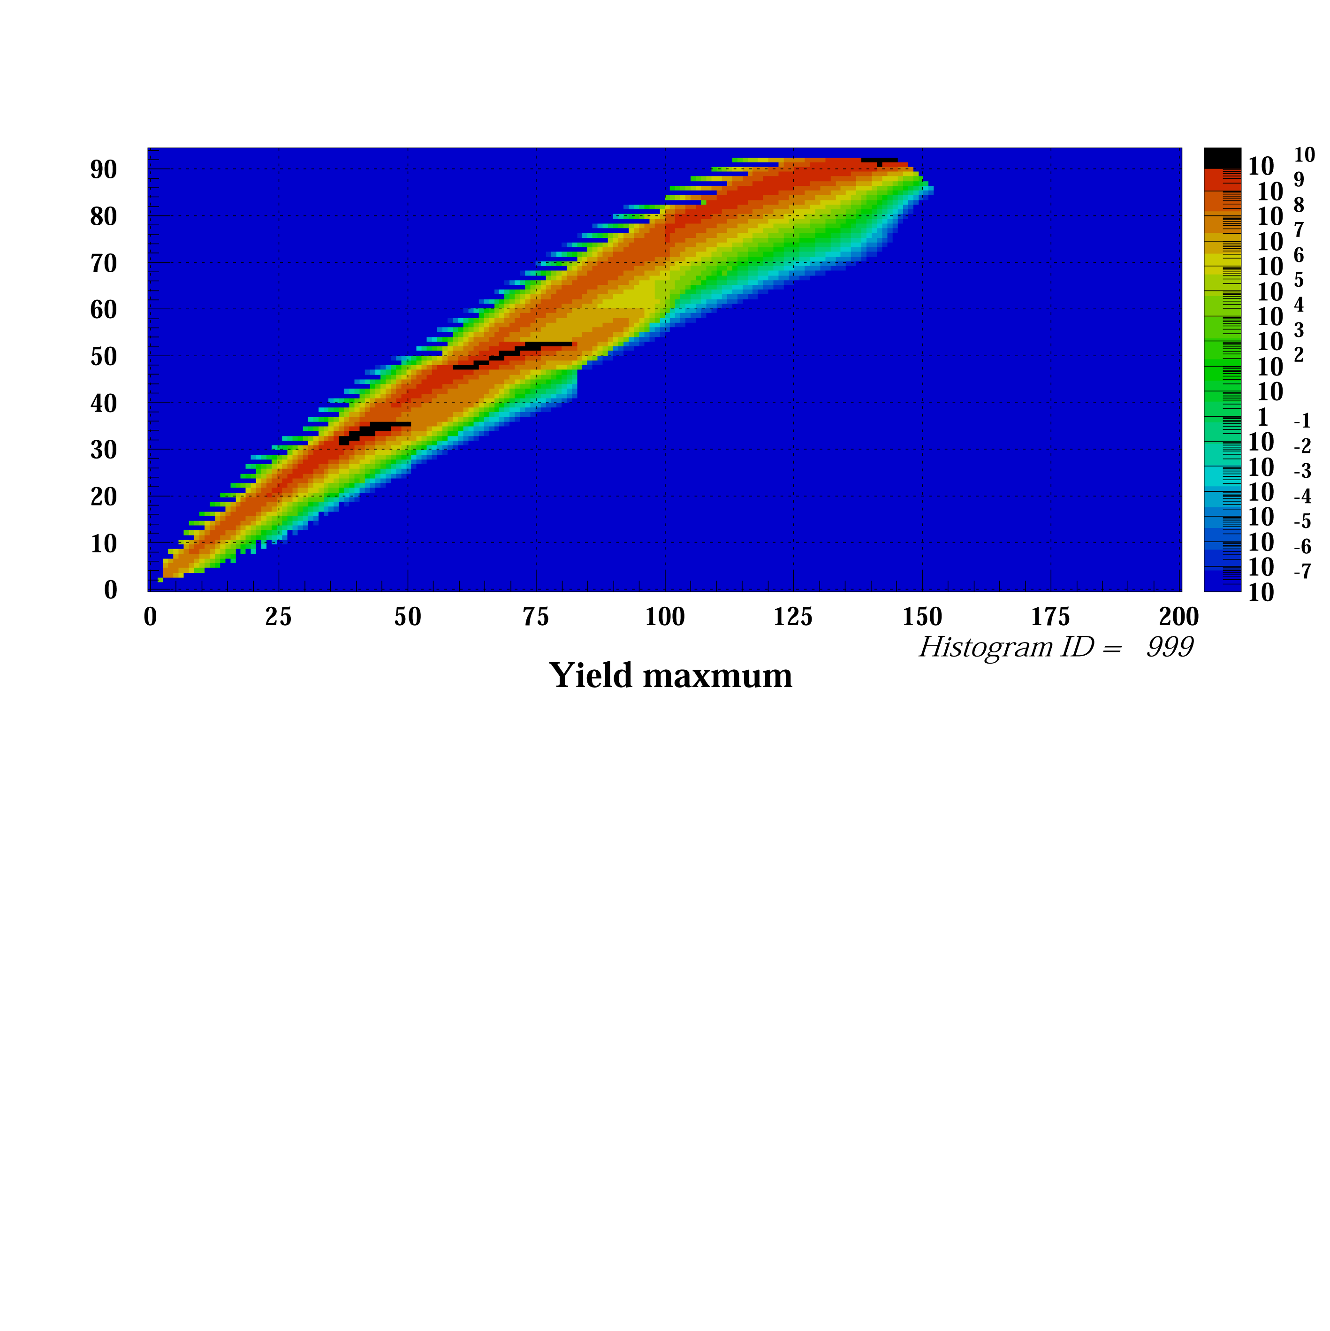
Region of Interest
⁸⁶Kr/¹³⁶Xe/²³⁸U 1pμA
N=82
N=50
N=28
Z=50
N=126
r-process
Z=28
Z=20
Collectivity: B(E2), E_{x}(2⁺)
Type of Coll.: E_{x}(2⁺) / E_{x}(4⁺)
Single Part.: E_{x}, J^{π}

Slide 6
Region of Interest
⁸⁶Kr/¹³⁶Xe/²³⁸U 1pμA
N=82
~¹⁰⁰Sn
N=50
~¹³²Sn
N=28
Z=50
N=126
N=34
Magic#
r-process
Z=28
Z=20
Collectivity: B(E2), E_{x}(2⁺)
Type of Coll.: E_{x}(2⁺) / E_{x}(4⁺)
Single Part.: E_{x}, J^{π}
Island of
Inversion

Slide 7
Region of Interest
⁸⁶Kr/¹³⁶Xe/²³⁸U 1pμA
N=82
PS1-A024
¹²²⁻¹²⁶Pd
H. Wang
^{10x}Sn
A. Corsi
N=50
PS2-A029
³⁵Mg
S. Momiyama
Z=50
N=28
N=126
PS1-A021
~⁷⁸Ni
Y. Shiga
r-process
Z=28
Z=20
Collectivity: B(E2), E_{x}(2⁺)
Type of Coll.: E_{x}(2⁺) / E_{x}(4⁺)
Single Part.: E_{x}, J^{π}
MINOS
A. Obertelli
PS1-A004
³⁰Ne
H. Liu
⁵⁴Ca
D. Steppenbeck

Slide 8
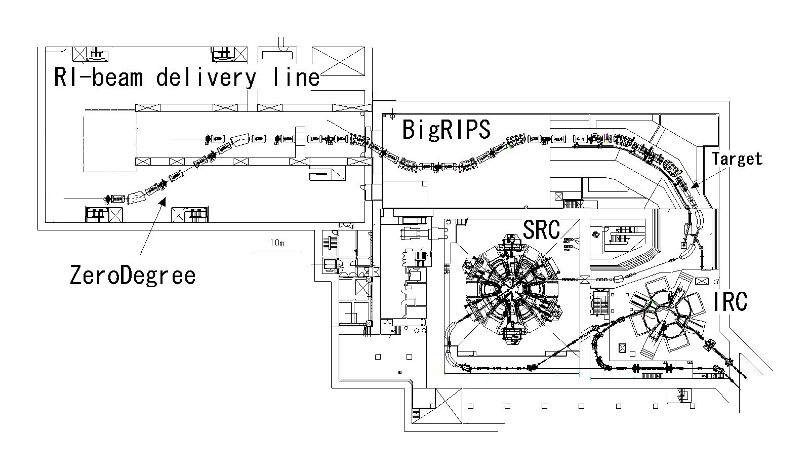
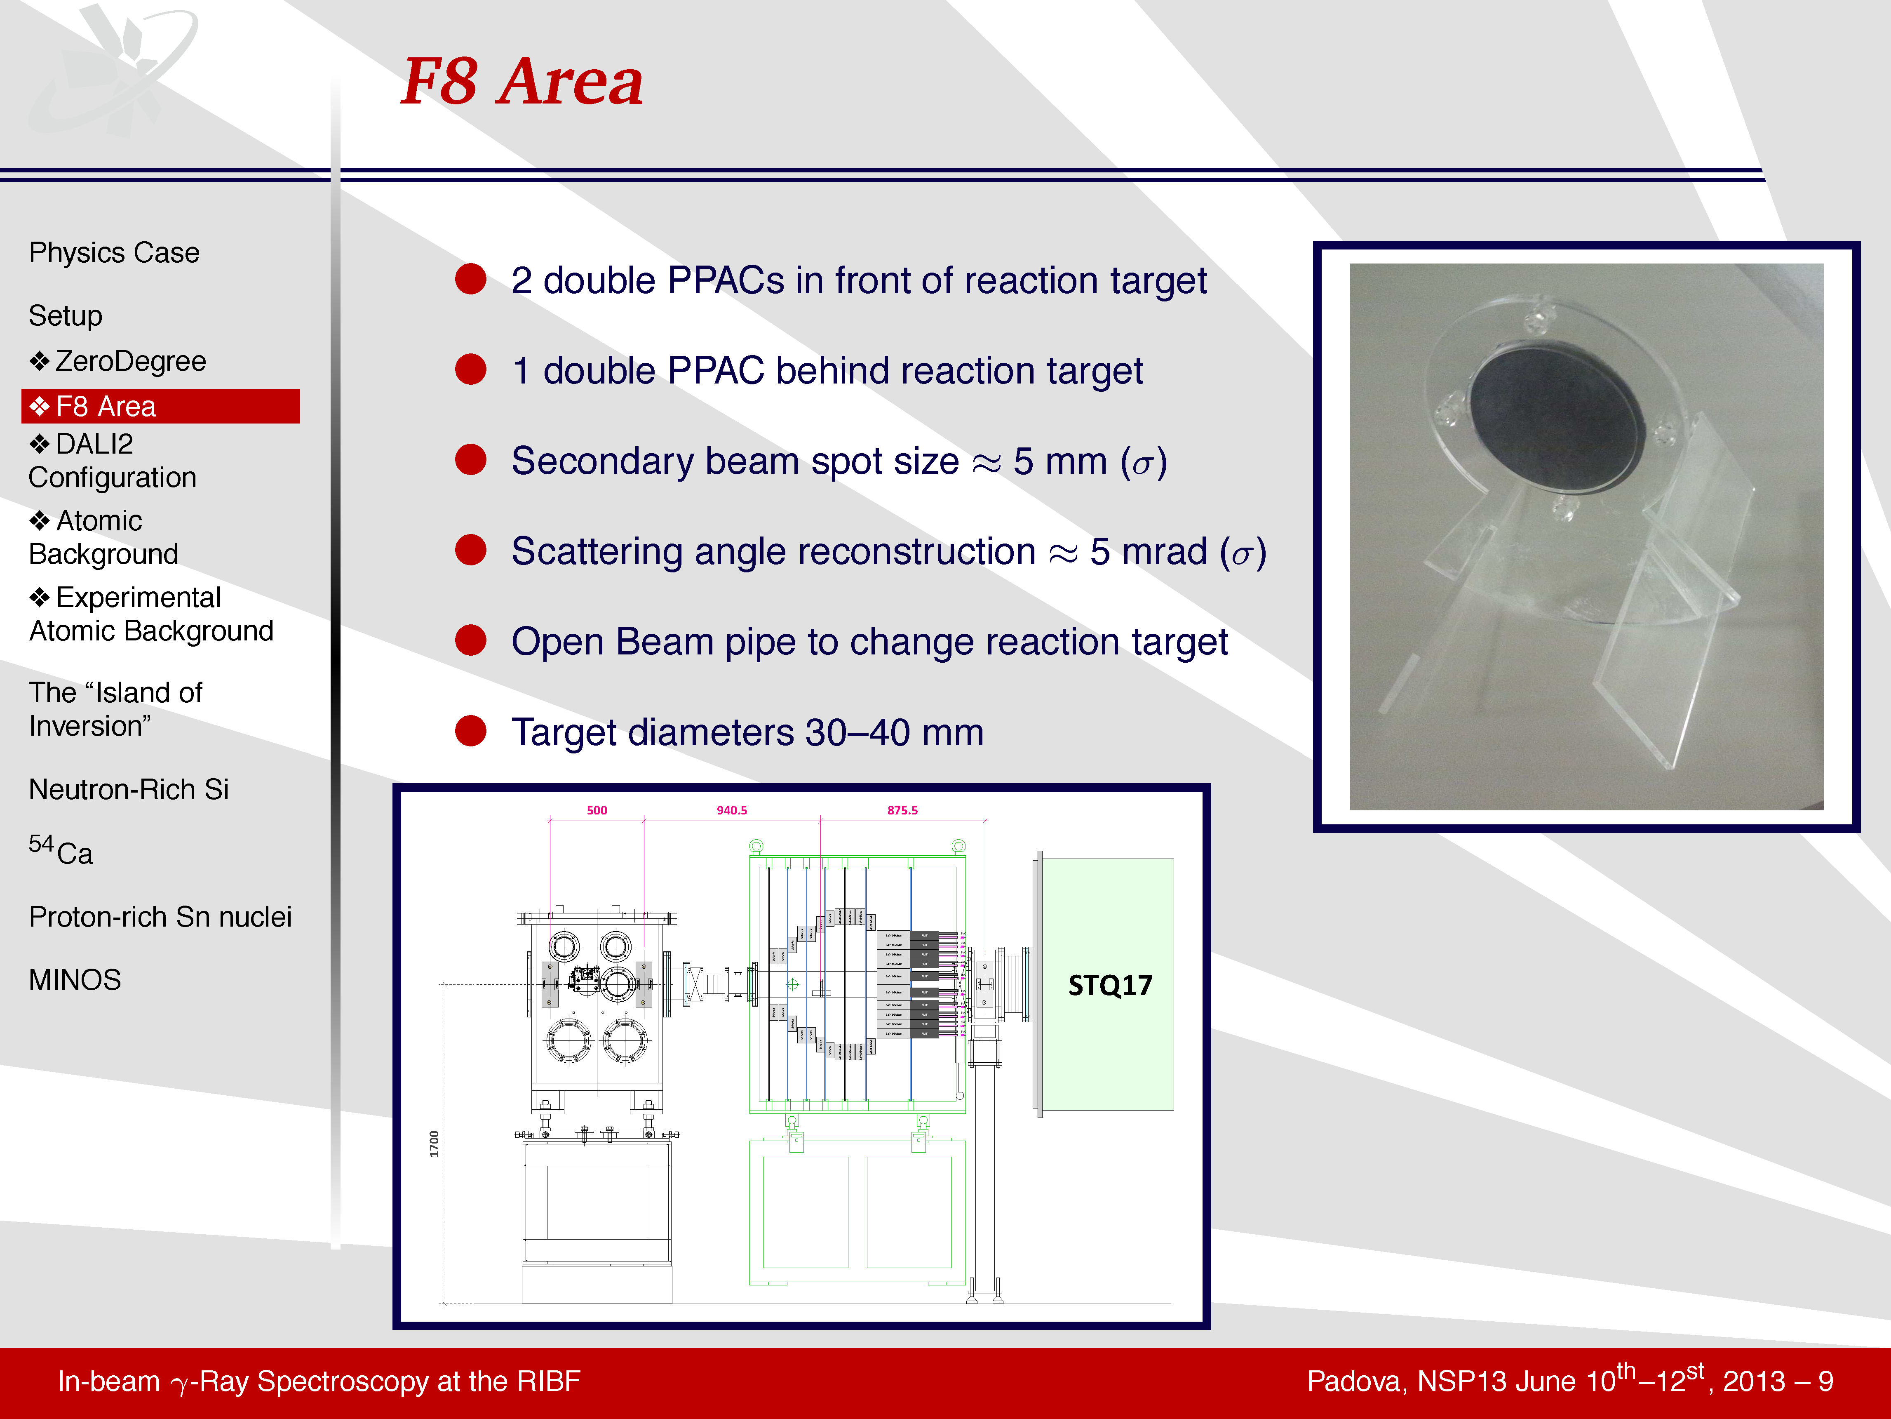
γ-ray spectroscopy setup @ BigRIPS/ZeroDegree
IRC
SRC
Production
Target
F11
F5
F1
F2
F3
F7
F7
F8
F12
1st stage
separation
Target
2nd stage
analysis
ZeroDegree
analysis of 2ndary
reaction products
Notes:
8

Slide 9
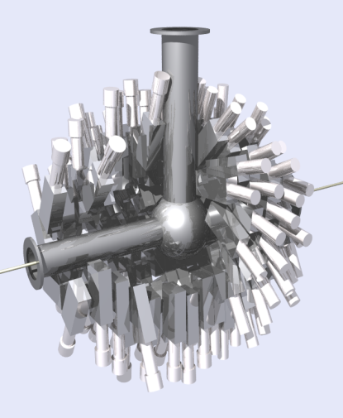
γ-ray spectroscopy setup @ BigRIPS/ZeroDegree
DALI2
IRC
SRC
Production
Target
F11
F5
F1
F2
F3
F7
F7
F8
F12
1st stage
separation
Target
2nd stage
analysis
ZeroDegree
analysis of 2ndary
reaction products
Notes:
9

Slide 10
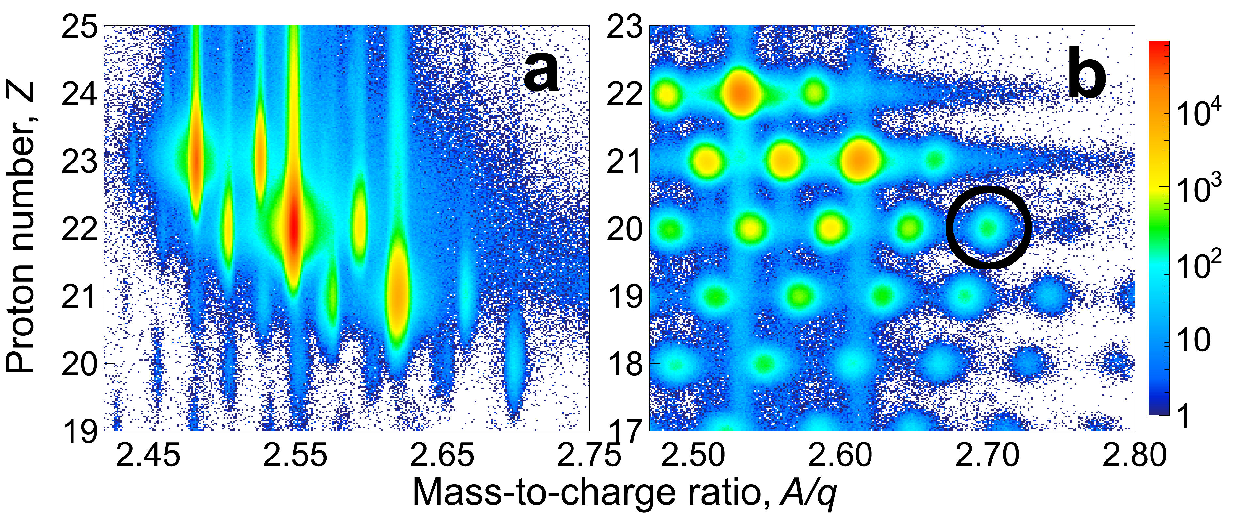
γ-ray spectroscopy setup @ BigRIPS/ZeroDegree
DALI2
Ejectile PID@ZeroDegree
Projectile PID@BigRIPS
IRC
SRC
Production
Target
F11
F5
F1
F2
F3
F7
F7
F8
F12
1st stage
separation
Target
2nd stage
analysis
ZeroDegree
analysis of 2ndary
reaction products
Notes:
10

Slide 11
Region of Interest
⁸⁶Kr/¹³⁶Xe/²³⁸U 1pμA
N=82
~¹⁰⁰Sn
N=50
~¹³²Sn
N=28
Z=50
N=126
N=34
Magic#
r-process
Z=28
Z=20
Collectivity: B(E2), E_{x}(2⁺)
Type of Coll.: E_{x}(2⁺) / E_{x}(4⁺)
Single Part.: E_{x}, J^{π}
Island of
Inversion

Slide 12
Island of deformation
³²Mg
20
³⁴Mg
³⁰Ne
28
8
Island of Inversion
³²Mg: T. Motobayashi et al., PLB 346, 9 (1995).
³¹F: H. Sakurai et al., PLB 448, 180 (1999).
³⁴Mg: K. Yoneda et al., PLB 449, 233 (2001).
³⁰Ne: Y. Yanagisawa et al., PLB 556, 84 (2003).
Notes:
12

Slide 13
γ-ray spectra for ³⁸Mg
P. Doornenbal, et al.,
PRL 111, 212502 (2013).
Notes:
13

Slide 15
Island of deformation
³⁸Mg
³⁶Mg
³²Mg
20
³⁴Mg
^{36,38}Mg:
P. Doornenbal, et al.,
PRL 111, 212502 (2013).
28
8
Island of Inversion
Notes:
15

Slide 16
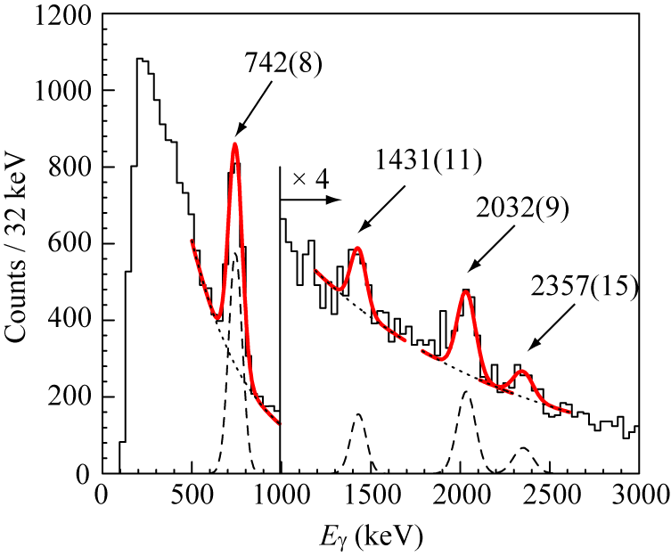
Island of deformation
³⁸Mg
³⁶Mg
³²Mg
20
³⁴Mg
^{36,38}Mg:
P. Doornenbal, et al.,
PRL 111, 212502 (2013).
28
8
Island of Inversion
⁴²Si: S. Takeuchi et al.,
PRL 109, 182501 (2012)
E_{x}(4⁺)
→ Large deformation in ⁴²Si
Notes:
16

Slide 17
Island of deformation
⁴²Si: S. Takeuchi et al.,
PRL 109, 182501 (2012)
E_{x}(4⁺)
→ Large deformation in ⁴²Si
³²Mg
20
28
⁴²Si
8
Island of Inversion
³²Ne: P. Doornenbal et al., PRL 103, 032501 (2009).
⁴²Si: S. Takeuchi et al., PRL 109, 182501 (2012).
^{36,38}Mg: P. Doornenbal, et al., PRL 111, 212502 (2013).
Notes:
17

Slide 18
E_{x}(2⁺) and E_{x}(4⁺) in Mg/Si @ N=20~28
Sound magicity
in Si @ N=20
Magicity disappeared
in Mg @ N=20
Large collectivity
in Si/Mg @ N~28
Smooth transition
in Si
Almost identical in
³⁴Mg, ³⁶Mg, ³⁸Mg

Slide 19
E_{x}(2⁺) and E_{x}(4⁺) in Mg/Si @ N=20~28

Slide 20

E_{x}(2⁺) and E_{x}(4⁺) in Mg/Si @ N=20~28
E_{x}(2⁺)
[MeV]
Mg
Sound magicity
in Si @ N=20
³⁴Si
Si
Magicity disappeared
in Mg @ N=20
³²Mg
Large collectivity
in Si/Mg @ N~28
⁴²Si
Smooth transition
in Si
R_{4/2}
Almost identical in
³⁴Mg, ³⁶Mg, ³⁸Mg

Slide 21
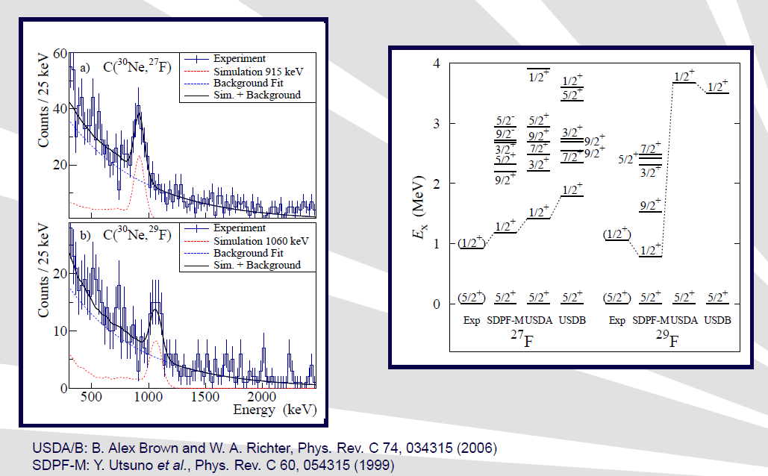
Island of deformation
²⁹F : ²⁸O+p
p
p
²⁸O
²⁸O
³²Mg
20
28
8
²⁹F
Island of Inversion
³²Mg: T. Motobayashi et al., PLB 346, 9 (1995).
³¹F: H. Sakurai et al., PLB 448, 180 (1999).
³⁴Mg: K. Yoneda et al., PLB 449, 233 (2001).
³⁰Ne: Y. Yanagisawa et al., PLB 556, 84 (2003).
³²Ne: P. Doornenbal et al., PRL 103, 032501 (2009).
⁴²Si: S. Takeuchi et al., PRL 109, 182501 (2012).
^{36,38}Mg: P. Doornenbal, et al., PRL 111, 212502 (2013).
Notes:
21

Slide 22
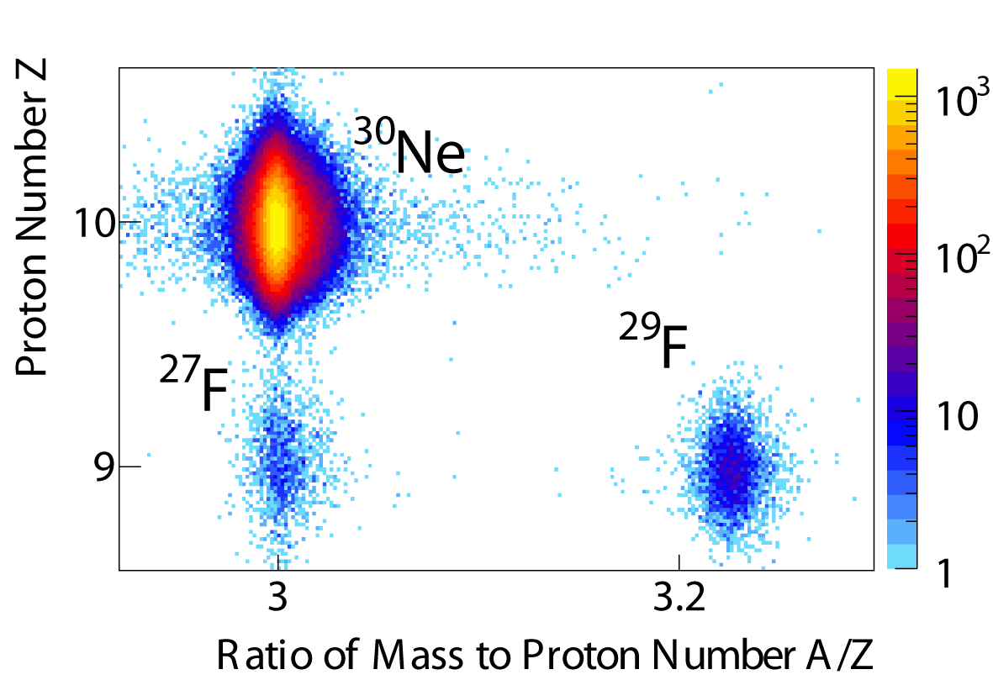
Spectroscopy of ²⁹F P.Dorrnenbal et al
Aim: Search for the Southern boundary of the “Island of Inversion”
Excitation energy of the first excited state
²⁷F: 915 keV
²⁹F: 1060 keV

Slide 23
²⁹F : Belongs to Island of inversion
Inclusion of pf-shell necessary
2p-2h configuration seen in IOI
²⁹F belongs to Island of inversion
← agreement with
BE calculations using SDPF-M
USDA/B: B.A.Brown and W.A.Richter, PRC74(2006)034315
SDPF-M: Y.Utsuno et al., PRC60(1999)054315
Notes:
I will send you my slide from Zakopane. You can omit the 28O part. just mention that:
need sdpf interaction to be in agreement with experiment for SM calculations. Then from the gamma ray energy you have a limit on the S2n separation energy -> Limit on the mass -> lower limit on BE.
Comparison with BE calculations -> agreement not with USDA/B but with SDPF-M
-> 29F belongs to IOI
I will send you the BE spectra later.

Slide 24
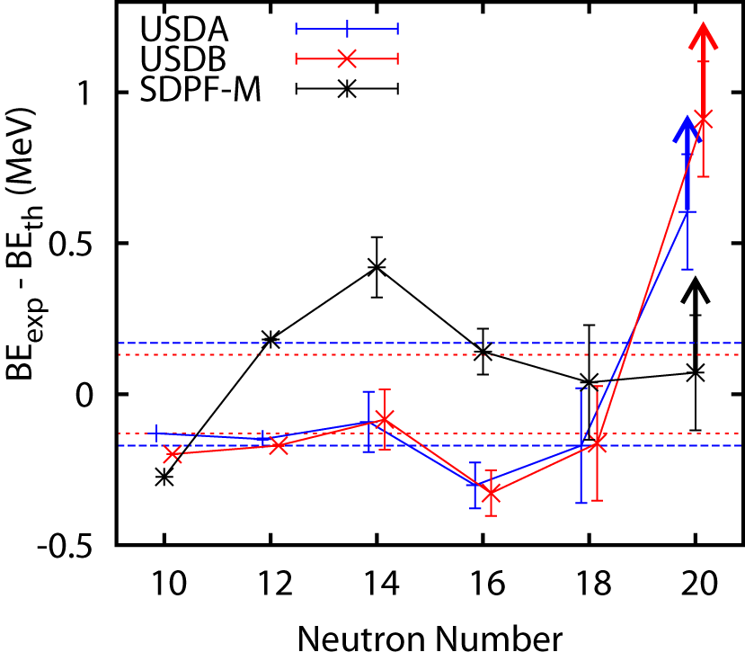
²⁹F : Belongs to Island of inversion
To reproduce low first excitation energy in ²⁹F,
we need sd-pf interaction in SM calculation.
2p-2h configuration seen in IOI
²⁹F belongs to Island of inversion ← agreement with BE calculations using SDPF-M
USDA/B: B.A.Brown and W.A.Richter, PRC74(2006)034315
SDPF-M: Y.Utsuno et al., PRC60(1999)054315
Notes:
I will send you my slide from Zakopane. You can omit the 28O part. just mention that:
need sdpf interaction to be in agreement with experiment for SM calculations. Then from the gamma ray energy you have a limit on the S2n separation energy -> Limit on the mass -> lower limit on BE.
Comparison with BE calculations -> agreement not with USDA/B but with SDPF-M
-> 29F belongs to IOI
I will send you the BE spectra later.

Slide 25
Island of deformation
³⁶Mg
³⁸Mg
-2003
³²Mg
20
³⁴Mg
28
⁴²Si
8
²⁹F
Island of Inversion
³²Mg: T. Motobayashi et al., PLB 346, 9 (1995).
³¹F: H. Sakurai et al., PLB 448, 180 (1999).
³⁴Mg: K. Yoneda et al., PLB 449, 233 (2001).
³⁰Ne: Y. Yanagisawa et al., PLB 556, 84 (2003).
³²Ne: P. Doornenbal et al., PRL 103, 032501 (2009).
⁴²Si: S. Takeuchi et al., PRL 109, 182501 (2012).
^{36,38}Mg: P. Doornenbal, et al., PRL 111, 212502 (2013).
Notes:
25

Slide 26
Island of deformation
2013
⁴²Si
³²Mg
20
^{34,36,38}Mg
Mg
28
8
³¹F
³²Ne
Island of Inversion
³²Mg: T. Motobayashi et al., PLB 346, 9 (1995).
³¹F: H. Sakurai et al., PLB 448, 180 (1999).
³⁴Mg: K. Yoneda et al., PLB 449, 233 (2001).
³⁰Ne: Y. Yanagisawa et al., PLB 556, 84 (2003).
³²Ne: P. Doornenbal et al., PRL 103, 032501 (2009).
⁴²Si: S. Takeuchi et al., PRL 109, 182501 (2012).
^{36,38}Mg: P. Doornenbal, et al., PRL 111, 212502 (2013).
Notes:
26

Slide 27
Island of deformation
⁵⁴Ca
2013
⁴²Si
³²Mg
20
^{34,36,38}Mg
N=34?
Mg
28
8
³¹F
³²Ne
Island of Inversion
³²Mg: T. Motobayashi et al., PLB 346, 9 (1995).
³¹F: H. Sakurai et al., PLB 448, 180 (1999).
³⁴Mg: K. Yoneda et al., PLB 449, 233 (2001).
³⁰Ne: Y. Yanagisawa et al., PLB 556, 84 (2003).
³²Ne: P. Doornenbal et al., PRL 103, 032501 (2009).
⁴²Si: S. Takeuchi et al., PRL 109, 182501 (2012).
^{36,38}Mg: P. Doornenbal, et al., PRL 111, 212502 (2013).
Notes:
27

Slide 28

“New” magic number N=34 in ⁵⁴Ca
ARIS talk on Friday
David Steppenbeck (CNS, Tokyo)
In-Beam Gamma-Ray Spectroscopy of
Very Neutron-Rich N=32 and 34 Nuclei

Slide 29
Region of Interest
⁸⁶Kr/¹³⁶Xe/²³⁸U 1pμA
N=82
~¹⁰⁰Sn
N=50
~¹³²Sn
N=28
Z=50
N=126
N=34
Magic#
r-process
Z=28
Z=20
~⁷⁸Ni
Collectivity: B(E2), E_{x}(2⁺)
Type of Coll.: E_{x}(2⁺) / E_{x}(4⁺)
Single Part.: E_{x}, J^{π}
Island of
Inversion

Slide 30
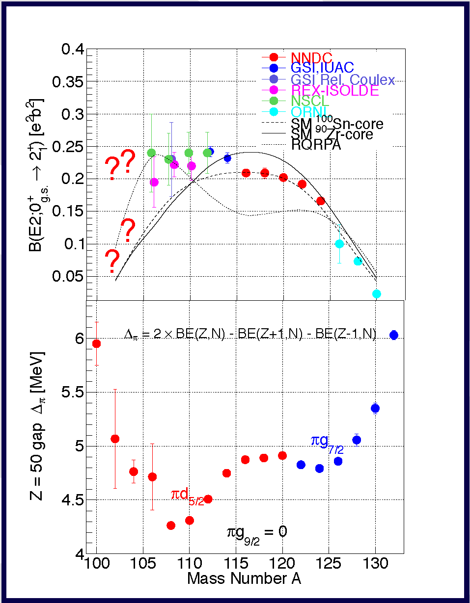
B(E2) Systematics in Sn
ARIS Talk on Monday
Anna Corsi (CEA Saclay)
Shell Evolution towards ¹⁰⁰Sn

Slide 31
Region of Interest
⁸⁶Kr/¹³⁶Xe/²³⁸U 1pμA
N=82
~¹⁰⁰Sn
N=50
~¹³²Sn
N=28
Z=50
N=126
N=34
Magic#
r-process
Z=28
Z=20
~⁷⁸Ni
Collectivity: B(E2), E_{x}(2⁺)
Type of Coll.: E_{x}(2⁺) / E_{x}(4⁺)
Single Part.: E_{x}, J^{π}
Island of
Inversion

Slide 32
H. Wang
H. Wang

Slide 33
H. Wang
H. Wang

Slide 34
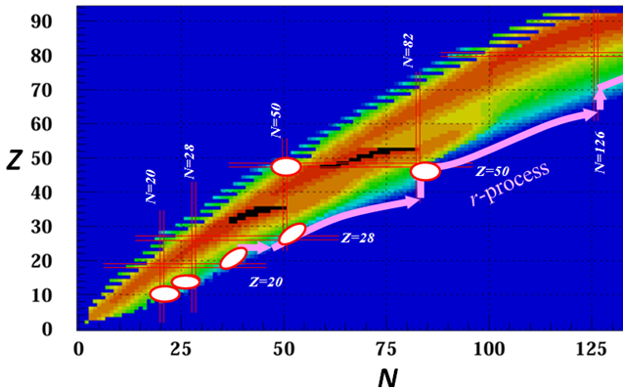
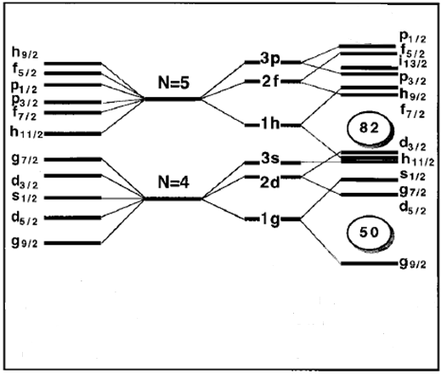
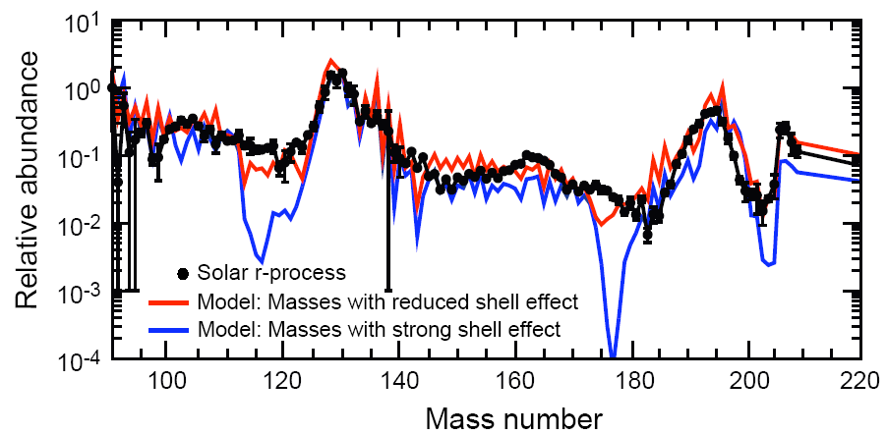
Shell structure of the nuclei beyond ¹³²Sn
Quenching or NOT Quenching at N=82, this is the question
N=82 magic number disappear in neutron-rich region
N/Z ~ 3
N/Z
N/Z ~1.6
r-process waiting points
corresponding to r-process abundance peak
Shell gap disappear
Shell quenching at N=82 and the r-process abundance
Neutron-drip line
Quenching
Shell reordering
Stability
Not
Quenching
J. Dobaczewski et al., Phys. Rev. C 53,2809(1996)
Significant changes in the shell structure with (very) large N/Z

Slide 35
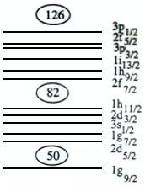
Motivation
Xe
I
Te
Sb
Valley of stability
¹³⁶Sn
Sn
In
Cd
Ag
Pd
¹²²Pd
¹²⁴Pd
¹²⁶Pd
70
72
74
76
78
80
82
84
86
88
2⁺ excited state known
2⁺ excited state unknown

Slide 36
γ-ray spectroscopy setup @ BigRIPS/ZeroDegree
DALI2
IRC
SRC
Production
Target
F11
F5
F1
F2
F3
F7
F7
F8
F12
1st stage
separation
Target
2nd stage
analysis
ZeroDegree
analysis of 2ndary
reaction products
Notes:
36

Slide 37
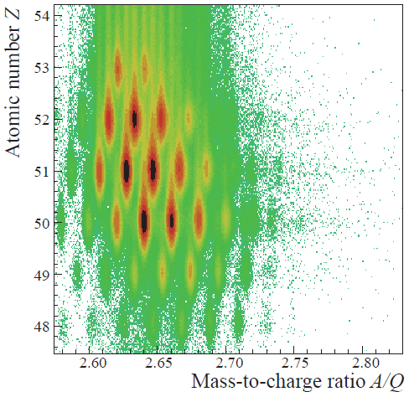
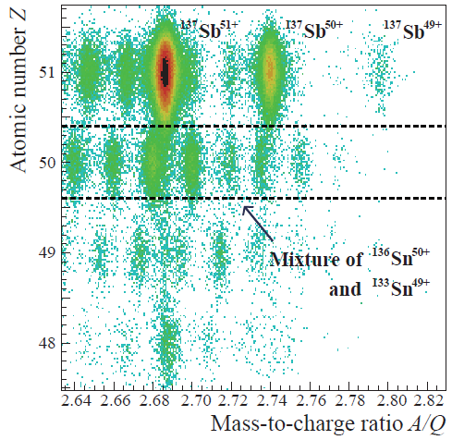
Particle Identification
¹³⁷Sb → ¹³⁶Sn
BigRIPS PID
ZeroDegree PID
¹³⁷Sb
A+3
A-1
A

Slide 38
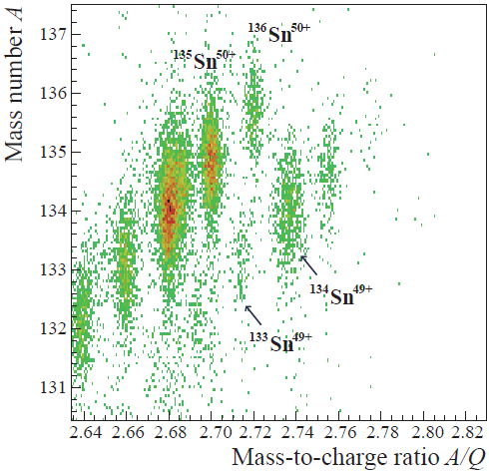
Particle Identification
¹³⁷Sb → ¹³⁶Sn
Charge State ID by TKE
ZeroDegree PID
¹³⁶Sn⁵⁰⁺
Q=Z
Q=Z-1

Slide 39
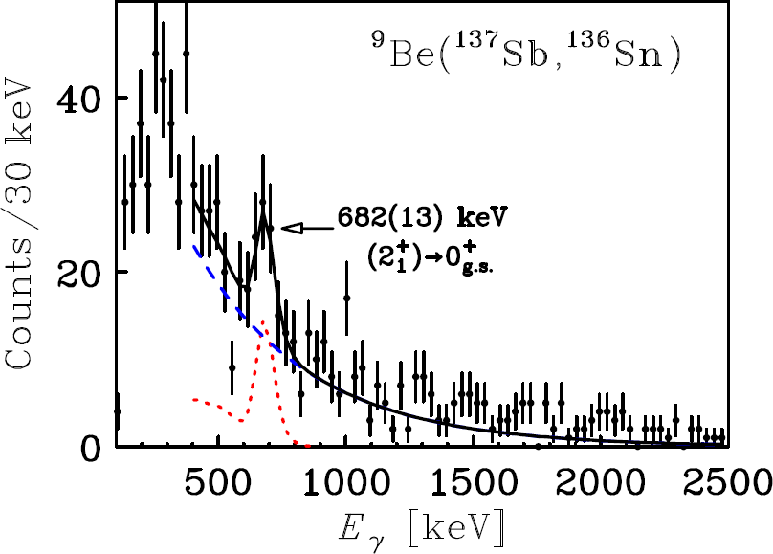
The first 2⁺ excited state in ¹³⁶Sn
One proton removal reaction

Slide 40
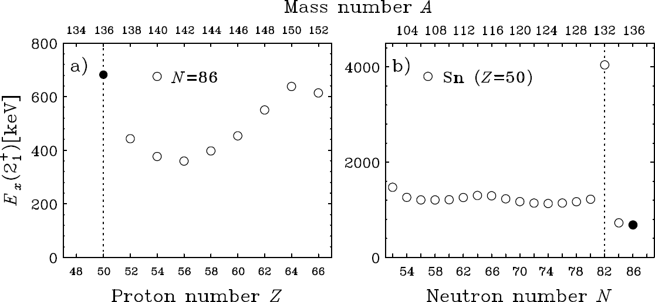
Systematics of E_{x}(2⁺)
Z=50 magicity in N=86 isotones
Constant E_{x}(2⁺) beyond N=82 → Seniority scheme
Asymmetric E_{x}(2⁺) pattern around N=82
Z=50 magicity in N=86 isotones
Constant E_{x}(2⁺) beyond N=82 → Seniority scheme
Asymmetric E_{x}(2⁺) pattern around N=82
Mass Number A

Slide 41
Systematics of E_{x}(2⁺)
Z=50 magicity in N=86 isotones
Constant E_{x}(2⁺) beyond N=82 → Seniority scheme
Asymmetric E_{x}(2⁺) pattern around N=82
Z=50 magicity in N=86 isotones
Constant E_{x}(2⁺) beyond N=82 → Seniority scheme
Asymmetric E_{x}(2⁺) pattern around N=82
Mass Number A
Mass Number A

Slide 42
Systematics of E_{x}(2⁺)
Z=50 magicity in N=86 isotones
Constant E_{x}(2⁺) beyond N=82 → Seniority scheme
Asymmetric E_{x}(2⁺) pattern around N=82
Z=50 magicity in N=86 isotones
Constant E_{x}(2⁺) beyond N=82 → Seniority scheme
Asymmetric E_{x}(2⁺) pattern around N=82
Mass Number A
Mass Number A
~500 keV

Slide 43
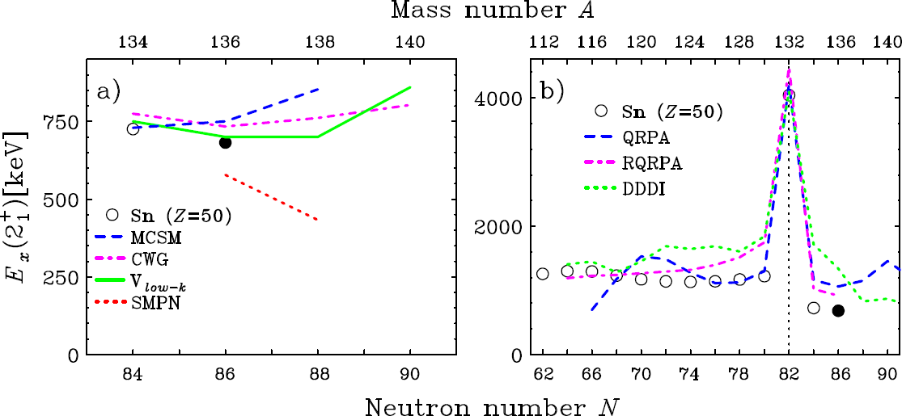
Comparison with Theory
Mean-field calculations cannot reproduce
  Constancy
  asymmetry with respective to N=82
Mass Number A
Neutron Number N

Slide 44
Comparison with Theory
Shell-model calculations
¹³²Sn core + 4 valence neutrons
Mean-field calculations
cannot reproduced the two features at the same time
Present work

Slide 45
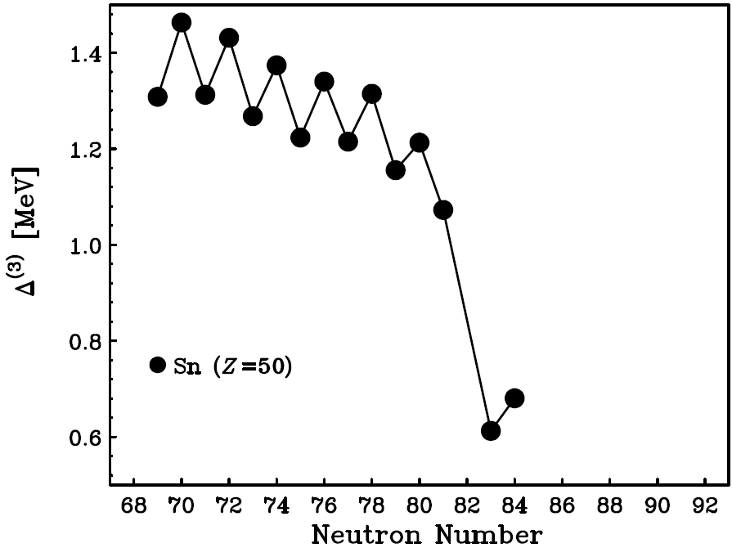
Possible Reason
Reduction of pairing ?
Δ⁽³⁾(N)=(-1)^{N}[B(N-1)+B(N+1)-2B(N)]/2
J. Hakala, et al.,
PRL 109, 032501(2012)
N<82
N>82
A. Jokinen’s talk
at ARIS2014

Slide 46
Motivation
Xe
I
Te
Sb
Valley of stability
¹³⁶Sn
Sn
In
Cd
Ag
Pd
¹²²Pd
¹²⁴Pd
¹²⁶Pd
70
72
74
76
78
80
82
84
86
88
2⁺ excited state known
2⁺ excited state unknown

Slide 47
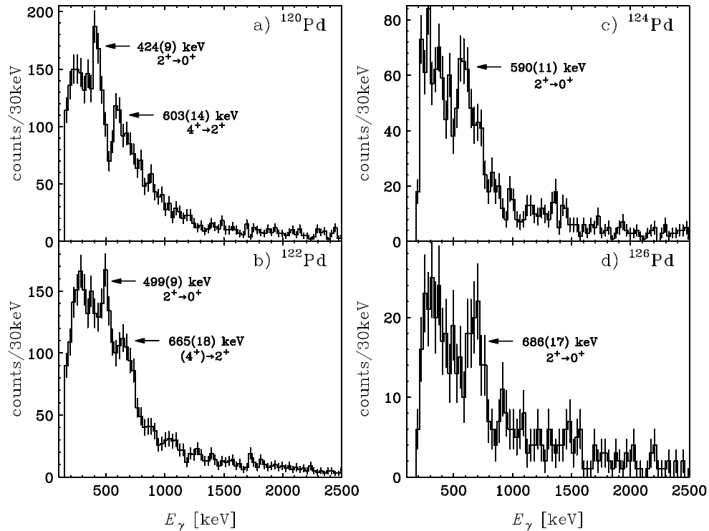
Excited states in ^{120,122,124,126}Pd

Slide 48
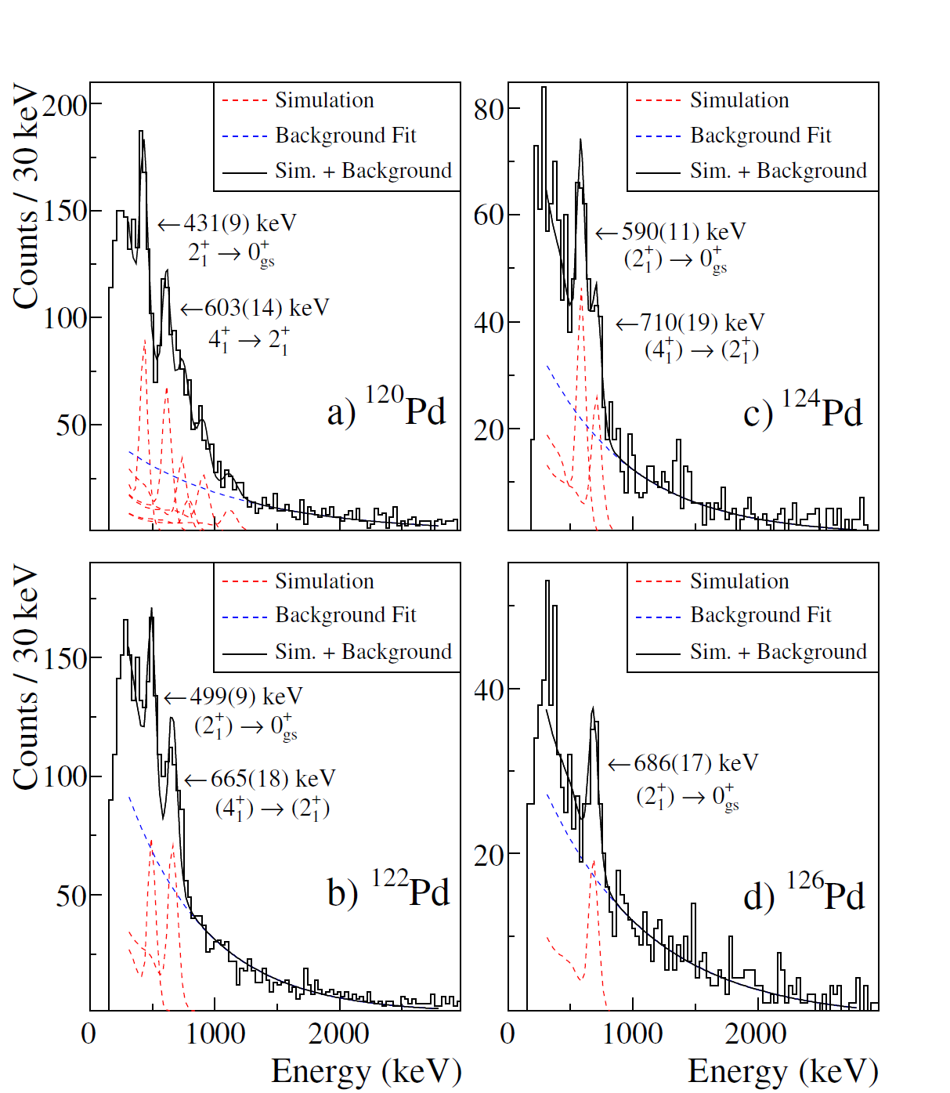
γ-ray spectra for ^{120,122,124,126}Pd

Slide 49
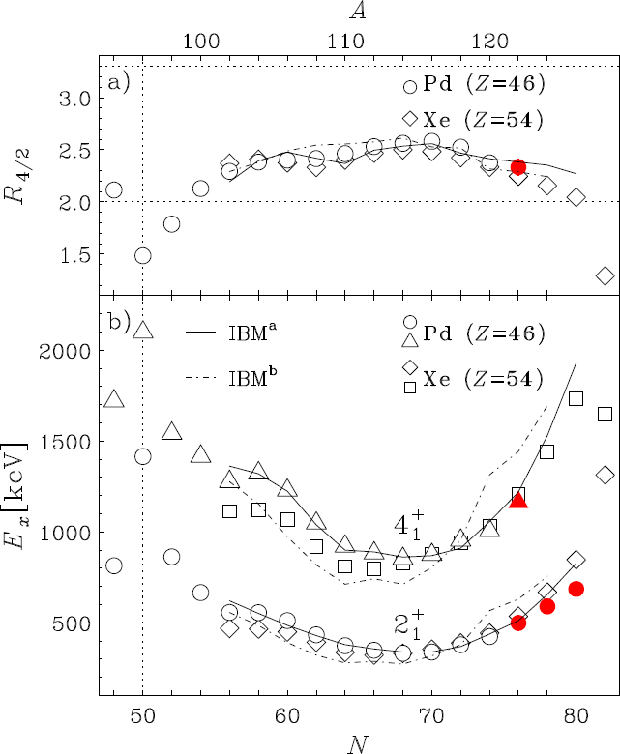
Collectivity in Pd towards N=82
Present work
The collectivity decreases towards
N=82 due to the shell effect
All systematics are similar to those
of the Xe (Z=54)
Overall systematics trends are well
reproduced by two IBM-2
calculations using a model space
with a good N=82 shell closure

Slide 50
The collectivity decreases towards
N=82 due to the shell effect
All systematics are similar to those
of the Xe (Z=54)
Overall systematics trends are well
reproduced by two IBM-2
calculations using a model space
with a good N=82 shell closure

Slide 51
Region of Interest
⁸⁶Kr/¹³⁶Xe/²³⁸U 1pμA
N=82
~¹⁰⁰Sn
N=50
~¹³²Sn
N=28
Z=50
N=126
N=34
Magic#
r-process
Z=28
Z=20
Collectivity: B(E2), E_{x}(2⁺)
Type of Coll.: E_{x}(2⁺) / E_{x}(4⁺)
Single Part.: E_{x}, J^{π}
Island of
Inversion

Slide 52
Region of Interest
⁸⁶Kr/¹³⁶Xe/²³⁸U 1pμA
N=82
~¹⁰⁰Sn
N=50
~¹³²Sn
N=28
Z=50
N=126
N=34
Magic#
r-process
Z=28
Z=20
Collectivity: B(E2), E_{x}(2⁺)
Type of Coll.: E_{x}(2⁺) / E_{x}(4⁺)
Single Part.: E_{x}, J^{π}
MINOS
A. Obertelli
Island of
Inversion

Slide 53
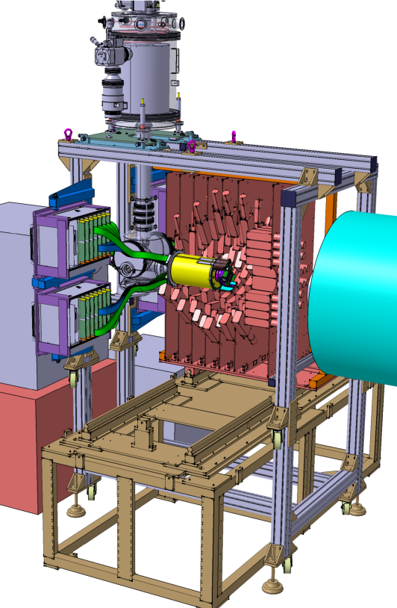
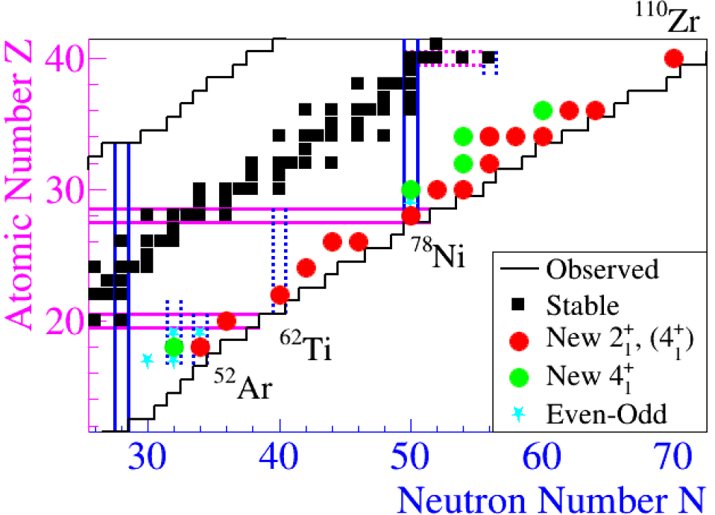
Shell Evolution and Search for Two-plus Energies
At the RIBF (SEASTAR) – a RIKEN Physics program
Spokespersons: P. Doornenbal (RIKEN), A. Obertelli (CEA, RIKEN)
ARIS talk on Wed
Alexandre Obertelli (CEA Saclay / RIKEN)
EPJ A sponsored lecture : Physics Program with MINOS at RIBF
PSP framework promoted by H. Sakurai (RIKEN, Univ. of Tokyo)
You are welcome to the SEASTAR collaboration!
http://www.nishina.riken.jp/collaboration/SUNFLOWER/experiment/seastar/index.html

Slide 54
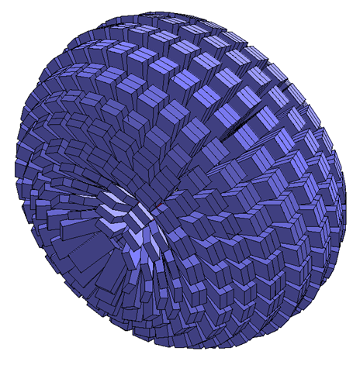
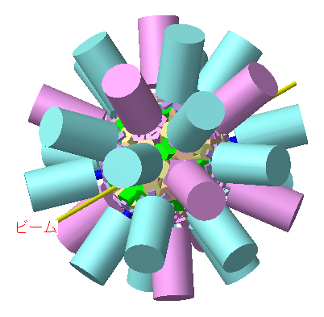
Future
Beam intensity will continue increasing
→ Expansion of region
More elaborate measurements
→ Higher excited states
→ Low energy reactions (OEDO [Shimoura])
New detectors
Shogun ?
Ge based (tracking array?)

Slide 55
4π high resolution scintillator array
(eg. LaBr3)
4π high resolution scintillator array
(eg. LaBr3)

Slide 56
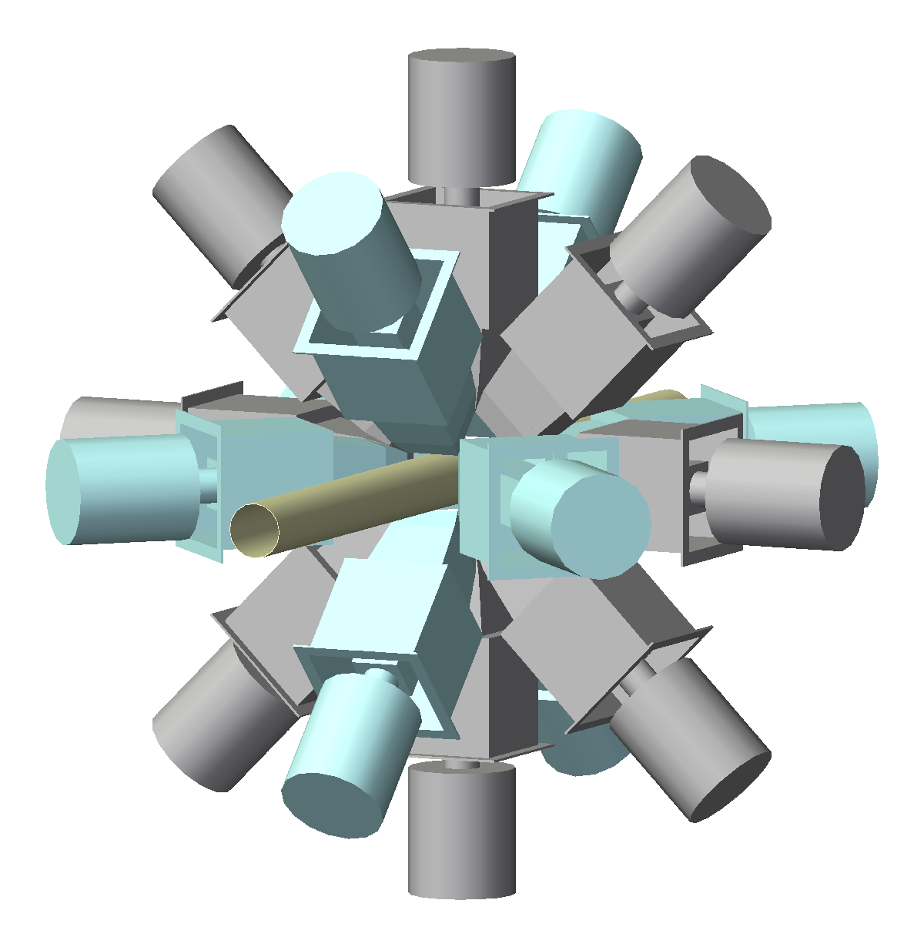
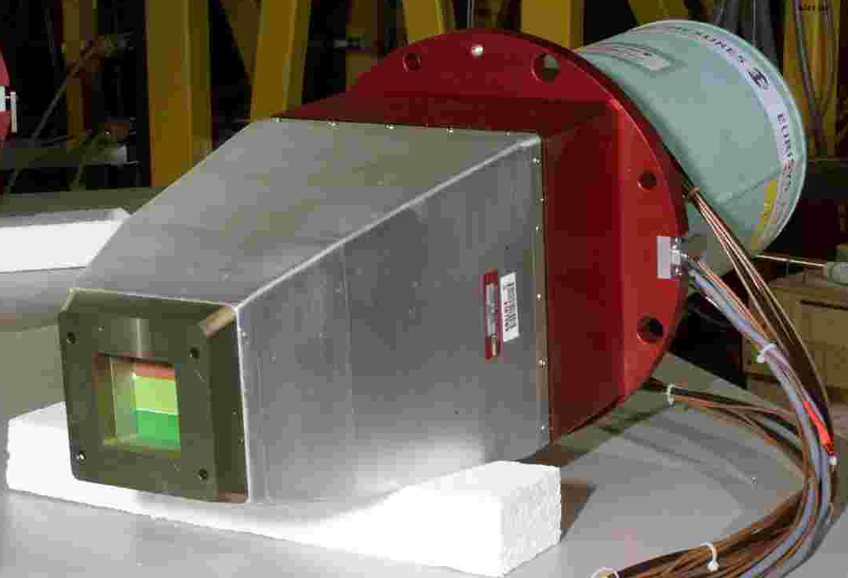
CAGRA(Clover Array)
M. Carpenter, E. Ideguchi, T. Koike et al.
CAGRA
(Clover Array Gamma-ray spectrometer
at RCNP/RIBF for Advanced research)
Clover with BGO suppressor x 16
US :10
Tohoku :6
Approved by DOE
    Transportation
    Digital electronics
    Liq. N2 filling system

Slide 57

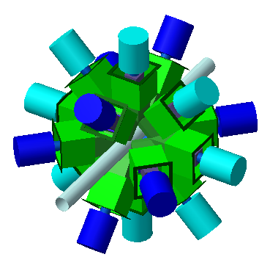
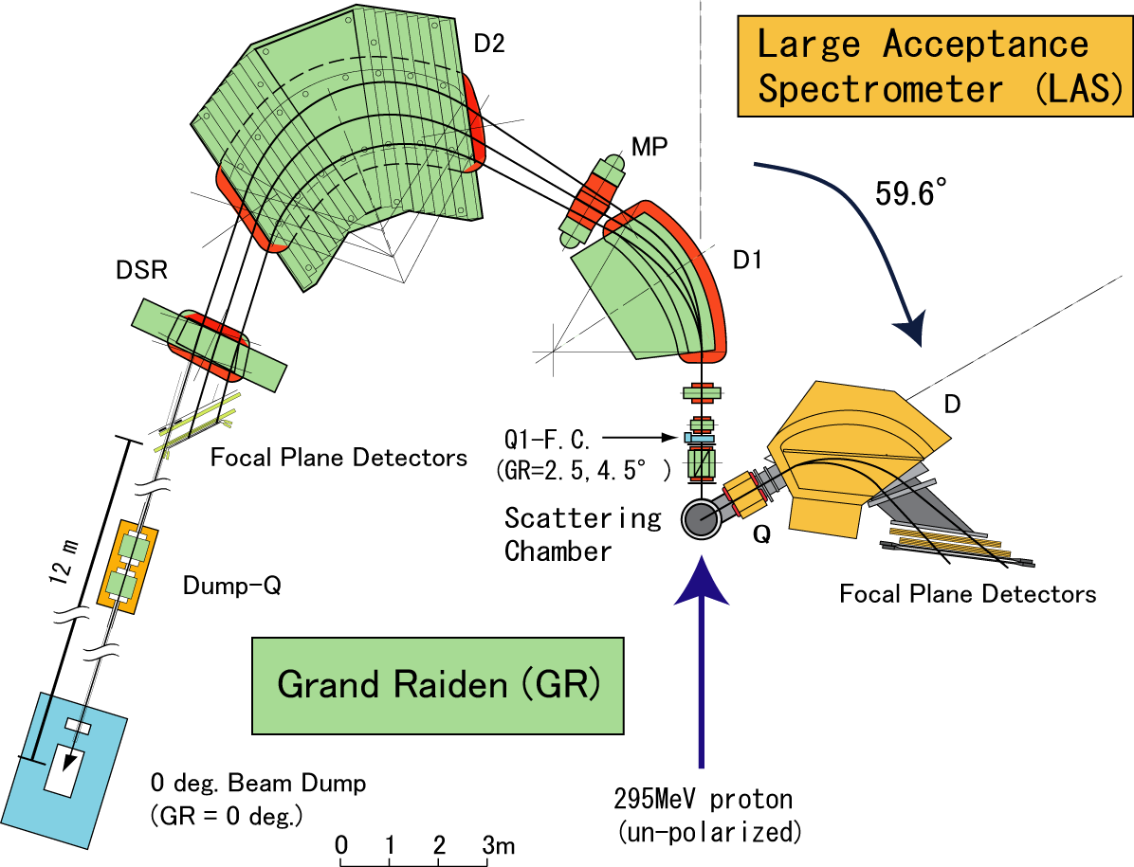
CAGRA@RCNP
High Spin with RI beam
at EN course
Giant Resonance/
Charge exchange
At Grand Raiden
Selection
Beams of
unstable nuclei
of interest
Various
unstable nuclei
不安定核
ビームライン
Target
Heavy ion
primary beam (Stable)

Slide 58
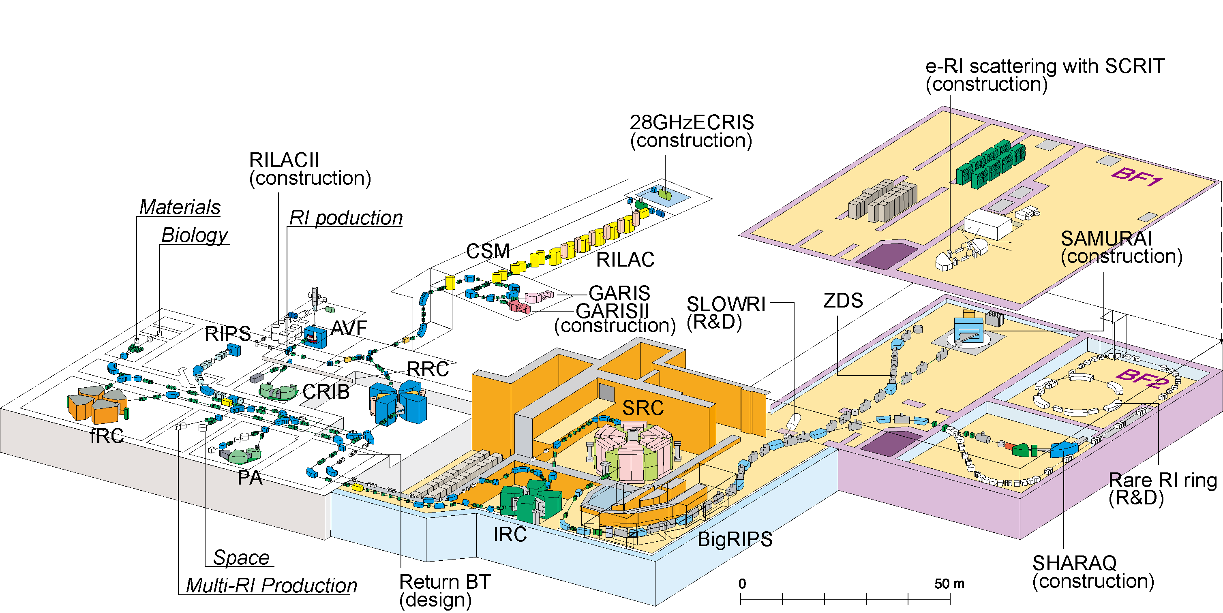
CAGRA@RIBF ?
Notes:
58

Slide 59
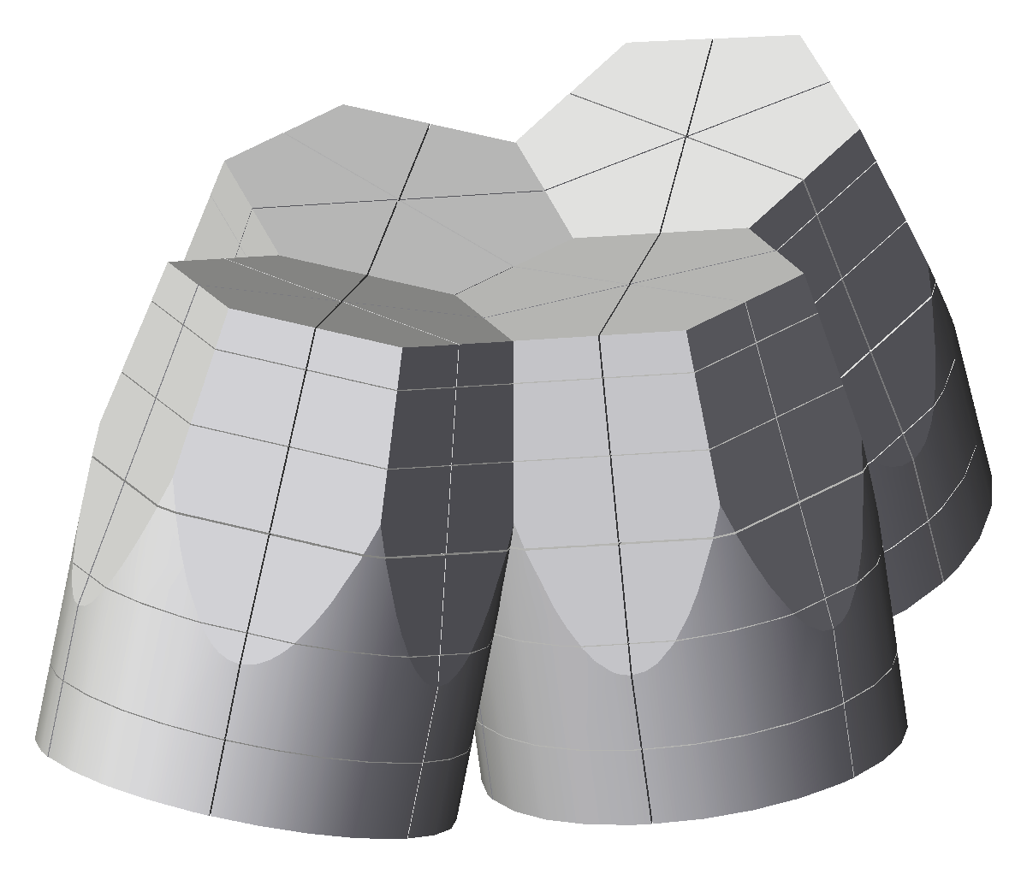
Ge Tracking Detector in Japan
RCNP
One Ge module with
four segmented crystal
Funded
(To be delivered in 2015 Mar)

Slide 60
Collaborators
^{36,38}Mg, ⁴²Si
P. Doornenbal, H. Scheit, S. Takeuchi , N. Aoi , K. Li , M. Matsushita,
D. Steppenbeck, H. Wang, H. Baba, H. Crawford, C.R. Hoffman, R. Hughes,
E. Ideguchi, N. Kobayashi, Y. Kondo, J. Lee, S. Michimasa, T. Motobayashi,
H. Sakurai, M. Takechi, Y. Togano, R. Winkler, and K. Yoneda
RIKEN Nishina Center, Peking University, Rikkyo,
LBNL, ANL, Richmondm CNS, NSCL/MSU
^{122,124,126}Pd, ¹³⁶Sn
H. Wang, N. Aoi, S. Takeuchi, M. Matsushita4, P. Doornenbal, T. Motobayashi,
D. Steppenbeck, K. Yoneda, H. Baba, Z. Dombrádi, K. Kobayashi, Y. Kondo,
J. Lee, H. Liu1, R. Minakata, D. Nishimura, H. Otsu, H. Sakurai, D. Sohler,
Y.L. Sun, Z.-Y. Tian, R. Tanaka, Z. Vajta, Z.-H. Yang, T.Yamamoto, Y.-L. Ye, and R. Yokoyama
Peking, RIKEN Nishina Center, RCNP, Osaka, ,
CNS, Tokyo, Rikkyo, TITech, Tokyo Univeristy of Science

