Slide 1
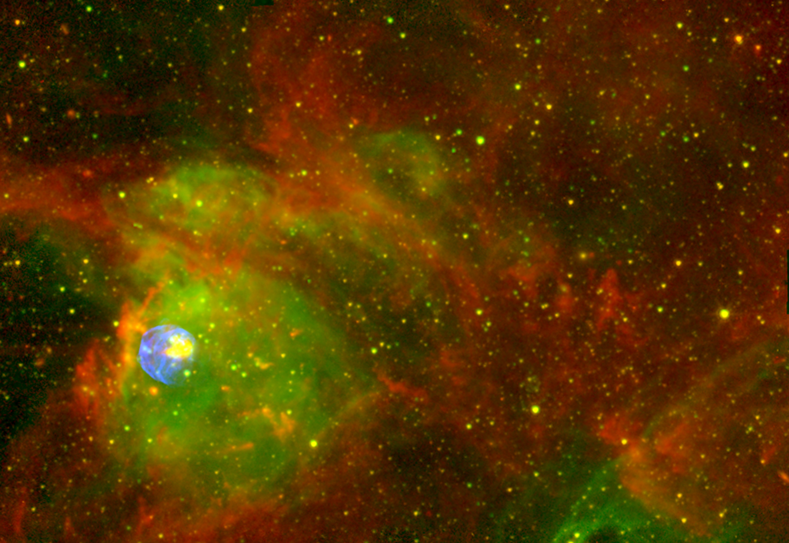


Studies on Nuclear Astrophysics and Exotic Structure at the Low-Energy RI beam Facility CRIB
Nuclear astrophysics group (CRIB supporting
members) in Center for Nuclear Study, Univ. of Tokyo:
Hidetoshi Yamaguchi (Lecturer),
Daid Kahl (Postdoc.)
Yuji Sakaguchi (Student)
with an Aid of Technical Staff:
N. Yamazaki (CRIB/Wien Filter), K. Yoshimura, M.Katayanagi, Y. Ohshiro (Hyper ECR ion source), S. Yamaka
in Collaboration with:
RIKEN, KEK, Kyushu, Tsukuba, Tohoku, Osaka, … (Japan)
McMaster (Canada), CIAE, IMP (China), Chung-Ang, Ehwa, SNU (Korea), INFN Padova/Catania (Italy), IOP(Vietnam) and others.

Slide 2
Outline
Introduction of RI-beam facility “CRIB”.
    Cryogenic gas target for RI beam production.
Topics
  Resonant scattering experiments using thick-target method in inverse kinematics (TTIK).
  Active target (GEM-MSTPC):
  ¹⁶N beta-delayed α decay experiment in Sep. 2013.
  Reaction mechanism study: ⁸B+Pb experiment in May 2014.

Slide 3
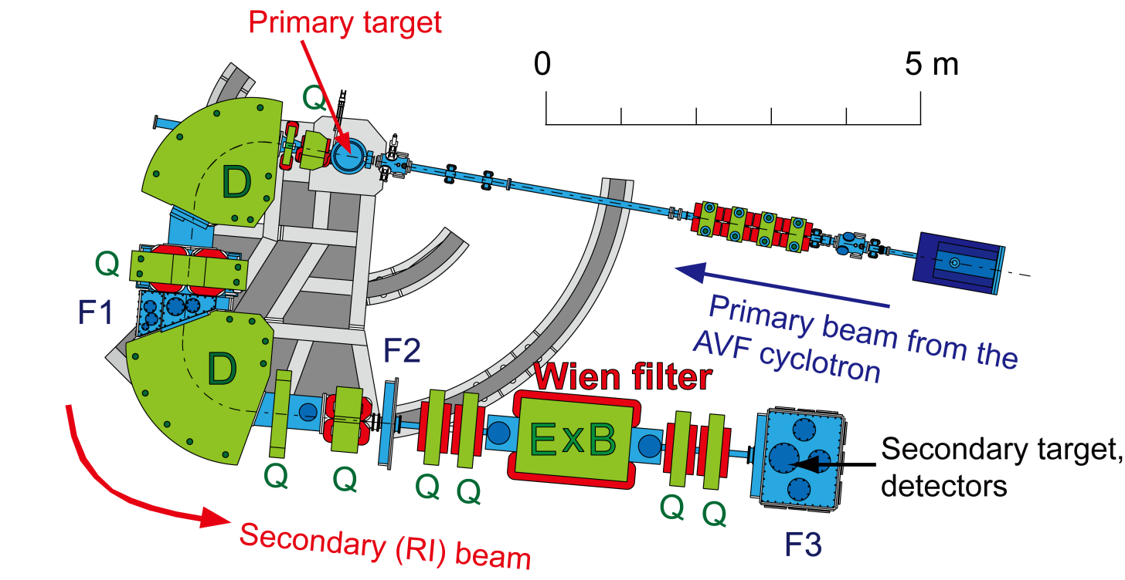
CRIB
CNS Radio-Isotope Beam separator , operated by CNS (Univ. of Tokyo), located at RIBF (RIKEN Nishina Center).
  Low-energy(<10MeV/u) RI beams by in-flight method.
  Primary beam from K=70 AVF cyclotron.
  Momentum (Magnetic rigidity) separation by “double achromatic” system, and velocity separation by a Wien filter.
  Orbit radius: 90 cm, solid angle: 5.6 msr, momentum resolution: 1/850.

Slide 4
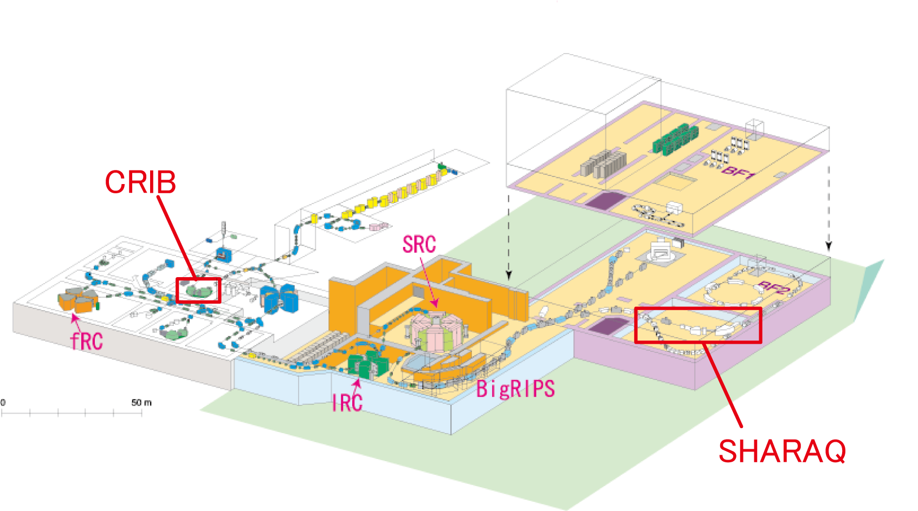
CRIB in RIBF
AVF alone, operation cost ~1/10 of BigRIPS.
Ion source / AVF/ CRIB…have been developed under CNS-RIKEN collaboration (joint venture).
AVF

Slide 5
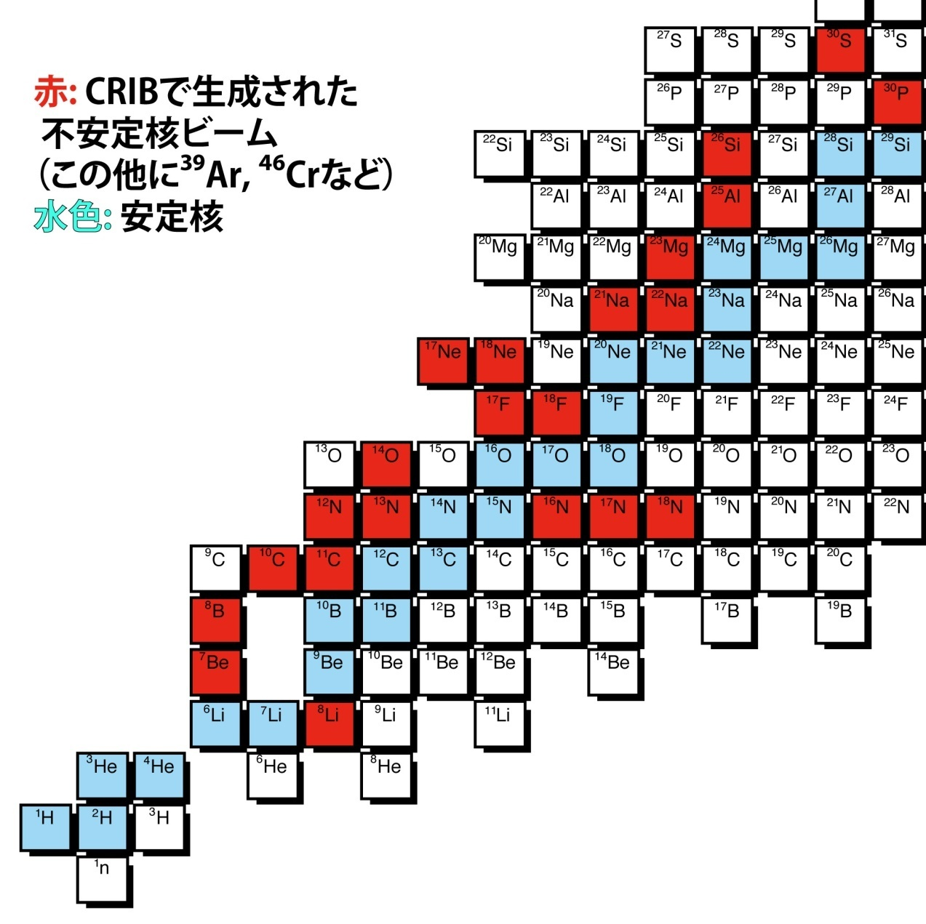
Low-Energy RI beam Productions at CRIB
Direct reactions such as (p,n), (d,p) and (³He,n) in inverse kinematics are mainly used for the production….large cross section
Many RI beams have been produced at CRIB:
typically 10⁴-10⁶ pps
2013 Dec. ¹⁵O
2014 Jan.
¹⁰Be
RI beam at CRIB /
Stable nuclei

Slide 6
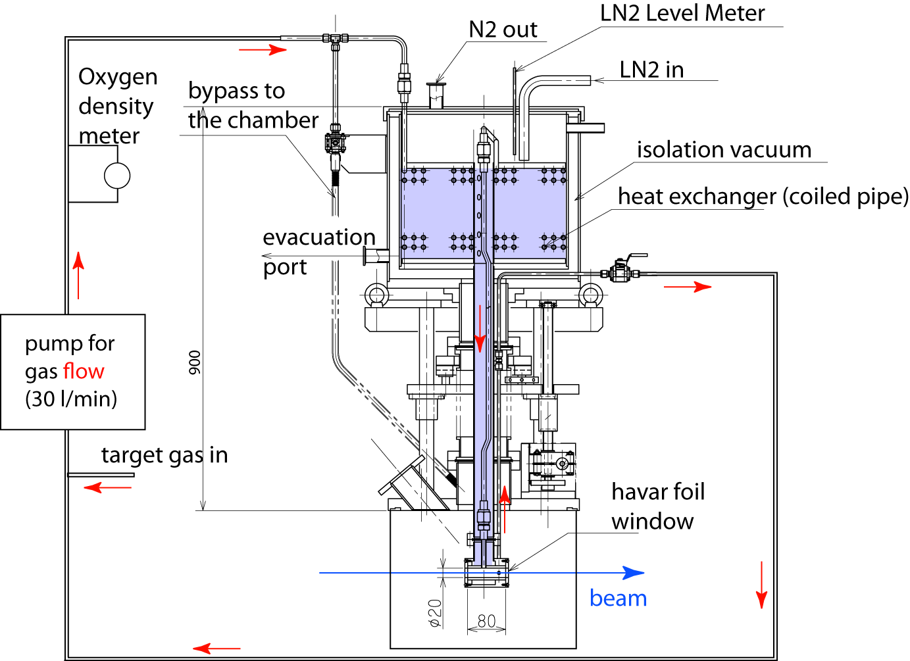
Cryogenic target: design
Features:
Lq. N₂ cooling (automatic refill)
for the better cooling power (~100 W) and thicker target.
Forced target gas flow (>30 l/min) to have a better cooling, and to avoid target thickness reduction by the high-current beam.
Oxygen density monitoring

Slide 7
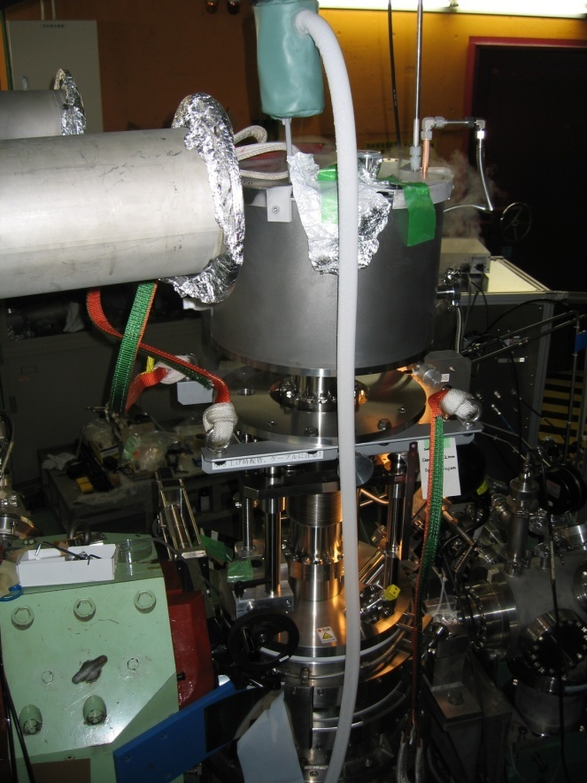
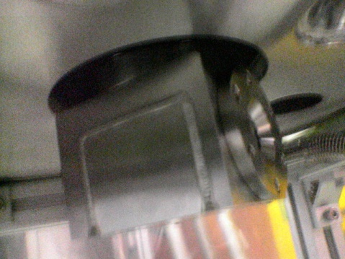
Intense secondary beam production using cryogenic gas target
H₂ gas target of 760 Torr and 80 mm-long worked at 85K stably for a ⁷Li²⁺ beam of 1.3 pμA. (which deposits heat of 7.4W).
Secondary beam: ⁷Be⁴⁺ at 4.0 MeV/u, purity 75% (without degrader/ WF),
  2x10⁸ pps was achieved.
H. Yamaguchi et al., NIMA (2008)
Price of ³He gas became 10 times higher since 2008….a recycling system for ³He gas was built.

Slide 8
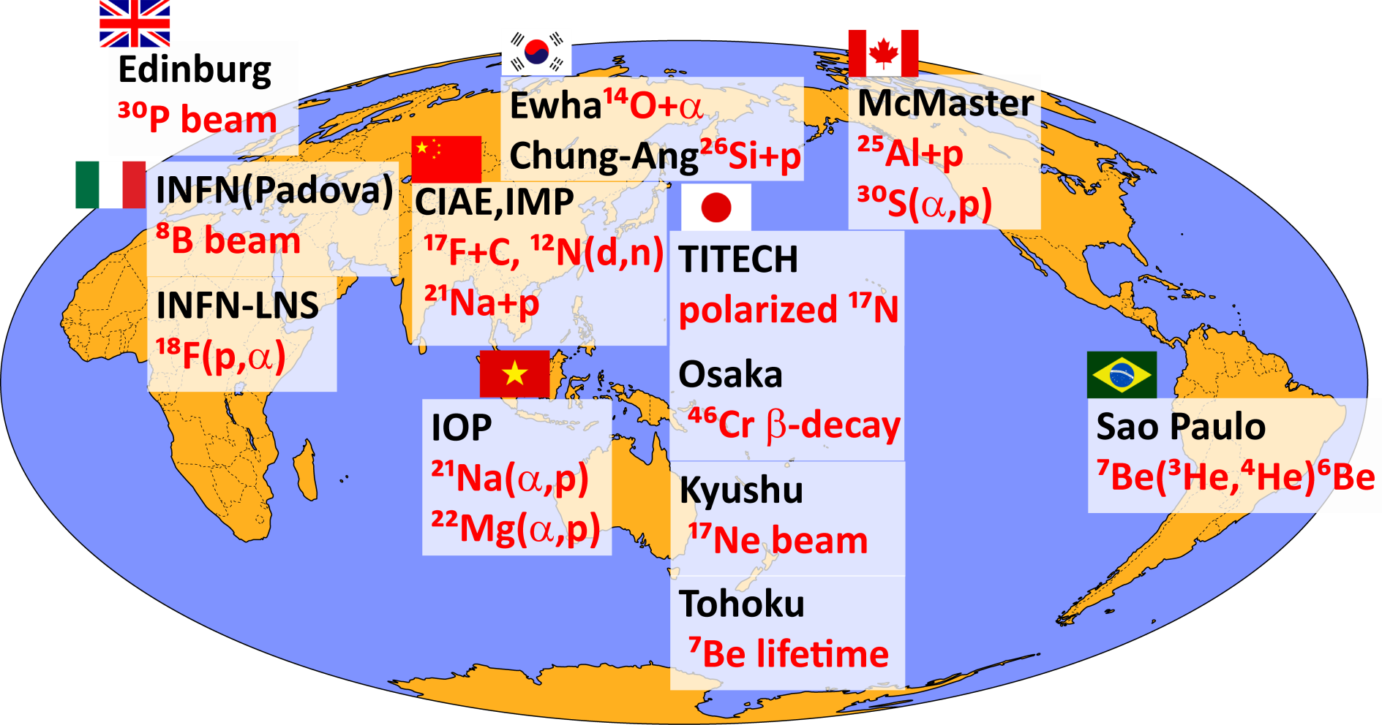
International collaborations at CRIB
CRIB experiments performed in 2007-2011,
by collaborated members of CNS and other institutes:

Slide 9
Recent research projects (2010-present)
Proton/alpha resonant scattering
  ²⁶Si+p (Collaborated with Chung-Ang, Korea) H.S. Jung et al., published at PRC (2012).
  ⁷Li/⁷Be+α (CNS) H. Yamaguchi et al., PRC (2011&2013).
  ²¹Na+p, ²²Na+p [¹⁸Ne(α,p), Ne-Na cycle] (IMP/CIAE, China) PRC(2014) & PRC (2013).
  ¹⁷F+p [Resonances for ¹⁴O(α,p)](IMP/CIAE, China)
(α,p) reaction measurement, Active target (GEM-MSTPC)
  ¹⁸Ne(α,p) (CNS, Hashimoto (now at RCNP))
  ³⁰S(α,p) (CNS, Daid Kahl)
  ²²Mg(α,p) (IOP, Vietnam , Nguyen Ngoc Duy)
  ⁴⁴Ti(α,p) (KEK, Ishiyama) …⁴⁴Ti beam test successful.
(α,γ)
  ¹⁶N⇒¹⁶O*⇒¹²C+α for ¹²C(α,γ) (Catania, Italy, S. Cherubini) Measurement finished in Sep 2013.
Reaction mechanism
  ⁸B+Pb (Padova, Italy, C. Signorini) Measurement finished in May 2014.
β-decay
  ⁷Be lifetime in metal (Tohoku Univ, Otsuki)

Slide 10
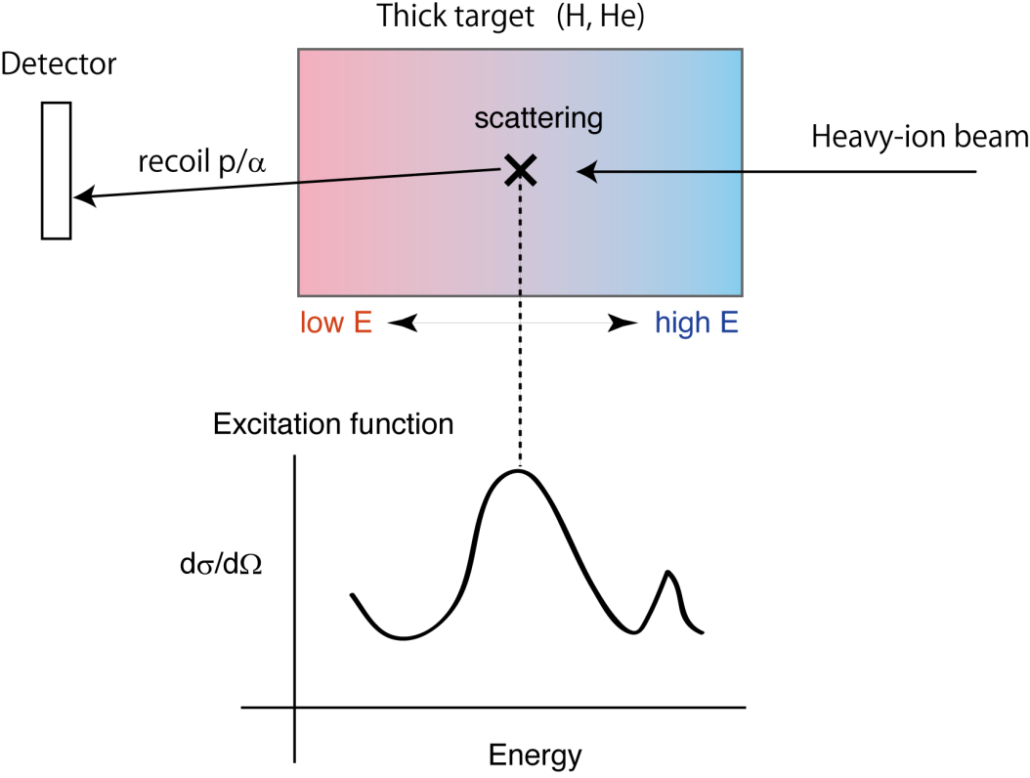
The thick-target method in inverse kinematics
Measurement of
resonance scattering
  Inverse kinematics… measurement is possible for short-lived RI which cannot be used as the target.
  Simultaneous measurement of the excitation function for certain energy range.(Small systematic error, no need to change beam energy.)
  The beam can be stopped in the target…measurement at θ_{cm}=180 deg. (where the potential scattering is minimal) is possible.

Slide 11
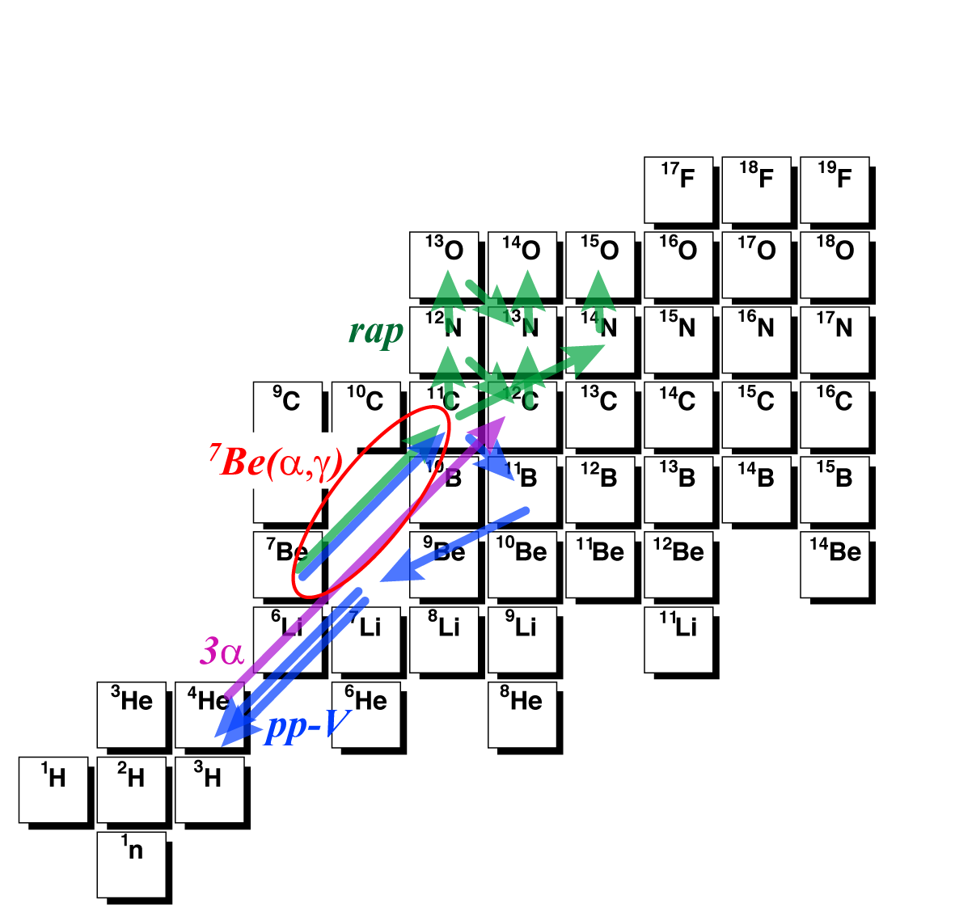
⁷Li+α/ ⁷Be+α study
⁷Li(α,γ)¹¹B …important at high-T, as a production reaction of ¹¹B (the ν-process in core-collapse supernovae).
⁷Be(α,γ)¹¹B … one of the reaction in hot p-p chain, relevant at high-T.
α-cluster structure in ¹¹B/¹¹C :
  2α+t / 2α+³He cluster states are known to exist (similar to the dilute cluster structure in ¹²C.)
  Several “bands” which have α-cluster structure could be formed. We can study the band and cluster structure more in detail.

Slide 12
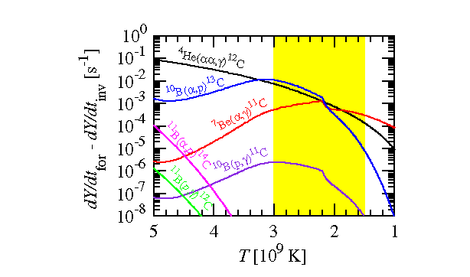
⁷Be(α,γ) in supernovae
νp-process calculation (T₉>1) shows considerable contribution by ¹⁰B(α,p)¹³C and ⁷Be(α,γ)¹¹C as much as the triple-alpha process.
S. Wanajo et al., Astrophys. J (2010)

Slide 13
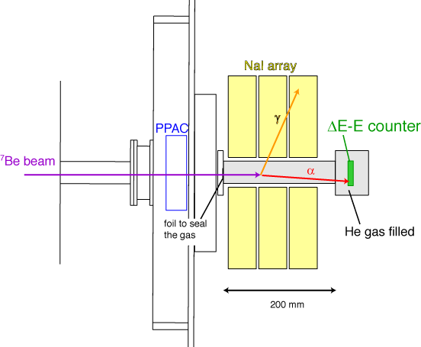
Setup for ⁷Li/⁷Be+α
Thick target method with inverse kinematics …An efficient method to measure excitation function.
  ⁷Be beam is monitored by a PPAC (or an MCP detector).
  ⁷Be beam stops in a thick helium gas target (200 mm-long, 1.6 atm).
  Recoiled α particles are detected by ΔE-E counter (10 μm and 500 μm Si detectors) at forward angle.
  NaI array for γ-ray measurement (to identify inelastic events).

Slide 14
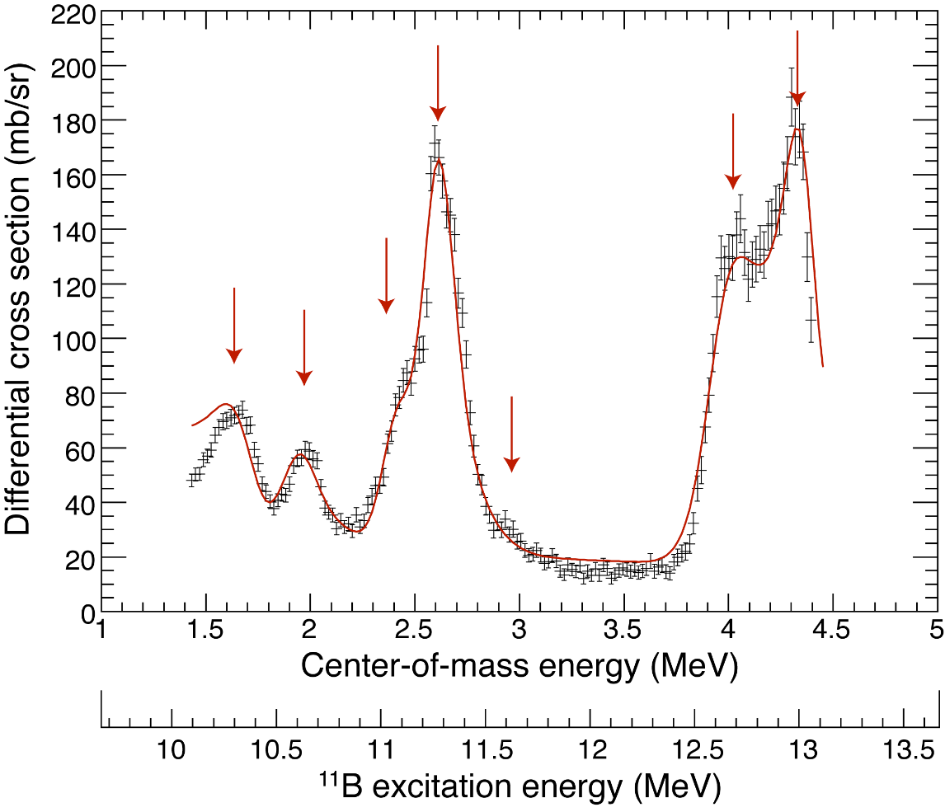
⁷Li+α result
Strong alpha resonances were successfully observed, and we determined the α widths (Γ_{α}). H. Yamaguchi et al., Phys Rev. C (2011).
T=3/2? 1/2?
Is J^{π} really 9/2-?
New!

Slide 15
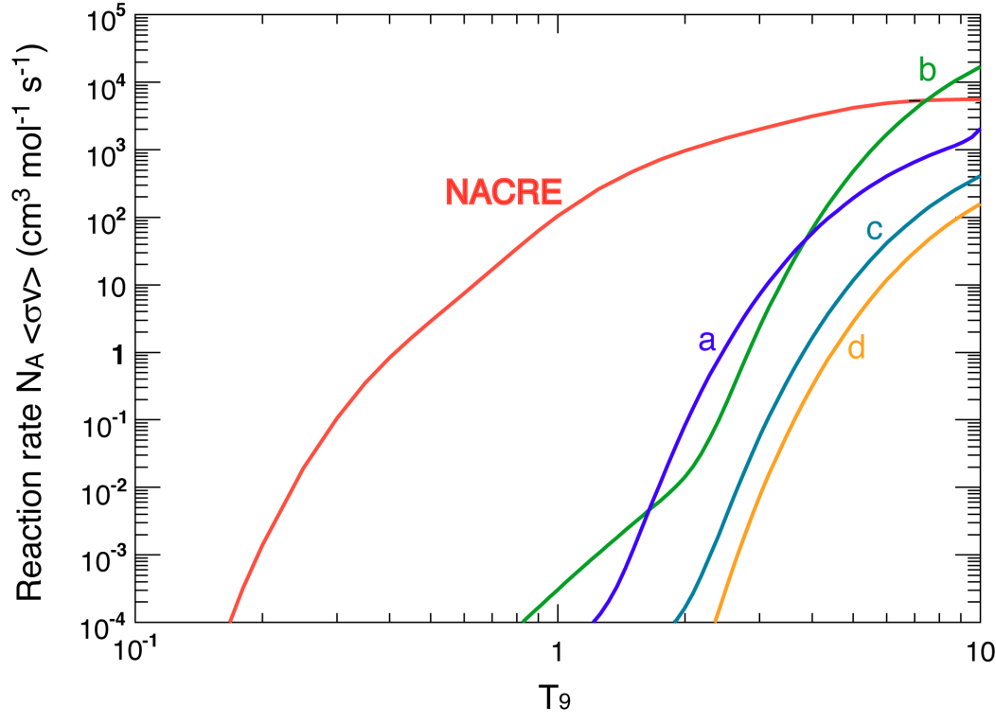
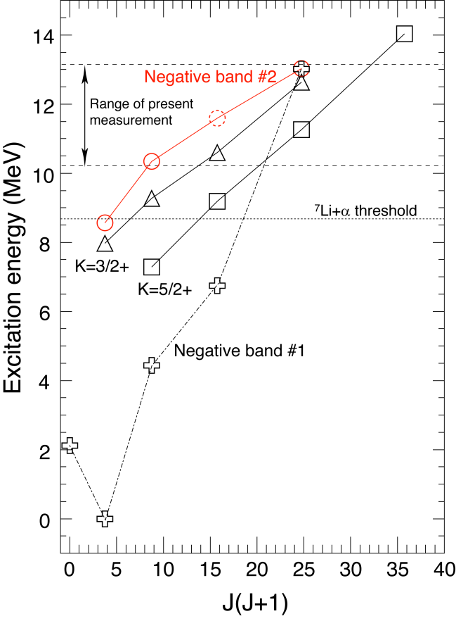
⁷Li+α; results
Resonant reaction rates for the observed resonances are compared with NACRE evaluation (including resonances below 11 MeV).
Conclusion: No need to modify NACRE evaluation (for T₉<5).
Newly proposed a negative parity band.
It may not be a simple rotational band, but corresponds to a 2α-t structure [AMD Calc. by Suhara & En’yo]

Slide 16
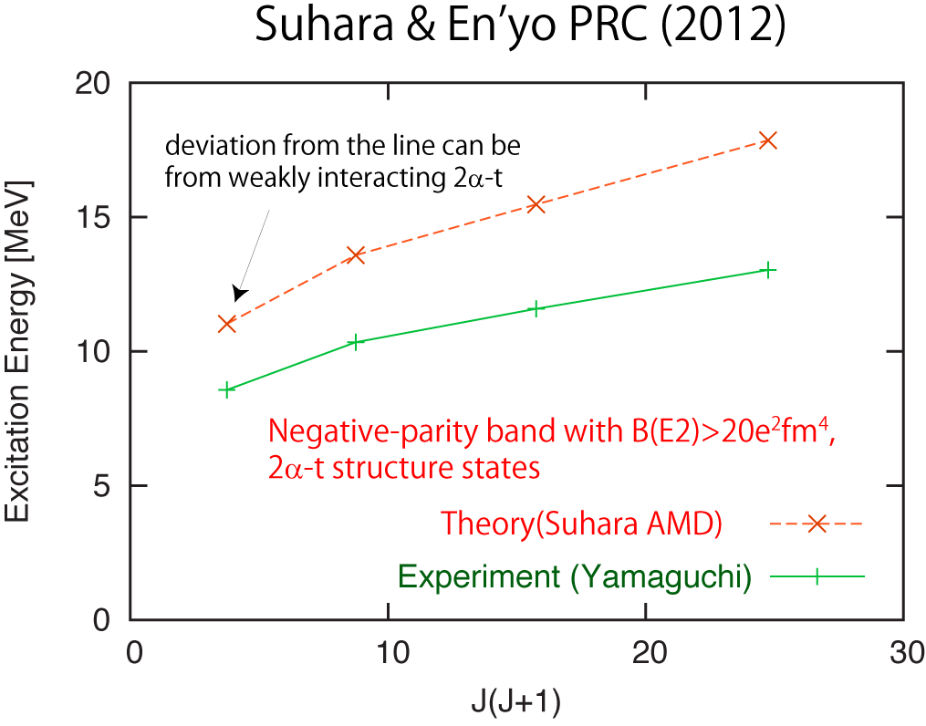
Interpretation of the new negative-parity band

Slide 17
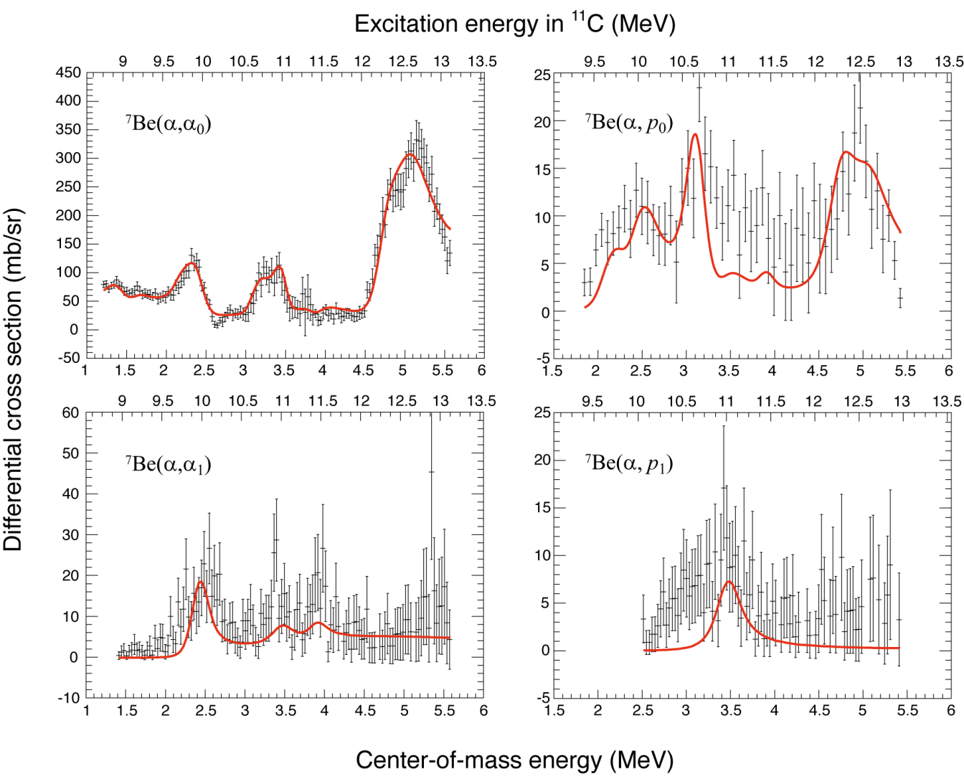
⁷Be+α Excitation functions
4 excitation functions… new information on resonant widths, spin, and parity. H. Yamaguchi et al., PRC (2013).

Slide 18
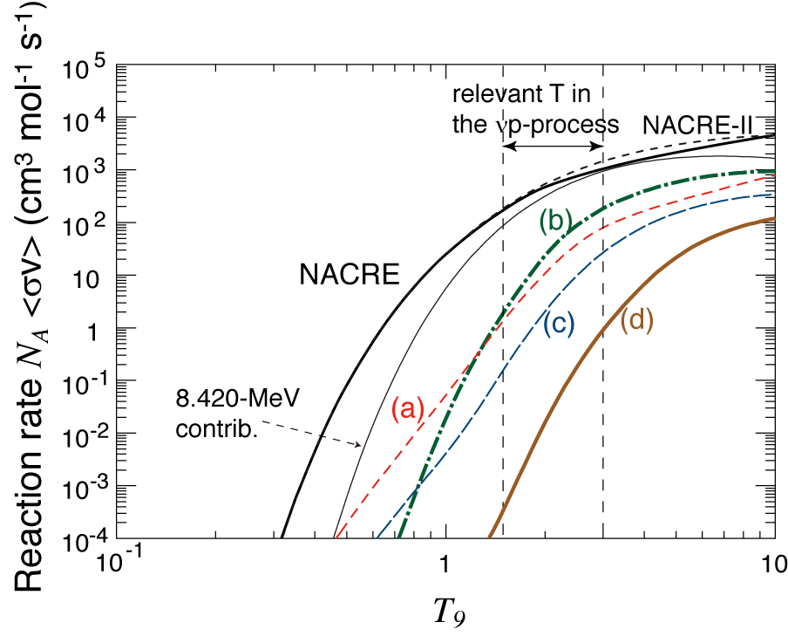
Resonant contribution to ⁷Be(α,γ)
Small but not negligible contribution compared to lower-lying states (~10%).

Slide 19
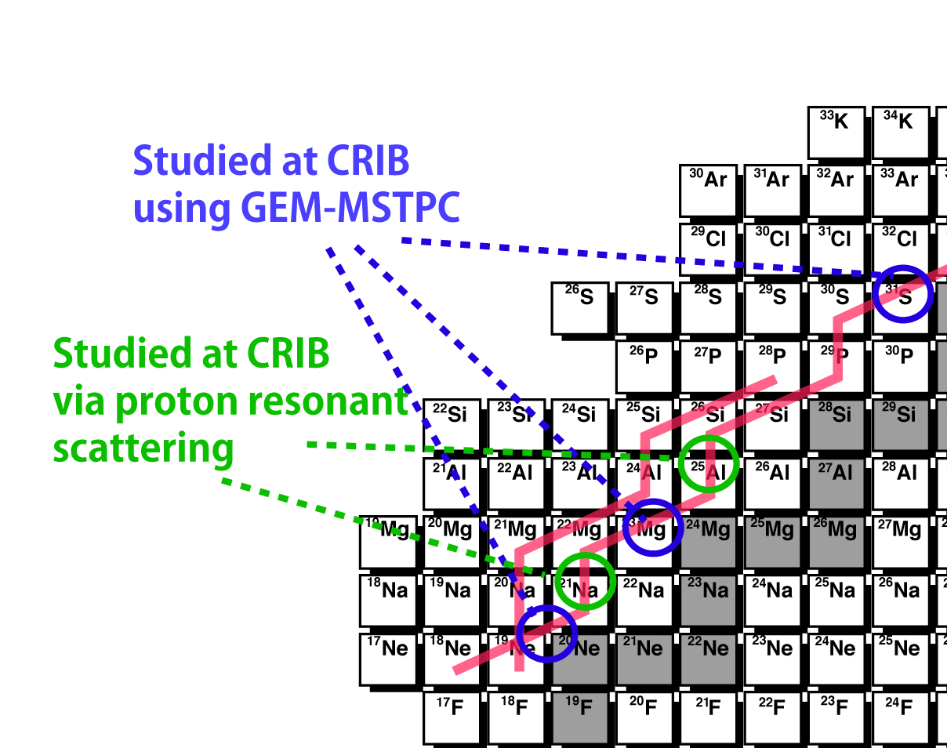
Study on the αp-process
αp-process: (α,p),(p,γ) reactions occur faster than β-decay at high temperature. Accelerates the rp-process (Wallace and Woosley, 1981).
Suitable objective for CRIB
  Not many direct measurements of (α,p) reactions have been performed in other facilities.
  Involves A=18-30, proton rich
  unstable nuclei.
  T=1.5GK, close to the
  beam energy at CRIB.
  [See Daid Kahl’s presentation]

Slide 20
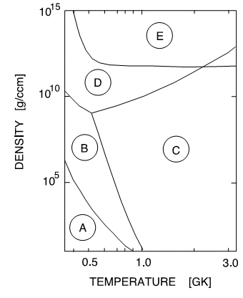
¹⁸Ne(α,p) (T. Hashimoto; RCNP)
²⁰Na
²¹Na
²²Na
²²Na
²³Na
stable
¹⁷Ne
¹⁸Ne
¹⁹Ne
²⁰Ne
²¹Ne
²²Ne
unstable
¹⁷F
¹⁸F
¹⁹F
A: hot-CNO
B: second hot-CNO
C: ¹⁸Ne(α, p)²¹Na
D: ¹⁸Ne(2p, γ)²⁰Mg
E: ¹⁵O(2p, γ)¹⁷F
X-ray bursts
¹⁴O
¹⁵O
¹⁶O
¹⁷O
¹⁸O
¹¹N
¹²N
¹³N
¹⁴N
¹⁵N
⁹C
¹⁰C
¹¹C
¹²C
¹³C
J. Phys. G: Nucl. Part. Phys. 25 (1999)R133
hot-CNO
¹²C(p, γ)¹³N(p, γ)¹⁴O(β)¹⁴N(p, γ)¹⁵O(β)¹⁵N(p, α)¹²C
second hot CNO cycle
¹⁴O(α, p)¹⁷F(p, γ)¹⁸Ne(β)¹⁸F(p, α)¹⁵O(β)¹⁵O(p, α)¹²C
¹⁸Ne(α, p)²¹Na
¹⁸Ne(α, p)²¹Na is an important breakout reaction from hot-CNO cycle
to the rp-process (B to C in the figure)
Relevant energy (temperature):
E_{cm} = 0.5 - 3.8 MeV (T = 0.6 - 3 GK).
Notes:
Explosive hydrogen and helium burning is thought to be the main source of energy generation in novae, X-ray bursts, and also provides an important route for nucleosynthesis of elements up to masses 100 region via the rapid-proton capture process.
This figure shows the estimated temperature and density condition which allow break-out paths to the rp-process from the hot-CNO cycles. Region A characterizes typical condition hot-CNO cycles. Region B indicates the condition of the second hot-CNO cycle. The hot-CNO and the second hot-CNO cycles are linked by the 14O(a, p) reaction. Region C indicates the temperature and density region as which a sufficient reaction flow via 18Ne(a, p)21Na reaction lead to rp-process from the second hot-CNO cycles.
The typical densities in X-ray bursts and nova are estimated in this region.
Therefore, the 18Ne(a, p)21Na reaction is important for break-out to the rp-process from the hot-CNO cycle, which converts the initial CNO elements into heavier elements.
The lowest temperature in Regin C is about 0.6 GK.
In addition, according to some theories, this reaction has important role of the nucleosynthesis in Type II supernovae.
The typical expected temperature region in the type II supernove is 1 to 3 GK.
Therefore, we need the information of reaction cross sections at Ecm =0.5 and 3.8 MeV which corresponds T = 0.6 - 3 GK.

Slide 21
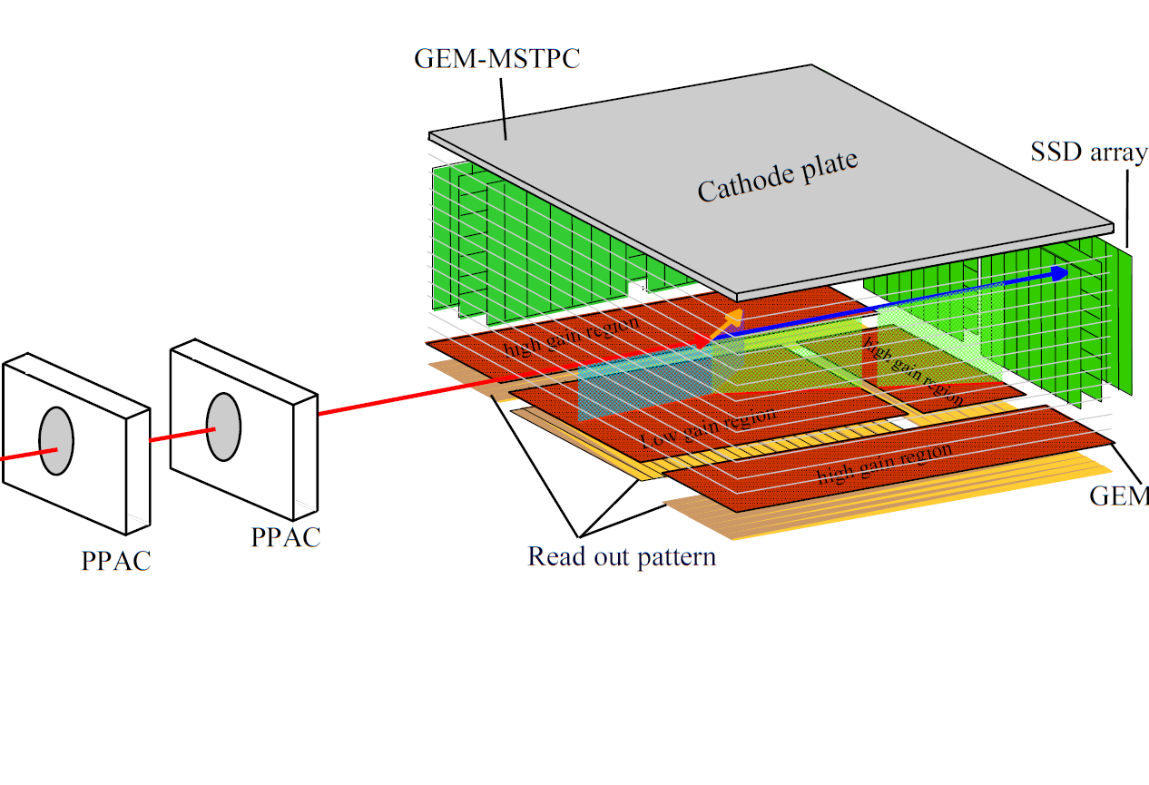
Experimental Setup
y
z
Beam monitor
x
¹⁸Ne beam
He (90%) +CO₂ (10%)
mixture gas(160 torr)
Acts as a He target and a detector (TPC) simultaneously
GEM with “backgammon” type readout pad.
3-dimentional trajectory and energy loss can be measured
⇒ Good event identification.

Slide 22
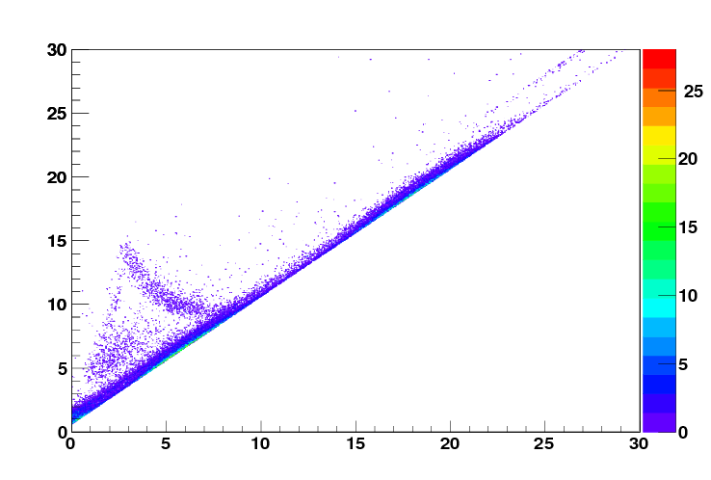
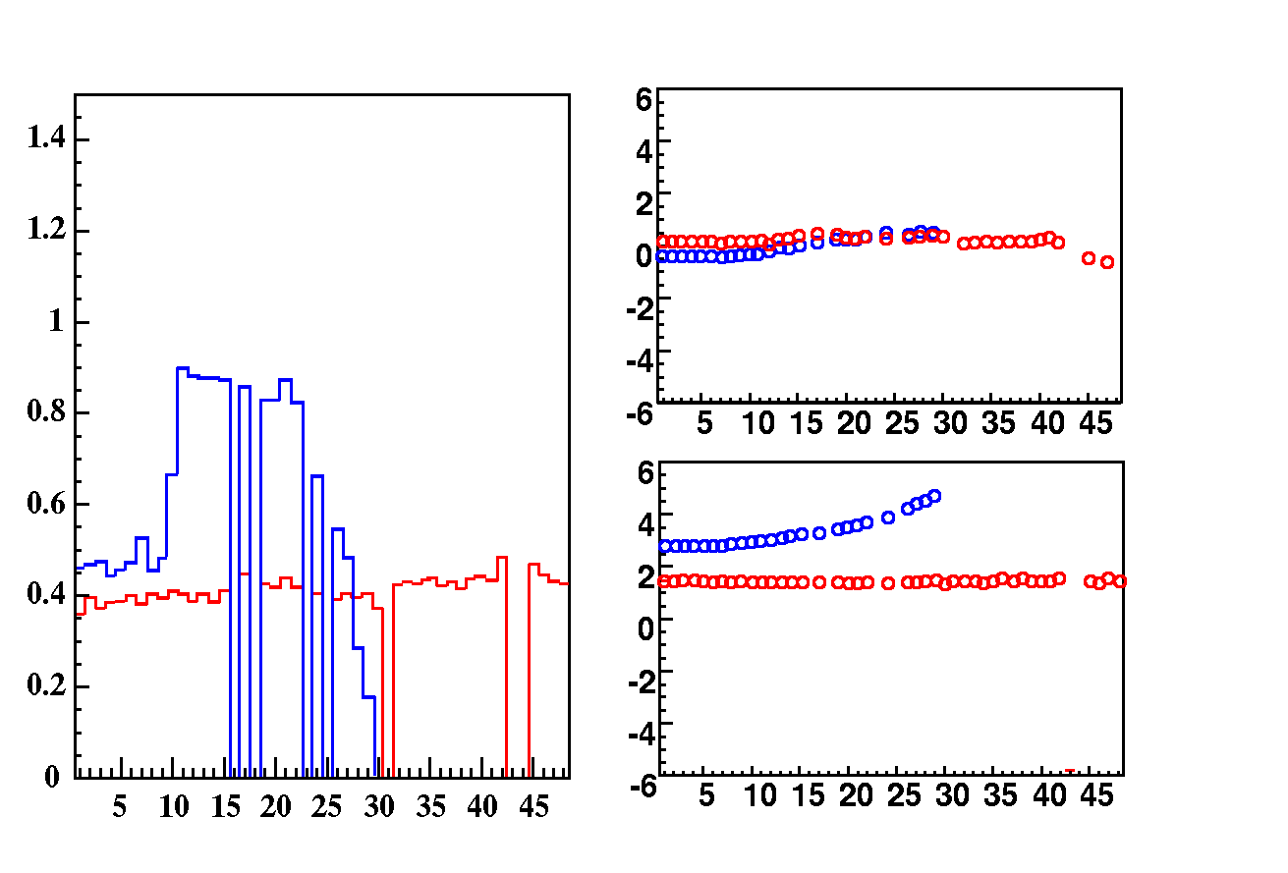
Typical event of ¹⁸Ne(α, p)²¹Na reaction
Si telescopes
Preliminary
Total energy (MeV)
α (Stopped in first layer)
p
Preliminary
¹⁸Ne
X position (cm)
dE/Pad (MeV)
²¹Na
¹⁸Ne
²¹Na
¹⁸Ne
Pad No.
¹⁸Ne
²¹Na
Energy loss in first layer (MeV)
Y position (cm)
¹⁸Ne
¹⁸Ne
Pad No.
Pad No.
Reaction events are observed !
Analysis is in progress …

Slide 23
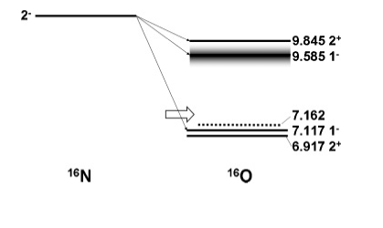
¹⁶N beta-delayed alpha decay
¹⁶N→¹⁶O*→¹²C+α decay…carrying information of ¹²C(α,γ) reaction cross section (E1 component) at low energy.
Tang et al. (Argonne)…measurement with 2 ionization chambers. (Low-energy events cannot be detected.)
Using the active target for decay measurement…sensitivity at low-energy events.
Experiment at CRIB proposed by INFN-LNS group (S. Cherubini et al.)

Slide 24
Performed measurement
Measurement at CRIB performed in Sep. 2013.
RI Beam…¹⁶N
  Beam pulsing (on-off) operation by 150-ms interval.
  1-4 x 10⁵ pps after the pulsing, purity 40-80%.
  30-MeV beam injected into the TPC, stopped in the middle of it.
Total 16 days of beamtime, about 2 weeks of data accumulation.
Branching ratio of α-decay…~10⁻⁵
⇒ a few decay events /sec.
Pulse shape was recorded by Flash ADC, and the number of injected beam particles was counted by PPAC detectors.

Slide 25
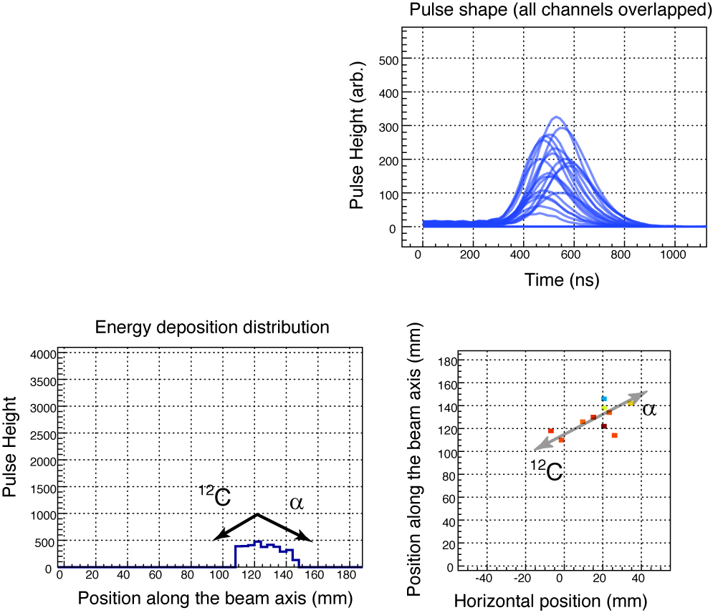
Typical event (preliminary)
Signals observed in several neighboring channels…candidate of α-decay event.
Event selection by energy and tracking information.

Slide 26
²¹Na/²²Na+p experiment
Proton resonant scattering on
²¹Na: J.J. He, et al., Phys. Rev. C 88, 012801(R) (2013), L.Y Zhang et al., Phys Rev. C 89, 015804 (2014).
Astrophysical reaction ¹⁸Ne(α,p)²¹Na, important breakout reaction in x-ray bursts.
²²Na: S. J. Jin, et al, Phys. Rev. C 88, 035801 (2013).
Related to ²²Na(p,γ) astrophysical reation and Ne-E problem.

Slide 27
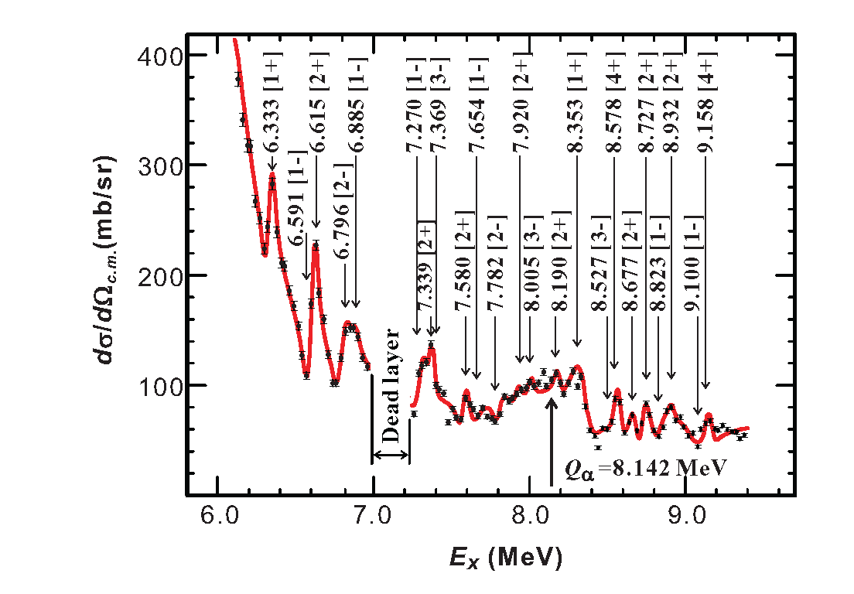
²¹Na+p
2x 10⁵ pps ²¹Na beam was produced with ²⁰Ne primary beam at 8.2 MeV/u and D₂ gas (2.9 mg/cm²) target.
²¹Na Beam was stopped in CH₂/C targets and scattered protons were measured with double-sided SSD at forward angles.
Resonances above 8.14MeV…contributes to ¹⁸Ne(α,p)²¹Na
8.385 MeV…new assignment of J^{π}=1⁺ (was 2⁺).

Slide 28
⁸B+Pb; reaction mechanism
Project in collaboration with INFN-LNL (Padova) group (C. Signorini, M. Mazzocco et al.)
Elastic Scattering measurement. Reaction cross section as large as for reactions induced by the 2n-halo ⁶He.
E.F. Aguilera et al., PRC 79, 021601 (2009)
More recently the fusion cross section for the system ⁸B + ⁵⁸Ni has been measured. E.F. Aguilera et al., PRL 107, 092701 (2011)
The sum of the fusion and breakup cross sections exhausts the reaction cross section. V. Guimaraes et al., PRL 84, 1862 (2000)
←RI+Heavy target(Pb/Bi) “reduced” reaction cross section
Measurement at CRIB performed in May, 2014.
⁸B Beam at CRIB: 50 MeV, 2 x 10⁴ pps on target

Slide 29
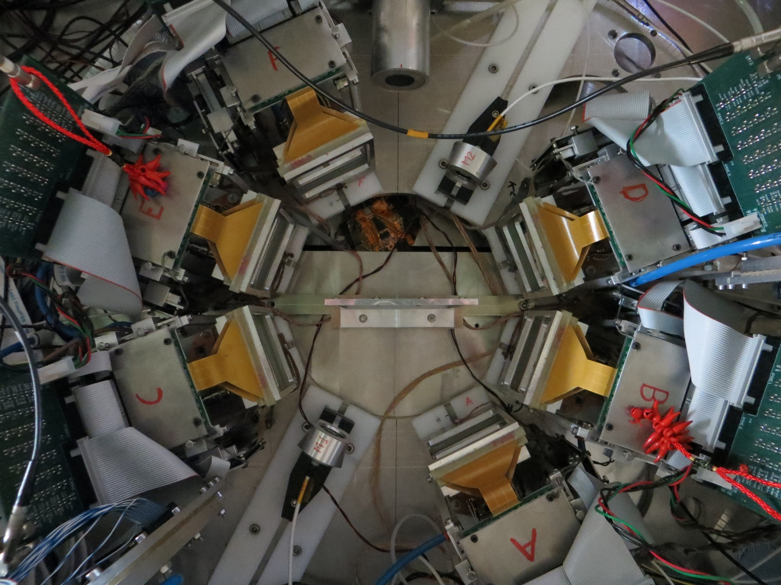
Detector Arrangement
BEAM
TARGET

Slide 30
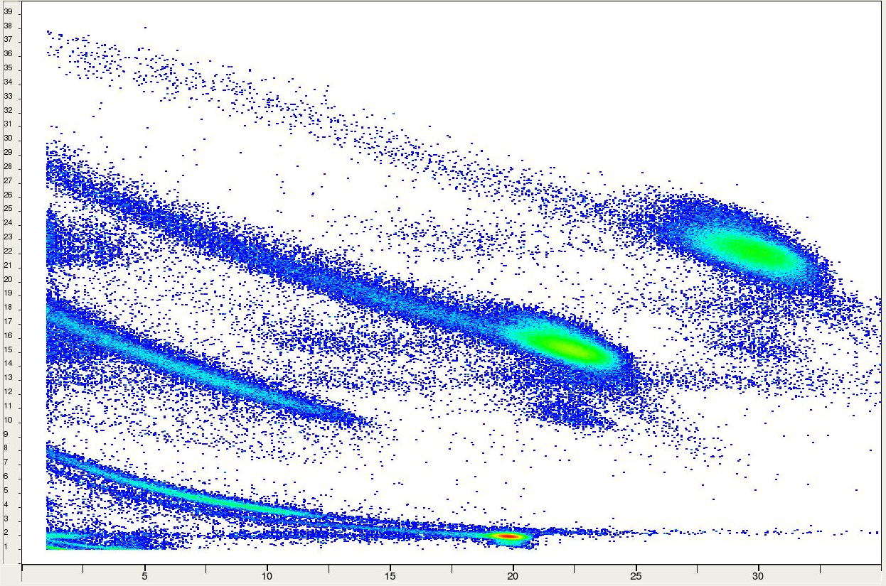
∆E-E_{res}: Tel. A (θ_{cm} = 9° - 47°)
⁸B
⁶Li
⁷Be
⁴He
H
³He

Slide 31

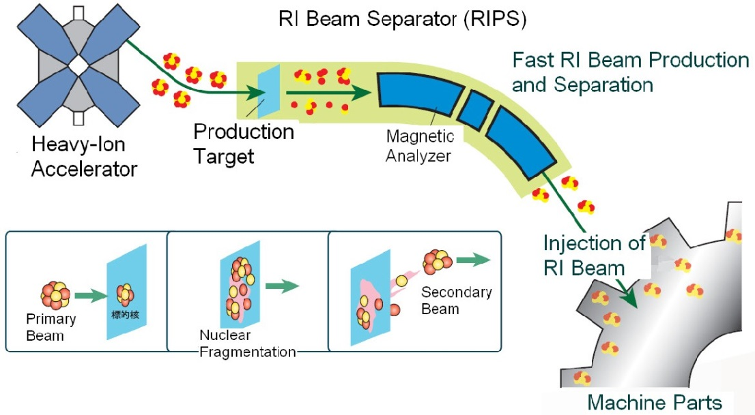
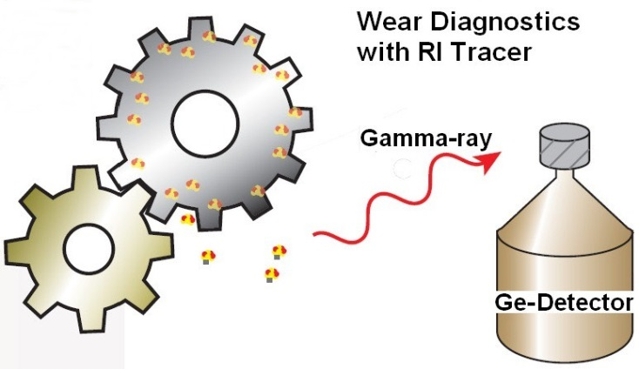
Nishina Center, Industrial Cooperation Team http://ribf.riken.jp/sisetu-kyoyo/
Development of a material-wear test with tracer inplanted as an RI beam
－ Industrial use of ⁷Be beam at E7-CRIB －
To measure surface wear of industrial material
Samples: (part of) engine, bearing, ceramic parts, lubricating oil
Purpose: real-time measurement of wear at the surface (100 μm thickness)
Requirements: long-lived RI (~months) [for off-line measurement]
implant only on the surface with a high density (>100kBq) [for sensitive test ～μm/hour]
Previous method: direct activation
p, d, 3He 10～20MeV, to activate the surface.
→ Problem: Must contain nuclides which become long-lived RI.
High heat and radiation damage
RI beam implantation
merit: Independent of composition of samples
low-heat, low-radiation damage
Implantation depth can be adjusted
Achieved: E6-RIPS, ²²Na(2.6y) 1.5x10⁸ cps
Two trial beamtimes
Tests in 2012-2013: E7-CRIB, ⁷Be(53 days) 2x10⁸ cps possible
²²Na 3 x 10⁶ pps.
Measure reduction of radiation at the sample,
or increasement of radiation at the oil

Slide 32
Summary
CRIB is a low-energy RI beam facility in RIBF operated by CNS, University of Tokyo, providing RI beams of good intensity and purity.
Manpower…Minimum to carry out experiments. We are making experiments in a worldwide collaboration with external groups.
Standard experiments: Proton/alpha resonant scattering, direct (α,p) reaction measurement using an active target (GEM-MSTPC)
GEM-MSTPC
  Has been used in several (α,p) measurements, and recently also for alpha decay measurement of ¹⁶N.
Resonant elastic scattering
  ⁷Li+α,⁷Be+α…strong resonances were observed. The “thick target method with inverse kinematics” could be applied to many nuclides. We can study astrophysical reactions and alpha-cluster structures.
  ²¹Na/²²Na+p…proton resonant scattering to study astrophysical reactions
Reaction mechanism study
⁸B+Pb elastic scattering has been measured for studying the reaction mechanism.
We welcome new users and new ideas!

