Slide 1
Recent advances in shell evolution with shell-model calculations
Yutaka Utsuno
Advanced Science Research Center, Japan Atomic Energy Agency
Center for Nuclear Study, University of Tokyo
In collaboration with
T. Otsuka (Tokyo), N. Shimizu (CNS), Y. Tsunoda (Tokyo),
M. Honma (Aizu), T. Mizusaki (Senshu), T. Togashi (CNS), T. Yoshida (CNS)

Slide 2
Introduction
Shell evolution
Important not only in single-particle energy levels but also in collectivity
How to deduce?
Follow the change of “single-particle energies” along a long isotope chain.
Purity of single-particle (SP) states
Controversial levels in Sb (Z=51) isotopes
SP (Schiffer et al., 2004) or coupling to collective (Sorlin and Porquet, 2008)
Absolute values of C²S: ambiguous
h_{11/2}
Many-body calculations with a
suitable shell-evolution mechanism
are needed.
g_{7/2}
J. P. Schiffer et al., Phys. Rev. Lett. 92, 162501 (2004).

Slide 3
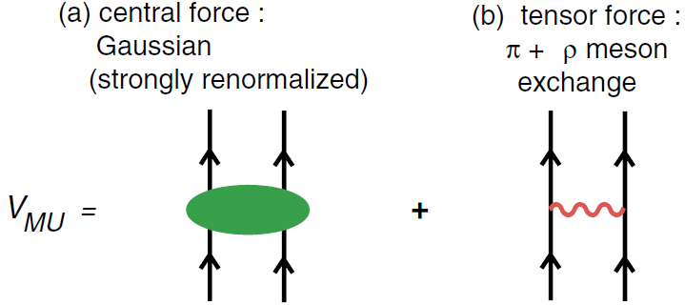
Two major sources of evolution in p-n channel
For a review of shell-evolution mechanism,
see T. Otsuka, Phys. Scr. T152, 014007 (2013).
Central and tensor forces
node = n
j’>=l’ +1/2
node ≠ n
j<=l-1/2
central
node = n
tensor
j>=l+1/2
known for several decades
known for a decade: Otsuka mechanism (2005)
Monopole-based universal interaction V_{MU} (Otsuka et al., 2010)
Quantitative implementation of this concept on a microscopic basis of “Renormalization Persistency” (N. Tsunoda et al., 2011)

Slide 4
Topics to be discussed
Shell evolution driven by the p-n force on the basis of large-scale shell-model calculations
Evolution of single-particle-like states
Sb (Z=51) isotopes
Cu (Z=29) isotopes
Shape coexistence in Ni isotopes: Type II shell evolution
Evolution of the new N=34 magic number

Slide 5
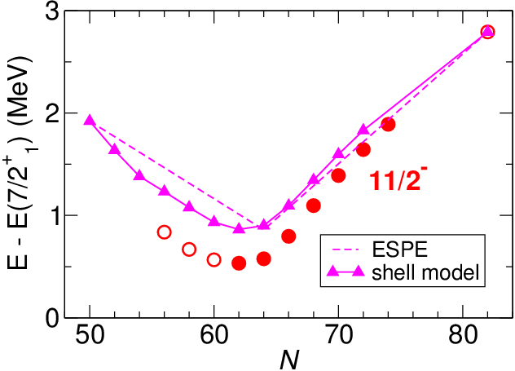
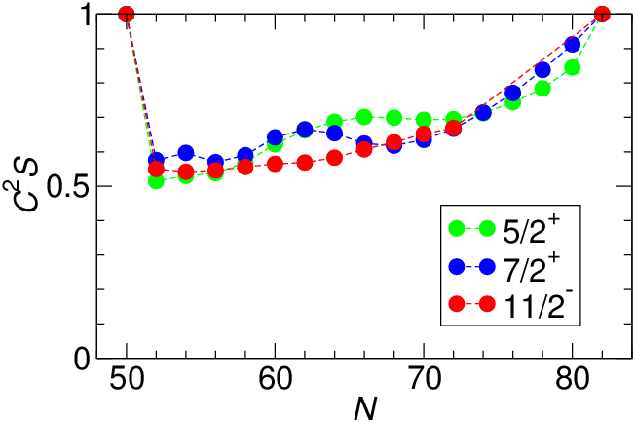
1.1. Sb (Z=51) isotopes
Shell-model calculation in the 50 ≤ N(Z) ≤ 82 space
n-n interaction: semi-empirical SNBG3 by Honma et al. (good fit including 3⁻)
p-n interaction: V_{MU} with a scaling factor 0.84 for the central (binding energy)
11/2⁻₁ levels measured from 7/2⁺₁
Single-particle strengths
Considerable contribution from correlation exists in w.f., but the energy
levels are close to ESPE due to cancellation of p-n and n-n correlations.

Slide 6
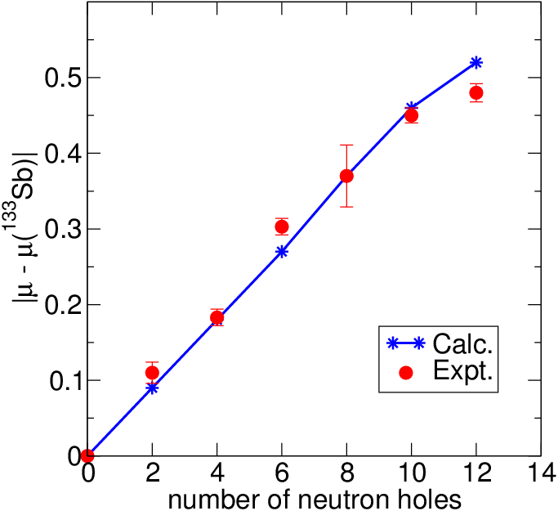
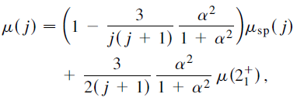
Magnetic moments: indicators of SP structure
Particle-vibration coupling
7/2⁺₁
N=70
N=82
11/2⁻₁ | Expt. | Calc.
¹¹⁵Sb | 5.53(8) | 5.53
¹¹⁷Sb | 5.35(9) | 5.63
effective nucleon g factor adopted:
isovector shift δg_{l}(IV)=0.1, spin quenching factor 0.6
μ(¹³³Sb)=2.97 (calc.) vs. 3.00(1) (expt.)
c.f. single-particle value = 7.18

Slide 7
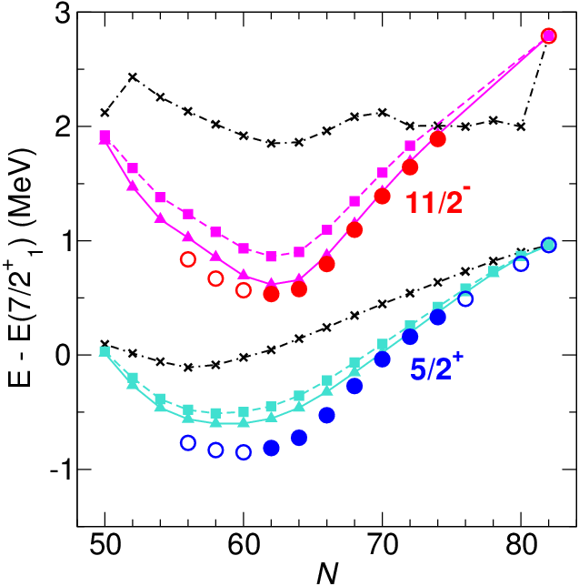
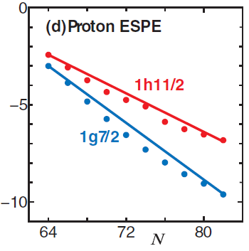
Importance of the tensor force
11/2⁻₁ and 5/2⁺₁ levels measured from 7/2⁺₁
tensor
w/o tensor
π+ρ tensor
h_{11/2}
Without tensor
11/2⁻ ≈ 2 MeV
3NF effect
Enhances effective T=0 tensor force (Kohno, 2013).
π+ρ plus
“3NF” tensor

Slide 8
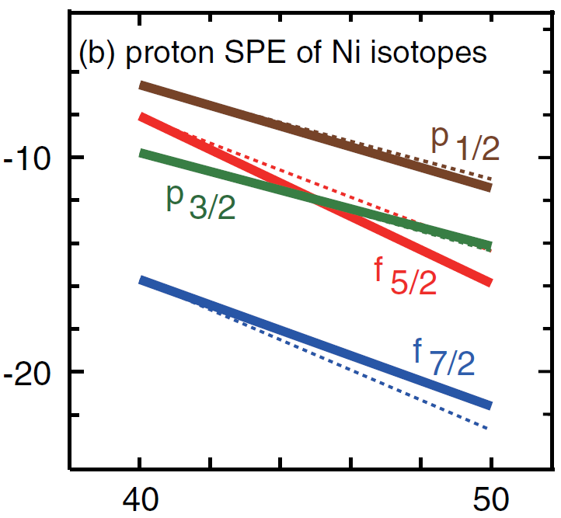
1.2. Cu (Z=29) isotopes
Cu isotopes: one major-shell below Sb isotopes
 | Sb |  | Cu
proton | 1d_{5/2} | → | 1p_{3/2}
 | 0g_{7/2} | → | 0f_{5/2}
 | 0h_{11/2} | → | 0g_{9/2}
neutron | 0h_{11/2} | → | 0g_{9/2}
0g_{9/2}
Δl=1
0f_{5/2}
N=40
1p_{3/2}
Z=28
V_{MU}
Sharp decrease of proton 0f_{5/2} due to a cooperative effect of central and tensor
p_{3/2}-f_{5/2} level crossing
g_{9/2}
T. Otsuka et al., Phys. Rev. Lett. 104, 012501 (2010).

Slide 9
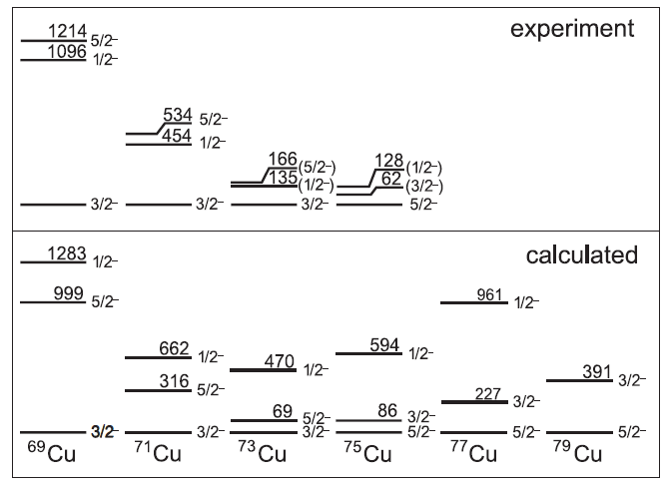
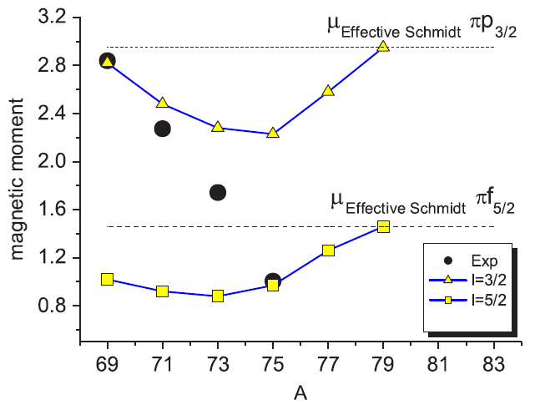
Experiment and early shell-model analyses
Energy levels
Magnetic moments
Shell model
K. T. Flanagan et al., Phys. Rev. Lett. 103, 142501 (2009).
Change of the ground state at ⁷⁵Cu
Magnetic moments: deviation from single-particle values
SM in the 28 ≤ N(Z) ≤ 50 space with the Lisetskiy-Brown interaction
Still some deviation in magnetic moments

Slide 10
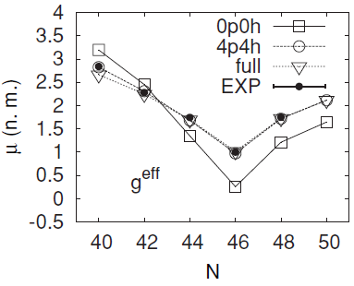
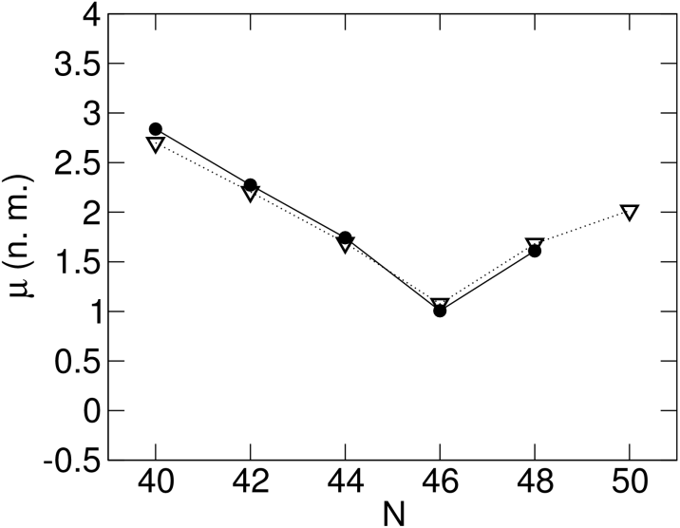
Large-scale shell model and remaining issue
Proton excitation from 0f_{7/2}: non-negligible contribution
20 ≤ Z ≤ 40, 28 ≤ N ≤ 50 shell calculation (Sieja and Nowacki, 2010)
MCSM calculation in the full 20 ≤ N(Z) ≤ 56 space (Y. Tsunoda et al., 2014)
Quantifying the f_{5/2} lowering: still ambiguous
~5 MeV from Sieja, 4.5 MeV from JUN45
3.0 MeV from Tsunoda, 3.4 MeV from V_{MU}
⁷⁹Cu levels: important information as well as 2⁺ in ⁷⁸Ni
Sieja
Tsunoda
⁶⁹Cu
⁷⁹Cu
1p_{3/2}
0f_{5/2}

Slide 11
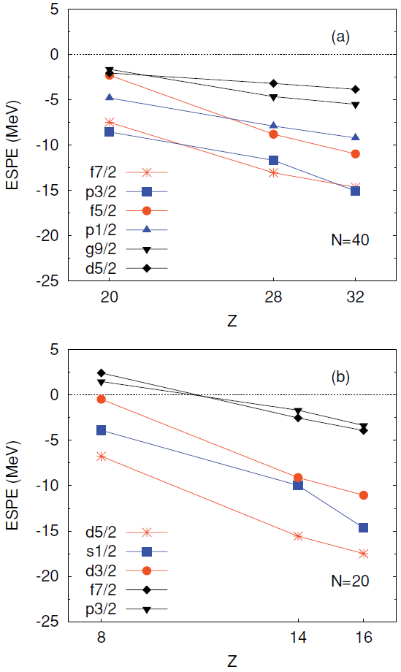
2. Ni isotopes: Type II shell evolution
Neutron-rich Cr-Ni region
Successful SM calc. (Lenzi et al., 2010)
Similarity to the “island of inversion”
Tensor-force effect
40
Island of
inversion
 | N=40 |  | N=20
neutron | 0f_{5/2} | → | 0d_{3/2}
 | 0g_{9/2} | → | 0f_{7/2}
 | 1d_{5/2} | → | 1p_{3/2}
proton | 0f_{7/2} | → | 0d_{5/2}
Δl=1
gap
20
We will demonstrate that the tensor-driven shell evolution plays a crucial role also in Ni isotopes (Y. Tsunoda, PS2-A037).
Island of
inversion
S. M. Lenzi et al., Phys. Rev. C 82, 054301 (2010)

Slide 12
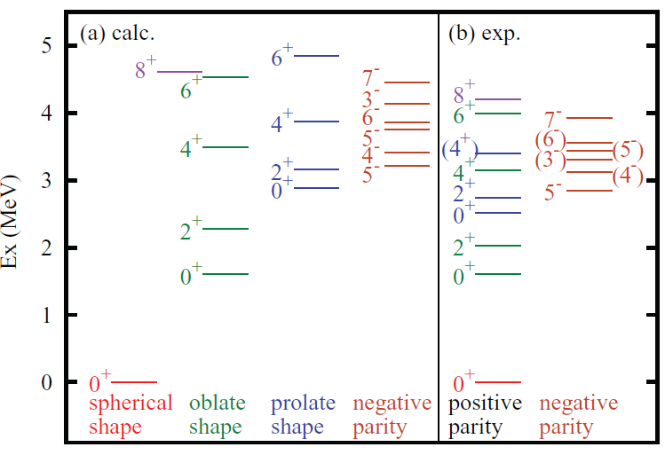
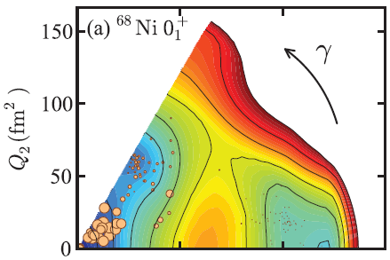
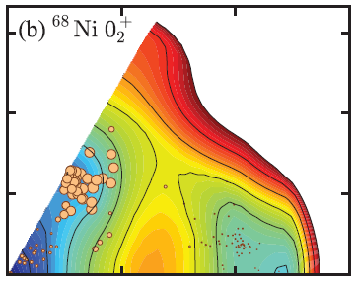
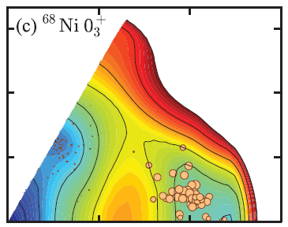
MCSM calculations for ⁶⁸Ni
Y. Tsunoda et al., Phys. Rev. C 89, 031301(R) (2014).
Triple shape coexistence
Analysis of MCSM w.f. (talk of Shimizu on Thursday)
Similar to ¹⁸⁶Pb (Andreyev et al., 2000)
Deformed 0⁺₂: Supported by E0 measurement (Suchyta et al., 2014 and PS2-A039)

Slide 13
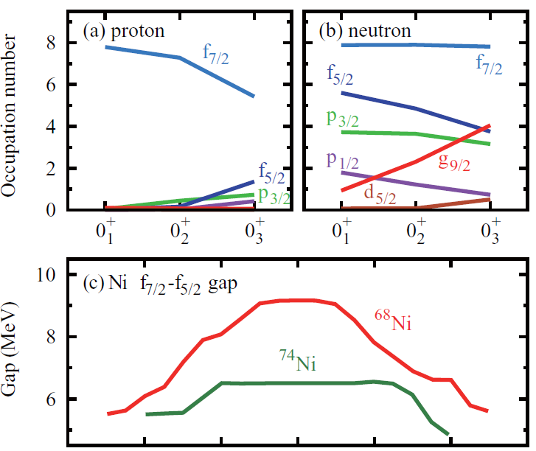
Type II shell evolution: within a nucleus
configuration of prolate 0⁺₃
0g_{9/2}
1p_{1/2}
0f_{5/2}
0f_{5/2}
0f_{7/2}
excitation
from j< to j>
deformation
Contrary to the conventional potential picture, the spherical mean field can be different inside a nucleus. In ⁶⁸Ni, neutron-excited configurations give a reduced spin-orbit splitting, enhancing the Jahn-Teller effect and thus more stabilizing deformation.

Slide 14
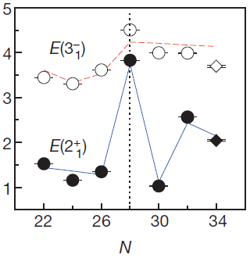
3. Evolution of the N=34 magic number
N=34 magic number (at Ca)
Predicted by Otsuka et al. in 2001, but no experimental signs were found before
Direct measurement of 2⁺₁ for ⁵⁴Ca at RIBF
Establishing magicity (Steppenbeck et al., 2013 and talk on Friday)
Very localized magic number
Sharp lowering of f_{5/2} due to central and tensor
D. Steppenbeck et al., Nature 502, 207 (2013).

Slide 15
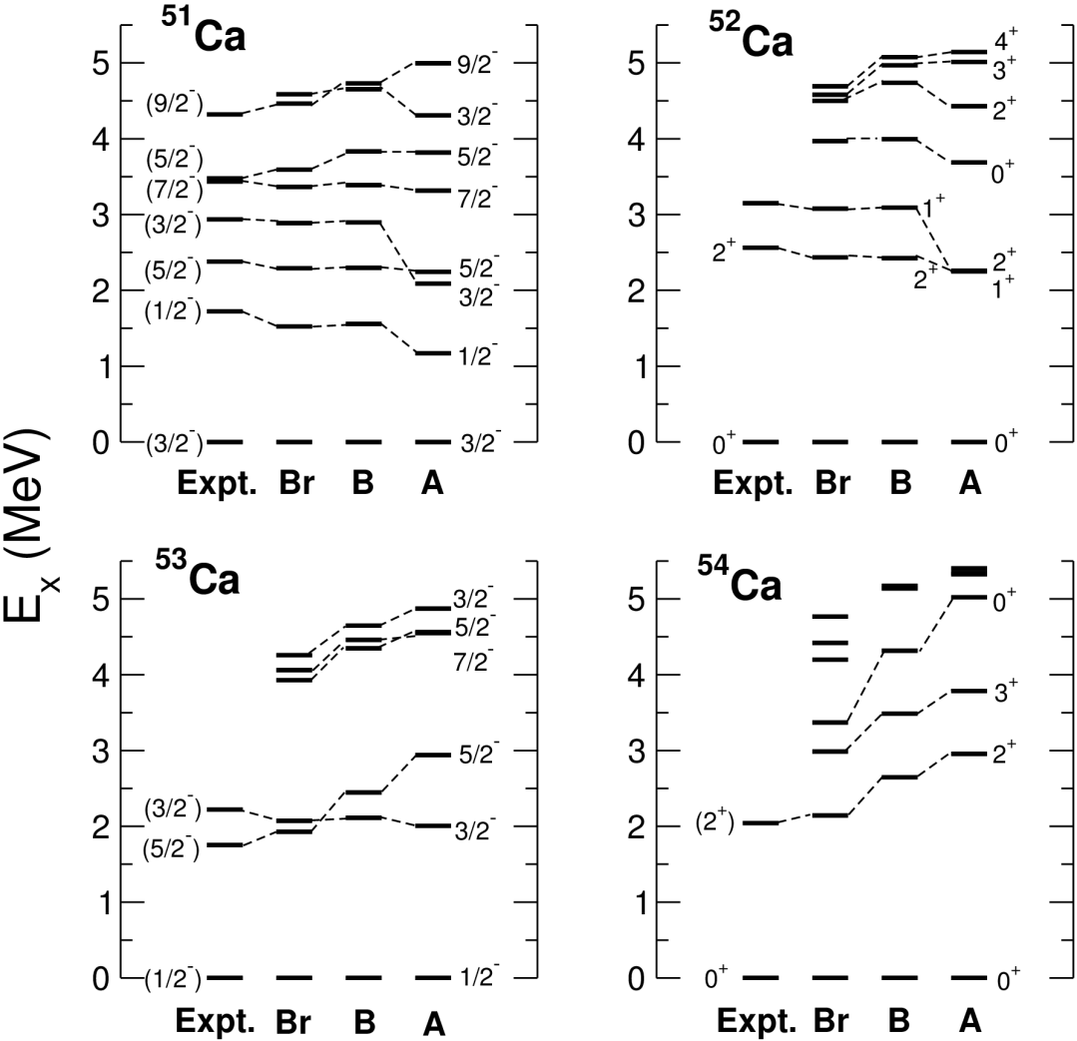
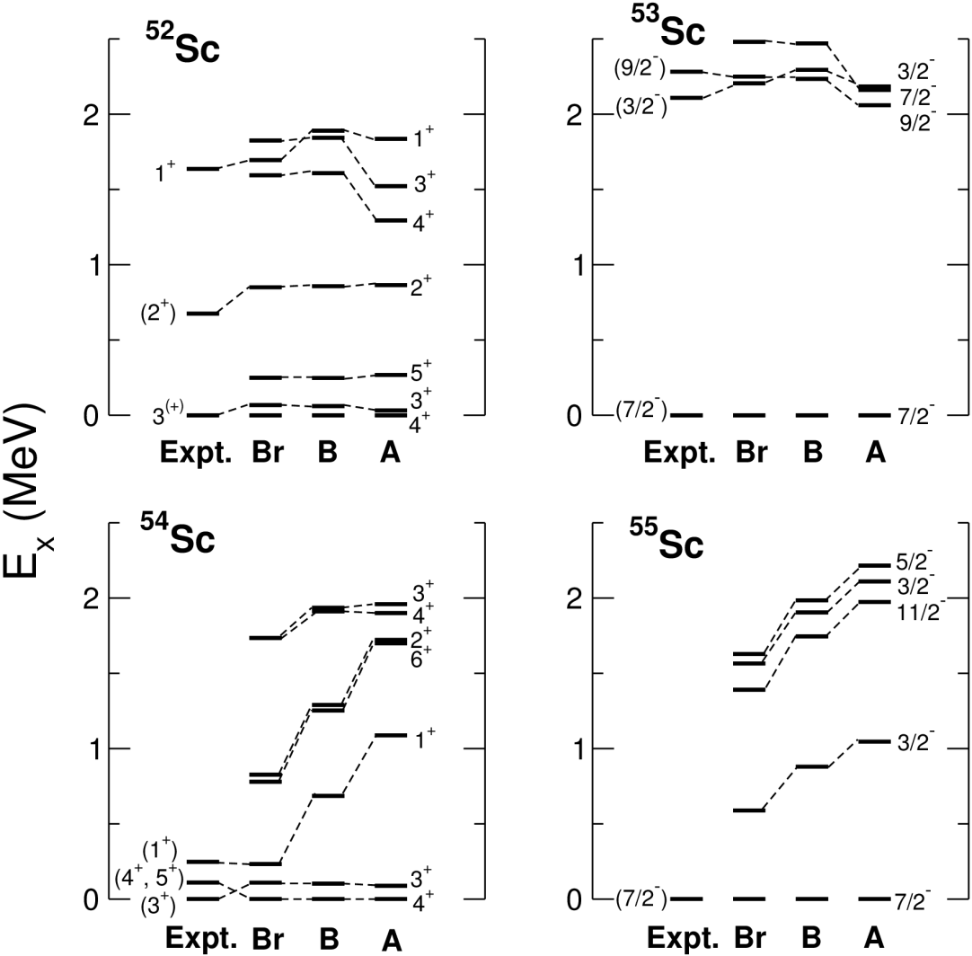
How large is the N=34 gap at Ca?
GXPF1B (Honma, 2008: 3.21 MeV gap) vs. GXPF1Br (2.66 MeV gap)
Systematic improvement with GXPF1Br (⁵¹Ca: suggested by Rejmund et al.) ~2.5 MeV gap is established.

Slide 16
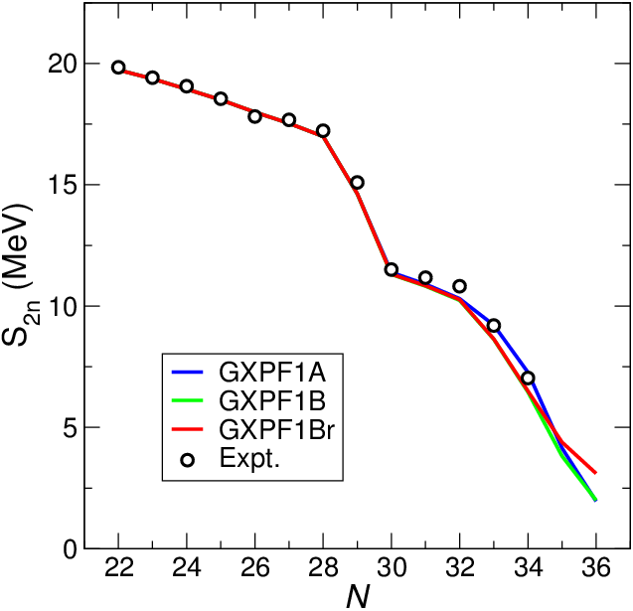
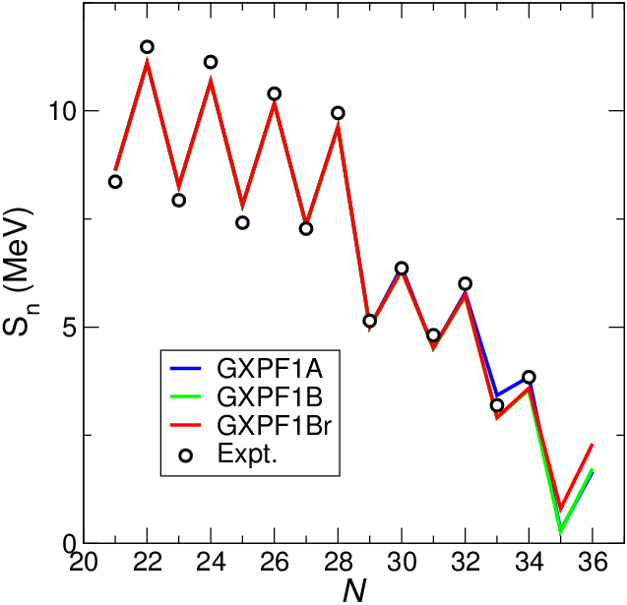
Separation energies of Ca isotopes
Prediction with GXPF1Br
Drop of separation energies beyond N=34 is predicted due to the N=34 gap, but it is not as pronounced as that of GXPF1A or GXPF1B.

Slide 17
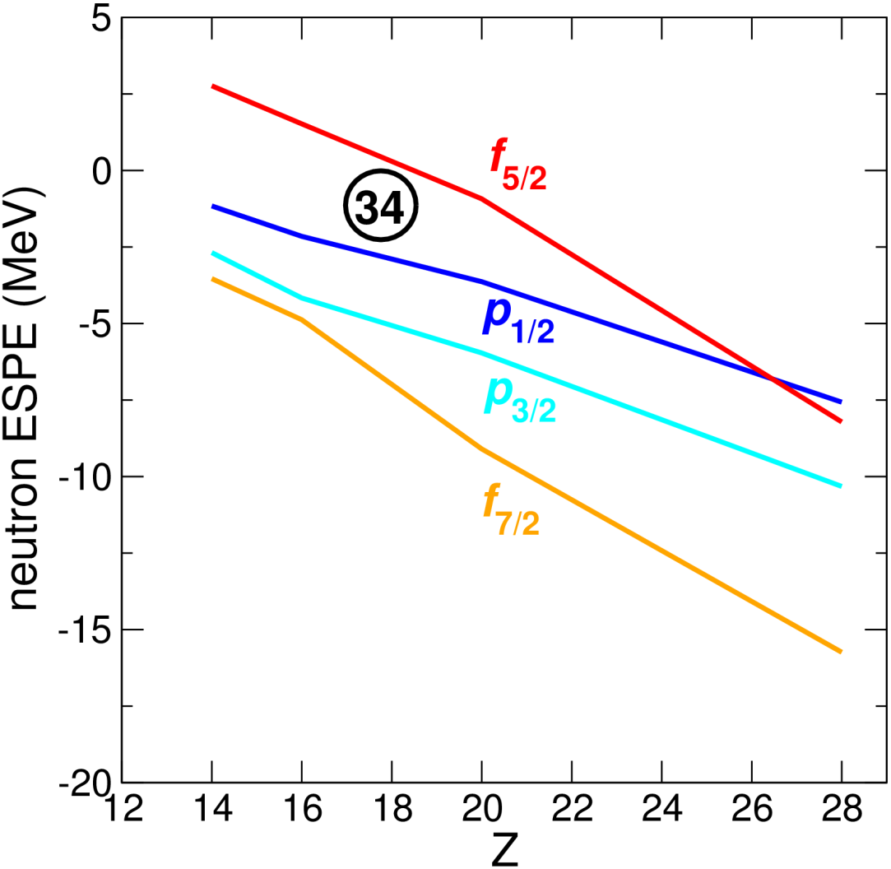
N=34 gap: Persist or diminish in lower Z?
0f_{5/2}
34
1p_{1/2}
0d_{3/2}
V_{MU} (with spin-orbit force)
 | Central | SO | Tensor
d3-f5 | -1.184 | +0.041 | +0.278
d3-p1 | -0.706 | +0.045 | +0.091
diff. | -0.478 | -0.004 | +0.187
Some enhancement of the N=34 gap for lower Z

Slide 18
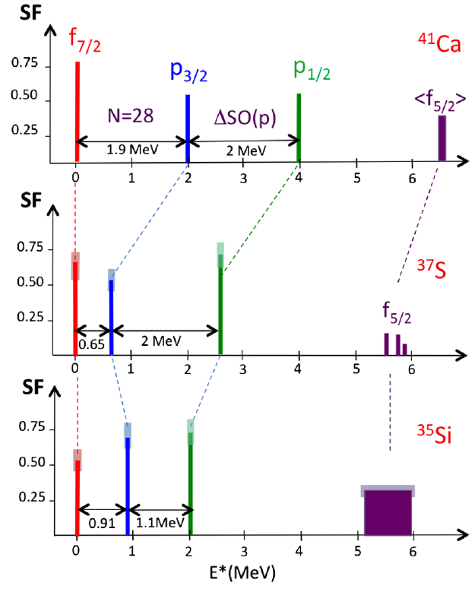
Possible widening of the N=34 gap for lower Z
Spectroscopic factors available
Along the N=20 core, but not the N=34 core
However, according to shell evolution due to the monopole interaction, the change of the shell gap is irrelevant to the neutron core assumed.
N=34 core
Shell gap
N=20 core
Si
Ca
G. Burgunder et al., Phys. Rev. Lett. 112, 042502 (2014).

Slide 19
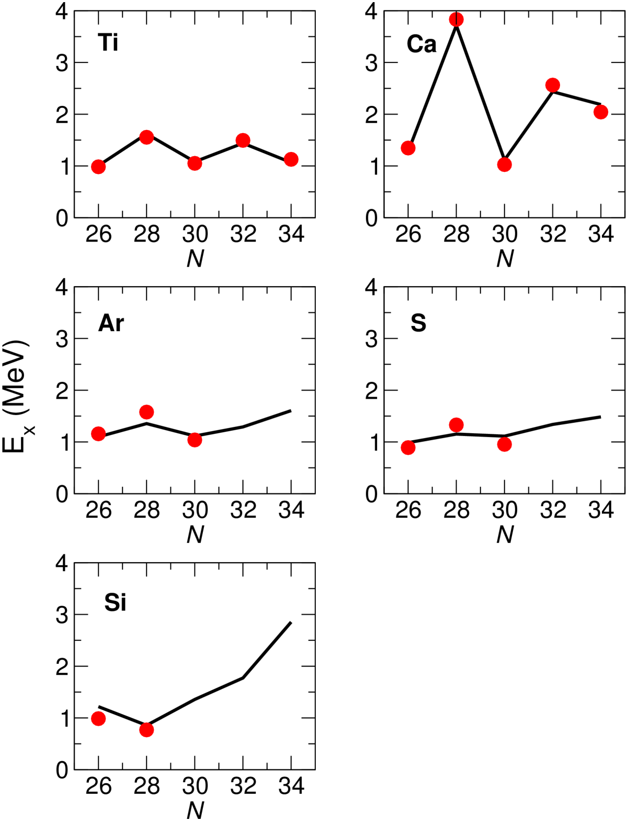
2⁺ levels: comparison between π(pf) and π(sd)
π(pf)
π(sd)
doubly magic

Slide 20
Summary
To evaluate shell evolution quantitatively, large-scale shell-model calculations are very powerful.
We have presented some examples of shell evolution driven by p-n central and tensor forces in wide mass regions.
Sb isotopes: Dominance of the tensor force in the lowering of the 11/2⁻₁ levels even though they are not pure single-particle states.
Cu isotopes: Level crossing of p_{3/2} and f_{5/2} due to central and tensor forces. Need for large-scale calc. Quantitative SPE change to be determined.
Triple shape coexistence in ⁶⁸Ni: Stabilization of prolate shape due to Type II shell evolution which causes different effects within a single nucleus.
N=34 gap toward π(sd) nuclei: Predicted widening of the N=34 gap for π(sd) nuclei due to competition between central and tensor.

Slide 21
backup

Slide 22
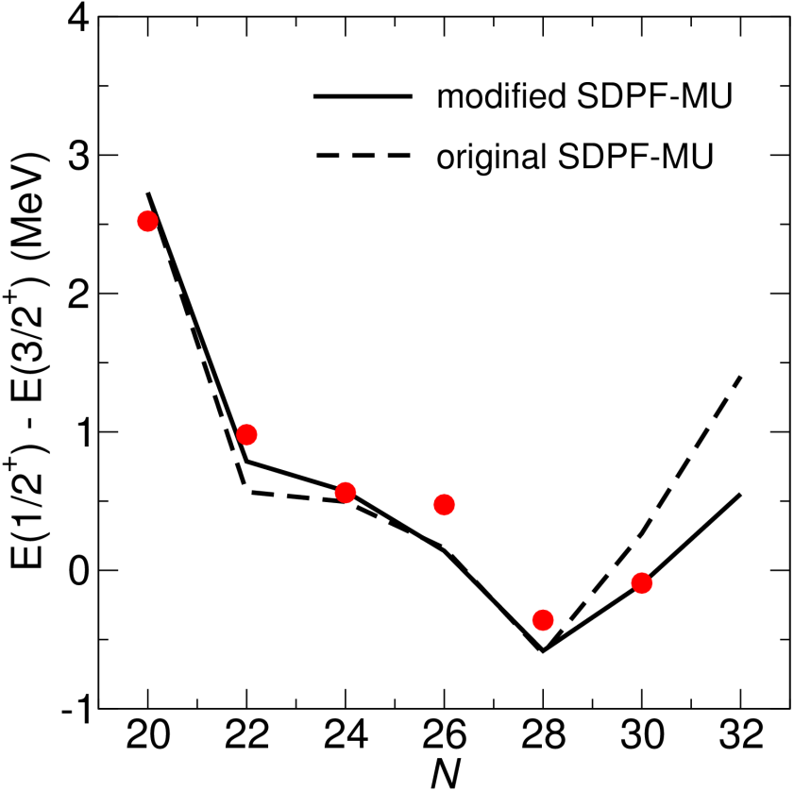
K levels and simple modifications to SDPF-MU
p_{3/2}
 | Expt. | SDPF-MU | modified
S_{p}(⁴⁰Ca) | 8.328 | 8.282 | 8.282
S_{p}(⁴⁸Ca) | 15.802 | 15.881 | 15.801
S_{p}(⁵²Ca) | 19.039 | 18.912 | 18.875
28
f_{7/2}
d_{3/2}
s_{1/2}
K isotopes from N=20 to 28
K isotopes from N=28 to 32
Modified SDPF-MU
Replace GXPF1B with GXPF1Br
$v_{s1,p}^{m,T=0}$ → +0.6 MeV shift
Monopole pairing in f7 → original GXPF1(A,B)

Slide 23
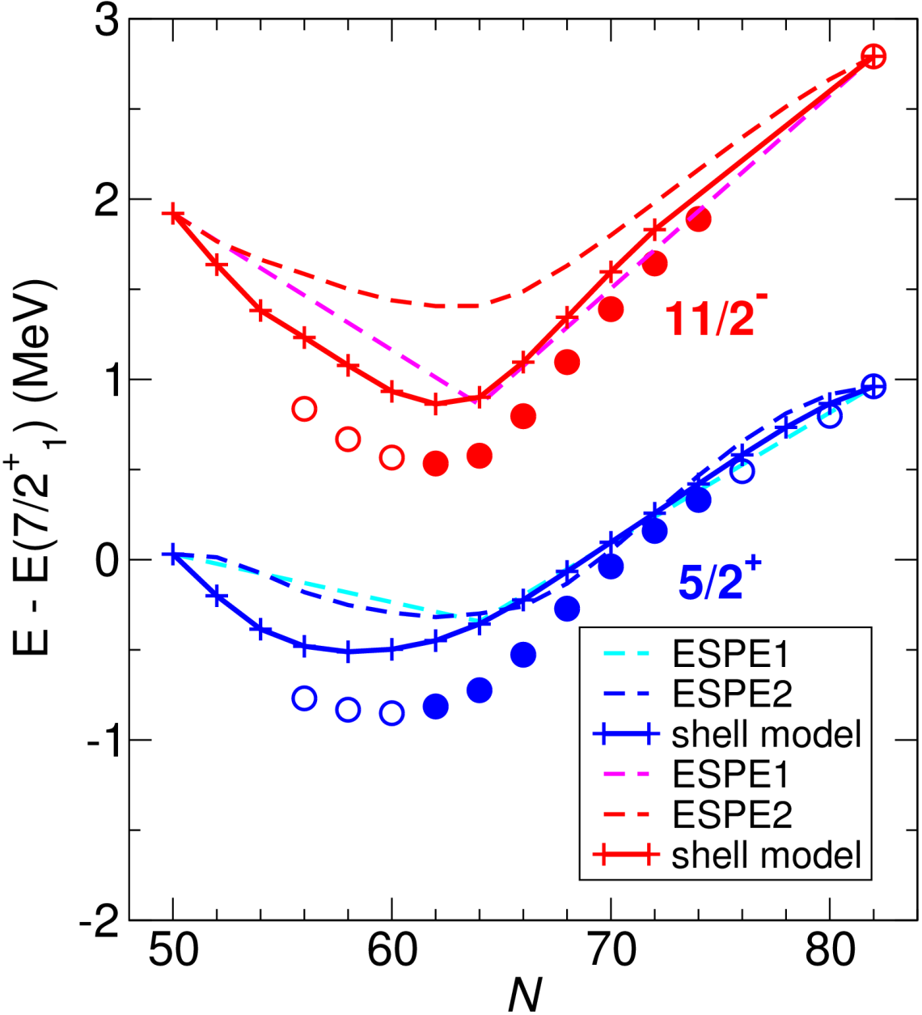
Evolution of the energy levels in Sb
11/2⁻₁ and 5/2⁺₁ levels measured from 7/2⁺₁
Non-monotonic evolution is reproduced.
full shell-model results vs. estimate from effective single-particle energies (ESPE) of two kinds
ESPE1: filling configuration at N=64, i.e., no correlation included
ESPE2: π(j)×Sn(0⁺₁), i.e., n-n correlation included
2.25 MeV

