Slide 1
Cluster Phenomena in Stable and Unstable Nuclei
Y. Kanada-En’yo (Kyoto Univ.)
Collaborators:
Y. Hidaka(RIKEN), T. Ichikawa(YITP),
M. Kimura(Hokkaido), F. Kobayashi(Kyoto),
T. Suhara (Matsue) ,Y. Taniguchi(NIMS), Y. Yoshida (Kyoto)

Slide 2
1.Introduction

Slide 3
Cluster structures in stable and unstable nuclei
Typical cluster structures known in stable nuclei
⁷Li
⁸Be
¹²C
²⁰Ne
¹⁶O*
α + t
α + α
3α
¹⁶O + α
¹²C + α
Heavier nuclei
Unstable nuclei
Si-Si, Si-C, O-C, O-O
α-cluster
excitation
3α linear chain
α
α-cluster
³⁶Ar-α, ²⁴Mg-α, ²⁸Si-α
¹⁴C*
Molecular
orbital
⁴⁰Ca*, ²⁸Si*, ³²S*
Be, C, O, Ne, F

Slide 4
Cluster & Mean field
Mean field, shell structure
Independent single-particle
Cluster:
Many-body correlation
Shell structure・MF
v.s.
Cluster
Independent particle in MF
Cluster excitation
Cluster formation
many-body correlation
Developed cluster
no correlation
g.s. correlation
excited states

Slide 5
Cluster structures
Nuclear structure
0 MeV
10 MeV
100 MeV
Energy
Shell & cluster corr.
cluster excitation
¹²C
+
Nucleon liquid
Cluster gas, crystal
Nucleon gas
high density
low density
ρ₀
ρ₀/3~ ρ₀/5
Cluster
enhancement

Slide 6
Cluster phenomena in low density
Heavy Ion collision
Multi
fragmentation
AMD cal.: ¹²⁹Xe+Sn E/A 50 MeV
by A. Ono PRC66 (2002)
Liquid-gas phase
Supernova,
Neutron star crust
Nuclear pasta
QMD cal.
by Watanabe PRL109 (2009)

Slide 7
Cluster structures in n-rich nuclei
gs cluster
correlation
cluster
weakening/
melting
Clustering
in deformed
Neutron density
n-rich Be, F, Ne
α-cluster
excitation
Molecular
orbital
n-skin suppression
large deformation
breaking of magic number N=8, N=20
stable
nuclei
n-rich
nuclei
n-rich C
cluster gas
linear chain
in C*

Slide 8
Roles of excess neutrons in cluster structures of n-rich nuclei
Soic et al., Freer et al., Saito et al.,
Curtis et al., Milin et al., Bohlen et al.,
Scholz et al., Rogachev et al., Goldberg et al.,
Ashwood et al., Yildiz et al.,
Descouvemont, Kimura,
¹⁰Be
Seya, Von Oerzten, Descouvemont et al.,
Itagaki et al., Dote et al., K-E et al.
Arai et al., M. Ito et al.
¹⁸O+α
⁶He+He
Atomic:
Cluster resonance
¹⁶O
α
Weak
coupling
α
α
Molecular Orbital:
bonded clusters
¹⁶O
Strong
coupling
α
α
α
shell
model-like
α
α
Normal states
Be isotopes
Ne, F, O isotopes

Slide 9
MO bond and Cluster res. in ²²Ne
Exp Scholz et al., Rogachev et al., Goldberg et al.,Ashwood et al., Yildiz et al.,
Theor: Descouvemont, Kimura,
²²Ne
AMD study by Kimura, PRC75 (2007)
¹⁸O+α
¹⁶O
Cluster res.
α
¹⁶O
MO-bond
α
EXP
AMD

Slide 10
MO structures in F isotopes
AMD study by Kimura et al., PRC83 (2011)
¹⁹⁻²⁹F
α
3hω
MO bond with
2hω
¹⁵N+α core
play an important role in lowering
intruder states
in N~20 region
also in Ne isotopes
1hω
3hω
2hω
0hω
¹⁹F
²¹F
²³F
²⁵F
²⁷F
²⁹F

Slide 11
α-cluster states in n-rich nuclei
Cluster resonances
α
New states discovered and suggested at
Ex = several ~ 20 MeV
in α-decay, α-transfer, α-scattering
^{6,8}He+α in Be
¹⁰Be+α in ¹⁴C
¹⁴C+α in ¹⁸O
¹⁸O+α in ²²Ne
Exp: Soic et al., Freer et al., Saito et al., Curtis et al., Milin et al., Bohlen et al.,
Theor: Seya, von Oerzten, Descouvemont et al.,Itagaki et al., K-E et al.
Arai et al., M. Ito et al.
Exp Soic 04, von Oertzen ‘04, Price 07, Haigh 08,
Theor: Suhara ‘10
Exp Scholz et al., Rogachev et al., Goldberg et al.,Ashwood et al., Yildiz et al.,
Theor: Descouvemont, Kimura,
Exp Scholz ‘72, Rogachev ‘01, Goldberg ‘04, Ashwood ‘06, Yildiz et al.,
Theor: Descouvemont ’88, Kimura ‘07
-> information of nucleus-nucleus potential and valence neutron effects there.

Slide 12
Rich cluster phenomena in nuclear systems
as functions of proton&neutron numbers and excitation energy
Cluster formation/breaking in low-lying states
Cluster excitation and resonances
Molecular Bond in neutron-rich nuclei
Many clusters : cluster gas, chain
New types of cluster
^{6,8}He+He in Be, ¹⁰Be+α in ¹⁴C,¹⁴C+α in ¹⁸O, ¹⁸O+α in ²²Ne
A theoretical method:
AMD (antisymmetrized molecular dynamics)

Slide 13
2. A theoretical model: AMD
An approach for nuclear structure to study
cluster and mean-field aspects
Stable and unstable nuclei
Ground and excited states

Slide 14
AMD method for structure study
AMD wave fn.
Gaussian wave packet
Slater det.
det
Gaussian
spatial
isospin
Intrinsic spins
Similar to FMD wave fn.
A variety of
cluster st.
Shell-model
like st.
Energy Variation
Effective nuclear force
phenomenological)
Notes:
14

Slide 15
3. Some topics of cluster phenomena

Slide 16
3-1. MO bond in n-rich Be
& vanishing of magic number
3-2. Cluster resonances
3-3. Linear chain in n-rich C

Slide 17
3-1. MO bond in n-rich Be
& vanishing of magic number
3-2. Cluster resonances
3-3. Linear chain in n-rich C

Slide 18
Cluster structures in neutron-rich Be
¹⁰Be: energy levels
cluster
res.
⁶He+⁴He
+
AMD calc. Y. K-E, et al. PRC (98)
0
Exp: Milin et al. ’05, Freer et al. ’06
3
MeV
4+
Ito et al.
Kobayashi et al.
Kuchera et al.
4+
+
2+
MO bond
0
2
0+
exp
AMD
+
2+
¹⁰Be
0
1
Normal
J(J+1)

Slide 19
Molecular orbital(MO) structure in Be
2α-core formation
Seya PTP65(81), von Oertzen ZPA354(96)
N. Itagaki PRC61(00), Y. K-E.. Ito PLB588(04)
MO formation
+
α
-
α
+
MO state
σ-orbital
MO formation
Gain kinetic energy
in developed 2α system
±
Normal state
+
α
α
-
Level inversion
in ^{11,12,13}Be
π-orbital
vanishing of magic number in ¹¹Be, ¹²Be, ¹³Be

Slide 20
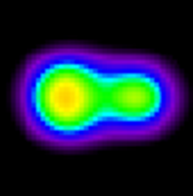
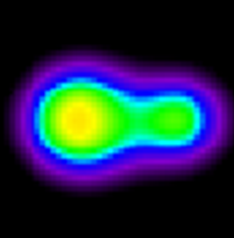
Vanishing of N=8 magic number in neutron-rich Be
Y.K-E.PRC (03),(12) , Ito PRL(08) Dufour NPA(10)
Fortune PRC(06), Blanchon PRC(10)
Energy
¹⁰Be
¹²Be, ^{11,13}Be
deformation in ¹²Be(gs)
Inelastic scat. life time:
Iwasaki PLB481(00),
Imai PLB673(09)
+
Normal 0hω
0
2
+
σ
π
0
intruder config. in ¹²Be(gs)
MO bond
Inversion
2
1n-knockout reac.:
Navin PRL85(00),
Pain PRL96(06)
+
σ
Intruder 2hω
0
π
+
1
0
¹²Be(0₂⁺) with p-shell config.
1
Shimoura PLB654 (07)
Normal state
B(GT) with charge ex.:
Meharchand PRL108 (12)
n-rich
¹²Be g.s. 0+
¹³Be g.s. 1/2-
abnormal parity of ¹³Be(gs)
Kondo et al. PLB690 (10)

Slide 21
Breaking of magic number in ¹³Be
¹³Be: unbound
¹³Be spectra measured by 1n knock-out reactions
at GSI(Simon et al. 2007) and RIKEN(Kondo et al.,2010)
AMD calc. Y. K-E. PRC(12)
¹³Be
Er
(MeV)
EXP.
(1/2-)
3.04
(5/2+)
(5/2+)
2.39
2
2.0
AMD
Kondo10
Simon07
1
¹²Be+n
1/2- ?
(1/2-)
1/2+ virtual st.
0.51
d_{5/2}
1/2- is lowest
in ¹³Be
0
intruder
p_{1/2}
¹²Be+n
Simon07
Kondo10
s_{1/2}
p_{3/2}
s_{1/2}

Slide 22
3-1. MO bond in n-rich Be
& vanishing of magic number
3-2. Cluster resonances
3-3. Linear chain in n-rich C

Slide 23
Cluster resonances
Kuchera et al.
Ito et al.
Kobayashi et al.
Freer PRL.82(99)(06)
Saito NPA738 (04)
Yang PRL112 (14）
Exotic cluster res. also suggested
⁸He+⁶He in ¹⁴Be
Ito et al. Y. K-E et al.
⁶He+⁴He
^{6,8}He+^{6,4}He
⁹Li+⁶He in ¹⁵B
0⁺_{3,4?}
+
0
α
α
3
α
α
⁶He+³H
α
t
0⁺₂
α
α
MO bond
Cluster res. ?
0⁺₂
α
α
MO bond ?
K=0⁺₁
0⁺₁
α
α
α
t
α
α
Normal
¹⁰Be
¹²Be
⁹Li

Slide 24
⁶He+³H cluster resonances in ⁹Li
⁹Li: energy levels(calculation)
Y. K-E. et al
PRC.85(12)
MeV
⁶He+³H
resonance
5/2-
7/2-
1/2-
3/2-
K=1/2- band
α
t
⁶He+³H threshold
J(J+1)
⁹Li(3/2₃⁻)
3/2-
g.s.
⁹Li
α
t
⁹Li(gs)

Slide 25
Cluster structures in ¹⁰Be and ⁹Li
Cluster resonances
t decoupling
α
α
K=0⁺_{3,4?}
α
K=1/2⁻
t
(3/2⁻₃)
⁶He
⁶He
MO bond
NO MO bond
α
α
K=0⁺₂
α
t
α
α
α
t
¹⁰Be
⁹Li
α
α
α
3/2⁻₁
t
K=0⁺₁
g.s(3/2⁻₁)

Slide 26
3-1. MO bond in n-rich Be
& vanishing of magic number
3-2. Cluster resonances
3-3. Linear chain in n-rich C

Slide 27


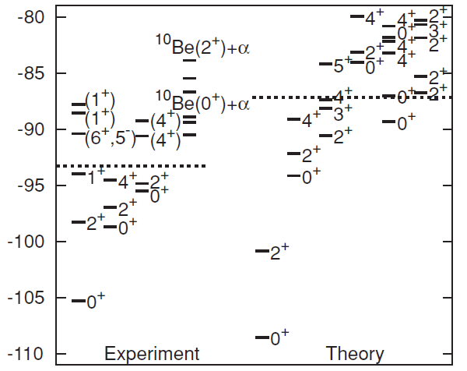
Linear chain state in ¹⁴C*
Neutron-rich
¹⁴C
AMD by T.Suhara and Y.K-E,
Phys.Rev.C82:044301,2010.
¹²C
^{14,16}C
3α linear chain
¹²C*
not linear
¹⁴C*,¹⁶C*
proton
neutron
+
0₃
Y.K-E.et al.,
T. Neff et al.
Linear chain?
von Oertzen ZPA354(96)
EPJA21(04),PR 432(06)
Itagaki PRC64(01)
Suhara PRC82(10)
Maruhn NPA833(10)
+
0₂
Tohsaki et al.,
Funaki et al.
Energy (Mev)
+
¹⁴C
¹²C g.s.
¹⁴C g.s.

Slide 28
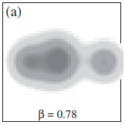
Linear chain in n-rich C
Meta stable
for bending motion
Stretching effect
in rotation
AMD by Y.K-E,
PR432(2006)
MO model for ^{14,16}C
Itagaki et al. PRC64(01)
HF calc. for ^{16,20}C
by Maruhn et al. NPA833(10)
¹⁵C*(19/2-)
β=0.78
suggested
to be a
yrast state
¹¹Be+α
Largely deformed ¹¹Be
with MO-bond

Slide 29
4. Summary

Slide 30
Summary
Rich cluster phenomena in n-rich nuclei
MO bond & breaking of N=8 shell
Cluster resonances
Linear chain
Cluster formation, development, and valence neutrons
play important roles in nuclear structure.
Extended
Ikeda diagram?
by von Oertzen et al
Ikeda et al.PTP464-S (1968)
Taken from Phys. Report 432 (2006)

Slide 31
Many-body correlations at low density
Information of many-body correlations in low density, in isospin asymmetric systems.
Cluster gas, chain ?
Dineutron correlation ?
Nuclear matter
Neutron matter
α-cond.
in low density
Matsuo et al. PRC73 044309 (‘06)
+
Dilute α-cluster gas
¹²C(0₂ )
α
Unbound
BEC-BCS
BCS
¹⁶O*
α
α
Geometric
（crystal ？）
¹⁴⁻²⁰C*
α
Dineutron at surface of
neutron-rich nuclei
α
α
α
α
α
Itagaki et al.,
Von Oertzen et al.
Price et al.

Slide 32
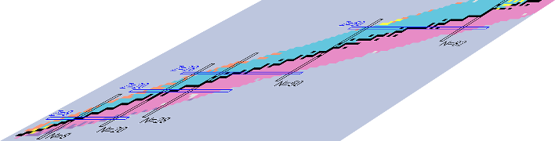
Systematic study in a wide region
Excitation energy
multidimension
* proton number
* neutron number
* excitation energy
* density
Low density
proton number
Neutron number
Notes:
In such the expanding nuclear chart, we should also stress another axis “excitation energy” on the nuclear chart, because a variety of phenomena appears also in excited states in each of nucleus. Namely, our research target is in this three dimensional space.

