Slide 1
The Atomic Mass Evaluation:
Present and Future
ARIS2014, Tokyo, June 2
WANG Meng
Institute of Modern Physics, CAS

Slide 2
Outline
Introduction
atomic mass, measurement, evaluation …
Present status
publication of AME2012, comparison with AME03…
Some considerations about future
correlation, workload… …

Slide 3
Atomic mass
mass→ binding energy → interaction
Nuclear physics
Nuclear astrophysics
Atomic physics
Atomic energy
Fundamental symmetries
Metrology
…

Slide 4
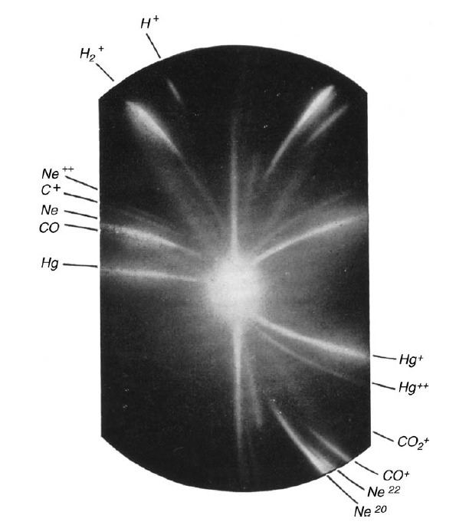
Mass spectroscopy
19th century, weights of elements
1913, discovery of isotopism
Magic number
deformation
island of inversion
…
“100 years of Mass Spectrometry”
International Journal of Mass Spectrometry, Volumes 349–350 (2013)
Edited by Dr. Yuri Litvinov and Dr. Klaus Blaum

Slide 5
Mass measurements
Mass measurement:
inertial mass
energy
Relative
Measurements
Energy released from neutron capture of ³²S
³²S + n - ³³S = 8641.6398(33) keV
Mass ratio M[³³S⁺]/M[³²SH⁺]
³³S- (³²S + H) = -8437.29682(30) μu

Slide 6
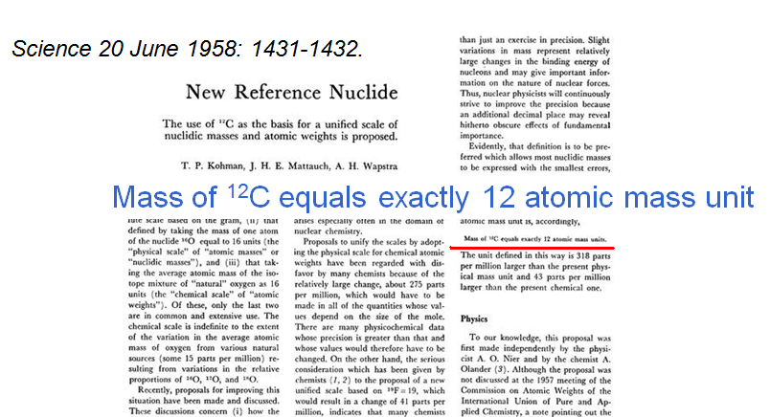
Atomic mass evaluation
M.S. Livingston, H.A. Bethe, “Nuclear Physics, C. Nuclear dynamics, experimental”, Rev. Mod. Phys. 9 (1937) 245, XVIII. Nuclear masses, combining data from mass spectroscopy and nuclear reaction/decay
In 1950s, A. H. Wapstra created AME, to solve the problem of overdetermination

Slide 7
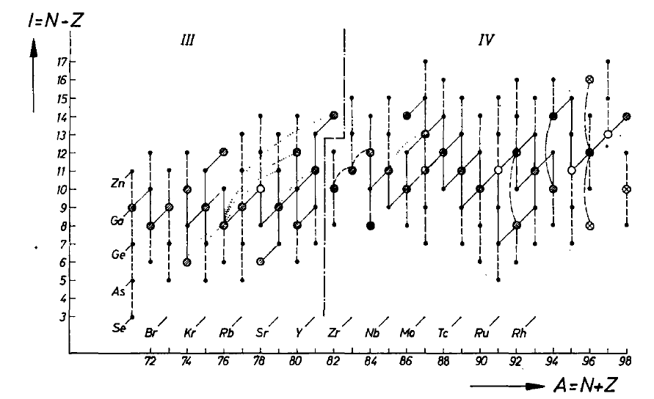
Series of the AME
Ame1961, Ame1964, Ame1971, Ame1977
Ame1983, Ame1993, Ame2003, Ame2012
Konig et al., Nucl. Phys. A 28 (1961) 1

Slide 8
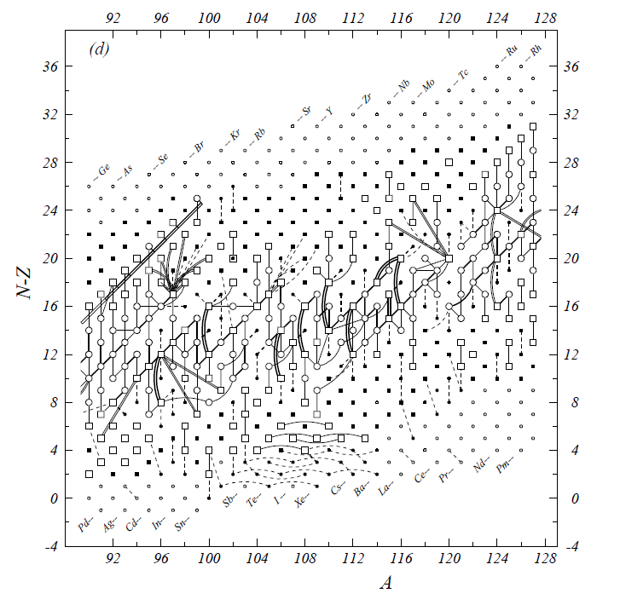

Slide 9
An example
1970Bo29 7624.6(1.5)
2006Fi.A 7625.6(0.9)
2011Go23
1203.27(0.36)
¹⁰²Pd
¹⁰³Pd
1958Ro09 764(4)
1965Mu09 760(6)
1970Pe04 762(5)
1982Oh04 769(4)
1961Hi06 1150（6）
¹⁰²Rh
¹⁰³Rh
1961Hi06 2317(10)
1963Bo17 2325(10)
1983Do11 (p,n) 2332(15)
1986Be53 543.0(0.8)
¹⁰²Ru
¹⁰³Ru
1982Ba69 6232.2(0.3)
2006Fi.A 6232.00(0.17)
Q_{ββ}: 1172.7(2.4) keV

Slide 10
Outline
Introduction
atomic mass, measurement, evaluation …
Present status
publication of AME2012, comparison with AME03…
Some considerations about future
correlation, workload… …

Slide 11
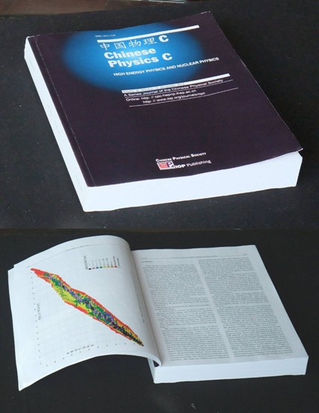
AME2012
December 2012 issue of Chinese Physics C (IOP Science)
Volume 36 Number 12 December 2012
1157 The NUBASE2012 evaluation of nuclear properties
G. Audi, F.G. Kondev, M. Wang, B. Pfeiffer, X. Sun,
J. Blachot, M. MacCormick
1287 The AME2012 atomic mass evaluation (I). Evaluation of input data, adjustment procedures
G. Audi, M. Wang, A.H. Wapstra, F.G. Kondev,
M. MacCormick, X. Xu, B. Pfeiffer
1603 The AME2012 atomic mass evaluation (II). Tables, graphs and references
M. Wang, G. Audi, A.H. Wapstra, F.G. Kondev,
M. MacCormick, X. Xu, B. Pfeiffer
a.CSNSM-Orsay b.IMP-Lanzhou c.GSI-Darmstadt
d.ANL-Argonne e.MPIK-Heildelberg f.IPN-Orsay
3711 Masses
2416 known ground state
232 known isomers
1063 extrapolated
13809 input equations in AME12
5275 mass spectrometry
8534 reactions & decays
For reprints, write to me: wangm@impcas.ac.cn

Slide 12
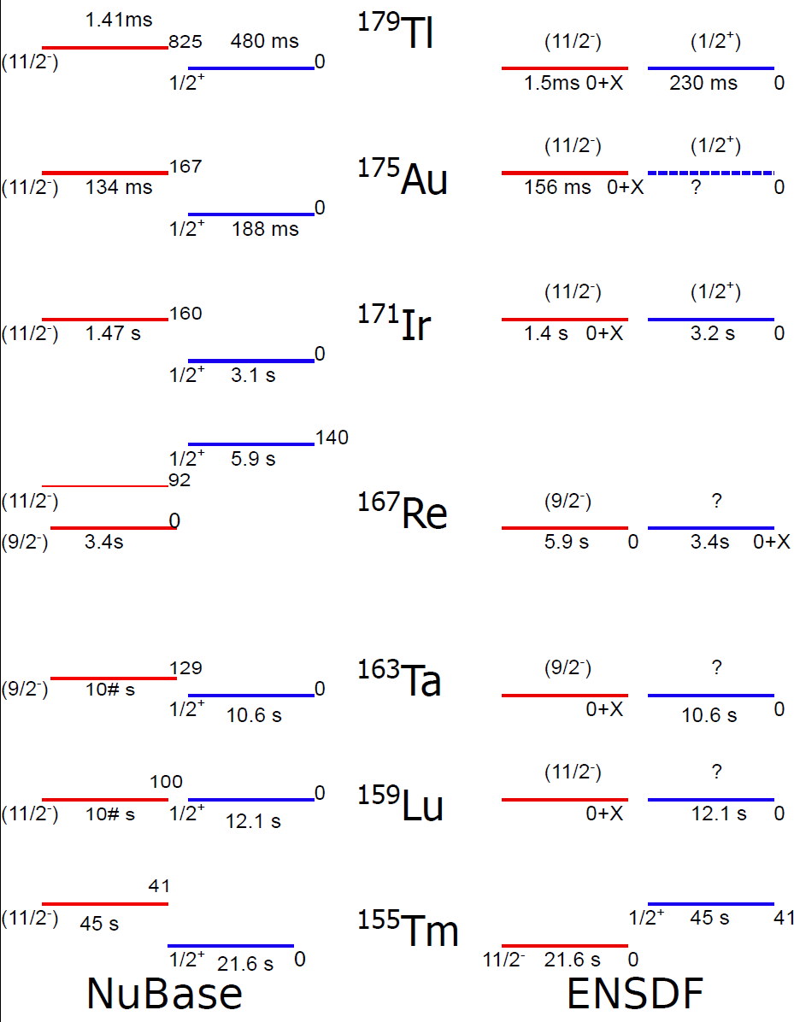
NUBASE2012
Ex, J^{π}, T_{1/2} & decay modes
both ground state & Isomers
(T_{1/2}>100ns)
Independently evaluated data
  complete
  up-to-date
  credible & reliable
  properly referenced
Poster session1- A055

Slide 13
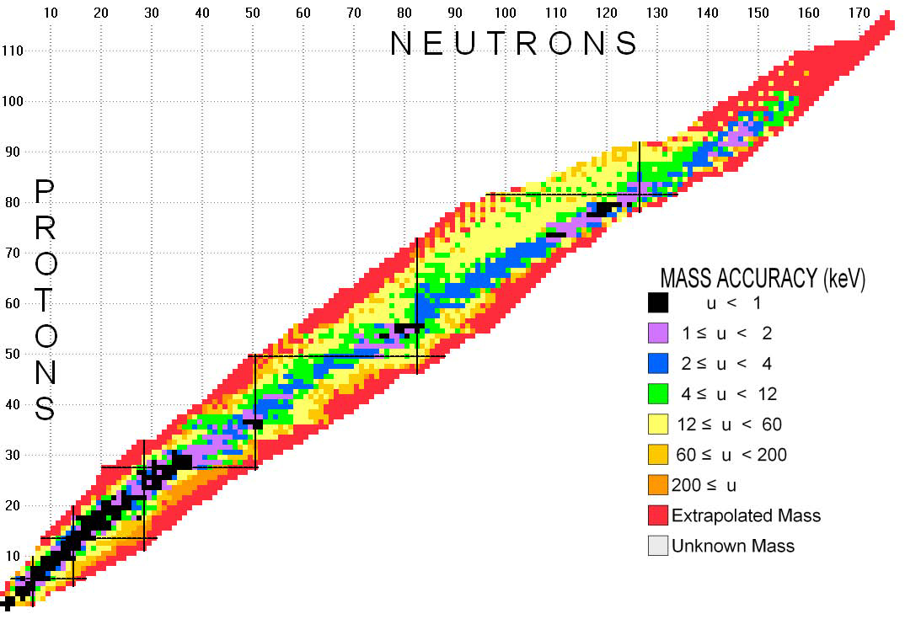
Accuracy of masses

Slide 14
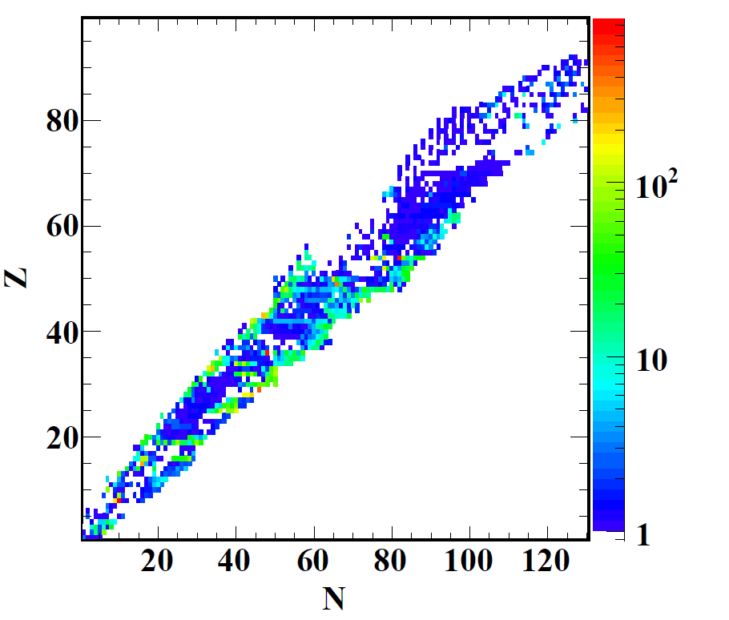
Comparison of uncertainties
σ03/σ12

Slide 15
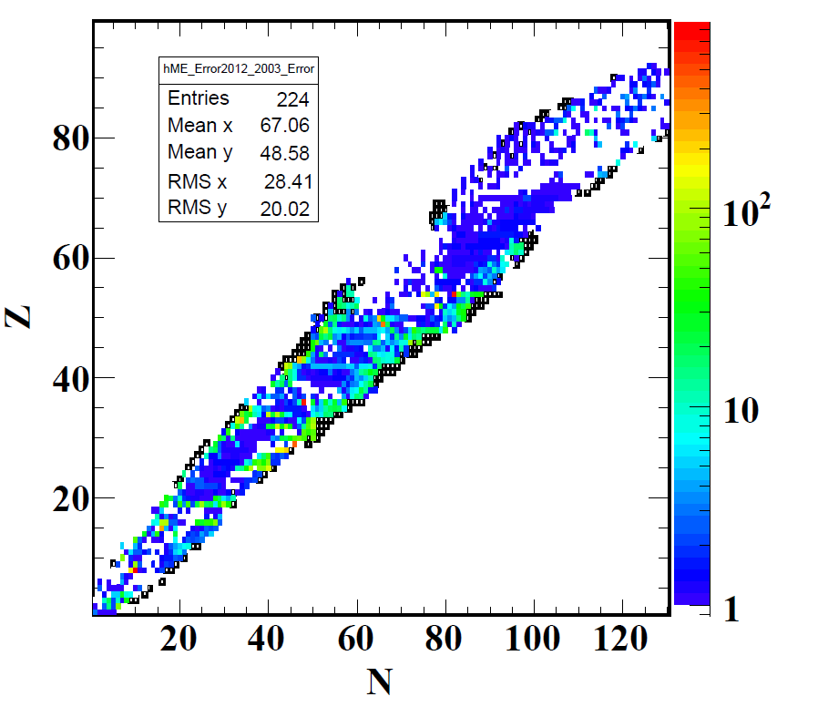
Comparison of uncertainties
225 new masses
σ03/σ12

Slide 16
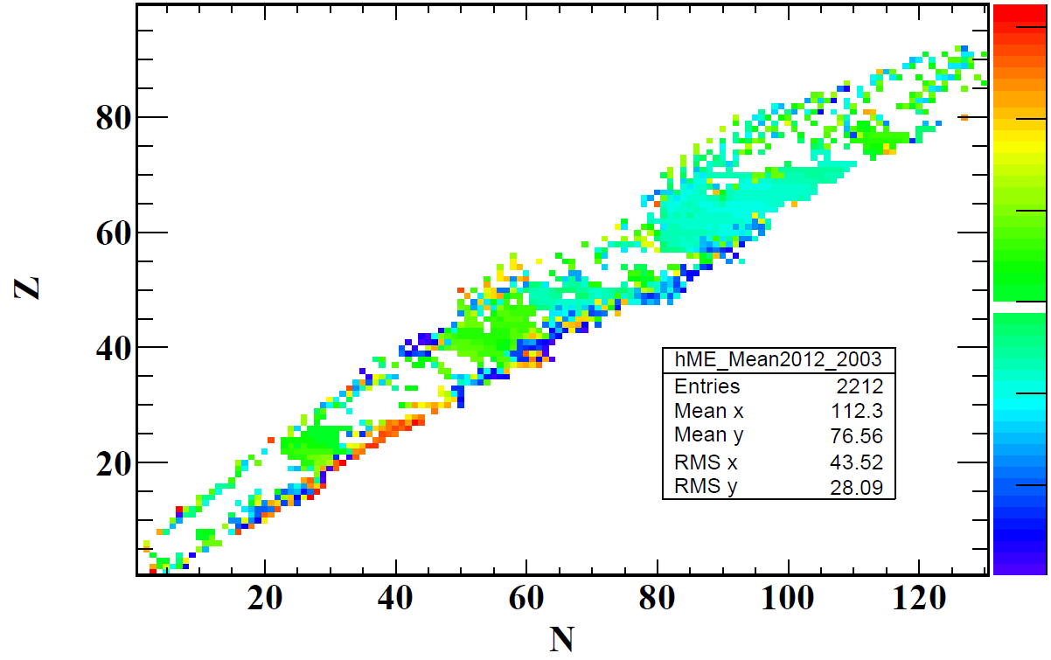


Comparison of values
1000
100
10
-10
-100
-1000
99Y: 18 σ
⁵²Ca: 1754 keV
ME03 – ME12

Slide 17
Information from mass
shell
subshell
deformation

Slide 18
Correlations
H | 3H | 3He | 4He | 36Ar | 38Ar | 40Ar | 87Rb | 107Ag | 109Ag | 133Cs
8.71E-03
1.11E-07 | 5.63285
1.06E-07 |  | 6.2714672
-1.40E-10 | 3.59E-09 | 3.61E-09 | 4.01E-03
4.06E-06 | 2.01E-09 | 2.04E-09 | 1.58E-13 | 840.6494
3.98E-02 | 3.13E-06 | 3.12E-06 | -5.04E-10 | 4.93E-03 | 43815.16
2.65E-02 | 1.96E-06 | 2.01E-06 | 2.22E-10 | 2.25E-03 | 3.1189932 | 5.7662911
3.85E-02 | -2.72E-06 | -3.20E-06 | 1.69E-08 | 1.58E-04 | 0.4443539 | 0.52151054 | 42.66677
2.49E-02 | 0.16063632 | 0.16276504 | 5.85E-06 | 1.86E-04 | 0.40712302 | 0.5403117 | 9.869235 | 6540624.4
2.18E-02 | -4.10E-03 | -3.06E-03 | 3.35E-06 | 1.00E-04 | 0.2328728 | 0.251655 | 5.648021 | 22.305292 | 1974735.2
4.66E-02 | -1.27E-05 | -1.25E-05 | 2.88E-08 | 9.03E-05 | 0.4132173 | 0.3665098 | 5.723106 | 4.7454233 | 9.444008 | 73.71616
5.553018
Covariance matrix provided to CODATA group as request.

Slide 19
Outline
Introduction
atomic mass, measurement, evaluation …
Present status
publication of AME2012, comparison with AME03…
Some considerations about future
correlation, workload… …

Slide 20
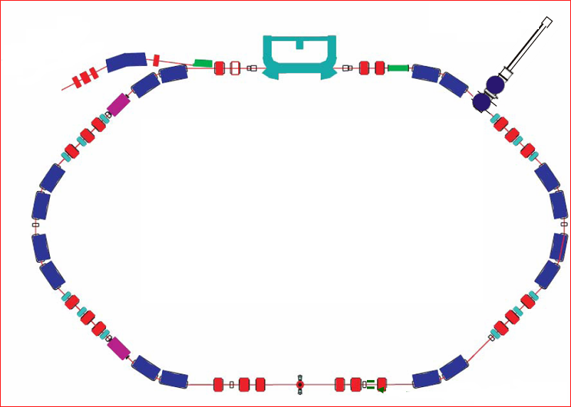
Correlation: mass measurement with a storage ring
ToF
Injection
Plenary talk: ZHANG Yuhu, June 5

Slide 21
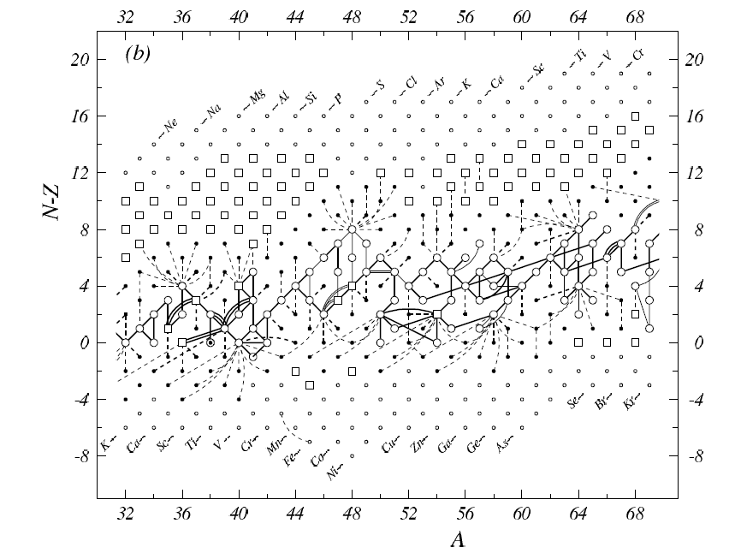

Slide 22
Amount of work: reference per year

Slide 23


Amount of work: reference + equation
Evaluators:
M. Wang, G. Audi, F.G. Kondev, M. MacCormick, X. Xu
kondev@anl.gov

Slide 24
Conclusion
The AME12 & NuBase12 evaluations have been published– significant improvement compared to AME03 & NuBase03 evaluations – more nuclei & better precision.
Individual files are available for download (ascii):
http://amdc.impcas.ac.cn
If you need a hard copy – please contact me: wangm@impcas.ac.cn
The AMDC coordination at IMP-Lanzhou
Next Tables are foreseen in 2016 (electronic publication only)
mass.mass12
nubase.mas12
Thank you for your attention!

Slide 25
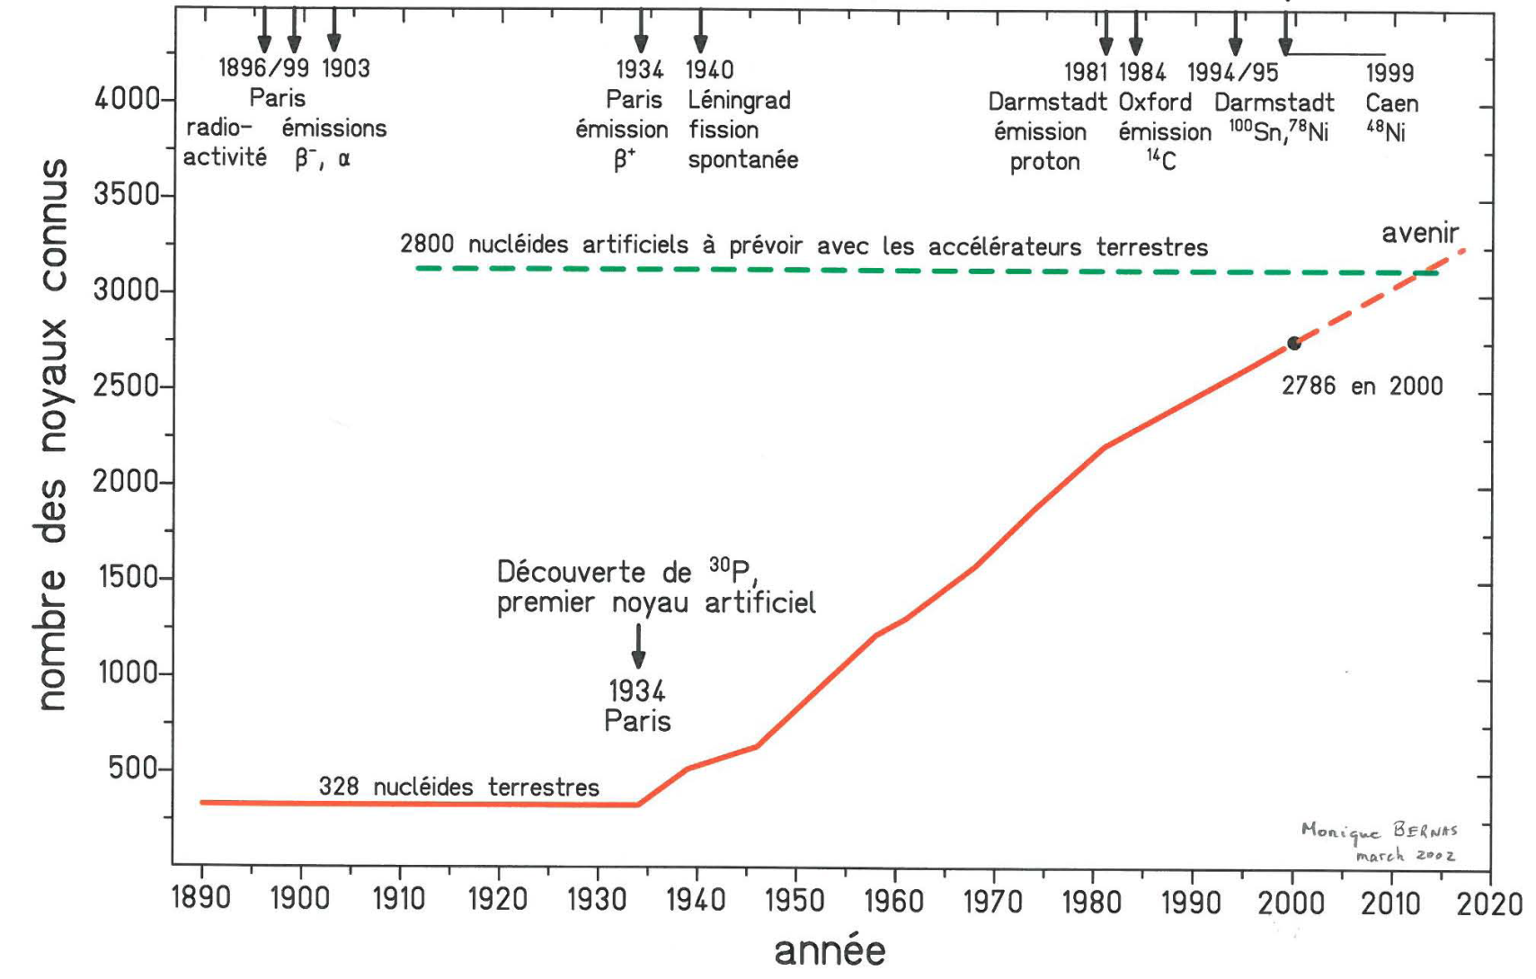

Slide 26
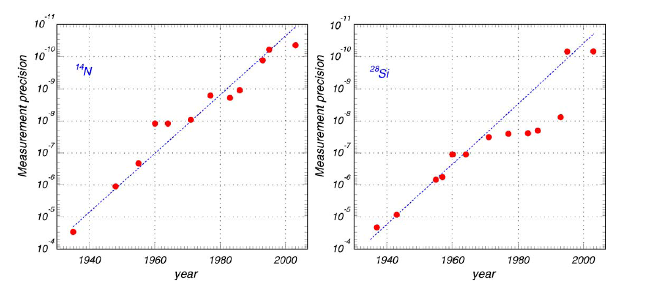

Slide 27
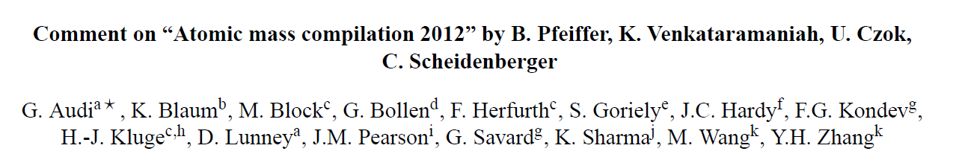
Accepted by ADNDT
arXiv:1401.2021v4

Slide 28
