Slide 1





Investigating Shape Coexistence With Coulomb Excitation
Above And Below Z=82
Nele Kesteloot^{1,2}
On behalf of the IS452/IS479 collaboration
¹KU Leuven, Instituut voor Kern- en Stralingsfysica, Leuven, B-3001, Belgium
²SCK CEN (Studiecentrum voor Kernenergie, Mol, B-2400, Belgium

Slide 2
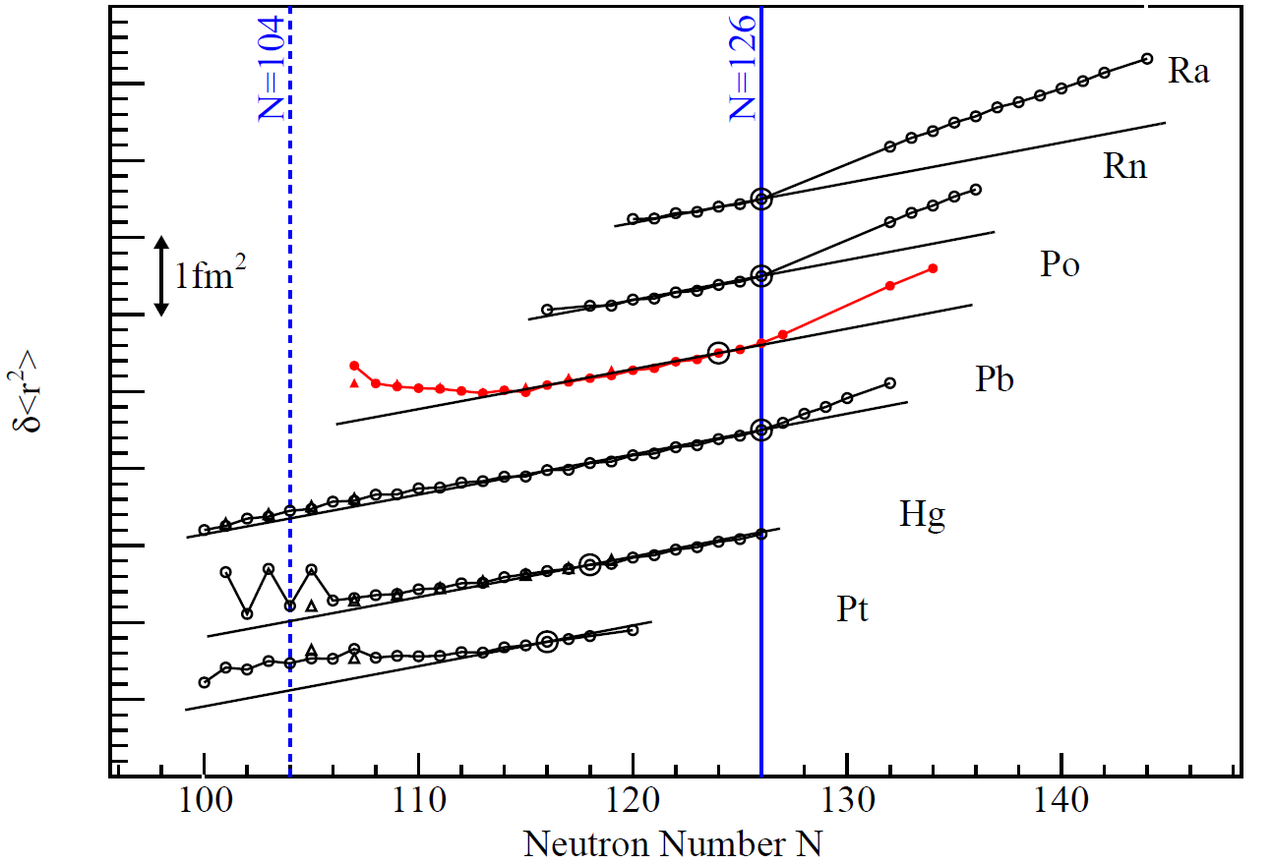
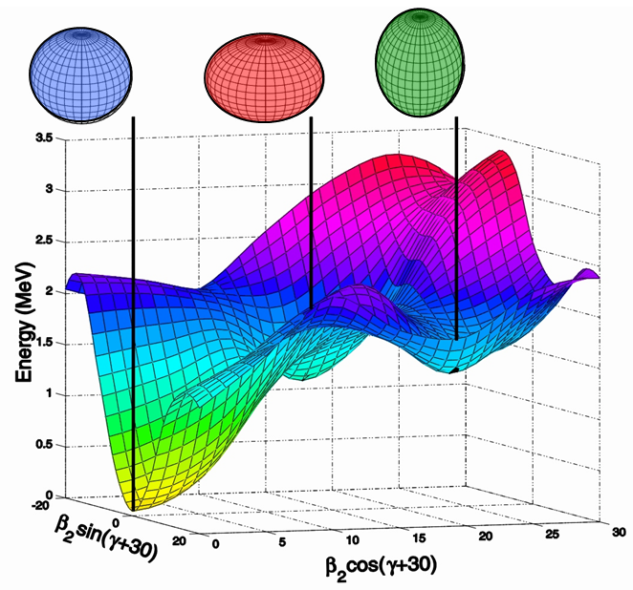
Shape coexistence
Shape coexistence
Miniball @ REX-ISOLDE
Z = 84:¹⁹⁶⁻²⁰²Po
Z = 80: ¹⁸²⁻¹⁸⁸Hg
Outlook
  Different types of deformation at low excitation energy
Interplay between two opposing tendencies
  Stabilizing effect of closed shells
  Residual proton-neutron interaction
Heyde and Wood, Review of Modern Physics (2011)
T.E. Cocolios et al, Phys. Rev. Lett. (2011)
  Evidence across the light lead region
  Lack of experimental information
    Nature of deformation
    Degree of mixing
Andreyev et al Nature 405:430 (2000)
Notes:
Coulex studies performed in light lead region: Hg (below Z=82) and Po (above Z=82)

Slide 3
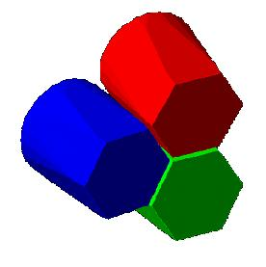
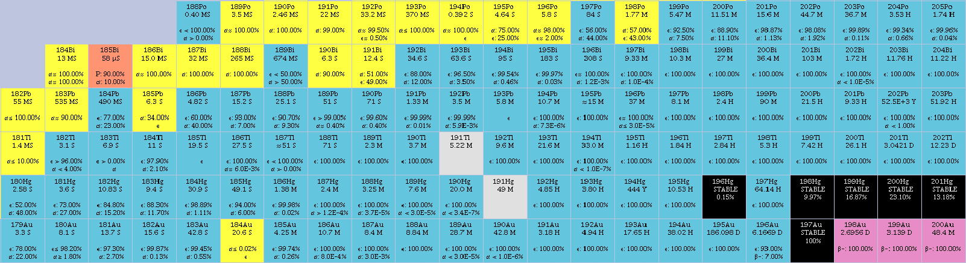
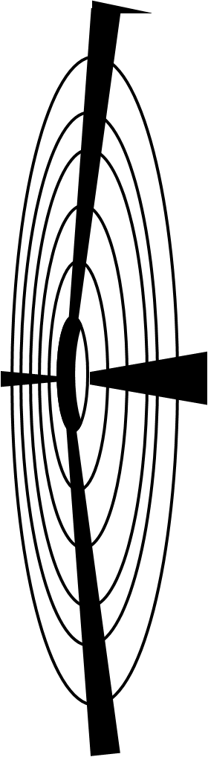
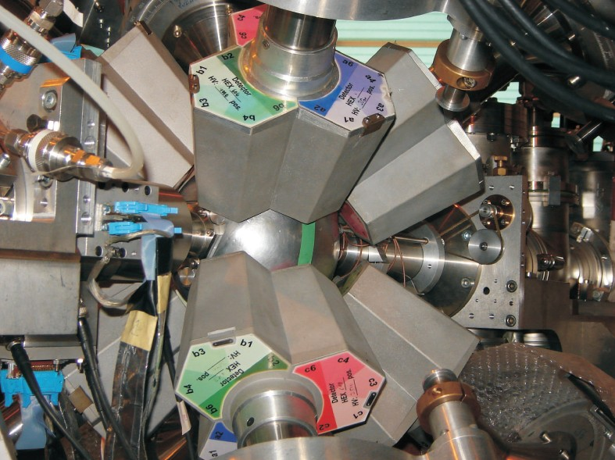
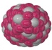
Miniball @ REX-ISOLDE
Shape coexistence
Miniball @ REX-ISOLDE
Z = 84:¹⁹⁶⁻²⁰²Po
Z = 80: ¹⁸²⁻¹⁸⁸Hg
Outlook
Z = 82
I_{196Po} = 2x10⁴ pps
Purity = 54(1)%
I_{202Po} = 7x10⁴ pps
Purity = 98(2)%
E_{P}
I_{182Hg} = 4x10³ pps
I_{188Hg} = 2x10⁵ pps
θ_{P}
2.9 MeV/A Projectile eg: ²⁰⁰Po
Target
eg: ¹⁰⁴Pd
E_{T}

Slide 4
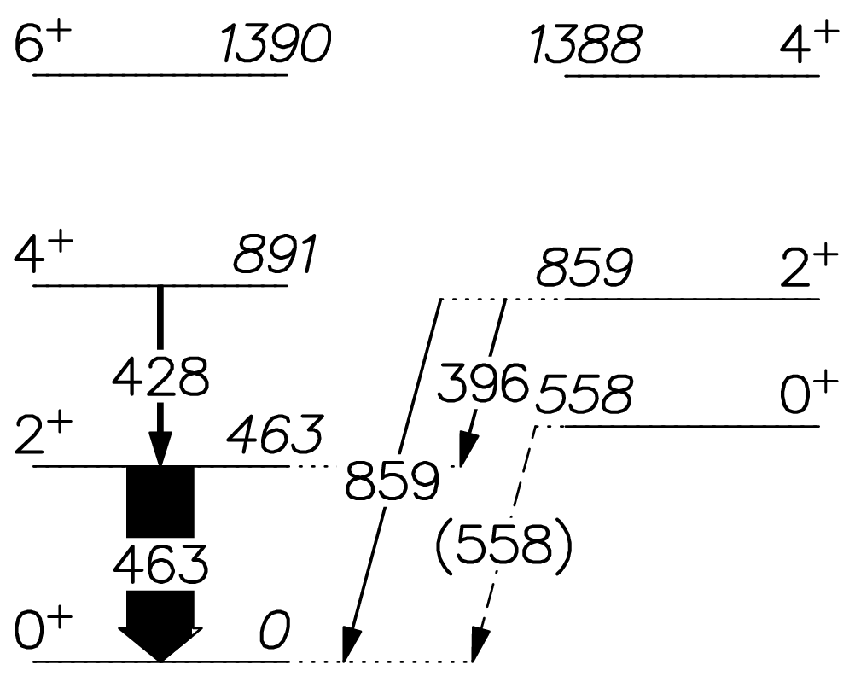
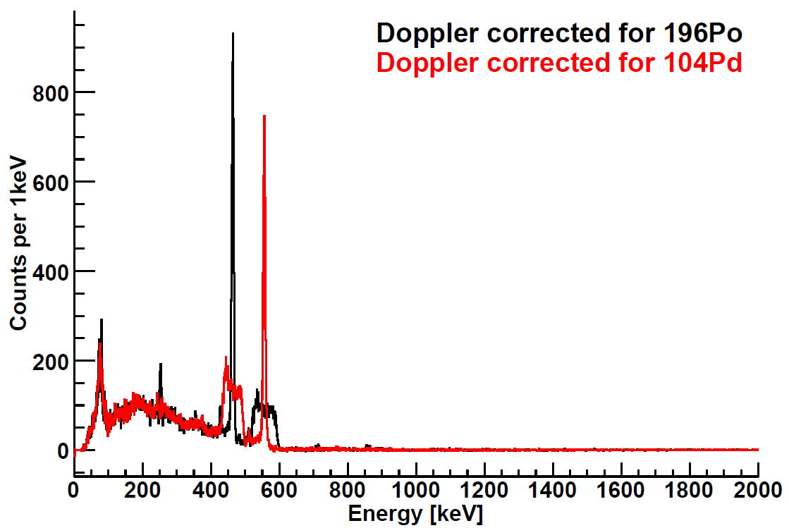
Z = 84: ¹⁹⁶⁻²⁰²Po: Quality of the data
Shape coexistence
Miniball @ REX-ISOLDE
Z = 84:¹⁹⁶⁻²⁰²Po
Z = 80: ¹⁸²⁻¹⁸⁸Hg
Outlook
Data analysis
  pγ coincidences
  Population of 2⁺₁ state in all isotopes
  Multi-step coulex observed in ^{196,198}Po
Extraction of matrix elements
  Gosia
  χ² fit of experimental data
¹⁹⁶Po on ¹⁰⁴Pd
¹⁹⁶Po
¹⁹⁶Tl
¹⁰⁴Pd
T. Czosnyka et al, Am. Phys. Soc. (1982)
ARIS 2014, Tokyo
4

Slide 5
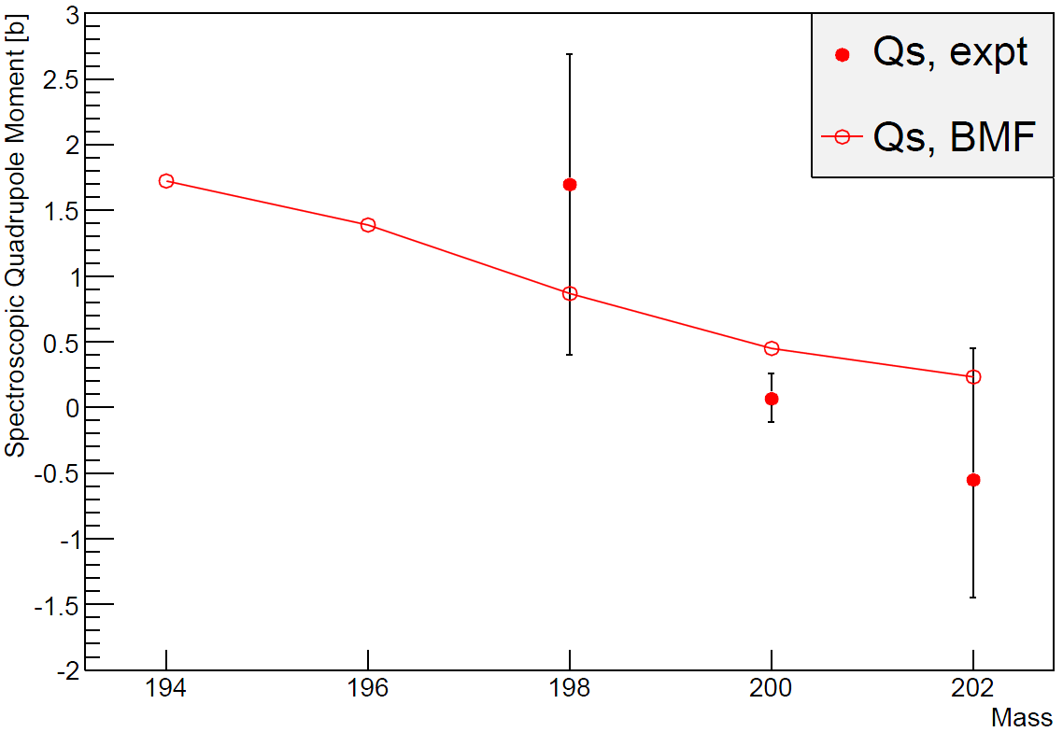
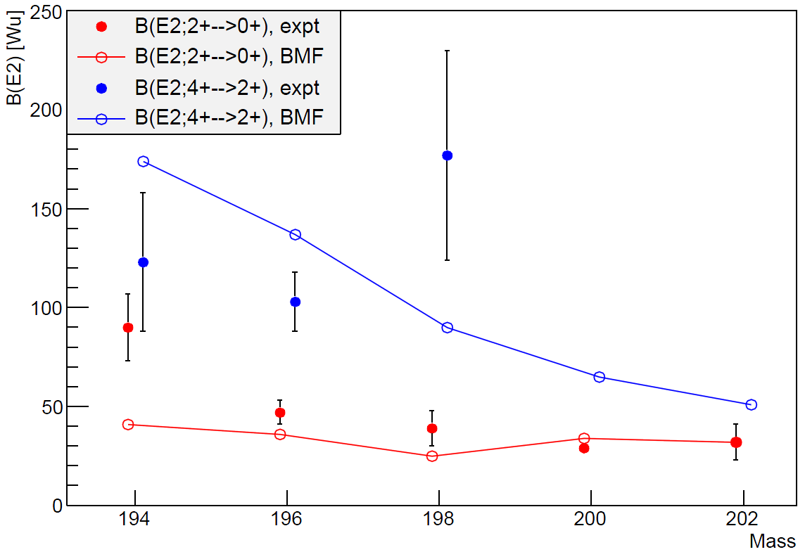
Comparison with Beyond Mean Field
Shape coexistence
Miniball @ REX-ISOLDE
Z = 84:¹⁹⁶⁻²⁰²Po
Z = 80: ¹⁸²⁻¹⁸⁸Hg
Outlook
Lifetime experiments
¹⁹⁴Po: T. Grahn et al PRL 97, 062501 (2006)
¹⁹⁶Po: T. Grahn et al PRC 80, 014323 (2009)
J.M. Yao, M. Bender, P.-H. Heenen PRC 87, 034322 (2013)
Notes:
B(E2): BMF has right order of magnitude but gets the wrong trend
Trend naar grotere prolate vervorming wanneer we naar lichtere kernen gaan wordt bevestigd.

Slide 6
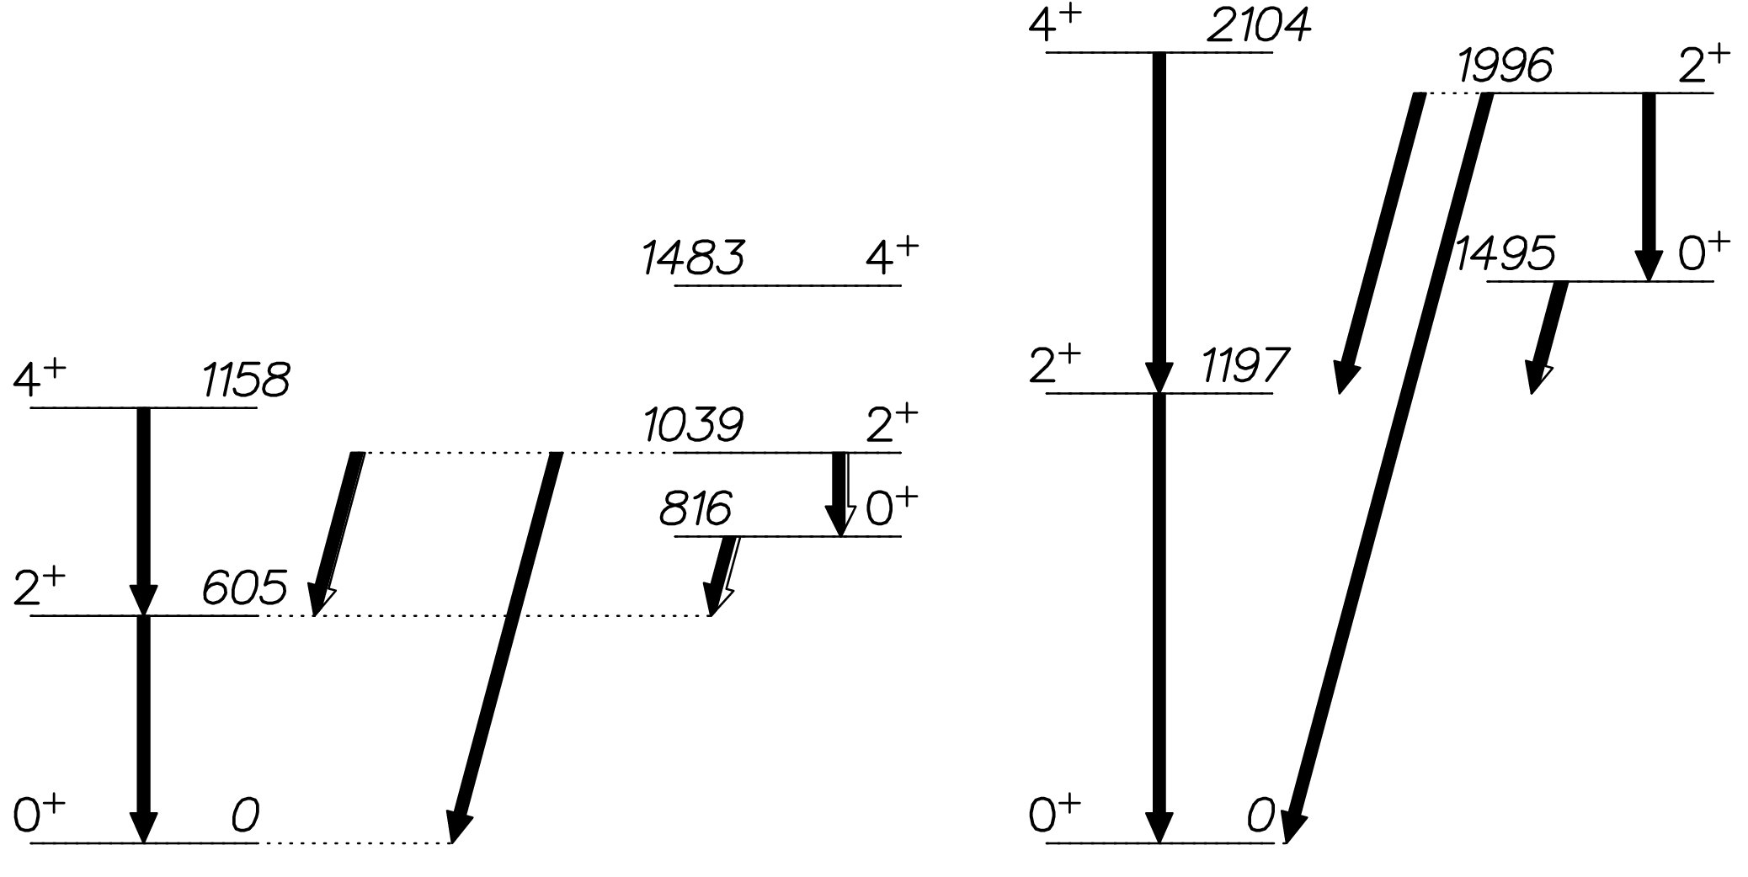
Comparison with Beyond Mean Field:¹⁹⁸Po
Shape coexistence
Miniball @ REX-ISOLDE
Z = 84:¹⁹⁶⁻²⁰²Po
Z = 80: ¹⁸²⁻¹⁸⁸Hg
Outlook
J.M. Yao, M. Bender, P.-H. Heenen PRC 87, 034322 (2013)
B(E2) down [Wu]
63
90
53
37
180(50)
70(90)
230(130)
300(300)
25
1
1.8(6)
39(9)
Experiment
BMF
Notes:
Energies are overestimated and B(E2) underestimated with BMF.
BMF:
B(E2; 4+2→2+2) = 60Wu
B(E2; 4+1→2+2) = 50Wu

Slide 7
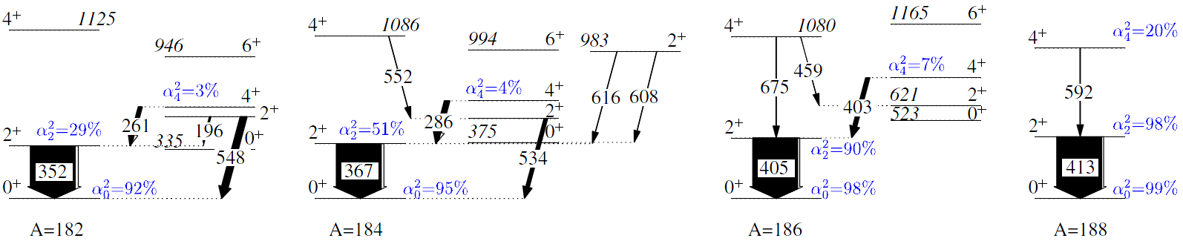
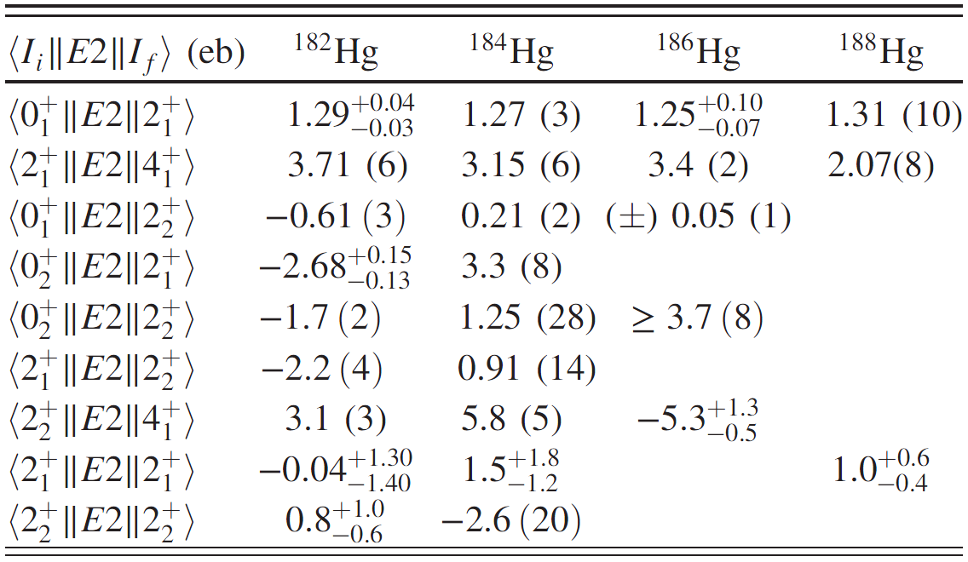
Z = 80: ¹⁸²⁻¹⁸⁸Hg
Shape coexistence
Miniball @ REX-ISOLDE
Z = 84:¹⁹⁶⁻²⁰²Po
Z = 80: ¹⁸²⁻¹⁸⁸Hg
Outlook
0
N.Bree et al, PRL 112, 162701 (2014)

Slide 8
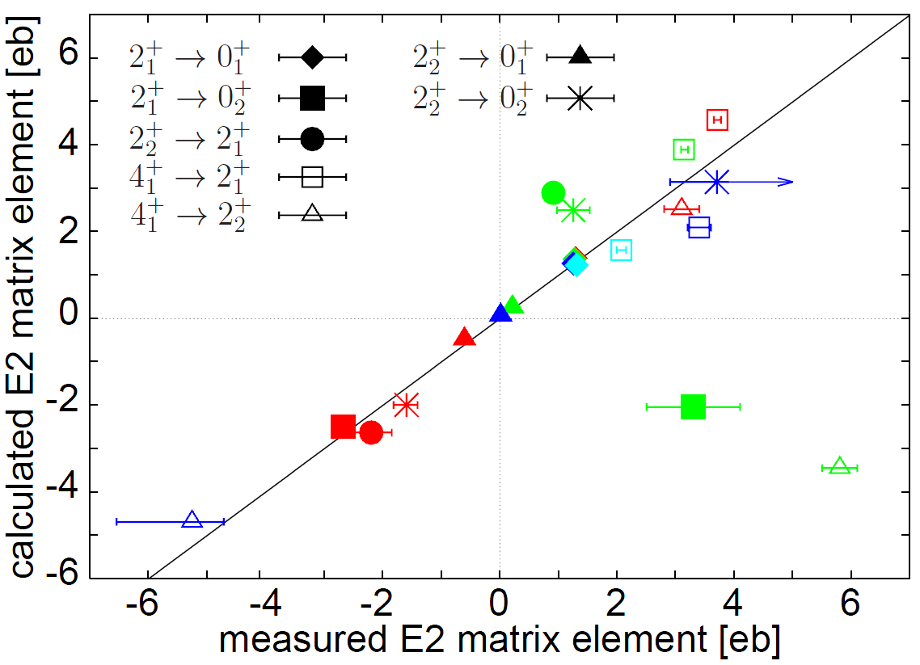
Interpretation with two-level mixing model
Shape coexistence
Miniball @ REX-ISOLDE
Z = 84:¹⁹⁶⁻²⁰²Po
Z = 80: ¹⁸²⁻¹⁸⁸Hg
Outlook
N.Bree et al, PRL 112, 162701 (2014)
 | α₀₊² | α₂₊² | α₄₊²
¹⁸²Hg | 92% | 29% | 3%
¹⁸⁴Hg | 95% | 51% | 4%
¹⁸⁶Hg | 98% | 90% | 7%
¹⁸⁸Hg | 99% | 98% | 20%
L.P. Gaffney et al, PRC 89, 024307 (2014)
¹⁸²Hg
¹⁸⁴Hg
¹⁸⁶Hg
¹⁸⁸Hg
“concealed” configuration mixing of the 2⁺₁ states of ¹⁸²⁻¹⁸⁸Hg
un-mixed ME2’s:
-4.0 eb
2⁺_{II}
2⁺_{I}
1.8 eb
3.3 eb
0⁺_{II}
0⁺_{I}
1.2 eb
Notes:
Eind conclusie, kan beschreven worden als twee 'shapes' een oblate en een prolate dit mengen.

Slide 9
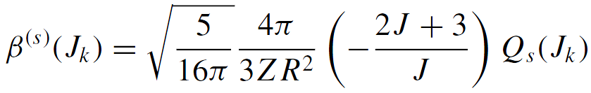
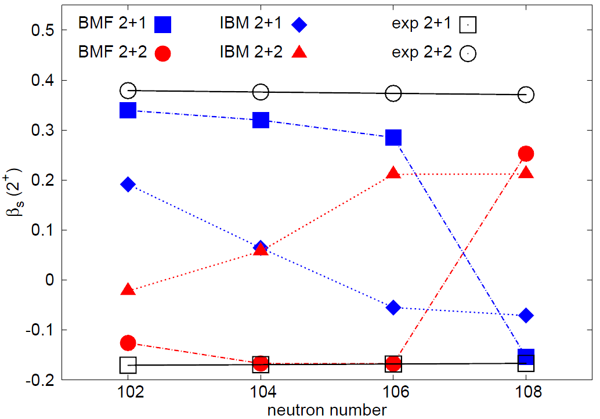
Comparison to theory – IBM and BMF
Shape coexistence
Miniball @ REX-ISOLDE
Z = 84:¹⁹⁶⁻²⁰²Po
Z = 80: ¹⁸²⁻¹⁸⁸Hg
Outlook
unmixed 2+1
unmixed 2+2
Courtesy of K. Wrzosek-Lipska
BMF: J.M. Yao, M. Bender, P.-H. Heenen PRC 87, 034322 (2013)
IBM: J.E. Garcia-Ramos, K. Heyde PRC 89, 014306 (2014)
Notes:
Qs exp = quadr moment coming from the TLM fit that reproduces the TRANSITIONAL ME between 2+2 and 2+1
BMF has the correct intrinsic structures
Unmixed values are deduced from the 2+1-2+2 transitional matrix element!
Verder zie je dat BMF en IBM ook een vorm van menging voorspellen, maar BMF voorspelt een kleiner Qs. Ook belangrijk om op te merken is dat de Qs uit de twee niveau menging afkomstig is van het transitiematrix element tussen 2+1-2+2 (kunnen we in Japan nog even doorpraten).

Slide 10
Outlook
Shape coexistence
Miniball @ REX-ISOLDE
Z = 84:¹⁹⁶⁻²⁰²Po
Z = 80: ¹⁸²⁻¹⁸⁸Hg
Outlook
Coulex of Po isotopes
  Finish analysis
  Compare matrix elements with BMF and IBM
HIE-ISOLDE
  Radioactive ion beams @ 5MeV/A
    Continuation of shape-coexistence studies in the light lead region
      Coulex of ^{182,184}Hg: proposal accepted
    Establish deformation of 0⁺₂ state
    B(E2)’s between non-yrast states up to 8⁺
  Extend studies towards odd-A
SPEDE (Spectrometer for Electron Detection)
  Detection of conversion electrons
  Constructed jointly by universities of Jyväskylä and Liverpool

Slide 11












Thank you for your attention!
A. Andreyev
J. Butterworth
D.G. Jenkins
P. Marley
N. Bree
H. De Witte
J. Diriken
L.P. Gaffney
M. Huyse
N. Kesteloot
O. Ivanov
R. Orlandi
N. Patronis
I. Stefanescu
P. Van Duppen
K. Wrzosek-Lipska
T. Grahn
R. Julin
J. Konki
J. Pakarinen
P.J. Peura
P. Rahkila
A. Petts
P.A. Butler
R.-D. Herzberg
R.D. Page
A. Blazhev
B. Bruyneel
Ch. Fransen
K. Geibel
H. Hess
P. Reiter
B. Siebeck
N. Warr
A. Wiens
M. Guttormsen
A.C. Larsen
S. Siem
G.M. Tveten
B. Hadinia
M. Scheck
J.F. Smith
J. Cederkäll
V. Fedosseev
L.M. Fraile
B. Marsh
E. Piselli
E. Rapisarda
M. Seliverstov
T. Stora
D. Voulot
J. Van de Walle
F. Wenander
T.E. Cocolios
A. Deacon
C. Fitzpatrick
S.J. Freeman
A.P. Robinson
P.-H. Heenen, Université Libre de Bruxelles
K. Heyde, Ghent University
J.L. Wood, Georgia Institute of Technology
T. Kröll, Technische Universität Darmstadt
M. Zielinska, CEA Saclay
M. Bender, Université Bordeaux
M. Carpenter, Argonne National Laboratory
A. Ekström, University of Lund
J.E. Garcia-Ramos, Universidad de Huelva
K. Hadynska-Klek
P.J. Napiorkowski
J. Srebrny
B. Bastin
E. Clément
N. Lecesne
R. Gernhäuser
R. Krücken

