Slide 1
The nature of a shell closure at N = 82 explored with seniority and spin-gap isomers in neutron-rich palladium and silver isotopes
Hiroshi Watanabe
Advances in Radioactive Isotope Science (ARIS2014)
1 - 6 June 2014, Tokyo, Japan

Slide 2
Collaborators of EURICA campaign in 2012
H. Baba, G. Benzoni, F. Browne, P. Doornenbal, N. Fukuda, G. Gey, N. Inabe, T. Isobe,
H-S. Jung, A. Jungclaus, D. Kameda, I. Kojouharov, F.G. Kondev, T. Kubo, S. Kubono,
N. Kurz, G.J. Lane, Z. Li, G. Lorusso, A. Montaner, C-B. Moon, K. Moschner, F. Naqvi,
M. Niikura, H. Nishibata, S. Nishimura, D. Nishimura, A. Odahara, Z. Patel, Z. Podolyak,
E. Sahin, H. Sakurai, H. Schaffner, Y. Shimizu, G. Simpson, P.A. Söderström, K. Steiger,
T. Sumikama, H. Suzuki, H. Takeda, J. Taprogge, Z. Vajta, H. Watanabe, J. Wu, Z. Xu,
A. Yagi, K. Yoshinaga
Theoretical support
T. Otsuka, K. Ogawa, K. Kaneko, Y. Sun
RIKEN Nishina Center, Biehang University, INFN, University of Brighton,
University of Joseph Fourier, Chung-Ang University, University of Madrid,
GSI, Argonne National Laboratory, Australian National University,
Peking University, Instituto de Fisica, Hoseo University, University of Koeln,
Yale University, University of Tokyo, Osaka University, Tokyo University of Science,
University of Surrey, University of Oslo, Grenoble, TU Munich, Tohoku University,
University of Debrecen

Slide 3
Change of magic numbers in exotic nuclei
New magic numbers
N = 16, 32, 34
20
Shell quenching
N = 8, 20, 28, (40)
8
28
20
8
?
126
?
82
T_{1/2} [s]
?
Proton
50
Does the shell quenching
take place at the heavier
magic numbers, 50, 82 …?
Neutron

Slide 4
Shell structure and isomers in the “south-west” of ¹³²Sn
π-π
Seniority scheme
⇒ probe of shell closure
51
¹³⁰Sb
¹³¹Sb
¹³²Sb
¹³³Sb
¹³⁴Sb
ν-ν
50
¹²⁹Sn
¹³⁰Sn
¹³¹Sn
¹³²Sn
¹³³Sn
49
¹²⁸In
¹²⁹In
¹³⁰In
¹³¹In
¹³²In
48
¹²⁷Cd
¹²⁸Cd
¹²⁹Cd
¹³⁰Cd
¹³¹Cd
47
¹²⁶Ag
¹²⁷Ag
¹²⁸Ag
¹²⁹Ag
¹³⁰Ag
79
80
81
82
83
f7/2
82
d3/2
h11/2
s1/2
High-j orbitals,
νh_{11/2} and πg_{9/2},
play important
roles in forming
nuclear levels
d5/2
g_{7/2}
50
g_{9/2}
p_{1/2}

Slide 5
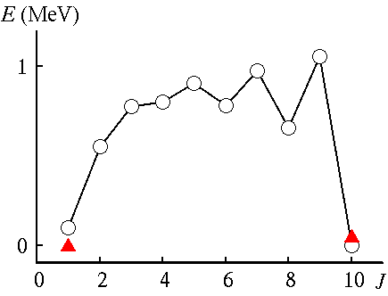
Shell structure and isomers in the “south-west” of ¹³²Sn
π-π
Seniority scheme
⇒ probe of shell closure
51
¹³⁰Sb
¹³¹Sb
¹³²Sb
¹³³Sb
¹³⁴Sb
ν-ν
50
¹²⁹Sn
¹³⁰Sn
¹³¹Sn
¹³²Sn
¹³³Sn
49
¹²⁸In
¹²⁹In
¹³⁰In
¹³¹In
¹³²In
48
¹²⁷Cd
¹²⁸Cd
¹²⁹Cd
¹³⁰Cd
¹³¹Cd
47
¹²⁶Ag
¹²⁷Ag
¹²⁸Ag
¹²⁹Ag
¹³⁰Ag
79
80
81
82
83
Monopole
⇒ shift SPE
Multipole
⇒ split multiplet
π-ν
f7/2
82
d3/2
h11/2
s1/2
High-j orbits,
νh_{11/2} and πg_{9/2},
play important
roles in forming
nuclear levels
d5/2
¹³⁰In
g_{7/2}
50
g_{9/2}
p_{1/2}
T. Otsuka et al.,
PRL 104, 012501 (2010)
Spin trap

Slide 6
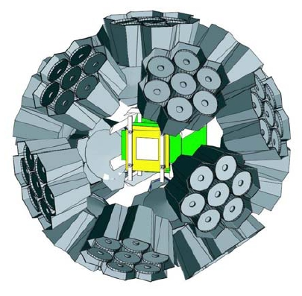
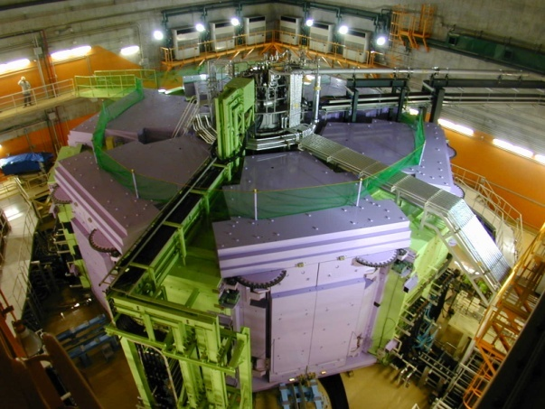
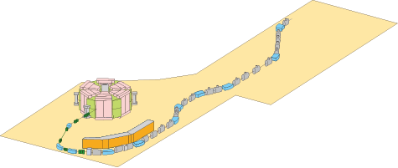
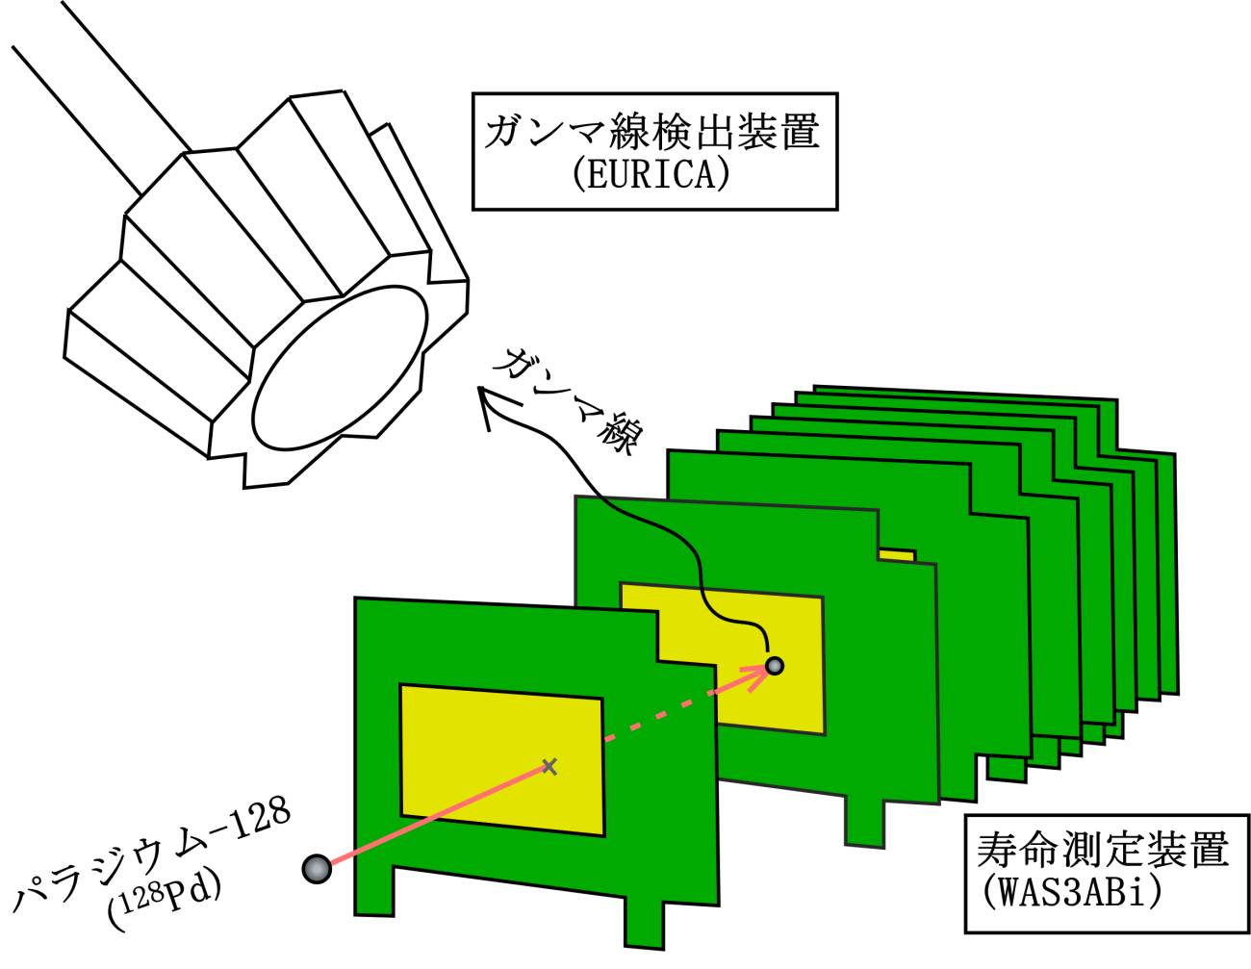
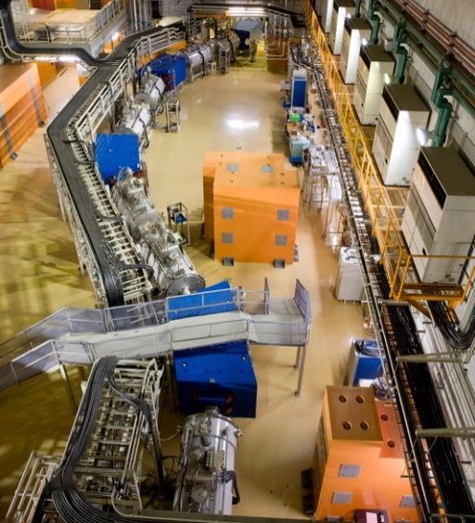
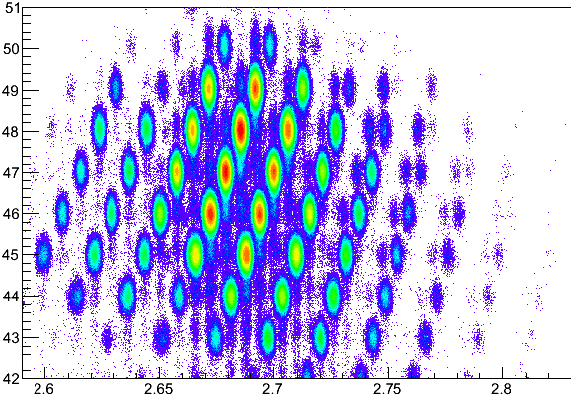
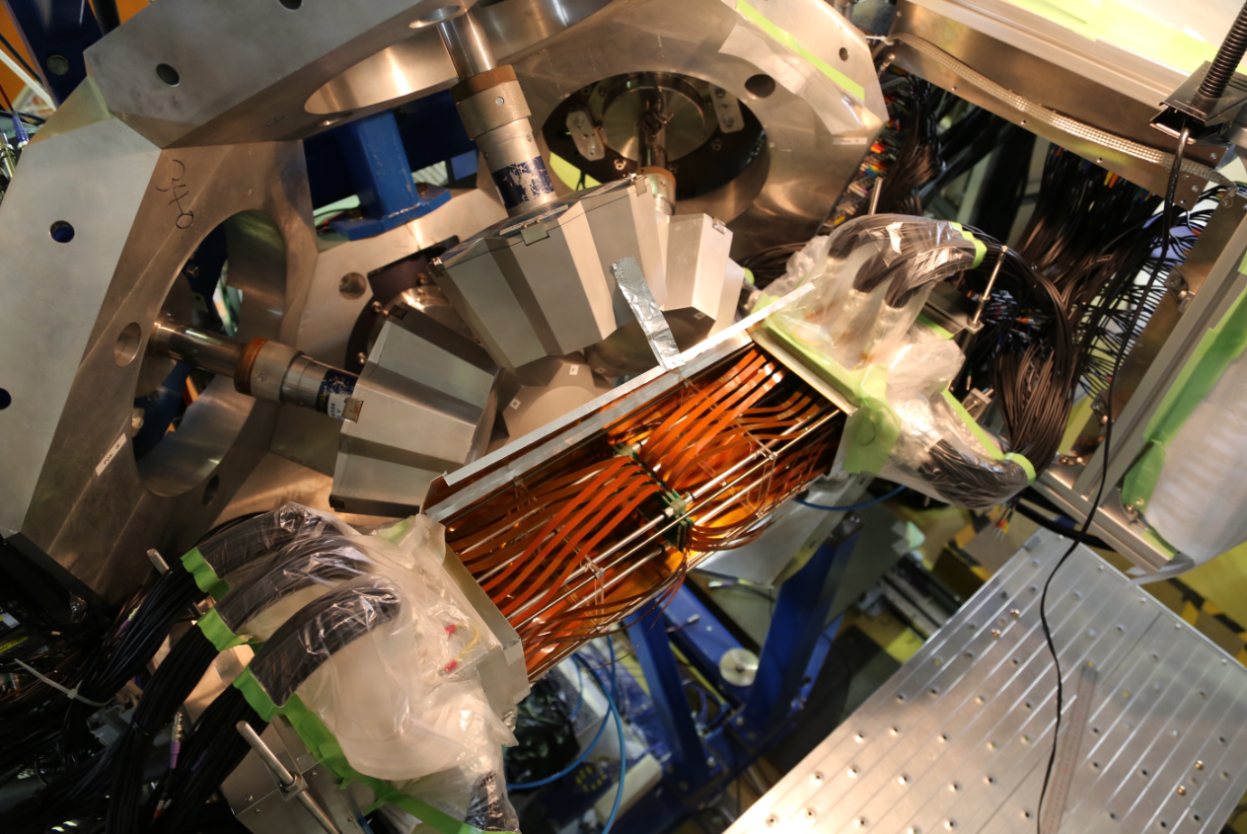
Layout of the entire experimental setup
12 Clusters
(7 Ge each)
“EURICA”
SRC
BigRIPS
8 DSSSDs
(60×40 each)
“WAS3ABi”
²³⁸U beam
(345 AMeV)
Identification and
further separation
γ
β
Be target
Separation of RI beam
RI
Z
A/Q

Slide 7
Experimental result (Ⅰ)
Seniority isomer in ¹²⁸Pd₈₂
Isomer

Slide 8
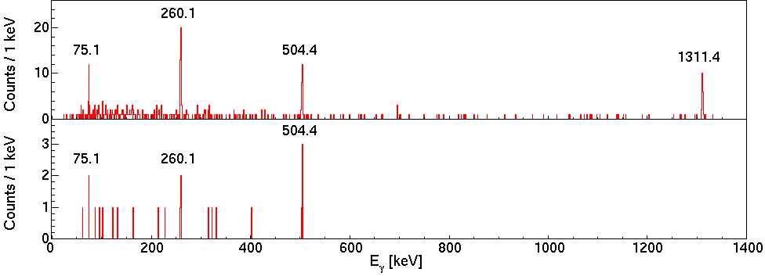
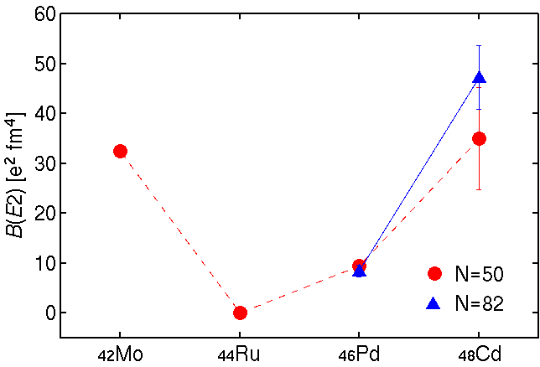
Seniority isomer in ¹²⁸Pd
H. Watanabe et. al.,
Phys. Rev. Lett. 111,
152501 (2013)
Delayed coin. with ¹²⁸Pd ions
(Δt=0.15-25 μs)
γ-γ coincidence with
a gate on 1311 keV
B(E2;8⁺→6⁺)
Seniority (ν) scheme
¹²⁸Pd₈₂
Good ν=2 in the well isolated πg_{9/2} subshell
Robust shell closure at N=82

Slide 9
Experimental result (Ⅱ)
Isomeric states in ¹²⁶Pd₈₀
Isomer

Slide 10
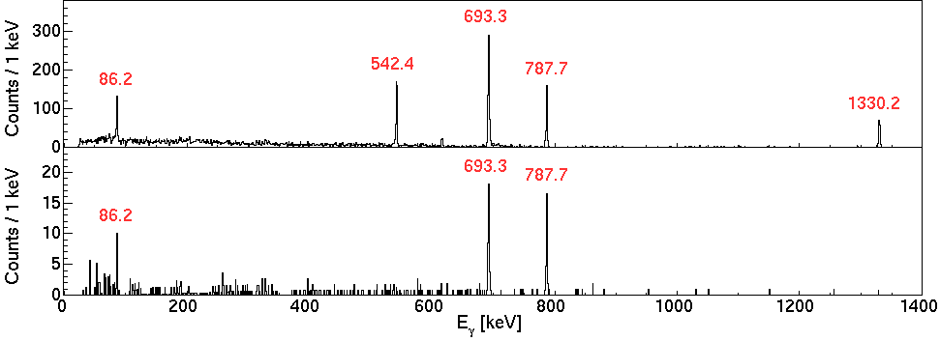
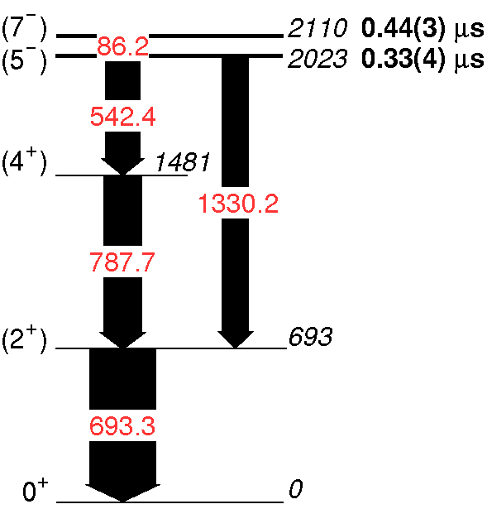
Sub-microsecond isomers in ¹²⁶Pd
Delayed coincidence with ¹²⁶Pd ions (Δt = 0.15-5 μs)
γ-ray singles
γ-γ coincidence with
a gate on 542 keV
Time relative to beam
Time difference
Two isomers lie at 2110 and 2023 keV
¹²⁶Pd₈₀

Slide 11
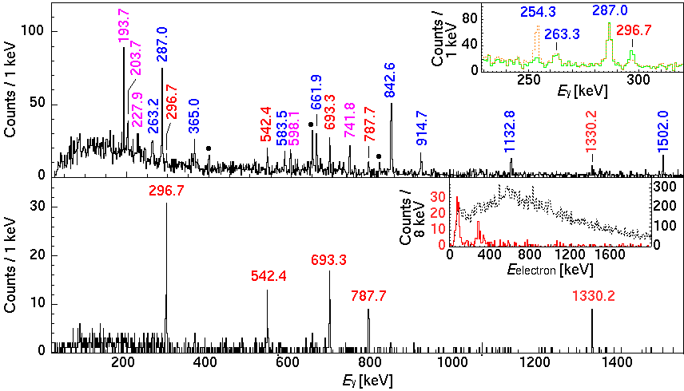
Long-lived isomer in ¹²⁶Pd
Within 50 ms after implantation of ¹²⁶Pd ions
Coincidence with electrons:
-0.5 ≦ Δt_{eγ} ≦ 0.5 μs (prompt)
-4.0 ≦ Δt_{eγ} ≦ 0.5 μs (early)
-0.5 ≦ Δt_{eγ} ≦ 50 μs (delayed)
Electron spectrum:
Gate on γ rays below 5⁻
Without γ-ray gate
86 keV IC
Gate on 86-keV IC ⇒ A new γ ray at 297 keV
H. Watanabe et. al., submitted
¹²⁶Pd₈₀

Slide 12
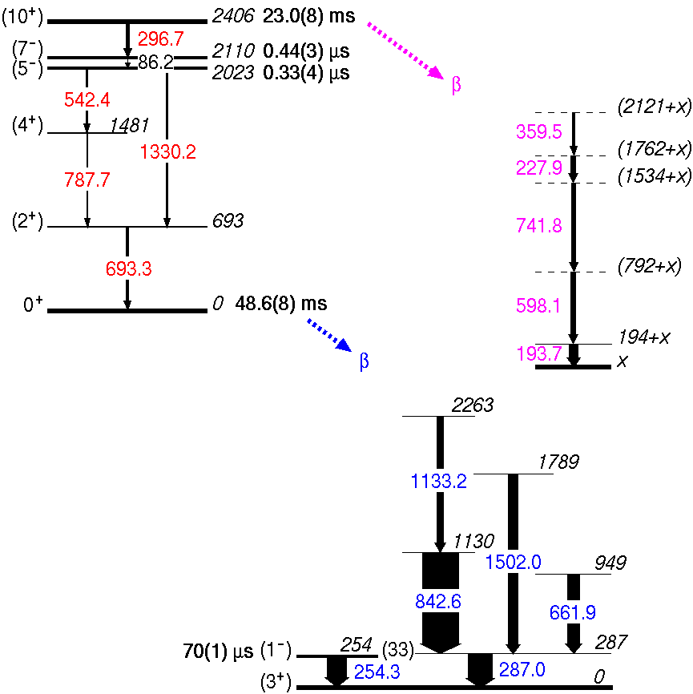
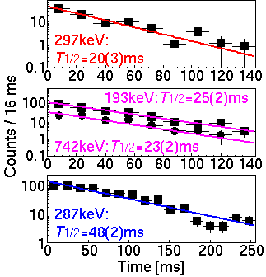
Decay schemes of the (10+) isomer and the ground state of ¹²⁶Pd
Long-lived isomer
E_{x} = 2406 keV
T_{1/2} = 23.0(8) ms
J^{π} = (10⁺)
R_{int} = 26(8) %
B(E3) = 0.07(2) W.u.
¹²⁶Pd₈₀
¹²⁶Ag₇₉
T_{1/2} average
20.4(13) ms
25.1(10) ms
48.6(8) ms

Slide 13
N=80 isotone
7⁻ : ν(h_{11/2}⁻¹d_{3/2}⁻¹)
10⁺ : ν(h_{11/2})⁻²
N=81 isotone
3/2⁺ : νd_{3/2}⁻¹
11/2⁻ : νh_{11/2}⁻¹
d_{5/2}
82
g_{7/2}
d_{3/2}
50
h_{11/2}
s_{1/2}
πg_{7/2}
g_{9/2}
Proton
Neutron
Monopole interaction
between πg_{7/2} (+ πd_{5/2})
and νh_{11/2}
For Z > 50, E(11/2⁻) decrease as Ce → Sn
Similar trend for E(10⁺)- E(7⁻) : Good probe for the evolution of shell orbits

Slide 14
N=80 isotone
7⁻ : ν(h_{11/2}⁻¹d_{3/2}⁻¹)
10⁺ : ν(h_{11/2})⁻²
N=81 isotone
3/2⁺ : νd_{3/2}⁻¹
11/2⁻ : νh_{11/2}⁻¹
Central only
d_{5/2}
V_{MU}
82
Central+Tensor
g_{7/2}
d_{3/2}
50
h_{11/2}
s_{1/2}
πg_{9/2}
g_{9/2}
Proton
Neutron
For Z < 50
πg_{9/2}-νh_{11/2} monopole
V_{MU}: monopole-based universal interaction
T. Otsuka et al., Phys. Rev. Lett. 104, 012501 (2010)
Central only ⇒ 11/2⁻ energy rapidly decreases
+ Tensor ⇒ Suppress the upward drift of νh_{11/2}

Slide 15
N=80 isotone
7⁻ : ν(h_{11/2}⁻¹d_{3/2}⁻¹)
10⁺ : ν(h_{11/2})⁻²
¹²⁸Cd
¹³⁰Sn
¹²⁶Pd
N=81 isotone
3/2⁺ : νd_{3/2}⁻¹
11/2⁻ : νh_{11/2}⁻¹
Central only
d_{5/2}
V_{MU}
82
Central+Tensor
g_{7/2}
d_{3/2}
50
h_{11/2}
s_{1/2}
πg_{9/2}
g_{9/2}
Proton
Neutron
For Z < 50
πg_{9/2}-νh_{11/2} monopole
V_{MU}: monopole-based universal interaction
T. Otsuka et al., Phys. Rev. Lett. 104, 012501 (2010)
Central only ⇒ 11/2⁻ energy rapidly decreases
+ Tensor ⇒ Suppress the upward drift of νh_{11/2}
Smaller energy difference between the 10⁺ and 7⁻ states in ¹²⁶Pd can be
explained by the monopole interaction including the central and tensor effects

Slide 16
N=80 isotone
7⁻ : ν(h_{11/2}⁻¹d_{3/2}⁻¹)
10⁺ : ν(h_{11/2})⁻²
±0 MeV
¹²⁸Cd
¹³⁰Sn
¹²⁶Pd
N=81 isotone
3/2⁺ : νd_{3/2}⁻¹
11/2⁻ : νh_{11/2}⁻¹
-0.1 MeV
-0.2 MeV
Monopole corrections for
the πg_{9/2}-νh_{11/2} TBME in SM
d_{5/2}
82
g_{7/2}
d_{3/2}
50
h_{11/2}
s_{1/2}
πg_{9/2}
g_{9/2}
Proton
Neutron
E(10⁺)- E(7⁻) shows
“kink” at Z=48 (¹²⁸Cd)
Other multipole components must be introduced
in a shell-model framework
Shell-model
calculation
¹³²Sn core, Z=28-50, N=50-82 model space
TBME: p-p, n-n (SDI)
p-n (Yukawa type) + monopole corrections for πg_{9/2}-νh_{11/2}
For Z < 50, E(10⁺)-E(7⁻) sensitive to the monopole part of the πg_{9/2}-νh_{11/2} TBME

Slide 17
Experimental result (Ⅲ)
Spin-gap isomer in ¹²⁷Ag₈₀ and its decay properties
Isomer

Slide 18
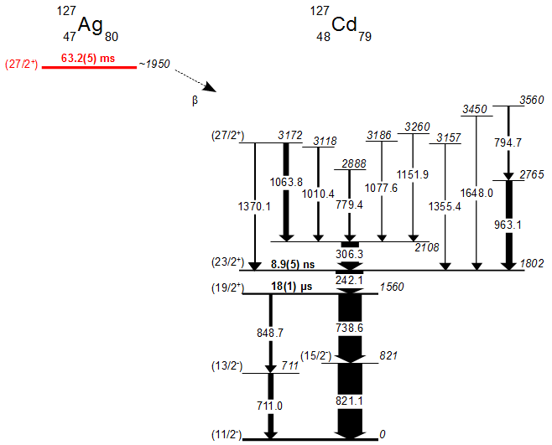
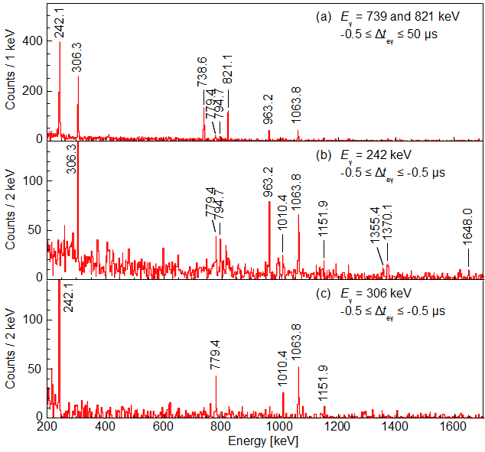
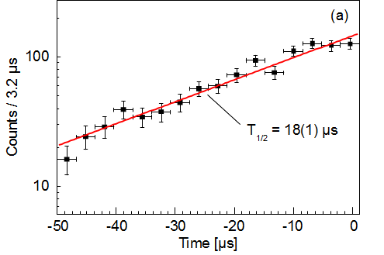
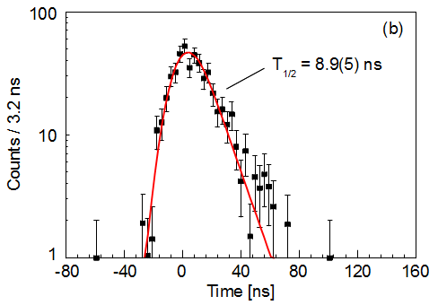
Long-lived isomer in ¹²⁷Ag
β-decay from ¹²⁷Ag to ¹²⁷Cd
739, 821 keV gate
242 keV gate
(19/2⁺)
(23/2⁺)
306 keV gate
ns, μs isomers

Slide 19
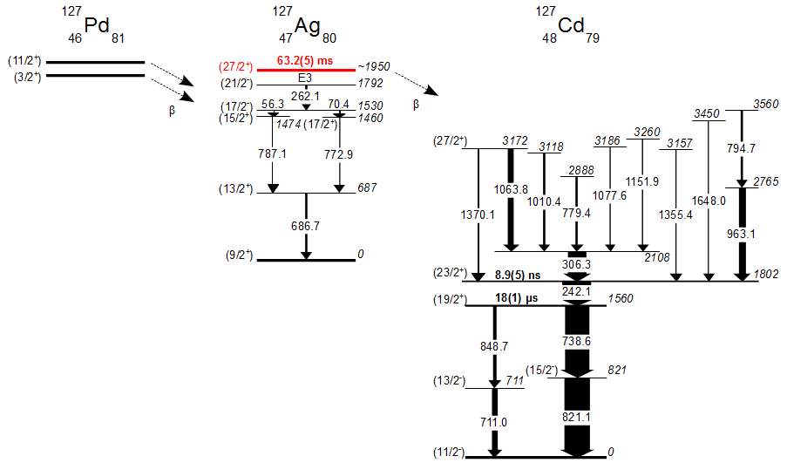
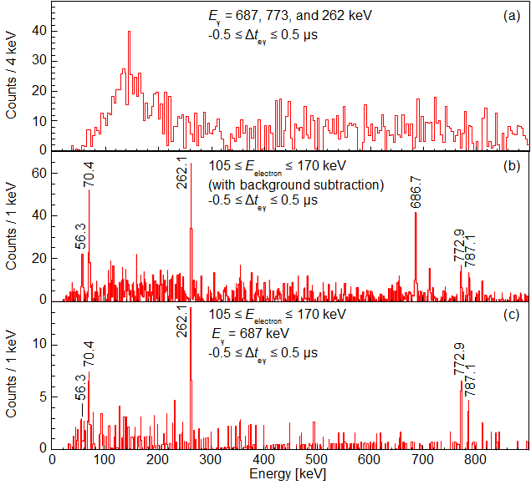
Long-lived isomer in ¹²⁷Ag
¹²⁷Ag internal decay
Electron spectrum
(687, 773, 262 keV gate)
Decay via E3 and β-decay
J^{π} = (27/2⁺), Ex ~ 1950 keV

Slide 20
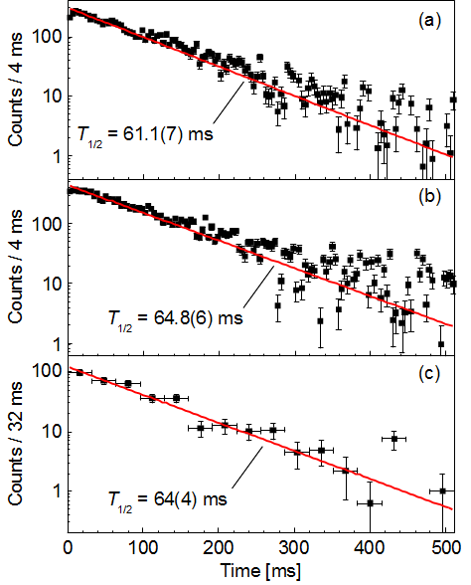
Long-lived isomer in ¹²⁷Ag
739, 821
242, 306
Decay via E3 and β-decay
687
J^{π} = (27/2⁺), Ex ~ 1950 keV
T_{1/2} = 63.2(5) ms
B(E3) = 0.32(3) W.u.

Slide 21
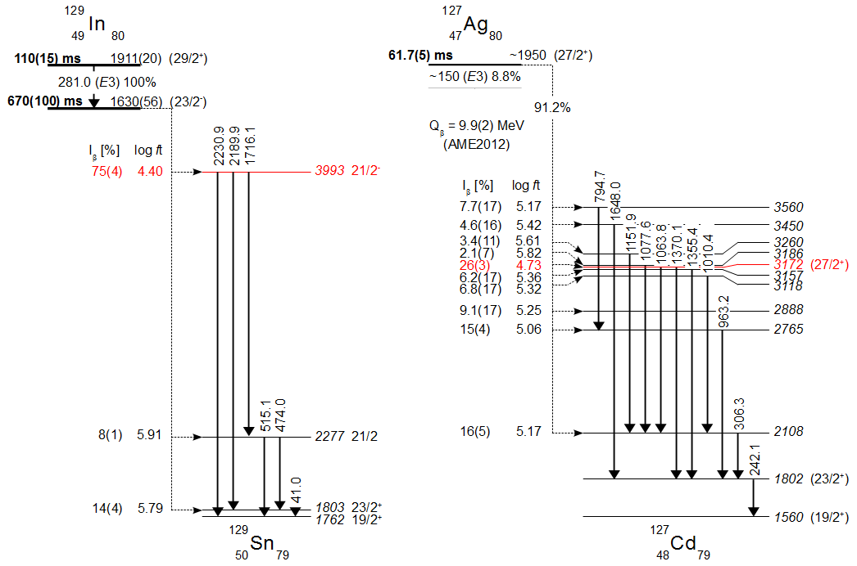
πg_{9/2}⁻¹ νh_{11/2}⁻²
πg_{9/2}⁻¹ νh_{11/2}⁻²
πg_{9/2}⁻¹ νh_{11/2}⁻¹d_{3/2}⁻¹
GT
GT
νg_{7/2}⁻¹h_{11/2}⁻¹d_{3/2}⁻¹
νg_{7/2}⁻¹ h_{11/2}⁻²
νd_{3/2}⁻¹ h_{11/2}⁻²
GT level with νg_{7/2}⁻¹ ~0.6 MeV
lower in ¹²⁷Cd than in ¹²⁹Sn
Upward drift of the νg_{7/2} orbital
in the N = 50-82 shell

Slide 22
Summary
Isomeric states in neutron-rich ₄₆Pd and ₄₇Ag isotopes have been studied as part of the EURICA U-beam campaign in 2012
¹²⁸Pd₈₂
T_{1/2} = 5.8(8) μs, E_{ex} = 2151 keV, J^{π} = (8⁺)
Good seniority as a result of the robust shell closure at N = 82
¹²⁶Pd₈₀
T_{1/2} = 0.33(4) μs, E_{ex} = 2023 keV, J^{π} = (5⁻)
T_{1/2} = 0.44(3) μs, E_{ex} = 2110 keV, J^{π} = (7⁻)
T_{1/2} = 23.0(8) ms, E_{ex} = 2406 keV, J^{π} = (10⁺)
Small energy difference between the 10⁺ and 7⁻ isomers, explained by the p-n monopole interaction including the central and tensor forces
¹²⁷Ag₈₀
T_{1/2} = 63.2(5) ms, E_{ex} = ~1950 keV, J^{π} = (27/2⁺)
Lowering the GT level due to the monopole drift of the νg_{7/2} orbital

Slide 23
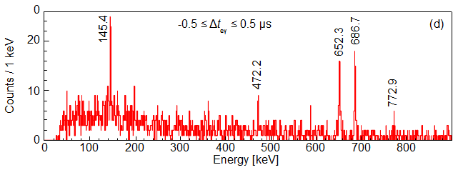
β-decay of ¹²⁷Pd
Decay via E3 and β-decay
J^{π} = (27/2⁺), Ex ~ 1950 keV
T_{1/2} = 63.2(5) ms
B(E3) = 0.32(3) W.u.

