Slide 1
Proton Inelastic Scattering on Island-of-Inversion Nuclei
Shin’ichiro Michimasa (CNS, Univ. of Tokyo)
Phy. Rev. C 89, 054307 (2014)
Notes:
First of all, I would like to thank organizers to giving a chance to show our experiment in ARIS conference.
My talk title is “Proton inelastic scattering on Island of Inversion Nuclei”.
My name is Shin’ichiro Michimasa from CNS, University of Tokyo.

Slide 2
Contents
Motivation
Details of the experiment
Results (Gamma-ray spectra)
Discussion
Summary
Notes:
This talk will proceed as follows:
As an introduce of this work, I will show a motivation.
After that, I will show a details of the experimental setup.
Thirdly, I will show some spectra of very neutron-rich nuclei.
Based on the results, I will discuss the evolution of Island of inversion region.
Finally I will give a summary of this talk.

Slide 3
Details of the Experiment
1) Motivation
2) Details of Experiment (Secondary beam and Setup)
Notes:
I move to the motivation section.

Slide 4
Motivation
Q. How broad is “Island of Inversion” ?
This work
Explore deformation of nuclei located at n-rich side of IoI
by using proton inelastic scattering
Nuclei in Island of Inversion
N=20
(conventional magicity)
A/Z=3
Low E_{x}(2⁺₁)
Large deformation
Small B(E2）
Notes:
As you know, the Island of Inversion region is an interesting region
where this is located near the conventional magic number of N=20,
but their low excitation energies, large deformation and small B(E2) values were observed.
Here, our question is “How broad is Island of inversion region.
To answer the question, we investigate the deformation of nuclei located at neutron-rich side of Island of Inversion
By using proton inelastic scattering.
Actually, we measured south and east parts of Island of Inversion region.

Slide 5
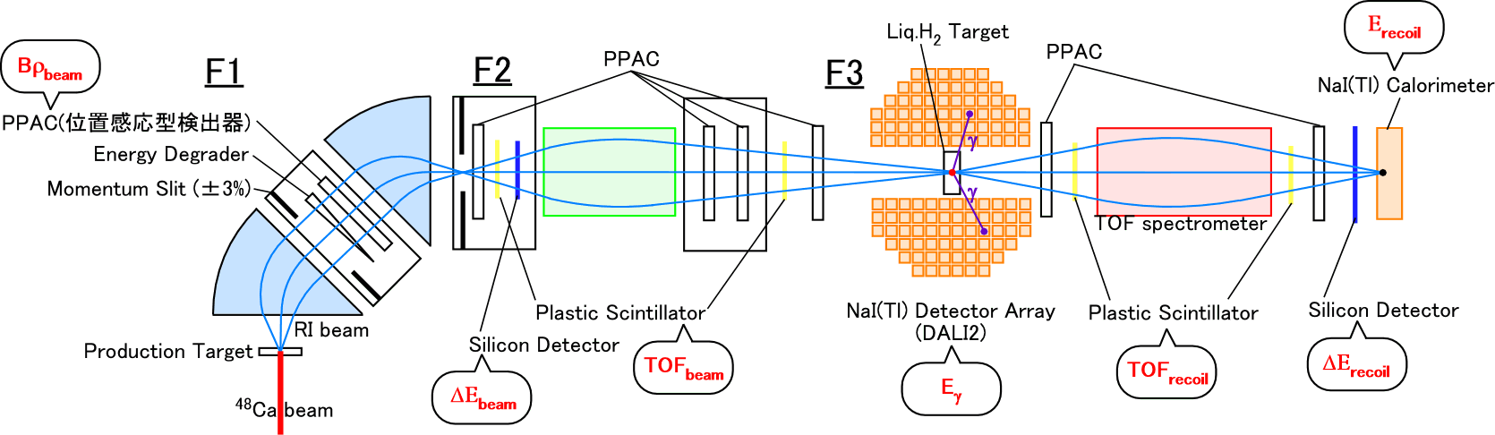
Experimental Setup (RIPS @ RIBF)
Configuration
Conditions
Primary beam: ⁴⁸Ca beam at 63 MeV/u, 80pnA (typically)
Primary Target: ¹⁸¹Ta or ⁶⁴Ni
Secondary beam: Tuned A/Z=3 nuclei (³⁶Mg 44.5 MeV/u, ³⁰Ne 45.0 MeV/u)
Secondary Target: Liq. H₂ target with 95 mg/cm²
Notes:
This is the experimental setup of this experiment.
The experiment was a gamma-ray spectroscopy of proton inelastic scattering with inverse kinematics.
The experiment was performed in RIPS beam line of RIBF.
The primary beam was 63 MeV per nucleon Calcium-48, typical intensity was 80 particle nA.
The RIPS was tuned for A/Z=3 nuclei, such as 30Ne and 36Mg.
The secondary target was a liquid hydrogen target of 95 mg/cm2.
The PID of incident and outgoing particles were done by RIPS separator and TOMBEE spectrometer, respectively.
The excitation energies of outgoing particles were determined by the de-excitation gamma-rays,
which was detected by DALI2 array surrounding the secondary target.

Slide 6
Secondary beam conditions
³⁶Mg : Typically ~0.3 cps
Notes:
This slide shows the secondary beam condition.
The secondary beam contained a lot of nuclei around Ne and Mg region,
and we could measure the inelastic channel of these nuclei at the same time.
Typical intensity of ³⁶Mg was 0.3 counts per second.

Slide 7
Results (Gamma-ray spectra)
1) ³⁴Mg
2) ³⁰Ne
3) ³⁶Mg
Notes:
Next, we move to the resultant the de-excitation gamma-ray spectra.

Slide 8
³⁴Mg
Multiplicity gate (Mγ) works well
to reduce γ-cascade events,
therefore the cross section
of the 2⁺₁→0⁺₁ transition
is estimated with a gate of Mγ=1
σ_{(p,p’)} = 63(5) mb
→ β₂ ~ 0.62
Notes:
These spectra show the gamma-ray spectra from Magnesium-34.
The left figure show single spectra and right side was limited by detection multiplicity of 1.
The detection multiplicity works well to reduce the gamma-ray cascade events.
And therefore, by using this gate, we can determine the first 2^+ excitation cross section clearly.
The cross section was determined by comparison between the measured spectra and the simulated spectra.
In 34Mg case, the deduced cross section for 2^+ state was 63 mb.
It corresponds to beta_2 of 0.62
In the left figure, we found gamma-rays except the 660 keV line.
To determine the excitation energies of the states, we checked gamma-gamma coincidence of these lines.

Slide 9
³⁴Mg (2)
2011 keV
σ_{(p,p’)} = 5(2) mb
3194 keV
σ_{(p,p’)} = 10(2) mb
Cascade component
in the 658-keV peak
is 24%.
Notes:
The left figure shows coincident spectra with 660-keV line.
The upper panel show the case that incident particles were not selected,
And lower panel show the inelastic channel.
In both figure, we can clearly show the 1.35 MeV and 2.53 MeV lines coincident with 0.66 MeV line.
Therefore we conclude the level scheme shown in the right side.
The cross sections for 2.0 MeV and 3.2 MeV are 5 mb and 10 mb, respectively.
Those components effects 24% enhancement of 0.6 MeV peak in the single spectrum.

Slide 10
³⁴Mg (2)
Ref. P. Doornenbal et al., PRL 111, 212502 (2013).
(Typical intensity: 90 cps of ³⁶Mg )
Notes:
About the reconstructed level scheme,
the right figure shows the resent result by Peter Doornembal.
Our result is consistent with this result.

Slide 11
³⁰Ne
σ_{(p,p’)} = 37(4) mb
→ β₂ ~ 0.45
Notes:
These spectra show the gamma-ray spectra from Neon-30.
In 30Ne case, we could not find any gamma-ray cascade.
The deduced cross section for 2^+ state was 37 mb from the both spectra.
It corresponds to 0.45 of beta_2.

Slide 12
³⁶Mg
σ_{(p,p’)} = 48(8) mb
→ β₂ ~ 0.50
Notes:
These spectra show the gamma-ray spectra from Mg-36.
In this case, we could not find any gamma-ray cascade, either.
The deduced cross section for 2^+ state was 48 mb from the both figures.
It corresponds to 0.50 of beta_2.

Slide 13
Deformation Lengths of IoI nuclei
Standard error bar: Statistical error
Orange bar: Systematic error
Optical Potential: WP09, S.P. Weppner et al., PRC 80, 034608 (2009).
Notes:
From the deduced cross sections, we calculated deformation lengths by DWBA calculation.
This figure shows comparisons with the previous works.
As the optical potential, WP09 potential was adopted.
The present experiment could provide deformation lengths of more n-rich nuclei such as 30Ne, 34Mg and 36Mg.
And these deformation lengths are consistent with those from Coulomb Excitation works.

Slide 14
Discussion
1) Systematics of deformation lengths
2) Difference of shell evolution
in Ne/Mg and Mg/Si isotones.
Notes:
As a discussion,
We show the systematic of deformation lengths,
And difference of shell evolution in Ne/Mg and Mg/Si isotones.

Slide 15
Systematics of deformation lengths
Isotope
Notes:
This figure shows the systematic trends of deformation lengths along Ne an Mg isotopes.
Generally speaking, theories implementing sd-pf configuration mixing were well reproduced the trends
and 0hbar omega fails especially N=20 and 22.
In Ne isotopes, these systematically overestimate the deformation lengths.
However at N=24, sd-pf shell model and 0hw shell model predict similar deformation length.
One of this reason was that intruder configuration decrease between N=22 and 24.
To make clear this property, we make the ratio of deformation length of Ne/Mg and Mg/Si.

Slide 16
Comparisons of deformation lengths of Ne/Mg and Mg/Si isotopes
⇒ Shell evolutions of Ne and Mg
are similar in the normal and IoI regions
Ne is systematically weak (~90%) compared with Mg.
⇒ Deformation lengths ratio
of Mg and Si isotones are different
between the normal and IoI regions.
Mg/Si ratio increases gradually up to N=20, and it turns to decrease along N number.
It may indicate that evolution of intruder configuration in ^{32,34,36}Mg is decreasing, although they are still well-deformed nuclei.
Notes:
The figure shows the ratios of deformation lengths of Ne/Mg and Mg/Si.
In panel (a), the experimental result of the Ne/Mg ratio is almost flat around 0.9
in the inside and outside of Island of Inversion.
On the other hands, theories were slightly increase in Island of Inversion.
The results seems that shell evolutions of Ne and Mg isotopes were similar trend through neutron number.
While, Mg and Si ratio was different between stable side and island of inversion region.
We consider deformation of Si isotopes is reflected from shell evolution of neutron pf shell.
So the enhancement of this ratio is considered to come from intruder configuration mixing in Mg.
Mg/Si ratio increases gradually up to N=20,
And it turns to decrease along the neutron number.
So it may indicate that evolution of intruder configuration in Mg isotopes is decreasing,
Although thy are still well-deformed nuclei.

Slide 17
Summary
We have investigated nuclear deformation lengths of n-rich Ne and Mg isotopes (³⁰Ne, ^{34,36}Mg)
by using a proton inelastic scattering reaction.
Deformation lengths of these nuclei were successfully deduced with considering cascade γ-rays
from upper excited states.
Systematic trends of Ne an Mg deformation are well reproduced by SDPF-M and AMPGCM,
which take into account intruder configuration in island-of-inversion region.
In Ne isotopes, they overestimate the deformation lengths somehow.
Deformation trend of Ne isotopes is similar to that of Mg isotopes.
Regardless of stable side and inside of the IoI region, the ratio of Ne/Mg is almost constant (~0.9).
Deformation trends of Mg and Si are different. The Mg/Si ratio is increasing up to N=20, and
decreasing in N=22, 24. It may indicate that evolution of intruder configuration in ^{34,36}Mg are
weakening along the neutron number, although they are still well-deformed nuclei.
Notes:
This is the summary.

Slide 18
Collaboration
Notes:
They are collaborators.
Thank you for your attention.

Slide 19
Backup

Slide 20
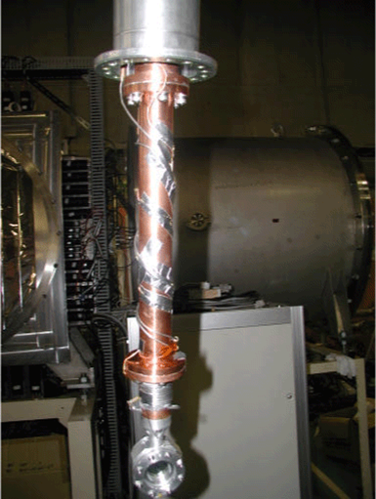
CRYPTA (Liquid H₂ target)
Specification of Liquid Hydrogen Target
Thickness : 100 mg/cm²
Size : 30 mm diameter
Window : 6-μm Havor
Cryostat : Keeping at ~15 K
Developed in CNS/RIKEN¹⁾
Ref: H.Ryuto et al., NIM A 555, 1 (2005).
Cryostat
Target
Notes:
This slide shortly shows our liquid hydrogen target, CRYPTA system.
This system provided 100 mg/cm2 pure hydrogen target for our experiment.

Slide 21
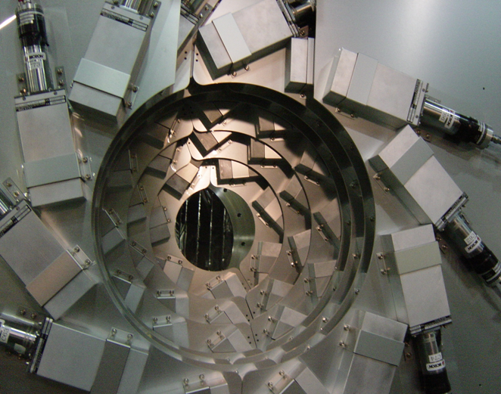
DALI (NaI(Tl) Array for Gamma rays)
Specifications
160 NaI(Tl) Crystals
Surrounding a secondary target:
θ_{lab} = 20-160 degrees.
Efficiency for γ-rays:
17.6% for 0.66-MeV γ-ray (¹³⁷Cs)
Energy Resolution for Moving Particles:
8.2%(σ) for 0.66-MeV γ-rays
from ³⁴Mg(2₁⁺→0₁⁺) at β = 0.27.
Photograph taken at the position
of the secondary target.
We will show γ-ray spectra outgoing Mg isotopes
Notes:
This is the specification of DALI2.
DALI2 consisted of 160 NaI crystal,
and typical efficiency was 17.6% for a Cs source.
The energy resolution was 8.2% for 0.6 MeV from moving particles.

Slide 22
Backup
Refs.
[26] Y. Yanagisawa et al., PLB 566, 84 (2003).
[29] S. Takeuchi et al., PRC 79, 054319 (2009).
[38] Zs. Dombradi et al., PRL 96, 182501 (2006)

Slide 23
PID of Outgoing Particles (Mg cases)
PID resolution
Z: 1.8%(FWHM)
A: 2.3%(FWHM)
⇒ 3 sigma separation.

