Slide 1
Erosion of N=28 Shell Gap and
Triple Shape Coexistence in the vicinity of ⁴⁴S
M. Kimura (Hokkaido Univ.)
Y. Taniguchi (RIKEN), Y. Kanada-En’yo(Kyoto UNIV.)
H. Horiuchi (RCNP), K. Ikeda(RIKEN)

Slide 2
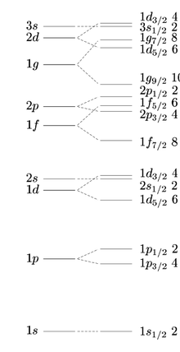
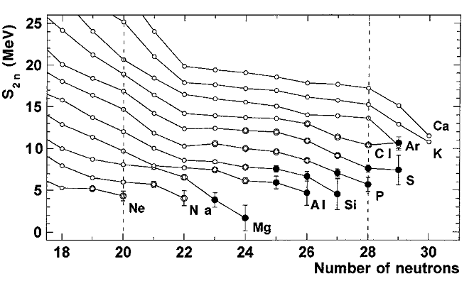
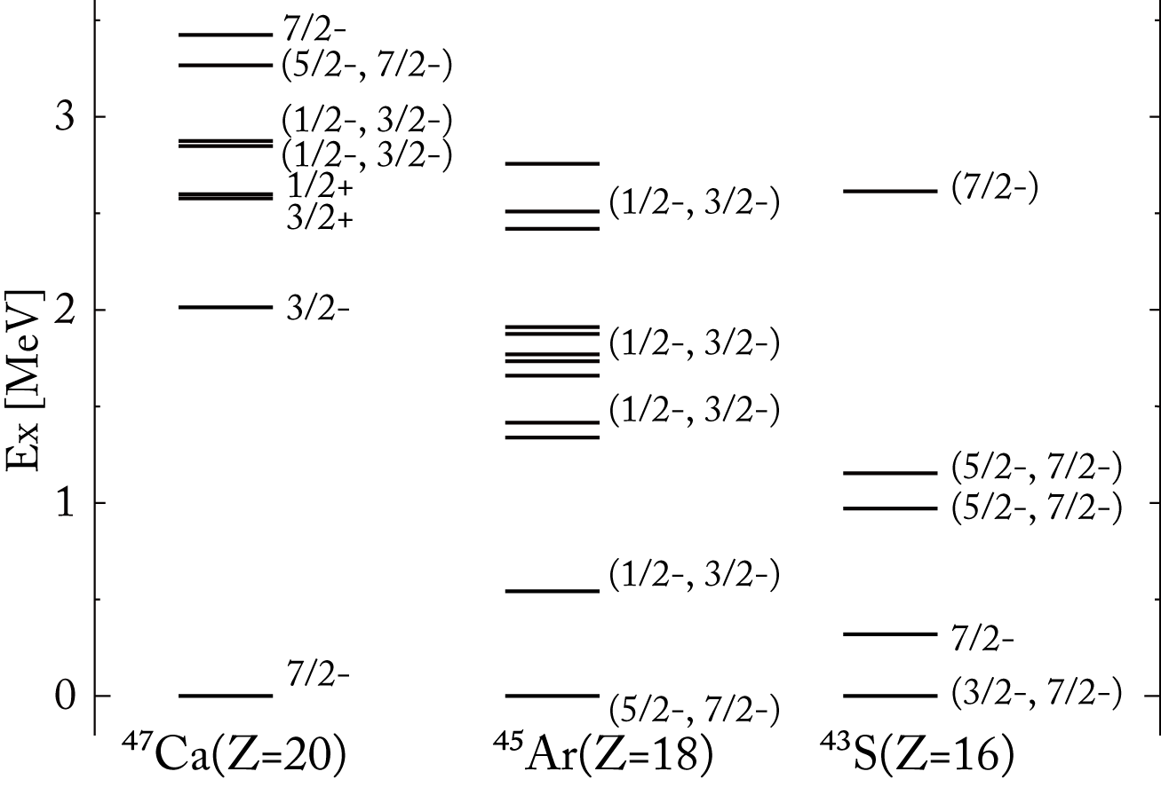
Erosion of N=28 shell gap
Erosion of N=28 shell gap in Si(Z=14) – Cl(Z=17) isotopes
Spectra of N=27 isotones
(http://www.nndc.bnl.gov/ensdf )
50
40
28
F. Sarazin, et al., PRL 84, 5062 (2000).
20
p_{3/2} particle
8
f_{7/2} hole?
f_{7/2} hole
2
p_{3/2} particle?
WS
WS+LS

Slide 3
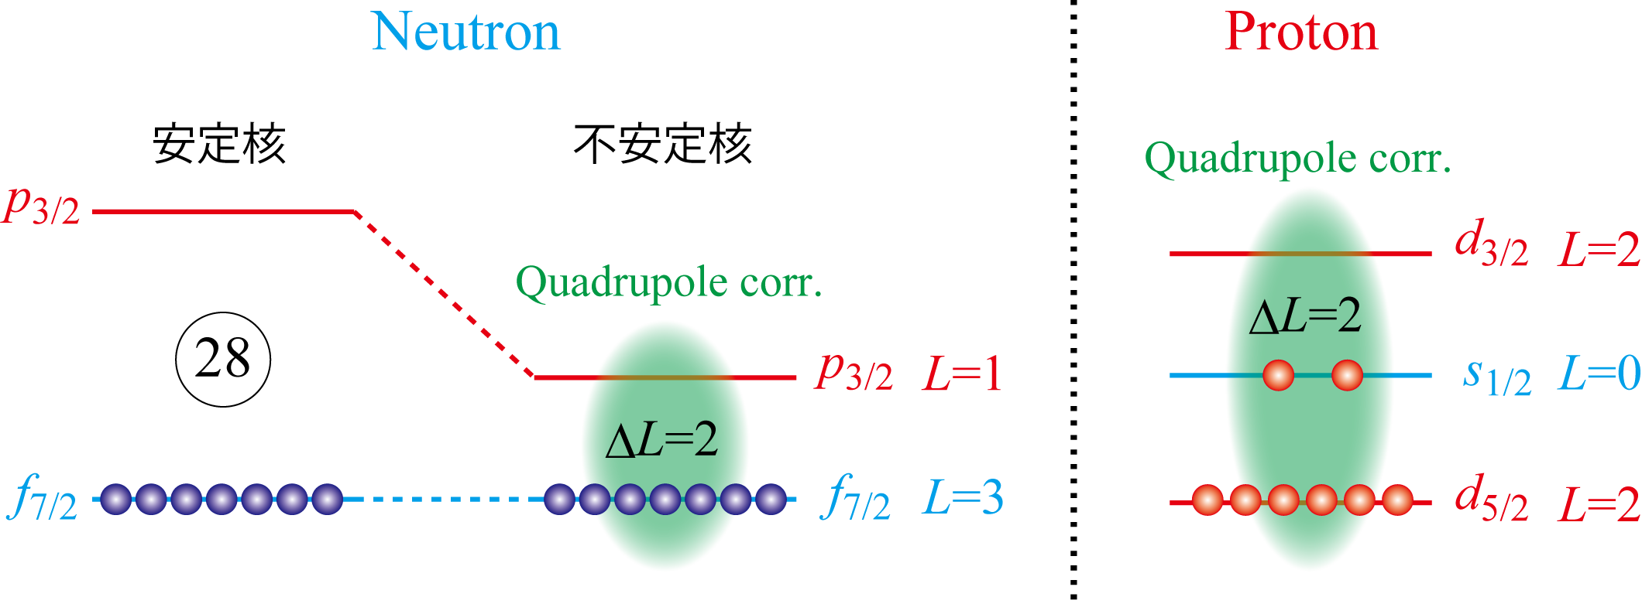
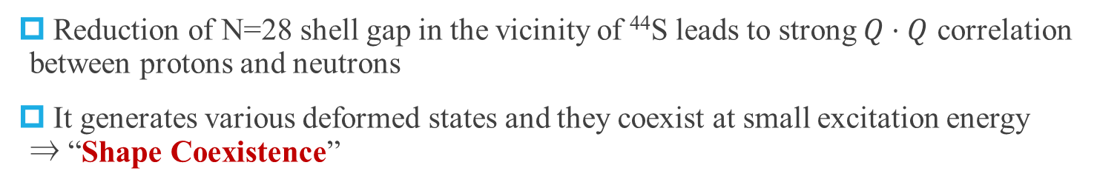
Enhancement of Quadrupole Correlation ⇒ Shape coexistence
Reduction of N=28 shell gap in the vicinity of ⁴⁴S leads to strong $Q⋅Q$ correlation between protons and neutrons
It generates various deformed states and they coexist at small excitation energy
⇒ “Shape Coexistence”
stable
unstable
“Triple configuration coexistence in ⁴⁴S”, D. Santiago-Gonzales, PRC83, 061305(R) (2011).
“Shape transitions in exotic Si and S isotopes and tensor-driven Jahn-Teller effect“,
T.Utsuno, et. al., PRC86, 051301(2012).

Slide 4
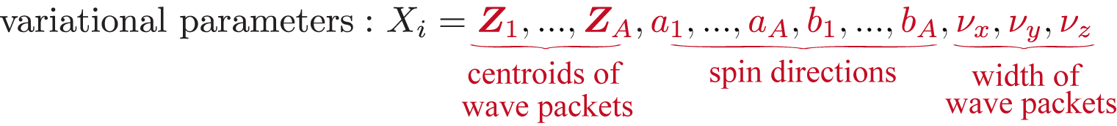
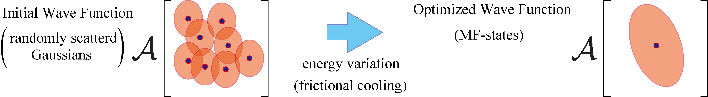
AMD framework
Microscopic Hamiltonian (A-nucleons)
Gogny D1S interaction, No spurious center-of-mass energy
Variational wave function
Gaussian wave packets, Parity projection before variation
Notes:
AMD framework. We start from microscopic Hamiltonian, uses Gogny D1S interaction. Our variational wave function is parity projected Slater determinant, in which each nucleon is described by a Gaussian wave packet. Of course there is no a priori assumption on cluster structure. Here the position of Gaussian wave packets are described by Z, and width of Gaussian, namely the size and deformation of nucleon wave function are represented by nu. And spin direction of each nucleon is parameterized by a and b. Those variational parameters are optimized by energy variation. Namely, we start our calculation from the randomly scattered Gaussian wave packets and energy variation determines position of wave packets. If there is MF state, the wave packets are close to each other, while if there is cluster state, wave packets are spatially separated to describe clusters.

Slide 5
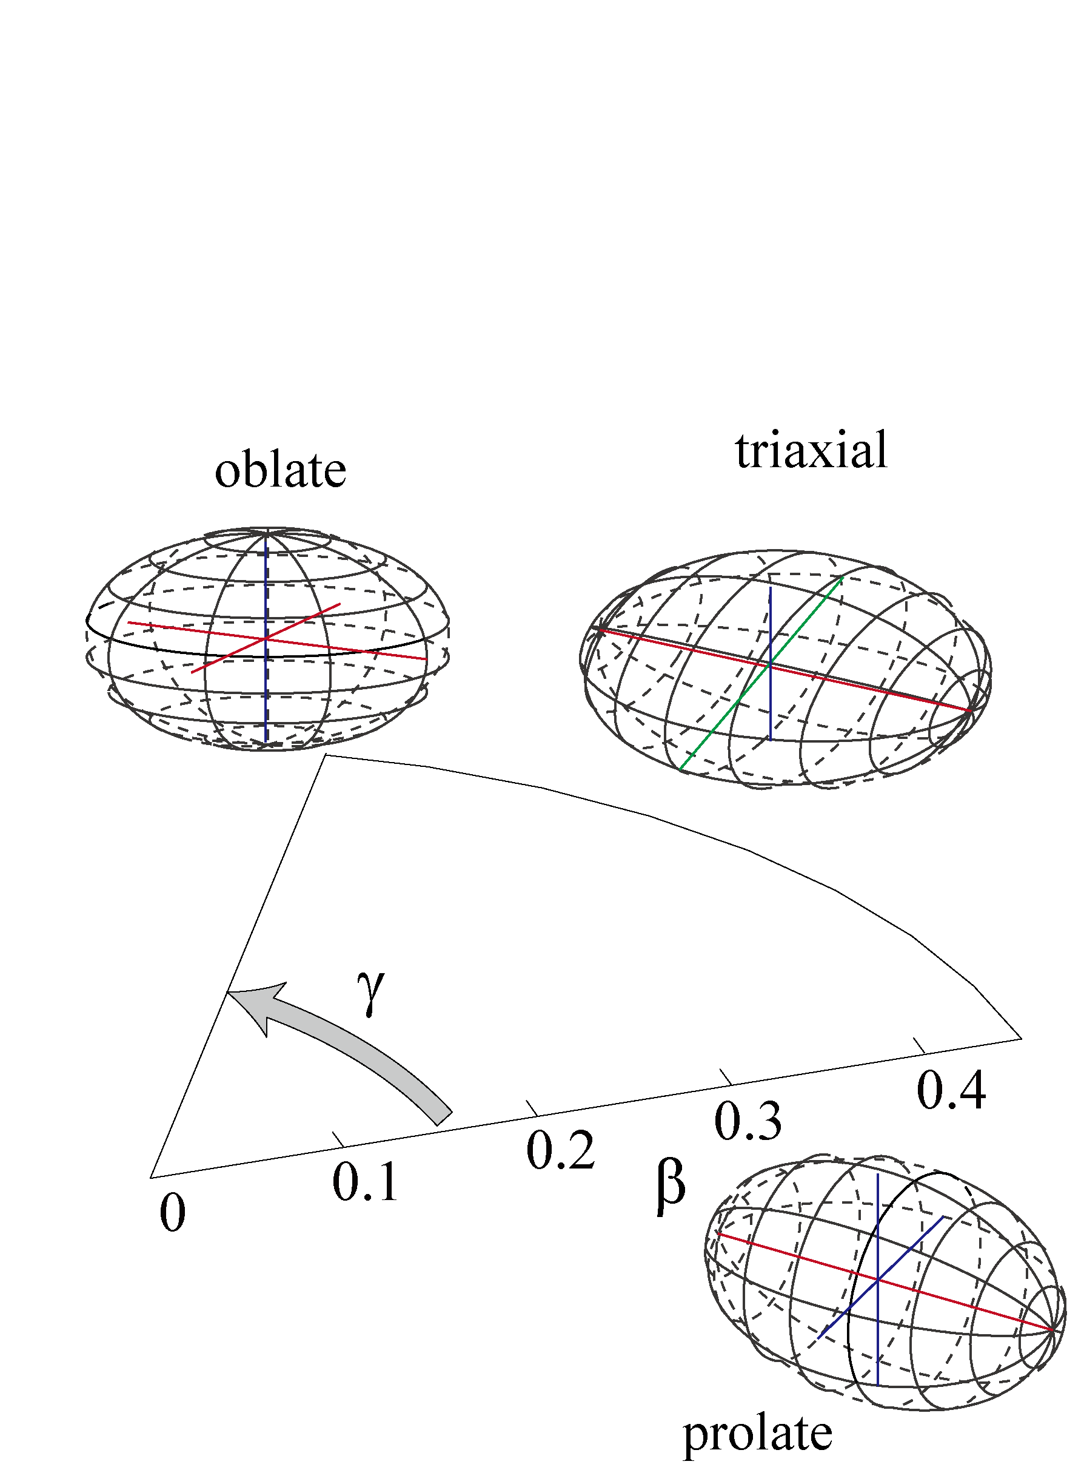
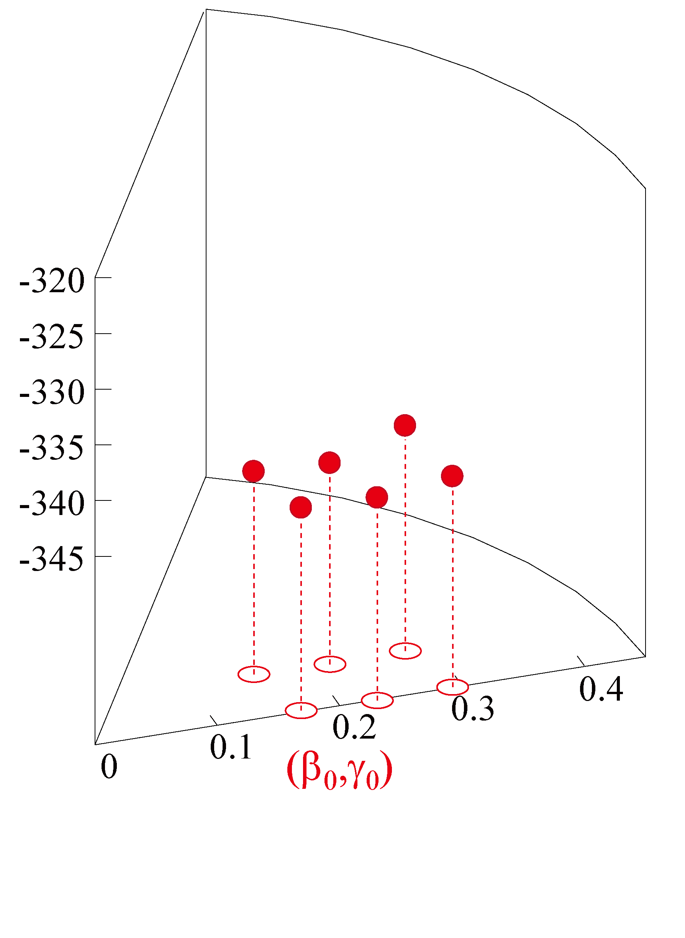
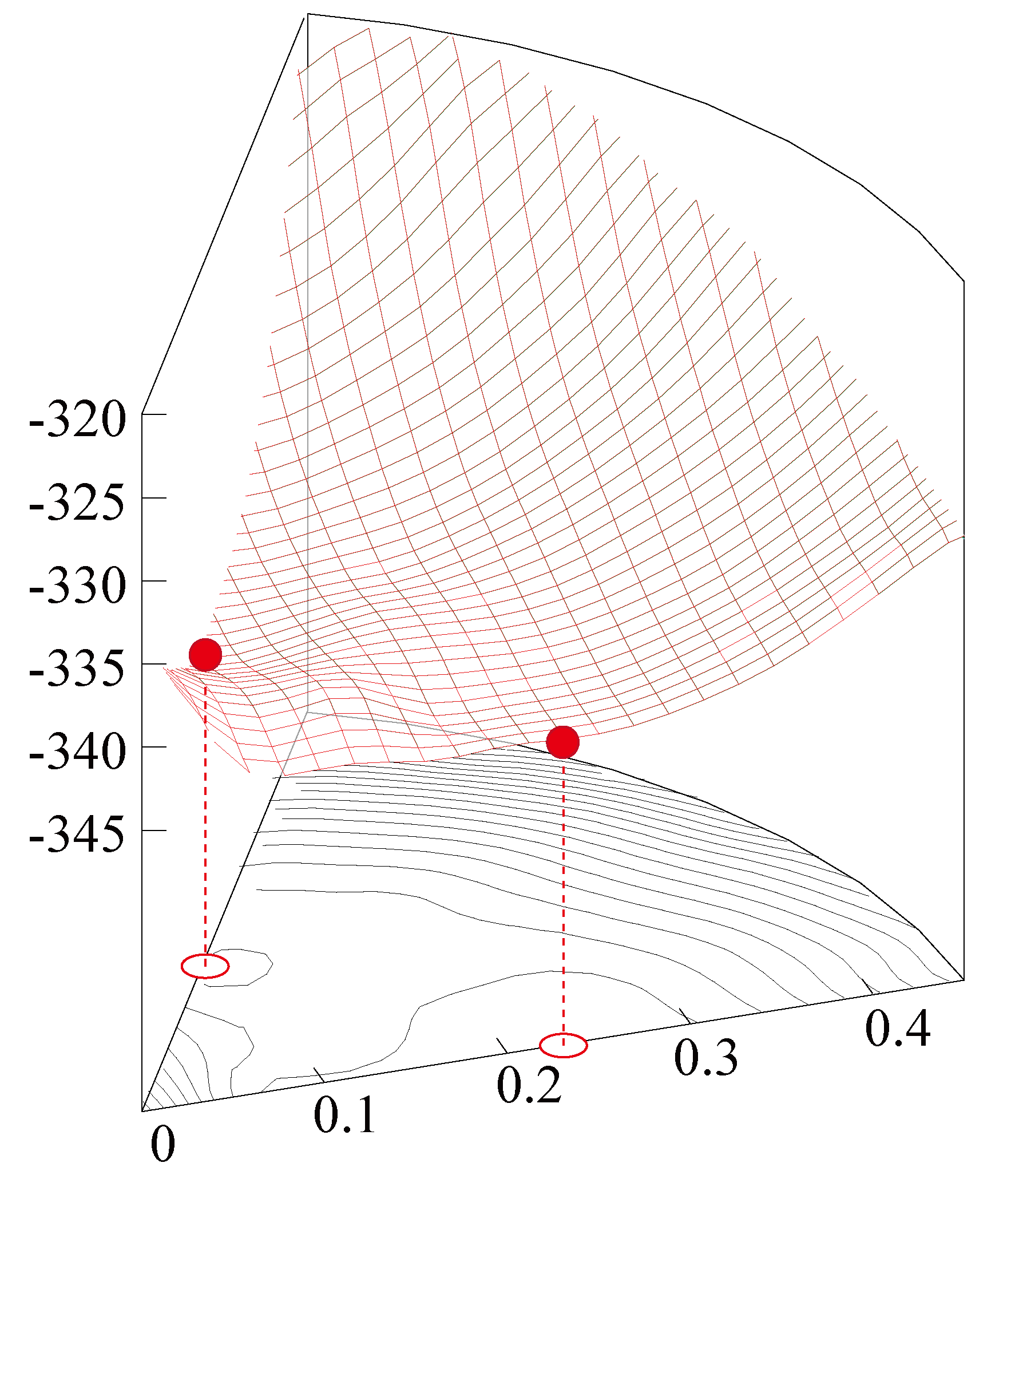
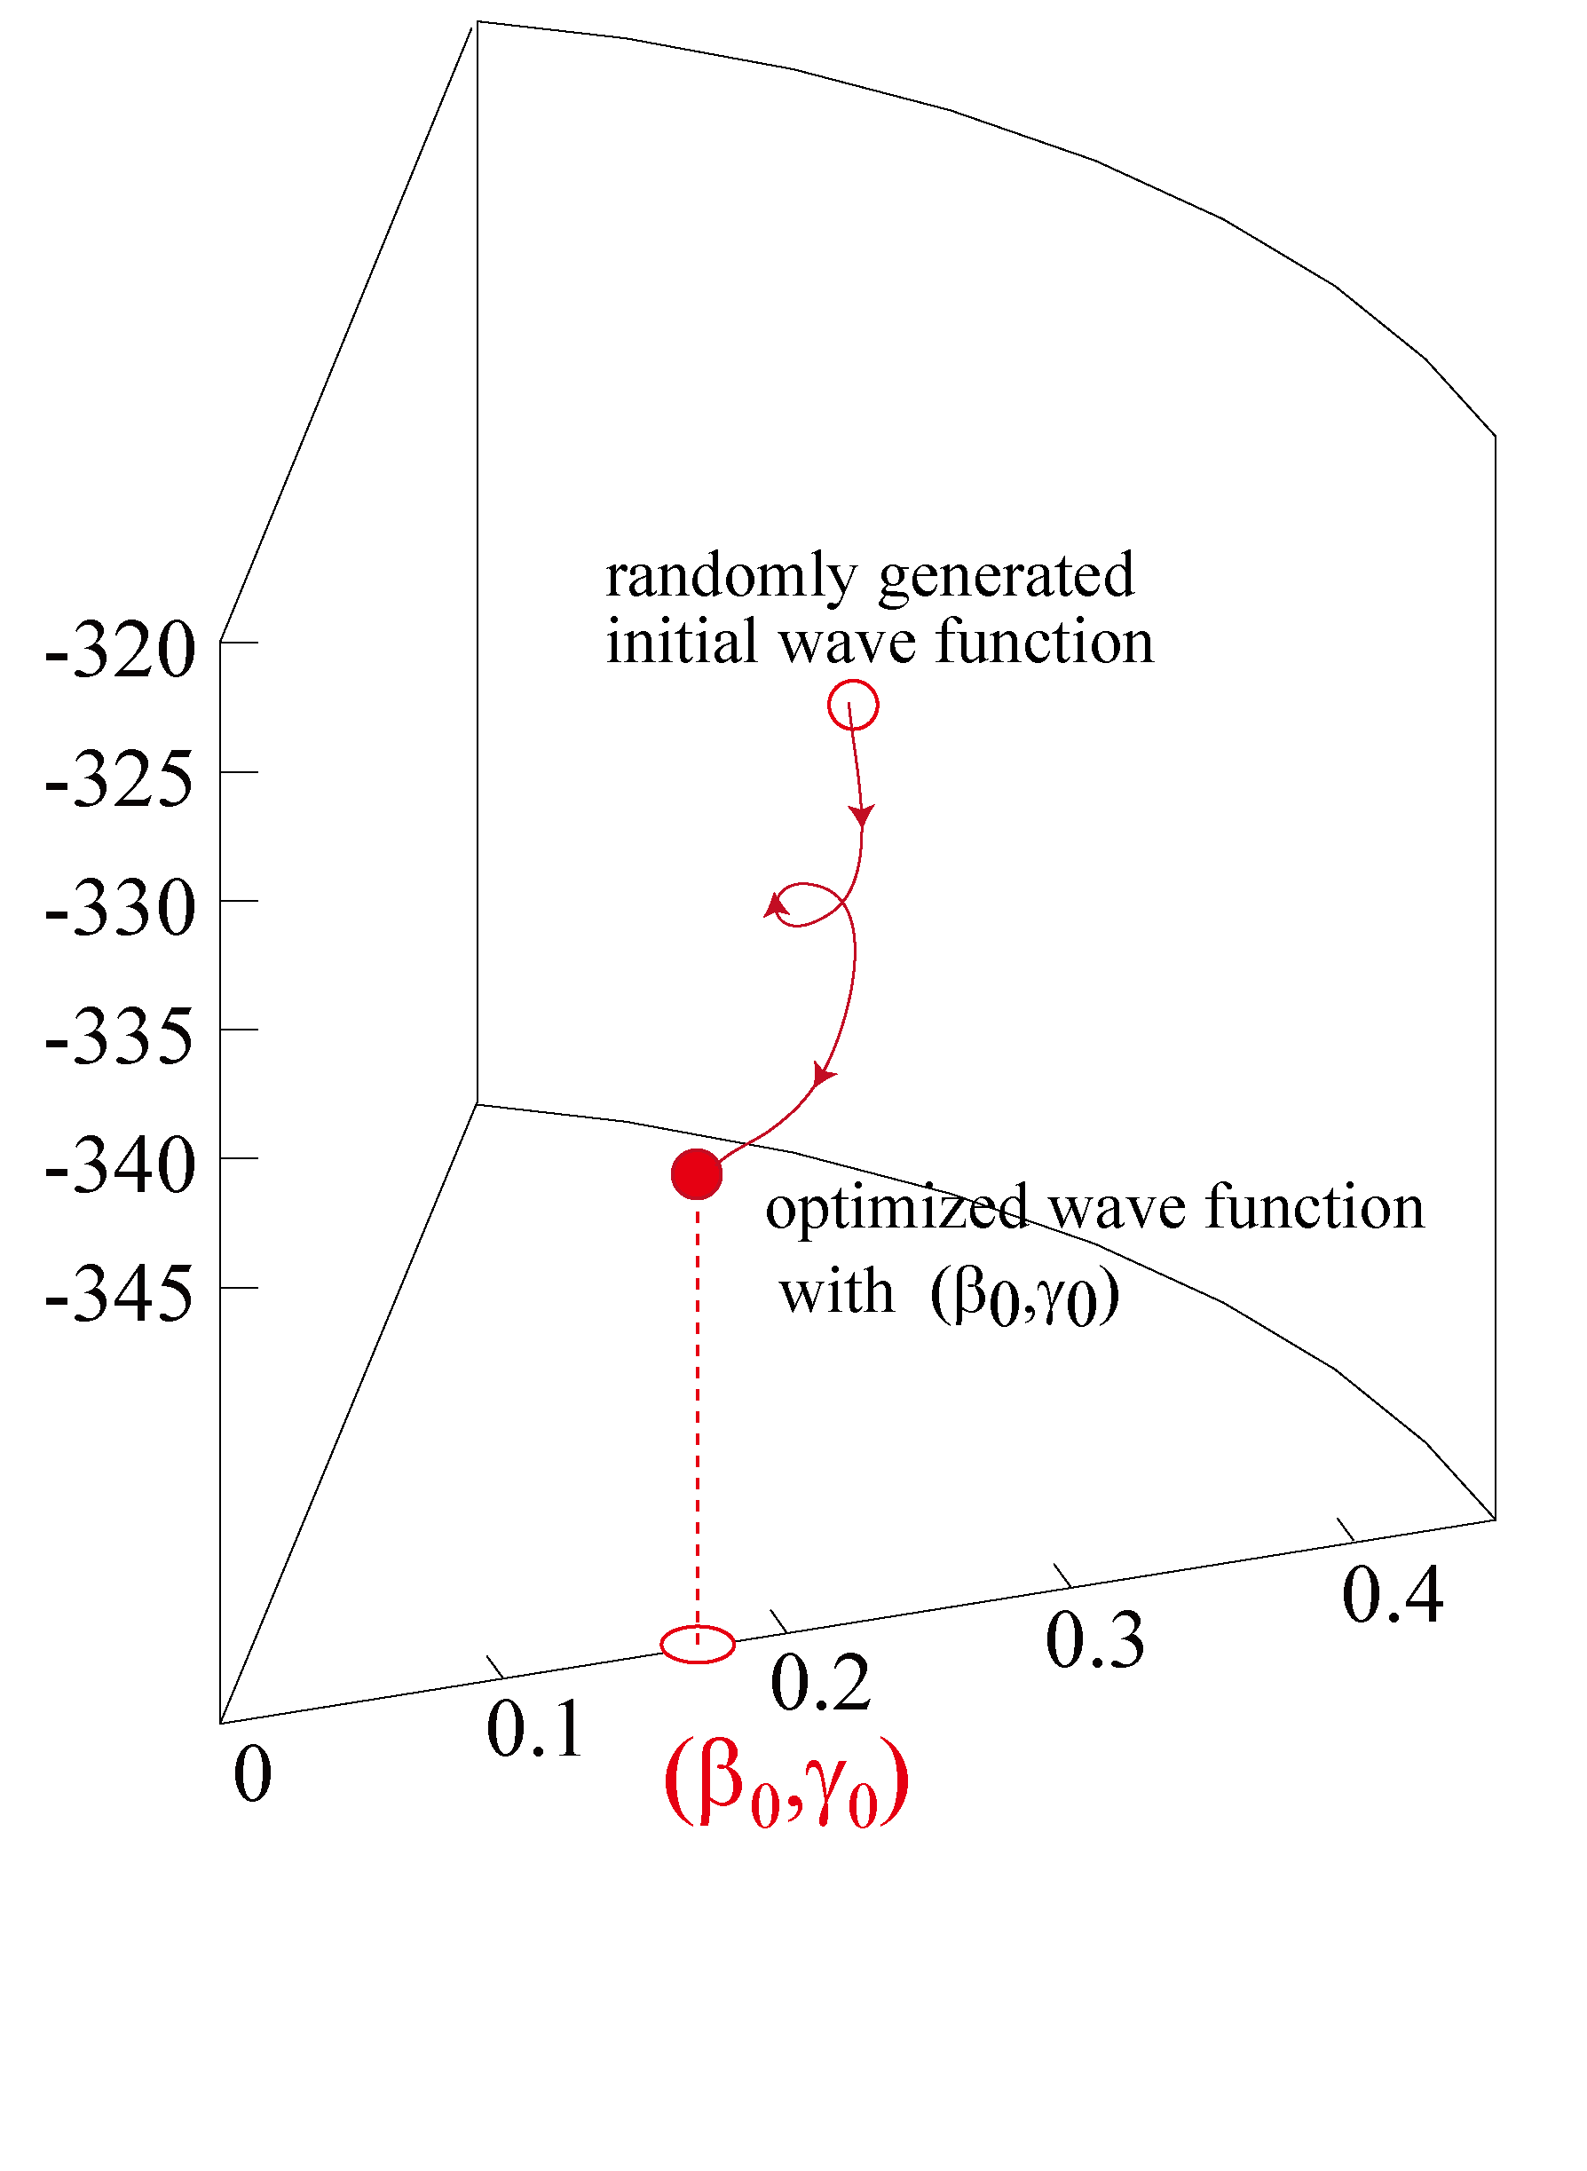
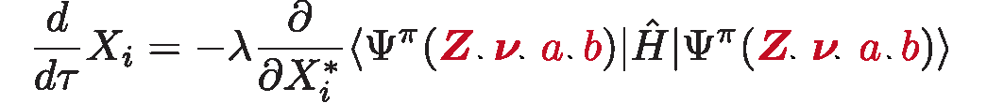
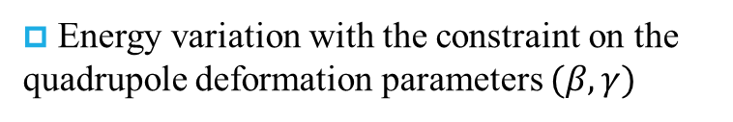
AMD framework: an example of ⁴⁵S
Step 1: Energy variation with constraint on quadrupole deformation
Energy variation with the constraint on the quadrupole deformation parameters $(β,γ)$
Equations for “frictional cooling method”
⁴⁵S(Z=16, N=29)
Prolate and oblate minima
Very soft energy surface
Notes:
Let’s practical AMD calculation procedure and low-lying quadrupole collectivity of Mg-24. The first step of the calculation is energy variation with constraint on quadrupole deformation. We start from randomly generated initial wave function and minimize energy for given values of quadrupole deformation. We continue this and get energy suface. This is the positive-parity state energy surface of Mg-24. At this stage, the energy minimum is axial symmetric and prolately deformed.

Slide 6
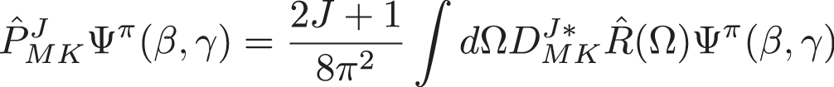
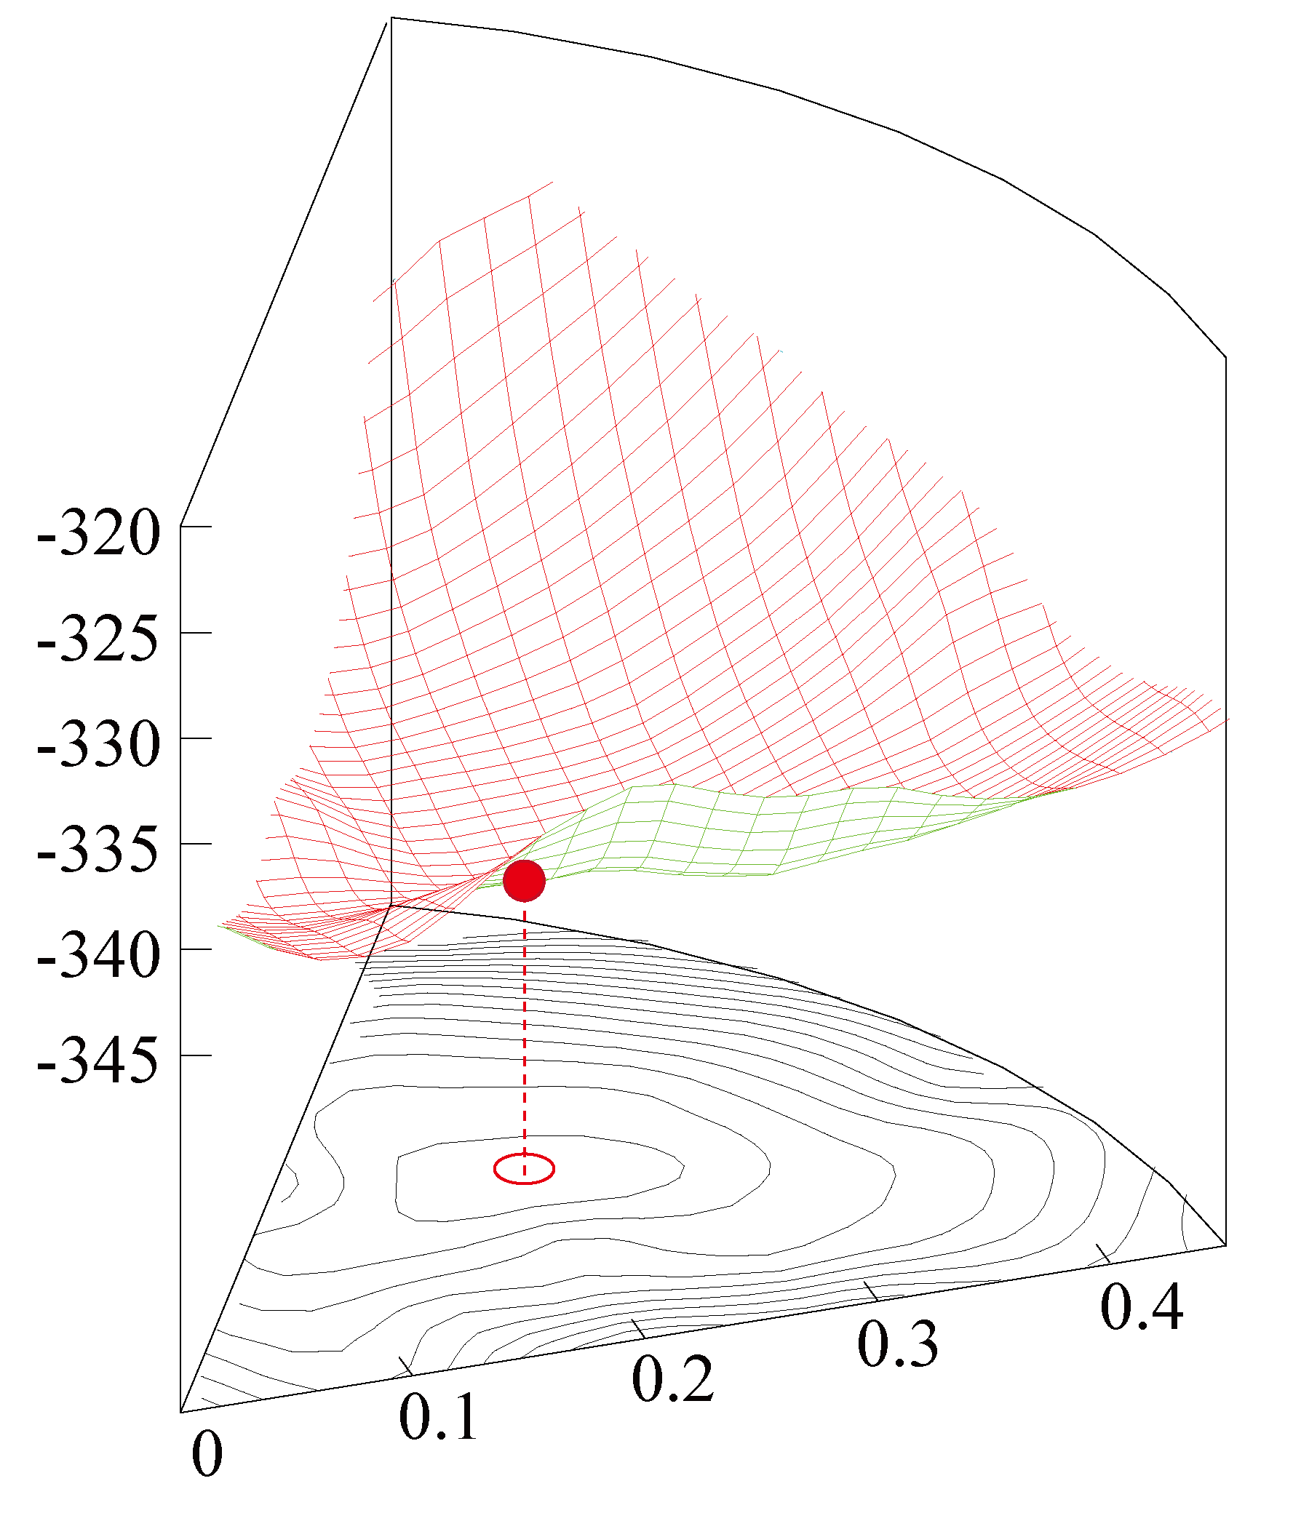
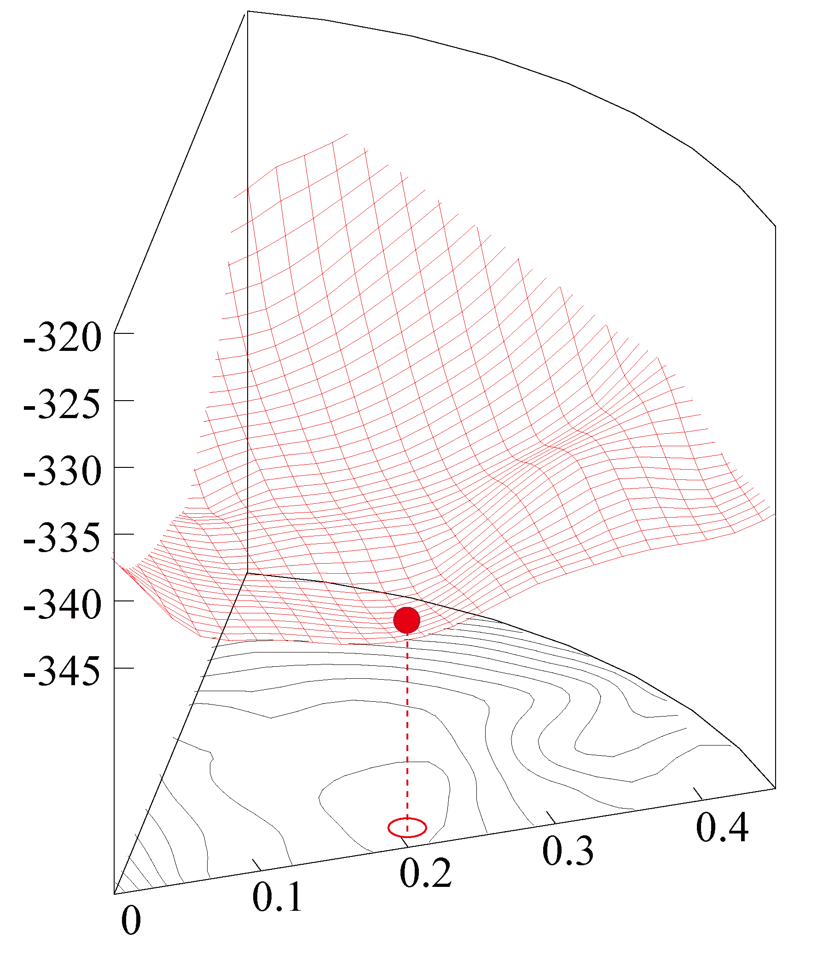
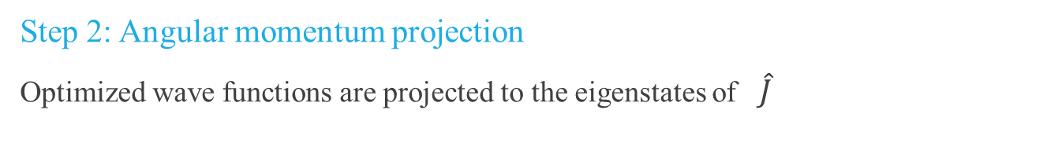
AMD framework : an example of ⁴⁵S
Step 2: Angular momentum projection
Optimized wave functions are projected to the eigenstates of $\hat{J}$
J=3/2-, K=1/2
J=3/2-, K=3/2
Notes:
The second step is angular momentum projection. The optimized wave functions are projected to the eigenstate of the angular momentum. This color plot shows the energy surface of the 0+ states. By the angular momentum projection, strongly deformed states gain larger energy and the energy minimum is changed and triaxially deformed. It induces low-lying collectivity as you see later. This is a density profile of the triaxially deformed minimum.

Slide 7
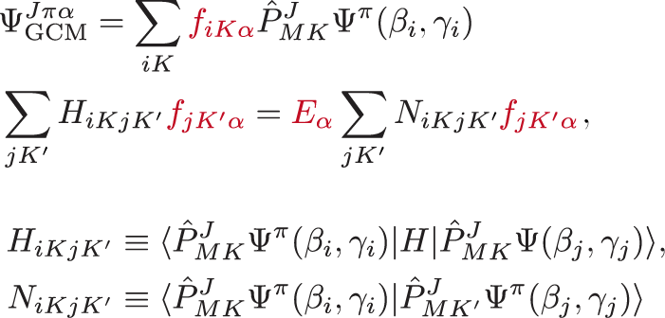
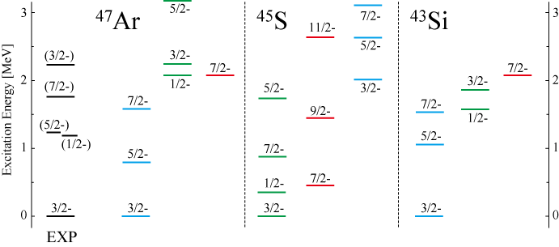
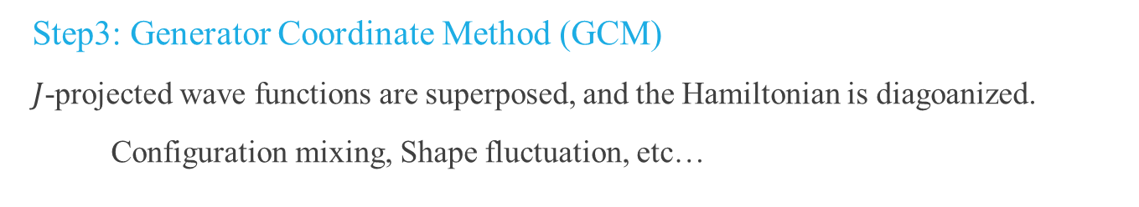
AMD framework : an example of ⁴⁵S
Step3: Generator Coordinate Method (GCM)
$J$-projected wave functions are superposed, and the Hamiltonian is diagoanized.
Configuration mixing, Shape fluctuation, etc…
J=3/2-, K=1/2
J=3/2-, K=3/2
Notes:
The second step is angular momentum projection. The optimized wave functions are projected to the eigenstate of the angular momentum. This color plot shows the energy surface of the 0+ states. By the angular momentum projection, strongly deformed states gain larger energy and the energy minimum is changed and triaxially deformed. It induces low-lying collectivity as you see later. This is a density profile of the triaxially deformed minimum.

Slide 8
Illustrative example of
Triple Shape Coexistence － ⁴³S －

Slide 9
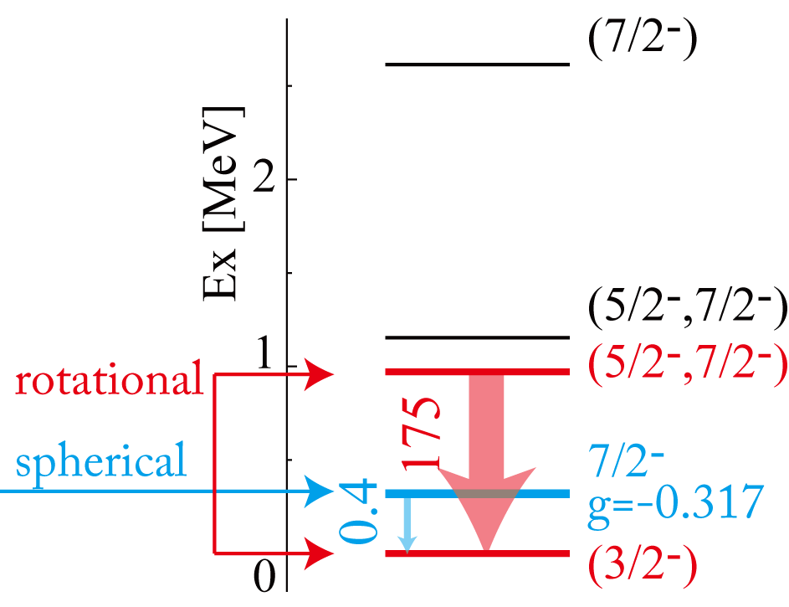
Erosion of N=28 shell gap: An example ⁴³S
3/2- assignment for the ground state
7/2⁻ state at 940 keV
connected with g.s. with strong B(E2)=85 e²fm⁴
⇒ rotational band?
Another 7/2⁻ state at 319 keV (isomeric state)
very weak E2 transition to g.s. B(E2)=0.4e²fm⁴
⇒ spherical isomeric state?
Red: prolate deformed band K=1/2⁻
Blue: spherical or deformed f_{7/2} state
⁴³S
spherical & prolate shape coexistence
85
There must be more than this
R. W. Ibbotson et al., PRC59, 642 (1999). F. Sarazin, et al., PRL 84, 5062 (2000).
L. A. Riley, et al., PRC80, 037305 (2009). L. Gaudefroy, et al., PRL102, 092501 (2009).

Slide 10
Enhancement of Quadrupole Correlation ⇒ Shape coexistence
Reduction of N=28 shell gap in the vicinity of ⁴⁴S leads to strong $Q⋅Q$ correlation between protons and neutrons
It generates various deformed states and they coexist at small excitation energy
⇒ “Shape Coexistence”
stable
unstable
“Triple configuration coexistence in ⁴⁴S”, D. Santiago-Gonzales, PRC83, 061305(R) (2011).
“Shape transitions in exotic Si and S isotopes and tensor-driven Jahn-Teller effect“,
T.Utsuno, et. al., PRC86, 051301(2012).

Slide 11
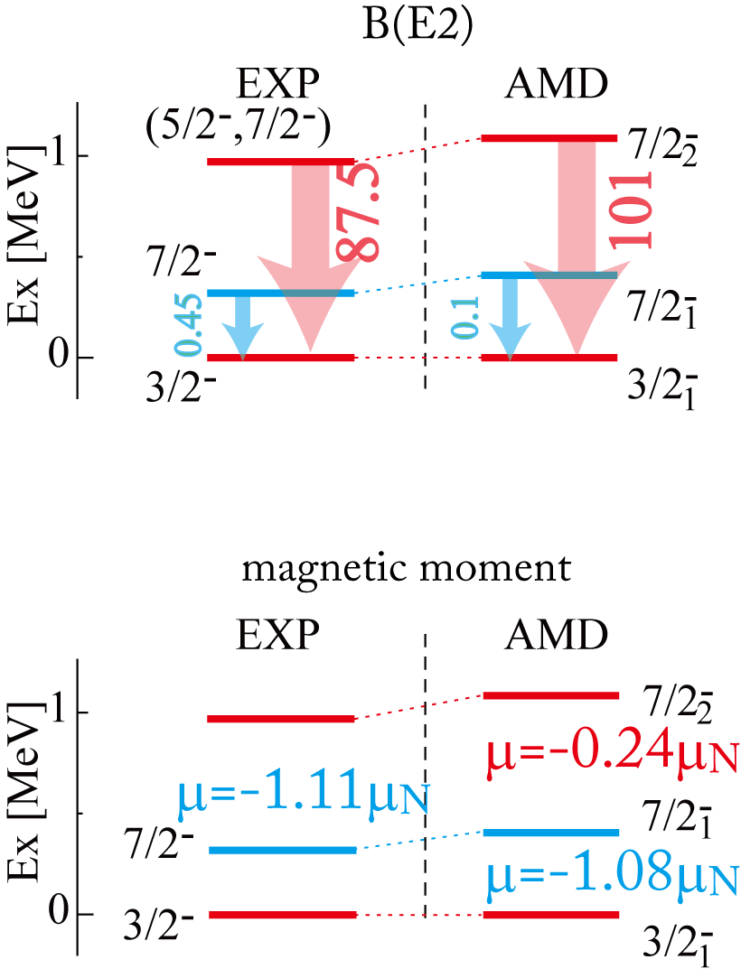
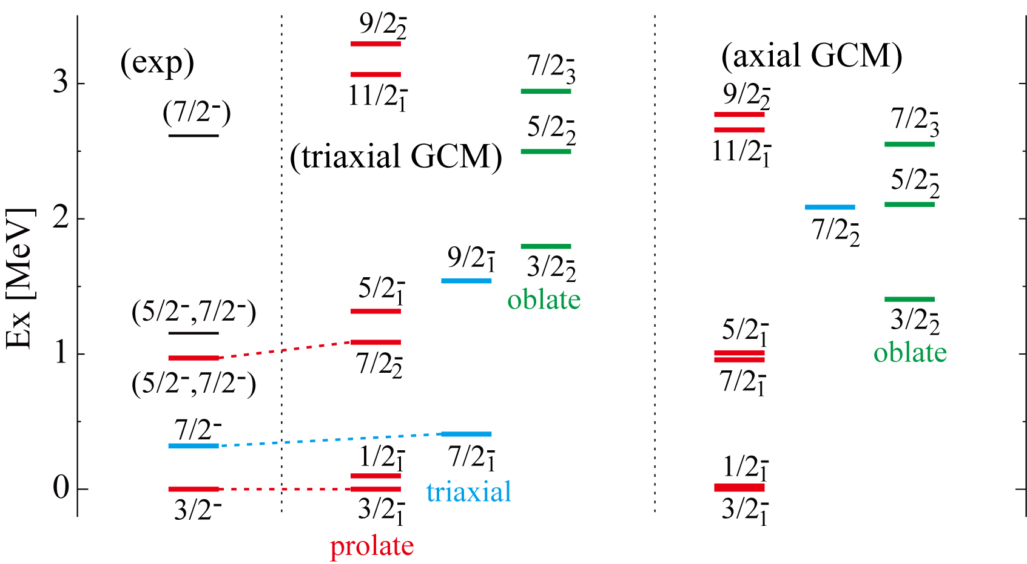
Result: Spectrum of ⁴³S
M.K. et.al., PRC 87, 011301(R) (2013)
Triple Shape Coexistence (prolate, oblate and triaxial)
Need triaxial calculation to reproduce observation

Slide 12
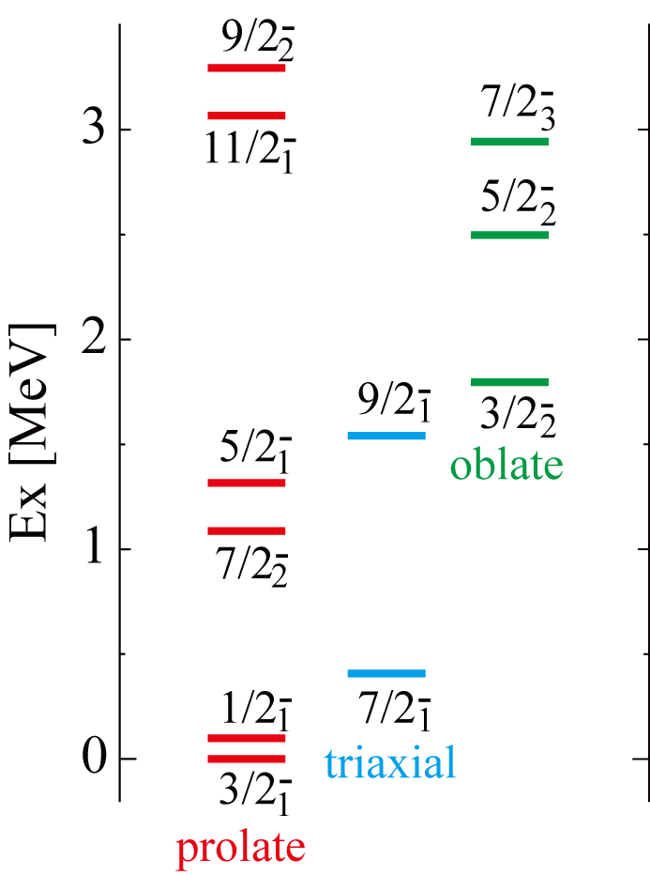

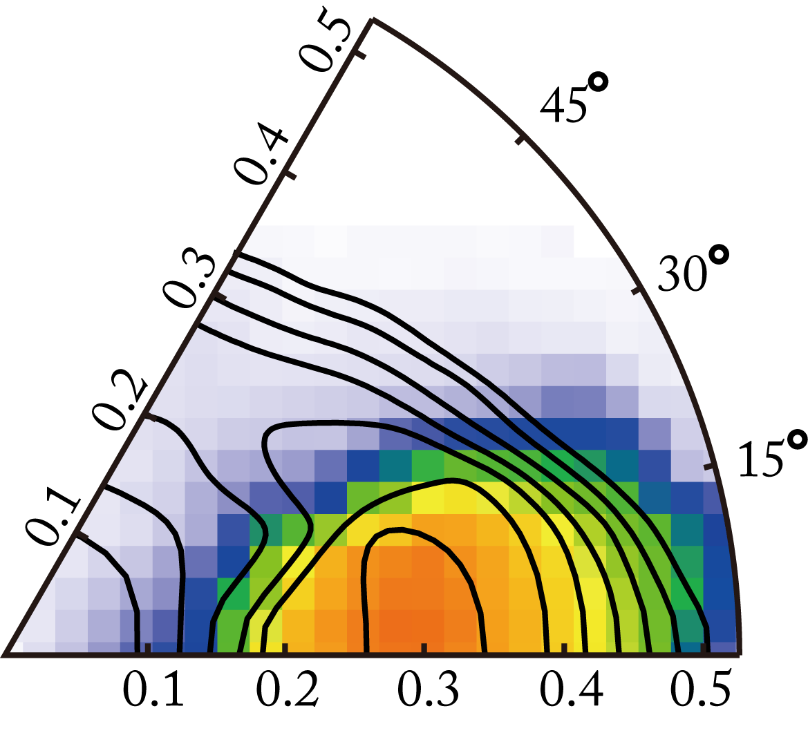
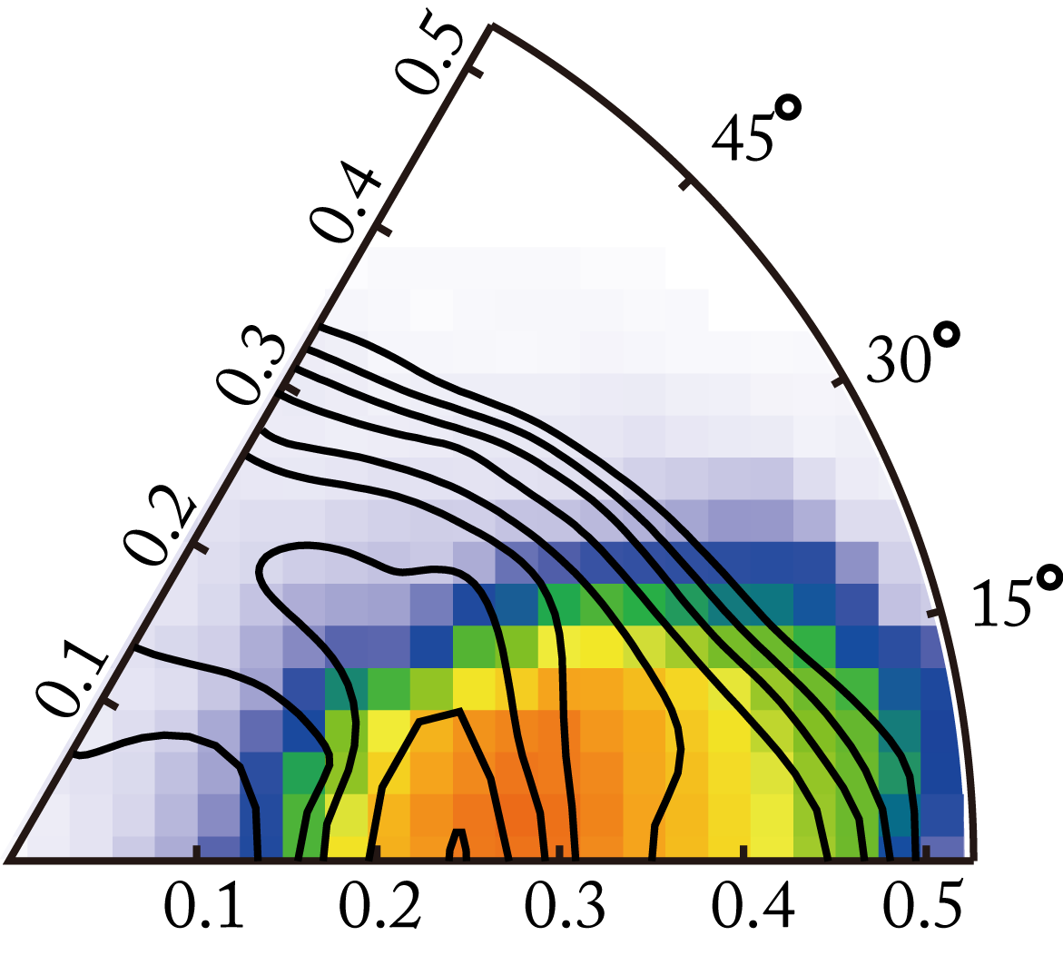
Discussions: Prolate band (ground band) in ⁴³S
Prolate band (ground band) with K=1/2-
Wave function is localized in the prolate side (γ=0)
Dominated by the K=1/2⁻ component
(1p1h, f_{7/2} → p_{3/2})
B(E2) and B(M1) show particle+rotor nature
⁴²S(def g.s.) × (νp_{3/2})¹
Contour: energy surface after J projection
Color: distribution of wave function in β−γ plane
J=3/2-
J=7/2-

Slide 13
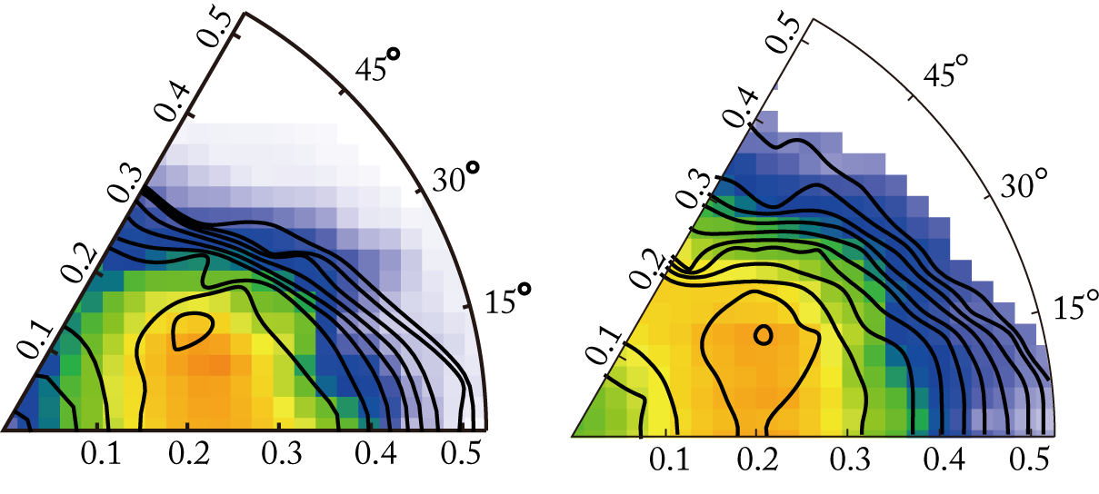
Discussions: Triaxial isomeric state at 319keV in ⁴³S
Triaxial states (7/2⁻_{1,} 9/2⁻₁)
Wave function is distributed in the triaxial (γ=30 deg. ) region
Strong B(E2; 9/2⁻₁ → 7/2⁻₁), Not spherical state
Non-vanishing quadrupole moment
Q = 26.1 (AMD), Q=23(EXP)
(R. Chevrier, et al., PRL108, 162501 (2012).
Weak transition to the g.s. is due to
  Different K-quantum number (high K-isomer like)
  Difference of deformation
J=7/2-
J=9/2-

Slide 14
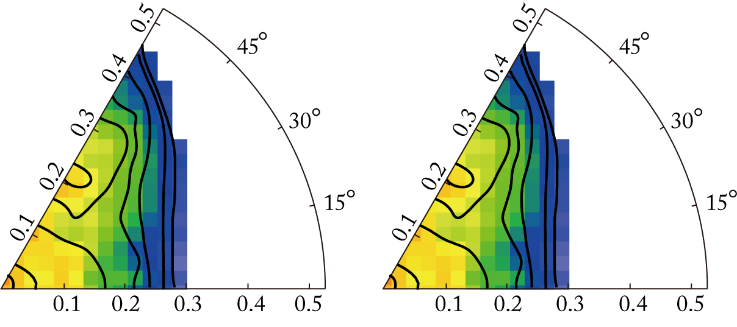
Discussions: Oblate states (non-yrast states) in ⁴³S
Oblate states (3/2⁻_{2,} 5/2⁻_{2, …})
No corresponding states are reported
Oblate (γ=60 deg. ) and spherical region
Large N=28 gap, but large deformation
Strong transition within the band
prolate, triaxial and oblate shape coexistence
J=3/2-
J=5/2-

Slide 15
Some predictions in the vicinity of ⁴⁴S
－ N=29 system －

Slide 16
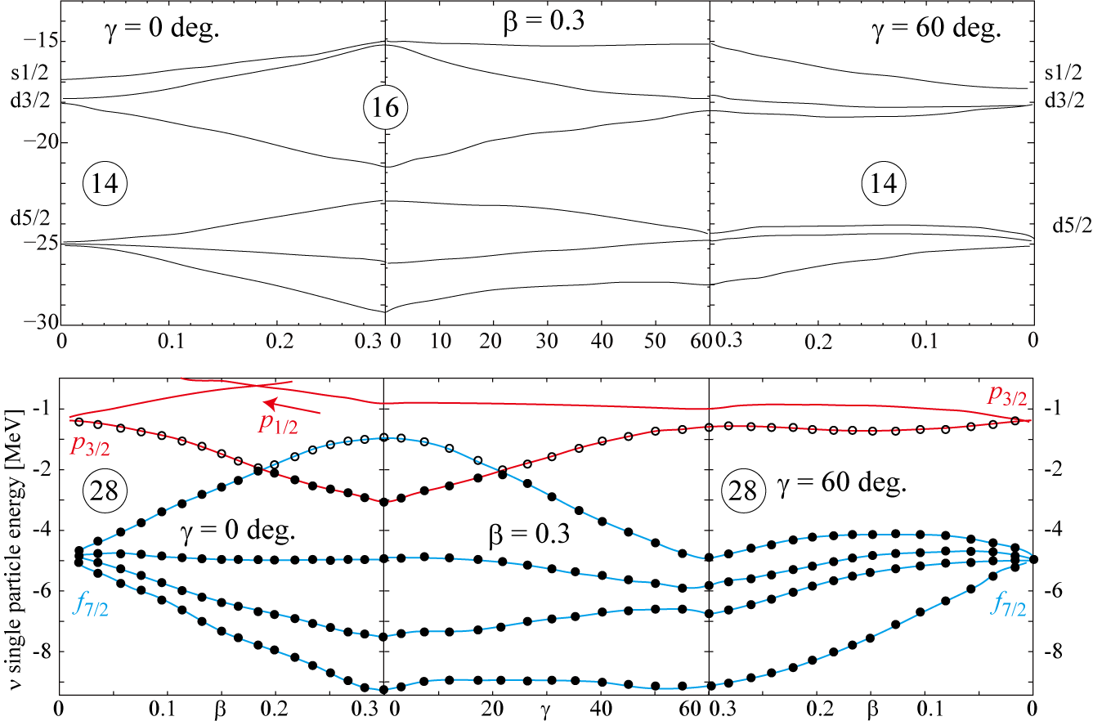
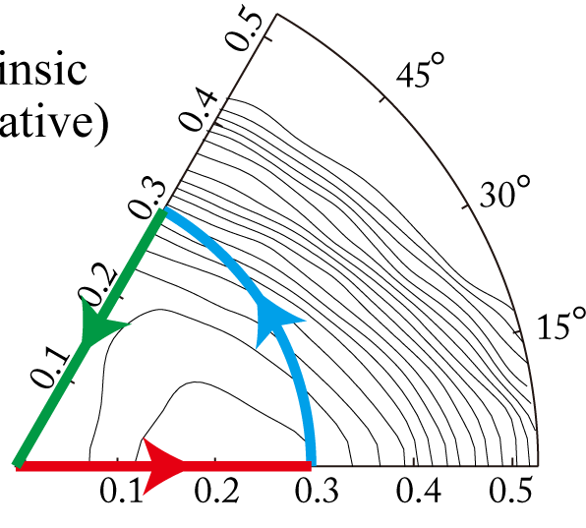
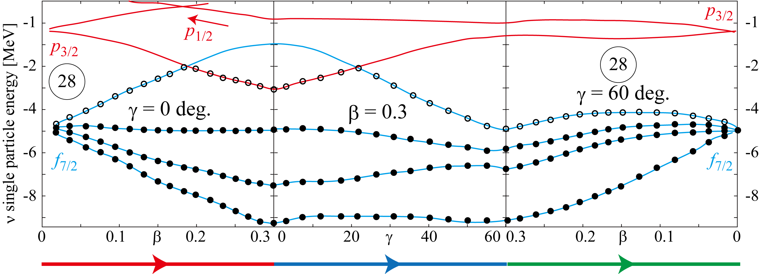
What is behind this shape coexistence ?
N=29 system has no particular deformation
⇒ Most prominent shape coexistence should exist
18

Slide 17
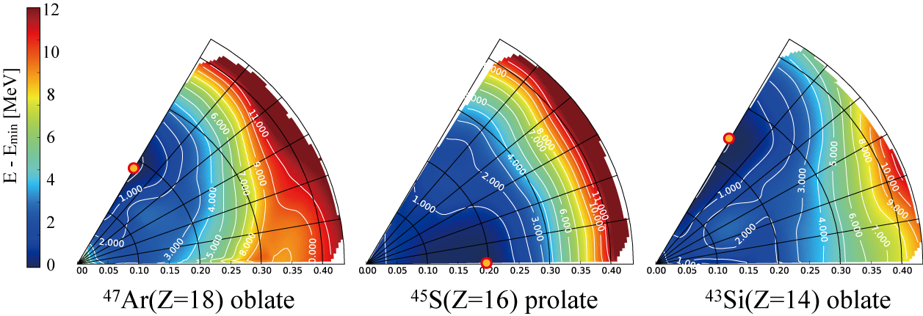
Intrinsic Energy Surfaces (N=29 Systems)
Prolate & Oblate minima depending on Z
⁴⁷Ar(Z=18) : oblate minimum
⁴⁵S (Z=16) : plolate minimum, γ-soft
⁴³Si (Z=14) : oblate minimum, γ-soft

Slide 18
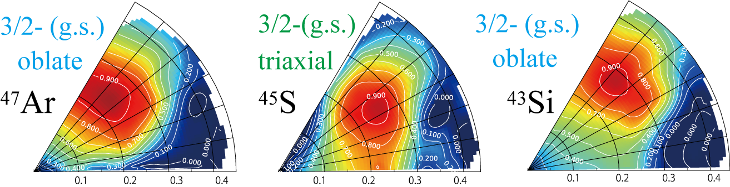
Spectra and Shape Coexistence (N=29)

Slide 19
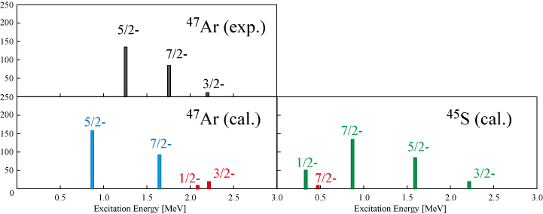
How to track them? B(E2) distributions
R. Winkler, et al, PRL 108, 182501 (2012).

Slide 20
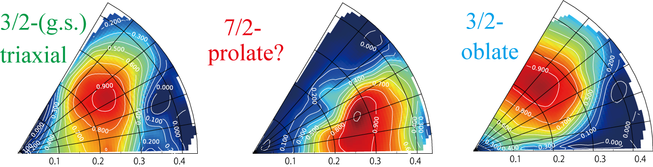
How to track them? E(7/2-)

Slide 21
Summary & Outlook
“Erosion of N=28 shell gap” and “Shape Coexistence with Exotic deformation”
Odd mass system is very useful to see it
AMD calculation for N=27, 28, 29 systems
Quenching of N=28 shell gap enhances quadrupole deformation and generates various states
Prolate, triaxial, oblate shape coexistence in the vicinity of neutron-rich N～28 nuclei
Spectra and properties of non-yrast states are good signature of shape coexistence
Effective interaction dependence (dependence on tensor force)

