Slide 1

Nuclear Astrophysics in
Astrophysical Big Bang Laboratory
Shigehiro Nagataki
RIBF Hall, RIKEN 9th July 2013

Slide 2
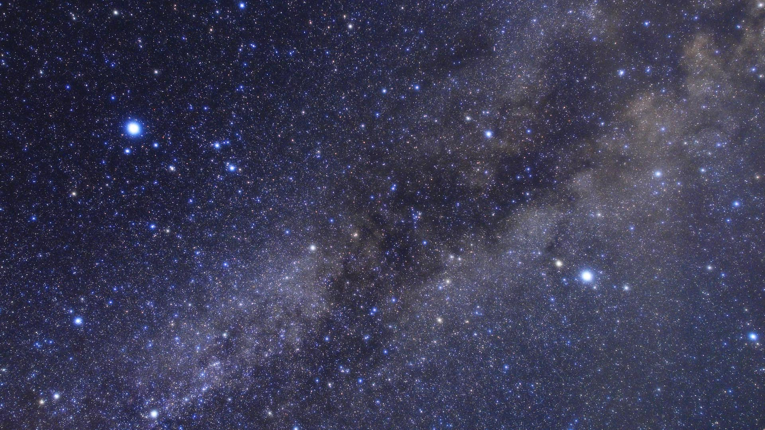

Slide 3
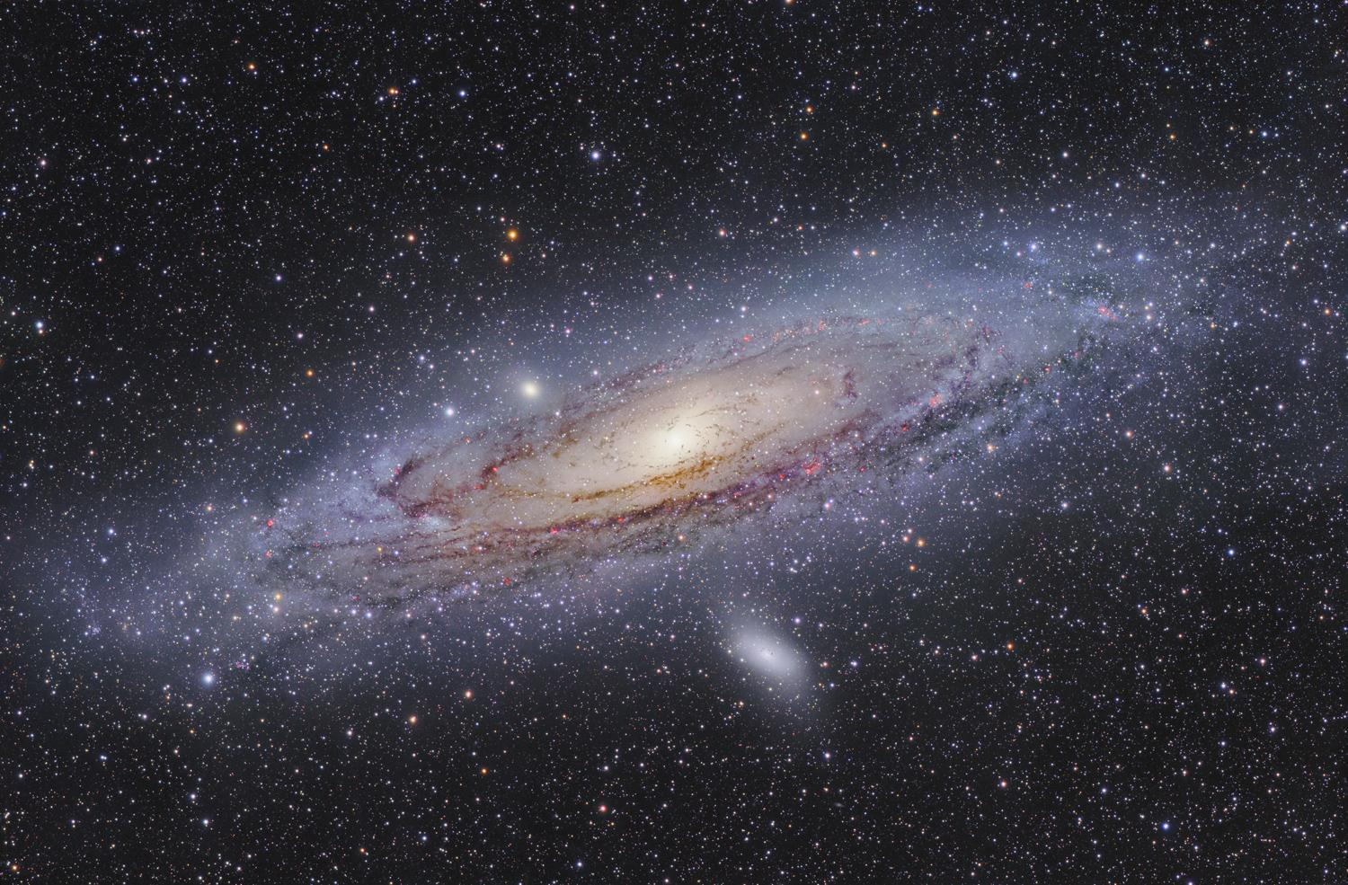

Slide 4
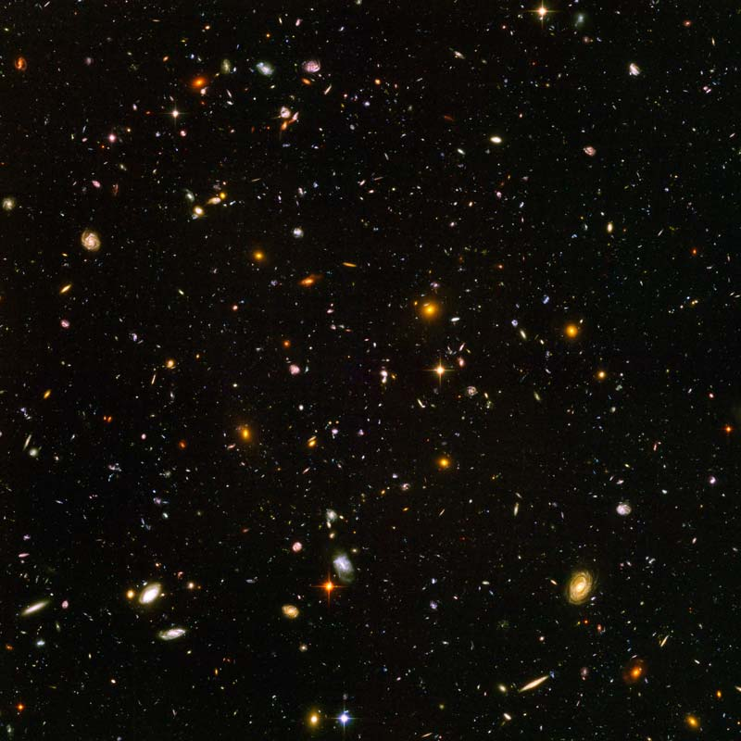

Slide 5
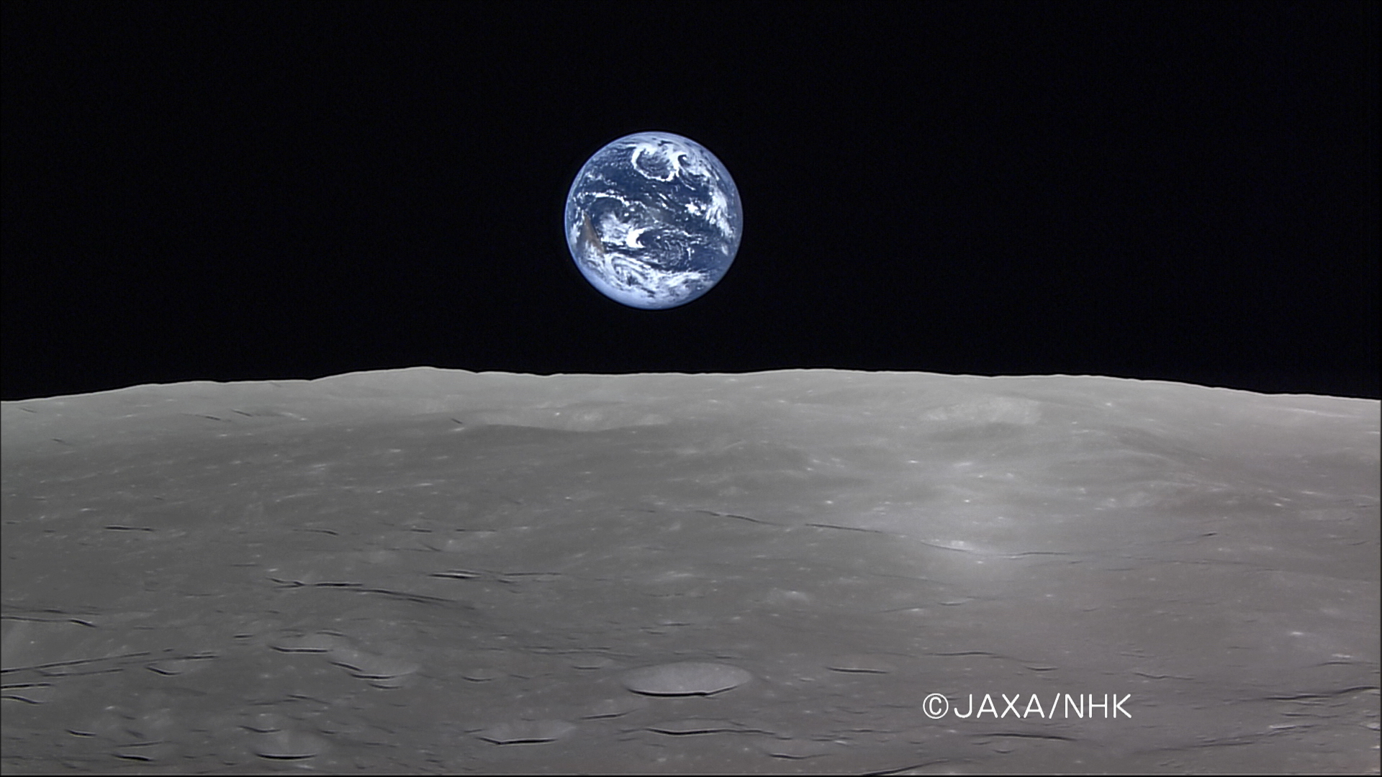

Slide 6
What is Astrophysics?
（From my HP）
The Universe itself is mysterious. When we see the universe, we cannot help but to feel mysteries. In the universe, there are also mysterious phenomena and objects. When we face on these things, we cannot help but to think these are far beyond human knowledge. However, we, Astrophysicists, do not regard them as too mysterious or far beyond human knowledge. Rather, we try to understand them by human intelligence. This is called as Astrophysics.

Slide 7
Main Topics of Astrophysical Big Bang Lab.
～Toward Understanding Supernovae and Gamma-Ray Bursts～
How do the biggest explosions in the universe happen? （Large-Scale Numerical Simulations, Nuclear Physics in Dense Matter, Gravitational Waves, Neutrinos）
Are they origins of very heavy elements? （r-process nucleosynthesis, Origins of Planets and Lives）
Are they origins of Very High-Energy Cosmic Rays? （Particle Physics, Astro-H・JEM-EUSO）

Slide 8
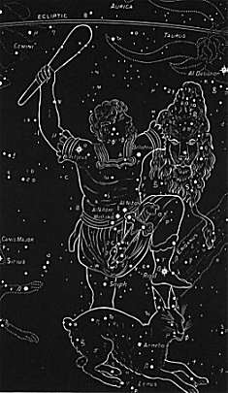
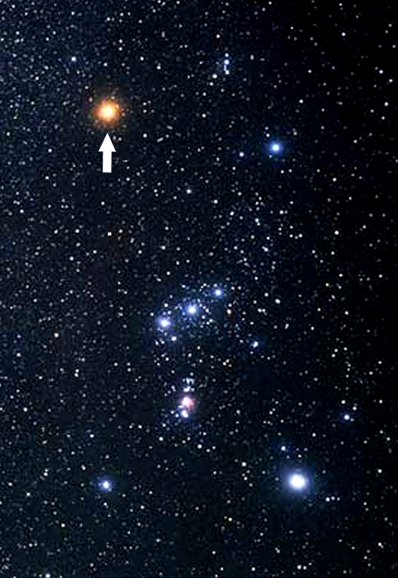
A Supernova that may happen tomorrow
～Betelgeuse～

Slide 9
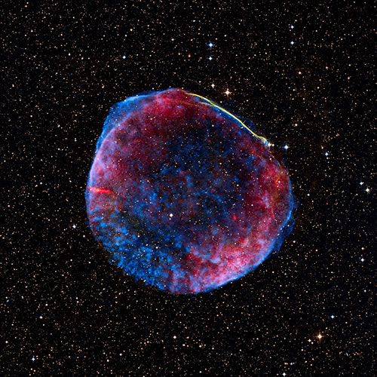
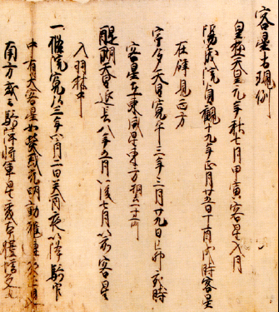
Human beings experienced such a great sky-show in the past!
Supernova Remnant 1006
(A.D.1006)
フラックス
A record on SN1006 in Meigetsu-Ki by
T. Fujiwara.
Blue：X-ray Red: Radio

Slide 10
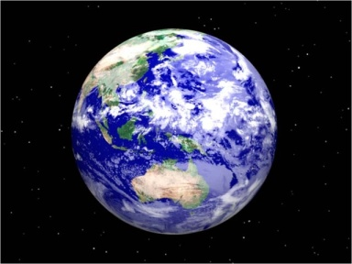
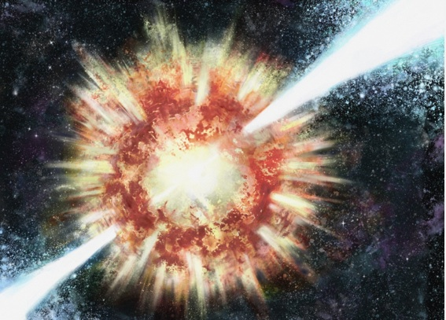
If Betelgeuse will explode as a Gamma-Ray Burst… → End of Human Beings.
Betelgeuse as a GRB.
（Imagination）
The Ozone layer is destroyed
In 10 sec.
Related with the Extinction
Event on the earth
Several 100M years ago?
They can be Origins of Lives
As well as causes of Mass
Extinction.

Slide 11
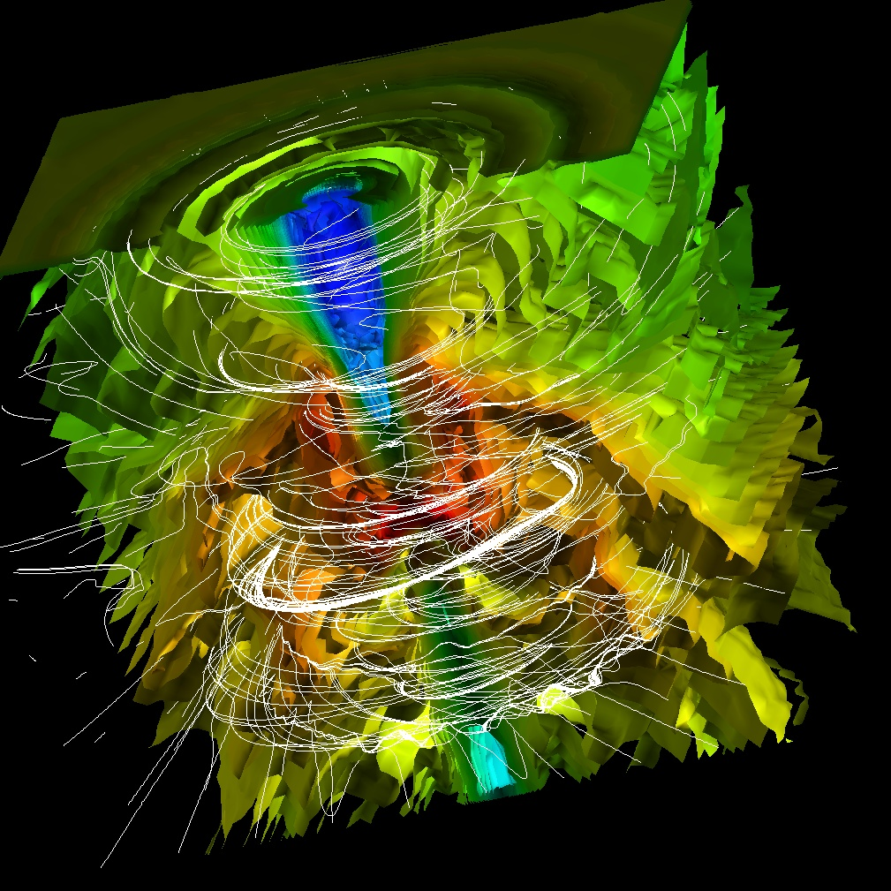
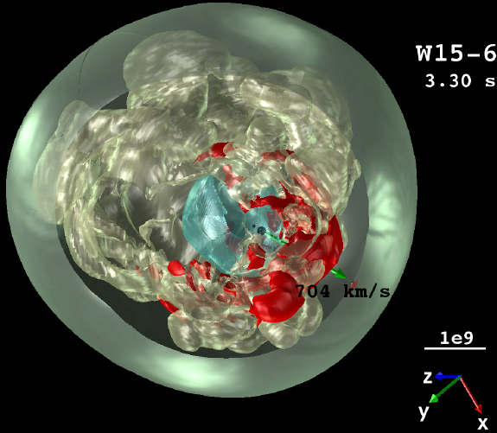
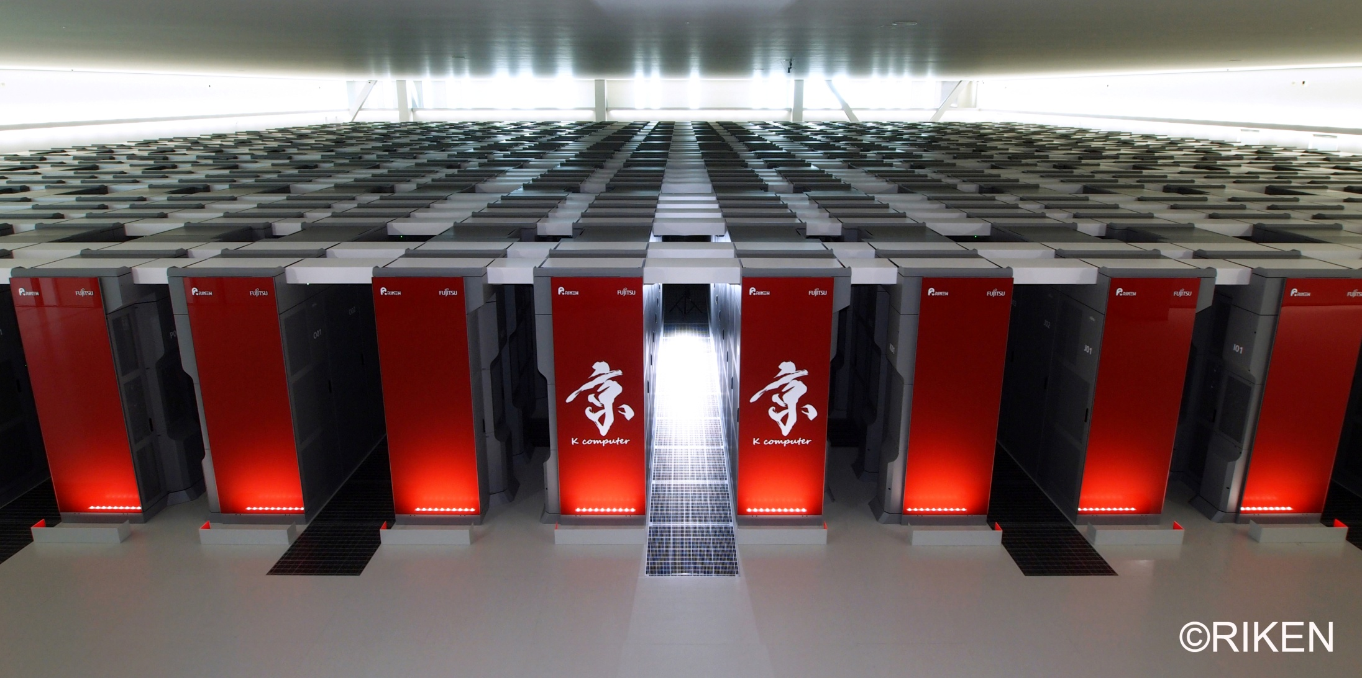

Challenge１ of Astrophysical Big Bang Lab：
Understanding Explosion Mechanism of SNe&GRBs
A Numerical Simulation of a supernova：
Color：Density. A neutron star is born
At the center. Courtesy of
Dr.Wongwathanarat in MPA.
A Numerical Simulation of a Gamma-Ray Burst：
Color：Density. White lines：Magnetic Fields.
A black hole is born at the center.
By S. N.

Slide 12
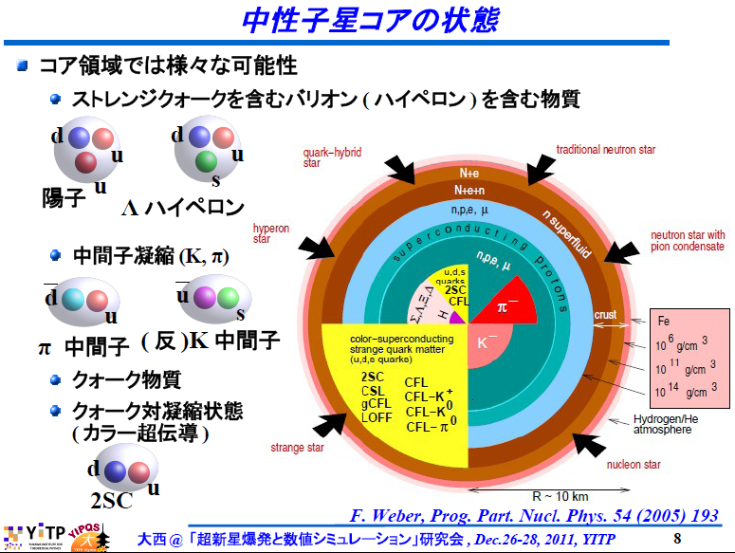
Nuclear Physics for the Dynamics
～Equation of State in Dense Matter@Center of Sne&GRBs～

Slide 13
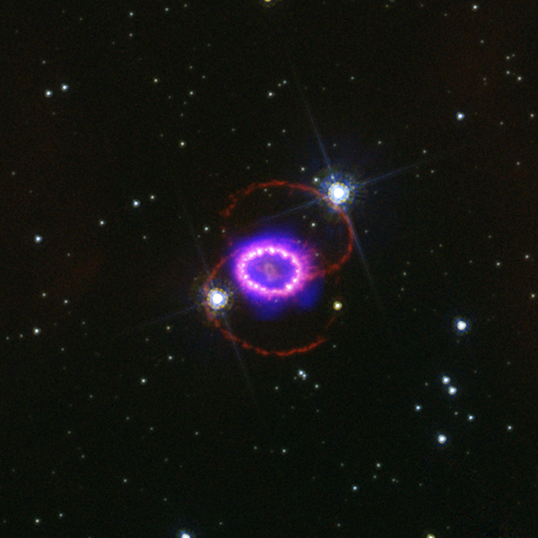
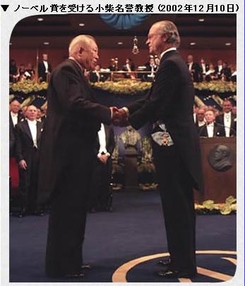
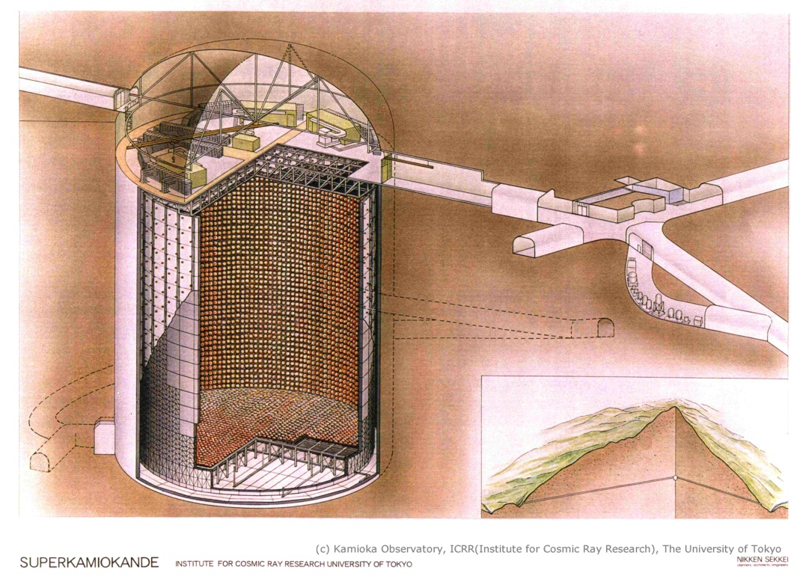
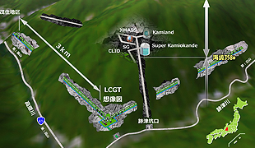
Gravitational Waves
& Neutrinos
SN1987A
At Kamioka, a GW detector
(KAGRA) will Be completed
in 2017!
We do theoretical predictions
On the signals!
Left：Prof. Koshiba who detected
Neutrinos from SN1987A.
Neutrinos
Gravitational
Waves
KAGRA
（GW Detector）
Super-Kamiokande
（Neutrino Detector）

Slide 14
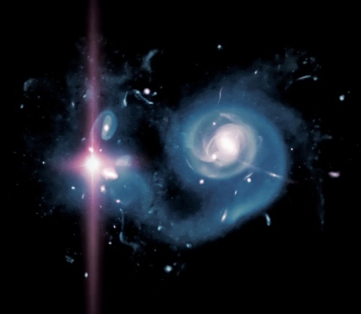
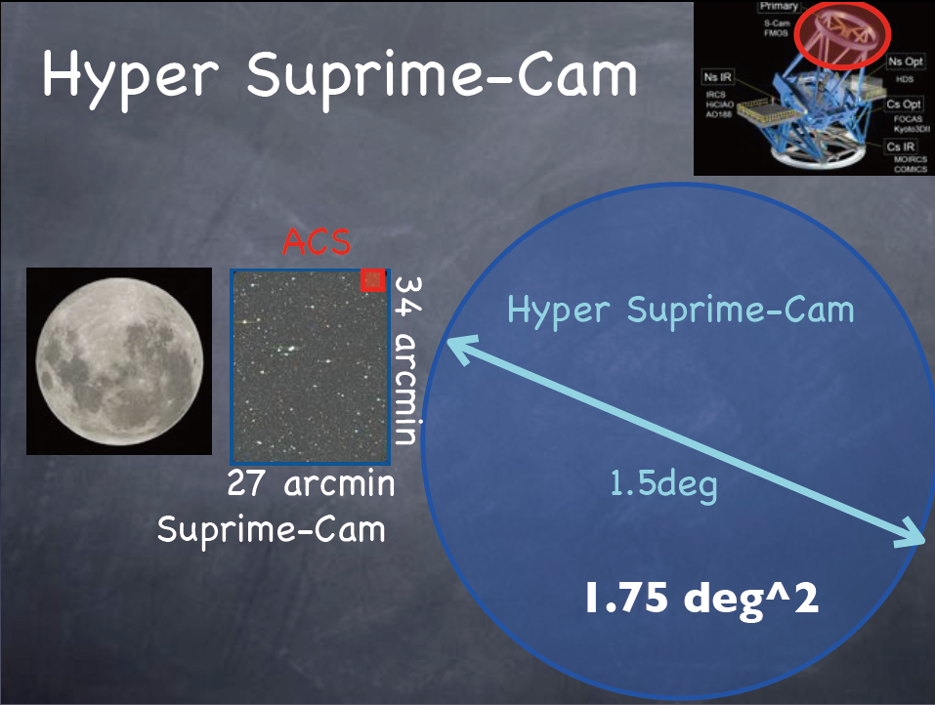
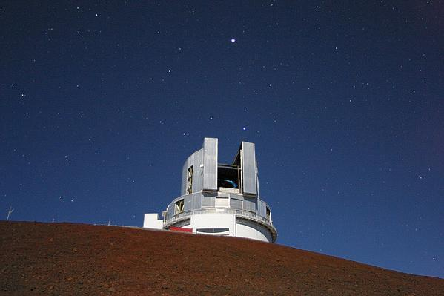
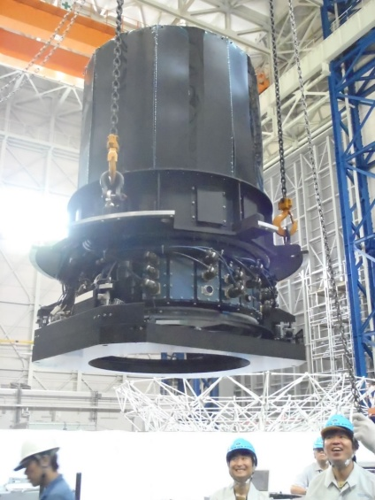
The Hyper-Suprime Camera of Subaru Telescope will see lots of shock breakouts of Supernovae (2014-).

Slide 15

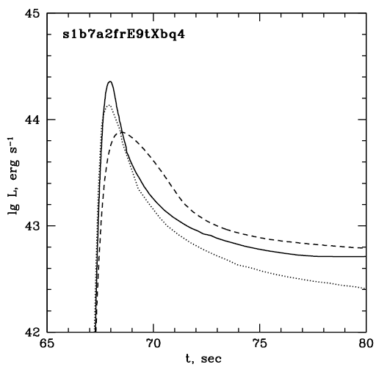
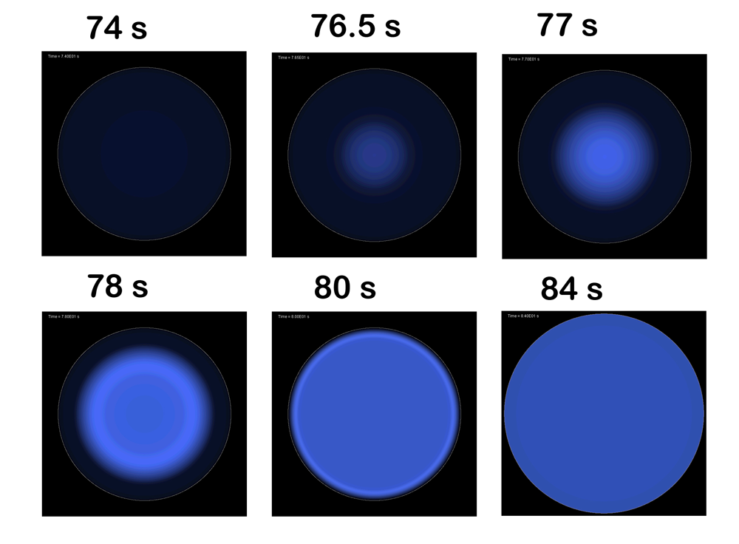
Theoretical Predictions on a Shock Breakout by Alexey Tolstov
Surface Brightness of a Supernova
As a function of time.
Time Evolution of luminosity

Slide 16
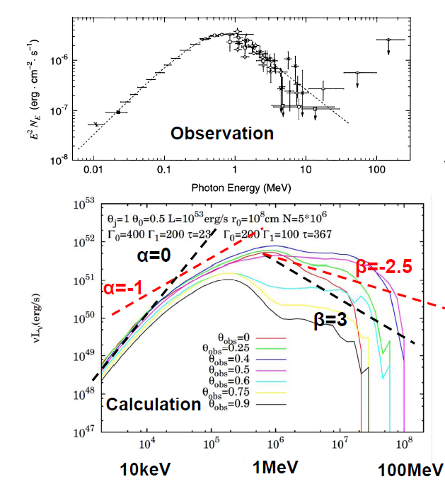
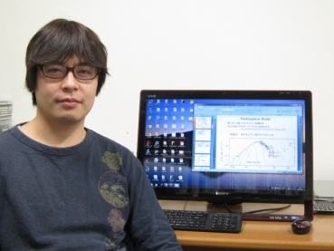
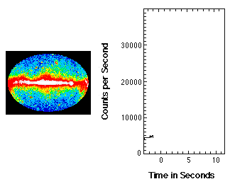
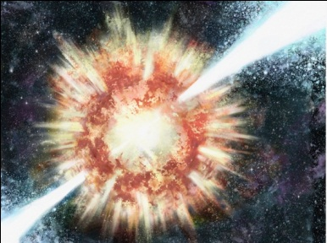
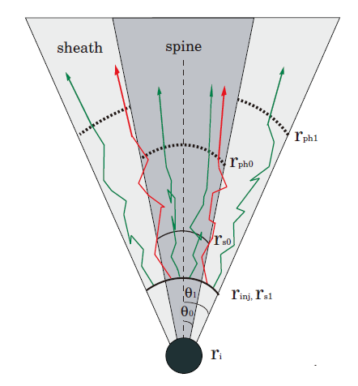
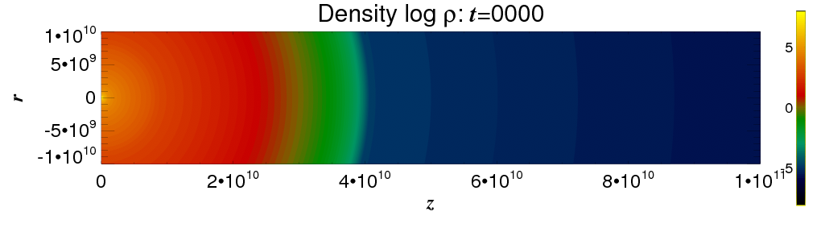
We succeeded to reproduce Gamma-Ray Bursts’ Spectrum well theoretically.
Ito-san
Theory
A (test) Simulation
By Matsumoto-san
Who will join our group
From Sep. 2013

Slide 17
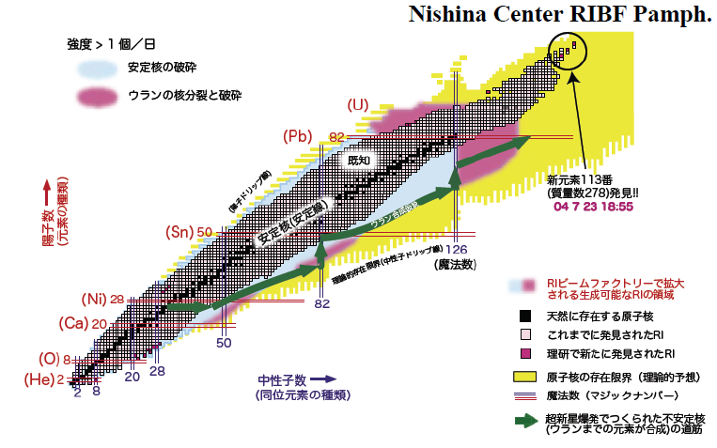
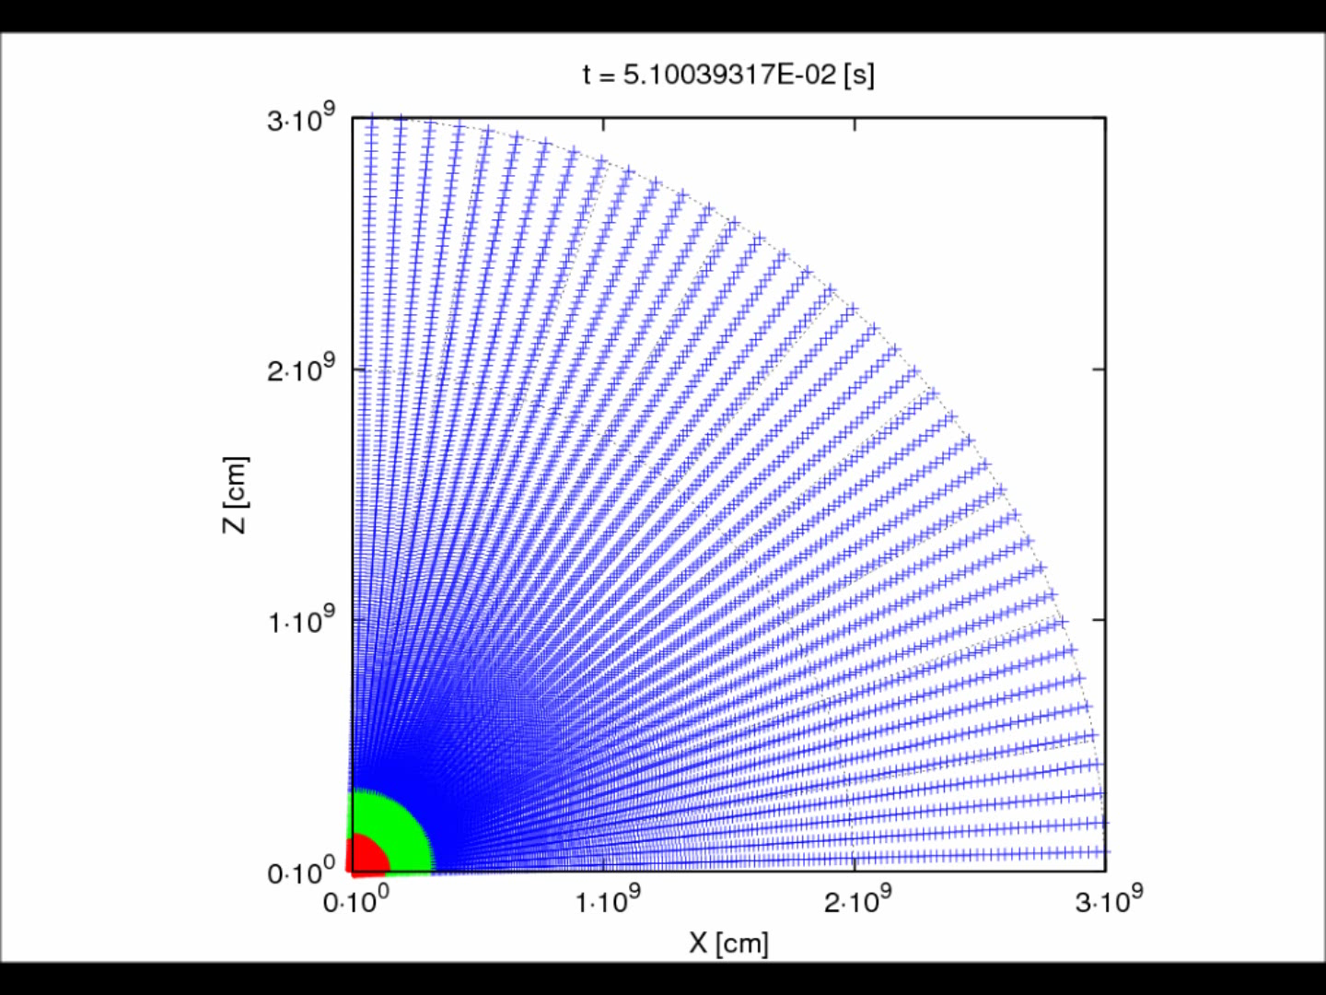
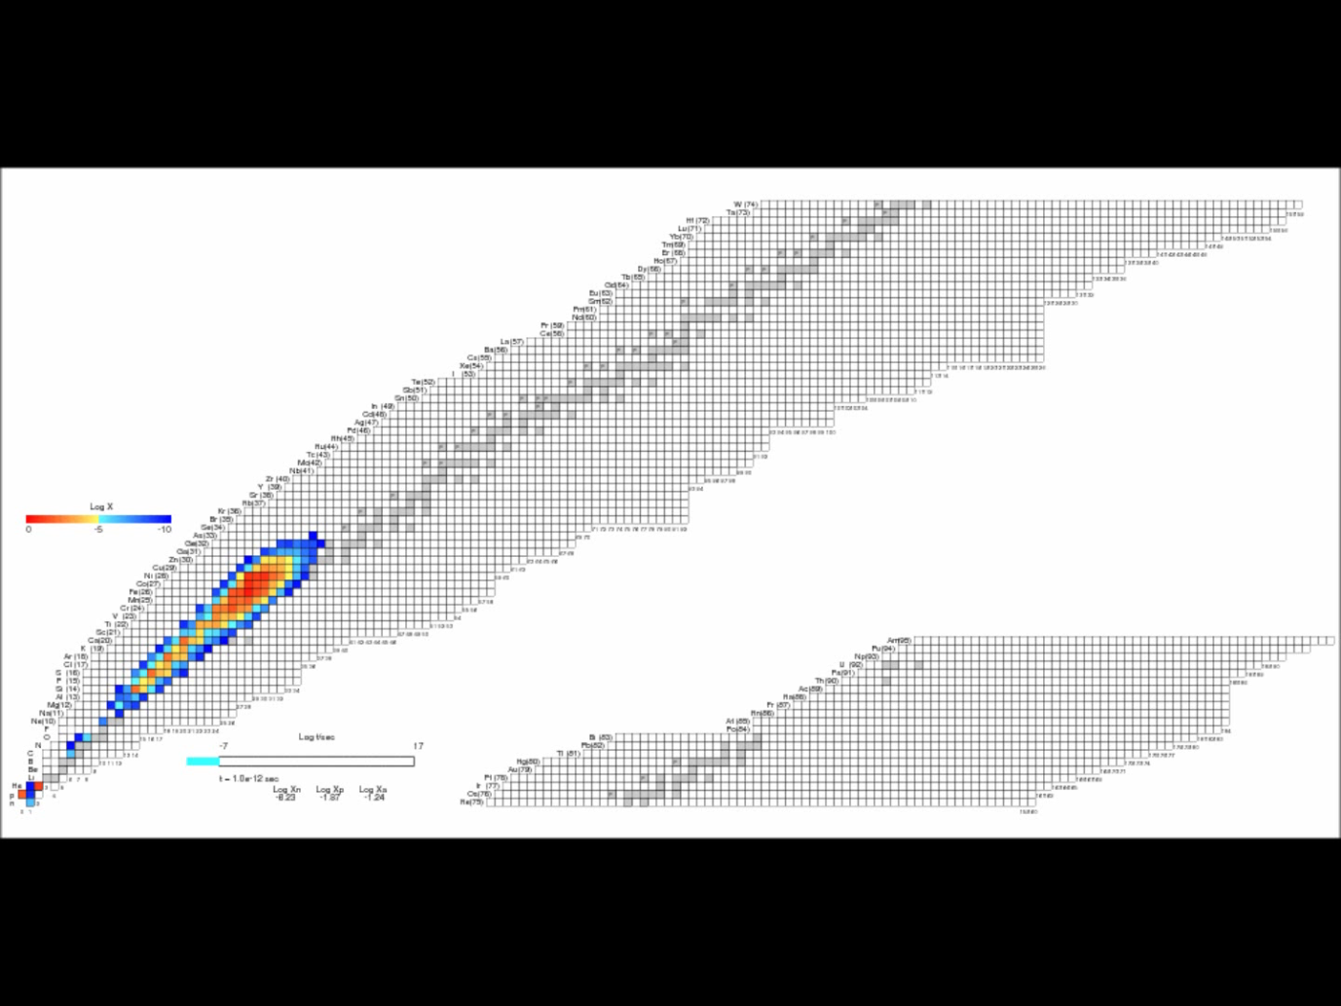
Challenge 2 of Astrophysical Big Bang Lab：
Are they origins of very heavy elements?
High entropy per baryon,
Neutron rich, and
Fast expansion are necessary
For r-process nucleosynthesis.
A Numerical Simulation of r-process Nucleosynthesis. By Ono-san.

Slide 18
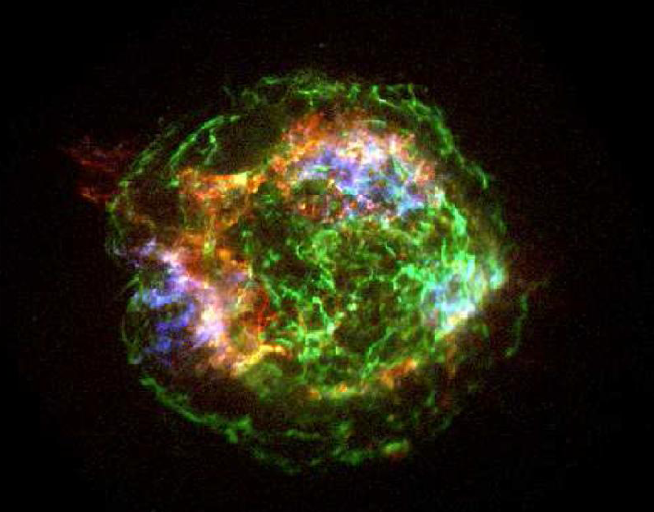

Can we obtain a direct evidence on r-process nucleosynthesis in a jet-induced Supernova?
Subaru Telescope
A background Star
Eu
Cassiopeia A (～350yrs old)
(a Jet-Like Supernova Remnant)
We are writing a proposal for that.
PI is Dr. Jirong Mao..
We might see absorption
Lines by r-process elements.

Slide 19
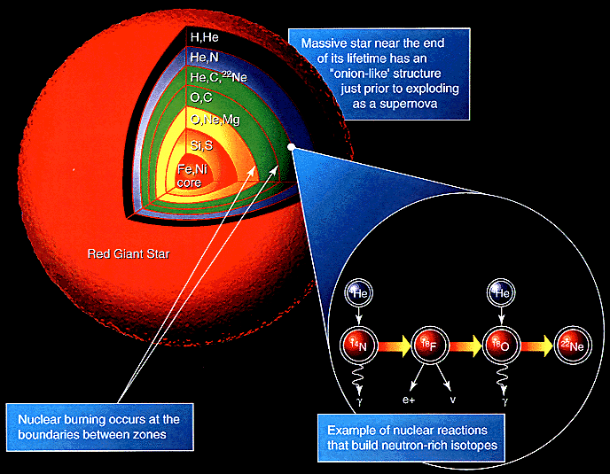
F
A stellar Structure.
From NASA HP
Heavy Elements are produced
In Massive Stars

Slide 20
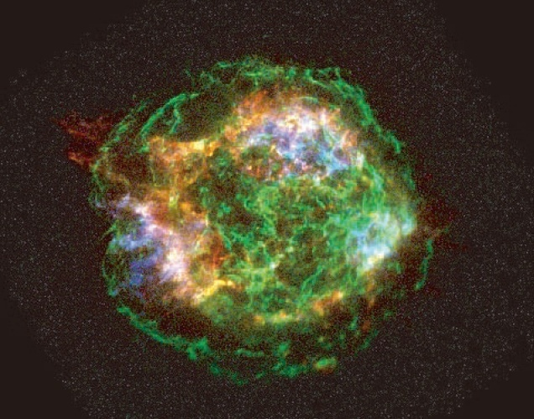
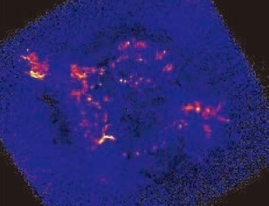
Cassiopeia A : A Strange Guy
Radio
Origin of Global Asymmetry:
Jet？
Ambient Matter/B-fields？
X-rays (Chandra)
Blue：Fe Why are Fe
Red: Si outside of Si?
Green：Continuum.

Slide 21
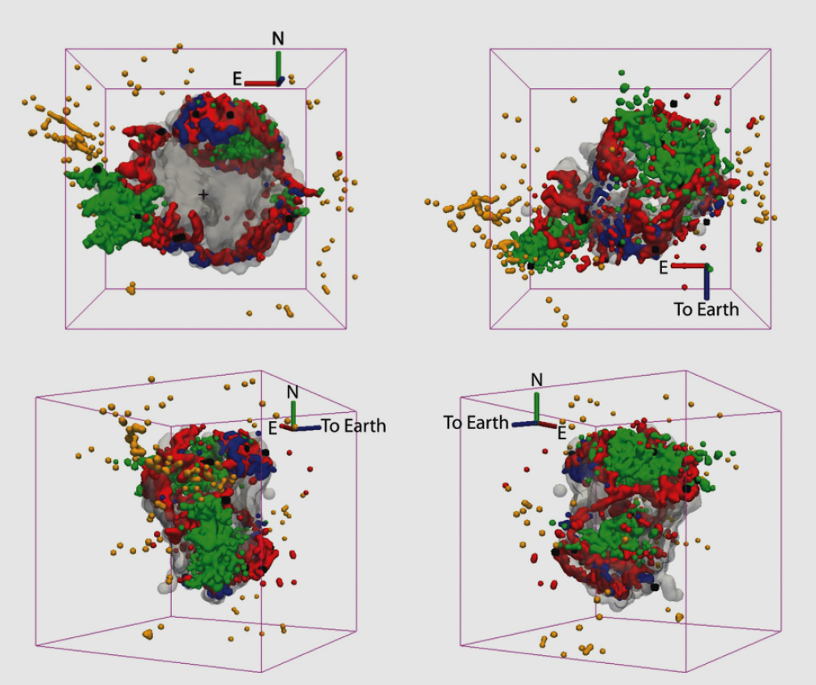
3D structure of Cas A
Delaney et al. 2010
Chandra ‘s X-rays
Spitzer ‘s infrared
Green: X-ray Fe-K
Black: X-ray Si XIII
Red: IR [Ar II]
Blue: high [Ne II]/[Ar II] ratio
Grey: IR [Si II]
Yellow: optical outer ejecta

Slide 22
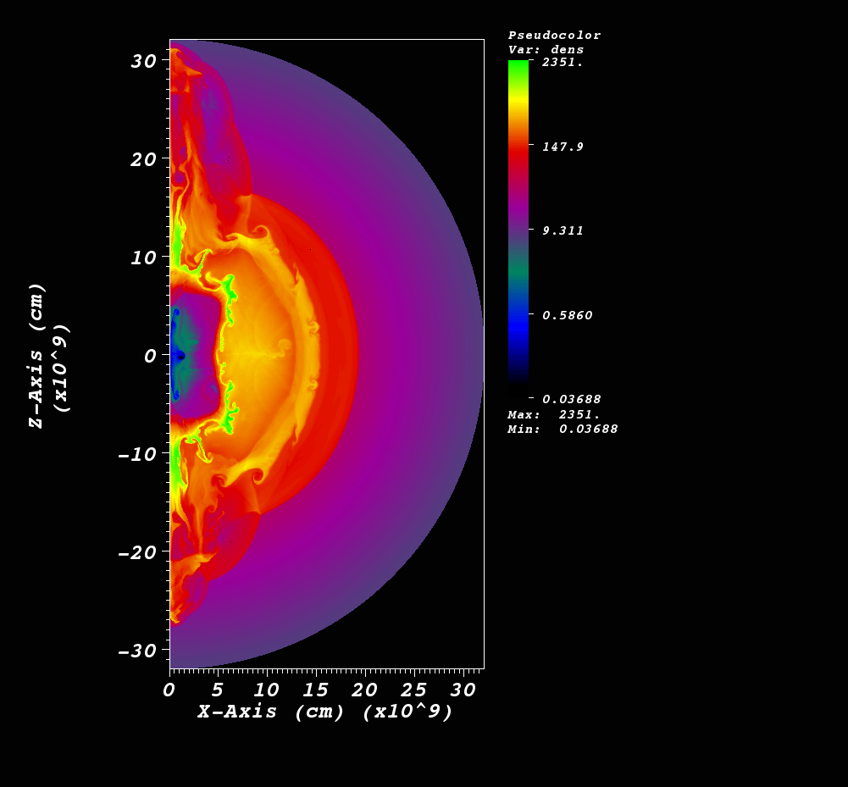
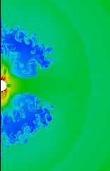
Explosive Nucleosynthesis
in Jet-Like SNe/GRBs by FLASH.
Do some Instabilities explain
The matter mixing?
Something more are necessary?
Ono, S.N.+ 2013 ApJ.

Slide 23
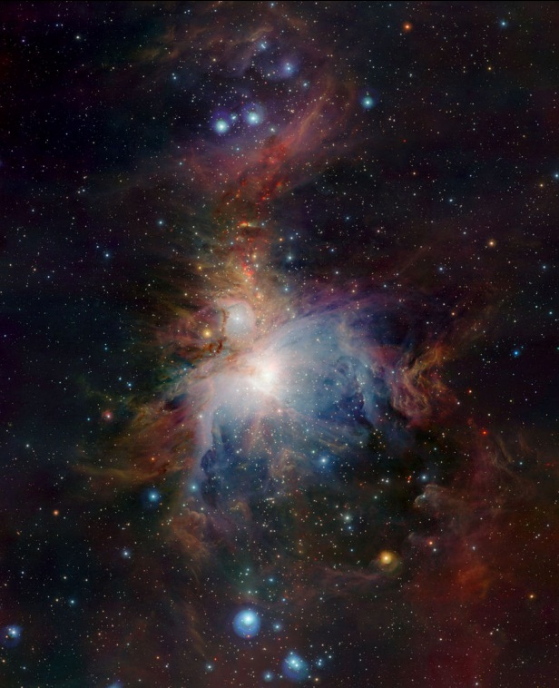
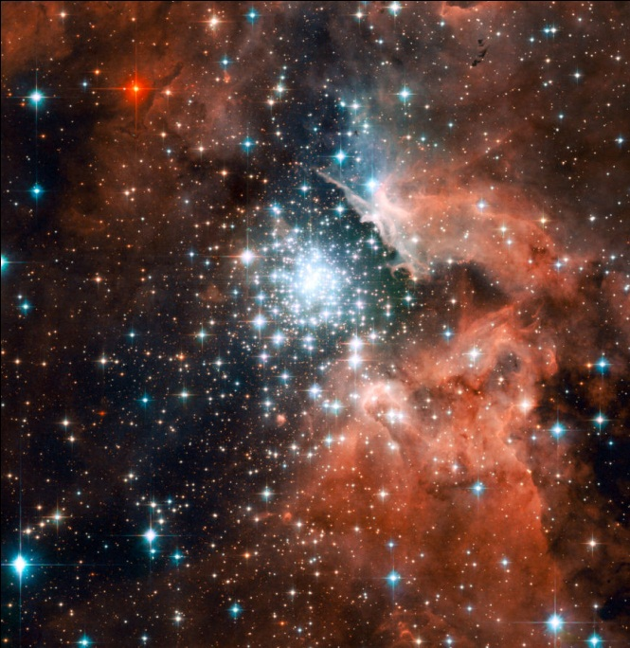
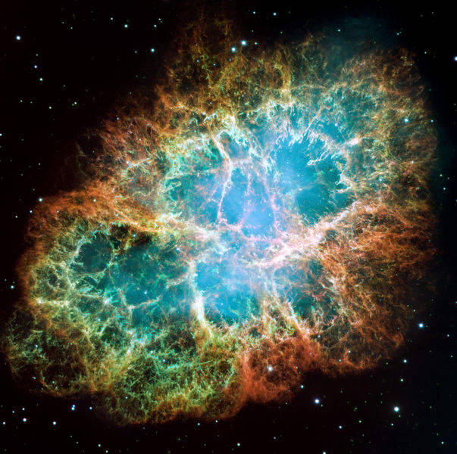
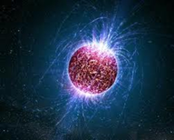
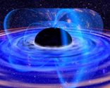
Cycles of Gas-Stars in the Universe
Gas
Stars
Through the cycle,
Heavy Elements are
Increasing in the
Universe
Neutron Star
The Earth
Supernova
Explosions
Black Hole

Slide 24
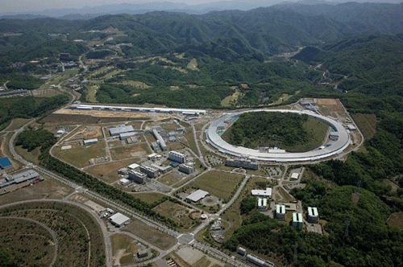
Challenge 3 of Astrophysical Big Bang Lab： Are they origins of Very High-Energy Cosmic Rays?
Supernova Remnant 1006
(A.D.1006)
Blue：X-ray Red: Radio
フラックス
A record on SN1006 in the book Meigetsu-Ki by T. Fujiwara.
c.f. Spring-8 in Harima

Slide 25

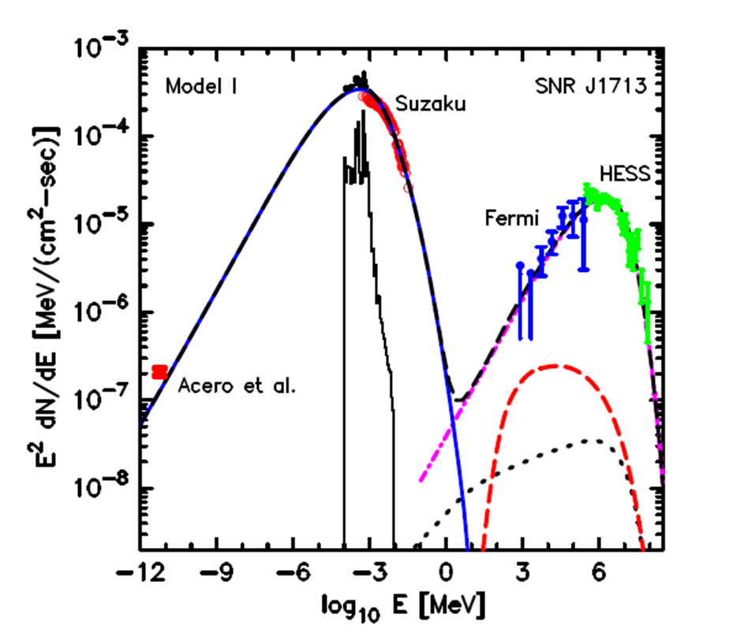
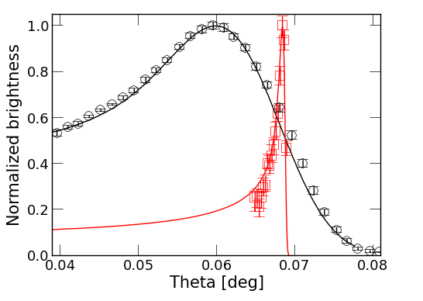
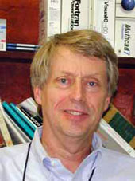
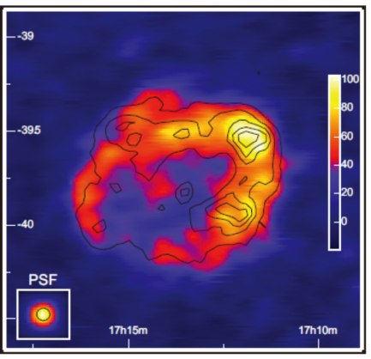


Supernova Remnants as Big Accelerators
Left： Spectrum of SNR RXJ1713 is well reproduced theoretically (CR-NEI-Hydro)!
Right：Spatial profile of radio and X-rays are well reproduced theoretically!
By Shiu-Hang Lee.
Dr. Lee
Radio &
X-ray
D. Ellison
Left：RXJ1713
Right：
Tycho（Raido：left
X-ray：right）

Slide 26





Morphology of SNRs: Obs vs 3-D Simulations
By Don Warren and J. Blondin
Tycho (SN1572)
Obs
Don and Ono-san
SN1006
Obs
γ：adiabatic Index
t: characteristic age.
SN1006 is dynamically
Young and producing
CRs efficiently at FS.

Slide 27



3-Dimensional Simulations of Supernova Remnants
Ono et al. 2013, in prep.
Amplified up to 50 micro-G
Density
～3 light year
B-filed（White）
Amp.Of
B-field( Color)
RXJ1713
Uchiyama+07
Obs: 100 micro-G

Slide 28





Composition of Ultra-High-Energy CRs
UHECRs are Iron-Dominated.
VS
UHECRs are Proton-Dominated.

Slide 29




UHECRs are coming from GRBs?
UHECRs are from Past GRBs in Milky Way?
Calvez, Kusenko, S.N. PRL 2010
Propagation of
UHE-Iron in Milky Way
By Arjen van Vliet in Hamburg.
Prof. Kusenko,
UCLA.

Slide 30
Summary: Nuclear Astrophysics in
Astrophysical Big Bang Laboratory
Theoretical Studies on SNe and GRBs are done.
Explosion Mechanisms.
Explosive Nucleosynthesis.
Production of Cosmic Rays.
Nuclear Physics plays important roles in these fields.
Communications and Collaborations with us are highly welcome!

