Slide 1
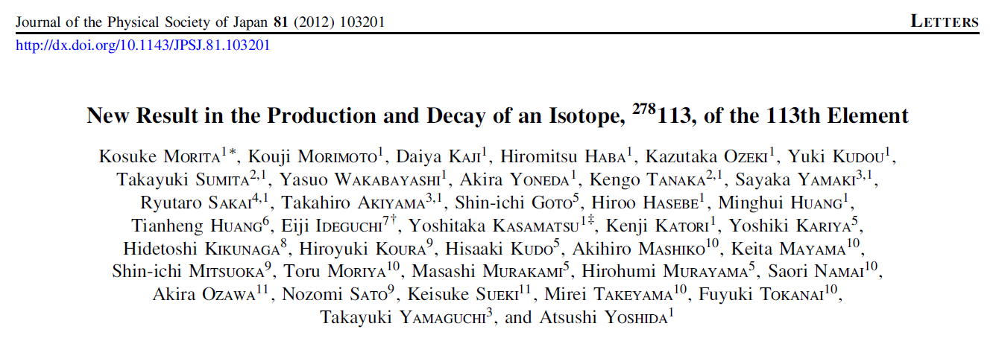
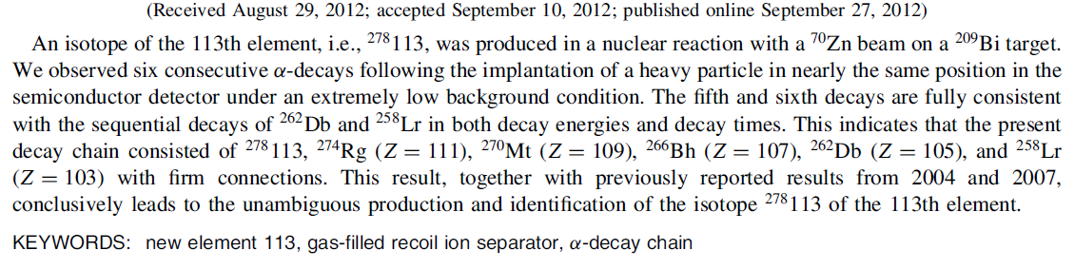
New Result in Production and Decay of an Isotope, ²⁷⁸113, of the 113th Element
Kosuke Morita
Superheavy Element Laboratory
RIKEN Nishina Center for Accelerator-Based Science, RIKEN

Slide 2
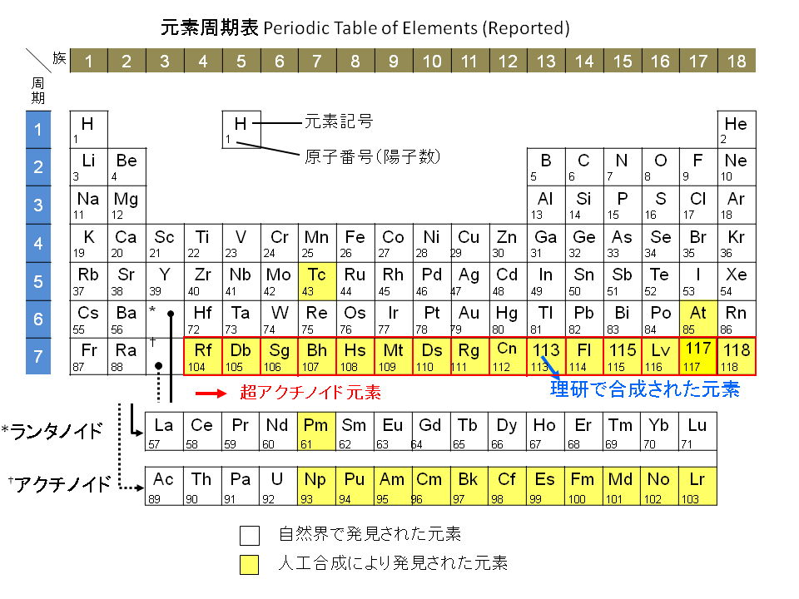

Slide 3
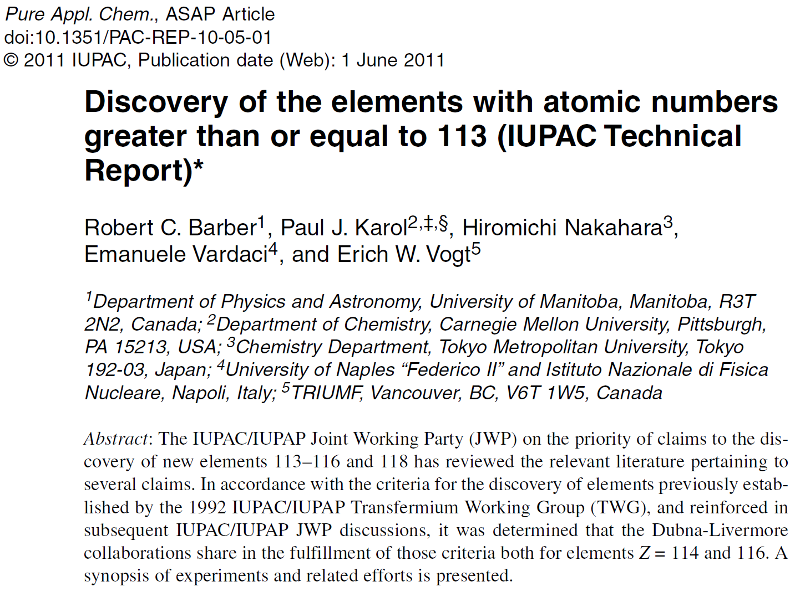
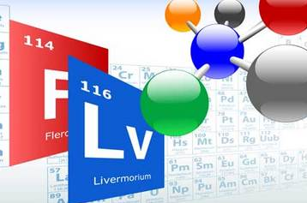
The Periodic Table has been evolving!

Slide 4
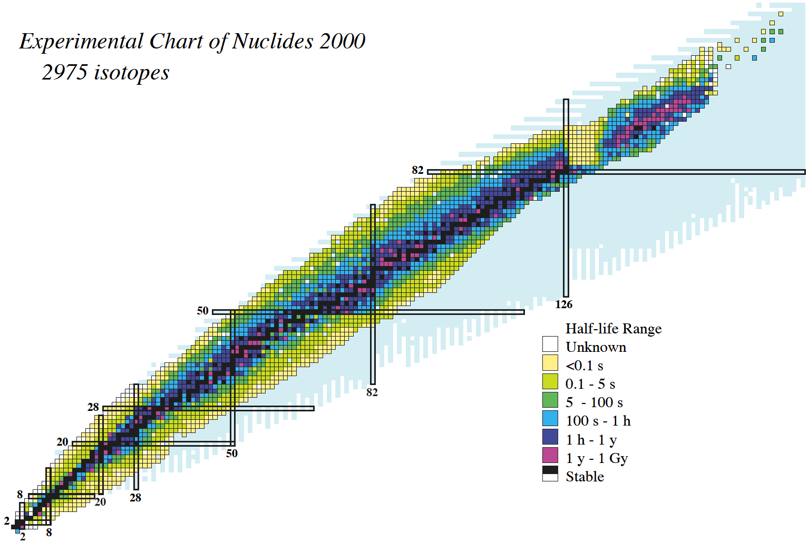
Region of interest
120?
114?
new nuclides: ～40/year
new element: ～0.3/year
184
Z
N

Slide 5
a
b
c
d
e
f
: saddle
d
c
e
: scission
b
f
Bf: fission barrier
a
Potential energy
Z1Z2e²
V=
R
Deformation or distance between two centers of fragments R

Slide 6
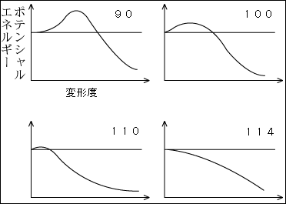
Potential energy
deformation

Slide 8
spherical
deformed (axially symmetric)
surface energy
Coulomb energy
β₂ deformation only
Weizsächer-Bethe

Slide 9
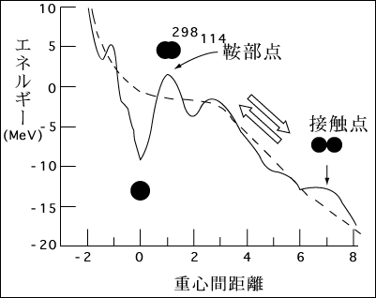
saddle
Energy
scission
deformation
Physics of heavy and superheavy nuclei
→ large scale nuclear transmutation
→ quantum mechanical shell effect

Slide 10
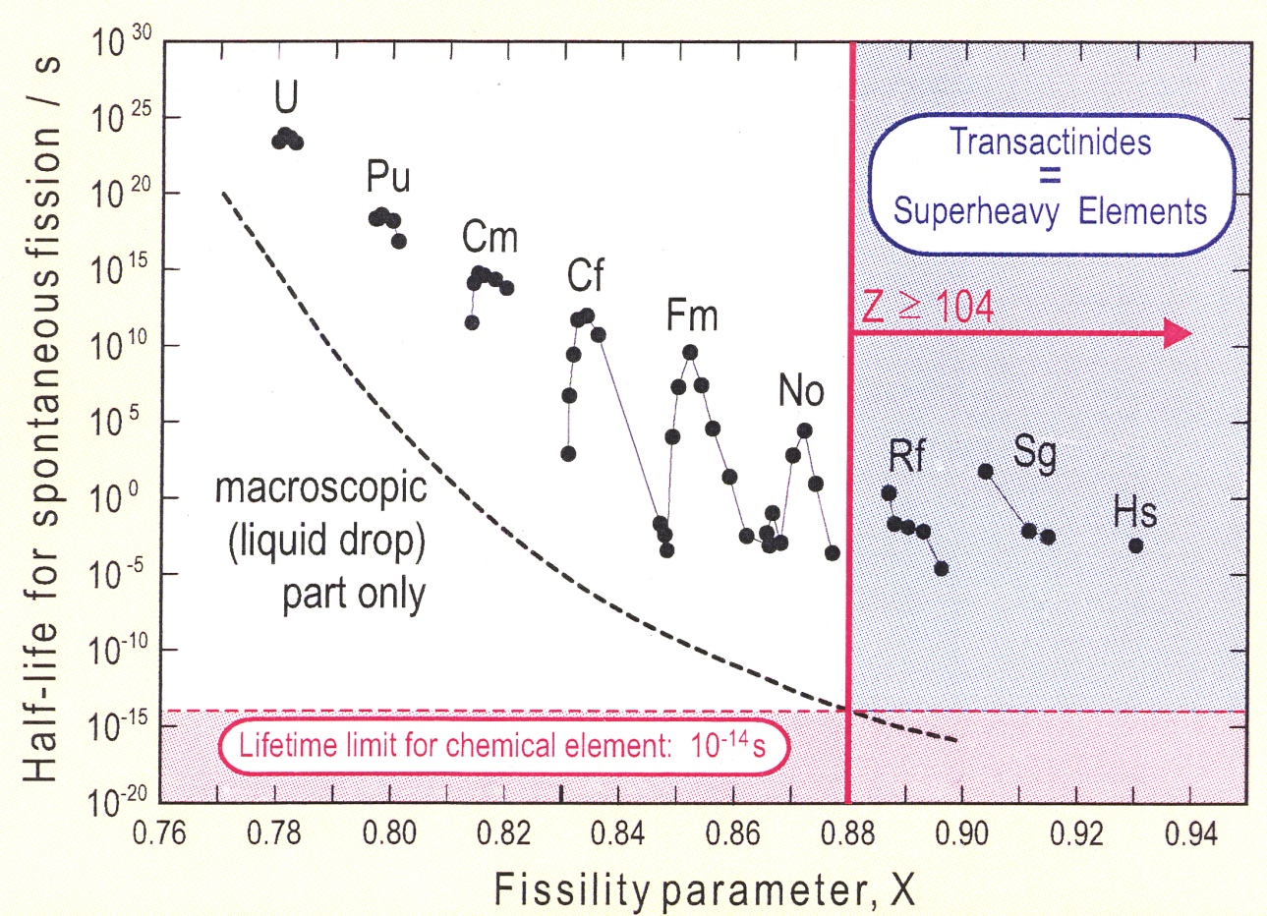
Superheavy Element
age of the universe ～ 4.3x10¹⁷ s

Slide 11
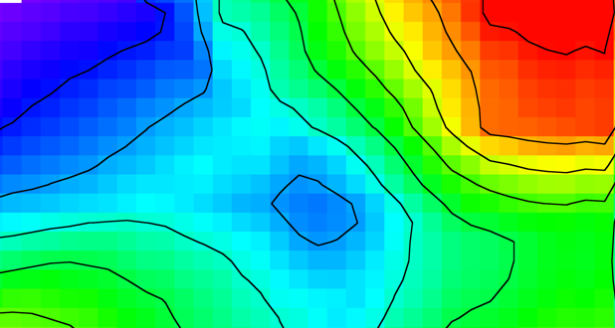
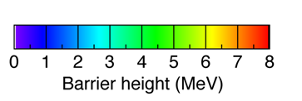
one end of nuclear chart ’84－’94
120
119
118
117
116
115
114
SHE
113
112
Rg
Ds
Mt
266
Hs
264
265
Bh
261
262
Sg
259
260
261
263
Db
258
260
261
262
257
258
259
260
261
262
Rf
262
162
184
A
α-decay
A
Spontaneous fission
A
β⁺ or EC decay

Slide 12
one end of nuclear chart 2010
one end of nuclear chart 2009
120
119
118
294
117
293
294
116
290
291
292
293
115
287
288
289
290
114
286
287
288
289
290
SHE
113
278
283
284
285
286
112
277
282
283
284
285
286
Rg
272
274
279
280
281
282
Ds
269
270
271
273
279
281
282
Mt
266
268
270
275
276
278
Hs
263
264
265
266
267
269
270
271
275
278
Bh
261
262
264
265
266
267
271
272
274
Sg
259
260
261
262
263
264
265
266
271
Db
258
259
260
261
262
263
267
268
270
257
258
259
260
261
262
263
267
268
Rf
261
262
162
184
A
α-decay
A
Spontaneous fission
A
β⁺ or EC decay

Slide 13
Main Limitations of Various Approaches to SHE
Reaction Mode | Proj. (Aproj) | Limitation | Heaviest Nuclide |  | comment
 |  |  | (Z) | (N)
multiple n-capture | n | SF* of Fm isotopes | 100 | 157 | maybe possible in nature (r-process)
hot fusion (HI,xn);x=3-6 Ucn≥40 MeV | ≤34 &48 | small survival prob. (Γ_{n}/Γ_{f} very small) | 118 | 176 | N-rich beam often improves. (cf. ⁴⁸Ca;warm fusion)
cold fusion (HI,xn);x=1,2 Ucn ≤20 MeV | 50-70 | small fusion prob. (dynamical hindrance of fusion?) | 113 | 165
transfer reaction | ≤22 | lack of target heavier than ²⁵⁴Es** | 103 | 159
*SF: spontaneous fission. cf. T_{1/2} of ²⁵⁸Fm₁₅₈ ≈ 400 μs.
**²⁵⁴Es(Z=99): T_{1/2} ≈ 276 day

Slide 14
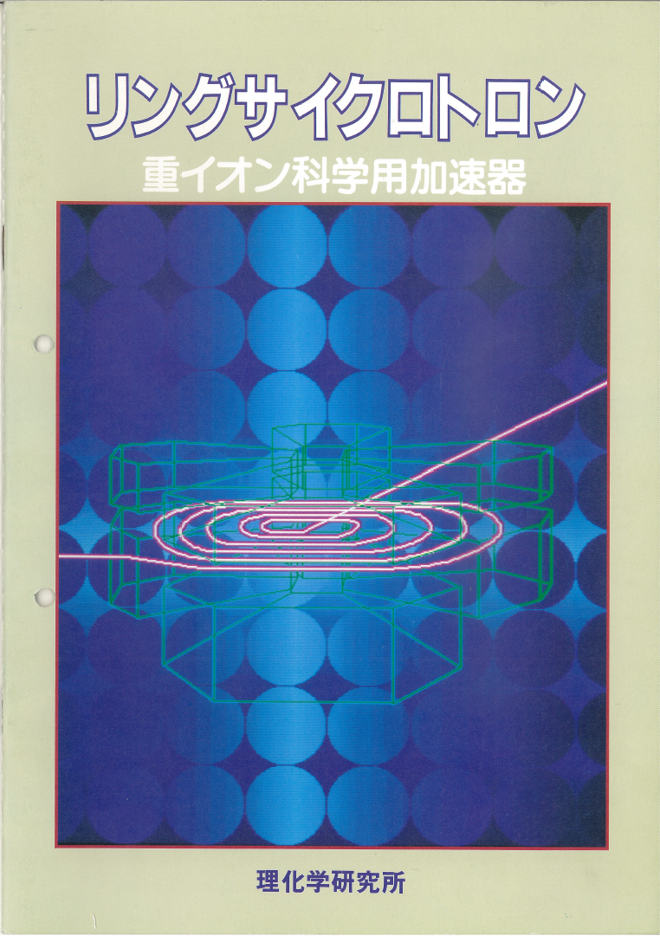
Ring Cyclotron pamphlet 1986
First Beam Dec. 1986

Slide 15
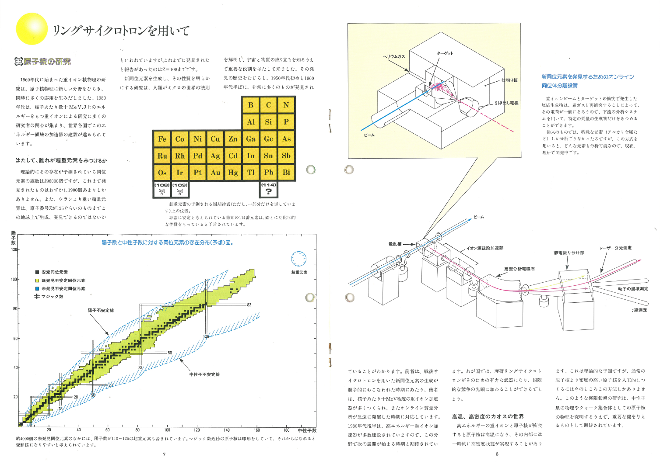
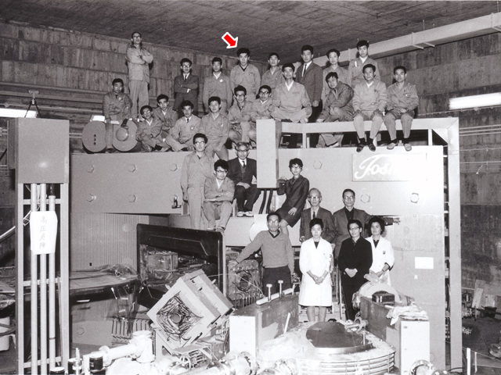
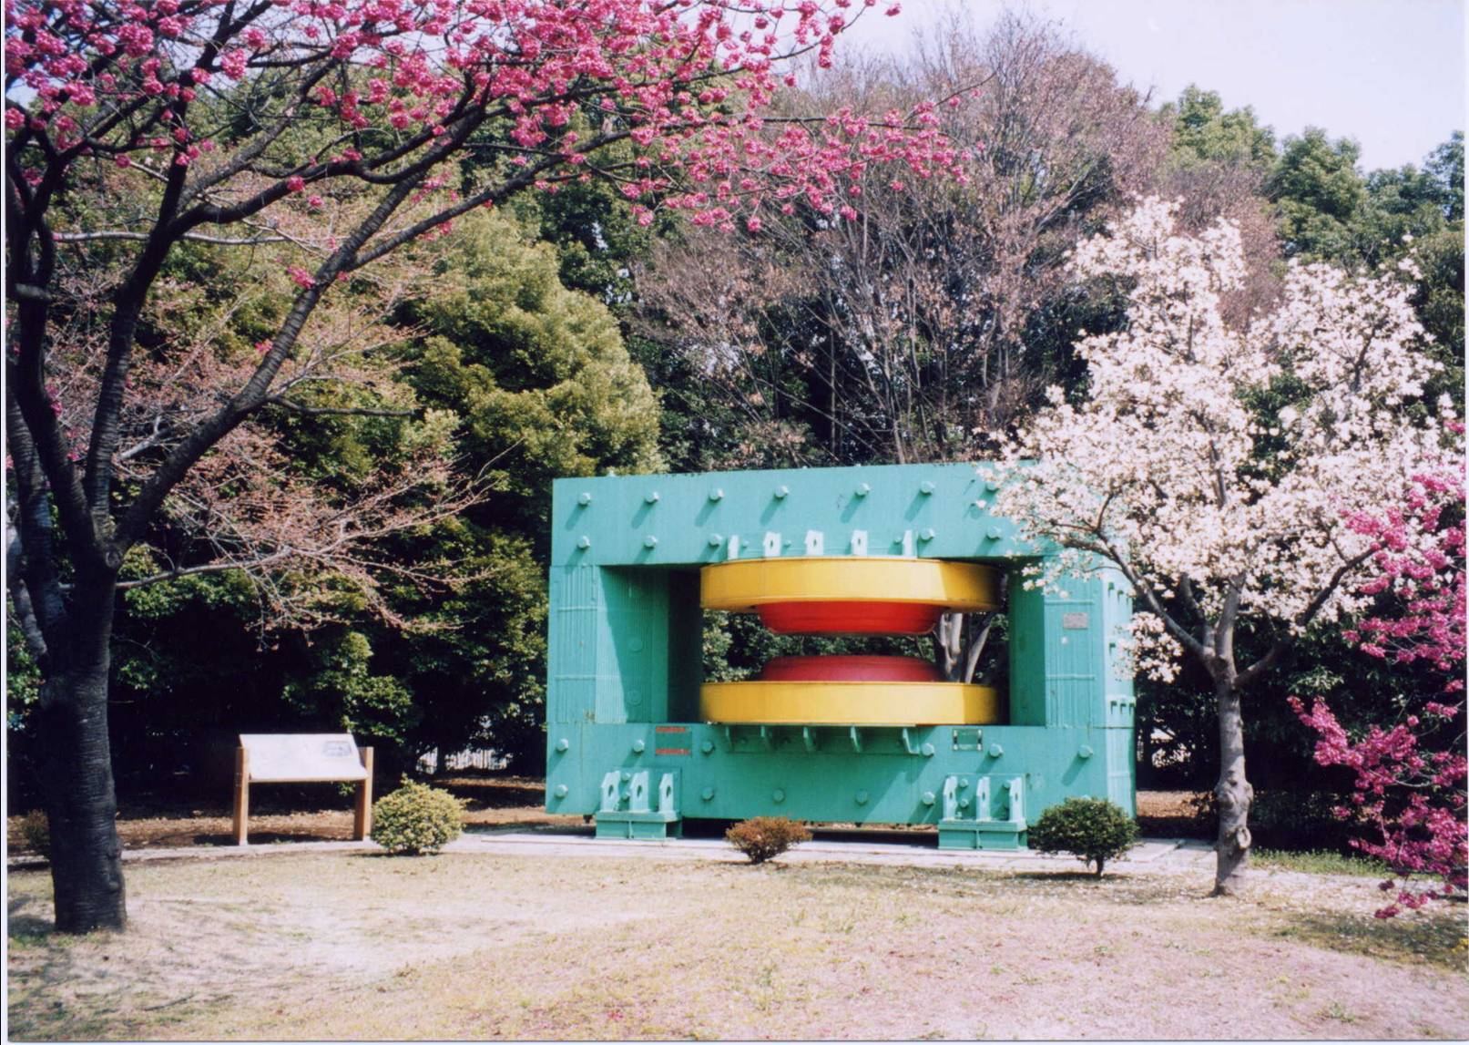
Ring Cyclotron pamphlet 1986

Slide 16
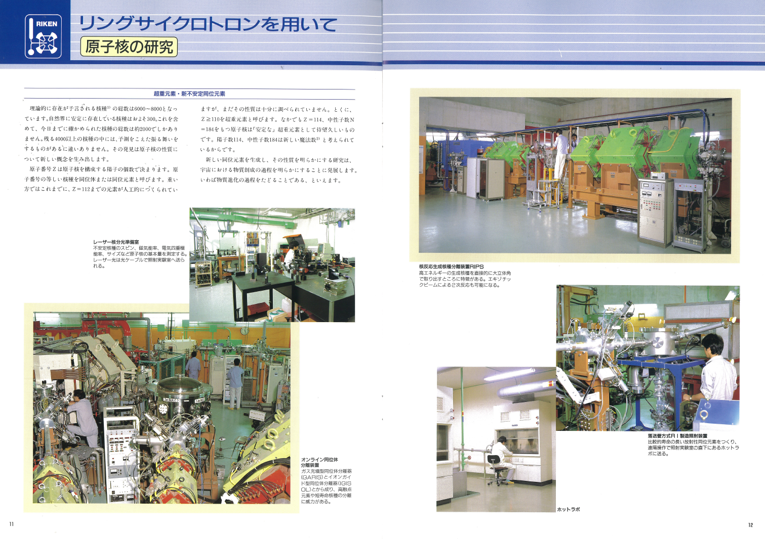
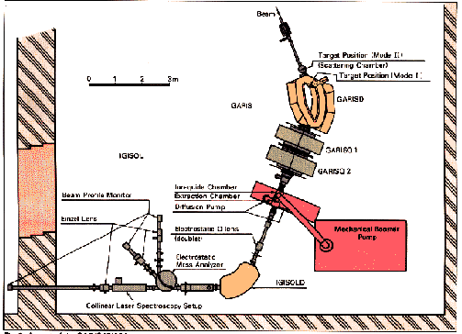
Ring Cyclotron pamphlet 1990
RIPS
GARIS/IGiSOL

Slide 18
2000

Slide 19
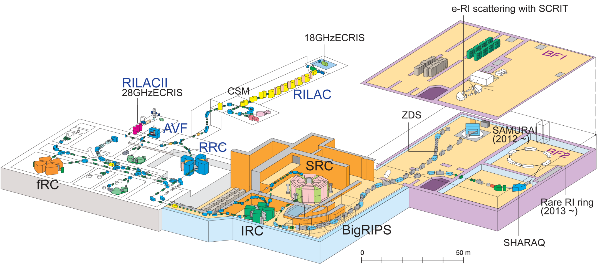
Superheavy Element Study at RIKEN RIBF
Experimental setups
Hot Lab.
CL
GARIS, GARIS-II

Slide 20
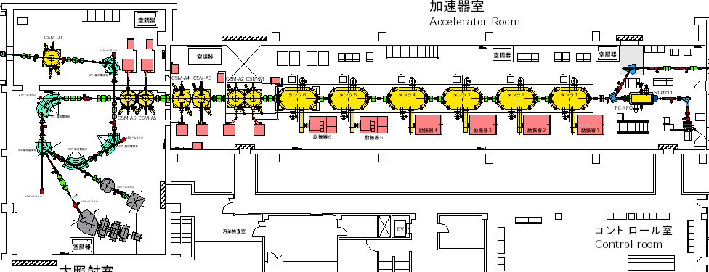
CSM Dec. Tank
CSM Acc. Tanks
RILAC Acc. Tanks
RFQ-Linac
GARIS
RILAC Facility
18GHz ECR Ion Source

Slide 21
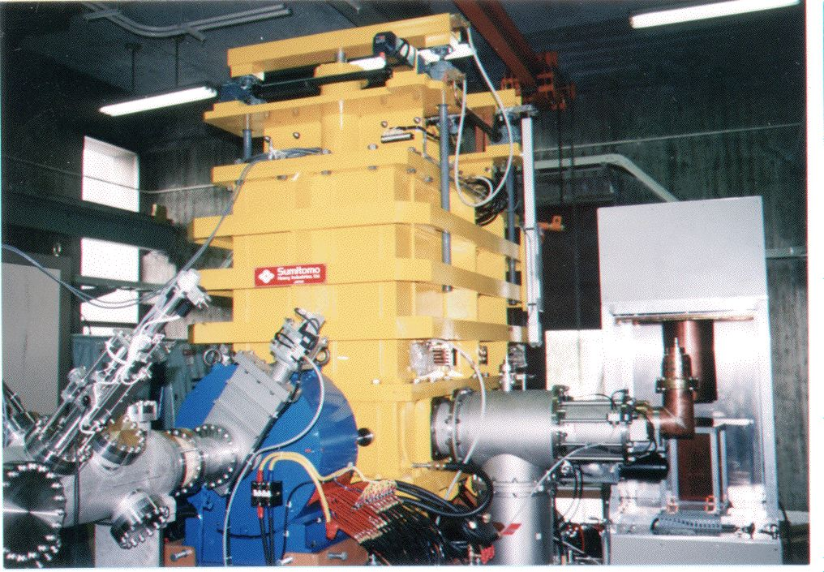
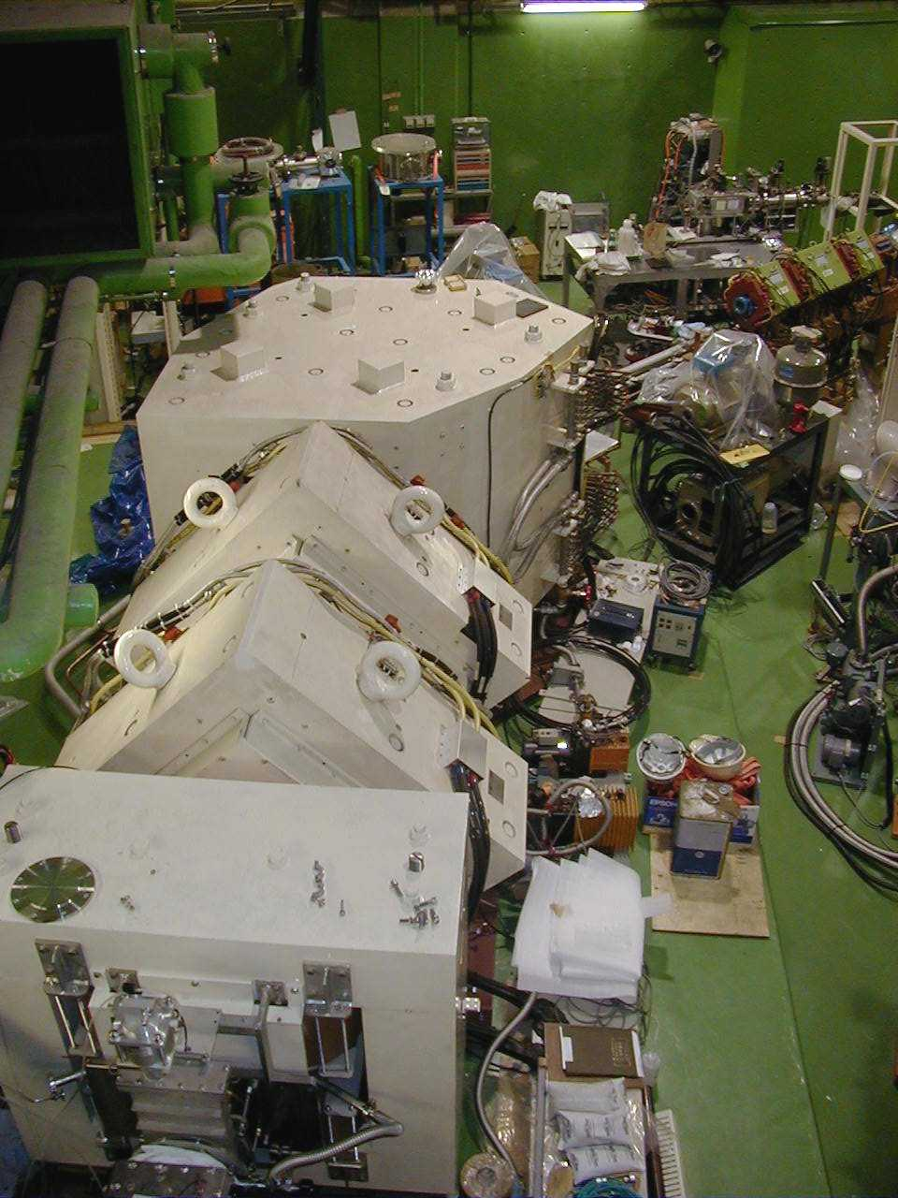
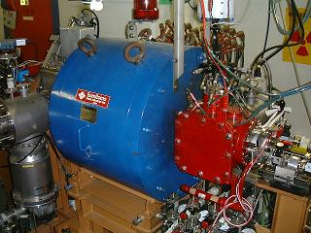
分離装置(separator)
Experimental setup
nucl. reaction
select the nuclei of our
interest from the unwanted
then transport to the
detector chamber
incident ion beam
（粒子の流れ）
GARIS
標的（金属薄膜）
加速器
検出器(detectors)
accelerate ions using electric field
information of energies or positions
of incoming ions and their decay
particles are transform to electric
signal
RFQ-Linac
イオン源
remove electrons from neutral atoms
理研original
18GHz ECR ion-source

Slide 22
Reactions studied at RIKEN-GARIS
²⁷²Rg
14 chains
²⁷⁸113
116
²⁷¹Ds
14 chains
115
176
114
²⁷⁷112
2 chains
113
^{263, 264, 265}Hs
112
111
²⁰⁸Pb(⁵⁸Fe, n)²⁶⁵Hs
²⁰⁸Pb(⁶⁴Ni, n)²⁷¹Ds
²⁰⁹Bi(⁶⁴Ni, n)²⁷²Rg
²⁰⁸Pb(⁷⁰Zn, n)²⁷⁷Cn
²⁰⁹Bi(⁷⁰Zn, n)²⁷⁸113
²⁰⁷Pb(⁵⁸Fe, n)²⁶⁴Hs
²⁰⁶Pb(⁵⁸Fe, n)²⁶³Hs
²⁰⁸Pb(⁵⁶Fe, n)²⁶³Hs
²⁰⁸Pb(⁵⁸Fe, 2n)²⁶⁴Hs
²⁴⁸Cm(¹⁸O,5n)²⁶¹Rf
²⁴⁸Cm(²²Ne,5n)²⁶⁵Sg
²⁴⁸Cm(²³Na,5n)²⁶⁶Bh
Ds
Mt
170
Hs
Bh
²⁶⁵Sg
Sg
Db
²⁶¹Rf
Rf
162
α
Lr
No
SF
Md
β+ or EC
Fm
β-
Es
Cf
New !
152
Notes:
The observed chain is locating here.

Slide 23

Standard method for heavy element physics: recoil separator + position sensitive FPD
RIKEN Gas-filled Recoil Separator GARIS
D1
Bending angle | 45 degree
Pole gap | 150 mm
Radius of central ray | 1200 mm
Maximum field | 1.54 T
Q1, Q2
Pole length | 500 mm
Bore radius | 150 mm
Maximum field gradient | 5.2 T/m
D2
Bending angle | 10 degree
Pole gap | 160 mm
Pole length | 400 mm
Maximum Field | 1.04 T
beam
Differential pumping section
Rotating Target
r | 150 mm
ω | 2000 rpm
D1 Q1 Q2 D2
Magnification | X | -0.76
 | Y | -1.99
Dispersion |  | 0.97 cm/%
Total length |  | 5760 mm
Acceptance | Δθ | ±68 mrad
 | Δφ | ±57 mrad
 | ΔΩ | 12.2 msr

Slide 24
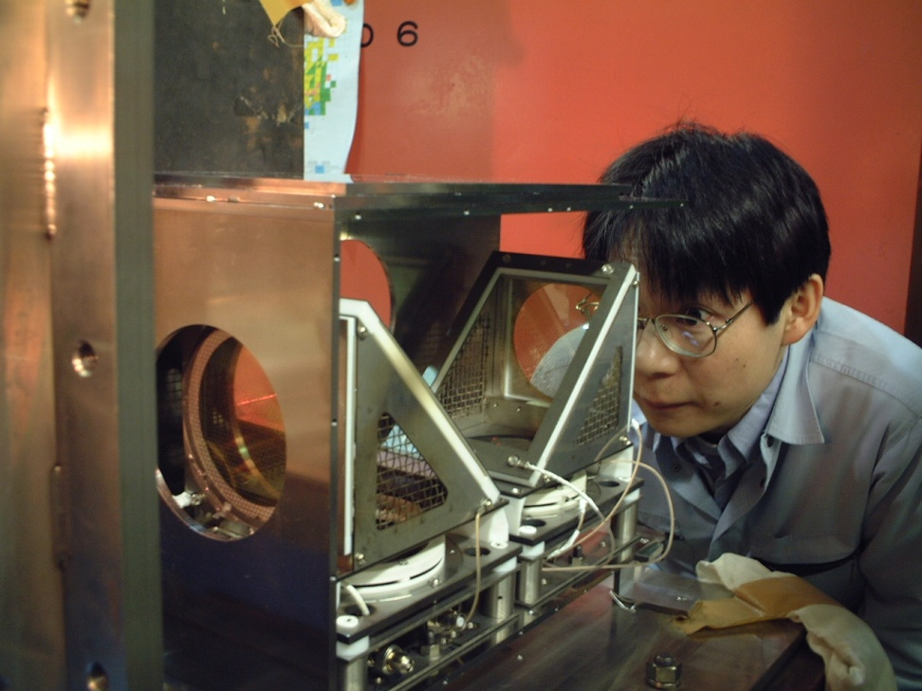
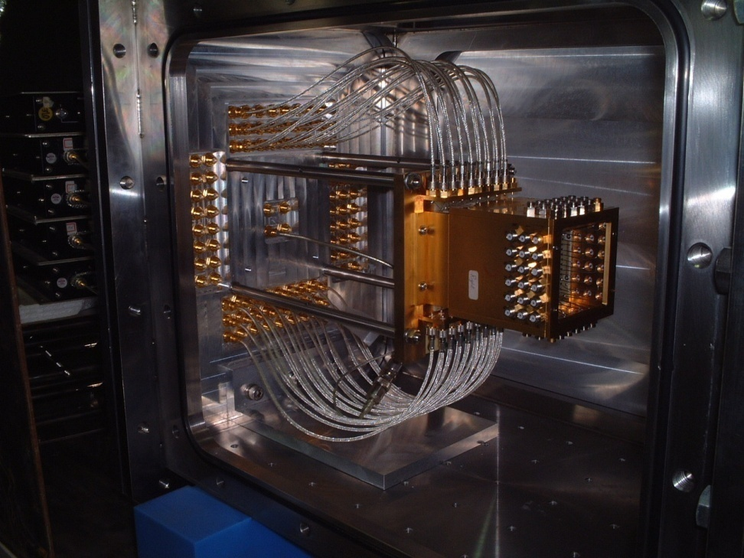
Focal Plane Detectors
PSD
SSD box
ions
MCP2
MCP1

Slide 25
20
²⁷²Ds
10
4
²⁷³111
2
σ (pb)
²⁷⁸112
Calculated threshold of fission
after 1n emission
1
0.5
Masses of Beams & Targets
Audi & Wapstra, Nucl. Phys A565, 1 (1993)
Masses of Compound Nuclei
Myers & Swiatecki, Nucl. Phys. A601, 141 (1996)
0.3
²⁷⁹113
0.2
0.1
5
10
15
20
Ex of C.N. (MeV)

Slide 26
B + T + Ecm
S_{n}
Second chance fission
sreshold
Ex(CN)
(A – n) + n
S_{n}
B_{f}
saddle point
A
Deformation
saddle point
Deformation
Ecm
Energy diagram of 1n emission
B + T

Slide 27
Cold fusion:
²⁰⁸Pb ²⁰⁹Biなど魔法数をもつ安定な標的に相手方となるビームを照射する。
クーロン障壁近傍の入射エネルギーでは複合核の励起エネルギーが
15～20MeV程度。複合核の脱励起の過程で1個ないし2個の中性子を出して
超重元素である蒸発残留核を生じる。核分裂との競合回数が少ない
のが利点であるが積Z₁・Z₂が大きくいわゆる融合阻害の度合いが大きい。
より中性子欠損の大きい核が合成されるため既知核へ連結することが多い。
Hot fusion：
アクチノイド標的に⁴⁸Caを照射する。クーロン障壁近傍の入射エネルギーでは複合核
の励起エネルギーが35～45MeV程度。2ないし4個の中性子を出して脱励起しする。
cold fusionに比べて標的とビームの原子番号がより非対称であるため、積Z₁・Z₂が
cold fusionに比べ小さく、いわゆる融合阻害は無いと言われている。
より中性子欠損が少ない核が合成され、α崩壊チェーンは中性子過剰な側に突っ込み
既知核へ到達しない。

Slide 28
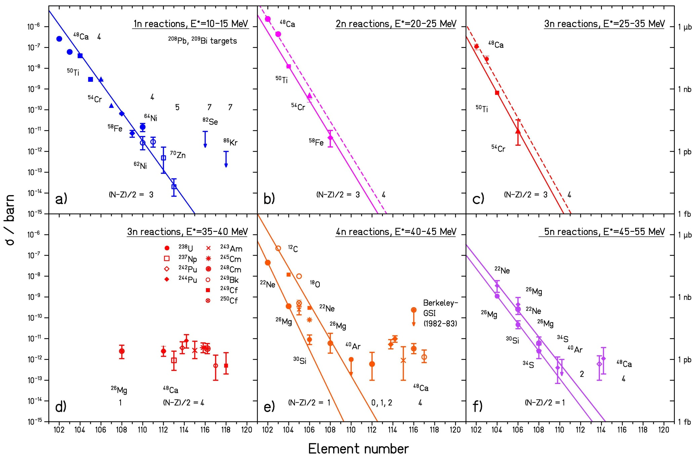
Cross-section systematics and extrapolation
400 fb
300 fb
²³Na+²⁴⁸Cm => ²⁶⁶Bh+5n

Slide 29
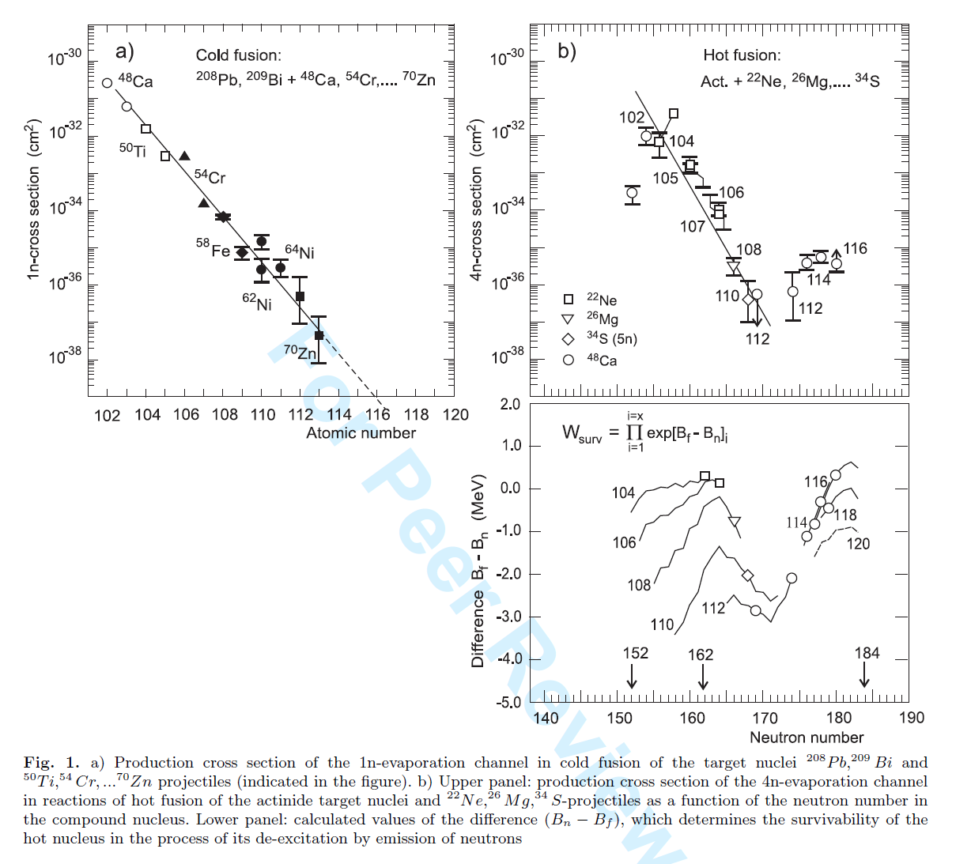

Slide 30
Summary of ²⁰⁹Bi + ⁷⁰Zn experiment
period 2003/9/5 ～ 2012/8/18
Beam Energy 5.03 AMeV
348 MeV at target half depth
Total Dose 1.35x10²⁰
Target Thickness 1.3x10¹⁸ /cm² (0.45 mg/cm²)
ε_GARIS 0.8
σ(3-events) 2.2x10⁻³⁸ cm²
22 ⁺²⁰₋₁₃ fb
Irradiation time 13274 Hours (553 Days)
Beam Intensity 2.8x10¹² /s (0.47 p-μA)
J. Phys. Soc. Jpn., Vol. 73 (2004) 2593
J. Phys. Soc. Jpn., Vol. 76 (2007) 045001
J. Phys. Soc. Jpn., Vol. 81 (2012) 103201

Slide 31
Table I. Summary of beamtime used.
beamtime |  | irradiation time | beam dose/sum | number of observed events
year | month/day | [days] | [×10¹⁹]
2003 | 9/5 - 12/29 | 57.9 | 1.24/1.24 | 0
2004 | 7/8 - 8/2 | 21.9 | 0.51/1.75 | 1
2005 | 1/20 - 1/23 | 3.0 | 0.07/1.82 | 0
2005 | 3/20 - 4/22 | 27.1 | 0.71/2.53 | 1
2005 | 5/19 - 5/21 | 2.0 | 0.05/2.58 | 0
2005 | 8/7 - 8/25 | 16.1 | 0.45/3.03 | 0
2005 | 9/7 - 10/20 | 39.0 | 1.17/4.20 | 0
2005 | 11/25 - 12/15 | 19.5 | 0.63/4.83 | 0
2006 | 3/14 - 5/15 | 54.2 | 1.37/6.20 | 0
2008 | 1/9 - 3/31 | 70.9 | 2.28/8.48 | 0
2010 | 9/7 - 10/18 | 30.9 | 0.52/9.00 | 0
2011 | 1/22 - 5/22 | 89.8 | 2.01/11.01 | 0
2011 | 12/2 - 12/19 | 14.4 | 0.33/11.34 | 0
2012 | 1/15 - 2/9 | 25.0 | 0.56/11.90 | 0
2012 | 3/13 - 4/17 | 33.7 | 0.79/12.69 | 0
2012 | 6/12 - 7/2 | 15.7 | 0.25/12.94 | 0
2012 | 7/14 - 8/18 | 32.0 | 0.57/13.51 | 1
Total |  | 553 | 13.51 | 3

Slide 32
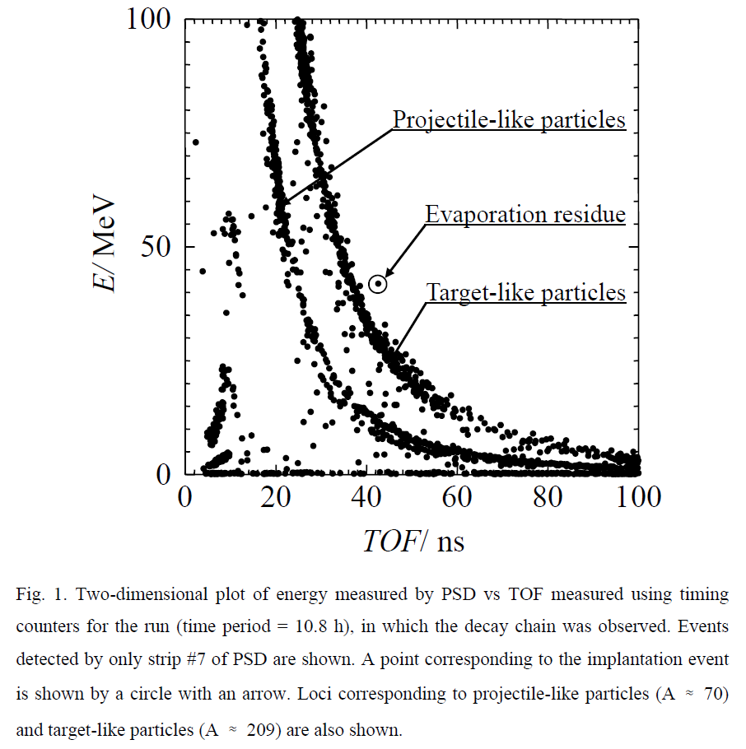

Slide 33
²⁰⁹Bi + ⁷⁰Zn → ²⁷⁸113 + n
36.75 MeV
TOF 44.61 ns
30.33 mm
36.47 MeV
TOF 45.69 ns
30.08 mm
²⁷⁸113
CN
²⁷⁸113
CN
1st chain
α
α
11.68 MeV (PSD)
344 μs
30.49 mm
11.52 MeV (PSD)
4.93 ms
30.16 mm
23-July-2004 18:55 (JST)
²⁷⁴111
²⁷⁴111
α
α
11.15 MeV
6.149+5.003 (PSD+SSD)
9.260 ms
30.40 mm
0.88+10.43=11.31 MeV
(PSD+SSD)
34.3 ms
29.61 mm
²⁷⁰Mt
²⁷⁰Mt
α
α
10.03 MeV
1.136+8.894(PSD+SSD)
7.163 ms
29.79 mm
2.32 MeV (escape)
1.63 s
29.45 mm
²⁶⁶Bh
²⁶⁶Bh
σ = 31 fb
α
α
9.08 MeV (PSD)
2.469 s
30.91 mm
9.77 MeV (PSD)
1.31 s
29.65 mm
2nd chain
²⁶²Db
²⁶²Db
2-April-2005 2:18 (JST)
204.05 MeV(PSD)
40.9 s
30.25 mm
192.32 MeV(PSD)
0.787 s
30.47 mm
s.f.
s.f.

Slide 34
250
α1-SF in (α1-α2-SF)
α2-SF in (α1-α2-SF)
b
200
α1-SF
F
E
J
I
G
E_{SF} (Daughter) [MeV]
H
150
100
50
10
α1-α2 in (α1-α2-α3/SF)
a
α2-α3 in (α1-α2-α3)
α1-α3 in (α1-α2-α3)
α1-α2
9
C
A
E_{α} (Daughter) [MeV]
²⁵⁸Lr
B
²⁶²Db
D
²⁶²Db
²⁶⁷Bh
²⁶⁶Bh
8
8
9
10
E_{α} (Mother) [MeV]

Slide 35
decays observed in ²⁷⁸113 synthesis
²⁷⁸113
²⁷⁹113
α
one n evaporation
decays observed in the present work
²⁷⁴Rg
²⁰⁹Bi + ⁷⁰Zn → ²⁷⁹113*
α
²⁷⁰Mt
α
²⁶⁶Bh
²⁶⁷Bh
²⁶⁸Bh
²⁶⁹Bh
²⁷⁰Bh
²⁷¹Bh
α
five n evaporation
²⁶²Db
²⁴⁸Cm + ²³Na → ²⁷¹Bh*
α
S.F.
²⁵⁸Lr
α
Notes:
This is the observed chain.
The decay chain consist of 4 alpha decays and ended by spontaneous fission of Db262.
The production cross section of this specific event is deduced to be 55 fb.

Slide 37
α₁
²⁷⁸113
Apr. 2, 2005
Jul. 23, 2004
11.68 ± 0.04 MeV
0.344 ms
α₂
²⁷⁴Rg
²⁷⁸113
11.15 ± 0.07 MeV
9.26 ms
α₁
11.52 ± 0.04 MeV
4.93 ms
α₃
²⁷⁰Mt
²⁷⁴Rg
10.03 ± 0.07 MeV
7.16 ms
α₂
²⁷⁸113
11.31 ± 0.07 MeV
34.3 ms
α₁
α₄
²⁶⁶Bh
11.82 ± 0.06 MeV
0.667 ms
²⁷⁰Mt
9.08 ± 0.04 MeV
2.47 s
α₃
²⁷⁴Rg
2.32 MeV (escape)
1.63 s
α₂
²⁶²Db
10.65 ± 0.06 MeV
9.97 ms
²⁶⁶Bh
204 MeV
40.9 s
α₄
²⁷⁰Mt
9.77 ± 0.04 MeV
1.31 s
α₃
S. F.
10.26 ± 0.07 MeV
444 ms
²⁶²Db
²⁶⁶Bh
192MeV
0.787 s
α₄
S. F.
9.39 ± 0.06 MeV
5.26 s
²⁶²Db
α₅
8.63 ± 0.06 MeV
126 s
Aug. 12, 2012
²⁵⁸Lr
α₆
8.66 ± 0.06 MeV
3.78 s
²⁵⁴Md

Slide 38
N=165
²⁷⁸113 τ = 2.0 ms
N=163
²⁷⁴Rg τ = 18 ms
previous
N=161
²⁷⁰Mt τ = 0.69 s
N=159
²⁶⁶Bh τ = 3.0 s
N=157
²⁶²Db τ = 56 s
10 μs
1 ms
0.1 s
10 s
1000 s
T_decay

Slide 39
N=165
²⁷⁸113 τ = 2.0 ms
N=163
present
²⁷⁴Rg τ = 18 ms
previous
N=161
²⁷⁰Mt τ = 0.69 s
N=159
²⁶⁶Bh τ = 3.0 s
N=157
²⁶²Db τ = 56 s
10 μs
1 ms
0.1 s
10 s
1000 s
T_decay

Slide 40
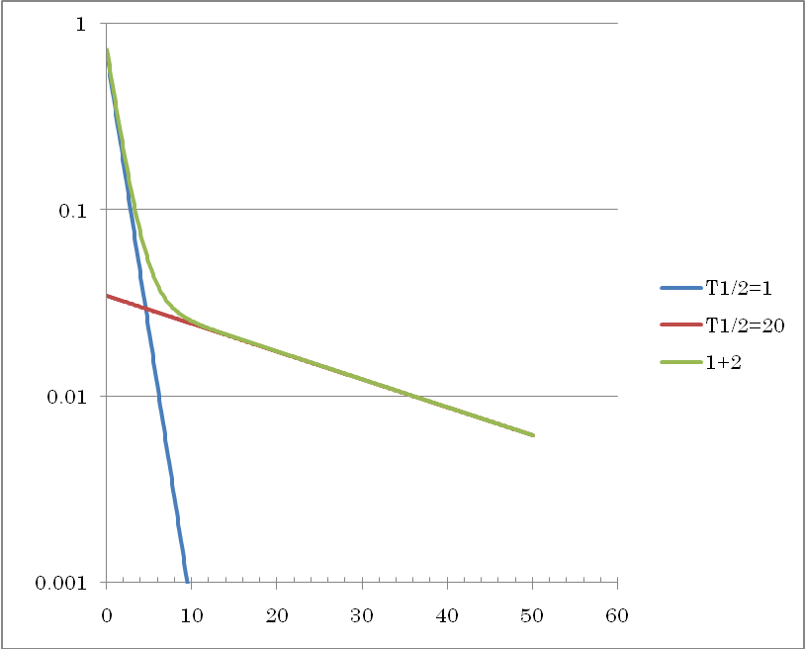
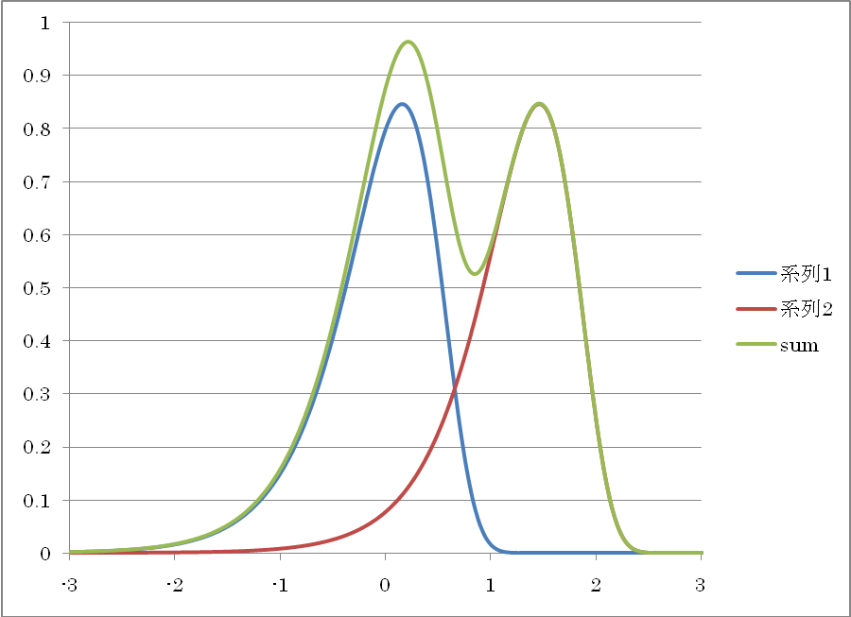
崩壊時間の常用対数

Slide 41
²⁶²Db(Z = 105):
b_{α}/b_{SF} = 67%/33%.
T_{1/2} = 34 ± 4 s
8.450 ± 0.020 MeV (75%),
8.530 ± 0.020 MeV (16%),
8.670 ± 0.020 MeV (9%)
α₅
E_{α} = 8.63 ± 0.06 MeV
= 126 s (present)
τ = 56 ⁺⁷⁷ ₋₂₁ s → T_{1/2} = 39 ⁺⁵³ _{–14} s (three events)
²⁵⁸Lr(Z = 103):
b_{α} = 97.5%.
T_{1/2} = 3.92^{+0.35}_{–0.42} s
8.565 ± 0.025 MeV (20%),
8.595 ± 0.010 MeV (46%),
8.621 ± 0.010 MeV (25%),
8.654 ± 0.010 MeV (9%)
α₆
E_{α} = 8.66 ± 0.06 MeV
= 3.78 s
→ T_{1/2} = 2.6 ⁺¹² _{-1.1} s (one events)
²⁵⁴Md/ ^{254m}Md(Z = 101):
b_{EC} = 100%/ 100%,
T_{1/2} = 10 ± 3 / 28 ± 8 min
no signal :
E(X-ray of ²⁵⁴Fm)_{max} = 142 keV
Energy threshold of PSD = 800 keV
²⁵⁴Fm(Z = 100):
b_{α} = 99.94%,
T_{1/2} = 3.240 ± 0.002 h
6.898 ± 0.003 MeV (0.0066%),
7.050 ± 0.002 MeV (0.82%),
7.150 ± 0.002 MeV (14.2%),
7.192 ± 0.002 MeV (84.9%).
α₇₋₁
E_{α} = 7.26 ± 0.07 MeV
= 3.96 h P_{acc} = 0.43
α₇₋₂
E_{α} = 7.18 ± 0.06 MeV
= 6.42 h P_{acc} = 0.70
²⁵⁰Cf (Z=98):
b_{α} = 99.92%
T_{1/2} = 13.08 y

Slide 42
²⁰⁹Bi + ⁷⁰Zn → ²⁷⁸113 + n
α₄: ²⁶⁶Bh (Z = 107)
1st E_{α} = 9.08 ± 0.04 MeV, τ = 2.47 s
2nd E_{α} = 9.77 ± 0.04 MeV, τ = 1.31 s
3rd E_{α} = 9.39 ± 0.06 MeV, τ = 5.26 s
mean-life = 3.0 ^{+4.2} _{-1.1} s → T_{1/2} = 4.3 ^{+6.1} _{-1.6} s
Cf:
²⁴⁸Cm + ²³Na → ²⁶⁶Bh + 5n
²⁶⁶Bh (Z = 107)
E_{α} = 9.05 －9.23 MeV, τ > s

Slide 43
118
117 |  |  |  |  |  |  |  |  |  |  |  |  |  |  | ²⁹³117 | ²⁹⁴117
116
115 |  |  |  |  |  |  |  |  |  |  | ²⁸⁷115 | ²⁸⁸115 | ²⁸⁹115 | ²⁹⁰115
114
113 |  |  |  |  |  |  |  | ²⁸²113 | ²⁸³113 | ²⁸⁴113 | ²⁸⁵113 | ²⁸⁶113
 |  |  |  |  |  | ²⁷⁸Rg | ²⁷⁹Rg | ²⁸⁰Rg | ²⁸¹Rg | ²⁸²Rg
 |  |  |  | ²⁷⁴Mt | ²⁷⁵Mt | ²⁷⁶Mt |  | ²⁷⁸Mt
 |  | ²⁷⁰Bh | ²⁷¹Bh | ²⁷²Bh |  | ²⁷⁴Bh
²⁶⁶Db | ²⁶⁷Db | ²⁶⁸Db |  | ²⁷⁰Db
 |  |  |  |  |  |  |  |  |  |  |  |  |  |  | ²⁹⁴118
 |  |  |  |  |  |  |  |  |  |  |  |  | ²⁹⁰Lv | ²⁹¹Lv
 |  |  |  |  |  |  |  |  |  |  | ²⁸⁶Fl | ²⁸⁷Fl
 |  |  |  |  |  |  |  |  | ²⁸²Cn
 |  |  |  |  |  | ²⁷⁵Hs
 |  | ²⁶⁷Rf
²⁰⁹Bi + ⁷⁰Zn → n
2nd event Apr. 2 2005
3rd event Aug. 12 2012
1st event Jul. 23 2004
²⁷⁸113
113
112 |  |  |  |  |  |  |  |  |  |  |  |  |  | ²⁷⁷Cn
111 |  |  |  |  |  |  |  |  |  | ²⁷²Rg
110 |  |  |  |  |  |  |  | ²⁶⁹Ds | ²⁷⁰Ds | ²⁷¹Ds |  | ²⁷³Ds
109 |  |  |  |  |  | ²⁶⁶Mt |  | ²⁶⁸Mt
108 |  |  |  | ²⁶³Hs |  | ²⁶⁵Hs | ²⁶⁶Hs | ²⁶⁷Hs |  | ²⁶⁹Hs | ²⁷⁰Hs | ²⁷¹Hs
107 |  |  | ²⁶¹Bh | ²⁶²Bh |  | ²⁶⁴Bh |  | ²⁶⁶Bh | ²⁶⁷Bh
106 | ²⁵⁸Sg | ²⁵⁹Sg |  | ²⁶¹Sg |  | ²⁶³Sg
105 |  |  | ²⁵⁹Db | ²⁶⁰Db
104 | ²⁵⁶Rf |  |  |  | ²⁶⁰Rf | ²⁶¹Rf | ²⁶²Rf
103 | ²⁵⁵Lr |  | ²⁵⁷Lr | ²⁵⁸Lr | ²⁵⁹Lr | ²⁶⁰Lr | ²⁶¹Lr | ²⁶²Lr
102 |  |  | ²⁵⁶No |  | ²⁵⁸No |  | ²⁶⁰No |  | ²⁶²No
101 | ²⁵³Md | ²⁵⁴Md |  |  |  |  | ²⁵⁹Md | ²⁶⁰Md
100 | ²⁵²Fm |  | ²⁵⁴Fm | ²⁵⁵Fm |  | ²⁵⁷Fm | ²⁵⁸Fm | ²⁵⁹Fm
99 | ²⁵¹Es |  | ²⁵³Es |  |  | ²⁵⁶Es | ²⁵⁷Es
98 | ²⁵⁰Cf | ²⁵¹Cf | ²⁵²Cf | ²⁵³Cf | ²⁵⁴Cf | ²⁵⁵Cf | ²⁵⁶Cf
α
²⁷⁸113
CN
α
²⁸³Cn
既知核種
²⁷⁴Rg
α
²⁷⁴Rg
α
²⁷⁹Ds
²⁷⁰Mt
α
²⁷⁰Mt
α
²⁶⁴Hs
²⁶⁶Bh
α
²⁶⁶Bh
α
FLNR/LLNR/GSI/LBNL
²⁶⁰Sg
²⁶²Sg
²⁶⁵Sg
²⁶⁶Sg
²⁷¹Sg
²⁵⁷Db
²⁶¹Db
²⁶²Db
²⁶³Db
²⁶²Db
²⁵⁸Db
²⁶²Db
α
SF
²⁵⁷Rf
²⁵⁸Rf
²⁵⁹Rf
²⁶³Rf
²⁵⁶Lr
²⁵⁸Lr
α
²⁵⁴No
²⁵⁵No
²⁵⁷No
²⁵⁹No
²⁵⁴Md
²⁵⁵Md
²⁵⁶Md
²⁵⁷Md
²⁵⁸Md
²⁵³Fm
²⁵⁴Fm
²⁵⁶Fm
α
²⁵²Es
²⁵⁴ES
²⁵⁵Es
²⁵⁰Cf

Slide 44
²⁴⁹Bk + ⁴⁸Ca → 4n
²⁴⁹Bk + ⁴⁸Ca → 3n
118
117 |  |  |  |  |  |  |  |  |  |  |  |  |  |  | ²⁹³117 | ²⁹⁴117
116
115 |  |  |  |  |  |  |  |  |  |  | ²⁸⁷115 | ²⁸⁸115 | ²⁸⁹115 | ²⁹⁰115
114
113 |  |  |  |  |  |  |  | ²⁸²113 | ²⁸³113 | ²⁸⁴113 | ²⁸⁵113 | ²⁸⁶113
 |  |  |  |  |  | ²⁷⁸Rg | ²⁷⁹Rg | ²⁸⁰Rg | ²⁸¹Rg | ²⁸²Rg
 |  |  |  | ²⁷⁴Mt | ²⁷⁵Mt | ²⁷⁶Mt |  | ²⁷⁸Mt
 |  | ²⁷⁰Bh | ²⁷¹Bh | ²⁷²Bh |  | ²⁷⁴Bh
²⁶⁶Db | ²⁶⁷Db | ²⁶⁸Db |  | ²⁷⁰Db
 |  |  |  |  |  |  |  |  |  |  |  |  |  |  | ²⁹⁴118
 |  |  |  |  |  |  |  |  |  |  |  |  | ²⁹⁰Lv | ²⁹¹Lv
 |  |  |  |  |  |  |  |  |  |  | ²⁸⁶Fl | ²⁸⁷Fl
 |  |  |  |  |  |  |  |  | ²⁸²Cn | ²⁸³Cn
 |  |  |  |  |  | ²⁷⁵Hs
 |  | ²⁶⁷Rf
²⁹⁴117
CN
²⁴³Am + ⁴⁸Ca → 2n
²⁹³117
CN
²⁴³Am + ⁴⁸Ca → 3n
α
α
²⁴³Am + ⁴⁸Ca → 4n
²⁹⁰115
CN
CN
²⁸⁹115
CN
²⁰⁹Bi + ⁷⁰Zn → n
²⁸⁷115
²⁸⁸115
²⁸⁹115
α
α
²³⁷Np + ⁴⁸Ca → 3n
α
α
α
3rd event Aug. 12 2012
²⁷⁸113
²⁸²113
²⁸⁵113
²⁸⁶113
²⁸⁴113
²⁸⁵113
113
112 |  |  |  |  |  |  |  |  |  |  |  |  |  | ²⁷⁷Cn
111 |  |  |  |  |  |  |  |  |  | ²⁷²Rg
110 |  |  |  |  |  |  |  | ²⁶⁹Ds | ²⁷⁰Ds | ²⁷¹Ds |  | ²⁷³Ds
109 |  |  |  |  |  | ²⁶⁶Mt |  | ²⁶⁸Mt
108 |  |  |  | ²⁶³Hs |  | ²⁶⁵Hs | ²⁶⁶Hs | ²⁶⁷Hs |  | ²⁶⁹Hs | ²⁷⁰Hs | ²⁷¹Hs
107 |  |  | ²⁶¹Bh | ²⁶²Bh |  | ²⁶⁴Bh |  | ²⁶⁶Bh | ²⁶⁷Bh
106 | ²⁵⁸Sg | ²⁵⁹Sg |  | ²⁶¹Sg |  | ²⁶³Sg
105 |  |  | ²⁵⁹Db | ²⁶⁰Db
104 | ²⁵⁶Rf |  |  |  | ²⁶⁰Rf | ²⁶¹Rf | ²⁶²Rf
103 | ²⁵⁵Lr |  | ²⁵⁷Lr | ²⁵⁸Lr | ²⁵⁹Lr | ²⁶⁰Lr | ²⁶¹Lr | ²⁶²Lr
102 |  |  | ²⁵⁶No |  | ²⁵⁸No |  | ²⁶⁰No |  | ²⁶²No
101 | ²⁵³Md | ²⁵⁴Md |  |  |  |  | ²⁵⁹Md | ²⁶⁰Md
100 | ²⁵²Fm |  | ²⁵⁴Fm | ²⁵⁵Fm |  | ²⁵⁷Fm | ²⁵⁸Fm | ²⁵⁹Fm
99 | ²⁵¹Es |  | ²⁵³Es |  |  | ²⁵⁶Es | ²⁵⁷Es
98 | ²⁵⁰Cf | ²⁵¹Cf | ²⁵²Cf | ²⁵³Cf | ²⁵⁴Cf | ²⁵⁵Cf | ²⁵⁶Cf
²⁸³113
CN
α
²⁷⁸113
CN
α
α
α
α
α
α
²⁷⁴Rg
²⁷⁸Rg
²⁸¹Rg
²⁸²Rg
既知核種
α
²⁷⁴Rg
²⁷⁹Rg
²⁸⁰Rg
²⁸¹Rg
α
α
α
α
SF
SF
²⁷⁹Ds
²⁷⁰Mt
²⁷⁴Mt
²⁷⁵Mt
²⁷⁶Mt
²⁷⁸Mt
α
²⁷⁰Mt
α
α
α
α
²⁶⁴Hs
²⁶⁶Bh
²⁷⁰Bh
²⁷¹Bh
²⁷²Bh
²⁷⁴Bh
α
²⁶⁶Bh
α
α
α
α
FLNR/LLNR/GSI/LBNL
Actinide-based, ⁴⁸Ca induced
Hot fusion reactions
²⁶⁰Sg
²⁶²Sg
²⁶⁵Sg
²⁶⁶Sg
²⁷¹Sg
²⁵⁷Db
²⁶¹Db
²⁶²Db
²⁶³Db
²⁶⁶Db
²⁷⁰Db
²⁶²Db
²⁶⁷Db
²⁶⁸Db
²⁵⁸Db
²⁶²Db
α
SF
SF
SF
SF
²⁵⁷Rf
²⁵⁸Rf
²⁵⁹Rf
²⁶³Rf
²⁵⁶Lr
²⁵⁸Lr
α
²⁵⁴No
²⁵⁵No
²⁵⁷No
²⁵⁹No
²⁵⁴Md
²⁵⁵Md
²⁵⁶Md
²⁵⁷Md
²⁵⁸Md
²⁵³Fm
²⁵⁴Fm
²⁵⁶Fm
α
²⁵²Es
²⁵⁴ES
²⁵⁵Es
²⁵⁰Cf

Slide 45
²⁴⁹Bk + ⁴⁸Ca → 4n
118
117 |  |  |  |  |  |  |  |  |  |  |  |  |  |  | ²⁹³117 | ²⁹⁴117
116
115 |  |  |  |  |  |  |  |  |  |  | ²⁸⁷115 | ²⁸⁸115 | ²⁸⁹115 | ²⁹⁰115
114
113 |  |  |  |  |  |  |  | ²⁸²113 | ²⁸³113 | ²⁸⁴113 | ²⁸⁵113 | ²⁸⁶113
 |  |  |  |  |  |  |  |  |  | ²⁸³Cn
 |  |  |  |  |  | ²⁷⁸Rg | ²⁷⁹Rg | ²⁸⁰Rg | ²⁸¹Rg | ²⁸²Rg
 |  |  |  | ²⁷⁴Mt | ²⁷⁵Mt | ²⁷⁶Mt |  | ²⁷⁸Mt
 |  | ²⁷⁰Bh | ²⁷¹Bh | ²⁷²Bh |  | ²⁷⁴Bh
²⁶⁶Db | ²⁶⁷Db | ²⁶⁸Db |  | ²⁷⁰Db
 |  |  |  |  |  |  |  |  |  |  |  |  |  |  | ²⁹⁴118
 |  |  |  |  |  |  |  |  |  |  |  |  | ²⁹⁰Lv | ²⁹¹Lv
 |  |  |  |  |  |  |  |  |  |  | ²⁸⁶Fl | ²⁸⁷Fl
 |  |  |  |  |  |  |  |  | ²⁸²Cn
 |  |  |  |  |  | ²⁷⁵Hs
 |  | ²⁶⁷Rf
α
²⁹³117
CN
²⁰⁹Bi + ⁷⁰Zn → n
²⁸⁹115
α
²⁸⁹115
CN
α
3rd event Aug. 12 2012
²⁷⁸113
113
112 |  |  |  |  |  |  |  |  |  |  |  |  |  | ²⁷⁷Cn
111 |  |  |  |  |  |  |  |  |  | ²⁷²Rg
110 |  |  |  |  |  |  |  | ²⁶⁹Ds | ²⁷⁰Ds | ²⁷¹Ds |  | ²⁷³Ds
109 |  |  |  |  |  | ²⁶⁶Mt |  | ²⁶⁸Mt
108 |  |  |  | ²⁶³Hs |  | ²⁶⁵Hs | ²⁶⁶Hs | ²⁶⁷Hs |  | ²⁶⁹Hs | ²⁷⁰Hs | ²⁷¹Hs
107 |  |  | ²⁶¹Bh | ²⁶²Bh |  | ²⁶⁴Bh |  | ²⁶⁶Bh | ²⁶⁷Bh
106 | ²⁵⁸Sg | ²⁵⁹Sg |  | ²⁶¹Sg |  | ²⁶³Sg
105 |  |  | ²⁵⁹Db | ²⁶⁰Db
104 | ²⁵⁶Rf |  |  |  | ²⁶⁰Rf | ²⁶¹Rf | ²⁶²Rf
103 | ²⁵⁵Lr |  | ²⁵⁷Lr | ²⁵⁸Lr | ²⁵⁹Lr | ²⁶⁰Lr | ²⁶¹Lr | ²⁶²Lr
102 |  |  | ²⁵⁶No |  | ²⁵⁸No |  | ²⁶⁰No |  | ²⁶²No
101 | ²⁵³Md | ²⁵⁴Md |  |  |  |  | ²⁵⁹Md | ²⁶⁰Md
100 | ²⁵²Fm |  | ²⁵⁴Fm | ²⁵⁵Fm |  | ²⁵⁷Fm | ²⁵⁸Fm | ²⁵⁹Fm
99 | ²⁵¹Es |  | ²⁵³Es |  |  | ²⁵⁶Es | ²⁵⁷Es
98 | ²⁵⁰Cf | ²⁵¹Cf | ²⁵²Cf | ²⁵³Cf | ²⁵⁴Cf | ²⁵⁵Cf | ²⁵⁶Cf
²⁷⁸113
²⁸⁵113
α
CN
α
²⁸⁵113
α
²⁴³Am + ⁴⁸Ca → 2n
既知核種
²⁷⁴Rg
²⁷⁴Rg
²⁸¹Rg
α
²⁸¹Rg
SF
²⁷⁹Ds
SF
²⁷⁰Mt
α
²⁷⁰Mt
²⁶⁴Hs
²⁶⁶Bh
α
²⁶⁶Bh
FLNR/LLNR/GSI/LBNL
Actinide-based, ⁴⁸Ca induced
Hot fusion reactions
²⁶⁰Sg
²⁶²Sg
²⁶⁵Sg
²⁶⁶Sg
²⁷¹Sg
²⁵⁷Db
²⁶¹Db
²⁶²Db
²⁶³Db
²⁶²Db
²⁵⁸Db
²⁶²Db
α
²⁵⁷Rf
²⁵⁸Rf
²⁵⁹Rf
²⁶³Rf
²⁵⁶Lr
²⁵⁸Lr
α
²⁵⁴No
²⁵⁵No
²⁵⁷No
²⁵⁹No
²⁵⁴Md
²⁵⁵Md
²⁵⁶Md
²⁵⁷Md
²⁵⁸Md
²⁵³Fm
²⁵⁴Fm
²⁵⁶Fm
α
²⁵²Es
²⁵⁴ES
²⁵⁵Es
²⁵⁰Cf

Slide 46
1000
Rg
100
Bh
Mt
113
10
Hindrance Factor (T_{exp}/T_{calc})
112
Hs
Ds
1
Rf
Sg
0.1
156
158
160
162
164
166
neutron number
Systematics by Viola & Seaborg
a=1.81040, b=-21.7199, c=-0.26488, d=-28.1319
by Smolanczuk, Phys. Rev. C56(1997)812

Slide 47
Program of SHE search and spectroscopy
²⁰⁹Bi(⁷⁰Zn, n)²⁷⁸113 experiment completed on Oct. 1, 2012.
Study ²⁰⁸Pb(⁷⁶Ge, n)²⁸³114(Fl) reaction (under discussion).
Start ²⁴⁸Cm(⁵⁴Cr, 3n)²⁹⁹120 experiment.
Systematic study of ⁵⁰Ti induced hot-fusion reactions
²⁴⁸Cm(⁴⁸Ca, 3n)²⁹³Lv
²⁴⁴Pu(⁵⁰Ti, 3n)²⁹¹Lv
²⁴⁸Cm(⁵⁰Ti, 3n)²⁹⁵118
New isotope search of the heaviest nuclei and detailed spectroscopy with cold and hot fusion reactions.
Mass measurement of the heaviest nuclei with m-TOF system coupled to GARIS (Wada-san’s group)
Study of heavy ion transfer reaction with GARIS for the study of neutron rich nuclei around N=126 region.
Try to measure X-ray from evaporation residues (in collaboration with W. Henning).
Developing FPD detector system for α-γ-e coincidence experiment

Slide 48
Collaborators (2006 - )
RIKEN Nishina Center
H. Haba, H. Hasebe, D. Kaji, K. Katori, Y. Kudou,
T. Ohnishi, K. Ozeki, K. Morimoto, A. Yoneda, A. Yoshida,
Tokyo University of Science
T. Sumita, K. Tanaka, J. Chiba
Saitama University
T. Akiyama, R. Sakai, S. Yamaki, T. Yamaguchi
Tohoku University
T. Suda, H. Kikunaga, T. Shinozuka
JAEA
H. Koura, S. Mitsuoka, K. Ooe, N. Sato, A. Toyoshima,
K. Tsukada, Y. Wakabayashi
Niigata University
S. Goto, M. Murakami, M. Murayama,
Y. Kanaya, H. Kudo,
YITP Kyoto University
T. Ichikawa,
University of Tsukuba
A. Ozawa, K. Sueki
Yamagata University
Y. Fujimori, K. Mayama, T. Mashiko ,S. Namai,
M. Takeyama, F. Tokanai,
Center for Nuclear Science, University of Tokyo
E. Ideguchi
Osaka University
Y. Kasamatsu, Y. Kitamoto, Y. Komori, T. Kuribayashi,
K. Matsuo, D. Saika, A. Shinohara, T. Takabe,
Y. Tashiro, T. Yoshimura
Kanazawa University
T. Nanri, D. Suzuki, I. Yamazaki, A. Yokoyama

Slide 49
Thank you very much for your kind attention!

