Slide 1

Observation of 18 new microsecond isomers among fission products from in-flight fission of 345 MeV/nucleon ²³⁸U
The 159th RIBF Nuclear Physics Seminar
RIKEN Nishina Center, February 26, 2013
Daisuke Kameda
BigRIPS team, RIKEN Nishina Center
Introduction
Experiment
Results and Discussion
Summary
Notes:
I am Daisuke Kameda, BigRIPS team at RIKEN Nishina Center.
Recently, we have discovered a number of new microsecond isomers using in-flight fission of an uranium beam in this facility. Today, I would like to talk about the experimental results and discuss the nature of nuclear isomerism for observed isomers in the present work.

Slide 2
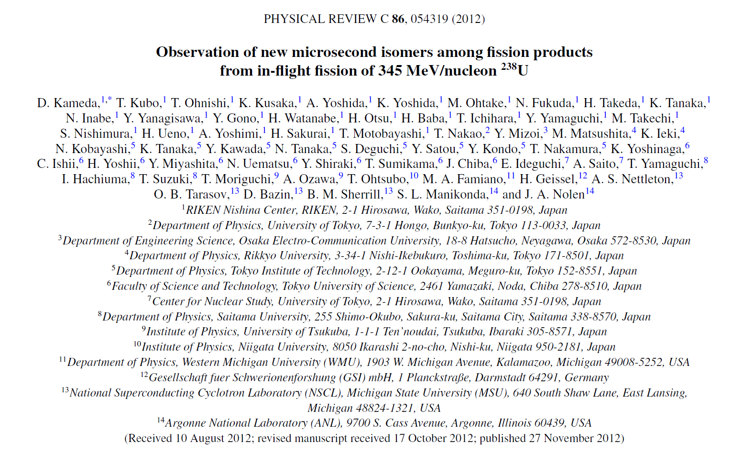
Notes:
All contents of my talk is coming from this original paper which was published last November. I will try to explain the essential points and main message of this paper and main message. I hope that you can catch some points during my presentation, before you read this long paper having 21 pages.

Slide 3
Introduction

Slide 4
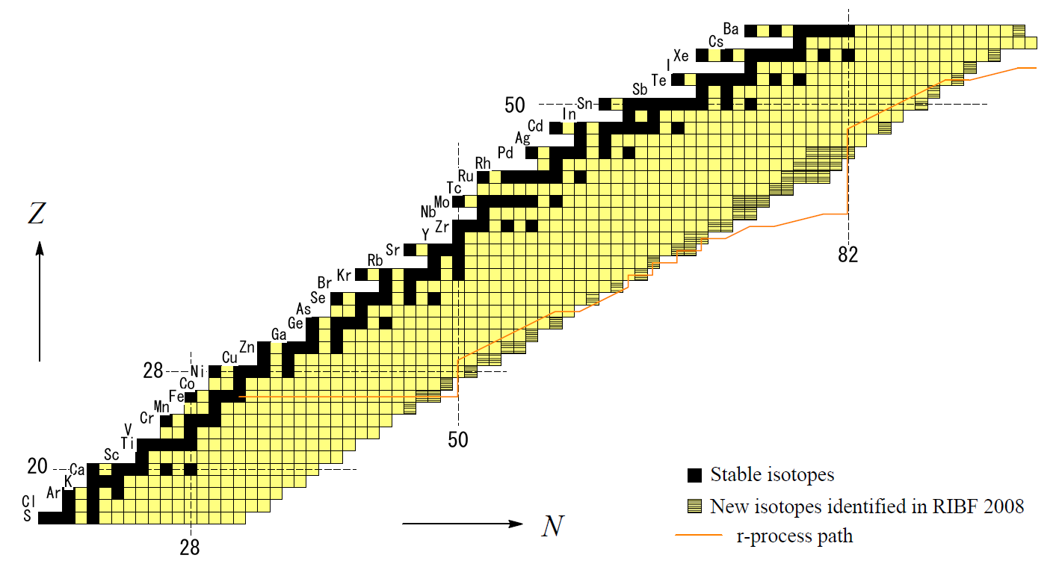
Evolution of nuclear structures
- between ⁷⁸Ni and ¹³²Sn-
Double closed-shells
(Spherical structure)
Double mid-shells
(Large deformation)
¹³²Sn
Shape transition ? where ? how ?
Shape evolution shape coexistence
N=60 sudden onset of large deformation shape coexistence
⁷⁸Ni
Stable
New isotopes in RIBF 2008
Path of the r-process
Notes:
Evolution of nuclear structures of neutron-rich exotic nuclei between double closed-shell nuclei, 78Ni and 132Sn is one of the most interesting and challenging issues of nuclear physics.
In the double mid-shell region, large nuclear deformation is known to emerge. We are interested in how dose nuclear structure change between two extreme nuclear structure, spherical and large deformed shapes along this line. Shell evolution in this very neutron-rich region is also interesting.
Sudden onset of large prolate deformation is known to occur at neutron number of 60. In this region, shape coexistence between spherical and prolate shape is well known. Around the center of double mid-shell region, shape evolution involving various kinds of nuclear shapes such as prolate, oblate, triaxial, tetrahedral shapes is known to emerge. In the neutron-rich region between double mid-shell region and 132Sn, possible shape transition has attract much attention so far. However, this region has remained unexplored region experimentally due to the difficulty of producing such rare isotopes using the conventional means.

Slide 5
Large variety of nuclear isomers
Single-particle isomer
  Spin gap due to high-j orbits such as g_{9/2}, h_{11/2}
  Small transition energy
Seniority isomer (^{76m}Ni, ^{78m}Zn, ^{132m}Cd, ^{130m}Sn)
  Spherical core ⊗ (g²_{9/2})^{I=8+} or (h²_{11/2})^{I=10+}
High-spin isomer
  Coupling of high-j orbits, g_{9/2} and h_{11/2}
K isomer (^{99m}Y, ^{100m}Sr)
  Large static deformation
Shape isomer (^{98m}Sr, ^{100m}Zr, ^{98m}Y)
  Shape coexistence
πg_{9/2}
νh_{11/2}
Paradise for various
kinds of isomers
νg_{9/2}
Notes:
This region is known to be paradise for various kinds of isomers.
Single-particle isomer often appears due to the spin gap which is realized by the high-j orbits such as g9/2 and h11/2 as well as due to the small transition energy in the middum-mass nuclei.
Seniority isomer is the characteristic isomer around the double closed-shell region. They provide a chance to investigate the persistence of shell gap at the magic number far from stability.
High-spin isomer is generated by the coupling of high-j orbits.
On the other hand, in the well-deformed region, K isomer often appears. They are well-known K isomers in this region.
In addition, in the shape transition region, shape isomer often appears due to the hindered transition between states having different shapes. They are well-known shape isomers in the N=60 region.

Slide 6
Search for new isomers at RIKEN RIBF in 2008
D. Kameda et al., Phys. Rev. C 86, 054319 (2012)
Comprehensive search for new isomers with T_{1/2} ~ 0.1 – 10 us
over a wide range of neutron-rich exotic nuclei
Discovery of various kinds of isomers is golden opportunity of study of the evolution of nuclear structures
Z~50
Z~40
Experimental data were recorded during the same runs as the search for new isotopes in Ref. T. Ohnishi et al., J. Phys. Soc. Japan 79, 073201, (2010).
Z~30
Stable
New isotopes in RIBF 2008
Path of the r-process
Notes:
We have searched for new isomers over the wide range of neutron-rich exotic nuclei in 2008. Our searched regions are roughly shown in the nuclear chart by red circles.
As we expected, we have observed a number of various kinds of isomers including 18 new microsecond isomers in these regions. They provide us golden opportunity of systematic study of the evolution of nuclear structure in the neutron-rich exotic nuclei in this region.

Slide 7
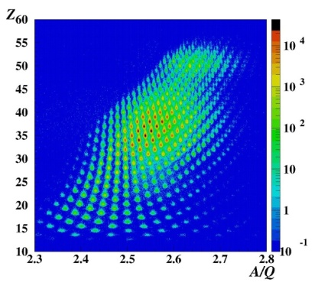
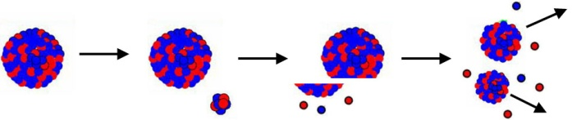
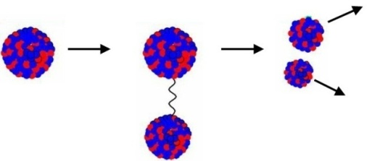
In-flight fission of U beam
Effective reaction to produce wide-range neutron-rich nuclei
Abrasion fission
²³⁸U(345 MeV/u) + Be at RIBF
²³⁸U
Fissile nucleus
Fission
fragment
Bρ = 7.249 Tm
ΔP/P = ±1 %
Fission
fragment
⁹Be
Coulomb fission
²³⁸U
Fission
fragment
photon
Fission
fragment
Pb
Notes:
In order to produce wide-range neutron-rich nuclei, we employed the in-flight fission of an U beam.
Because of the nature of in-flight fission mechanism, reaction products, so-called fission fragments, are distributed over a wide range of neutron-rich nuclei. This PID plot demonstrate this unique property of in-flight fission of uranium beam. We can see fission fragments distributed over a wide range of atomic number and nuclear masses toward the neutron-rich region.

Slide 8
Large kinematical cone (Momentum, Angle)
compared to the case of projectile fragments
345 MeV/u
Large spread
Fission fragments
Momentum ～10%
Angle ~100 mr
New-generation fragment separator
with large ion-optical acceptances
Superconducting in-flight RI beam separator
“BigRIPS”
at RIKEN RI Beam Factory
First comprehensive search using the BigRIPS in-flight separator with a U beam at RIBF
Notes:
However, fission fragments have large kinematical cone due to the Q value of fission reaction, compared to the case of projectile fragments.
This situation requires a new-generation fragment seperator with large ion-optical acceptances for efficient production of radioactive isotope beam using fission fragments.
The BigRIPS in-flgith separator was designed to realize such demand at RIBF. The present work is the first comprehensive search for new isomers using the BigRIPS in-flight separator with a U beam at RIBF.

Slide 9
Experiment
Notes:
Let’s go to the details of our experiment.

Slide 10
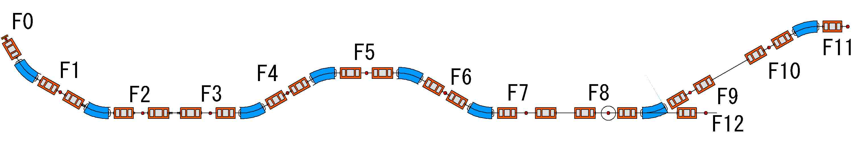
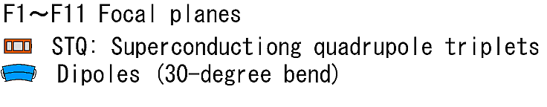
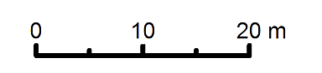
BigRIPS
T. Kubo: NIMB204(2003)97.
Superconducting in-flight separator
Superconducting
  14 STQ(superconducting quadrupole triplets)
  Large aperture φ240 mm
Large ion-optical acceptances
  Momentum 6 %, Angle Horizontal 80mr, Vertical 100 mr
Two-stage scheme
  Separator-Spectrometer (Particle identification)
  Separator-Separator
BigRIPS
Properties:
Δθ = 80 mr
Δφ = 100 mr
Δp/p = 6 %
Bρ = 9 Tm
L = 78.2 m
1st stage
2nd stage
D1
D4
D5
ZeroDegree
D2
D3
D6
F1～F7
Notes:
The large ion-optical acceptances of BigRIPS was realized by the use of 14 superconducting quadrupole tripets having a large aperture.
The BigRIPS has a two-stage structure. In the 1st stage, we separate the fission fragments by the difference of magnetic rigidities and stopping range. In the 2nd stage, the fission fragment is identified in-flight as mentioned later.

Slide 11
Optimization of BigRIPS setting
Conditions
Full momentum acceptance (+/- 3%)
Total rate < 1kcps (limit of detector system)
Good purity of new isotopes
Bρ
Setting parameters
Target material and thickness
Magnetic rigidity
Achromatic energy degrader(s)
Slit widths
Known
Range
Z
Range
New
Bρ
N
Notes:
We optimized the BigRIPS setting to fullfill the full momentum acceptance of BigRIPS and limit of total counting rate as well as purity of new isotopes.
This figure schematically shows the separation scheme. The magnetic rigidity select the isotopes having similar mass-to-charge ratio, while the stopping range determine the window of neutron numbers.

Slide 12
Experimental settings
(same as new-isotope search at RIBF in 2008)
Setting 1 (Z~30)
Setting 2 (Z~40)
Setting 3 (Z~50)
U intensity (ave.)
Target
Bρ of D1
Degrader* at F1
Degrader* at F5
F1 slit
F2 slit
Central particle
Irradiation time
Total rate (ave.)
0.20 pnA
Be 5 mm
7.902 Tm
1.3 mm (d/R=0.04)
none
± 64.2 mm
±13.5 mm
⁷⁹Ni
30.3 h
530 pps
0.25 pnA
Be 3 mm
7.990 Tm
2.2 mm(d/R=0.1)
none
± 64.2 mm
±15.5 mm
¹¹⁶Mo
45.3 h
270 pps
0.22 pnA
Pb 1 mm(+Al 0.3mm)
7.706m
2.6 mm(d/R=0.166)
1.8 mm
± 64.2 mm
±15 mm
¹⁴⁰Sb
27.0 h
870 pps
Total running time 4.3 days
*Achromatic energy degrader
F1: wedge shape
F5: curved profile

Slide 13
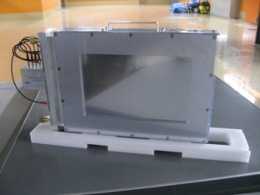
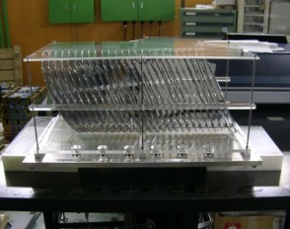
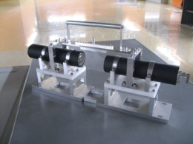
Setup for particle identification (PID)
TOF-Bρ-ΔE method
ΔE: Energy loss, TOF: Time of flight
Bρ: Magnetic rigidity
A/Q = Bρ /γβm
Z ← ΔE=f(Z,β)
PPAC
MUSIC
m: nucleon mass
β =v/c , γ =1/(1-β²)^{0.5}
γ-ray detector (next slide)
²³⁸U⁸⁶⁺ 345MeV/u
Bρ with track reconstruction
ΔE
BeamDump
ZeroDegree
Target
degrader
(degrader)
TOF → β
Plastic scintillation counter

Slide 14
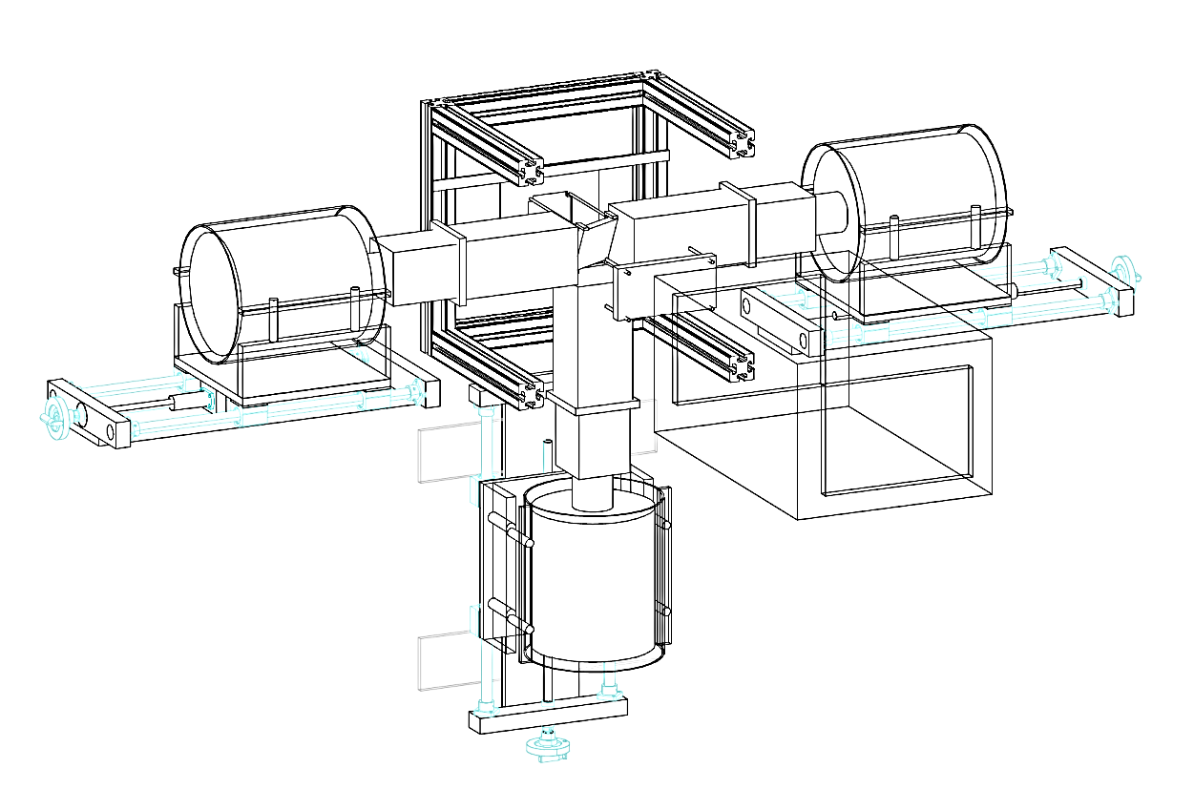
Setup for isomer measurement
Clover-type high-purity Ge detectors
Absolute photo-peak efficiency :
ε_{γ}=8.4%(122keV), 2.3 %(1.4MeV) t30mm stop.
ε_{γ}=11.9%(122keV), 2.7%(1.4MeV) t10mm stop.
Off-line measurement with standard sources
Monte Carlo Simulation with GEANT3
  Good reproducibility of off-line efficiencies as well as relative γ-ray intensities of known isomers: ^{78m}Zn,^{95m}Kr, ^{100m}Sr, ^{127m}Cd, ^{128m}Cd, ^{129m}In, ^{131m}Sn, ^{132m}Sn, ^{134m}Sn
F11 Ion
chamber
RI beam
TOF from target
600-700 ns
Al stopper
t30mm for Z~30
t10mm for Z~40,50
Area 90x90 mm²
Energy absorber （Al)
t15 mm for Z~30
t10 mm for Z~40
t8 mm for Z~50
Energy resolution:
2.1keV(FWHM)@1 MeVγ

Slide 15
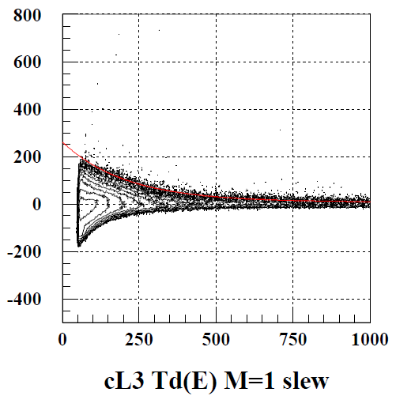
Particle-γ slow correlation technique
Highly-sensitive detection of microsecond isomers
T_{γ} (ns)
Timing of ion implantation (PL) :
crystal ID1
t
γ-ray signal
(each crystal):
delayed γ-rays of T_{γ} > 200 ns → low background condition
t
TDC
(Lecroy 3377):
T_{γ}
Prompt γ-rays:
~29 % / implant
t
Maximum time window : 20 us
(after slew correction)
  Dynamic range of E_{γ}:
  50-4000 keV
  ADC(Ortec, AD413)
E_{γ} (keV)
T_{γ} : Time interval between γ-ray and ion implant.
E_{γ} : γ-ray energy

Slide 16
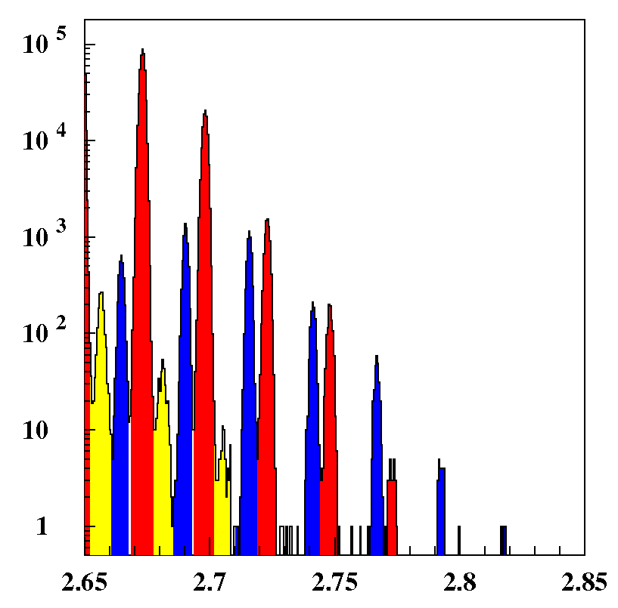
High resolution and accuracy of A/Q
T. Ohnishi et al., J. Phys. Soc. Japan 79, 073201,
A/Q resolution:
0.035 ~ 0.04 % (σ)
Clear separation of
charge states (Q=Z-1,…)
(thanks to track reconstruction with 1st and 2nd order transfer matrixes)
A/Q accuracy:
|(A/Q)_{exp}－(A/Q)_{calc}|< 0.1 %
→ Clear event assignment
Zr (Z=40)
Q=Z
Q=Z-1
Counts
Q=Z-2
¹⁰⁸Zr³⁹⁺
Z’=Z+1
¹¹¹Zr⁴⁰⁺
A/Q
  For example, 0.2% difference of A/Q between ¹¹¹Zr⁴⁰⁺ and ¹⁰⁸Zr³⁹⁺

Slide 17
Results

Slide 18
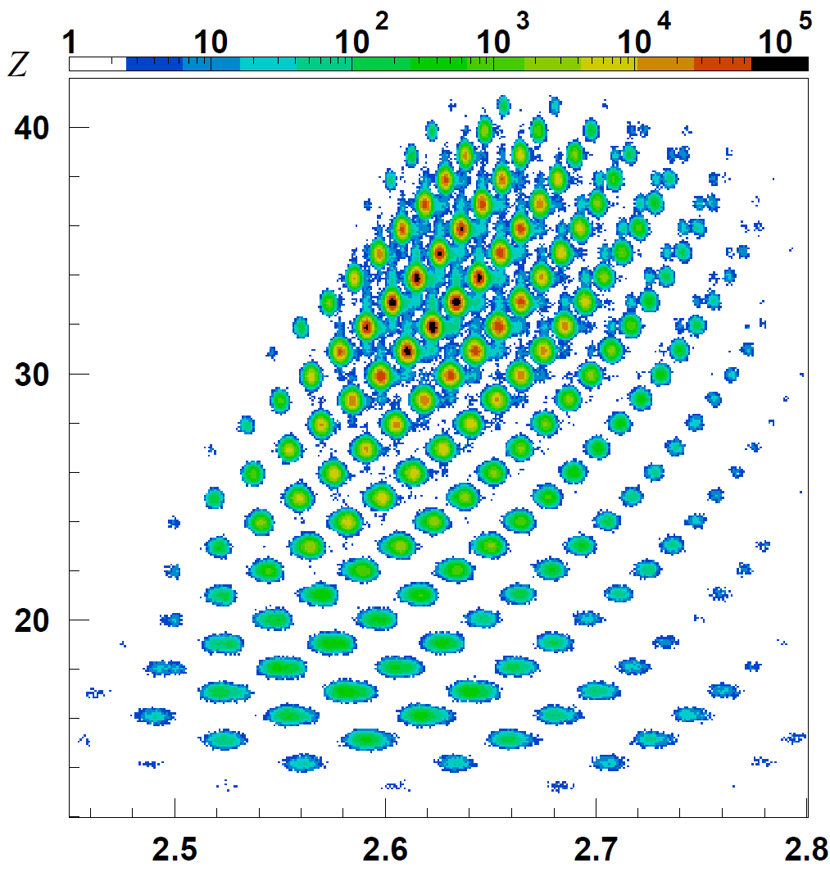
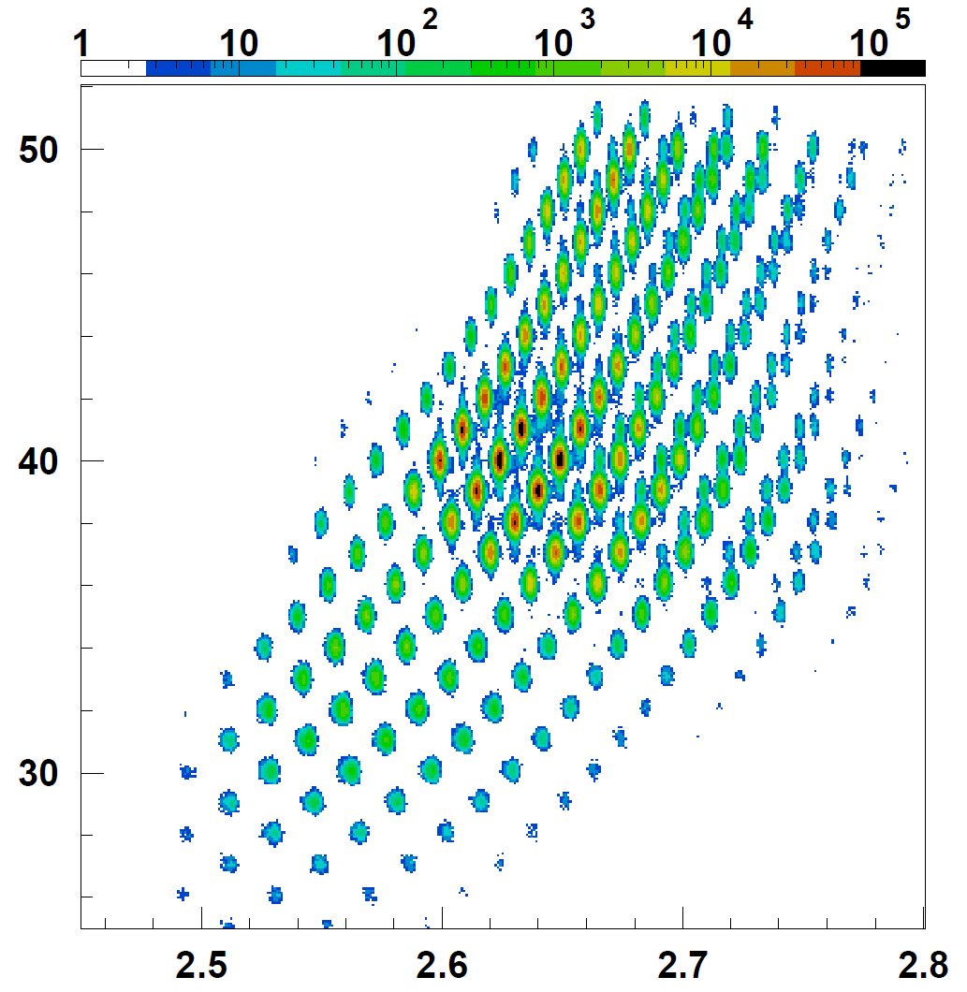
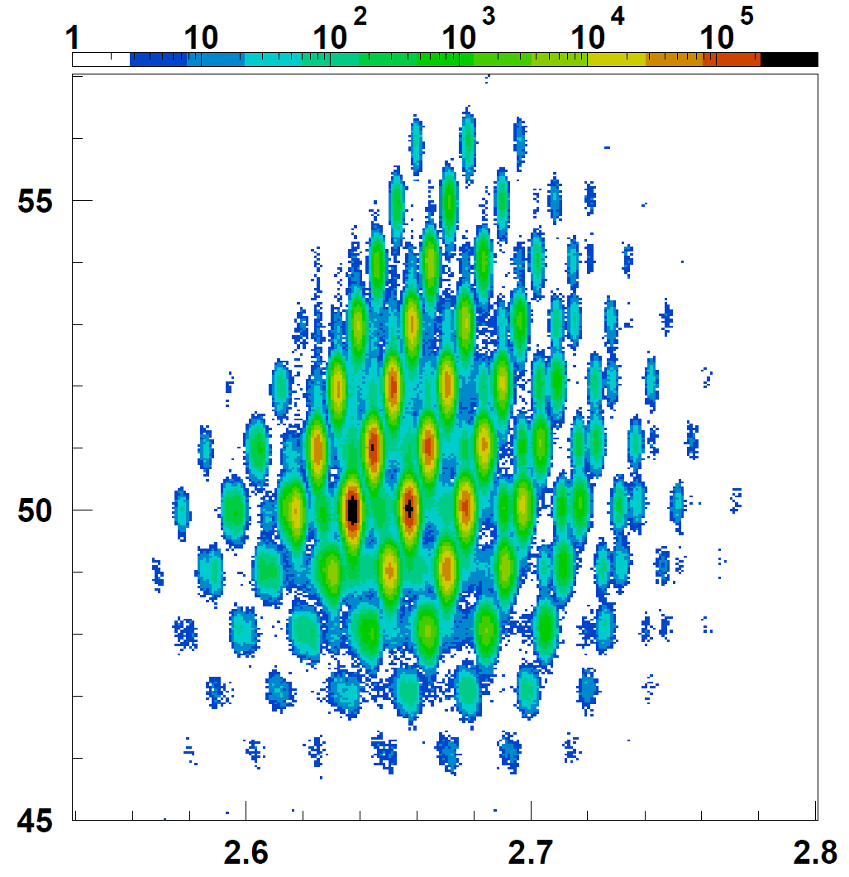
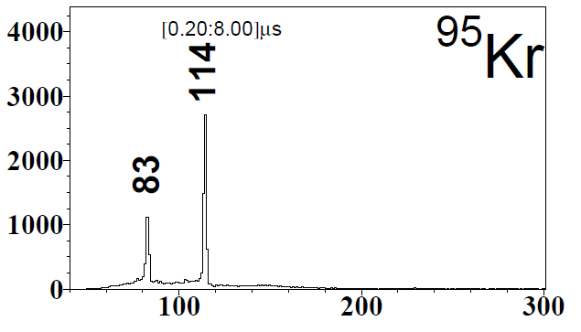
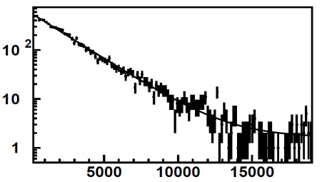
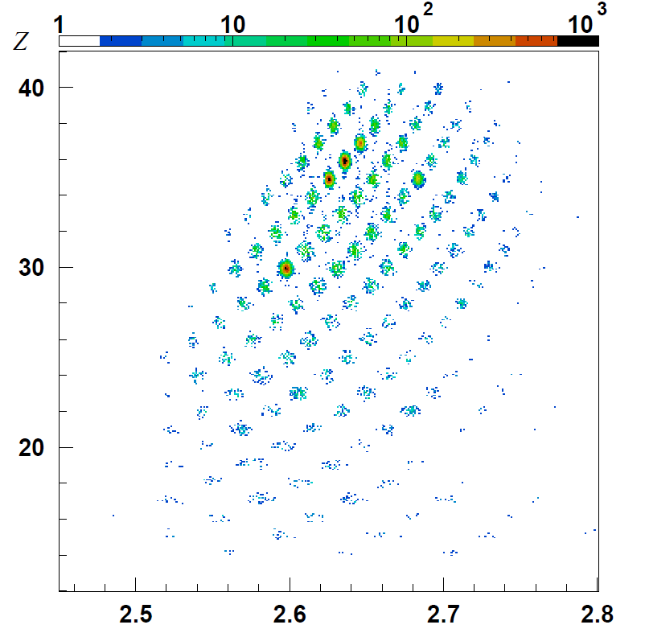
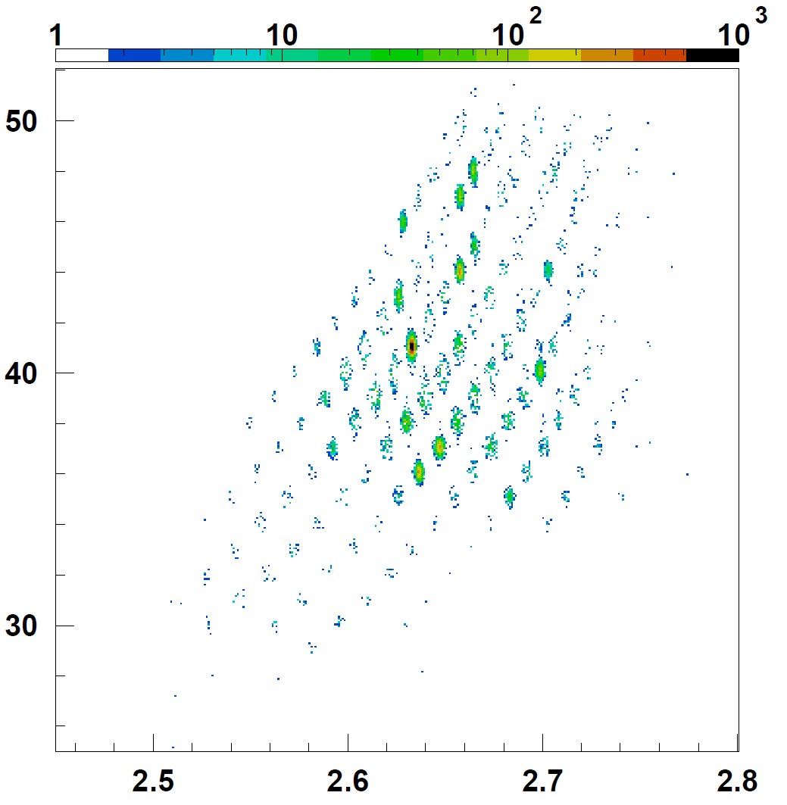
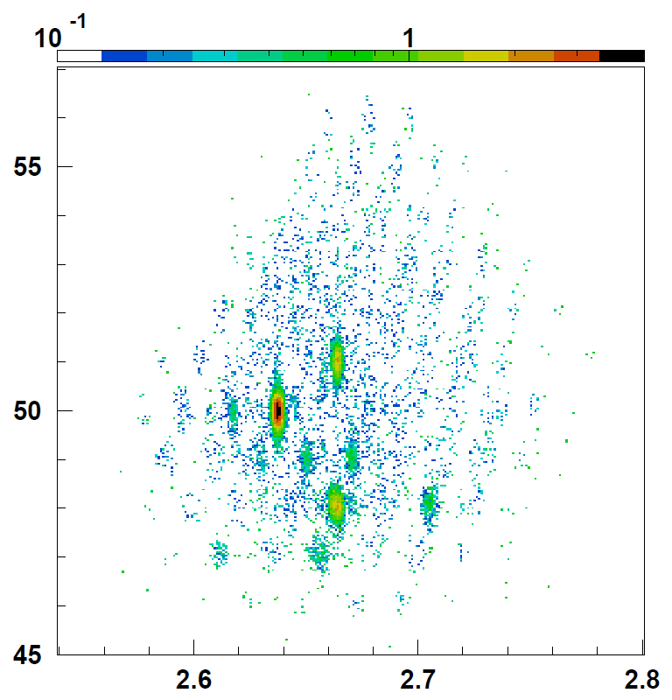
PID plots without/with delayed γ-ray events
Z
Z
Z
Z~30
Z~40
Z~50
w/o delayed γ gate
w/o delayed γ gate
w/o delayed γ gate
A/Q
T_{1/2}= 1.582(22) μs
Ref. 1.4(2) μs*
Counts/keV
Z~50
e^{-t/τ} + a
(maximum likelihood)）
γゲートあり
A/Q
A/Q
A/Q
Z~40
A/Q
E_{γ} (keV)
γゲートあり
*J. Genevey et al., PRC73, 037308 (2006).
Z~30
Z~40
Z~50
With delayed
γ gate
With delayed
γ gate
With delayed
γ gate
Time window:0.2-1.0 us
Time window:0.2-1.0 us
Time window:0.2-1.0 us
Notes:
These are particle identification plots, so-called PID plots, whose horizontal and vertical axis is the deduced mass-to-charge ratio and atomic number, respectively. Each isotope is fully identified by each small island as well as the charge state. By using these plots we fully identified over 450 isotopes during the experiment. These are the PID plots with the gate of delayed g-rays whose time window was selected to be from 200 ns to 1 us following the implantation. The presence of isomeric states whose half-lives are comparable to the time window are clearly shown by the enhanced islands in the respective regions. We identified isomeric g-rays for a number of known isomers as well as unknown ones. This is the case of known isomeric decay of 95Kr.

Slide 19
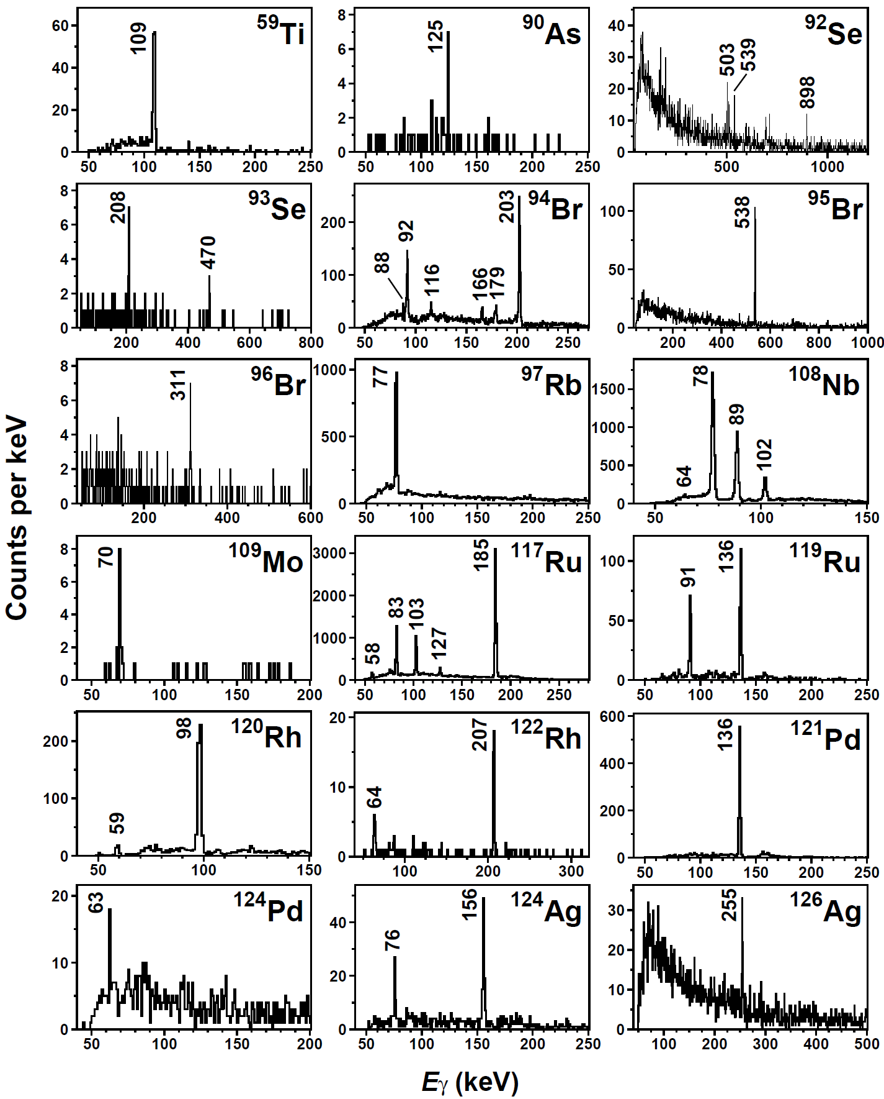
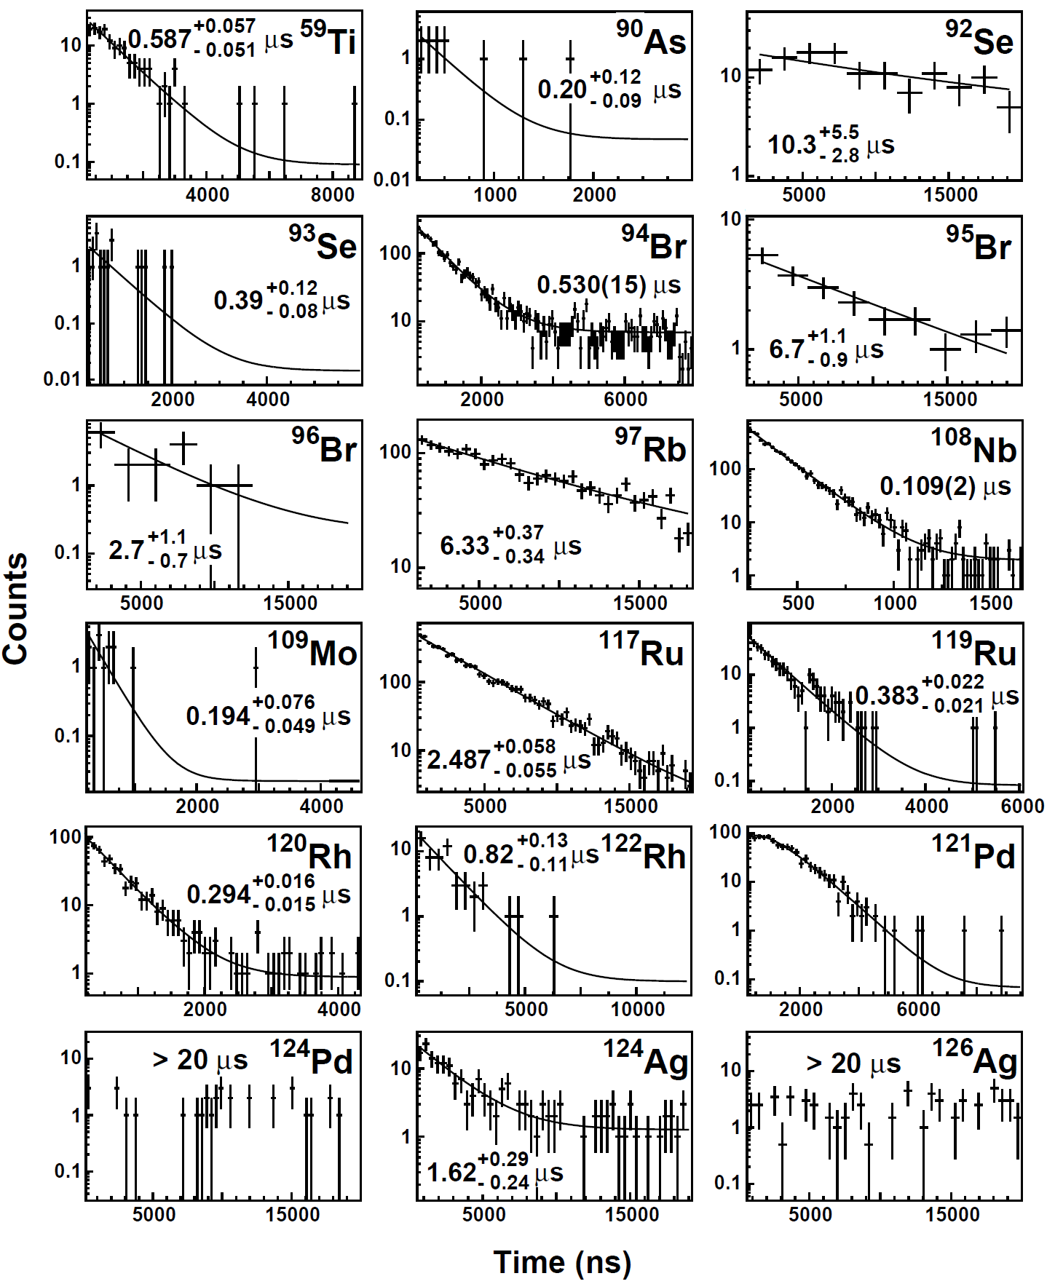
18 new isomers observed
Energy spectra
Time spectra
Notes:
Here I just show you the energy and time spectra for observed new isomers in the present work. In total, we observed 18 new isomeric decays.
The decay was fitted by the exponential plus constant background for isomeric g-rays observed. In the case of P

Slide 20
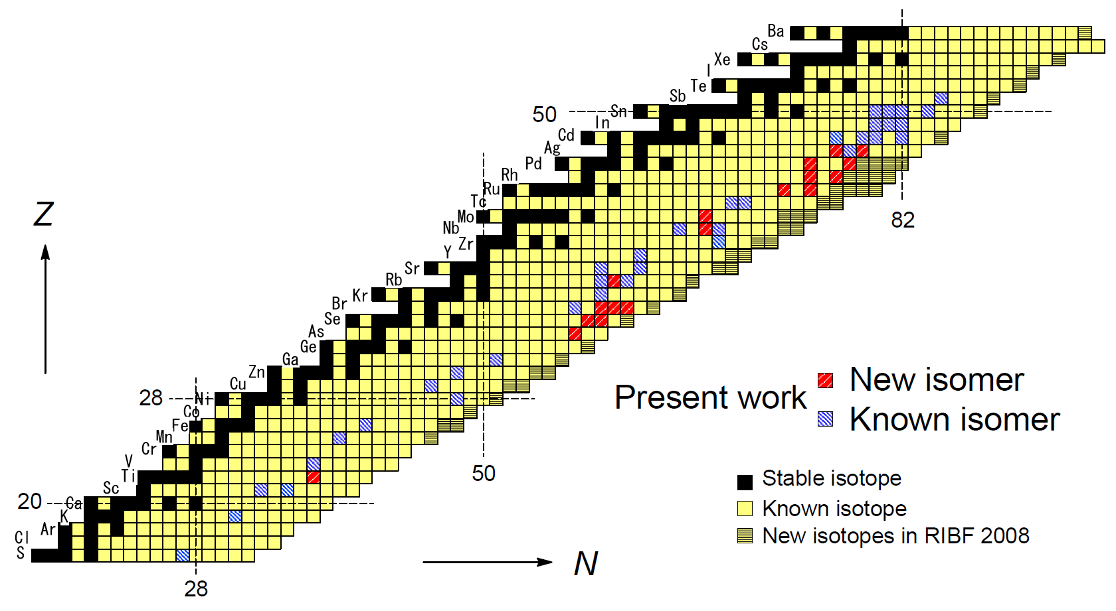
Map of observed isomers
A total of 54 microsecond isomers observed (T_{1/2}= 0.1-10 ms)
18 new isomers identified: ^{59m}Ti, ^{90m}As, ^{92m}Se, ^{93m}Se, ^{94m}Br, ^{95m}Br, ^{96m}Br, ^{97m}Rb, ^{108m}Nb,^{109m}Mo, ^{117m}Ru, ^{119m}Ru,^{120m}Rh, ^{122m}Rh,^{121m}Pd, ^{124m}Pd, ^{124m}Ag, ^{126m}Ag
A lot of spectroscopic information
  γ-ray energies
  Half-lives of isomeric states
  γ-ray relative intensities
  γγ coincidence
Running time only 4.3 days!
Notes:
This slide shows the summary of isomer measurement.
The blue ones are known isomers and the red ones are new isomers observed in this work..
We observed 54 microsecond isomers in total, including 18 new isomers.

Slide 21
17 proposed level schemes and isomerism
New level schemes for 12 new isomers: ^{59m}Ti, ^{94m}Br, ^{95m}Br, ^{97m}Rb, ^{108m}Nb, ^{109m}Mo, ^{117m}Ru, ^{119m}Ru, ^{120m}Rh, ^{122m}Rh, ^{121m}Pd, ^{124m}Ag
New level schemes for 3 known isomers: ^{82m}Ga, ^{92m}Br, ^{98m}Rb
Revised level schemes for 2 known isomers: ^{108m}Zr, ^{125m}Ag
energy sum relation
γγ coincidence
γ-ray Relative intensity
  Intensity balance with calculated total internal conversion coefficient
Correspondence of decay curves and half-lives
    Multi-polarities and Reduced transition probability
    Recommended upper limits (RUL) analysis
    Hindrance factor
Systematics in neighboring nuclei (if available)
    Nordheim rule for spherical odd-odd nuclei
Theoretical studies (if available)
Notes:
We proposed level schemes for 17 isomers, based on obtained spectroscopic information and the systematics in neighboring nuclei, which allowed us to study nuclear isomerism in relation to evolution of nuclear shape, shape coexistence and shell structure.

Slide 22
Discussion

Slide 23
Discussion on the nature of nuclear isomerism
Evolution of shell structure in spherical nuclei
^{59m}Ti → Narrowing of N = 34 subshell-gap
^{82m}Ga → Lowering of νs_{1/2} in N = 51 isotones
^{92m}Br → High-spin isomer
^{94m}Br, ^{125m}Ag → E2 isomers with small transition energies
^{117m,119m}Ru, ^{120m,122m}Rh, ^{121m}Pd, ^{124m}Ag,^{125m}Ag, ^{126m}Ag
Large deformation and shape coexistence:
^{95m}Br, ^{97m}Rb, ^{98m}Rb → N ~ 60 sudden onset of large deformation and shape coexistence
^{108m}Zr, ^{108m}Nb, ^{109m}Mo → N ~ 68 shape evolution
^{117m}Ru, ^{119m}Ru, ^{120m}Rh, ^{122m}Rh, ^{121m}Pd, ^{124m}Ag
→ N ~ 75 onset of new deformation
and shape coexistence
75
^{108m}Zr, ^{108m}Nb, ^{109m}Nb, ^{109m}Mo, ^{112m,113m}Tc
60
^{90m}As, ^{92m,93m}Se, ^{92m}Br, ^{94m,95m,96m}Br, ^{97m}Rb, ^{98m}Rb
⁸²Ga
⁵⁹Ti
Notes:
From now, let’s discuss our observation from the viewpoint of the possible nuclear isomerism.
The nuclear isomerism is sensitive to microscopic changes of nuclear structure in the relevant regions.

Slide 24
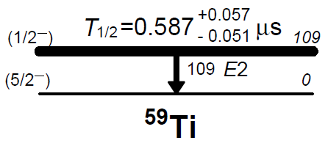
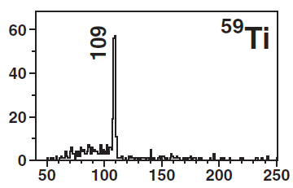
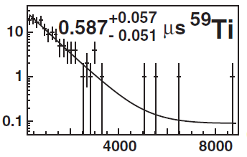
^{59m}Ti(Z=22,N=37): narrowing of the N=34 subshell gap
E2 isomer with small transition energy
⁵⁹Ti
νp⁻¹_{1/2}
νf_{5/2}
B(E2) = 3.68^{+0.37}_{-0.34} W.u.
N=34
νg_{9/2}
40
Narrowing of
the N=34 subshell gap
→ ^{59m}Ti
νf_{5/2}
34
(keV)
νp_{1/2}
νp_{3/2}
28
πf_{7/2}
νf_{7/2}
^{59m}Ti
(ns)
Notes:
From the observed spectra and half-life, we proposed the level scheme as shown here, the isomeric transition is likely E2 transition with small transiiton energy. According to the single particle structure around this region, we assign the spin and parity of ground state to be dominated by the f5/2 particle state, while the isomeric state to be hole state of p1/2 orbit. We interpret that this isomer is generated by narrowing of the N=34 subshell gap.

Slide 25
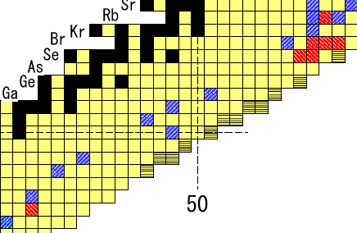
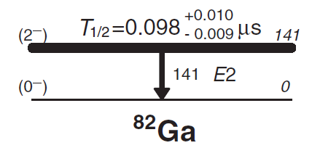
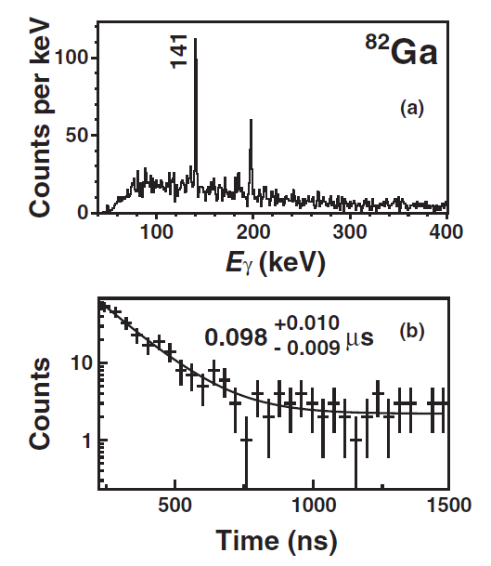
⁸²Ga(Z=31,N=51): Lowering of νs_{1/2} orbit in N=51 isotones
E2 isomer with small transition energy
(πf_{5/2}νs_{1/2})^{Iπ=2-}
(πf_{5/2}νd_{5/2})^{Iπ=0-}
⁸²Ga
Nordheim rule
N=51 systematics of νd5/2 and vs1/2
O. Perru et al., EPJA28(2006)307.
b.g.
Odd-mass N=51 isotones
1/2+
1031
νs_{1/2}
(1/2+)
532
(1/2+)
462
νd_{5/2}
(1/2+)
260
5/2+
0
(5/2+)
0
(5/2+)
0
(5/2+)
0
?
Z = 38
36
34
32
30
Systematics of πf_{5/2} (⁸¹Ga_{g.s.})
D. Verney Perru et al.,
PRC76(2007)054312.

Slide 26
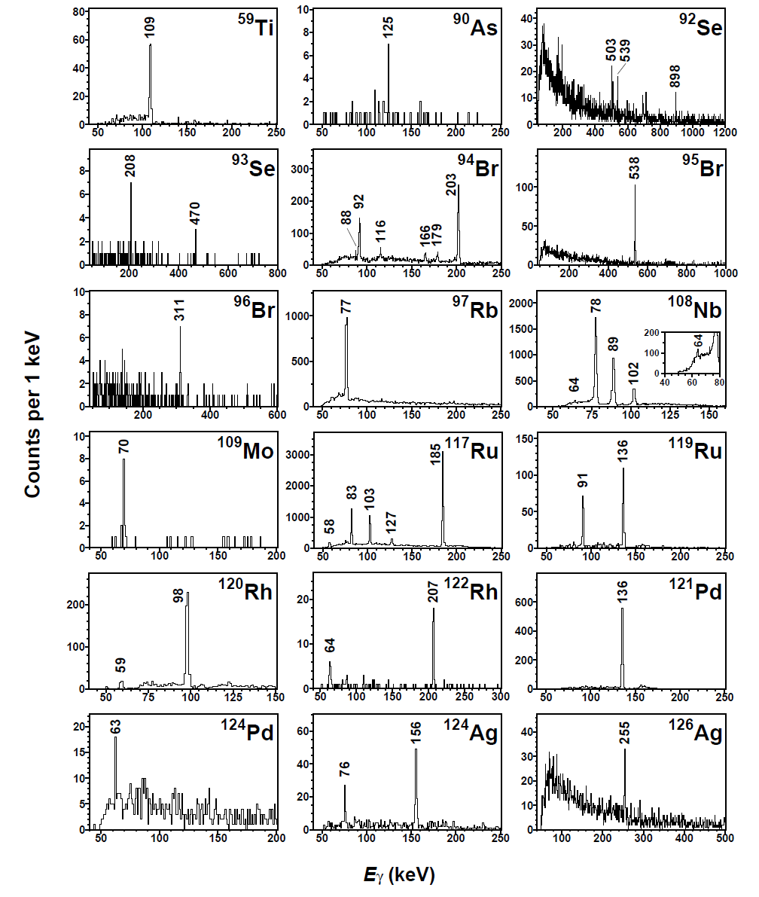
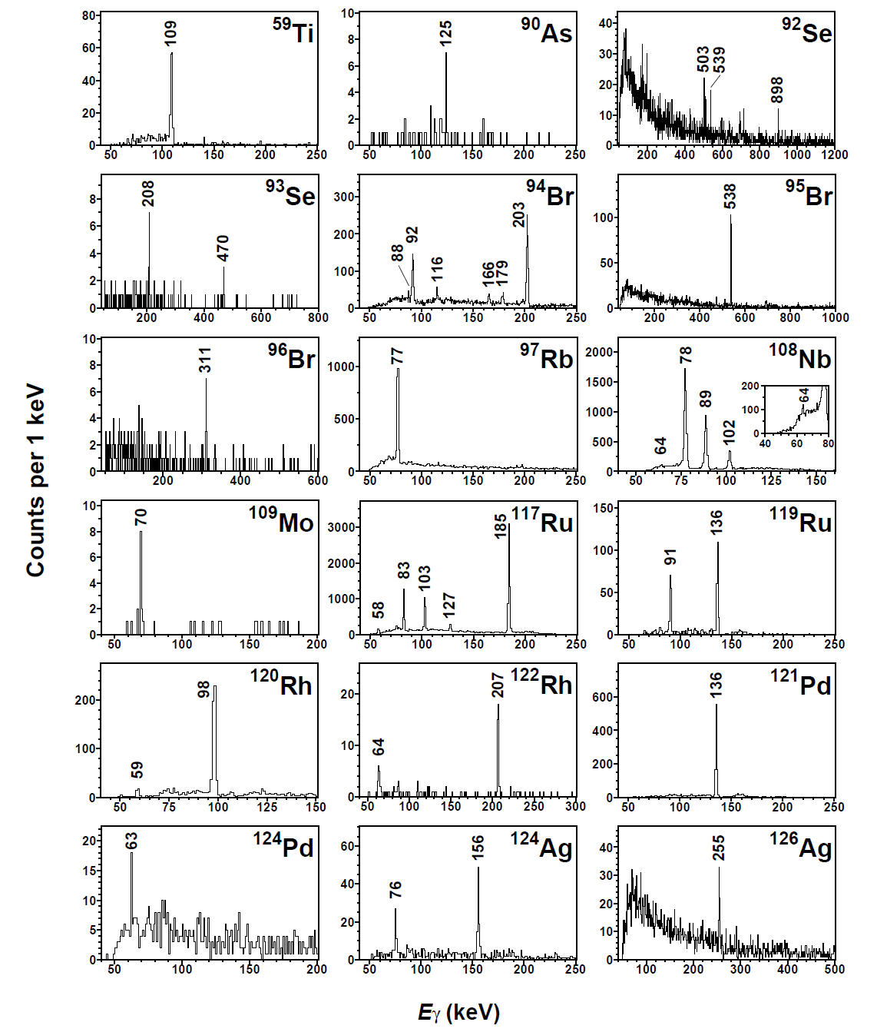
Energy spectra of new isomers in the N~60 region
What is the nuclear isomerism?
N=60
double
mid-shells
new
⁹⁷Rb
60
⁹⁵Br
N=59
N=60
N=61
N=60 sudden onset of large prolate
deformation
new
50
new
new
N=58
new
new
N=57
new
spherical
shape
large prolate
deformation
Notes:
This side shows the g-ray energy spectra obtained in the N=60 region.
We discovered several new isomers with lower Z numbers.
We discovered 97Rb and 95Br as for the N=60 isomers.

Slide 27
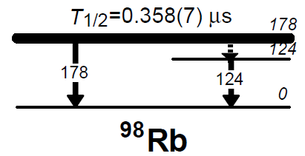
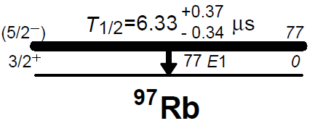
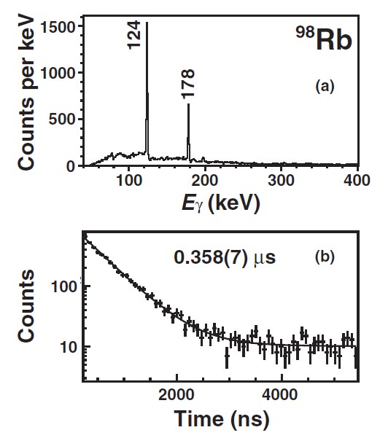
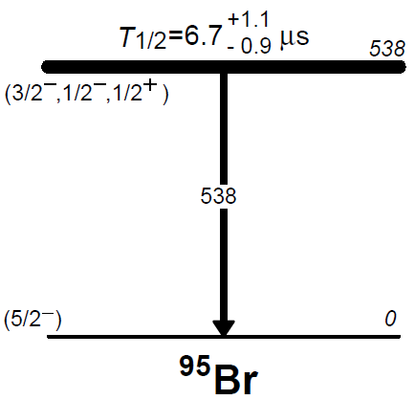
Shape isomerism proposed
Spherical
Prolate
Shape isomer
Shape isomer
Zr
Spherical
Y
Spherical
Sr
Rb
E1,M1,E2
Kr
[431]3/2⁺
Prolate
Prolate
Br
⁹⁸Rb
Se
Hindered E1:
B(E1)=9.37^{+0.61}_{-0.56} x 10⁻⁸ W.u.
Hindered nature of 178-keV transition
As
⁹⁷Rb
60
⁹⁵Br
Shape isomer
Prolate
Hindered nature
(RUL limits up to M2)
Spherical
Notes:
This slide show our proposed level schemes and isomerism. Our interpretation is here based on the hindrance of observed transition probability and the systematics in neighboring nuclei. In the cases of 97Rb, 98Rb and 95Br, the isomeric states are proposed to be shape isomer assuming that the shape coexistence between spherical and deformed state persists in the region of nuclei with neutron number of 60 and 61 more. On the other hand, in the case of 94Br, we considered the isomeric state to be spherical single particle isomer.

Slide 28
Evolution of shape coexistence in the N=60 even-even nuclei
Reversed
(our interpretation)
0₂+
698
Spherical 0⁺
?
0₂+
0₂+
331
215
⁹⁶Kr (g.s.,0⁺) :
not well deformed
0+
0
0+
0
0+
0
0+
0
Prolate-deformed 0⁺
⁹⁶Kr
(⁹⁷Rb)
⁹⁸Sr
¹⁰⁰Zr
¹⁰²Mo
⁹⁶Kr: S. Naimi et al., PRL105, 032502 (2010) and M. Albers et al., PRL108, 062701 (2012)
⁹⁸Sr,¹⁰⁰Zr, ¹⁰²Mo (review paper) : K. Heyde et al., Rev. Mod. Phys. 83, 1501 (2011)
Evolution of shape coexistence in the N=60 odd-mass nuclei
538
Reversed
599
(Spherical)
deformed
spherical
(5/2-)
77
spherical
(5/2-)
0
[431]3/2+
[422]5/2+
0
0
deformed
deformed
⁹⁵₃₅Br
⁹⁷₃₇Rb
⁹⁹₃₉Y
This work
This work
R. Petry et al., PRC31, 621 (1985)
Notes:
The slide shows the evolution of shape coexistence in the N=60 even-even nuclei here, and in the N=60 odd nuclei here.
In the case of even-even nuclei, it is known that the spherical O+ state located above the prolate-deformed ground state gets down as the proton number decreases, and the ordering could be reversed. In the case of odd nuclei, we propose that the ordering of the spherical and deformed states are reversed between 97Rb and 95Br.

Slide 29
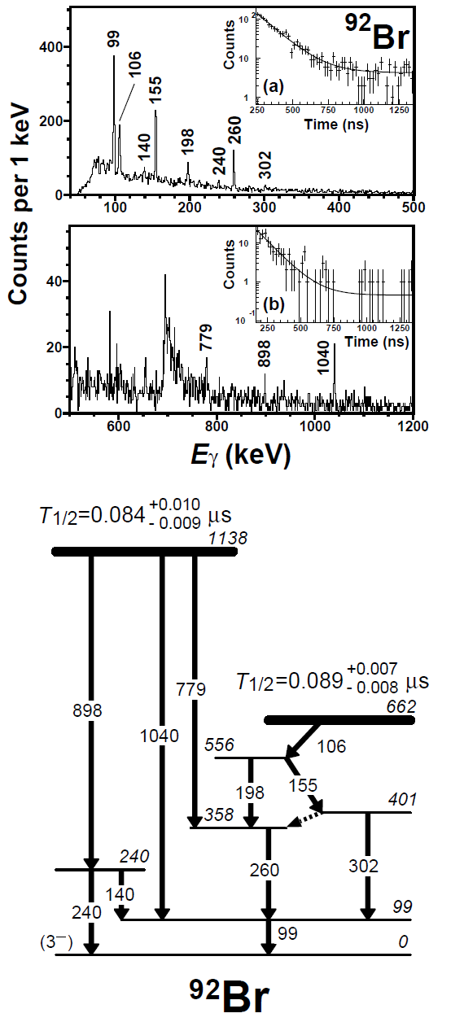
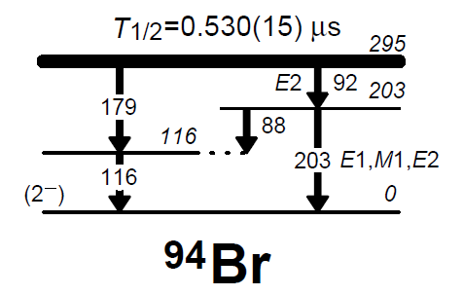
^{92m}Br, ^{94m}Br: Isomers in spherical shell structure
Spherical
Prolate
High-spin isomer
Zr
(πg_{9/2}νh_{11/2})¹⁰⁻
Y
Sr
Rb
Kr
Br
(πg_{9/2}νg_{7/2})⁸⁺
Se
⁹⁴Br
As
Spherical E2 isomer
60
⁹²Br
B(E2)= 2.5(3) W.u.
Analogy of known high-spin
isomers of ^{94m}Rb
Systematics of low-lying spherical
E2 isomers of N=59 isotones

Slide 30
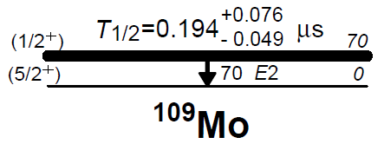
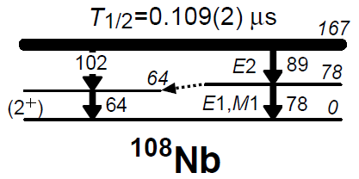
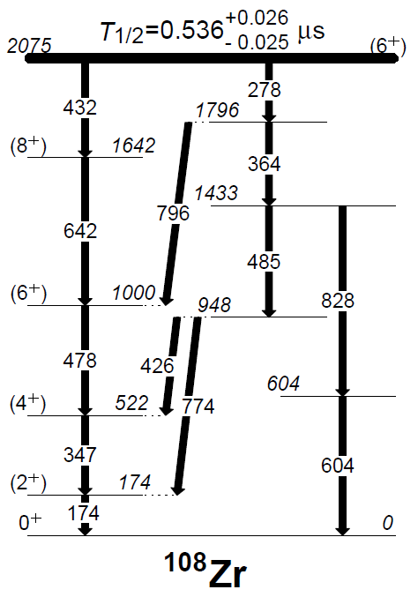
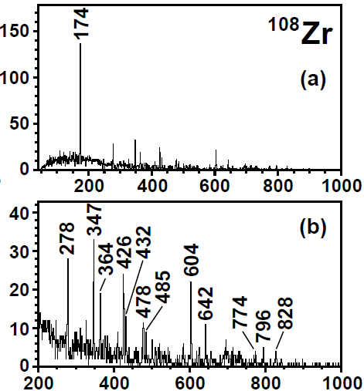
Shape evolution around the double mid-shell region
- Variety of shapes: prolate, triaxial, oblate, tetrahedral -
Deformed E2 isomer
triaxial
¹⁰⁹Mo
triaxial
¹⁰⁸Nb
Deformed E2 isomer
or shaper isomer
¹⁰⁸Zr
Prolate or Oblate
60
Prolate
50
K-isomer
Observed known isomers
^{112m,113m}Tc: Triaxial shape
A.M. Bruce et al., PRC82, 044311(2010)
^{109m}Nb: Oblate shape
H. Watanabe et al., PLB696, 186(2011)
^{108m}Zr: Tetrahedral shape
T. Sumikama et al., PRC82, 202501(2011)
Five isomeric γ-rays at 174, 278, 347, 478, 604-keV were previously reported.
Prolate
Notes:
This slide shows the g-ray energy spectra, our proposed level schemes and isomerism for the isomers observed in the N=68 region
It is known that a variety of nuclear shapes appear in this region.
We assigned the isomerism of 109Mo, 108Nb and 108Zr as shown here.

Slide 31
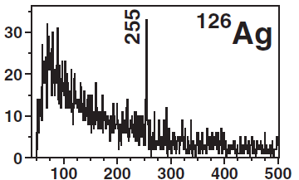
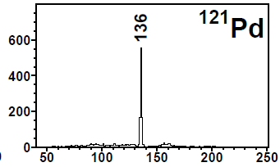
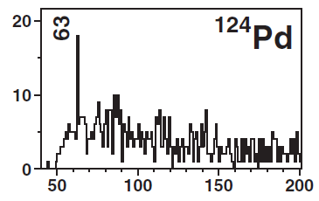
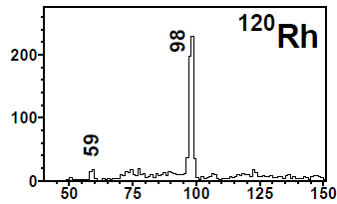
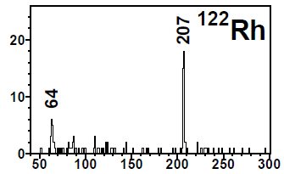
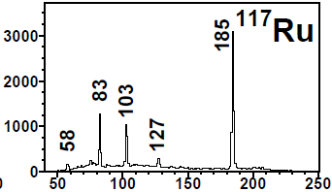
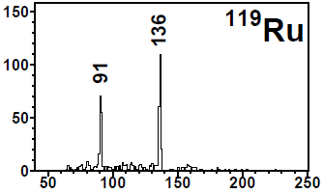
What happens here ?
What is the isomerism?
Energy spectra of new isomers in the N~75 region
- Unexplored region so far -
N=77
N=79
new
new
N=75
N=78
new
new
¹¹⁷Ru
¹¹⁹Ru
60
N=75
N=77
new
new
N=73
N=75
new
new
Notes:
This slide show the energy spectra of new isomers in the N=75 region, in which we discovered several new isomers.
As I mentioned already, this region is a new region and never explored before.

Slide 32






Our proposed level schemes and isomerism
(Shape isomer)
(Shape isomer)
E1, M1: hindered nature
E2: not hindered value
(Shape isomer)
(Shape isomer)
¹¹⁷Ru
¹¹⁹Ru
60
Shape isomer
Shape isomer
E1, M1
E1, M1
We propose shape coexistence in a new deformation region
Hindered nature of 185-keV transition
Hindered nature
Notes:
This slide shows our proposed level schemes and nuclear isomerism.
We assign shape isomerism to 117Ru and 119Ru, although not conclusive for other observed isomers.
We speculate that the N=75 region is a new deformation region which exhibits shape coexistence.

Slide 33


Theoretical indication of large deformation at N~75
- Mass systematics -
Extended Thomas-Fermi plus Strutinsky Integral (ETFSI-Q) model
J.M. Pearson et al., PLB 387, 455 (1996)
Experimental systematics at N~60
S. Naimi et al., PRL105, 032502 (2010)
Exp.
Cal.
50
55
N=60
65
N=60
N=75
Well-known humps at N~60 → sudden onset of large static deformation at N=60
Predicted humps at N~75 as well as N~60
Unknown onset of large static deformation at N~75, similarly to the case at N~60
onset of static oblate deformation?
Notes:
In order to investigate what happens in this region, we check the systematic trend of two-neutron separation energy as a function of neutron numbers: This plot again shows the experimental data for the N=60 region. This plot shows the theoretical calculation for the N=75 region. You see the humps here, and the theoretical calculation indicates the onset of ground state deformation at N~75.

Slide 34


^{125m}Ag(Z=47,N=78) : Spherical E2 isomer
Spherical structure appears at N=78
→ closeness of ¹³²Sn
B(E2)=1.08(12) W.u.
75
new
60
new
new
670, 684, 715, 728-keV γ-rays were previously reported
in I. Stefanescu et al., Eur. Phys. J. A 42, 407 (2009).
Revised level scheme

Slide 35
Summary
We performed a comprehensive search for new isomers among fission fragments from 345 MeV/u ²³⁸U using the in-flight separator
We observed in total 54 isomeric decays including 18 new isomers
The present results allow systematic study of nuclear structures
  N=34 region: Isomeric E2 decay in ^{59m}Ti due to the narrowing of the N=34 subshell
  N=51 region: Isomeric E2 decay in ^{82m}Ga due to the shell evolution of s_{1/2} orbit
  N=60 region: Shape isomerism for ^{97m}Rb, ^{95m}Br, ^{98m}Rb
  N=68 region: K-isomerism for ^{108m}Zr, Isomeric transition between deformed states in different bands for ^{108m}Nb, ^{109m}Mo, (shape isomerism for ^{108m}Nb)
  N=75 region: Shape isomerism for ^{117m}Ru, ^{119m}Ru. The origin is shape coexistence in a new large deformation region at N~75

Slide 36
What’s next?
Opportunity of detailed isomer spectroscopy
  More efficient γ-ray detector such as EURICA
  Low-energy γ-ray detector (LEPS)
Opportunity of systematic measurement of nuclear moments of isomeric states
  TDPAD
  Spin-controlled RI beam
Opportunity of efficient isomer tagging in the RI-beam production
Thank you very much

