Slide 1

不安定核と多体共鳴状態Unstable Nuclei and Many-Body Resonant States
Kiyoshi Kato
Nuclear Reaction Data Centre, Faculty of Science,
Hokkaido University

Slide 2
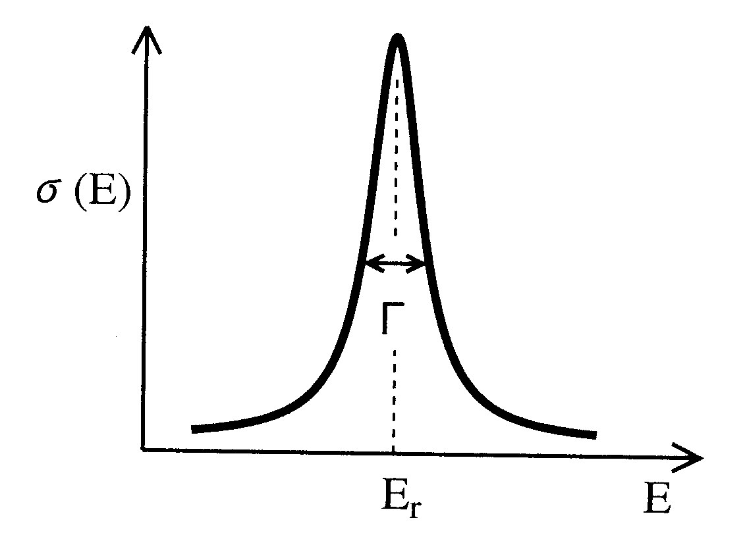
What is resonance？
Resonance is one of very familiar subjects in all areas of physics, but it is not so clear what is resonance. For instance, there are several definitions of resonances:
Def.1; Resonance cross section
Breit-Wigner formula
Decaying state
~ Resonant state
Phys. Rev., 49, 519 (1936)

Slide 3
Def.2: Phase shift
“Quantum Mechanics” by L.I. Schiff
… If any one of k_{l} is such that the denominator ( f(k_{l}) ) of the expression for tanδ_{l},
|tanδ_{l}| = | g(k_{l})/f(k_{l}) | → ∞ ,
( S_{l}(k) = e^{2iδ}l^{(k)} ),
is very small, the l-th partial wave is said to be in resonance with the scattering potential.
Then, the resonance: δ_{l}(k) = π/2 + n π

Slide 4
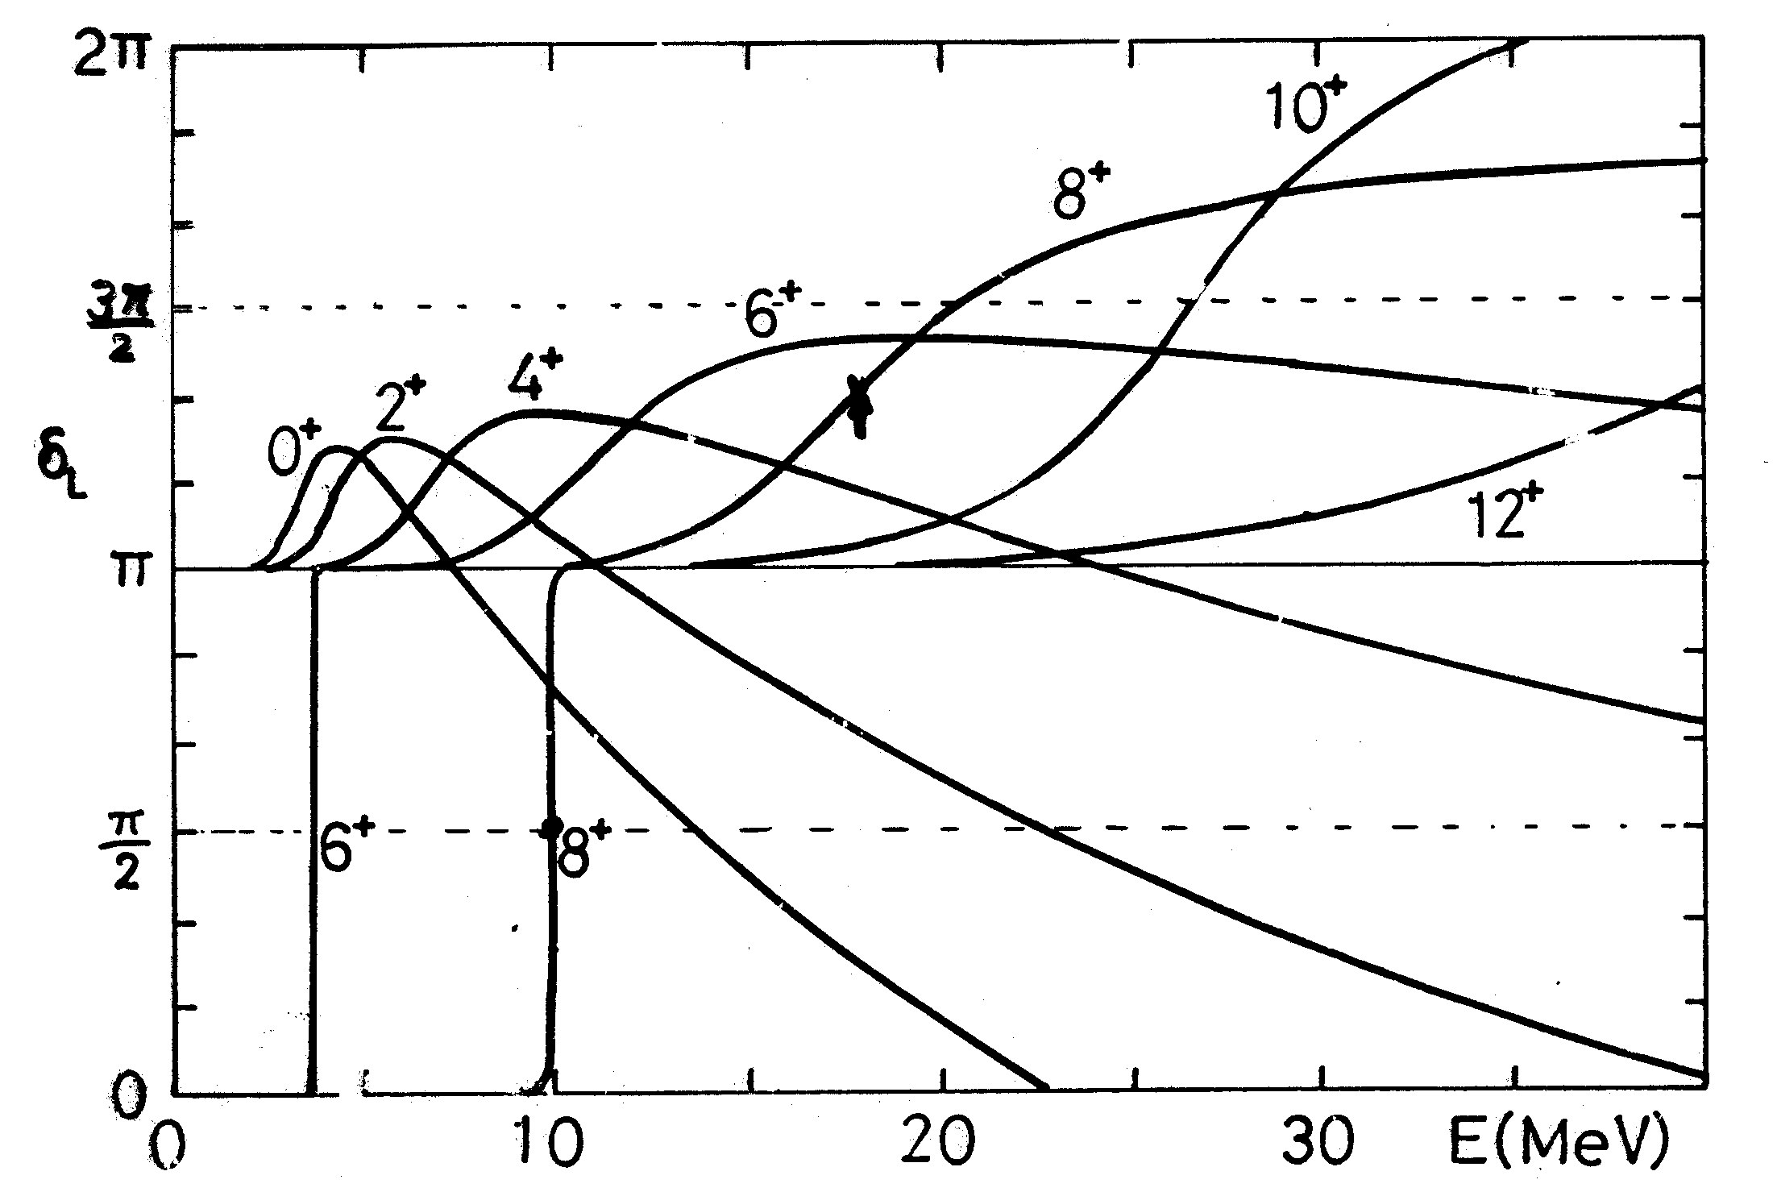
Phase shift of ¹⁶O +α

Slide 5
Def.3: Decaying state
“Theoretical Nuclear Physics”
by J.M. Blatt and V.F. Weisskopf
We obtain a quasi-stational state if we postulate that for r>R_{c} the solution consists of outgoing waves only. This is equivalent to the condition B=0 in
ψ (r) = A e^{ikr} + B e^{-ikr} (for r >R_{c}).
This restriction again singles out certain define solutions which describe the “decaying states” and their eigenvalues.
Decaying state ⬅➔ Gamow state
B=0 ➔ k: complex value (k= κ - iγ, k>0, γ>0)

Slide 6
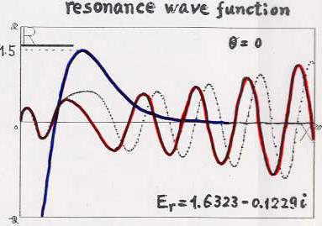

Slide 7
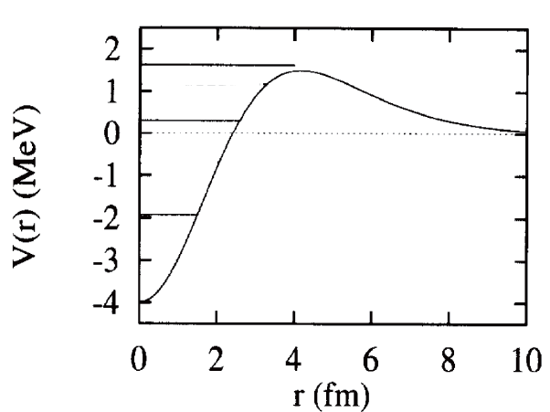
Def.4: Quasi bound state
Sharp Resonant state
Quasi-bound state
A large amplitude of the wave function gathers inside the potential and decays through the potential barrier due to the tunneling effect.

Slide 8
Def.5: Poles of S-matrix
The solution φ_{l}(r) of the Schrödinger equation;
Satisfying the boundary conditions
,
the solution φ_{l}(r) is written as

Slide 9
Then the S-matrix is expressed as
Resonance are defined as poles (f₊(k)=0) of the S-matrix.
Complex energy

Slide 10
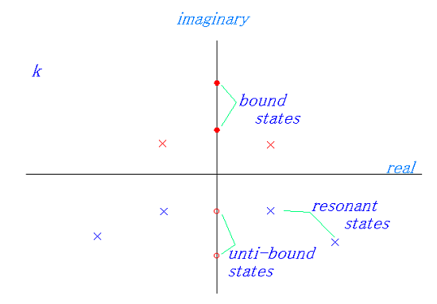
The pole distribution of the S-matrix in the momentum plane
(virtual states)

Slide 11
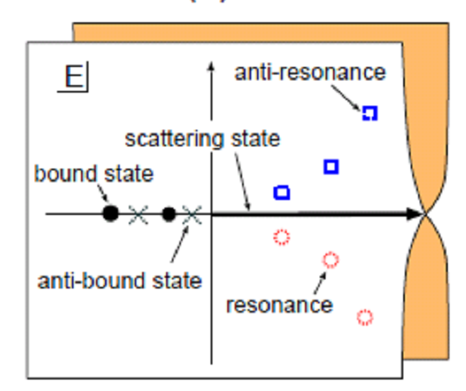
The Riemann surface for the complex energy:

Slide 12
The energy of a resonant state is described by a complex number.
However, the complex energies are not accepted in quantum mechanics.
Then, are resonant states defined by complex energy poles of the S-matrix unphysical?
Do they have no physical meaning?
My idea is that
“the complex energy states given by the S-matrix poles are not observable directly, but projected quantities from those states on the real energy axis are observable.”

Slide 13
E
0

Slide 14
Complex Scaling Method
In the method of complex scaling, a radial coordinate r and its conjugate momentum k are transformed as
Transformation of the wave function
Complex Scaled Schoedinger Equation

Slide 15
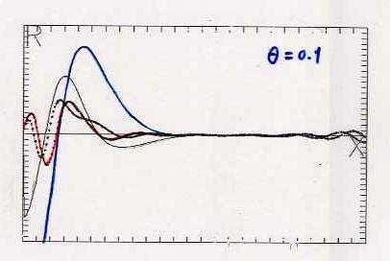

Slide 16
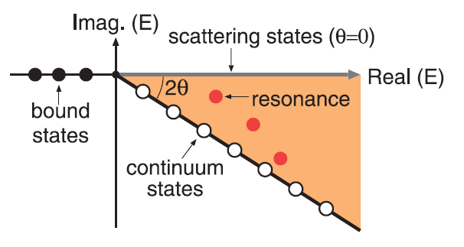
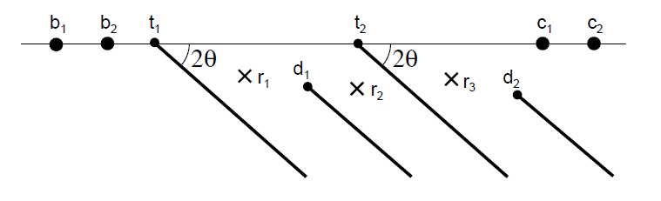
Eigenvalues of the complex scaled Schroedinger equation
Two-body system
Many-body system

Slide 17
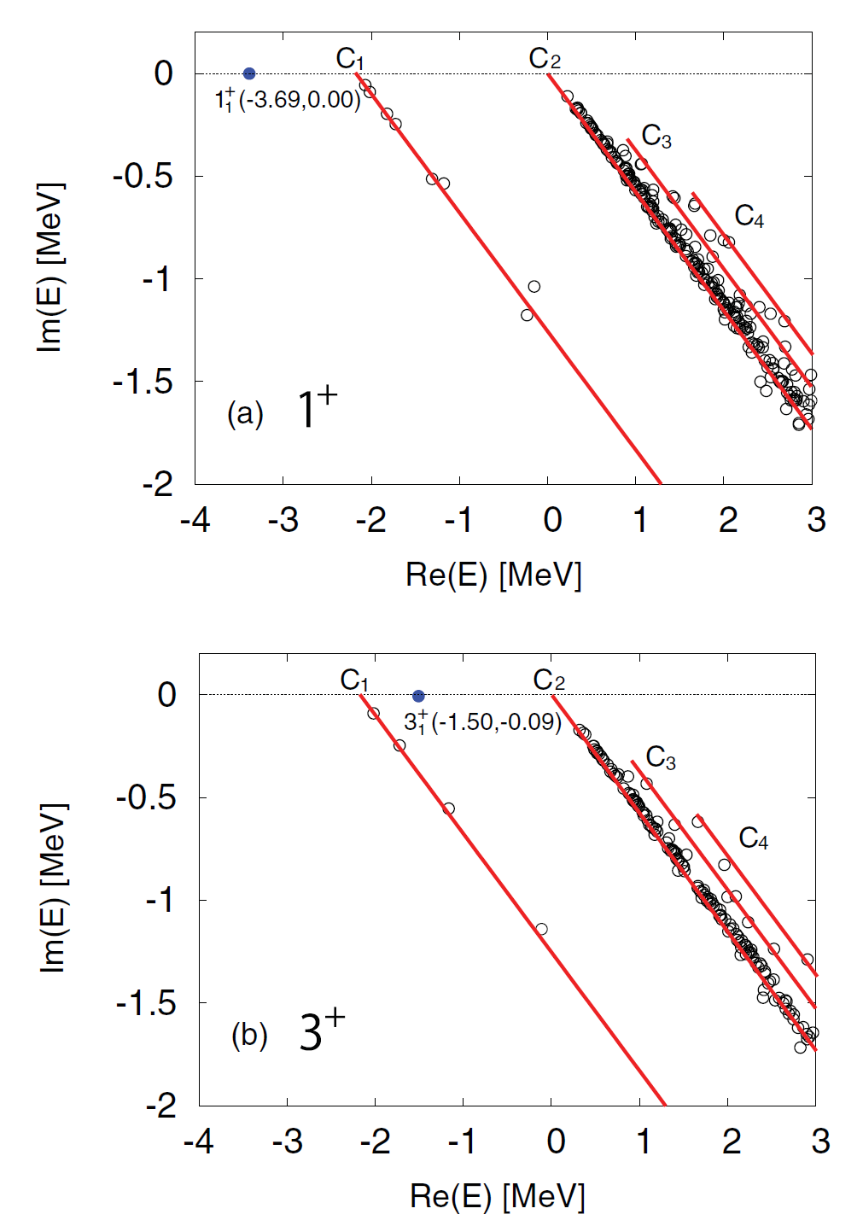
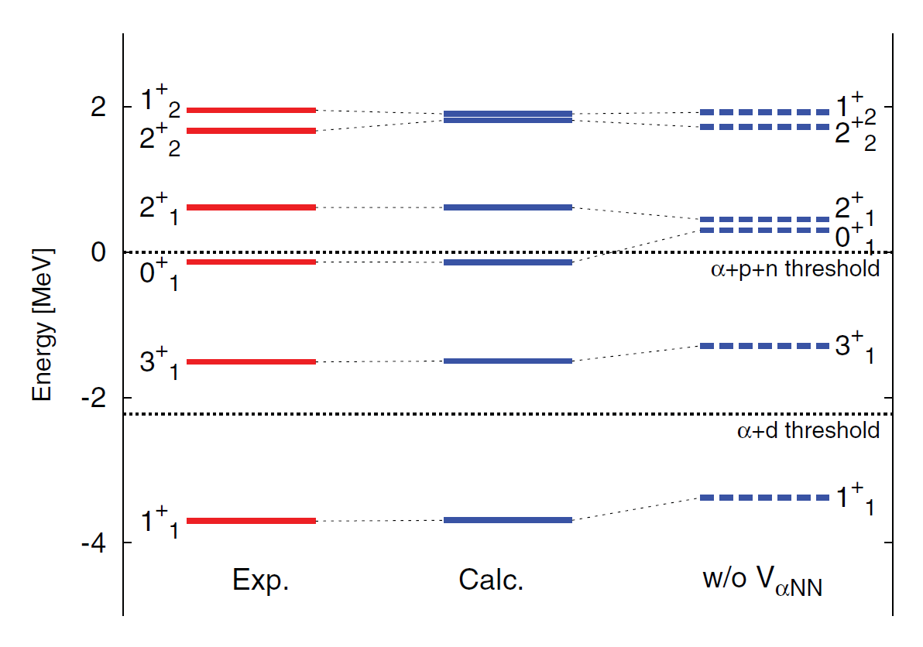
Reaction problems in complex scaling method
⁶Li in ⁴He+p+n model
N. Kurihara, Session B, Today’s afternoon

Slide 18
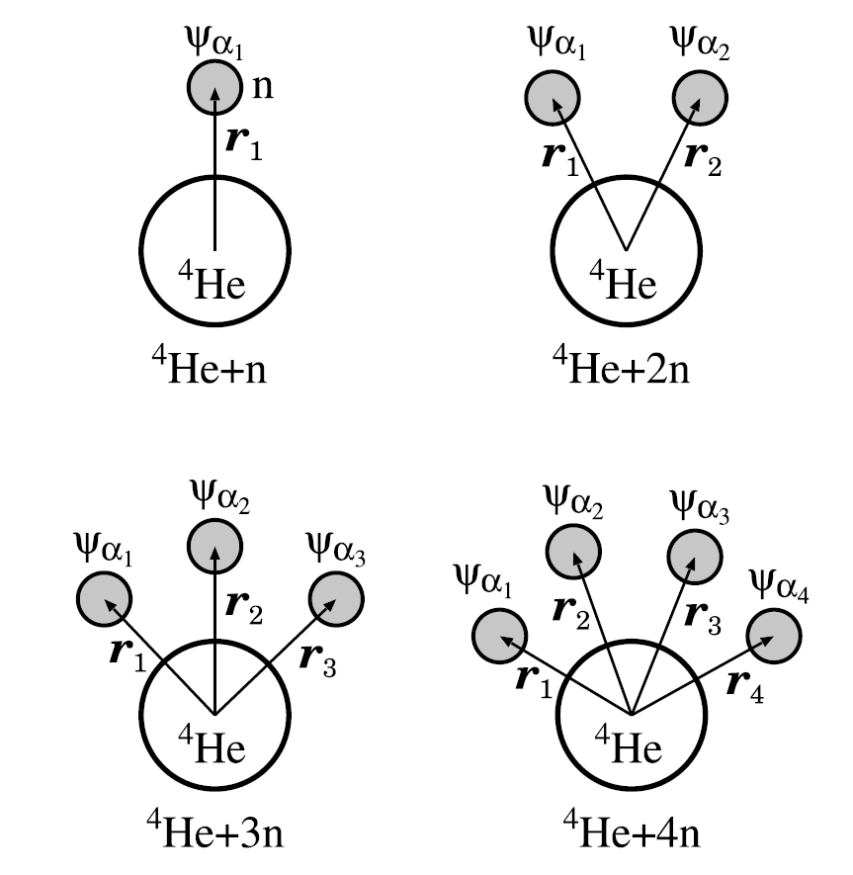
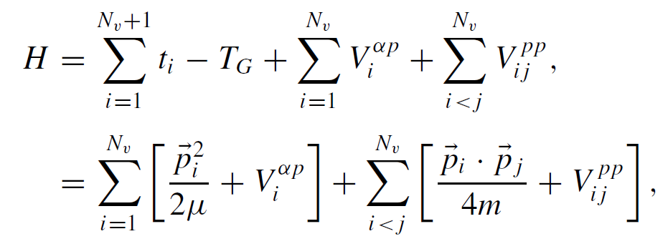
Cluster Orbital Shell Model
Y. Suzuki and K. Ikeda, Phys. Rev. C38, 310 (1988)
Gamow Shell Model
Comparison between the Gamow shell model and the cluster-orbital shell model for weakly bound systems,
H. Masui, K. Kato and K. Ikeda,
Phys. Rev. C 75 (2007), 034316-1-10.

Slide 19
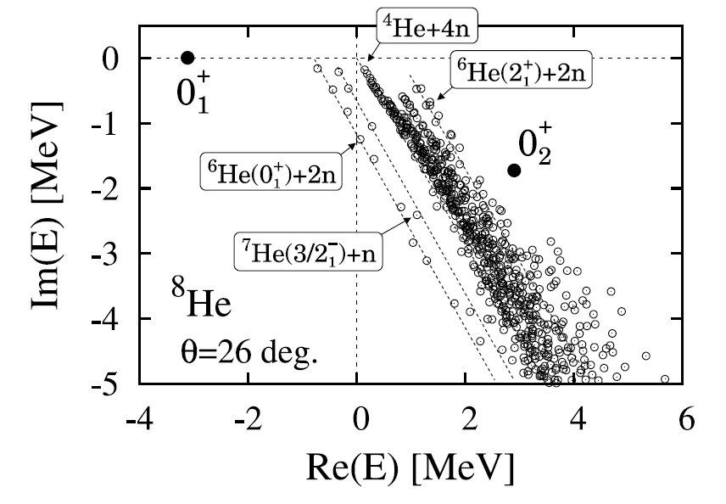
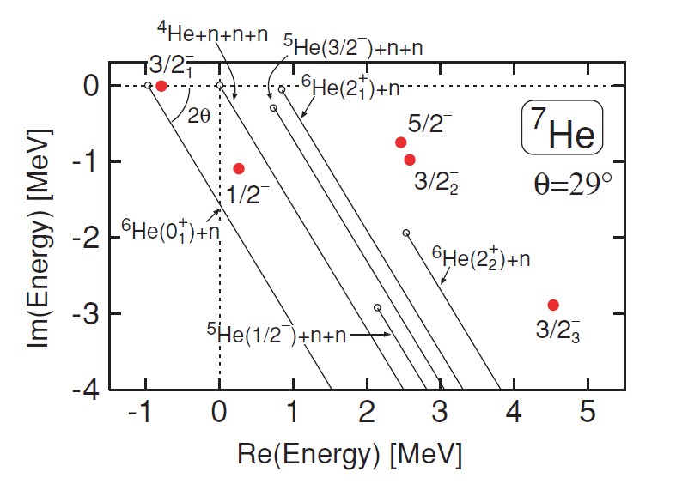
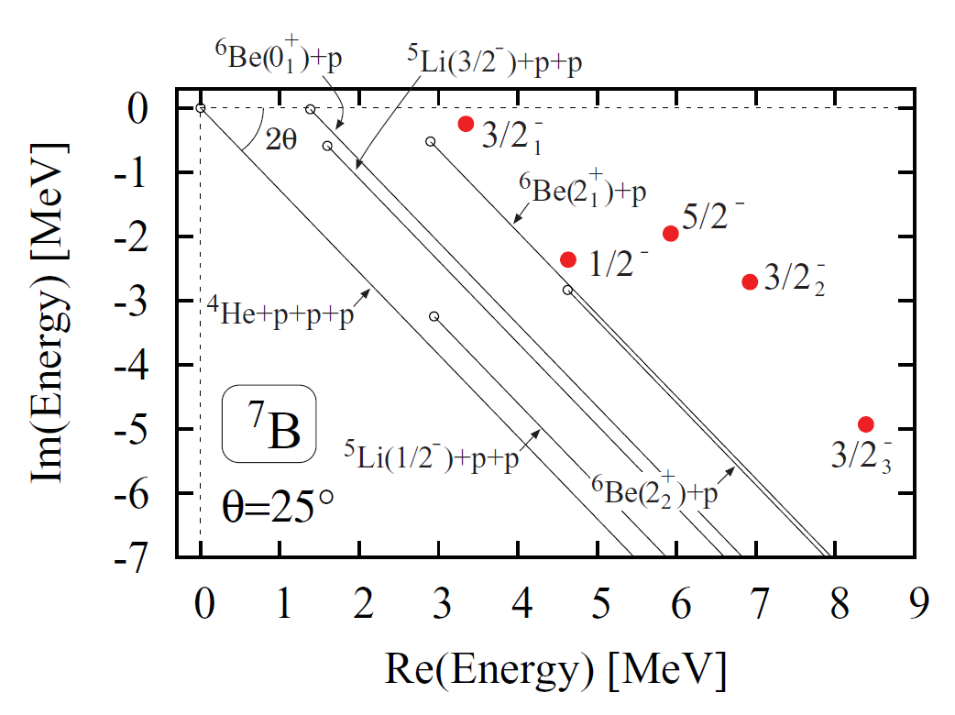
⁸He
Many open channels!
Resonance poles of ⁴He+3N (⁷He, ⁷B) and ⁴He+4N (⁸He)
Complex Scaling Method

Slide 20
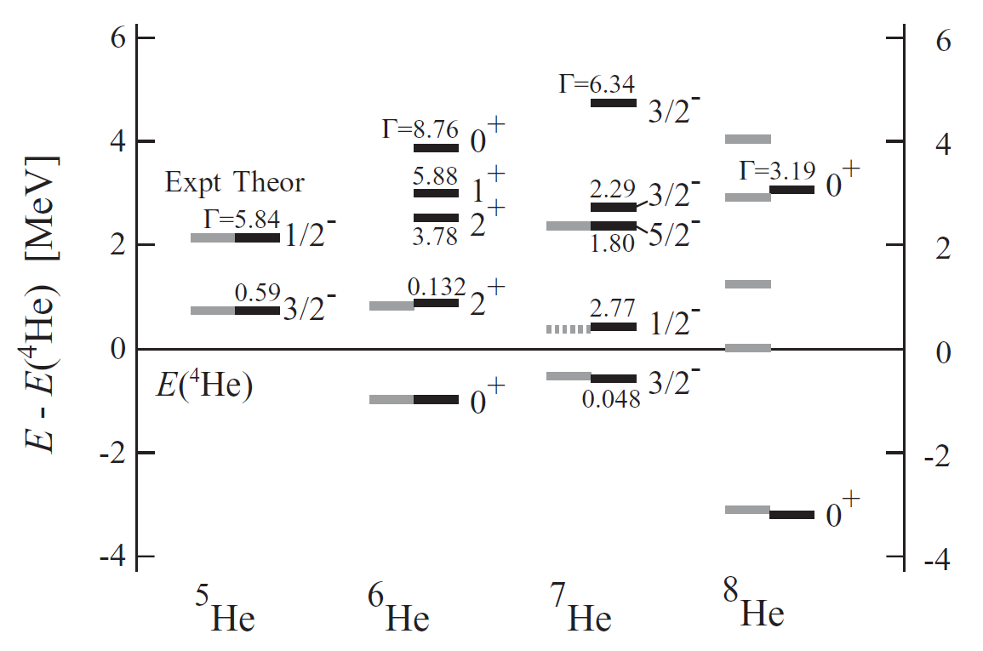
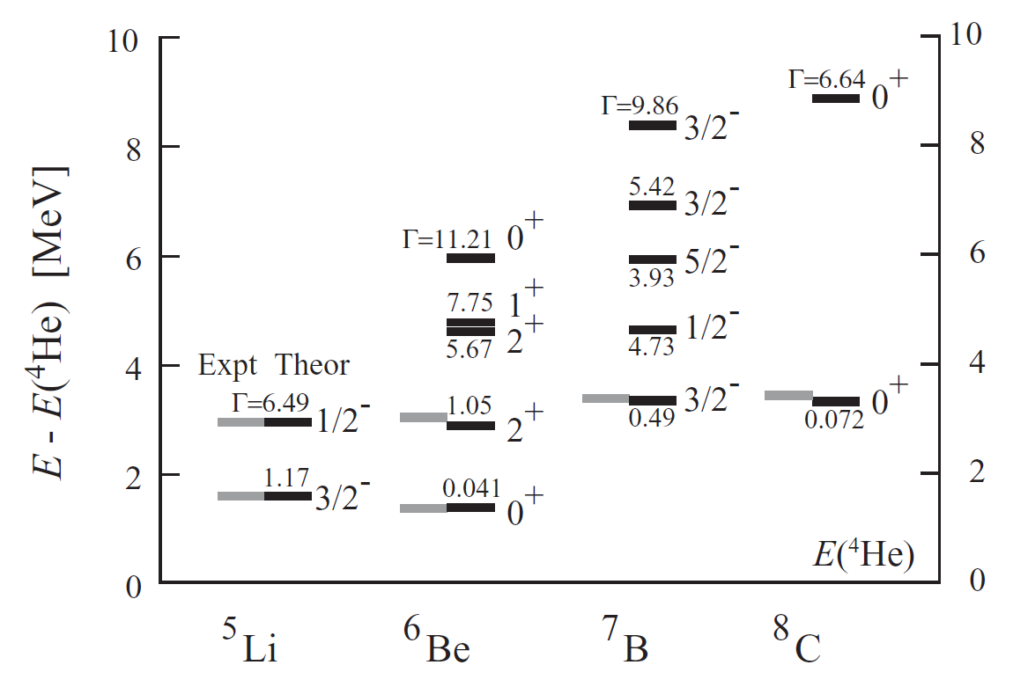
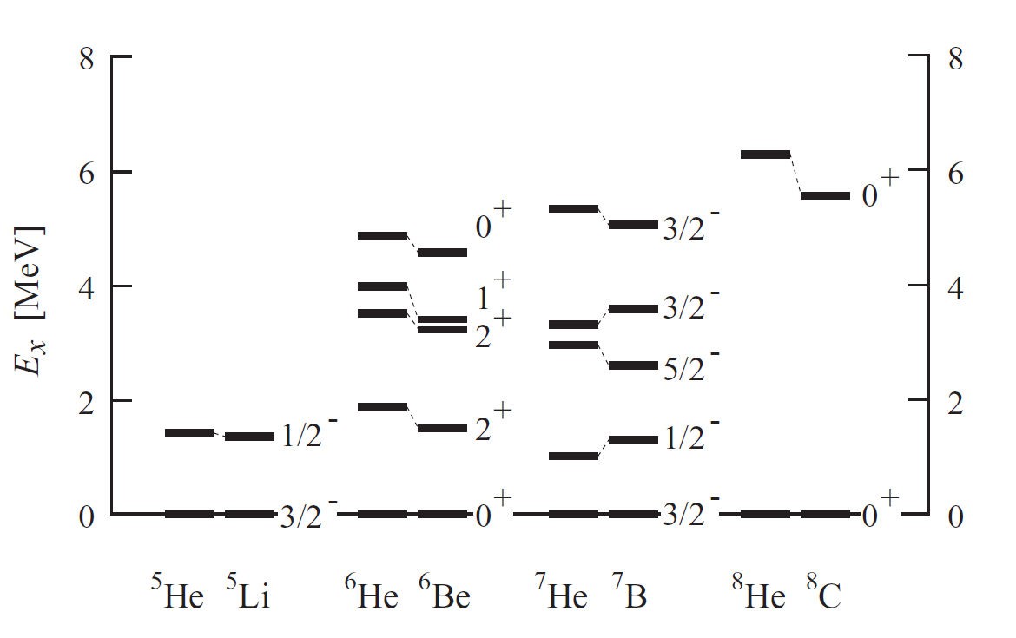
⁴He+Xp
⁴He+Xn
Mirror Symmetry

Slide 21
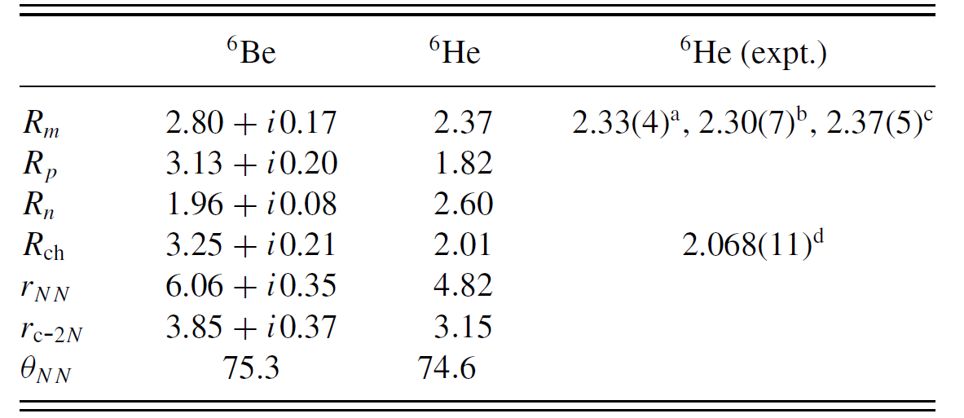
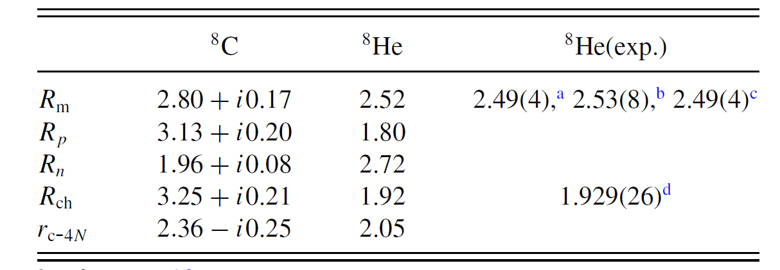
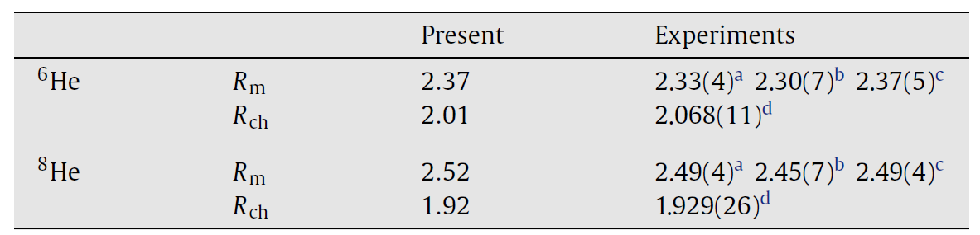
⁶He-⁶Be
⁸He-⁸C
⁶He-⁸He

Slide 22










Model : 3 α Orthogonality Condition Model (OCM)
folding for Nucleon-Nucleon interaction(Nuclear+Coulomb)
[Ref.]: E. W. Schmid and K. Wildermuth, Nucl. Phys. 26 (1961) 463
, -parity )
μ=0.15 fm⁻²
: OCM [Ref.]: S.Saito, PTP Supple. 62(1977),11
Phase shifts and Energies of ⁸Be, and Ground band states of ¹²C
α₂
α₁
,
c=2
α₃
[Ref.]: M.Kamimura, Phys. Rev. A38(1988),621

Slide 23
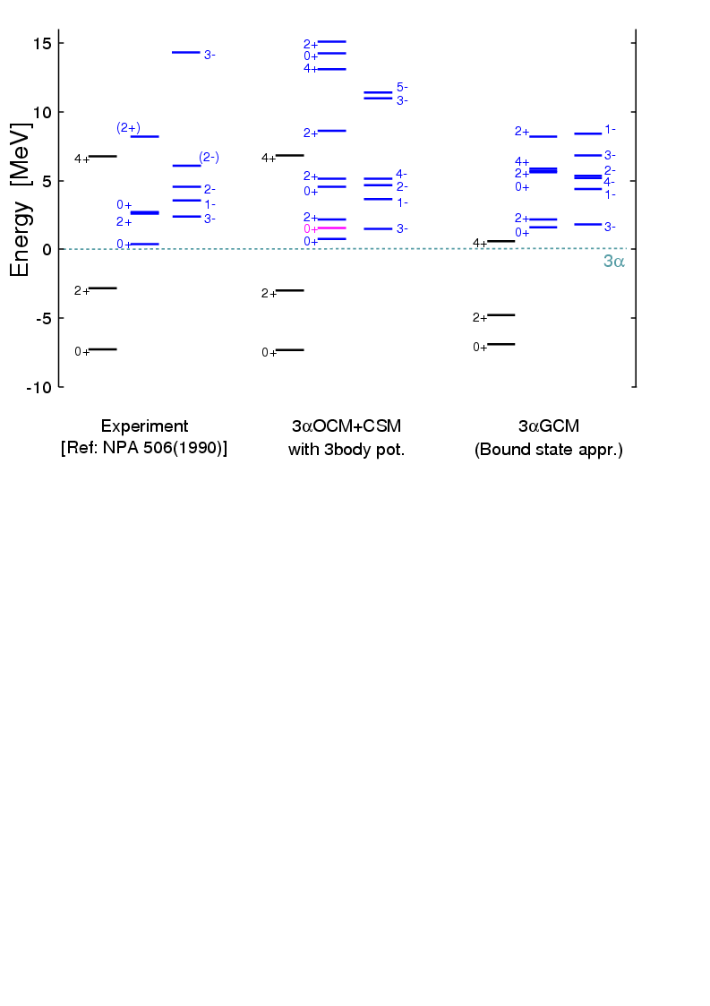
Results of applications of CSM and ACCC+CSM to 3αOCM －Energy levels Ex< 15 MeV－
(2+)
E_{r}
0⁺ : E_{r}=2.7+0.3 MeV, Γ= 2.7+0.3 MeV
2⁺ : E_{r}=2.6+0.3 MeV, Γ= 1.0+0.3 MeV
[Ref.]: M.Itoh et al., NPA 738(2004)268
0₃⁺: E_{r}=1.66 MeV, Γ=1.48 MeV
2₂⁺: E_{r}=2.28 MeV, Γ=1.1 MeV
3α Model can reproduce 2₂⁺ and 0₃⁺ in the same energy region by taking into account the correct boundary condition
ACCC+CSM
[Ref.]: M.Itoh et al., NPA 738(2004)268
E.Uegaki et al.,PTP(1979)

Slide 24
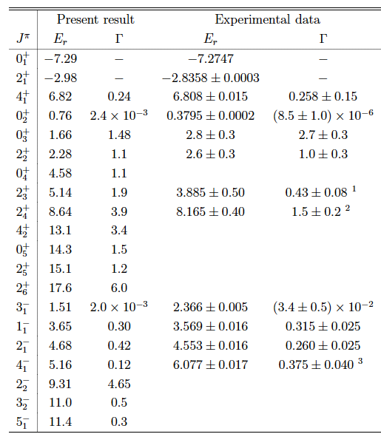

Slide 25
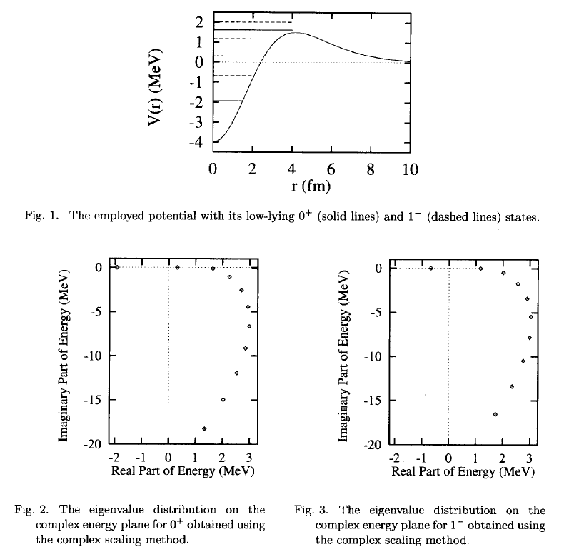
M. Homma, T. Myo and K. Kato, Prog. Theor. Phys. 97 (1997), 561.
red: 0⁺
blue: 1⁻
0⁺
1－

Slide 26
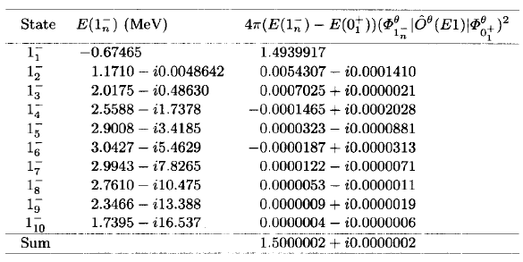
Contributions from B.S. and R.S. to the Sum rule value
B.S.
R.S.
S_{exc}=1.5
e²fm²MeV
The sum rule values are described by the resonant pole states!!

Slide 27
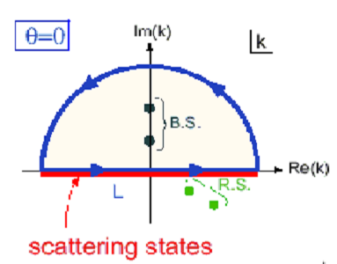
The complex scaling method is useful in solving not only resonant states but also continuum states.
Completeness Relation (Resolution of Identity)
R.G. Newton, J. Math. Phys. 1 (1960), 319
Bound states
Continuum states
Ｌ
Resonant states
non-resonant continuum states

Slide 28
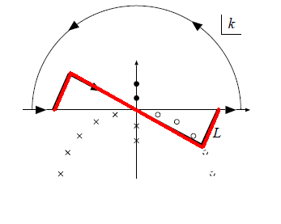
Separation of resonant states from continuum states
Deformed continuum states
Resonant states
T. Berggren, Nucl. Phys. A 109, 265 (1968)
Deformation of the contour
Matrix elements of resonant states
Convergence Factor Method
Ya.B. Zel’dovich, Sov. Phys. JETP 12, 542 (1961).
N. Hokkyo, Prog. Theor. Phys. 33, 1116 (1965).

Slide 29
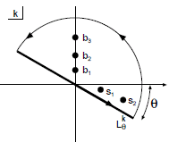
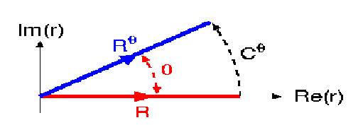
Complex scaling method
re^{iθ}
coordinate:
r
B. Gyarmati and T. Vertse, Nucl. Phys. A160, 523 (1971).
momentum:
T. Myo, A. Ohnishi and K. Kato. Prog. Theor. Phys. 99(1998)801]

Slide 30
Complex scaling method
momentum:
Resonant states
Rotated Continuum states
T. Myo, A. Ohnishi and K. Kato. Prog. Theor. Phys. 99(1998)801]
We can easily extend this completeness relation to many-body systems.

Slide 31
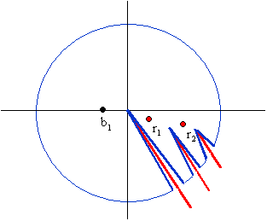
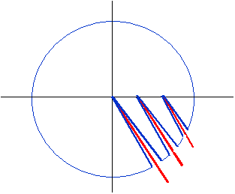
Resolution of Identity in Complex Scaling Method
k
E
k
E
Single Channel system
B.Giraud and K.Kato, Ann.of Phys. 308 (2003), 115.
E|
E|
b₃
b₂
b₁
r₁
r₂
r₃
B.Giraud, K.Kato and A. Ohnishi, J. of Phys. A37 (2004),11575
Coupled Channel system
Three-body system

Slide 32
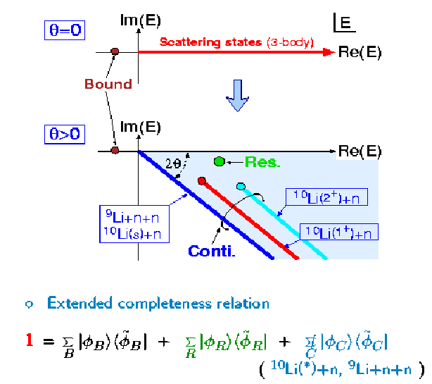
T. Myo, A. Ohnishi and K. Kato, Prog. Theor. Phys. 99 (1998), 801.
in CSM
Resonances
⁹Li+n+n
¹⁰Li(1⁺)+n
¹⁰Li(2⁺)+n

Slide 33
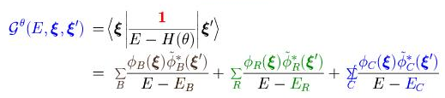
Complex Scaled Green’s Functions
Green’s operator
Complex scaled Green’s operator
Resolution of Identity
Complex Scaled Green’s function

Slide 34
Continuum Level Density
Level Density:
A.T.Kruppa, Phys. Lett. B 431 (1998), 237-241
A.T. Kruppa and K. Arai, Phys. Rev. A59 (1999), 2556
K. Arai and A.T. Kruppa, Phys. Rev. C 60 (1999) 064315

Slide 35
1
RI in complex scaling
Resonance:
Continuum:
0
E
Many-body level density is given by using the complex scaling method. => Four-body CDCC
Descretization
New Description of the Four-Body Breakup Reaction, T. Matsumoto, K. Kato and M. Yahiro, Phys. Rev. C 82, 051602(R)1-5 (2010)

Slide 36
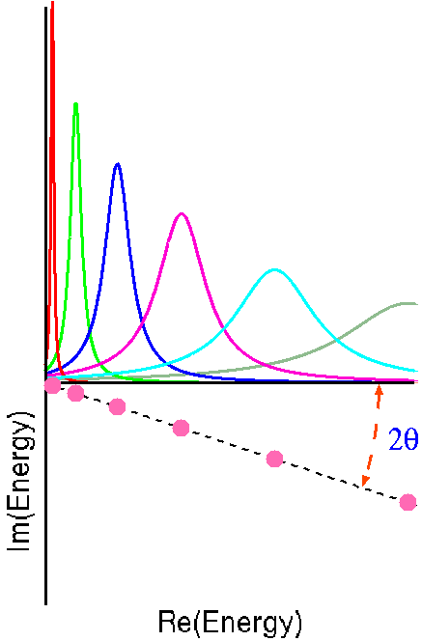
New Description of the Four-Body Breakup Reaction, T. Matsumoto, K. Kato and M. Yahiro, Phys. Rev. C 82, 051602(R)1-5 (2010)
The complex scaling gives an appropriate discretization of continuum states.
(Ogata-san’s talk )

Slide 37
Continuum Level Density:
Basis function method:

Slide 38
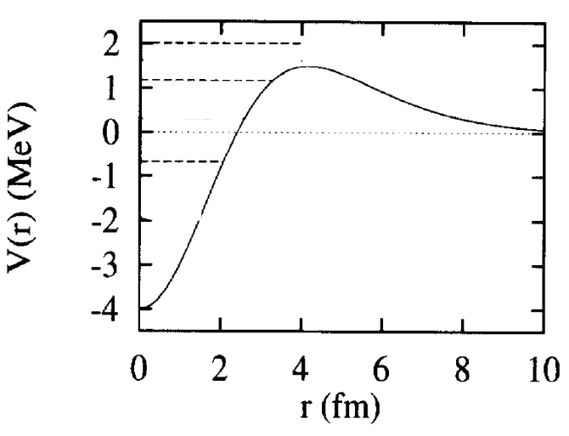
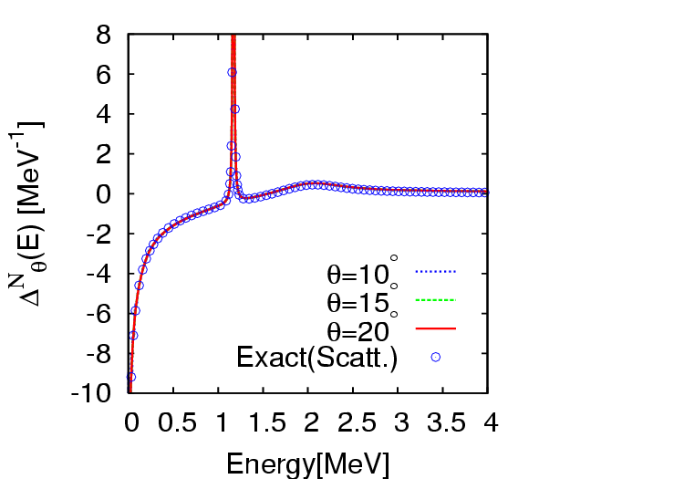

Slide 39
Phase shift calculation in the complex scaled basis function method
S.Shlomo, Nucl. Phys. A539 (1992), 17.
In a single channel case,

Slide 41
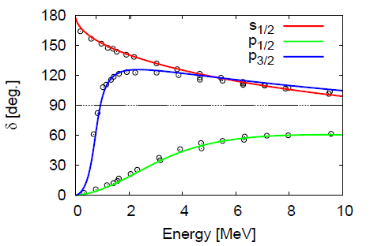
Phase shift of ⁵He=α+n calculated with discretized app.
; experimental data

Slide 42
Summary
The complex energy states can be mapped on the real energy axis by the complex scaled Green’s function.
Important properties of scattering cross sections can be described with the resonance poles.
The complex scaling method describes not only resonant states but also continuum states, which are obtained on different rotated branch cuts.
In the complex scaling method, many-body continuum states can be discretized without any ambiguity and loss of accuracy.

