Slide 1
冷反水素研究の最近の展開
Recent progress on cold antihydrogen research
仁科月例コロキウム2011/11/22
Y. Yamazaki, RIKEN Advanced Science Institute

Slide 2
Contents
1. A brief look back of antiparticle/antimatter
2. CPT symmetry: the fundamental question
3. What to measure, what to prepare
4. Manipulation of H: two schemes from latest results
5. Future
6. Summary

Slide 3
A brief look back of antimatter
1928: Dirac relativistic theory of electron
1933: discovery of e⁺
1955: discovery of p
1965: discovery of d
1973: discovery of ³He
(1982: LEAR started ← 1st storage ring, pure p)
1986: p trapped (He double ionization)
1989: p cooled with e⁻
(1991: long-lived pHe⁺)
1996: GeV H (LEAR shut down)
(1999: AD operation)
2002: cold H
2008: compression of p cloud
2010: trapping H, first step to H beam
2011 & beyond: H spectroscopy (HF & 1S-2S)
(⁴He, AMS2) , ELENA
15e⁺s
60ps
31 p trapped
11 Hs
38 trapped Hs
A few extracted

Slide 4
Contents
1. A brief look back of antiparticle/antimatter
2. CPT symmetry: the fundamental question
3. What to measure, what to prepare
4. Manipulation of H: two schemes from latest results
5. Future
6. Summary

Slide 5
CPT symmetry
P (Parity inversion) and CP(Charge conjugation and P) symmetries are broken although both were believed to be conserved (e.g., β-decay & K⁰-K⁰ decay, res.).
→ CPT symmetry is the last one still escaping from our chase!
The standard model constructed on flat space-time predicts that the CPT is conserved, which however may not conserved under curved space-time with gravity. Actually, no quantum theory taking into account gravity has been developed yet.
Further,

Slide 6
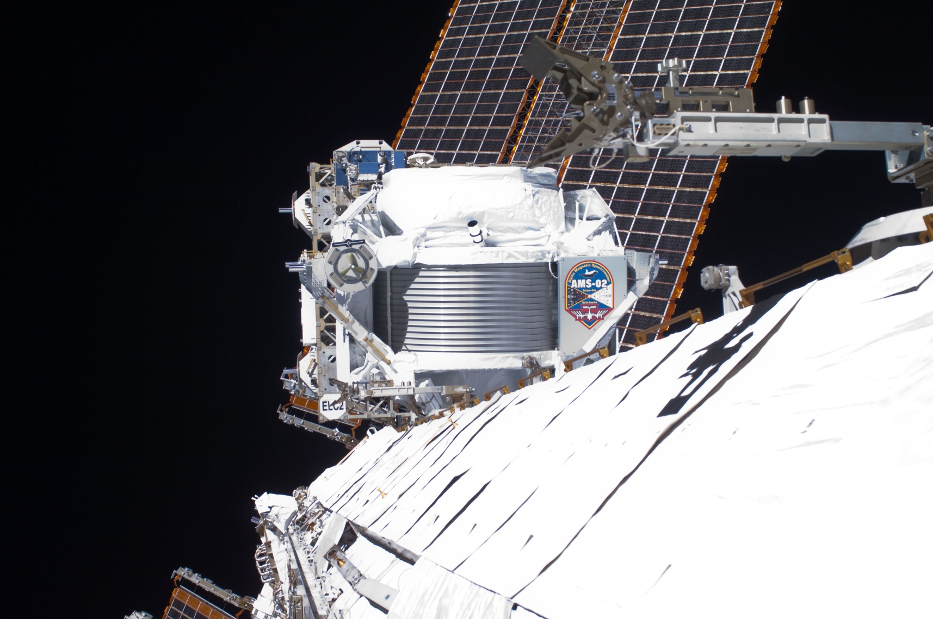
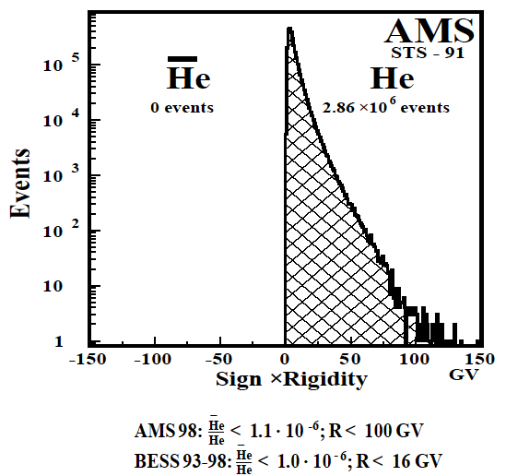
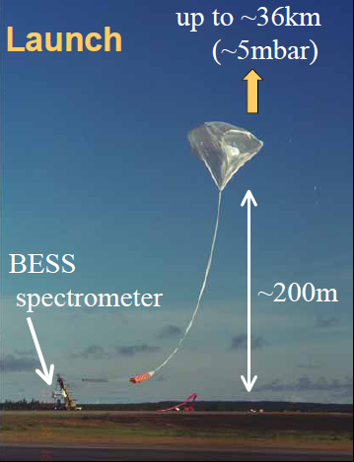
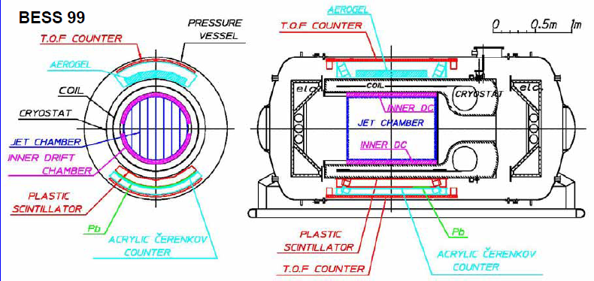
A in space
If the bigbang scenario is true, and the same amount of matter and antimatter were produced, antiparticles should be showering on our earth:
Soon, AMS2 (Alpha Mangetic Spectrometer) will tell us more!

Slide 7
A in space
Assuming the universe is a patch work of matter and antimatter
annihilation should come from the boundary
20Mpc
Our universe is full of matter…
Antimatter may be different from matter
CP violation is not enough
CPT can be violated in curved space-time?
1000Mpc
A. G. Cohen, A. de Ru Jula, and S. L. Glashow, Astrophys. J. 495:539

Slide 8
Curved space-time
ρ_{BH}~c²/GR²
ρ~m/R³=h/2πcR⁴
(R~h/2πmc)
→M_{Pl}~(hc/2πG)^{1/2}
~10¹⁹ GeV/c²!!

Slide 9
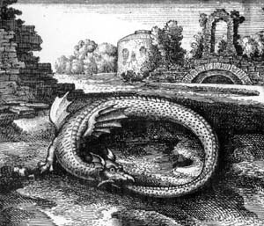
Curved space-time
Merging point of elementary particle physics & cosmology
High energy physics
→Too high in Energy!
Atomic Physics alternative scheme
Ouroboros

Slide 10
Curved space-time
Planck mass: M_{Pl}~(hc/G)^{1/2} ~10¹⁹GeV
(ρ_{pl}~ρ_{BH}: a measure of CPT violation)
→ Not accessible artificially (by accelerators) forever
→ high precision experiments
(m_{p}/M_{pl})m_{p}c²~10⁻¹⁹GeV
~10kHz
→ Listen to the whisper of nature: mild physics, where atomic and atomic collision physics play the vital role!

Slide 11
Contents
1. A brief look back of antiparticle/antimatter
2. CPT symmetry: the fundamental question
3. What to measure, what to prepare
4. Manipulation of H: two schemes from latest results
5. Future
6. Summary

Slide 12
Why antihydrogen?
The simplest antimatter
Hydrogen, the opposite number of antihydrogen, has been studied with extremely high precision, an excellent reference
And anyway, exotic!

Slide 13
Conceivable whisper?
 | |m_{m}-m_{a}|/m | |q_{m}+q_{a}|/|q| | |g_{m}-g_{a}|/|g|
e⁻ vs e⁺ | <8x10⁻⁹ | <4x10⁻⁸ | (-0.5±2.1)x10⁻¹²
p vs p | <2x10⁻⁹ | <2x10⁻⁹ | (-0.1±2.9)x10⁻³
Spectroscopic precision of hydrogen atom
 | experiments（Hz） | Δν_{exp}/ν
ν_{1S-2S} | 2,466,061,413,187,035 (10) | 4.2x10⁻¹⁵
ν_{HF} | 1,420,405,751.7667 (9) | 6.3x10⁻¹³
1S-2S and hyperfine transitions can be the target
g-factor or magnetic moment of p is the first quantity to determine

Slide 14
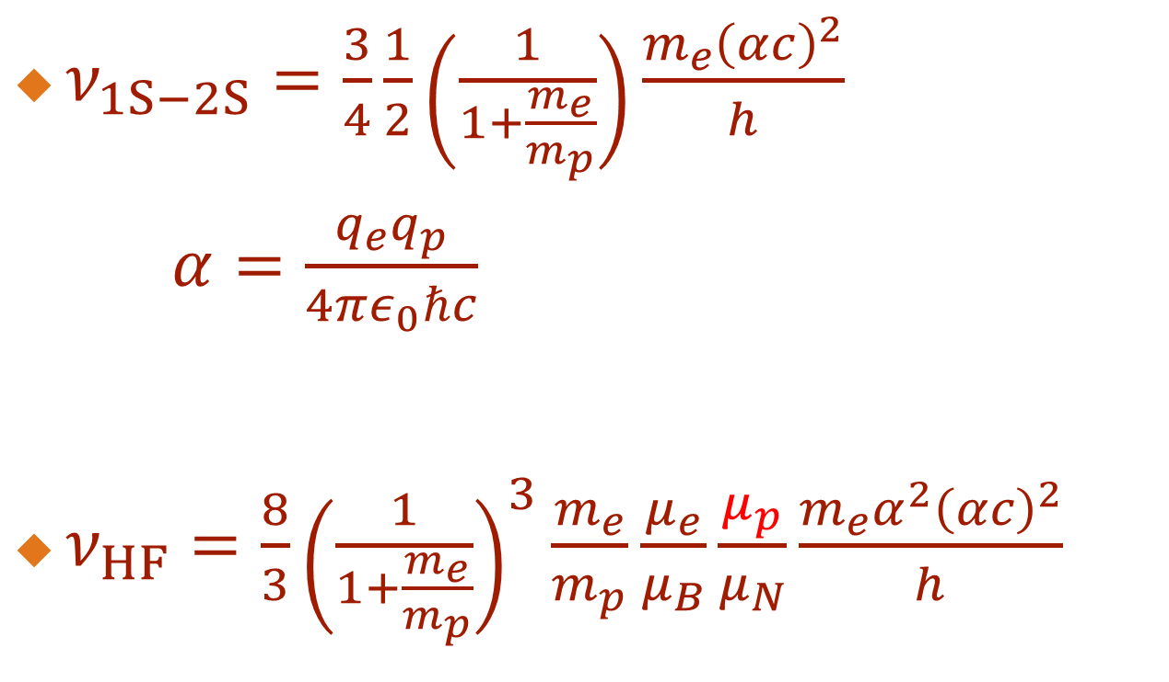
Conceivable whisper?
$ν_{1S−2S}=\frac{3}{4}\frac{1}{2}\left(\frac{1}{1+\frac{m_{e}}{m_{p}}}\right)\frac{m_{e}{\left(αc\right)}^{2}}{h}$
$α=\frac{q_{e}q_{p}}{4πε_{0}ℏc}$
$ν_{HF}=\frac{8}{3}{\left(\frac{1}{1+\frac{m_{e}}{m_{p}}}\right)}^{3}\frac{m_{e}}{m_{p}}\frac{μ_{e}}{μ_{B}}\frac{μ_{p}}{μ_{N}}\frac{m_{e}α^{2}{\left(αc\right)}^{2}}{h}$
g-factor or magnetic moment of H, ν_{HF}, looks better to be measured!

Slide 15
Conceivable whisper?
 | |m_{m}-m_{a}|/m | |q_{m}+q_{a}|/|q| | |g_{m}-g_{a}|/|g|
e⁻ vs e⁺ | <8x10⁻⁹ | <4x10⁻⁸ | (-0.5±2.1)x10⁻¹²
p vs p | <2x10⁻⁹ | <2x10⁻⁹ | (-0.1±2.9)x10⁻³
Spectroscopic precision of hydrogen atom
 | experiments（Hz） | Δν_{exp}/ν | |ν_{th}-ν_{exp}|/ν
ν_{1S-2S} | 2,466,061,413,187,035 (10)* | 4.2x10⁻¹⁵* | 1x10⁻¹¹
ν_{HF} | 1,420,405,751.7667 (9) | 6.3x10⁻¹³ | (3.5±0.9)x10⁻⁶
Red letter: theoretical limit for H
Unknown physics if at all should show up below this theoretical limit
*C.G.Parthey et al., PRL107(2011)203001

Slide 16
Conceivable whisper?
Spectroscopic precision of hydrogen atom
 | experiments | Δν_{exp}/ν | |ν_{th}-ν_{exp}|/ν
ν_{1S-2S} | 2,466,061,413,187.34 (84)* kHz | 3.4x10⁻¹³* | 1x10⁻¹¹
*Th. Udem et al., PRL79(1997)2646
ν_{1S-2S} | 2,466,061,413,187,103 (46)* | 1.7x10⁻¹⁴* | 1x10⁻¹¹
*M.Niering et al., PRL84(2000)5496
ν_{1S-2S} | 2,466,061,413,187,035 (10)* | 4.2x10⁻¹⁵* | 1x10⁻¹¹
*C.G.Parthey et al., PRL107(2011)203001

Slide 17
H projects
μ⁻p Lamb shift
Pohl, et al. 2010
p structure
?
CPT:
We are more relaxed from theory when H/H or μ⁻p/μ⁺p are compared!
CODATA 2006
H circular states,
De Vries, MIT thesis 2001
Haensch, et al. 1992
Haensch, et al. 1997
J. N. Tan

Slide 18
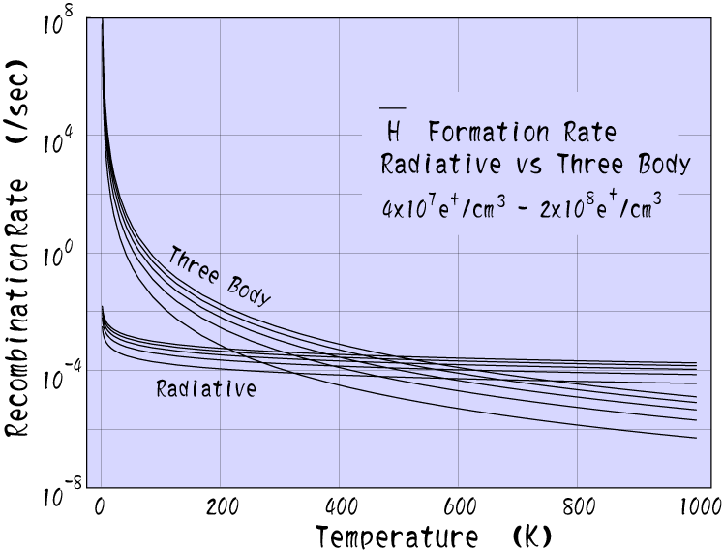
H synthesis
(1) p + e⁺ →H + hν
(2) p + e⁺ + nhν →H + (n+1)hν
(3) p + e⁺ + e⁺ →H + e⁺
(4) p + (e⁺e⁻) →H + e⁻
(5) p + A →H + e⁻ + A

Slide 19
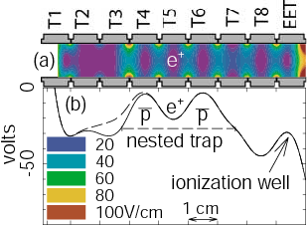
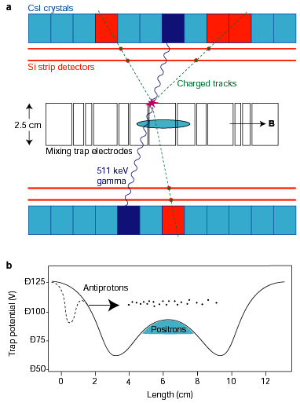
H synthesis
ATRAP 170000H Phys.Rev,Lett89(2002)213401
→no H trapping mechanism, high Rydberg, high temperature
→a big step, but archeological…
ATHENA 50000 H Nature 419(2002)456
→minimum B config. (-m・B), cold p

Slide 20
Contents
1. A brief look back of antiparticle/antimatter
2. CPT symmetry: the fundamental question
3. What to measure, what to prepare
4. Manipulation of H: two schemes from latest results
5. Future
6. Summary

Slide 21
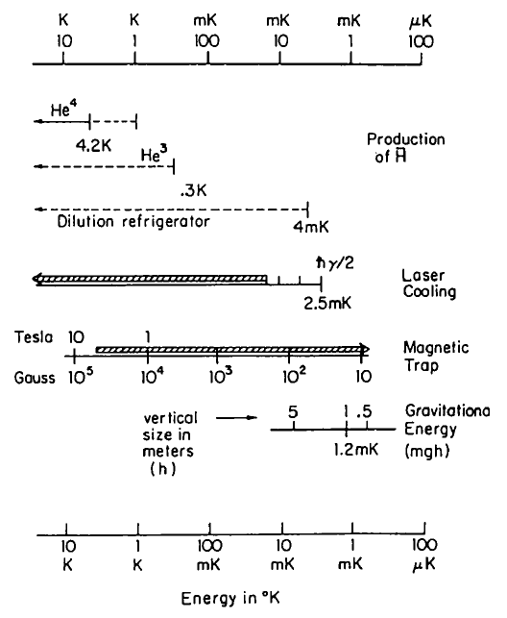
Necessary temperature of H
H free fall
H beam
H trap

Slide 22
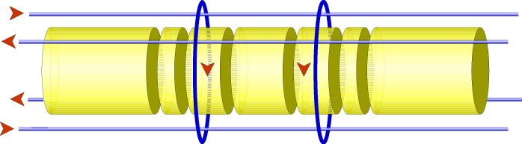
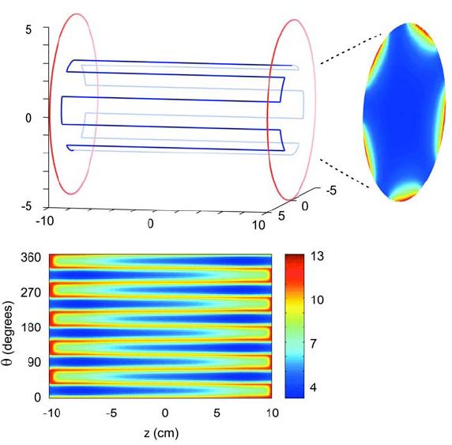
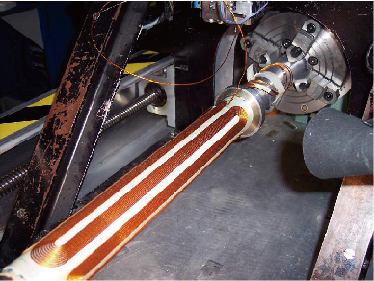
ALPHA: Octupole coil
Magnetic bottle scheme: H trapping
Usual neutral atom trap→ Quadrupole trap (Ioffe trap)
→ Charged particles unstable → higher multipole for uniform field near the axis

Slide 23
Magnetic bottle scheme: H trapping
E.P van der Werf, et al. J.Phys.Conf.Ser257(2010)012004

Slide 24
Magnetic bottle scheme: H trapping

Slide 25
Magnetic bottle scheme: H trapping
As long as 2000s
After 0.17s
1. Trap p and e⁺ under uniform B field
2. Energize octupole and mirror fields
3. Mix them for 1 s
4. Remove all p and e⁺
5. de-energize the magnetic bottle (octupole and mirror coils)
~200 H trapped as long as 2000s!
Andresen et al., Nature 468 (2010) 673, and Fujiwara et al, Nature Phys. 7(2011)558.

Slide 26
Cusp trap scheme: H beam
→~14GHz/T~60μeV/T~0.7K/T

Slide 27
Cusp trap scheme: H beam
Stable trapping of p and e⁺
LFS states focusing
HFS states defocusing
Minimum B configuration

Slide 28
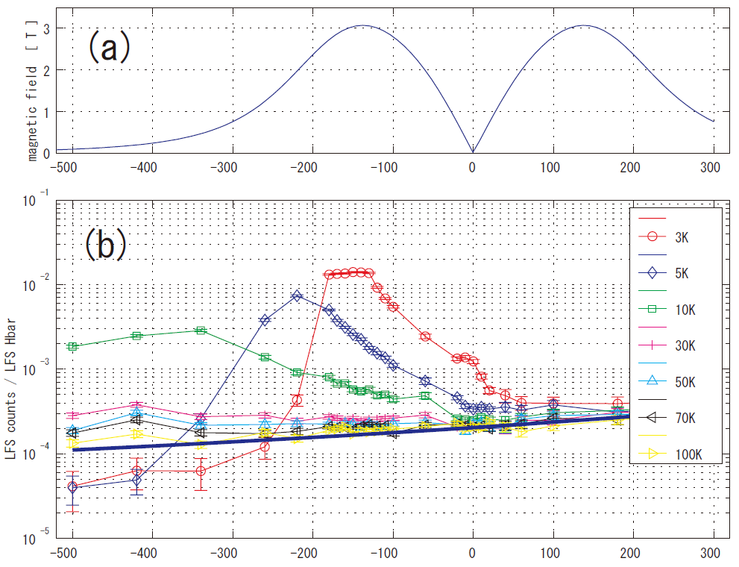
Cusp trap scheme: H beam
z axis (mm)
Y. Nagata et al.
Intensity enhancement
High spin polarization

Slide 29
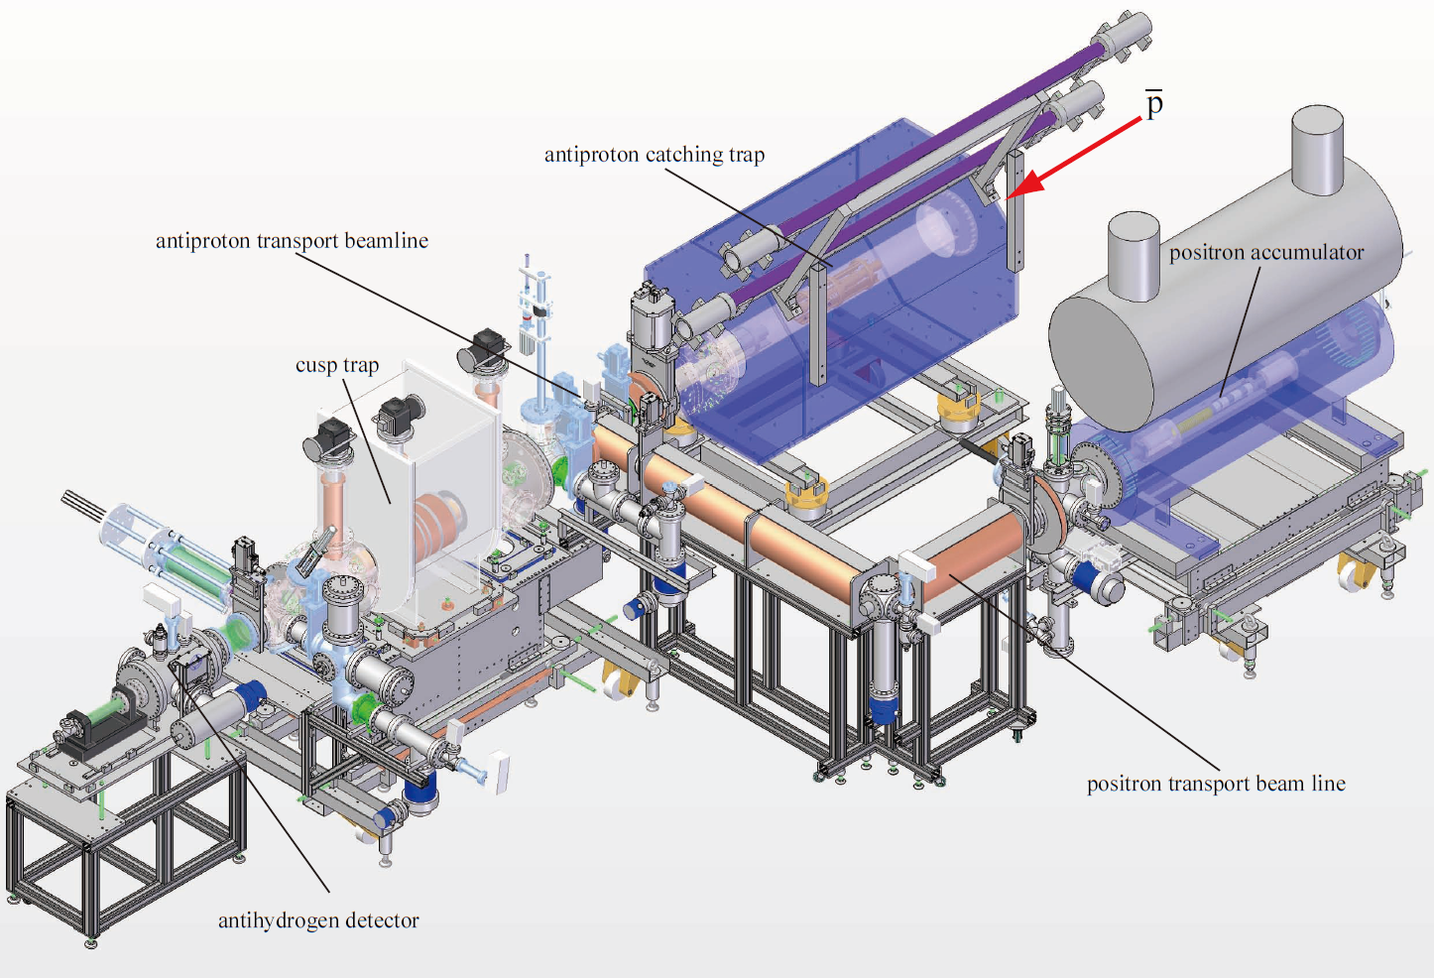
Cusp trap scheme: H beam

Slide 30
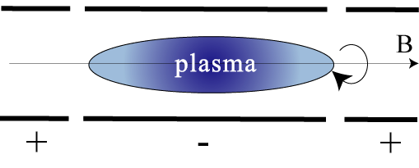
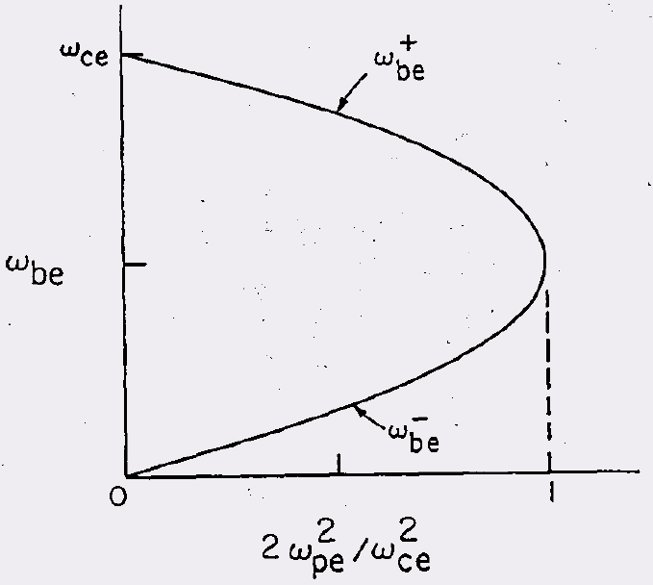
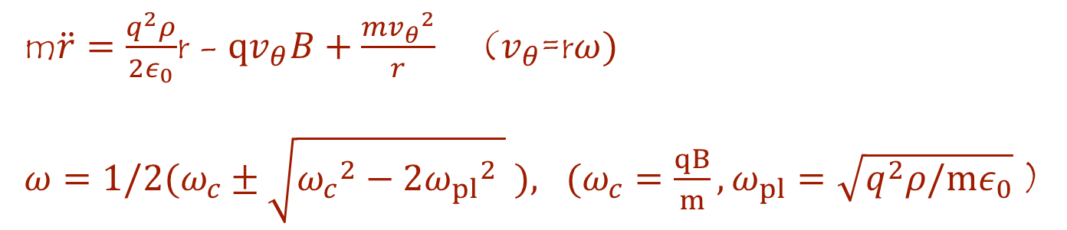
Manipulation of charged particles
m$\ddot{r}=\frac{q^{2}ρ}{2ε_{0}}$r - $qv_{θ}B+\frac{m{v_{θ}}^{2}}{r}$ ($v_{θ}$=r$ω)$
$ω={1/2(ω}_{c}±\sqrt{{ω_{c}}^{2}−2{ω_{pl}}^{2} } ), (ω_{c}=\frac{qB}{m}, ω_{pl}=\sqrt{q^{2}ρ/mε_{0}}$ )
ω independent of r → Rigid Rotation!
Higher ρ, higher rotation → drive rotation, higher ρ!

Slide 31
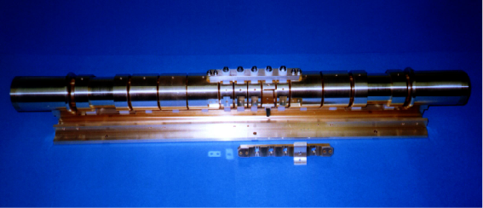
Manipulation of charged particles

Slide 32
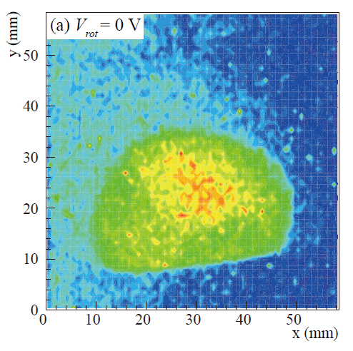
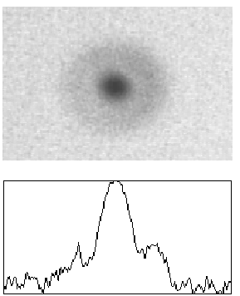
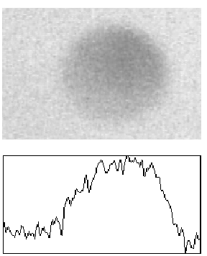
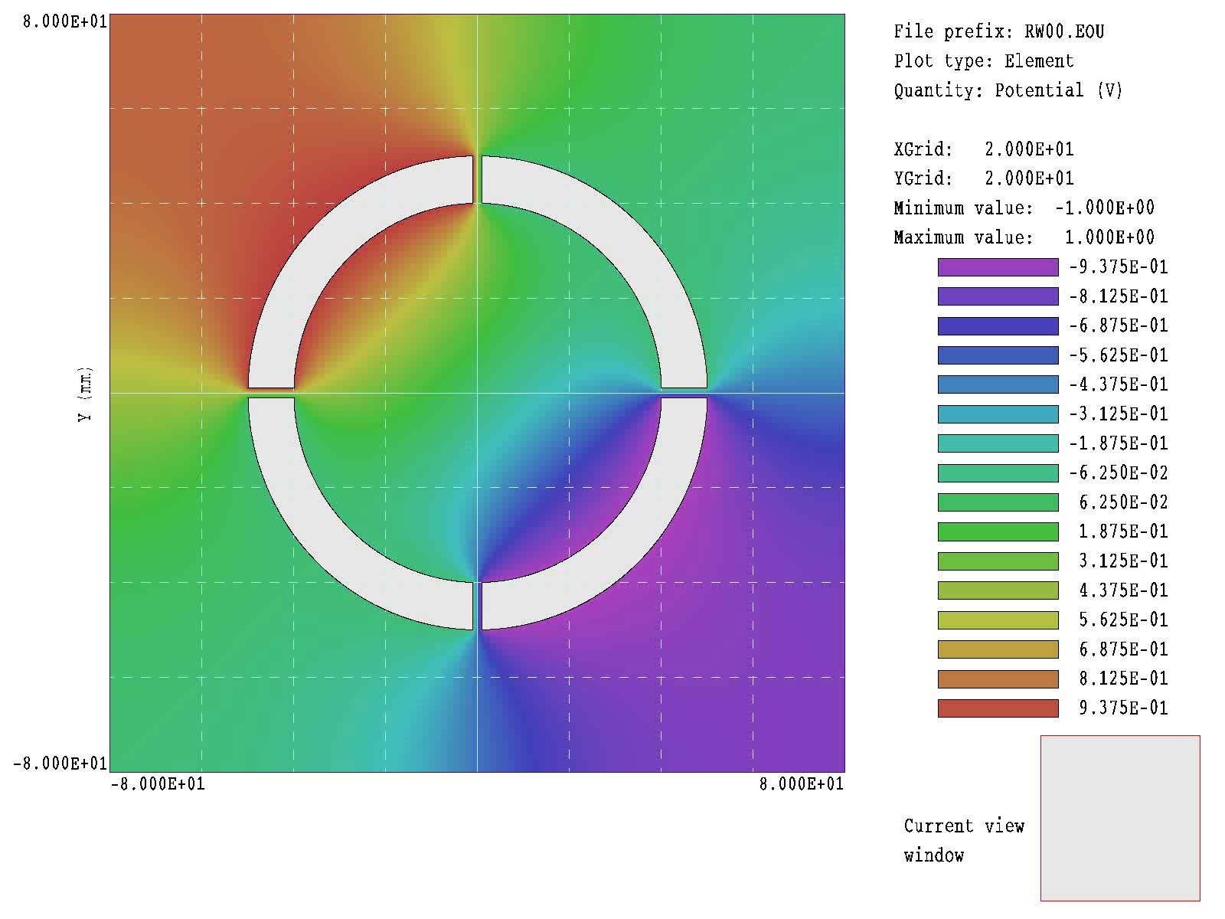
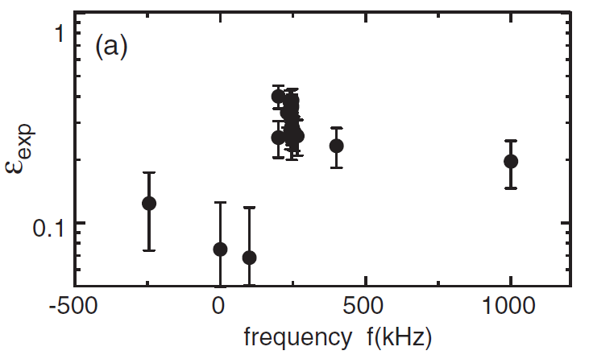
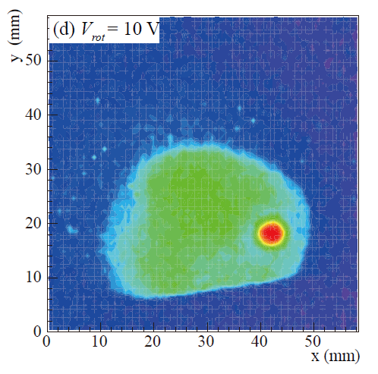
Manipulation of charged particles
p compression with and without electrons
Kuroda et al., PRL100(2008)203402

Slide 33
Cusp trap scheme: H beam
F~3.2x10⁸ n⁻⁴ (V/m)

Slide 34
Cusp trap scheme: H beam
Successful synthesis of H in the cusp trap → Access to H beam for MW spectroscopy for the first time!
Enomoto et al., Phys. Rev. Lett. 105 (2010) 243401

Slide 35
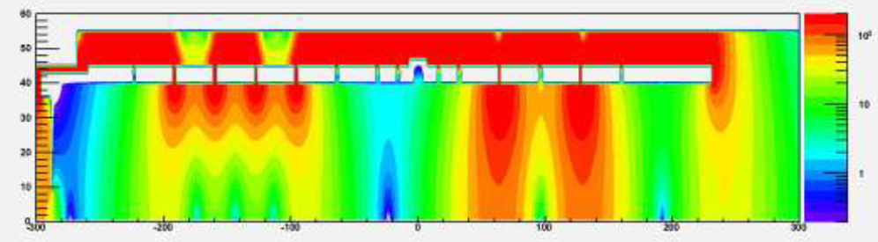
Cusp trap scheme: H beam
3x10⁵ ps, 3x10⁶ e⁺s → 6x10³ Hs
n ~ 45-50
Reaction efficiency: 2-7%
Enomoto et al., Phys. Rev. Lett. 105 (2010) 243401

Slide 36
Some consideration: 1S-2S vs HF
 | experiments（Hz） | Δν_{exp}/ν | |ν_{th}-ν_{exp}|/ν
ν_{1S-2S} | 2,466,061,413,187,035 (10) | 4.2x10⁻¹⁵ | 1x10⁻¹¹
ν_{HF} | 1,420,405,751.7667 (9) | 6.3x10⁻¹³ | (3.5±0.9)x10⁻⁶
Red letter: theoretical limit for H
: Achievable precision for H
1S-2S in a 1T trap: Δν~10⁶Hz Δν/ν ~ 10⁻¹⁰,
Hyperfine: Δν~10³Hz Δν/ν ~ 10⁻⁶,
Haensch and Zimmermann, Hyperfine Int. 76(93)47.

Slide 37
Contents
1. A brief look back of antiparticle/antimatter
2. CPT symmetry: the fundamental question
3. What to measure, what to prepare
4. Manipulation of H: two schemes from latest results
5. Future
6. Summary

Slide 38
H experiments from 2011 & beyond
With these schemes, experiments start to get real physics results from 2011:
Hyperfine transition
1S-2S transition
Near Future: ELENA (Extra Low Energy Antiprotons)
10⁷ ps/100s, 24hrs @100keV

Slide 39
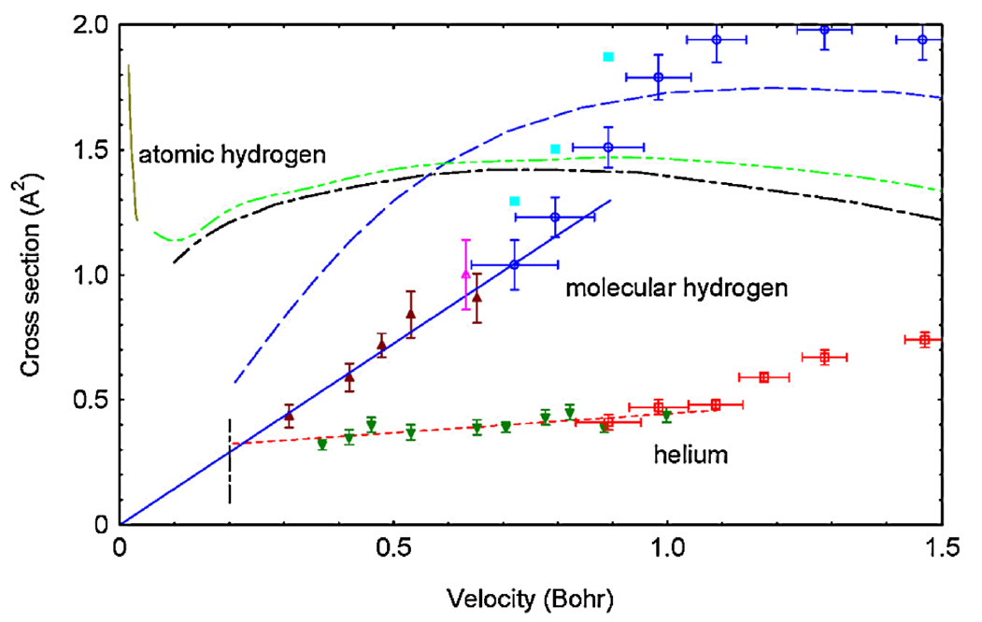
Other subjects, present and future
Atomic collision as heavy e-: H. Knudsen, R.W. McCollough, …
pHe laser and microwave spectroscopy
Spin-flip
Gravity: weak equivalence principle
Probe of nuclear structure
H.Knudsen et al., PRL105(2010)213201

Slide 40
pHe⁺ laser spectroscopy:
Antiproton-to-electron mass ratio measured: 1836.1526736(23)
Protons
Antiprotons
Antiproton mass will soon be known with better precision than the proton mass!
Hori et al., Nature 475, 484 (2011)

Slide 41
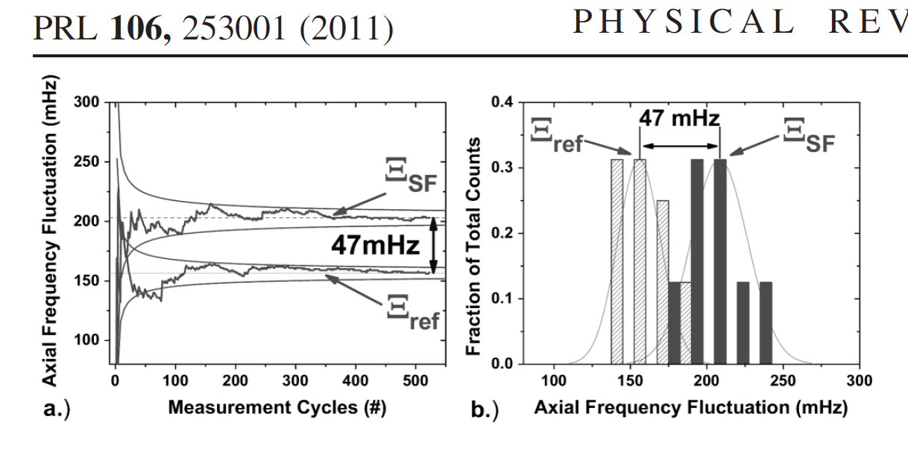
Other subjects, present and future
Atomic collision as heavy e-: H. Knudsen, R.W. McCollough, …
pHe laser and microwave spectroscopy
Spin-flip
Gravity: weak equivalence principle
Probe of nuclear structure
S. Ulmer et al., PRL106(2011)253001

Slide 42
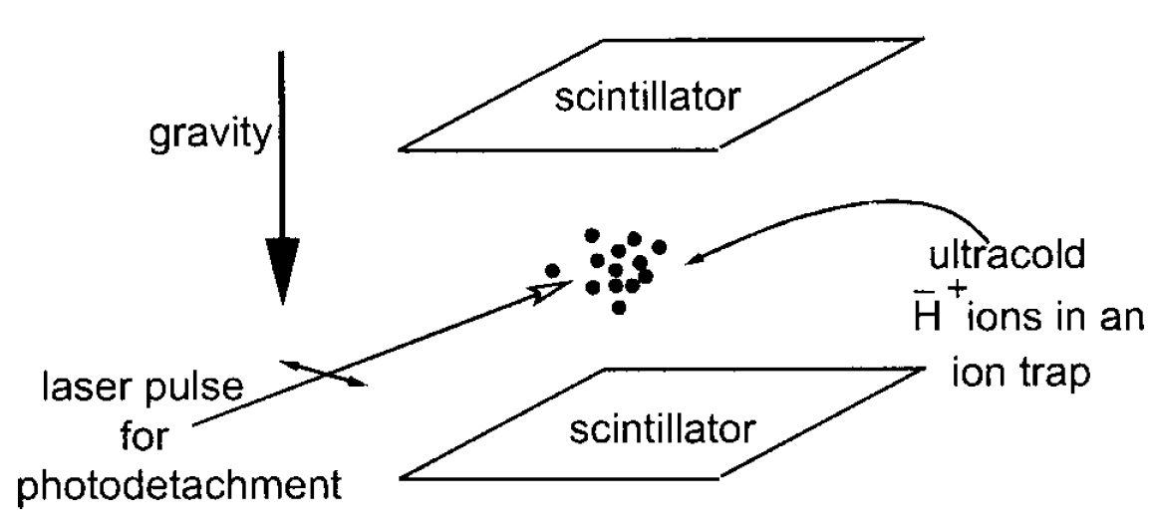
Free Fall: P.Perez (Sacley)
J.Walz, et al., General relativity and gravitation 36(2004)561
H + 2(e⁺e⁻) → H⁺ + 2e⁻ (P.Perez)
←recoil energy?
H⁺ + Be⁺ → laser cooling → H⁺ + hv → H + e⁺

Slide 43
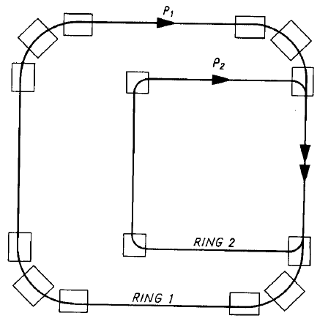
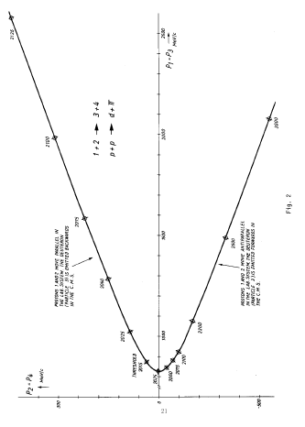
Future possibilities: ds
p + p → d + π⁺
(uud + uud → uududd + ud)
D.Moehl & K. Killian, H. Pilkuhn, H. Poth

Slide 44
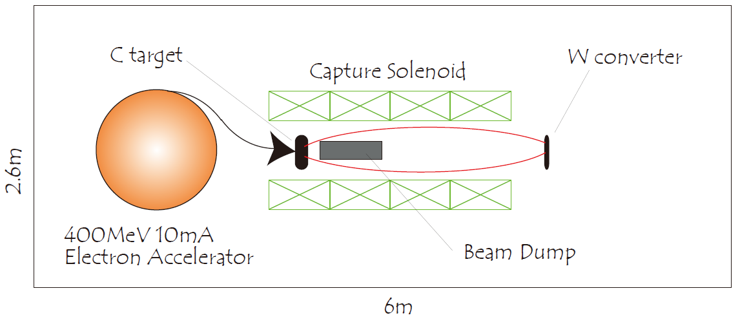
Future possibilities: Tabletop μ⁺ generator for μ⁺p study
μ⁺p vs μ⁻p is expected to be more sensitive to the CPTV than H vs H
Nagamine et al.

Slide 45
Summary and outlook
Antimatter matters: successful manipulation of Hs, i.e., fundamental symmetry will soon be tested employing atomic physics/atomic collision physics
ground-state hyperfine transitions
1S-2S transition
p/p spin-flip comparison ← S. Ulmer
Atomic collision matters to synthesize H and H⁺
antimatter(H)-matter(the earth) interaction
ELENA provides 10-100 times more ps, which really matters
( pμ⁺ vs pμ⁻), d?, antimatter chemistry….

Slide 46
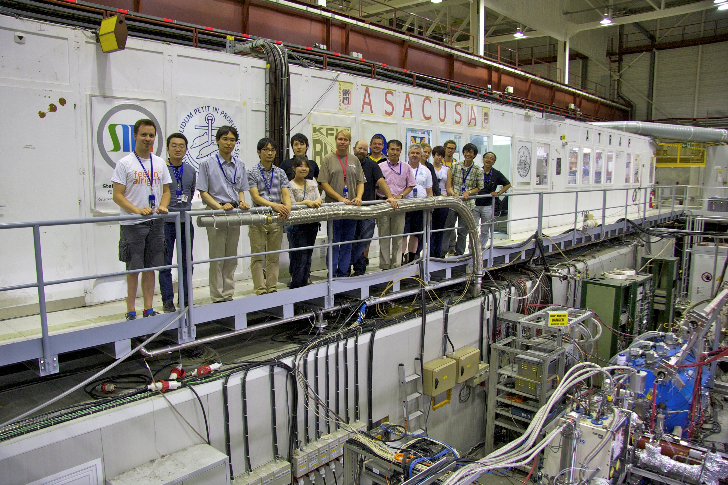
Cusp trap collaborators
Y. Enomoto, N. Kuroda, H. Higaki, K. Michishio, S. Ulmer, H. Imao, Y. Nagata, Y. Kanai, H.A.Torii, Y.Matsuda, A. Mohri, Y.Nagashima, K. Fujii, M. Ohtsuda, S. Takaki, S. Sakurai, Y. Yamazaki
Brescia group: V. Mascagna, N. Zurlo, M. Keali, L. Venturelli, E.Lodi-Rizzini,
SMI group: B. Juhasz, S. Federmann, O. Massiczek, F. Caspers, E. Widmann

Slide 47
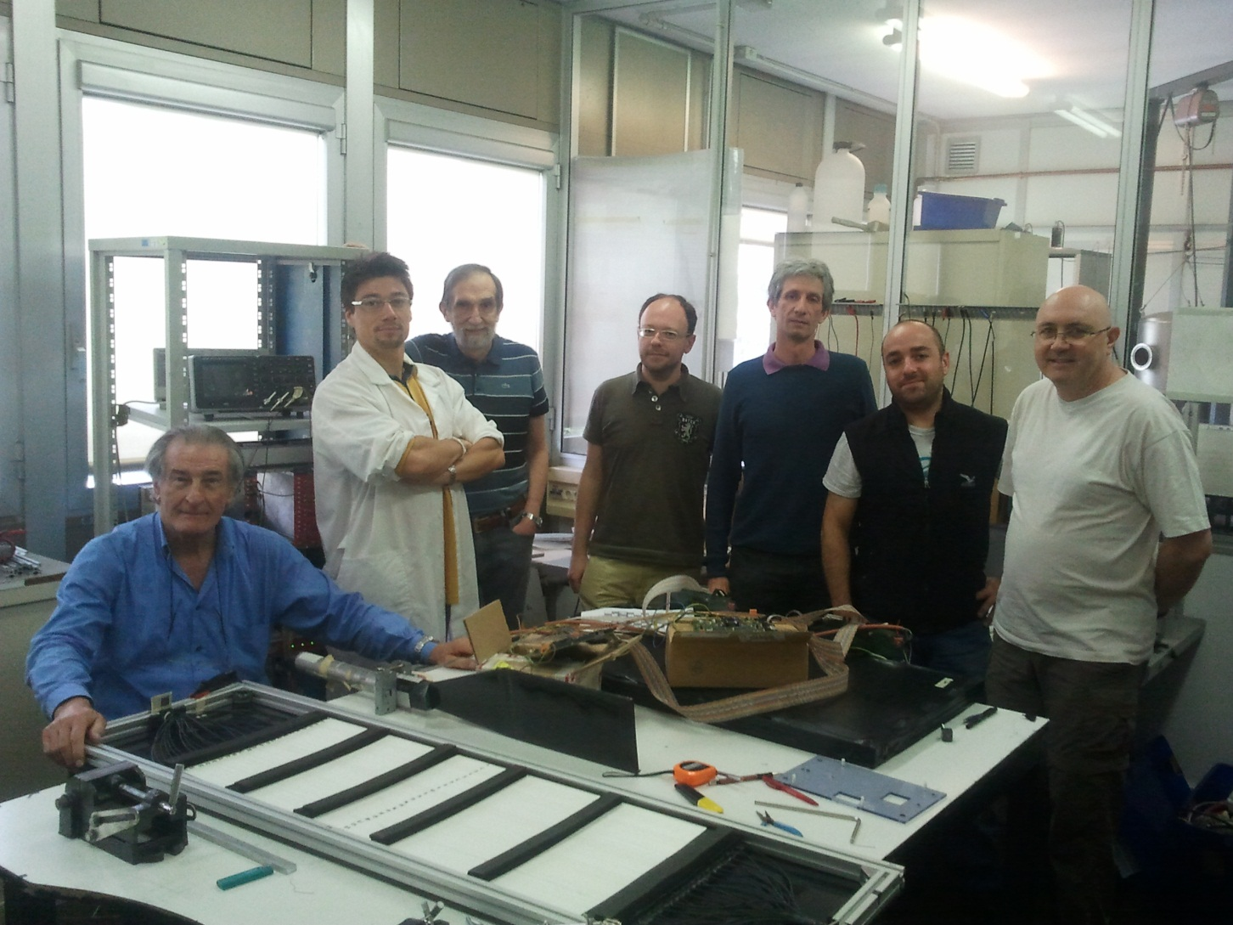
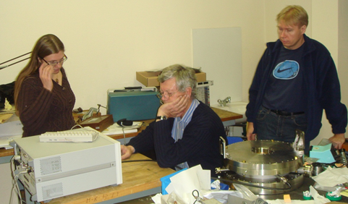
Cusp trap collaborators
Y. Enomoto, N. Kuroda, H. Higaki, K. Michishio, S. Ulmer, H. Imao, Y. Nagata, Y. Kanai, H.A.Torii, Y.Matsuda, A. Mohri, Y.Nagashima, K. Fujii, M. Ohtsuda, S. Takaki, S. Sakurai, Y. Yamazaki
Brescia group: V. Mascagna, N. Zurlo, M. Keali, L. Venturelli, E.Lodi-Rizzini,
SMI group: B. Juhasz, S. Federmann, O. Massiczek, F. Caspers, E. Widmann

Slide 48
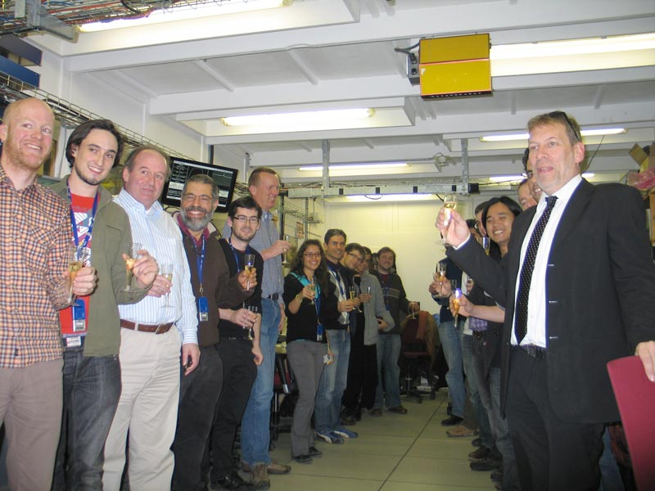
ALPHA collaborators
G. B. Andresen, M. D. Ashkezari, M. Baquero-Ruiz, W. Bertsche, P. D. Bowe, E. Butler, C. L. Cesar, S. Chapman, M. Charlton, A. Deller, S. Eriksson, J. Fajans, T. Friesen, M. C. Fujiwara, D. R. Gill, A. Gutierrez, J. S. Hangst, W. N. Hardy, M. E. Hayden, A. J. Humphries, R. Hydomako, M. J. Jenkins, S. Jonsell, L. V. Jorgensen, L. Kurchaninov,
N. Madsen, S. Menary, P. Nolan, K. Olchanski, A. Olin, A. Povilus, P. Pusa, F. Robicheaux, E. Sarid, S. Seif el Nasr, D. M. Silveira, C. So, J.W. Storey, R. I. Thompson, D. P. van der Werf, J. S. Wurtele, Y. Yamazaki

Slide 49
