Slide 1
TTC WG-2 focusing on
Nb Material
- Properties and Specifications -
Claire Antoine, Sam Posen, and Akira Yamamoto
TTC (at RIKEN, 26-29 June, ‘18), WG2 Co-Conveners
Original: 2018-5-26
2018-6-08
Updated: 2018-6-13

Slide 2
WG-2 is motivated to discuss:
How to improve the present requirement/specification for bulk Nb?
Bulk Nb is, at present, the most common material for superconducting RF cavities in accelerator applications.
Nb specifications are well established and successfully used for different projects.
Recent experience, however, has compelled us to re-evaluate the Nb material specification, in view of advances of technologies and cost-effective fabrication for wider applications in future.
The scope of WG-2 is to review the existing Nb specifications and discuss the improvement, variations/changes, and tradeoffs, depending on applications.
The cost effect of any change to be well understood, in the context of the delivered SRF systems (i.e. functioning cryomodules in accelerators)

Slide 3
A Reference: Specification for Nb Sheet
Courtesy: H. Weise & W. Singer
50?
To be discussed :
RRR : smaller than 300 ?
Grain size: FG(~ 50 um ) or LG, depending on applications?
Mechanical: 50 N < Rp0.2 ? Others?
Impurities: Ta : larger than 500 ?. Others ?
Further items ?

Slide 4
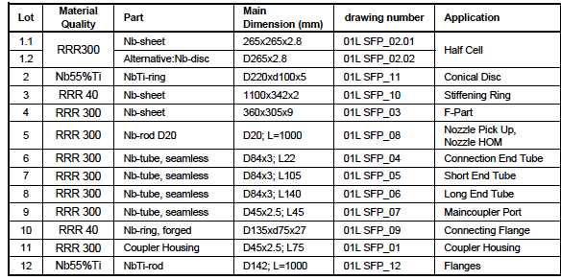
A reference: List of Semi-finished Nb Products for the European XFEL Cavity Fabrication
Courtesy: H. Weise and W. Singer

Slide 5
WG2 Discussions to be focused:
Fundamentals:
BCS resistance (low)
Residual resistance including trapped flux sensitivity (low)
Peak field (high)
Thermal conductivity at low temperature including the phonon peak (high)
Mechanical property (high in view of HP safety but to be compromised/optimized)
  for adapting mechanical fabrication methods (deep drawing, hydroforming, extrusion)
  during operation with respect to Lorentz force detuning, micro-phonics and safety in view of pressure vessel code, including cavity wall thickness, stiffening ring etc.
Surface finish (flat enough)
  with electro polishing or buffered chemical polishing.
Re-Optimizations to be discussed:
Large-grain (LG) or Fine-Grain (FG)?
RRR: can be lower than 300 or not (saying ~250 or lower)?
  Based on the value used in various project and on the performance results.

Slide 6
Communication with Nb Producers/Venders
Niobium specifications are well established and successfully used for various projects. But recent experiences have compelled us to re-evaluate the Niobium material specification in view of:
  Technology advances such as Nitrogen Doping/Infusion treatment where performance in terms of High-Q and/or High-Gradient is pushing the limits of the material, and
  Cost-effective SRF cavities to be provided for much wider applications expected in future.
The SRF community aims to provide information to refine the specifications for future projects, and to discuss them with Nb producers to make sure that any new specifications are taken into account, from the perspective of the producers.
It should be very important for both Nb producers and users to get together, discuss, and improve the Nb material specification for the future.

Slide 7
Advice expected from Nb Producers/Venders
Any general advices on specifications and/or any specific items causing difficulties?
Would there be cost-saving for:
  Accepting higher impurity content in the specifications (e.g. loosen tantalum allowance) or for accepting lower RRR?
  Cutting-out Large Grain disks/sheets from the Nb ingot vs Producing fine grain sheets after forging/rolling/polishing? What is the maximum diameter available?
What is the maximum recrystallized fraction possible and how measured/ensured? Would it be helpful to relax any other specifications, to help maximize recrystallized fraction? e.g. grain size? Hardness? Impurity content? Annealing temperature?
What is the temperature uniformity of sheets in the furnace during heat treatment after rolling in case of Fine Grain sheets (from a view point of QA/QC)?
Would it be possible to determine the damage-layer thickness of completed rolled sheets or sliced disks? If yes, What is the reproducibility of damage-layer thickness, and
Any other advices?

Slide 8
June 26, Session 1: Fundamentals
Chaired by S. Posen
# | Time | Preliminary title | Presenter
1-0 | 11:00–11:05 | Introduction | Conveners, presented by S. Posen
1-1 | 11:05-11:15 (6+4) | Performance in LCLS-II Cryomodules at Fermilab | S. Posen (FNAL)
1-2 | 11:15-11:35 (12+8) | Doping Results as a Function of Different Material for LCLS-II | D. Gonnella (SLAC)
1-3 | 11:35-11:55 (12+8) | Microscopic Investigation of Flux Expulsion in Production Grade Niobium | M. Martinello (FNAL)
1-4 | 11:55-12:10 (8+7) | Microstructural studies of Flux Expulsion and Entry in LCLS-II Material | S. Balachandran (NMFL), presented by P. Dhakal
1-5 | 12:10-12:30 | Discussion, including a short report: “First trial of temperature dependent EBSD measurement” | ALL T. Konomi (KEK)
Note: Speakers advised to minimize their presentations for more discussions (Q&As) to be encouraged.

Slide 9
June 26, Session 2: Fundamentals and LG/FG
Chaired by A. Yamamoto
# | Time | Preliminary title | Presenter
2-1 | 14:00-14:20 (12+8) | The importance of recrystallization | C. Antoine (CEA)
2-2 | 14:20-14:40 (12+8) | LG- and FG-Niobium SRF Cavity Fabrication and Test Results at KEK | T. Dohmae (KEK)
2-3 | 14:40-15:55 (8+7) | Ingot Niobium for Efficient and Potentially Low Cost SRF Cavities | P. Dhakal (JLab)
2-4 | 15:55-15:10 (8+7) | Experience with LG Niobium SRF Cavities | K. Saito (FRIB)
2-5 | 15:10-15:30 | Discussion, and preparation for Vender’s session | All, and A. Yamamoto
Note: Speakers advised to minimize their presentations for more discussions (Q&As) to be encouraged.

Slide 10
June 26, Session 3: Advices from Venders
Chaired by A. Yamamoto
# | Time | Preliminary title | Presenter
3-1 | 16:00-16:10 (10) | Report from Tokyo-Denkai | H. Umezawa
3-2 | 16:10-16:20 (10) | Report from ATI | P. O'larey
3-3 | 16:20-16:30 (10) | Response from OTIC | H. Zhao
3-4 | 16:30-16:40 (10) | Report from HERAEUS | B. Spaniol, presented by A. Yamamoto
3-5 | 16:40-16:50 (10) | Report from ULVAC | N. Abe
3-6 | 16:50-17:00 (10) | Report from CBMM | G. Abdo
3-7 | 17:00-17:30 | Panel Discussion to reach consensus for specification improvements | All
Note: Speakers advised to minimize their presentations for more discussions (Q&As) to be encouraged.

Slide 11
June 27, Session 4: LG and RRR, Discussion
Chaired by C. Antoine
# | Time | Preliminary title | Presenter
4-1 | 11:00-11:20 (12+8) | LG Cavity Experience at DESY | J. Sekutowicz (DESY)
4-2 | 11:20-11:35 (8+7) | Experimental Study of Flux Expulsion and Cold Work | S. Posen (Fermilab)
4-3 | 11:35-11:45 (6+4) | Eddy Current Scanning of Large Niobium Sheets | F. Schandler (ESS)
4-4 | 11:45-12:00 (8+7) | Effect of high Tantalum for cost-effective SRF Cavities | G. Myneni (ISOHIM)
4-5 | 12:00-12:10 (6+4) | Niobium RRR Dependence on SRF Cavity Performance | T. Kubo (KEK), presented by A. Yamamoto
4-6 | 12:10-12:30 | Discussion: How we may improve Nb specification? | All
Note: Speakers advised to minimize their presentations for more discussions (Q&As) to be encouraged.

Slide 12
Reference/Appendix

Slide 13
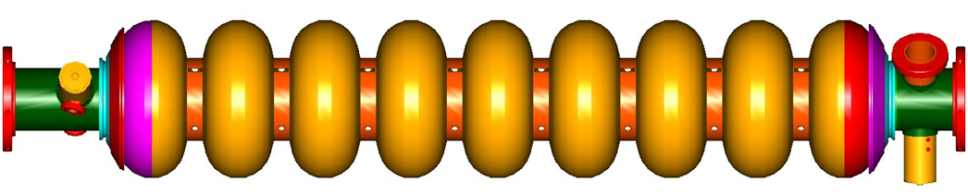
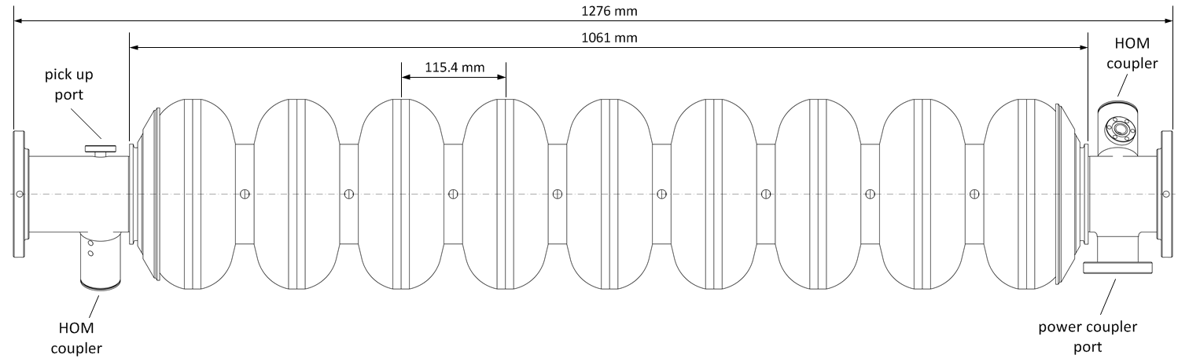
A Cavity Configuration

Slide 14
Cavity Fabrication (TESLA)
Coutessy: H. Weise, W. Singer
12 EBW place
Short End group
End cell : short side
HOM1
input port
beam pipe
Dumbbell x8
× ８
center cell x8
Long End group
beam pipe
pickup port
HOM2
End cell : long side
56 parts: Nb = 46, Nb-Ti = 10, by using press, de-burring, and machining

Slide 15
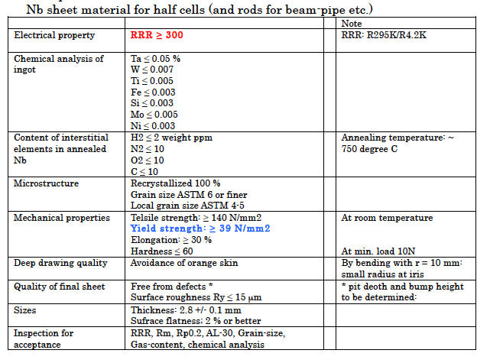
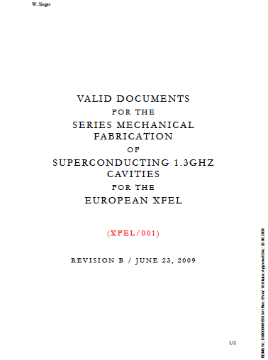
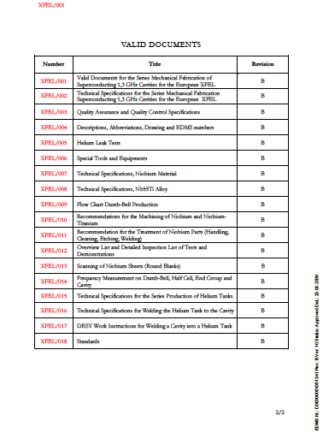
A Reference: European –XFEL Nb Specification
Courtesy: H. Weise & W. Singer
To be discussed:
< 300 ?
T > 0.05 ?
What relaxed more?
Optimum?
Max. recrystalisation ?
ASTM: lowered (5)?
LG allowed?
YS > (TBD) N/mm²?
(in view of HP safety)
Square or round?
Update/change ?
50?

