Slide 1

Advanced in Radioactive Isotope Science 2014 (ARIS2014)
Tokyo, Japan, June 1st-6th, 2014
Performance of the Fragment Separator BigRIPS
and
Perspectives on In-flight RI Beam Production
Naoki Fukuda, D. Kameda, H. Takeda, H. Suzuki,
D. S. Ahn, Y. Shimizu, N. Inabe, T. Kubo
RIKEN Nishina Center
Outline
In-flight RI beam production at BigRIPS at RIKEN RIBF
Search for new isotopes
RI beams produced at BigRIPS
Search for new isomers
Perspectives on in-flight RI beam production
Summary
Notes:
Thank you the chairman for the introduction.
First of all, I would like to thank the organizers for inviting me to this conference.
Today I would like to talk about
“Performance of the Fragment Separator BigRIPS and Perspectives on In-flight RI Beam Production”.
This work has been done with the people listed here.
The outline of my talk is shown here.
First I will present in-flight RI beam production at the BigRIPS separator at RIKEN RI Beam Factory,
Then, I will talk about search for new isotopes to demonstrate the capability of the BigRIPS.
Then, I will talk about RI beams produced at BigRIPS, search for new isomers.
In closing, I will briefly mention perspectives on in-flight RI beam production,
Finally, I will summarize my talk.

Slide 2
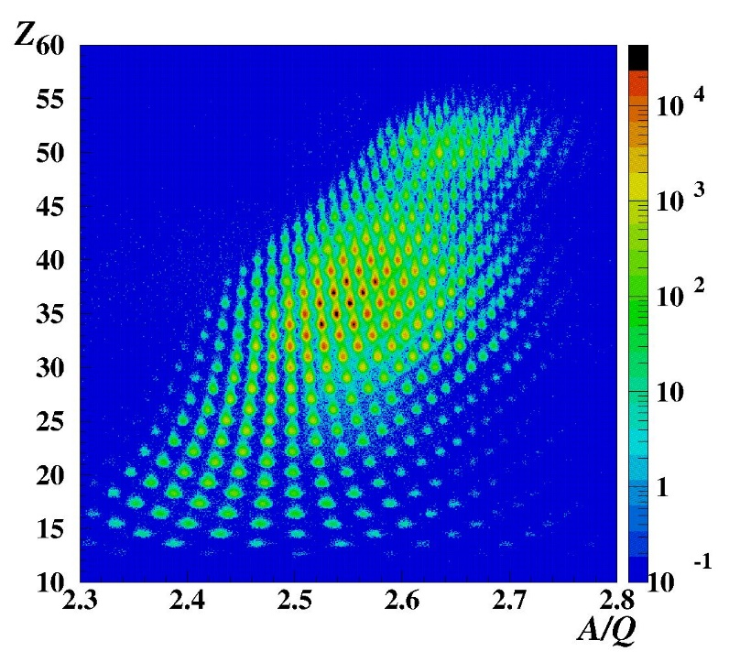
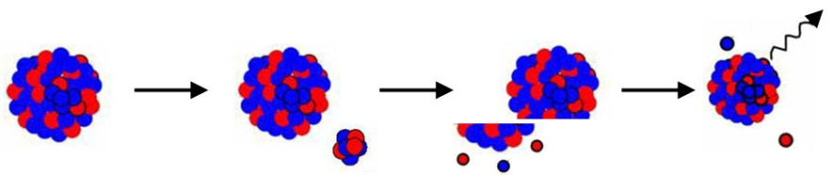
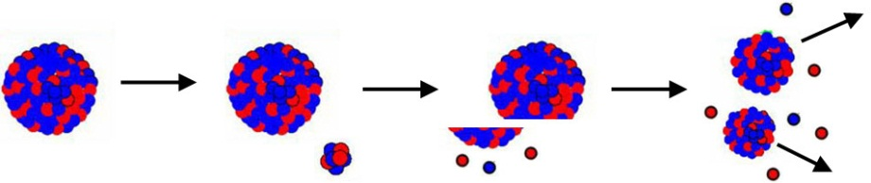
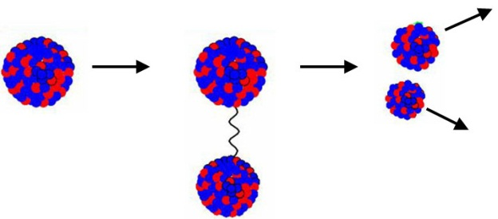
Production reactions at BigRIPS
Projectile fragmentation
(Any isotopes lighter than projectile can be produced)
²³⁸U(345 MeV/u) + Be 7 mm
abrasion
ablation
Bρ = 7.249 Tm
Δp/p = ±1 %
¹⁰⁰Sn
e.g.
¹²⁴Xe
⁹Be
hot participant zone
In-flight fission of ²³⁸U beam
(Very powerful for medium-heavy neutron-rich isotopes)
Abrasion fission
fission
Coulomb fission
¹³²Sn
abrasion
COULEX
fission
²³⁸U
²³⁸U
⁹Be
⁷⁸Ni
Pb
Figures are base on those from GSI.
Notes:
Here I show two kinds of reaction mechanisms used for in-flight RI beam production, projectile fragmentation and in-flight fission.
These figures shown here illustrate their mechanism schematically.
The projectile fragmentation can produce any isotopes lighter than the projectile.
In-flight fission of U beam is very powerful reaction to produce a wide-range of neutron-rich nuclei.
This figure shows a particle identification plot for fission fragments produced by in-flight fission of U beam.
A variety of neutron-rich isotopes are produced in a wide range as shown here.
----- 会議メモ (2014/06/05 17:04) -----
In-flight fission はこう。
BigRIPS はこの反応を最大限に活かすように設計されている。
----- 会議メモ (2014/06/05 18:38) -----
uran no koto wo kinisite BigRIPS ha sekkei sarete iru

Slide 3
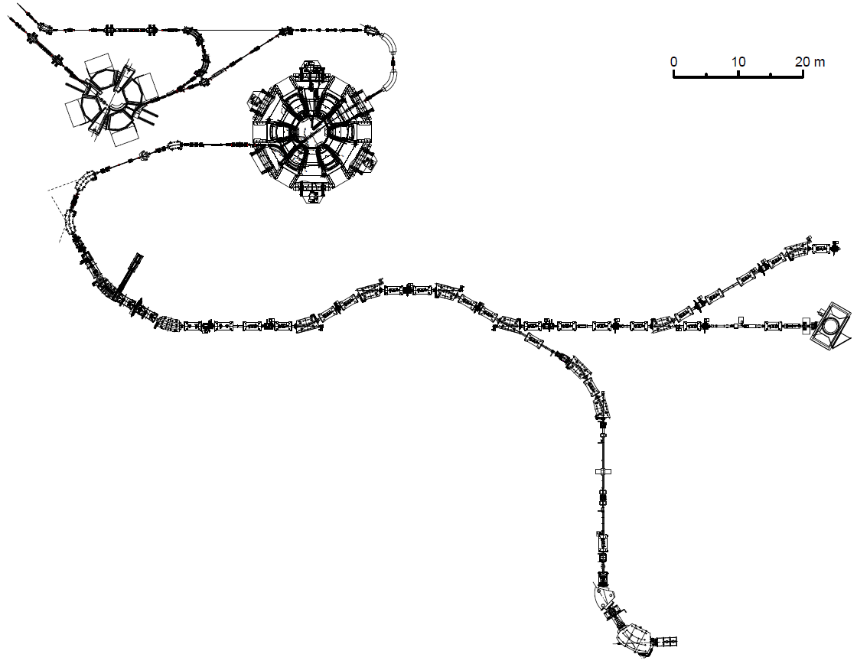
Layout of RIKEN RI Beam Factory (RIBF)
IRC
SRC
Max. rigidity
= 8 Tm max.
ZeroDegree
BigRIPS
Max. rigidity = 9 Tm
RI beams
RI beams
SAMURAI
Maximum energy is ~350 MeV/u
for heavy ions up to U ions.
Goal beam intensity is 1 pμA
(6 x 10¹² particles/sec).
Max. field integral
= 6.8 Tm max.
High-resolution beam line
Max. beam power ~100 kW
SHARAQ
by CNS
Max. rigidity
= 6.8 Tm max.
Notes:
This slide is to remind you of the layout of RIKEN RI Beam Factory, R-I-B-F.
What you see here is the IRC and SRC cyclotron.
The maximum energy is 350 MeV/u for heavy ions up to Uranium.
The goal beam intensity is 1 puA, which corresponds to the beam power of about 100 kW.
RI beams are produced at the BIgRIPS separator here,
Which is followed by the major experimental devices,
The ZeroDegree, SAMURAI, and SHARAQ spectrometers.
----- 会議メモ (2014/06/05 18:38) -----
BigRIPS

Slide 4
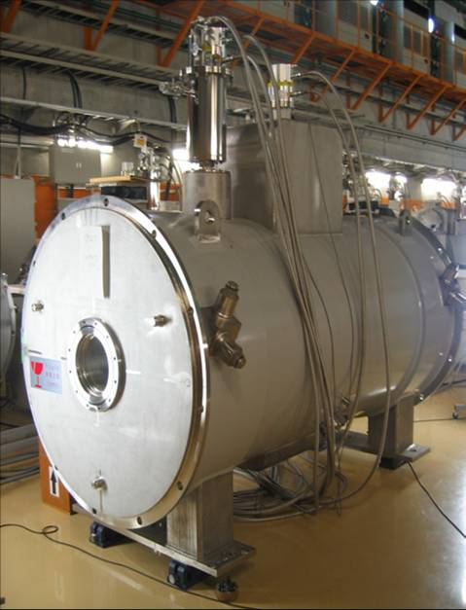
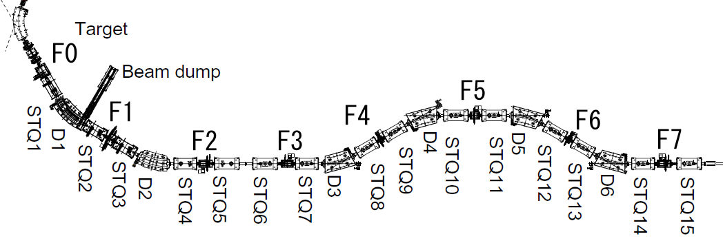
Major features of the BigRIPS separator
Large acceptances
  Comparable with spreads of in-flight fission at RIBF energies: ±50 mr, ±5%
Superconducting quadrupoles having a large aperture
  Pole-tip radius = 17 cm, pole tip field = 2.4—2.5 T
Two-stage separator scheme
2nd stage with high resolution
  Particle identification without measuring TKE ← charge states
Parameters:
Δθ = ±40 mr
Δφ = ±50 mr
Δp/p = ±3 %
Bρ = 9 Tm
L = 78.2 m
From SRC
STQ
Two-stage separator
Superferric Q
Wedge
Wedge
STQ1—14:
Superconducting
Q triplets
D1—D6:
Dipoles (30 deg.)
F1—F7: Focuses
1st stage
2nd stage
Production & separation
Particle identification & two-stage separation
Notes:
Here I will introduce the major features of the BigRIPS separator.
The BigRIPS is designed to have large acceptances which are comparable with the spreads of in-flight fission at R-I-B-F energies,
allowing efficient collection of fission fragments.
The large acceptances have been achieved by the use of superconducting quadrupoles with large apertures.
The second important feature is a two-stage separator scheme, in which the first stage is used to produce and separate RI beams,
while particle identification and two-stage separation are made in the second stage.
The second stage is designed to have high resolution, so that we can make particle identification
without measuring total kinetic energy in most cases.
At R-I-B-F energies, we have mixture of charge states, so this feature is very important.

Slide 5
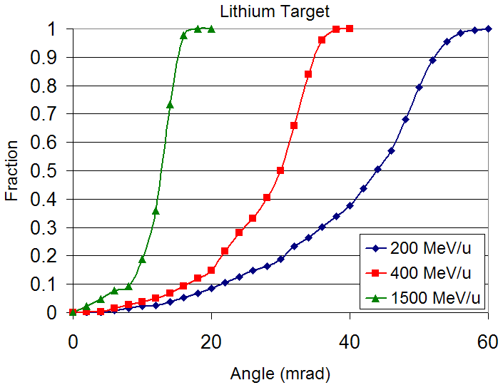
Reaction kinematics and collection efficiency of fission fragment
In-flight fission of U beam
Large acceptance needed!
345 MeV/u
Large spread
~100 mr ~10 %
BigRIPS:
Δθ = 80 mr
Δφ = 100 mr
Δp/p = 6 %
Projectile fragmentation
Much larger!
Small spread
~10 mr ~1 %
Fraction of ¹³²Sn contained in a cone of the respective angle
¹³²Sn
J. Nolen & H. Geissel
Notes:
This slide shows the reaction kinematics and collection efficiency for the in-flight fission of U beam.
This figure illustrates the angular and momentum spreads of fission fragments in the in-flight fission of U beam at 345 MeV/u.
We see a large angular spread of about 100 mrad and a large momentum spread of about 10%,
which are much larger compared to those in the projectile fragmentation.
In order to cover such large spreads, the BigRIPS separator has been designed to have large ion-optical acceptances shown here.

Slide 6
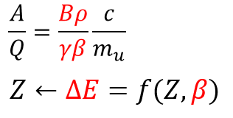
Particle identification scheme at BigRIPS
TOF-Bρ-ΔE method with track reconstruction → Improve Bρ and TOF resolution
TOF-Bρ-ΔE method
TOF: Time of flight
Bρ: Magnetic rigidity
ΔE: Energy loss
Bethe-Bloch formula
ΔE: MUSIC, Si Isomer γ-ray: Ge
Bρ with track reconstruction
Bρ₃₅
PPAC x2
Bρ₅₇
Wedge
Wedge
PPAC x2
PPAC x2
1st stage
2nd stage
L = 46.6 m
TOF: β
Plastic scinti.
Notes:
This slide shows the particle identification scheme and the beam line detectors at BigRIPS.
The particle identification is based on the TOF-Brho-DE method with track reconstruction,
to deduce the atomic number Z, and the mass-to-charge ratio, A/Q.
TOF is measured between two thin plastic scintillation counters placed at the achromatic foci, the F3 and F7.
The delta-E measurement is made at the F7 by using a MUSIC or a stack of Si detectors.
The Brho measurement is made by trajectory reconstruction from the positions and angles of fragments measured at the F3, F5, and F7
by using PPAC detectors.
The particle identification is calibrated by detecting isomeric gamma-rays of some fragments by using germanium detectors at F7.

Slide 7
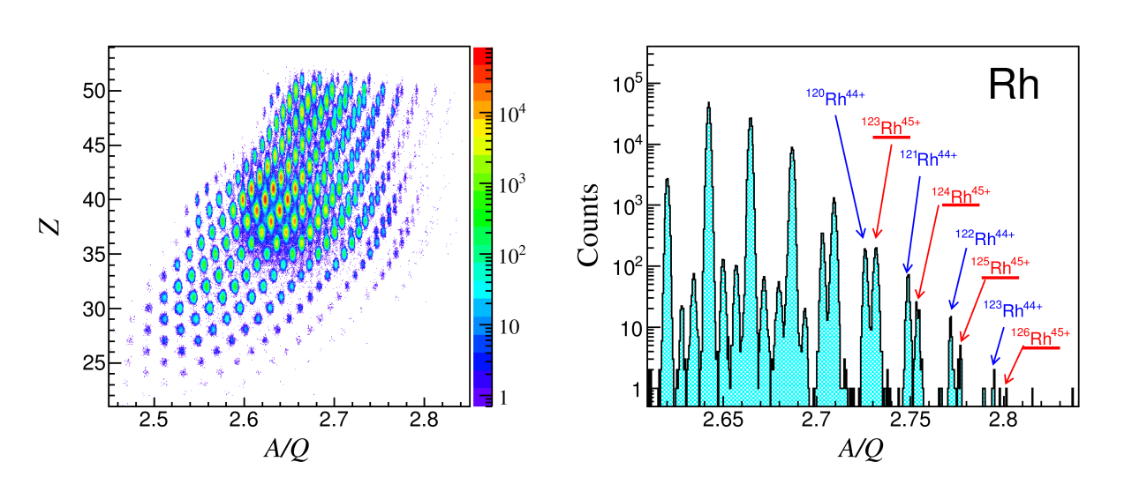
Particle identification (PID) resolving power
TOF-Br-ΔE method with trajectory reconstruction
A/Q resolution: High enough to identify charge states of fragments
Z vs. A/Q plot
A/Q spectrum for Rh isotopes (Z=45)
²³⁸U(345 MeV/u) + Be 2.9 mm
Bρ 01 = 7.990 Tm, F1 deg Al 2.18mm
r.m.s. A/Q resolution: 0.034 %
6.1σ separation
G2 setting in J. Phys. Soc. Jpn. 79 (2010) 073201.
PID at BigRIPS → N. Fukuda et al., Nucl. Instr. Meth. B 317 (2013) 323.
Notes:
In addition to the large acceptance, another important feature is the high resolving power in the particle identification.
This slide is to demonstrate excellent particle identification for fission fragments.
Particle identification is made by the atomic number Z and mass-to-charge ratio A/Q, based on the TOF-Br-deltaE method.
This is the Z vs A/Q plot and this is the one-dimensional A/Q spectrum for Rh isotopes.
The red and blue arrows indicate the fully-stripped and hydrogen-like ions, respectively,
and they are very close to each other with the relative A/Q difference of about 0.2%.
The achieved A/Q resolution is as good as 0.034%, which allows clear identification of the fully-stripped peak and the hydrogen-like peak as show here.
Next, I will show some details of particle identification.
----- 会議メモ (2014/06/05 18:52) -----
A/Q resolution is high ... wo ireru.

Slide 8
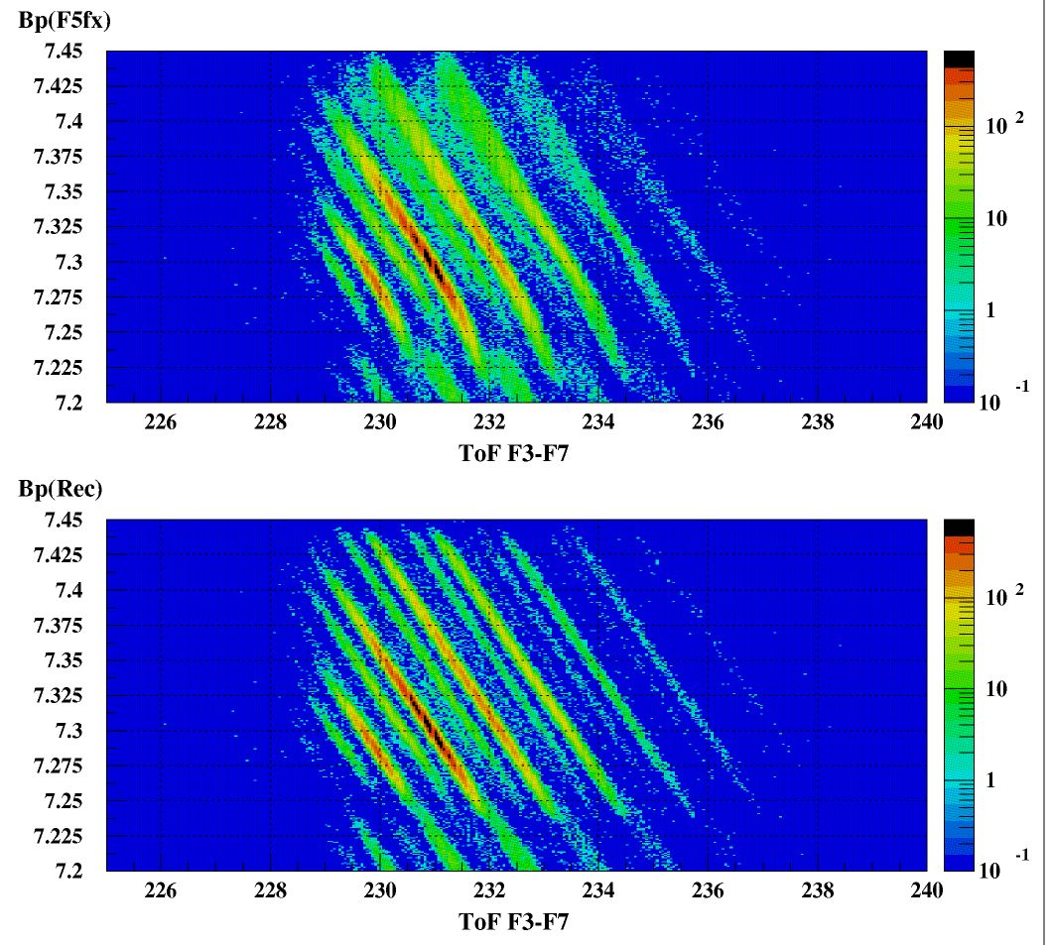
Trajectory reconstruction for Bρ detemination
by using the position and angle measured at the focuses (such as F5x, F5a, F3x) and the experimentally determined transfer matrices as follows:
F5x = (x|x)F3x + (x|a)F3a + (x|δ)δ
Measured F5x, F5a, F3x
→ deduce δ, F3a
F5a = (a|x)F3x + (a|a)F3a + (a|δ)δ
Bρ=Bρ₀(1+ δ)
Z=40 (Zr) isotopes
Without trajectory reconstruction
Bρ(F5X)
(from the position at dispersive focus)
For Z=40 isotopes produced by in-flight fission of a ²³⁸U beam at 345 MeV/u
With trajectory reconstruction
Bρ(Rec.)
TOF37

Slide 9
New isotope search at BigRIPS (2007—2014)
2007 (²³⁸U beam)
  ²³⁸U beam current 0.007 pnA
  ¹²⁵Pd, ¹²⁶Pd were observed for one day.
T. Ohnishi et al., J. Phys. Soc. Jpn. 77 (2008) 083201.
²³⁸U beam
10
6
12.6
2008 (²³⁸U beam)
  ²³⁸U beam current 0.22 pnA
  3 settings for Z ~ 30, 40, 50 region
  45 new isotopes
T. Ohnishi et al., J. Phys. Soc. Jpn. 79 (2010) 073201.
18
0.22
0.3
8
Number of new isotopes
18
Beam current (pnA)
73
0.007
pnA
26
2011 (²³⁸U and ¹²⁴Xe beam)
  ²³⁸U beam current 0.3 pnA
  2 settings for Z ~ 60—70 region
  26 new isotopes
  ¹²⁴Xe beam current 9 pnA
  ⁸⁵Ru, ⁸⁶Ru, ⁸⁰Mo, ⁸¹Mo were observed.
45
2
D. Kameda et al., to be published.
Year
H. Suzuki, et al., NIMB 317, 756-768 (2013)
2012/2013 (²³⁸U beam EURICA campaign)
  ²³⁸U beam current 6–10 pnA
  Total rates were limited at ~100 pps due to EURICA operation
  26 new isotopes
Y. Shimizu et al., to be submitted.
2014 (²³⁸U beam)
  ²³⁸U beam current 12.6 pnA
  2 settings for Z ~ 60—70 region
  18 new isotopes (Preliminary)
121 new isotopes (Preliminary)
Notes:
The large acceptance and high PID power of the BigRIPS are maximally used in the new isotope search experiment.
Here I show the history of the new isotope search performed at the BigRIPS.
The first experiment was conducted in 2007 by using a Uranium beam.
We could identify two new isotopes 125Pd and 126Pd,
Althogh the beam intensity was as low as 0.007 pnA and the running time was only one day.
This just demonstrated the performance of the BigRIPS.
After that we conducted the experiments with increasing the beam intensity, as listed here.
In 2011, we performed the experiment with a 124Xe beam for the first time.
----- 会議メモ (2014/06/05 17:59) -----
demonstrate

Slide 10
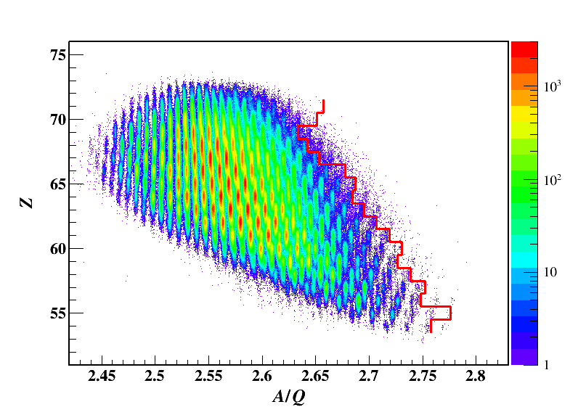
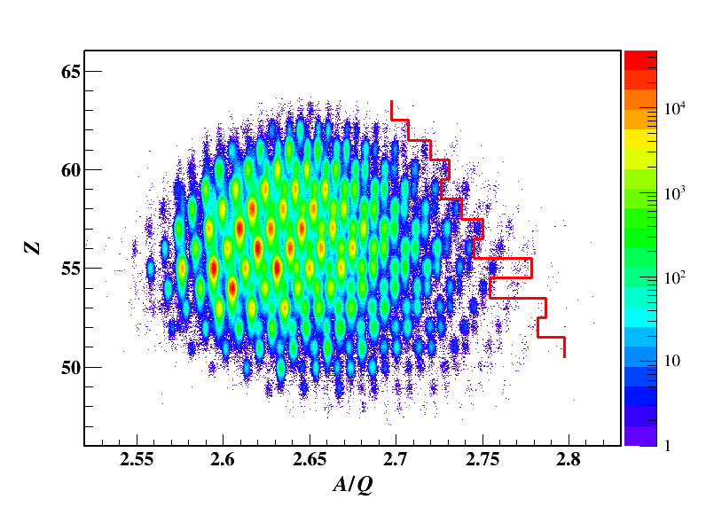
New isotope search 2014 April
Z ~ 68 region
Known frontier
²³⁸U + Be at 345 MeV/u
Setting | Z ~ 68 region | Z ~ 59 region
Tuned for | ¹⁸¹Er^{67+→68+} | ¹⁵⁹Pr⁵⁹⁺
²³⁸U | 3.39 pnA | 12.6 pnA
Run time | 1.8 days | 2.3 days
Target | Be 6.9 mm | Be 4 mm
Bρ | 6.311 Tm | 7.527 Tm
Δp/p | +2/-1.5% | +3/-3%
F1 degrader | Al 0.98 mm | Al 1.4 mm
F5 degrader | Al 0.96 mm | Al 1.4 mm
Preliminary
Z ~ 59 region
Known frontier
18 new isotopes
(Preliminary)
Notes:
This slide shows the preliminary result of the most recent new isotope search performed in this April.
We targeted two regions around Z= 68 and 59.
The beam intensity was 12.6 pnA on average.
And 18 new isotopes have been observed for about 5 days.

Slide 11
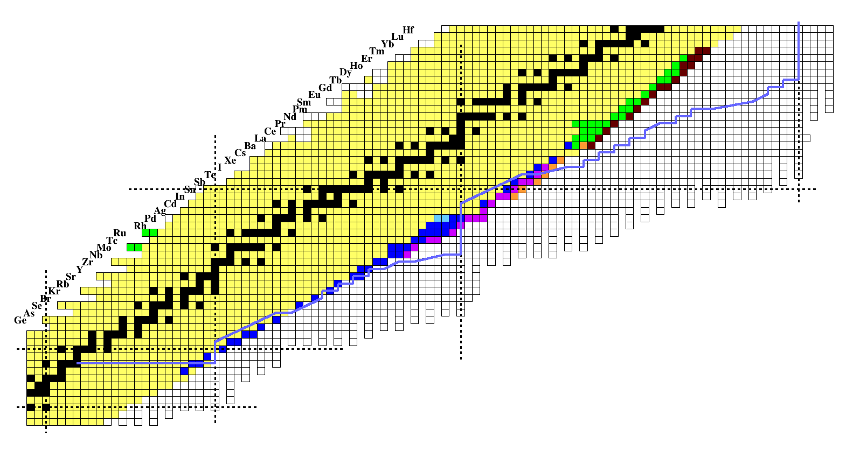
New isotopes observed at BigRIPS
²³⁸U
To expand the accecible region of exotic nuclei far from stability
Projectile fragmentation of ¹²⁴Xe beam
2012 (4) ¹²⁴Xe: 9 pnA
¹²⁴Xe
r-process path
Z
50
126
¹²⁸Pd
¹²⁷Rh
In-flight fission of ²³⁸U beam
2014 (18) ²³⁸U: 12.6 pnA
28
2013 (8) ²³⁸U: 6 pnA
82
2012 (18) ²³⁸U: 10 pnA
2011 (26) ²³⁸U: 0.3 pnA
20
2008 (45) ²³⁸U: 0.22 pnA
50
2007 (2) ²³⁸U: 0.007 pnA
28
N
Notes:
This slide summarizes the new isotopes observed at the BigRIPS on the nuclear chart.
For the waiting nuclei of N = 82 in the r-process, we have reached 127Rh at lowest Z.
For Sn isotope, the most neutron-rich one is 140.
As of now we have found 121 new isotopes at the BigRIPS.
----- 会議メモ (2014/06/05 17:59) -----
in the nuclear chart.
N = 82 に到達したのは、128Pd, 127Rh
Pd に関しては more neutron rich まで届いている。

Slide 12
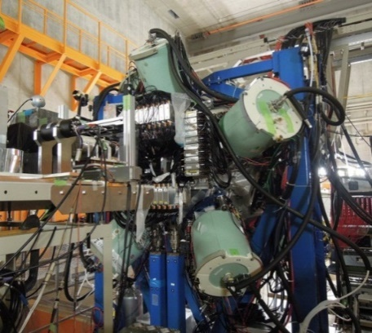
RI beams produced at BigRIPS (2007—2014)
²³⁸U
308 RI-beams have been produced for ~80 experimental programs.
RI beams produced (308)
70
new isotopes (121)
¹⁰⁰Sn 4 x 10⁻³ pps at 35 pnA
EURICA(M. Lewitowicz-Gr)
~2300 counts in total
60
¹²⁴Xe
50
Number of experiments
²³⁸U beam
EURICA campaign
β-and isomer-decay measurements
82
 | ²³⁸U | ¹²⁴Xe | ⁸⁶Kr | ⁷⁰Zn | ⁴⁸Ca | ¹⁸O | ¹⁴N | ⁴He | Yearly total
2007 | 4 |  | 1 |  |  |  |  |  | 5
2008 | 2 |  |  |  | 4 |  |  |  | 6
2009 | 3 |  |  |  | 3 |  | 3 | 1 | 10
2010 |  |  |  |  | 10 | 1 | 2 |  | 13
2011 | 4 | 2 |  |  |  | 2 |  |  | 8
2012 | 6 | 3 |  | 1 | 4 | 6 |  |  | 20
2013 | 4 | 2 |  |  |  | 3 |  |  | 9
2014 | 6 |  |  | 1 |  |  |  |  | 7
Total | 29 | 7 | 1 | 2 | 21 | 12 | 5 | 1 | 78
⁷⁰Zn
2012 Fall
Z
28
2013 Spring
⁴⁸Ca
50
¹²⁸Pd 2.0 x 10⁻³ pps at 10 pnA
“Robust shell closure at N = 82 in exotic Pd isotopes” EURICA(H. Watanabe-Gr)
PRL 111, 152501 (2013)
20
¹⁸O
N = 34
¹⁴N
28
8
⁷⁸Ni 2.3 x 10⁻² pps at 10 pnA
EURICA(S. Nishimura/M. Niikura-Gr)
7000—8000 ⁷⁸Ni for each exp.
20
8
N
EURICA Ge array
(EUROBALL RIKEN Cluster Array)
Notes:
We have provided 308 RI beams from 2007 till this spring.
This table summarizes the number of experimental programs performed at the BigRIPS,
Which amounts to 78 experiments.
I will highlight some RI beams as benchmark from the recent experiment.
The EURICA campaign was carried out with a Uranium beam for beta- and isomer-decay measurements.
Here, the 128Pd was provided at 2 x 10-3 pps at around 10 pnA.
The doubly magic nucleus 78Ni was at 2.3 x 10-2 pps.
In the neutron-deficient side, 100Sn was produced from the projectile fragmentation fo 124Xe
And delivered at 4 x 10-3 pps at around 35 pnA.
55Sc and 56Ti were produced from 70Zn at these rates.
----- 会議メモ (2014/06/05 17:59) -----
number of experiment for each beam and each year
U がメイン。

Slide 13
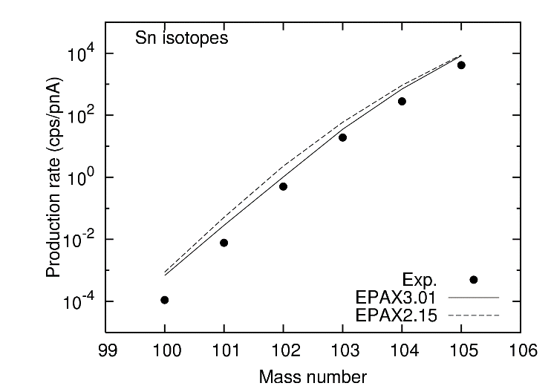
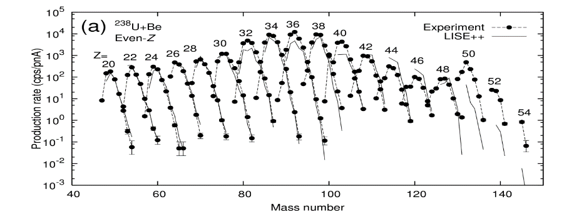
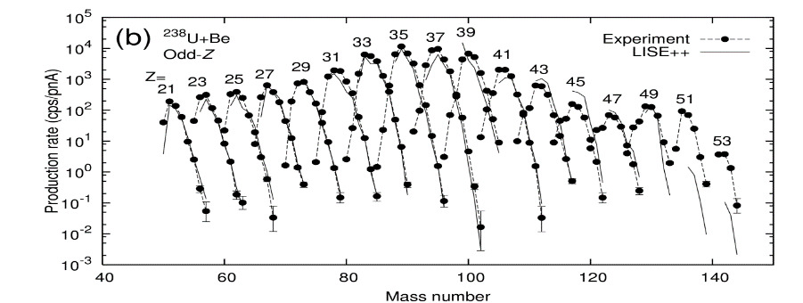
Production yields measurement
²³⁸U
Essential for designing RI beam experiments
¹²⁴Xe 345 MeV/u + Be 4 mm Δp/p = +/-2%
Sn isotopes
Production yield deduced (887)
New isotopes (121)
¹²⁴Xe
¹⁰⁰Sn
50
¹⁰⁰Sn: ~ 1/7 of EPAX 3.01
82
²³⁸U 345 MeV/u + Be 7 mm Δp/p = +/-1%
Z
⁷⁰Zn
28
⁴⁸Ca
50
20
Produced reactions
In-flight fission of ²³⁸U
Projectile fragmentation of
¹⁴N, ¹⁸O, ⁴⁸Ca, ⁷⁰Zn, ¹²⁴Xe
¹⁸O
¹⁴N
28
20
8
N
H. Suzuki, et al., NIMB 317, 756 (2013)
Notes:
We have also measured the production yields of RI beams in the beam production.
The number of isotopes amounts to 887 for these production reactions.
This plot is the production rates for neutron-deficient Sn isotopes produced from 124Xe.
The rate of 100Sn has been found to be lower than that expected by EPAX 3.
This plot is the production rates for fission fragments with Uranium beam,
Where we have obtained for a wide-range of isotopes.
----- 会議メモ (2014/06/05 17:59) -----
obtained for very wide range of isotopes

Slide 14
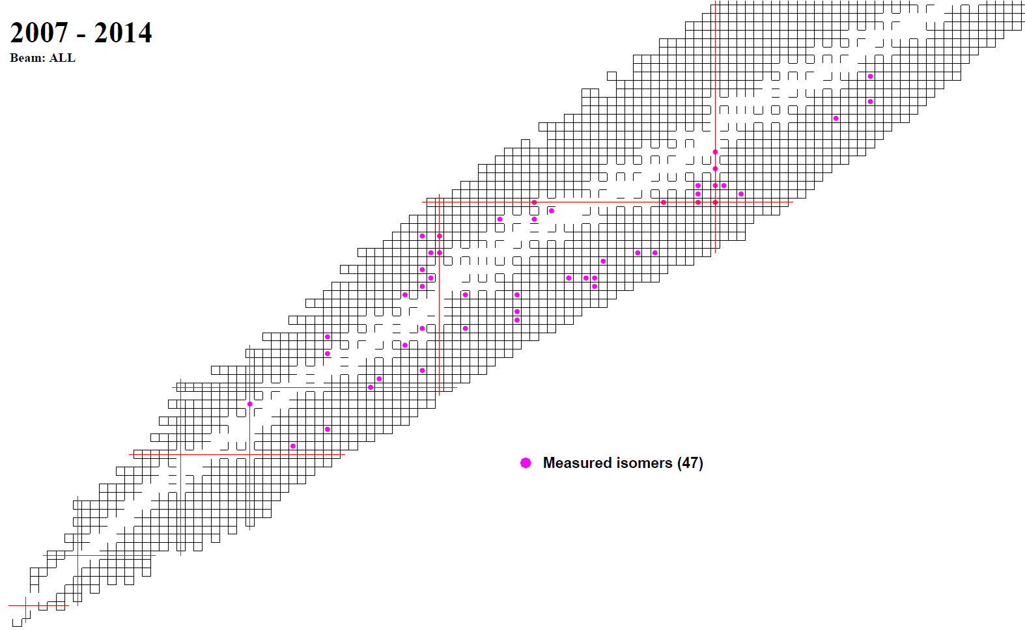
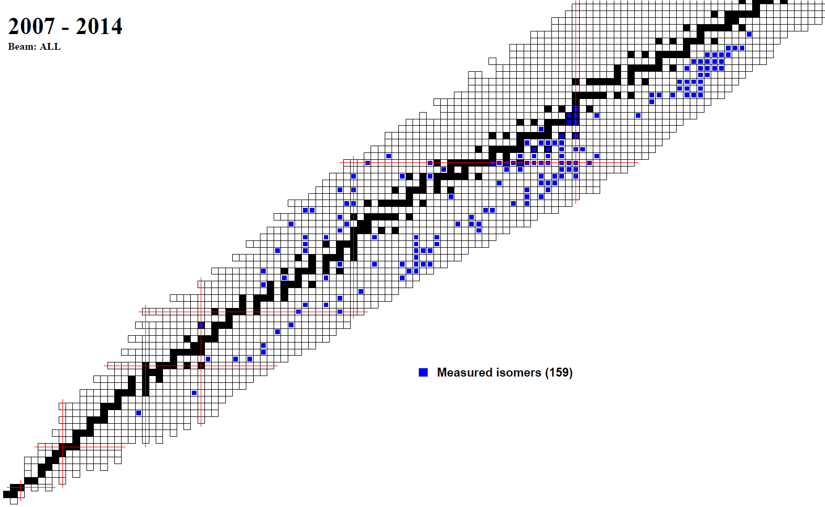
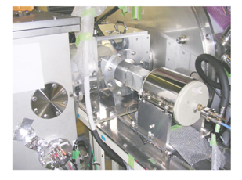
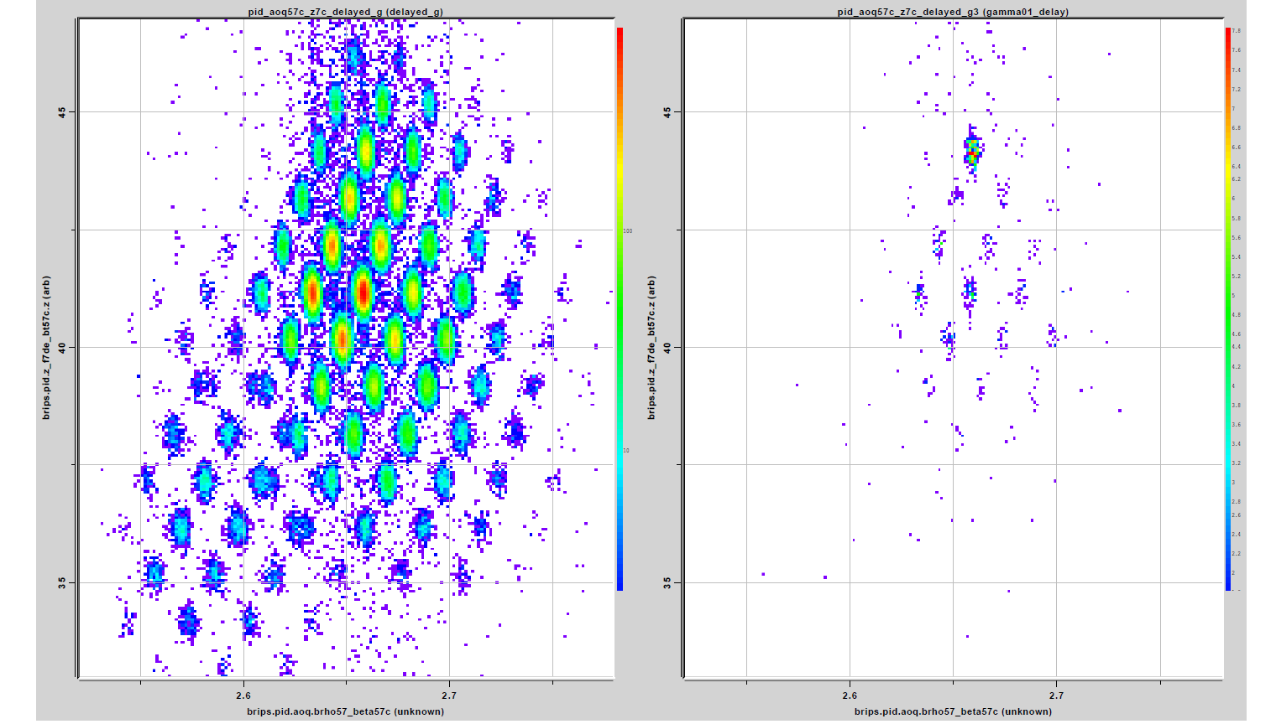
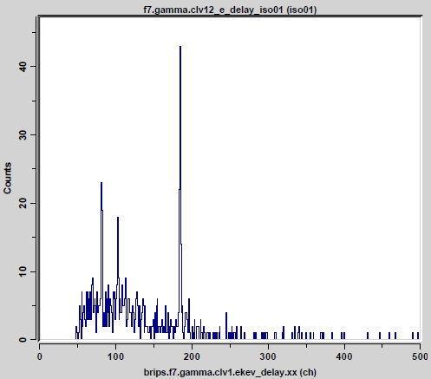

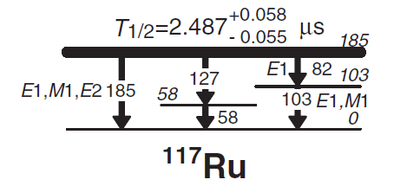
Isomers observed in the RI-beam production at RIBF
159 isomers observed with T_{1/2} = 0.1 – 100 us
47 isomers used for isomer tagging
Particle-γ slow correlation method
Time window: 30 us
Energy range: 50-4000 keV
Some of them are used
for isomer tagging
→ PID quickly established
Ge detectors
Al absorber
Al stopper
w/o delayed
γ –ray gate
BigRIPS F7
Only 1-hour run
Particle-gated delayed γ-ray spectrum
185
¹¹⁷Ru
83
103
w/ delayed
γ –ray gate
T_{w}: 0.5 – 10 us
E_{γ} : 180 – 189 keV
D. Kameda, et al., Phys. Rev. C 86, 054319 (2012).
Notes:
We have also measured the isomers in the RI beam production.
This slide shows microsecond isomers that we have observed in the new isotope search and the BigRIPS tuning.
Microsecond isomers are essential for our RI-beam production because they can be used for isomer tagging
to calibrate our particle identification in the medium-mass regions.
These figures show the example of the isomer tagging using the 117Ru microsecond isomer.
These are the PID plots without and with the delayed g-ray gate.
We observed the presence of isomeric state in this isotopes.
I would like to stress that this g-ray spectrum was obtained only for 1-hour during the BigRIPS tuning,
demonstrating how quickly the isomer tagging was performed with this isomer.
Search for such isomers are very important to provide RI beams with users at RIBF.
Such microsecond isomers tell us the location in the nuclear chart, like lighthouses in the ocean.
----- 会議メモ (2014/06/05 17:59) -----
new isotope search と同時に isomer も見つけている。
BigRIPS tuning

Slide 15
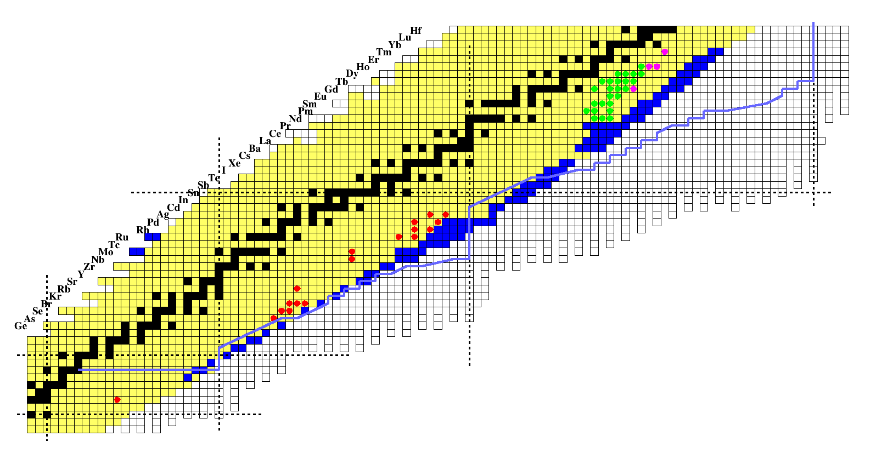
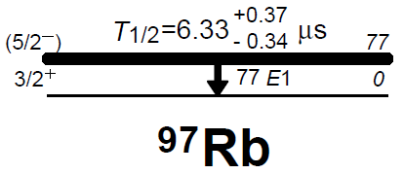
New isomers we discovered in the new isotope search runs
New isomers discovered:
18 in 2008
D. Kameda et al., RPC 86 054319 (2012)
25 in 2011
To be published
(4) in 2014
Preliminary
In total, 47 new isomers
Rich spectroscopic data
Isomer tagging
r-process path
Z
50
¹³²Sn
K isomer, Single-particle isomer
Large deformation
Shape isomer
N~75 shape coexistence
New deformation region
20
82
28
Shape isomer, K isomer, Single-particle isomer
N~70 shape evolution
Prolate, Triaxial, Oblate, Tetrahedral,…
⁷⁸Ni
Shape isomer
28
50
Shape isomer, High-spin isomer
N=60 shape transition
Shape coexistence
N
D. Kameda et al., RPC 86 054319 (2012)
Notes:
These are 47 new isomers discovered with a Uranium beam at R-I-B-F.
They not only provide rich spectroscopic information as shown here but also can be used for isomer-tagging in the particle identification
in the region of more neutron-rich isotopes.
----- 会議メモ (2014/06/05 18:15) -----
Isomer tagging の話はいらない。

Slide 16
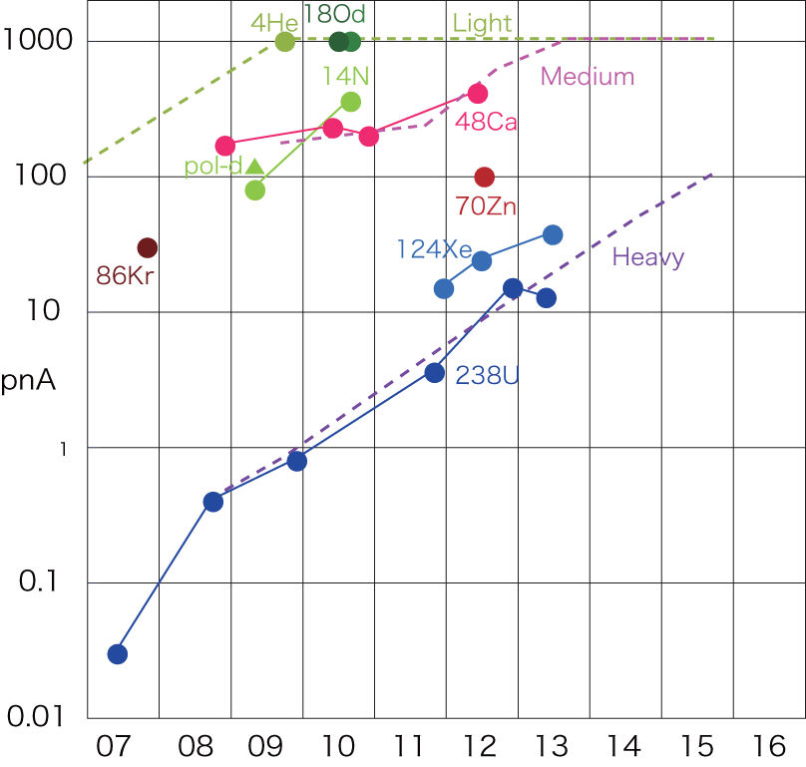
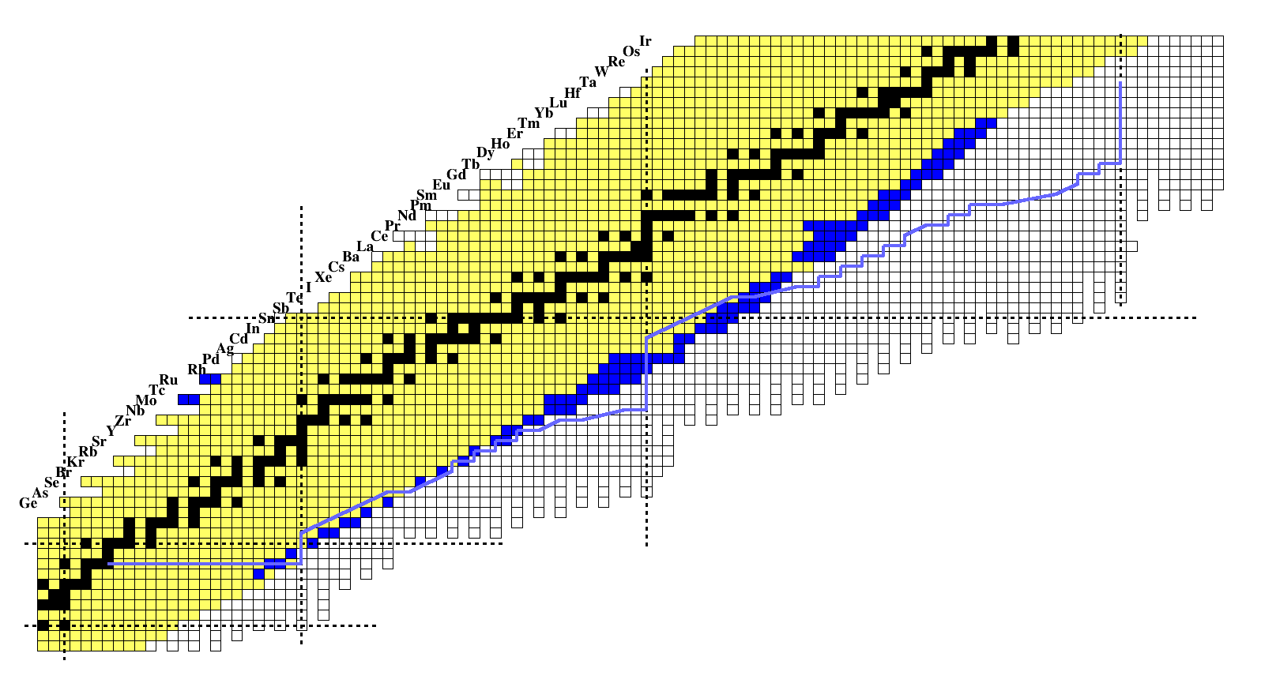
Perspectives
Current beam intensity (from RIBF site)
Beam particle | E/A(MeV) | Beam current (pnA) |  | Injector
 |  | Maximum record | Expected ¶
d | 250 | 1000 | 200 | AVF
d(pol.) | 250 | 120 | 30 | AVF
⁴He | 320 | 1000 | 1000 | AVF
¹⁴N | 250 | 400 | 400 | RILAC
¹⁸O | 345 | 1000 | 500 | RILAC
⁴⁸Ca | 345 | 415 | 150 | RILAC
⁷⁰Zn | 345 | 100 | 75 | RILAC
⁷⁶Ge | 345 | not tested | N/A | RILAC
⁷⁸Kr | 345 | under development | 50 | RILAC
⁸⁶Kr | 345 | 30 | 50 | RILAC
¹³⁶Xe | 345 | not tested | 20 | RILAC2
¹²⁴Xe | 345 | 38 | 20 | RILAC2
²³⁸U | 345 | 15.1 | 10 | RILAC2
¶ Some intensities are limited by shielding requirements
Beam intensity
Goal
100 pnA
Beam intensity (pnA)
²³⁸U beam
Here
²³⁸U
From O. Kamigaito
Year
Toward higher-Z
²⁰⁰W
¹²⁴Xe
¹³⁶Xe
N = 126
Toward more neutron-rich
⁸⁶Kr
Increase of beam intensity → Much further from stability
→ Various types of experiments
(Decay → Reaction)
Variety of primary beams → Variety of RI beams
⁷⁶Ge
⁶⁰Ca
Notes:
This plot shows increase of the primary beam intensity and this table summarizes the current beam intensity.
The intensity of Uranium beam is increasing with year, and we expect 100 pnA in near future.
The increase of beam intensity allows us to make various types of experiments, like secondary reaction experiments,
which require more beam intensity than that in decay experiments.
The use of variety of primary beams provides variety of RI beams.
----- 会議メモ (2014/06/04 15:14) -----
124Xe, 78Kr ビーム。反対側。
ビーム強度が増えれば反応実験が可能となる。例：100Sn
崩壊測定から反応測定へ。
ビームの種類を増やしてバリエーションを増やす。
----- 会議メモ (2014/06/04 17:21) -----
実験のタイプの話を入れる。
プライマリービームの種類を減らす。
60Ca ビームを作るには？何ビーム？
重い方のRプロセス。
Potentially doubly magic nuclei 60Ca
最後にドリップラインについて...
----- 会議メモ (2014/06/05 19:34) -----
48Ca
70Zn
124Xe
238U

Slide 17
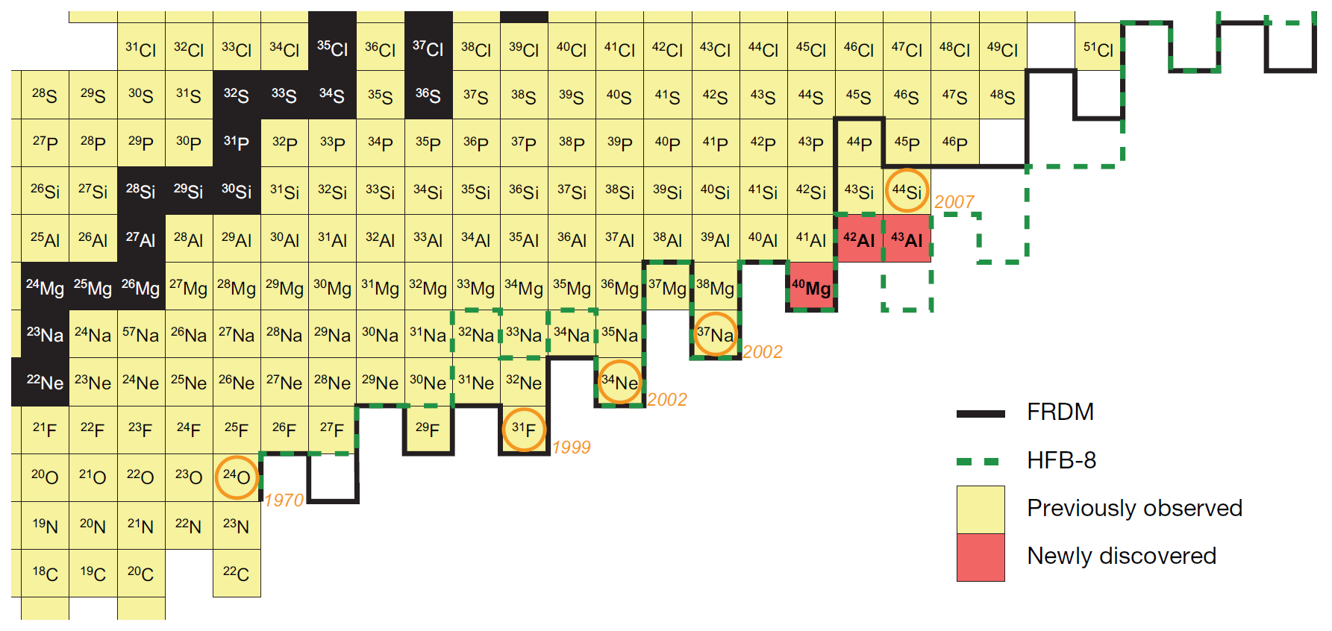
Neutron-drip line search with intense ⁴⁸Ca beam
⁴⁴Si
⁴⁵Al
⁴²Mg
³⁹Na
³⁶Ne
KTUY05
³³F
N=2Z+6
(A-3Z=6)
at RIBF
¹⁷B
¹⁹B
Search for the N=2Z+6 (A=3Z+6) nuclei: ³³F, ³⁶Ne, ³⁹Na, (⁴²Mg) : determination of existence/non-existence using an intense ⁴⁸Ca beam at RIBF
Oleg Tarasov et al.: Phys. Rev. C75 (2007) 064613 ⁴⁴Si
T. Baumann et al.: Nature 449 (2007)1022 ⁴⁰Mg and ^{42,43}Al
Notes:
Neutron-drip line will become possible with increasing beam intensity.
At the present, the neutron-drip line is known up to the Oxygen.
With an intense 48Ca beam at RIBF, we can determine the drip-line by searching on the A = 3Z + 6 line.
----- 会議メモ (2014/06/04 15:14) -----
Presented by T. K. at NSCL --> Delete
N = 2Z + 2, N = 2Z + 4 はいらない。
ドリップラインは O アイソトープまで。
ビーム強度が強くなれば O 以上のドリップラインが確定できる。
33F, 36Ne, とか。
48Ca ではここまで。それ以上は Zn, Kr, ...な
A-3Z = 6 at RIBF
----- 会議メモ (2014/06/05 18:25) -----
by searching 33F, 36Ne, and 39Na.

Slide 18
Summary
BigRIPS separator
  RI beam production in flight
  Large acceptance
  High particle identification power
More than 100 new isotopes have been observed so far.
308 RI-beams have been produced for about 80 experiment.
Production rates have been obtained for about 900 isotopes.
About 50 new isomers have been observed.
  They provides rich spectroscopic data.
  They are used for isomer-tagging in PID.
In future
  More various RI beams with more various primary beams
  More various types of experiment with higher beam intensity
  Neutron-drip line search
Thank you for your attention.

Slide 19
Backup slide

Slide 20
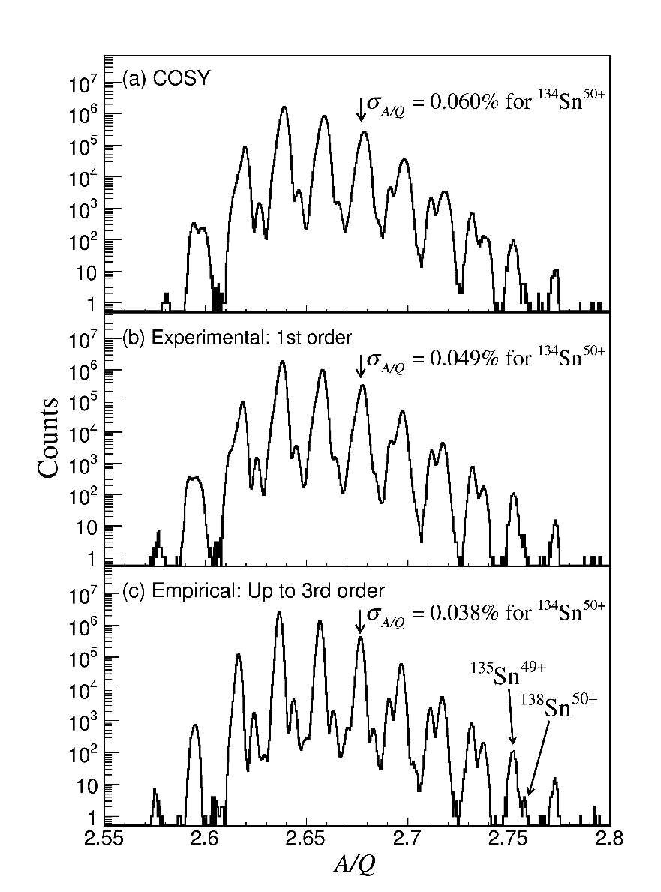
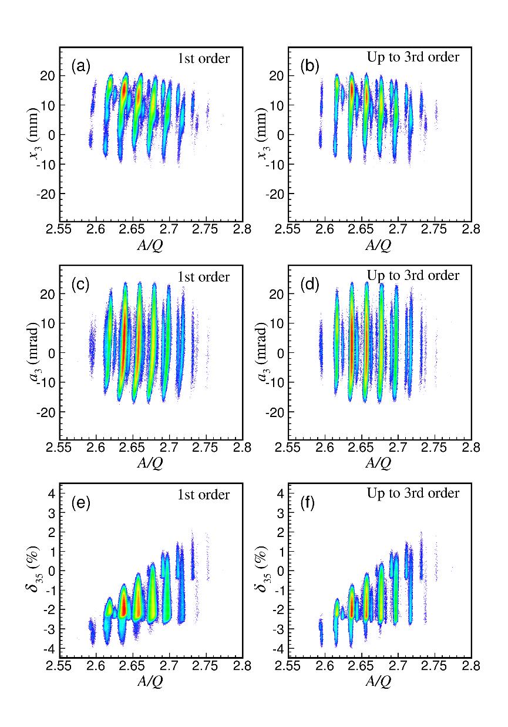
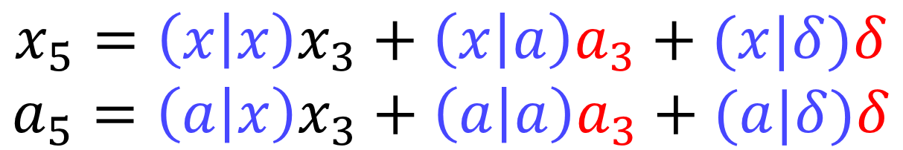
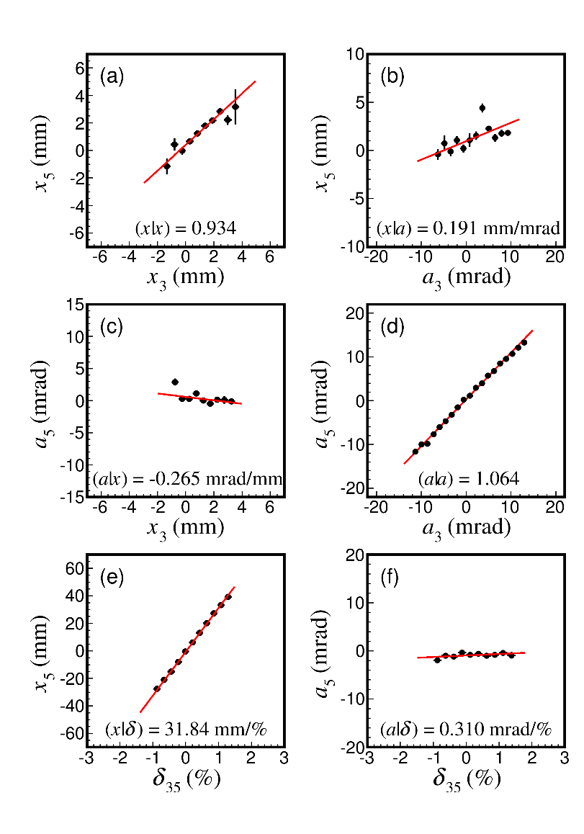
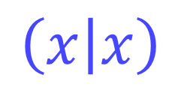
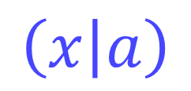
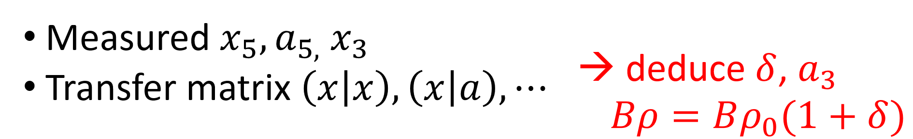
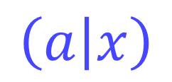
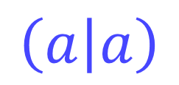
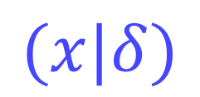
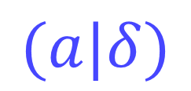
Trajectory reconstruction for Bρ determination
Trajectory reconstruction (F3—F5 case)
A/Q spectrum for Sn isotopes
produced by in-flight fission of U
Higher-order element derivation
Phase space correlation
1st order
Upt to 3rd order
δ: Bρ deviation
Calculation
1st order
Derivation of transfer matrix
First order matrix is determined from measurement.
Higher order matrix is determined empirically
to improve A/Q resolution.
Up to 3rd order
Notes:
This slide shows the details of the trajectory reconstruction, providing how to obtain the high Brho resolution.
The trajectory reconstruction is based on the ion-optical transfer matrix shown here.
The Brho deviation, delta, is reconstructed from the measured positions, angles, and
The transfer matrix by using this relation.
Then Brho is obtained like this.
In our method for derivation of transfer matrix,
First of all, a first order matrix is determined from the measurement,
by using phase space correlations between initial and final foci, F3 and F5, shown here.
Then higher order matrix elements are determined to improve the A/Q resolution.
Here, we use these kinds of plots, position, angle, and delta vs A/Q.
These A/Q spectra show the results of the trajectory reconstruction.
The best resolution is obtained with the matrix up to the 3rd order as shown here.

Slide 21
RI-beam production (2007—2014 May)
Number of experiments
 | ²³⁸U | ¹²⁴Xe | ⁸⁶Kr | ⁷⁰Zn | ⁴⁸Ca | ¹⁸O | ¹⁴N | ⁴He | Yearly total
2007 | 4 |  | 1 |  |  |  |  |  | 5
2008 | 2 |  |  |  | 4 |  |  |  | 6
2009 | 3 |  |  |  | 3 |  | 3 | 1 | 10
2010 |  |  |  |  | 10 | 1 | 2 |  | 13
2011 | 4 | 2 |  |  |  | 2 |  |  | 8
2012 | 6 | 3 |  | 1 | 4 | 6 |  |  | 20
2013 | 4 | 2 |  |  |  | 3 |  |  | 9
2014 | 6 |  |  | 1 |  |  |  |  | 7
Total | 29 | 7 | 1 | 2 | 21 | 12 | 5 | 1 | 78
Primary beam | Energy (MeV/u)
²³⁸U, ¹²⁴Xe, ⁸⁶Kr, ⁷⁰Zn, ⁴⁸Ca | 345
¹⁸O | 230, 250, 294, 345
¹⁴N | 250
⁴He | 320

Slide 22
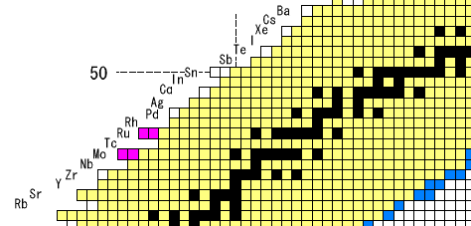
Yields of neutron-deficient RI beams using a ¹²⁴Xe beam at 345 MeV/u
Yields [pps/pnA]
The first Xe-beam experiment at RIBF in Dec. 2011.
¹²⁴Xe
¹⁰⁵Te | 0.00030
¹⁰⁴Sb | 0.066
¹⁰⁰Sn | 0.00011
¹⁰¹Sn | 0.0078
¹⁰²Sn | 0.51
⁹⁹In | 0.040
¹⁰⁰In | 1.4
⁹⁸Cd | 4.8
⁹⁶Ag | 17
⁹⁴Pd | 9.4
⁹⁴Rh | 12000
⁹²Ru | 7700
¹⁰⁰Sn
50
50
Recent ¹²⁴Xe-beam Intensity : ~35 pnA (Jun 2013)

Slide 23
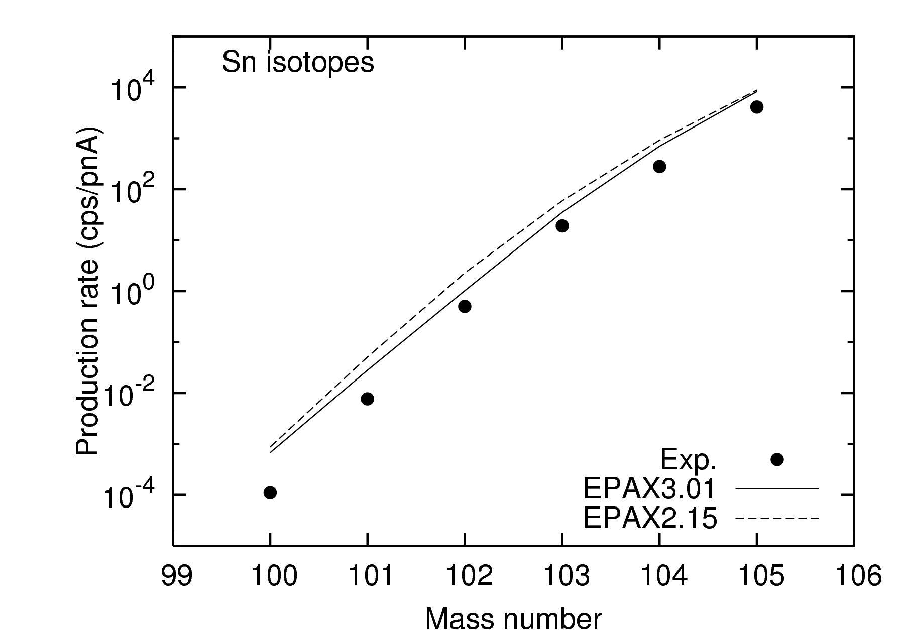
Production rate of neutron-deficient Sn isotopes from a ¹²⁴Xe beam at 345 MeV/u
¹²⁴Xe 345 MeV/u + Be 4 mm Δp/p = +/-2%
Yields [pps/pnA]
¹⁰⁰Sn | 0.00011
¹⁰¹Sn | 0.0078
¹⁰²Sn | 0.51
¹⁰³Sn | 19
¹⁰⁴Sn | 280
¹⁰⁵Sn | 4200
¹⁰⁰Sn
Production rate of ¹⁰⁰Sn is ~ 1/7 of EPAX 3.01.

Slide 24
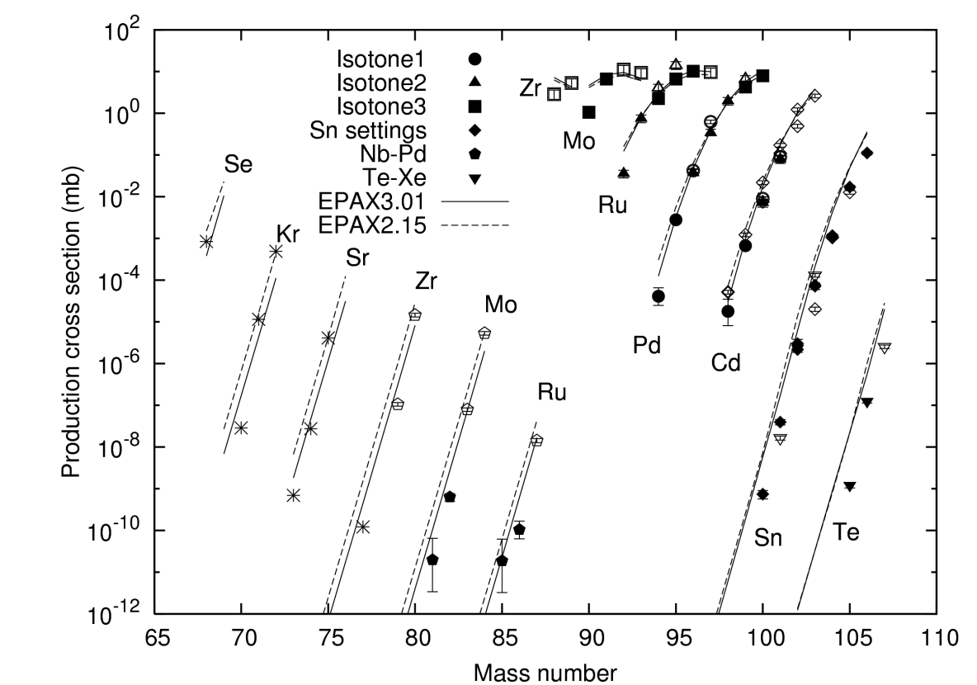
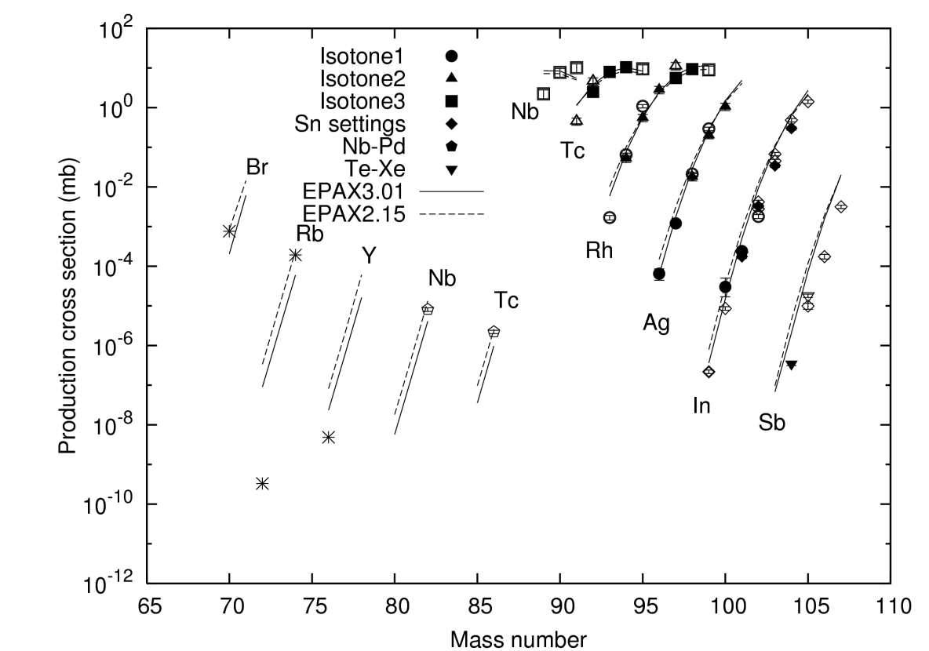
Measured production cross sections comparison with EPAX 2.15 & 3.01 (¹²⁴Xe 345 MeV/u + Be)
Even-Z Odd-Z
Preliminary
Preliminary
Filled symbol: distribution peak is located inside the slit opening at each focus.
Open symbol: distribution peak is located outside at some foci.
＊-data: Preliminary
Fairly good agreement between the experimental results and EPAX 3.01.
In more neutron-deficient region and higher Z region, the experimental cross sections are smaller than EPAX 3.01 (in the case of ¹⁰⁰Sn: 1/7).

Slide 25
Cross section of ¹⁰⁰Sn Discrepancy between RIKEN and GSI
There is a discrepancy between the cross section of ¹⁰⁰Sn measured at RIKEN and GSI (1 : 8).
 | Facility | event | Cross section | Energy | Be target
R0 | RIKEN | 23 | 0.74±0.17 pb* | 345 MeV/u | 4 mm
R1 | RIKEN | 6 | 0.40±0.17 pb* | 345 MeV/u | 4 mm
R2 | RIKEN | 12 | 0.71±0.21 pb* | 345 MeV/u | 4 mm
R3 | RIKEN | 9 | 1.6±0.5 pb* | 345 MeV/u | 8 mm + W-0.2mm
G0 | GSI | 259 | 5.8±2.1 pb | 1000 MeV/u | 32 mm (6 g/cm²)
G1 | GSI | 7 | 5 pb | 1095 MeV/u | 32 mm (6 g/cm²)
preliminary
preliminary
preliminary
5.76 pb (EPAX3.01)
7.43 pb (EPAX2.15)
R0 : H.Suzuki, et al, NIMB 317, 756-768 (2013)
R1-R3: preliminary
R3: charge striping method
G0 : C.B.Hinke, et al, Nature (London) 486, 341 (2012)
G1 : R. Schneider, et al, Z. Phys. A 348, 241 (1994)
* : Only the statistical error is described. The systematic one is assumed to be ~ 50%.
Is this discrepancy caused by…
Energy dependence of the projectile?
Secondary-reaction effect in the production target?
  RIKEN (345 MeV/u, 4 mm): ~1.16, GSI (1 GeV/u, 32 mm): ~3 (by LISE++)

Slide 26
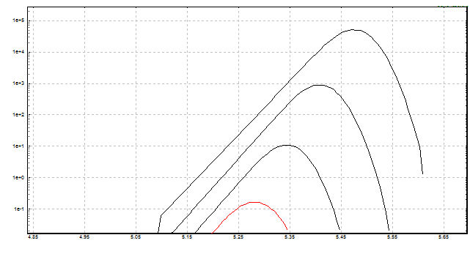
Momentum distribution
⁹⁷Ag
⁹⁸Cd
yield
⁹⁹In
: The objective nuclei (cf: ¹⁰⁰Sn)
¹⁰⁰Sn
: The contaminant nuclei (cf: ⁹⁹In, ⁹⁸Cd, ⁹⁷Ag)
Bρ / momentum
The low momentum tails of the contaminant nuclei make the purity worse.
The low-momentum tails of the neutron deficient nuclei were measured.
The shape of the low-momentum tail is very important especially for the neutron-deficient nuclei experiment.
We searched a tail-parameter, named “coef” in the LISE⁺⁺ calculation.

Slide 27
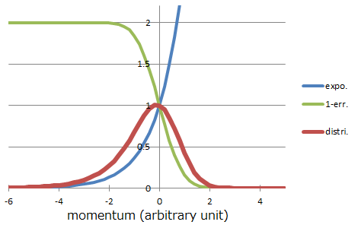
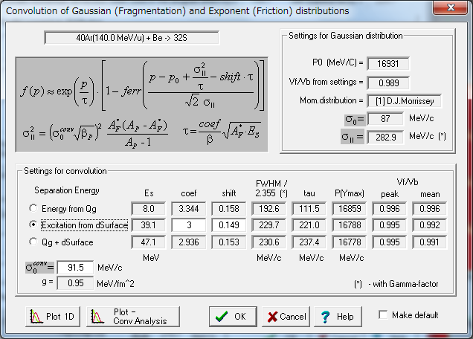
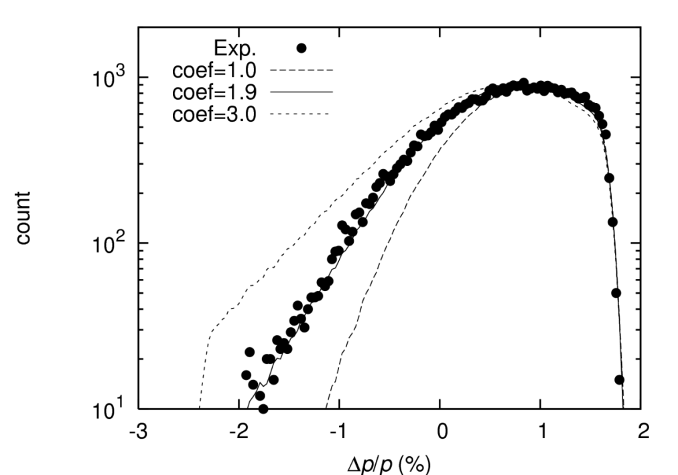
Low momentum tail
Production Mechanism
→ Settings (Projectile Fragmentation)
→ Momentum distribution
→ Settings
Concept of mom. distri. In LISE++
distri. = expo. x (1-err.)
The “coef” value of 1.9 gives the best result.
Cf) “coef” =
5.758 : 26-2200 MeV/u (mainly <100 MeV/u)
O. Tarasov, Nuclear Physics A734 (2004) 536-540
3 : 140-MeV/u NSCL data
O. Tarasov, private communication
1.9 : 345-MeV/u ¹²⁴Xe-beam data
Momentum acceptance
Momentum distribution of ⁹⁹Rh
(Monte Carlo simulation)

Slide 28
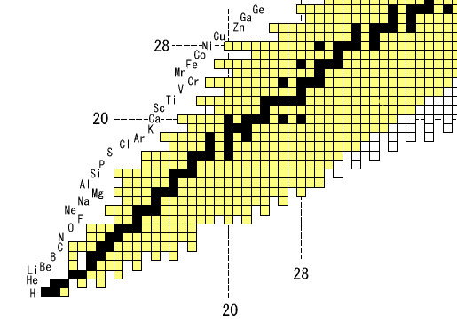
Yields of neutron-rich RI beams using a ⁷⁰Zn beam at 345 MeV/u
⁷⁰Zn
Yields [cps/pnA]
⁵¹K | 0.35
⁵²Ca | 2.2
⁵³Ca | 0.51
⁵⁴Ca | 0.11
⁵⁵Sc | 13
⁵⁶Sc | 0.85
⁵⁷Sc | 0.12
⁵⁶Ti | 140
⁵⁷Ti | 5.9
⁵⁸Ti | 3.7
⁵⁹Ti | 0.35
⁶⁰V | 2.2
Preliminary
28
20
⁵⁴Ca
8
20
28
Recent ⁷⁰Zn-beam Intensity : ~70 pnA (Jul 2012)

Slide 29
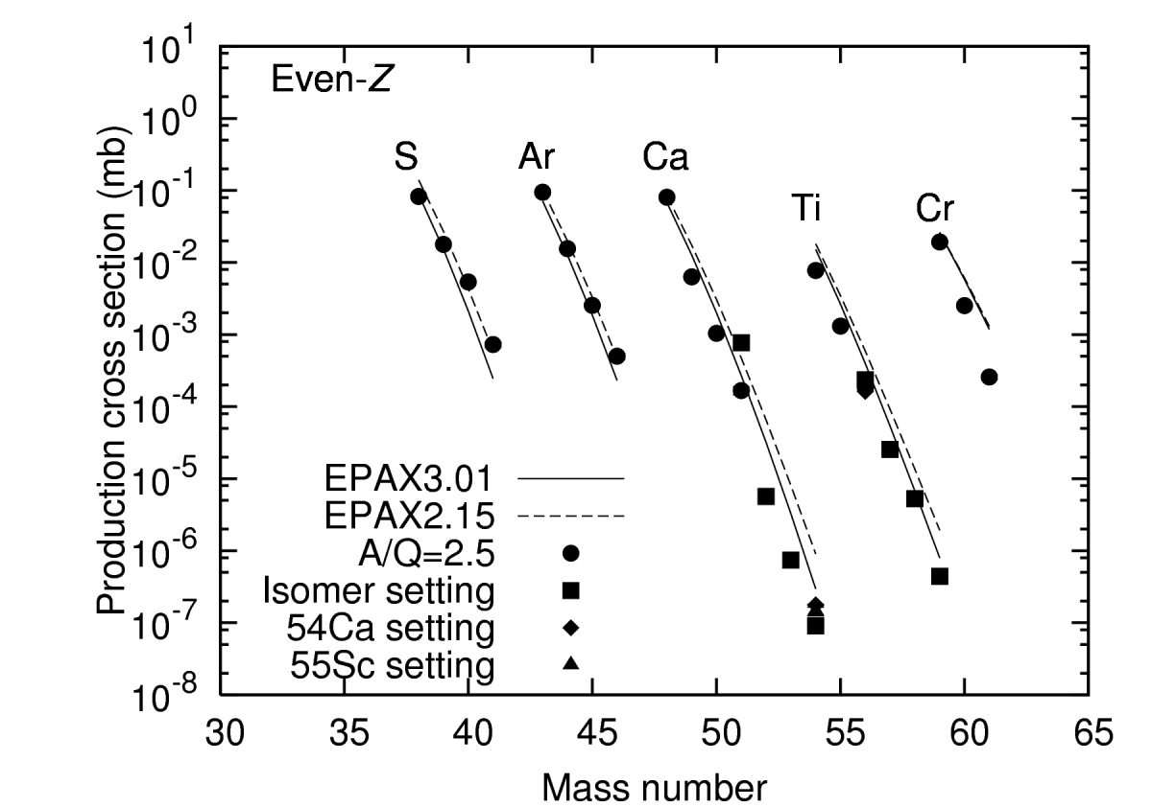

Measured production cross sections comparison with EPAX 3.01 & 2.15 (⁷⁰Zn 345 MeV/u + Be)
Preliminary
Overall, good agreement between the experimental cross section and the EPAX parameterizations.
For Z < 20 region, EPAX 2.15 estimates the cross sections well. EPAX 3.01 underestimates them.
for Z > 20 region, EPAX 3.01 estimates them well. EPAX 2.15 overestimates them.
For ⁵²⁻⁵⁴Ca, the experimental cross sections are less than the EPAX 3.01 estimations.
→ Next page.

Slide 30

Yields of neutron-rich RI beams using a ⁴⁸Ca beam at 345 MeV/u
⁴⁸Ca
Yields [pps/100 pnA]
¹⁹B | 5.5
²²C | 7.0
²²N | 4000
²⁴O | 1300
³²Ne | 3.4
³⁸Mg | 1.5
⁴¹Al | 0.63
⁴²Si | 25
⁴⁴S | 30000
20
8
⁴⁰Mg
20
28
Recent ⁴⁸Ca-beam Intensity : ~400 pnA (May 2012)

Slide 31


Measured production cross sections compared with EPAX 3.01 & 2.15 (⁴⁸Ca 345 MeV/u + Be)
Open symbols: cross sections with the correction for the secondary reaction effect in the target
(only for the nuclides whose augmentation factors are more than 1.6. )
Fairly good agreement between the experimental cross sections and EPAX 2.15.
EPAX 3.01 underestimates the cross sections.
Modification of EPAX3 from EPAX2
The c.s. of very neutron-rich fragments from medium-mass and heavy projectile were modified, which were overestimated by EPAX2. At the same time, the good agreement of EPAX2 for the neutron-deficient side is maintained.

Slide 32



Measured production cross sections compared with EPAX 3.01 & 2.15 (¹⁸O 230, 250, 294, 345 MeV/u + Be)
H
He
Li
Be
B
C
N
O
¹⁸O
Preliminary
Discrepancy was observed in some cases.

Slide 33

Search region for new isotopes
Newisotopes
( 2007, 2008)
Z = 60 region
Z = 60
Stable
Known
¹²⁴Xe
Z = 50 region
Z = 50
Z
Z = 40 region
Z = 30 region
N = 82
N = 50
N
Nuclear chart

Slide 34
BigRIPS settings for new isotope search
Two settings
Setting | ⁸⁵Ru setting (Z=41-46) | ¹⁰⁵Te setting (Z=52-54)
Isotope tuned | ⁸⁵Ru⁴⁴⁺ | ¹⁰⁵Te⁵²⁺
F0 target (mm^{t}) | Be 4.03 | Be 4.03
Bρ₀₁ (Tm) | 5.114 | 5.300
Bρ₃₅ (Tm) | 4.534 | 4.596
F1 degrader | Al 2.85 mm^{t}, 3.6 mrad | Al 2.85 mm^{t}, 3.6 mrad
F5 degrader | Al 1.97 mm^{t}, 1.6 mrad | Al 1.97 mm^{t}, 1.6 mrad
F1 slit | Δp/p : +/-2.0% | Δp/p: -2.0~+1.5%
F2 slit (mm) | +/-20 | -15~+20
F5 slit | fully open | fully open
F7 slit (mm) | +/-20 | +/-10
Beam intensity (pnA) | ~ 7.6 | ~ 8.9
F3 rate (pps) | ~ 40k | ~ 40k
F7 rate (pps) | ~ 1.5k | ~ 1.0k

Slide 35


⁸⁵Ru setting
Expand
^{A+2}Z+1
^{A}Z
^{A+1}Z
A/Q resolution (r.m.s.):
Z resolution (r.m.s.):
0.061%
0.40 % @ Zr (Z=40) isotopes
TOF(F0-F7): ~430 ns
The known limits are shown by solid lines.
New isotopes identified in this work: ⁸⁵Ru,⁸⁶Ru, ⁸¹Mo,⁸²Mo

Slide 36

⁸⁵Ru setting (Z vs A-2Q plot)
Full stripped events are shown in this plot.
A is deduced from the TKE measured with SSD at F12.
New isotopes
85Ru: 1 86Ru: 3
81Mo: 1 82Mo: 11

Slide 37
Unbound nuclei of Ru and Mo isotopes
On the line of A = 2Z-1,
  ⁸⁷Ru, ⁸³Mo, ⁷⁹Zr：observed
  ⁸⁵Tc, ⁸¹Nb: absent
→ There live times are short compared to the TOF (~440 ns).
Consistent with the results by Z. Janas, et al, Phys. Rev. Lett. 82, 295 (1999).
The upper limits of the half lives.
  Considering the yields expected relative to the neighboring isotopes.
  Assuming the observation limit of 1 count.
⁸⁵Tc ：42 ns, ⁸¹Nb: 38 ns
→ They are outside of the proton drip line.
On the other hand, the experimental yield of the new isotopes ⁸⁶Ru and ⁸²Mo are almost the same with the expected yield.
→ The half lives of them are long enough compared to the TOF (~440 ns)

Slide 38


¹⁰⁵Te setting
Expand
¹⁰³Sb
^{A+2}Z+1
^{A}Z
^{A+1}Z
A/Q resolution (r.m.s.):
Z resolution (r.m.s.):
0.054%
0.39 % @ Zr (Z=40) isotopes
TOF(F0-F7): ~440 ns
The known limits are shown by solid lines.
No new isotopes in this region.

Slide 39


Unbound nuclei of Sb isotopes
Upper limit : ~55ns
  The number at F0 : 413 counts
  (expected yield of ¹⁰³Sb is deduced from the ones of neighboring nuclei)
  TOF from F0 to F7 : ~440 ns
→ ¹⁰³Sb is outside of the proton drip line.
¹⁰³Sb was discovered by K. Rykaczewski, et. al. in 1995.
(observed after TOF of 1.5 μs)
K. Rykaczewski, et al, Phys. Rev. C, 52, R2310 (1995)

Slide 40

New isotopes and unbound nuclei
New isotopes
  Four new isotopes : ⁸¹Mo, ⁸²Mo (Z=42), ⁸⁵Ru, ⁸⁶Ru (Z=44) (NEW!!)
Outside of the proton-drip line
  Sb (Z=51) : ¹⁰³Sb (NEW!!)
  Tc (Z=43) : ⁸⁵Tc
  Nb (Z=41) : ⁸¹Nb
Proton emitter
α emitter
50
Known isotopes
New isotopes (our work)
Unbound isotopes
(confirmed / reconfirmed
in our work)
50
KTUY05 model (H. Koura et al, Prog. Theor. Phys. 113, 305 (2005).)
HFB-14 model (S. Goriely, M. Samyn, J.M. Pearson, Phys. Rev. C 75, 064312 (2007).)

Slide 41







Production rates of the fragments in setting-A and comparison with LISE++ predictions by AF model
²³⁸U⁸⁶⁺ 345MeV/u + Be, no degs.
Bρ = 7.2 Tm±1%
Abrasion Fission
By LISE++
⁷⁰Ni
+16%
⁷²Ni
FWHM=21%
⁷⁴Ni
Yield
+9.8%
⁷⁶Ni
:
LISE++
Ver. 8.4.1
⁷⁸Ni
+4.0%
Bρ (Tm)
Good agreement with LISE++ calculation with Abrasion fission model around Z = 20 - 50.
At Z > 50 region, experimental production rates are much larger than the LISE++ calculation.
Notes:
This slide shows production rates measured in the new isotope runs along with comparison with LISE++.
You see fairly good agreement with LISE++ simulations.

Slide 42

Production rates of the fragments in setting-G1 & G2 and comparison with LISE++ predictions by AF model
²³⁸U⁸⁶⁺ 345MeV/u + Be
Abrasion fission
Setting G1: Z~30
Setting G2: Z~40
LISE++(ver. 8.4.1)
Good agreement with LISE++ calculation with Abrasion fission model around the region of Z = 20 - 50.
Notes:
This slide shows production rates measured in the new isotope runs along with comparison with LISE++.
You see fairly good agreement with LISE++ simulations.

Slide 43

Production rates of the fragments in setting-G4t-Be
²³⁸U⁸⁶⁺ 345MeV/u + Be
Abrasion fission + Projectile fragmentation
(Center particle: ¹⁶⁸Gd^{63+→64+}(Z=64))
Z=57
58
59
60
*1 Distribution mode was used.
*2 The ΔE detectors were located at F12. The transmission between F7 to F12 was not considered (~50%).
61
62
63
64
Preliminary
65
66
73
68
69
Experiment LISE++ (AF) LISE++ (PF) ver. 9.2.66 β (=8.4.1)
Experimental production rates are much larger than the LISE++ calculation with AF model in the region of Z > 55.
Notes:
This slide shows production rates measured in the new isotope runs along with comparison with LISE++.
You see fairly good agreement with LISE++ simulations.

Slide 44






Kinematics of fragments: angular and momentum distributions for ¹⁶⁸Gd (Z=64)
Y-angle(φ) at F3
Wide spreads: consistent with fission!
Bρ distribution
-30 mr
+30 mr
6.324 Tm
6.711 Tm
Exp.
Exp.
Preliminary!
LISE++
LISE++
Abrasion-fission
LISE++
LISE++
Projectile fragmentation
Notes:
This slide shows the kinematics of fragments, angular distribution here and Brho disitribution here.
The experimental data, which shows wide distributions, are consistent with the abrasion fission model.

Slide 45







Production rates of the fragments in setting-B and comparison with LISE++ predictions by AF + CF model
²³⁸U⁸⁶⁺ 345MeV/u + Pb, no degs.
Bρ = 7.0 Tm±0.1%
Coulomb Fission
+ AF
By LISE++
¹²⁸Sn
+11%
¹³⁰Sn
FWHM=13%
¹³²Sn
Yield
+7.4%
¹³⁴Sn
:
LISE++
Ver. 8.4.1
¹³⁶Sn
+4.1%
Bρ (Tm)
Fairly good agreement with LISE++ calculation with “Coulomb fission + Abrasion fission”.
  Good agreement at the two peak regions (Z ~ 38 and Z ~ 52).
  Discrepancy is seen at other regions.
Notes:
This slide shows production rates measured in the new isotope runs along with comparison with LISE++.
You see fairly good agreement with LISE++ simulations.

Slide 46

Production rates of setting-G3 fragments and comparison with LISE++ predictions by CF+AF model
²³⁸U⁸⁶⁺ 345MeV/u + Pb
Z ~ 50
Coulomb fission + AF
SettingG3: Z~50
LISE++(ver. 8.4.1)
Good agreement with LISE++ calculation with “Coulomb fission + Abrasion fission” models around the region of Z ~ 50 (higher-Z peak).
Notes:
This slide shows production rates measured in the new isotope runs along with comparison with LISE++.
You see fairly good agreement with LISE++ simulations.

Slide 47

Production rates of the fragments in setting-G4t-W
²³⁸U⁸⁶⁺ 345MeV/u + W
Abrasion fission + Coulomb fission
(Center particle: ¹⁶⁸Gd^{63+→64+}(Z=64))
Z=58
59
60
61
Preliminary
62
63
64
65
66
67
Experiment
LISE++ (AF) LISE++ (CF) ver. 9.2.66 β
(=8.4.1)
*1 Distribution mode was used.
*2 The ΔE detectors were located at F12.
The transmission between F7 to F12
was not considered (~50%).
The experimental production rates are larger than the LISE++ calculation around Z=55 - 60.
However, they agrees well in the region Z > 63.
Notes:
This slide shows production rates measured in the new isotope runs along with comparison with LISE++.
You see fairly good agreement with LISE++ simulations.

Slide 48
Production rate comparison between G3’-Be and G3’-Pb
These Be and Pb targets are energy-loss equivalent thick.
The BigRIPS settings are the same.
50
51
52
Z=49
53
Be target
Pb target
Preliminary
In the neutron-rich region, the production rates are almost the same in these setting.
Notes:
This slide shows production rates measured in the new isotope runs along with comparison with LISE++.
You see fairly good agreement with LISE++ simulations.

Slide 49
Production rate comparison between G4t-Be and G4t-W
These Be and W targets are energy-loss equivalent thick.
The BigRIPS settings are the same.
62
61
63
60
64
65
66
59
67
Z=58
68
69
57
Be target
W target
Preliminary
In Z > 62 region, the production rates of the neutron-rich nuclei with Be target are larger than the ones with W target.
Notes:
This slide shows production rates measured in the new isotope runs along with comparison with LISE++.
You see fairly good agreement with LISE++ simulations.

Slide 50


2011 U experiment
²³⁸U⁸⁶⁺ + Be at 345 MeV/u,
~0.5 pnA (3 x 10⁹ pps)
2 different settings
Intensity almost same as 2008 experiment
Setting-G4b-Be
Setting-G4t-Be
Z~59
²³⁸U + Be
Z~64
²³⁸U + Be
Z
Unknown
Unknown
Preliminary!
A/Q
A/Q resolution: 0.035~0.040 % (σ)
A/Q accuracy: +/- 0.1 %
A/Q resolution: 0.035~0.040 % (σ)
A/Q accuracy: +/- 0.05 %
Z resolution: 0.46 % (σ)
Z resolution: 0.48 % (σ)
Notes:
This slide shows the results of the 2011 U-beam experiment, in which we searched for Z=60 region.
We ran the measurement for these two settings, and identified 14 new isotopes.
This shows the results of the Xe-124 experiment, in which we search for the proton-trip line in this Z region.
We identified these 4 new isotopes.

