Slide 1
β-delayed fission of neutron-deficient Fr and At isotopes Lars Ghys^{1,2} ¹Instituut voor Kern- en Stralingsfysica, KU Leuven, Celestijnenlaan 200D, B-3001 Leuven ² Belgian Nuclear Research Centre, SCK•CEN, Mol, Belgium
ARIS conference June 1-6, Tokyo (Japan)

Slide 2
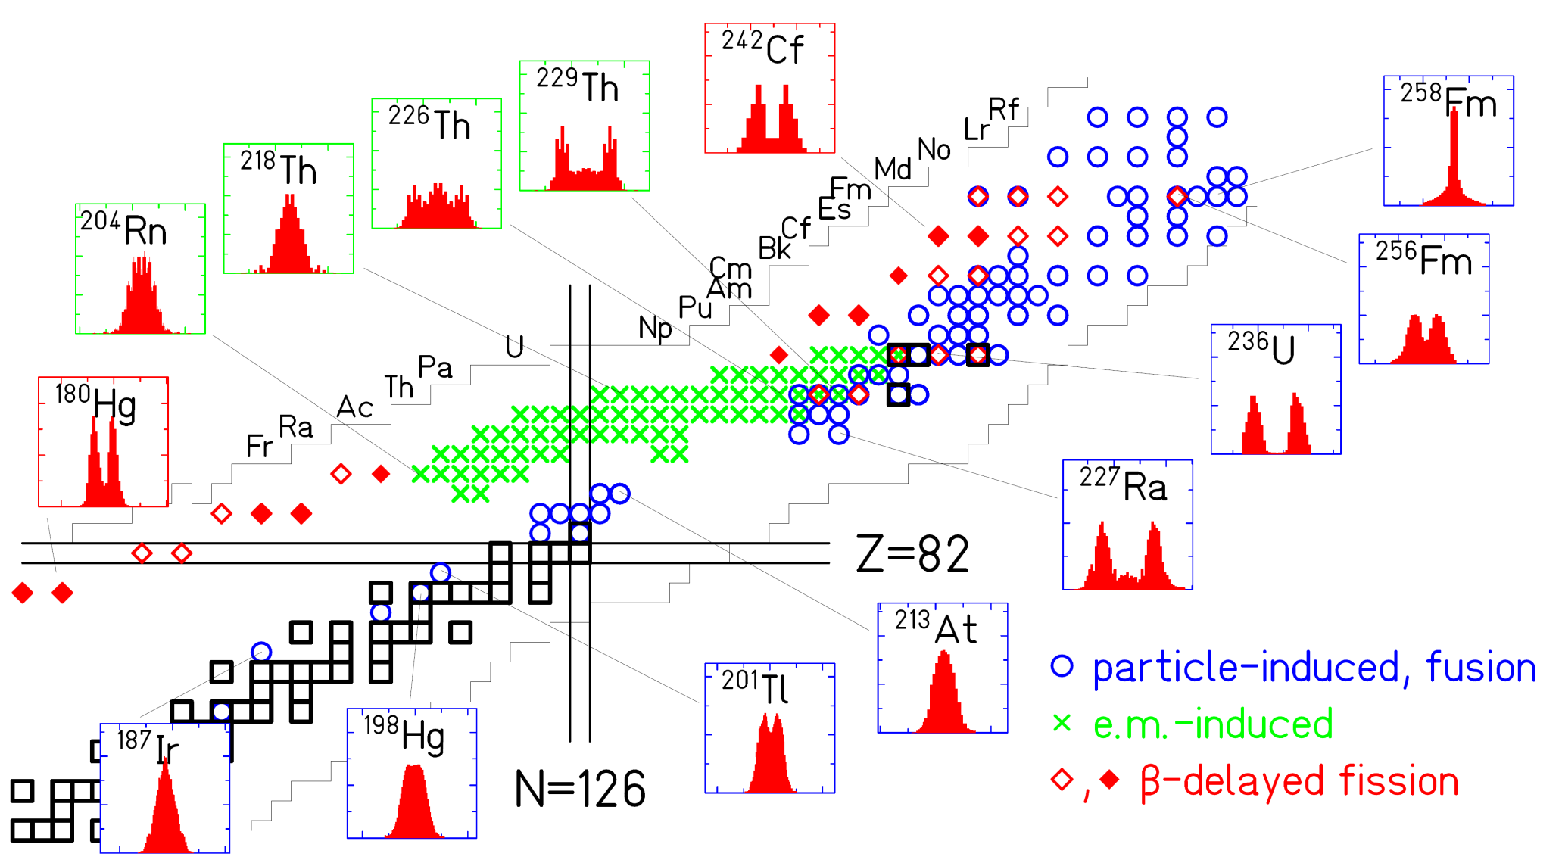
Low-energy fission throughout the nuclear chart
asymmetry
transition
asymmetry
symmetry
???
A.N. Andreyev , M. Huyse and P. Van Duppen, Rev. Mod. Phys. 85, 1541 (2013)
Introduction set up results conclusion

Slide 3
β- delayed fission (βDF)
β
βDF
γ
β decay
excitation energy < Q value
Spin/ parity sensitivity
fission
U and Pb region (isospin dependence)
Mass/ energy distributions
βdf probability and half life
Q_{β}
Q_{β}
B_{f}
γ
γ
Introduction setup results conclusion

Slide 4
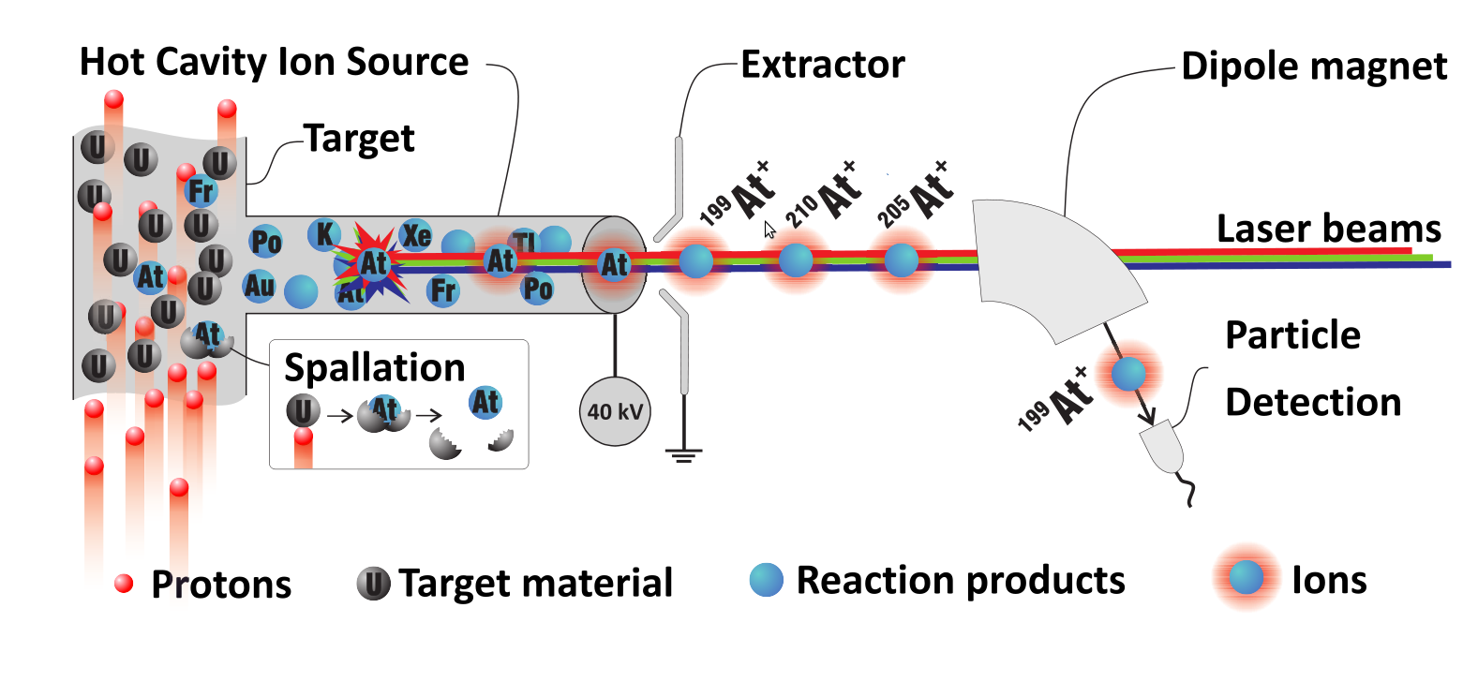
ISOLDE facility - CERN
HRS target
1.4 GeV protons
HRS mass
separator
2 µA of protons on UC_{x} target
isotopic (isomeric) pure beam
beam energy of 30-60 keV
GPS target
GPS mass
separator
Windmill
position
S.Rothe et al./ Nature Comm 4 (2013) 1835
Introduction setup results conclusion

Slide 5
Experimental set-up: “Windmill system”
Si front
Si back
C foil
ISOLDE beam
FF
e⁻/e⁺
α particles
Si spectrum
α-α summing
Fission fragments
Introduction setup results conclusion

Slide 6
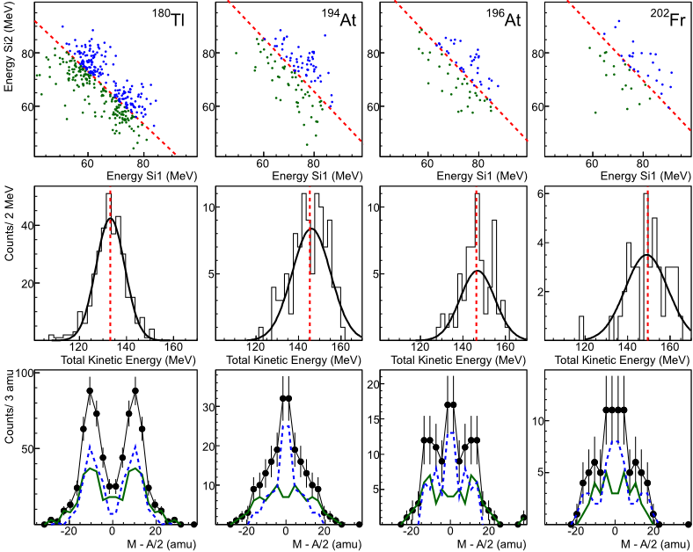
~27 FF/h
Reference
~43 FF/h
2 isomers
~2 FF/h
2 isomers
~8 FF/h
Introduction setup results conclusion

Slide 7
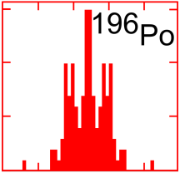
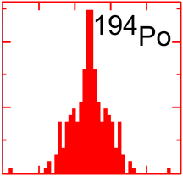
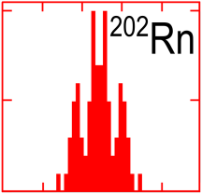
Fission at low excitation energies: systematics
A.N. Andreyev , M. Huyse and P. Van Duppen, Rev. Mod. Phys. 85, 1541 (2013)
Introduction set-up results conclusion

Slide 8
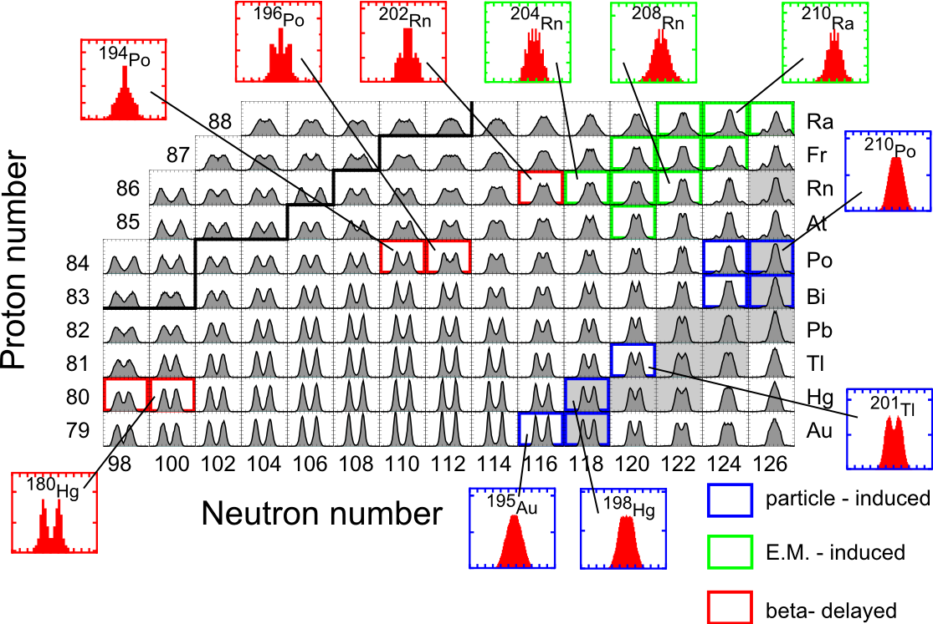
Finite Range Liquid Drop Model (P. Möller & J. Randrup, PRC 064606)
Experimental triple-humped vs calculated double-humped transition
Introduction setup results conclusion

Slide 9
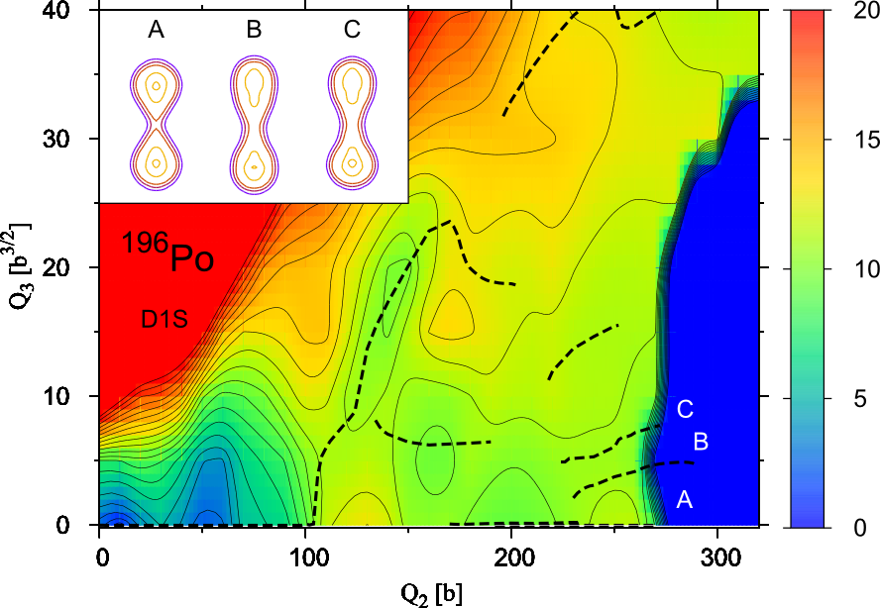
HFB theory with Gogny D1S nuclear force (M. Warda et al., PRC 024601)
Broad and flat plateau in potential- energy surface
Introduction setup results conclusion

Slide 10
Conclusions & outlook
Conclusions
βdf of ^{200,202}Fr and ^{194,196}At confirmed and studied at ISOLDE
Triple- humped mass distributions
Comparison with theoretical calculations (P. Möller et al., M. Warda et al.)
systematic comparison of T_{βdf}
Outlook
Separation of isomers in ²⁰²Fr (CRIS) and ¹⁹⁴At (RILIS)
detailed α- decay spectroscopy on investigated isotopes
Introduction set-up results conclusion

Slide 11
Thank you!
Comenius University, Bratislava
A.N. Andreyev
D. Jenkins
V. Truesdale
H. de Witte
J. Elseviers
L. Ghys
S. Sels
M. Huyse
D. Radulov
M. Rajabali
C. Van Beveren
P. Van den Bergh
P. Van Duppen
B. Andel
S. Antalic
Z. Kalaninova
X. Derkx
J. Lane
V. Liberati
T. E. Cocolios
E. Rapisarda
ISOLDE & RILIS
K. Nishio, Y. Nagame, JAEA, Tokai, Japan
F.P. Hessberger, SHIP (GSI), Darmstadt, Germany
U. Koster, ILL, Grenoble, France
R. Page, OLL, University of Liverpool
P. Möller, Los Alamos National Laboratory, US
M. Warda, M. Curie-Sklodowskiej, Poland
L. Ghys
L. Popescu
D. Pauwels

