Slide 1
Nuclear Spin-Isospin Excitations --- Towards exotic deformed nuclei
Haozhao Liang （梁豪兆）
RIKEN Nishina Center
June 6, 2014
Advances in Radioactive Isotope Science 2014
June 1-6, 2014, Tokyo, Japan

Slide 2
Contents
Introduction
Theoretical Framework
Results and Discussion
Towards Deformed Nuclei
Summary and Perspectives
Topic: Nuclear spin-isospin excitations
Goal: Towards exotic deformed nuclei
Method: Covariant Density Functional Theory + Finite Amplitude Method on 3D lattice

Slide 3
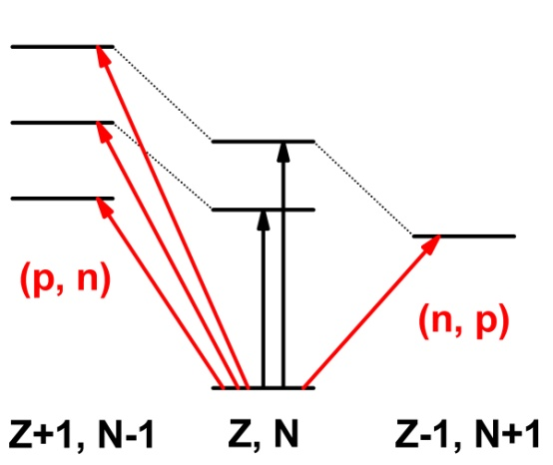
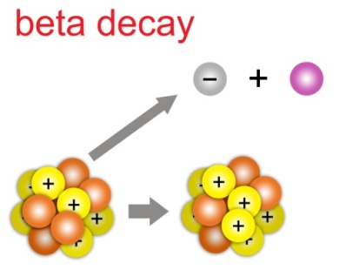
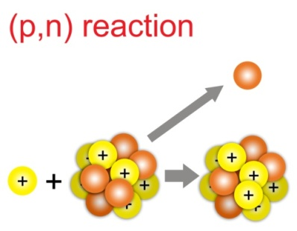
Nuclear spin-isospin excitations
Nuclear spin-isospin excitations
β-decays in nature
charge-exchange reactions in lab
These excitations are important to understand
spin and isospin properties of in-medium nuclear interaction
effective nucleon-nucleon tensor forces Bai:2010
neutron skin thickness Krasznahorkay:1999, Vretenar:2003, Yako:2006
β-decay rates of r-process nuclei Engel:1999, Borzov:2006
neutrino-nucleus cross sections Kolbe:2003, Vogel:2006, Paar:2008
ββ-decay rates Ejiri:2000, Avignone:2008
unitarity of Cabibbo-Kobayashi-Maskawa matrix Towner&Hardy:2010
The theories achieving consistent treatment of the spin and isospin degrees of freedom are highly desired.

Slide 4
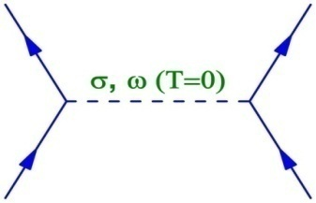
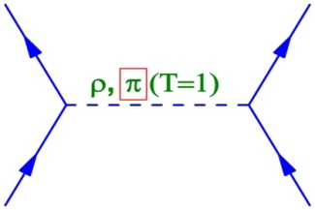
Covariant density functional theory
A most promising theory: covariant density functional theory (CDFT)
Starting point: effective Lagrangian density Walecka & Serot:1986, Long:2006
Energy functional of the system
δE/δρ → equation of motion for nucleons: Dirac (-Bogoliubov) equations
δ²E/δρ² → linear response equation: (Q)RPA equations Ring&Schuck:1980

Slide 5
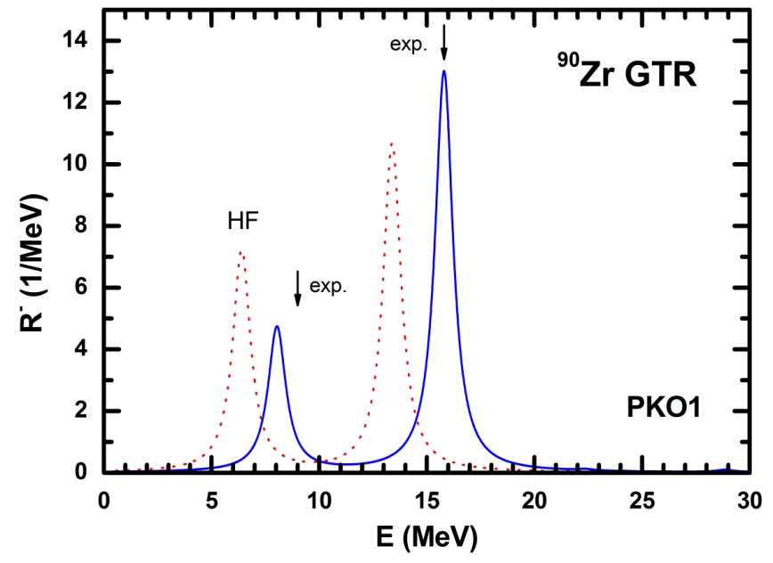
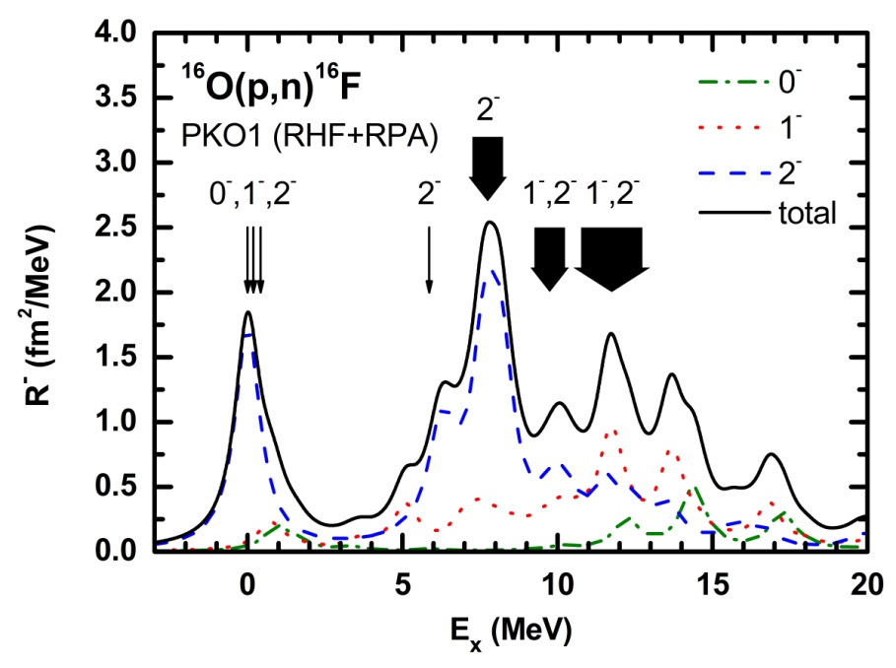
Spin-isospin resonances
Gamow-Teller and spin-dipole resonances
Wakasa et al. Exp. @ RCNP
HL, Giai, Meng, PRL 101, 122502 (2008); HL, Zhao, Meng, PRC 85, 064302 (2012)
New ingredient: exchange terms → Isoscalar mesons play an essential role via the exchange terms.
GTR and SDR excitation energies are described self-consistently.

Slide 6
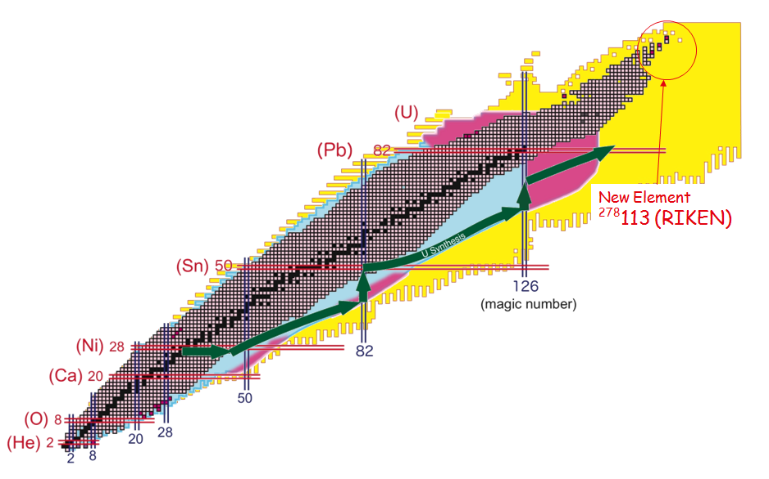
β decays and r-process
Nuclear β decays and r-process nucleosynthesis
EURICA :
Key exp. @ RIKEN
EURICA project is providing lots of new β-decay data towards r-process path.

Slide 7
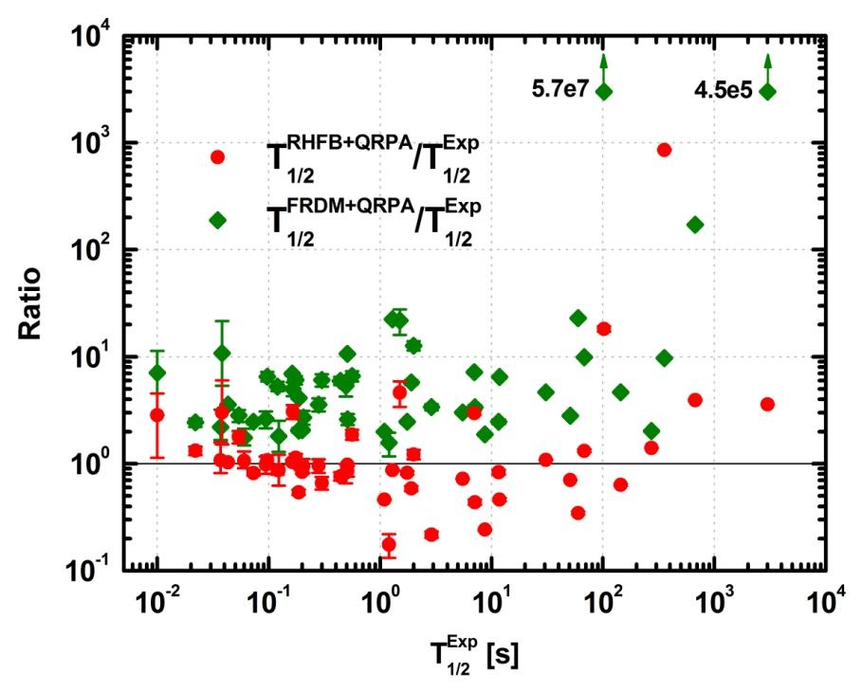
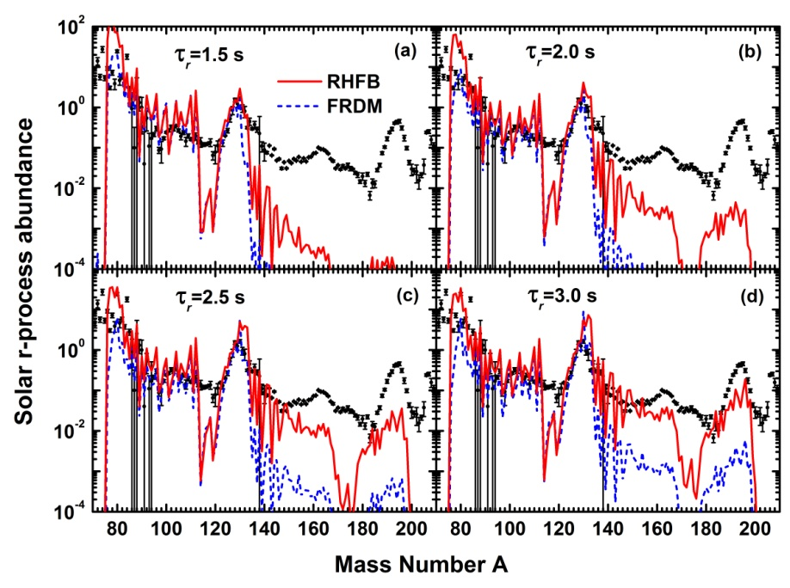
β decays and r-process
Nuclear β-decay rates and r-process flow (Z = 20 ~ 50 region)
FRDM: widely used nuclear input
RHFB: CDFT results with T=0 pairing
Niu, Niu, HL, Long, Niksic, Vretenar, Meng,
PLB 723, 172 (2013)
Classical r-process calculation shows a faster r-matter flow at the N = 82 region and higher r-process abundances of elements with A ~ 140.

Slide 8
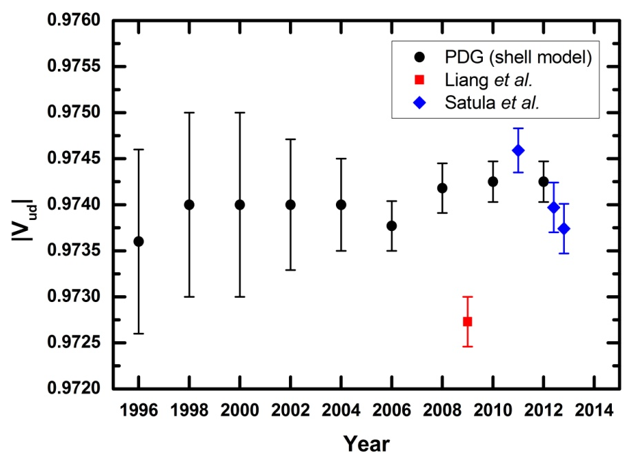
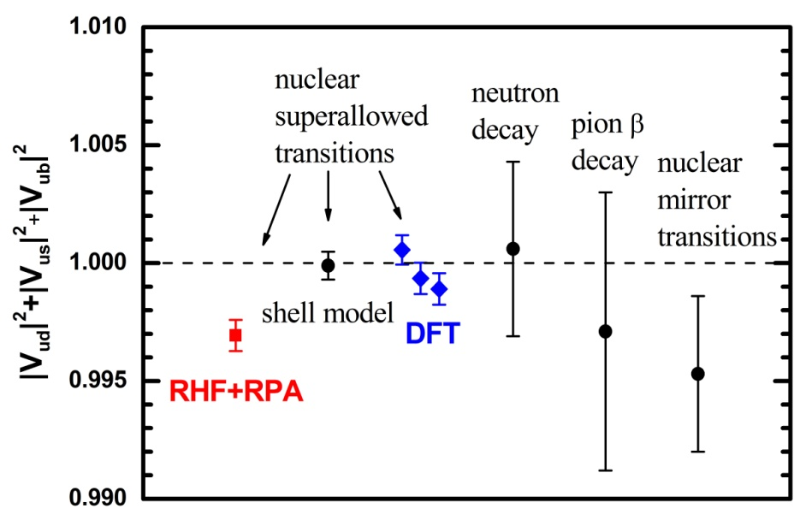
CKM matrix and its unitarity test
Cabibbo-Kobayashi-Maskawa matrix
|V_{ud}|² + |V_{us}|² + |V_{ub}|² = 0.9999(6) ?!!!
Isospin symmetry-breaking corrections
HL, Giai, Meng, PRC 79, 064316 (2009); Satula et al., PRL 106, 132502 (2011); PRC 86, 054316 (2012)
Pinning down the uncertainty of δ_{c} to 10⁻⁴ level is also one of the key issues.
Model self-consistency is crucial for eliminating the artificial isospin symmetry breaking.

Slide 9
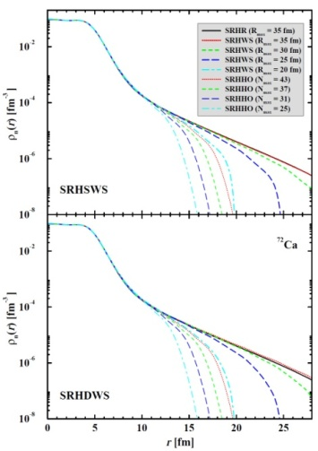
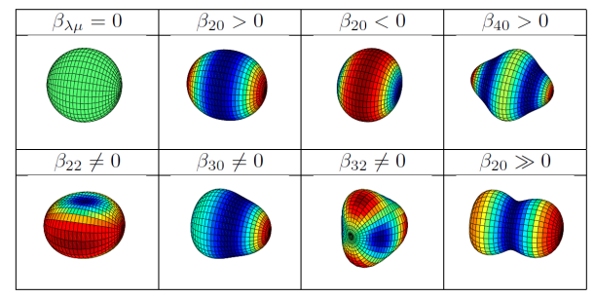
Towards deformed nuclei
Goal: To study spin-isospin excitations in exotic deformed nuclei
correct asymptotic behavior
to break all geometric symmetries
exotic shapes / exotic excitation modes
reasonable computational time
CDFT on 3D lattice:
ground states & excitations
Lu:2013
Zhou:2003

Slide 10
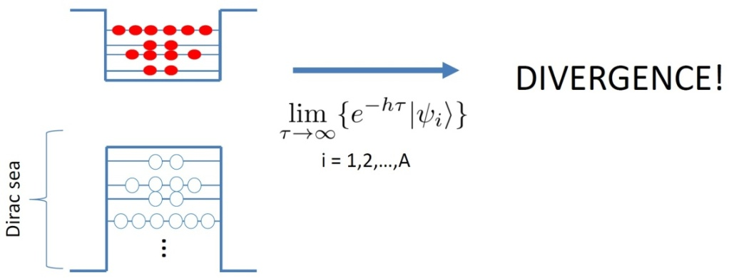
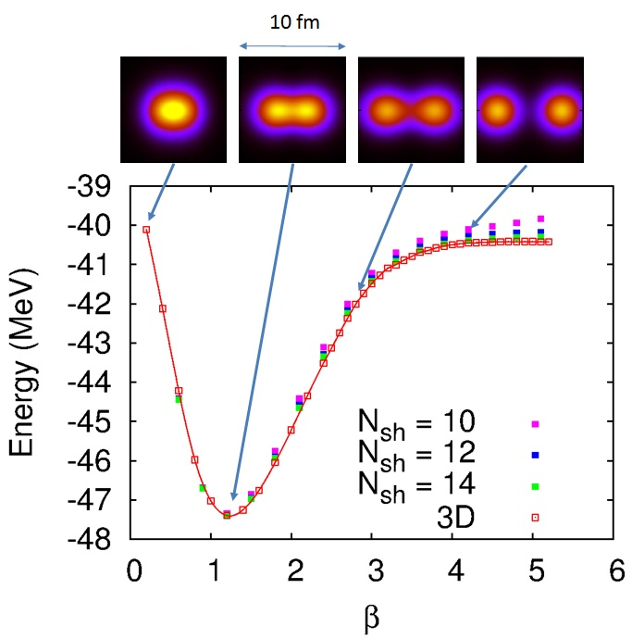
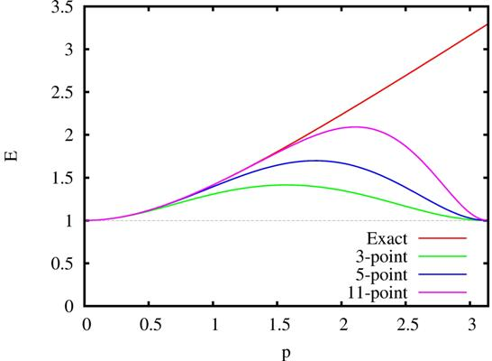
CDFT on 3D lattice: ground states
Challenge 1: Variational collapse
Preliminary results: ⁸Be
Tanimura & Hagino,
PRC 82, 057301 (2010)
Solution: Inverse Hamiltonian method
Challenge 2: Fermion doubling
Tanimura, HL, Hagino, ... in preparation
Solution: High-order Wilson terms

Slide 11
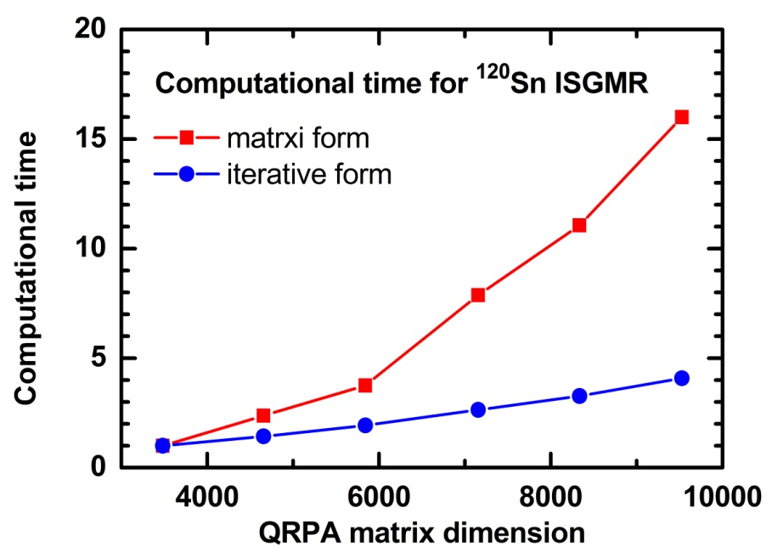
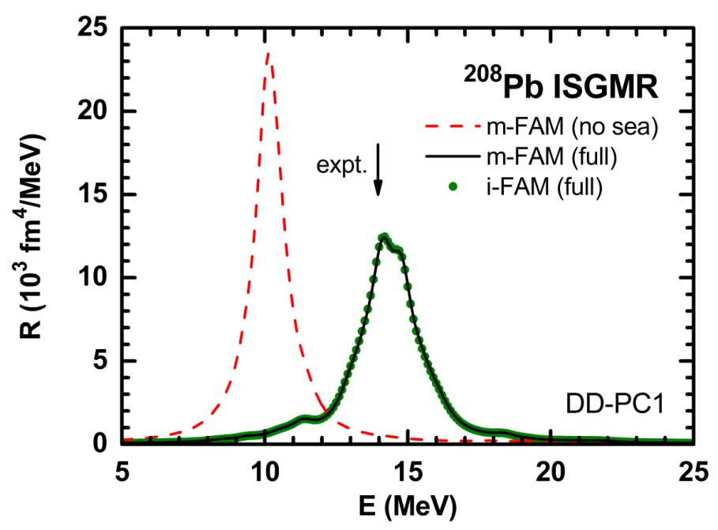
CDFT on 3D lattice: excitations
Computational challenge for the excitations in deformed systems
A promising solution: Finite amplitude method Nakatsukasa, Inakura, Yabana, PRC 76, 024318 (2007)
(Left: data from Avogadro:2013)
HL, Nakatsukasa, Niu, Meng, PRC 87, 054310 (2013)
The combination CDFT + FAM works well for the spherical and also the axially deformed systems. Niksic et al., PRC 88, 044327 (2013)
To develop CDFT + FAM for the 3D deformed systems.

Slide 12
Summary and Perspectives
Self-consistent and covariant descriptions of nuclear spin-isospin excitations for spherical cases. spin-isospin resonances, r-process, CKM unitarity, ….
Towards deformed cases: CDFT on 3D lattice
Ground states: Solving Dirac equations on 3D lattice inverse Hamiltonian method, high-order Wilson terms
Excitations: Finite amplitude method for relativistic RPA In lattice representation, the effects of Dirac sea can be included implicitly and automatically.
Exotic shapes
Exotic excitation modes
……

Slide 13
Acknowledgments
In collaboration with
INFN-Milan Gianluca Colò, Xavier Roca-Maza, Yifei Niu
Tohoku U. Kouichi Hagino, Yusuke Tanimura
Tokyo U. Sci. Chikako Ishizuka
Lanzhou U. Wen Hui Long
Peking U. Jie Meng, Pengwei Zhao
RIKEN Takashi Nakatsukasa
Zagreb U. Tamara Nikšić, Dario Vretenar
Anhui U. Zhongming Niu
TUM Peter Ring
Osaka U. Hiroshi Toki
IPN-Orsay Nguyen Van Giai
ITP-CAS Shan-Gui Zhou
Thank you!

