Slide 1



Beta-decay studies in N~Z nuclei using no-core
configuration-interaction model
Wojciech Satuła
in collaboration with: J. Dobaczewski, W. Nazarewicz, M. Rafalski & M. Konieczka
Isospin symmetry breaking corrections to the superallowed beta
decays from the angular momentum and isospin projected DFT:
brief overview focusing on sources of theoretical errors
and on limitations of the „static” MR DFT
Extension of the static approach:
towards NO CORE shell model with basis cutoff
dictated by the self-consistent p-h configurations
examples:
³²Cl-³²S, ⁶²Zn-⁶²Ga,
³⁸Ca-³⁸K
Summary & perspectives

Slide 2
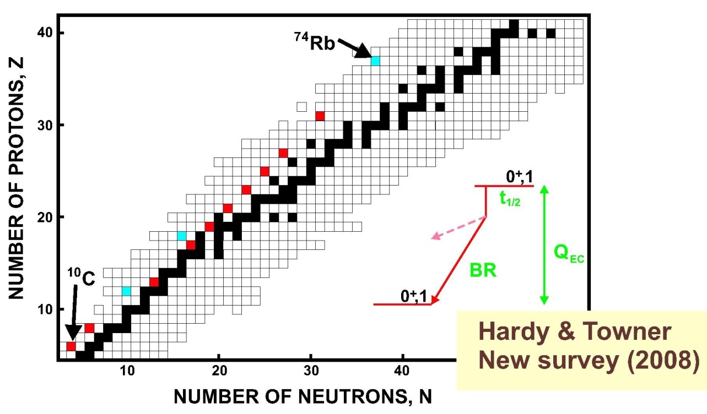
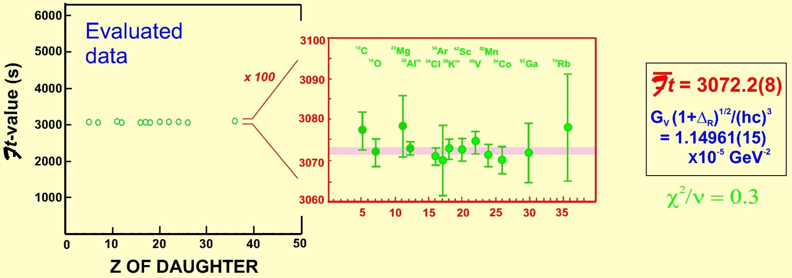
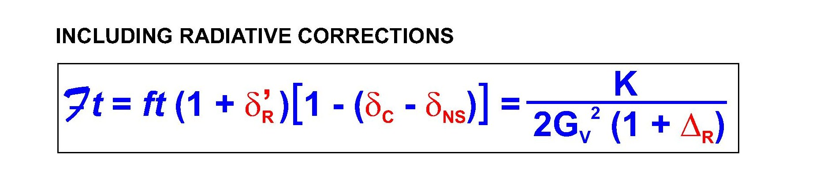
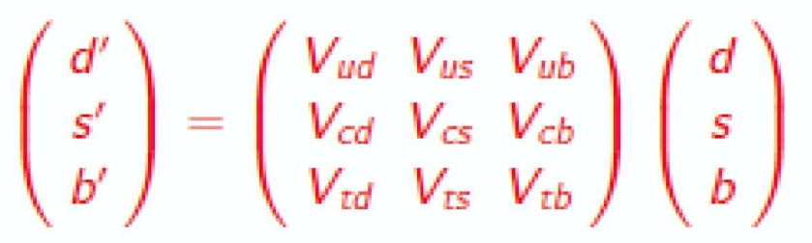
Superallowed I=0⁺ T=1→ I=0⁺ T=1 Fermi beta decays
(testing the Standard Model of elementary particles)
10 cases measured with accuracy ft ~0.1%
3 cases measured with accuracy ft ~0.3%
→ test of the CVC hypothesis
(Conserved Vector Current)
1.5%
0.3%
- 1.5%
~2.4%
adopted from J.Hardy’s, ENAM’08 presentation
Towner & Hardy
Phys. Rev. C77, 025501 (2008)
|V_{ud}| ⁼ 0.97418 + 0.00026
→ test of unitarity of the CKM matrix
-
|V_{ud}|²+|V_{us}|²+|V_{ub}|²=0.9997(6)
CKM
Cabibbo-Kobayashi
-Maskawa
mass
eigenstates
weak
eigenstates
0.9490(4)
0.0507(4)
<0.0001

Slide 3
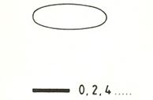
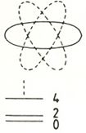
How to calculate the superallowed Fermi beta decay ME using the double-projected DFT
framework?
I=0⁺,T=1,T_{z}=-1
t_{1/2}
Q_{β}
BR
I=0⁺,T=1, T_{z}=0
Skyrme-Hartree-Fock
DF
ground state
in N-Z=+/-2 (e-e) nucleus
antialigned state
in N=Z (o-o) nucleus
Project on good isospin (T=1) and angular momentum (I=0)
(and perform Coulomb rediagonalization)
Project on good isospin (T=1) and angular momentum (I=0)
(and perform Coulomb rediagonalization)
|
T_{+/-}
|I=0,T~1,T_{z}=0>
|²=2(1-δ_{C})
<T~1,T_{z}=+/-1,I=0|
~
~

Slide 4
|V_{ud}| & unitarity of the CKM – a survey
0.976
1.0025
0.975
0.974
1.0000
(a)
(c)
(a)
|V_{ud}|
(d)
(c)
(d)
|V_{ud}|²+|V_{us}|²+|V_{ub}|²
0.973
0.9975
(b)
ν-decay
(b)
ν-decay
0.972
0.9950
0.971
superallowed 0⁺→0⁺
β-decay
superallowed 0⁺→0⁺
β-decay
0.970
mirror T=1/2
nuclei
mirror T=1/2
nuclei
0.9925
π-decay
π-decay
10
(a)
62
I.S. Towner and J. C. Hardy,
Phys. Rev. C 77, 025501(2008).
0.5
Ft=3071.4(8)+0.85(85);
V_{ud}=0.97418(26)
H. Liang, N. V. Giai, and J. Meng,
Phys. Rev. C 79,064316 (2009).
(b)
δ_{C} - δ_{C} [%]
(c,d)
W. Satuła, J. Dobaczewski, W. Nazarewicz,
M. Rafalski, Phys. Rev. Lett. 106, 132502 (2011);
Phys. Rev. C 86, 054314(2012).
(HT)
0
(SV)
Ft=3070.4(9);
V_{ud}=0.97444(23) PRL
-0.5
Ft=3073.6(12);
V_{ud}=0.97397(27) PRC
38
O. Naviliat-Cuncic and N. Severijns,
Eur. Phys. J. A 42, 327 (2009);
Phys. Rev. Lett. 102, 142302 (2009).
10
20
30
40
50
60
70
A

Slide 5
SOURCES OF THEORETICAL ERRORS
Basis-size dependence:
Configuration dependence:
~10%
j_{π}
Functional dependence:
l
j_{ν}
j_{π}
l
l
s
s
y
s
i
y
i
y
SV:
Ft=3073.6(12)
i
j_{ν}
j_{π}
j_{ν}
V_{ud}=0.97397(27)
x
x
x
|V_{ud}|²+|V_{us}|²+|V_{ub}|²=
=0.99935(67)
1.5
A=34
SV
³⁴Ar → ³⁴Cl
δ_{C} [%]
1.0
SHZ2:
Ft=3075.0(12)
V_{ud}=0.97374(27)
³⁴Cl → ³⁴S
|V_{ud}|²+|V_{us}|²+|V_{ub}|²=
=0.99890(67)
0.5
ΔE_{I=0,T=1}
0
a_{sym}=42.2MeV!!!
-0.1
ΔE [MeV]
-0.2
-0.3
ΔE_{HF}
(TO)
ΔE_{IV}
Relative orientation of shape and current

Slide 6
MEAN-FIELD
compute „n” self-consistent Slater determinants
corresponding to low-lying p-h excitations
ϕ₁
ϕ₂
ϕ₃
ϕ_{n}
…………
PROJECTION
non-orthogonal set of K- and T-mixed states
{|I>⁽¹⁾}_{k1}
{|I>⁽²⁾}_{k2}
{|I>⁽³⁾}_{k3}
…………..
{|I>^{(n)}}_{kn}
STATE MIXING
Hill-Wheeler equation : Hu=ENu
E_{i} |I_{i}>

Slide 7
No-core shell model with basis cutoff dictated
by the self-consistent p-h DFT states
³²Cl
theory
exp
6
5
4
ΔE (MeV)
3
(2⁺)
2
(2⁺)
1
(2⁺)
(0⁺)
0
(2⁺)
I=0⁺
I=1⁺
I=2⁺
I=3⁺
W.Satula, J.Dobaczewski, M.Konieczka, W.Nazarewicz, Acta Phys. Polonica B45, 167 (2014)

Slide 8
³²S
I=1⁺
³²Cl
I=1⁺
T
4622, 4636
(keV)
(keV)
1
4000
4000
1
T
3000
3000
1
1
W.Satula, J.Dobaczewski, M.Konieczka, W.Nazarewicz, Acta Phys. Polonica B45, 167 (2014)
2000
0
2000
1000
1
1000
1
0
0
1
0
1
7002keV
0keV
theory
experiment
theory
experiment
our: δ_{C} ≈ 6(2)%
Experiment: δ_{C} ≈ 5.3(9)%
SM+WS calculations: δ_{C} ≈ 4.6(5)%.
D. Melconian et al., Phys. Rev. Lett. 107, 182301 (2011).

Slide 9
⁶²Zn, I=0⁺ states below 5MeV
EXP
(old)
SM
(GXPF1)
SM
(MSDI3)
EXP
(new)
SV^{mix}
(6 Slaters)
2π_{ph}
5
2ν_{ph}
4
1ππ_{2p2h}
1ν_{ph}
3
Excitation energy of 0⁺ states [MeV]
2
K.G. Leach et al.
PRC88, 031306 (2013)
1π_{ph}
1
HF
I=0⁺
before
mixing
0⁺ ground state
0

Slide 10
Stability of configuration – interaction calculations
g.s.
+
π₁
+
ν₁
+
ν₂
+
π₂
+
ππ₁
EXP
-522
-523
Energy (MeV)
-524
-525
-526
~200keV
normalized
ν₁
6
-510
5
π₁
4
δ_{C} [%]
3
-511
E_{HF} (MeV)
2
Z
1
-512
0
X~Y

Slide 11
A case of A=38 (³⁸Ca→³⁸K)
Static approach gives: δ_{C}=8.9%
EXP
δ_{C}=1.5%
3.0
2.5
2.0
ΔE [MeV]
I=0⁺, T=1
1.5
1.0
0.5
δ_{C}=1.7%
0.0
³⁸Ca
³⁸K
4 Slaters
3 Slaters
mixing:

Slide 12
Summary & perspectives
Isospin symmetry breaking corrections from the
„static” double-projected DFT are in very good
agreement with the Hardy–Towner results.
We have to go BEYOND STATIC MR-EDF in order
to address high-quality spectroscopic data available
today.
First attempts are very encouraging at least
concerning energy spectra!!!

Slide 13
mixing the X,Y,Z orientations in light nuclei
T_{z}=-1 → T_{z}=0
averages
1.5
mixing
1.0
δ_{C} [%]
0.5
T&H
0
10
14
18
22
26
30
34
A
W.Satula, J.Dobaczewski, M.Konieczka, W.Nazarewicz, Acta Phys. Polonica B45, 167 (2014)

Slide 14
0.6
SV
SHZ2
⁴²Sc
0.4
ΔE (MeV)
0.2
nK pK
0
1/2
3/2
5/2
7/2
K
Mixing of states projected from the antialigned configurations:
⁴²Sc
( )
3.0
T=1
2.5
2.0
Excitation energy [MeV]
1.5
1.0
0.5
T=0
0
0
1
2
3
4
5
6
7
angular momentum

Slide 15
How to calculate the superallowed Fermi beta decay using the projected DFT
framework?
T_{z}=-/+1
I=0⁺,T=1
(N-Z=-/+2)
t_{1/2}
|<T_{+/−}>|²=2(1-δ_{C})
Q_{β}
BR
I=0⁺,T=1
T_{z}=0
(N-Z=0)
MEAN FIELD
ν
ν
π
π
ν
ν
π
π
CORE
CORE
aligned configurations
anti-aligned configurations
ν
π
or
ν
π
ν
π
or
ν
π
ISOSPIN PROJECTION
T=1
ν
π
T=0
ν
π
T=0
Mean-field can differentiate between
ν
π
and
ν
π
T=1 states
are not representable in a
„separable” mean-field!
only through time-odd polarizations!

Slide 16
MEAN FIELD
ν
ν
π
π
E-E CORE
anti-aligned configurations
ν
π
or
ν
π
T=1
ν
π
T=0
T=1 states
are not representable in a
„separable” mean-field!!!

