Slide 1
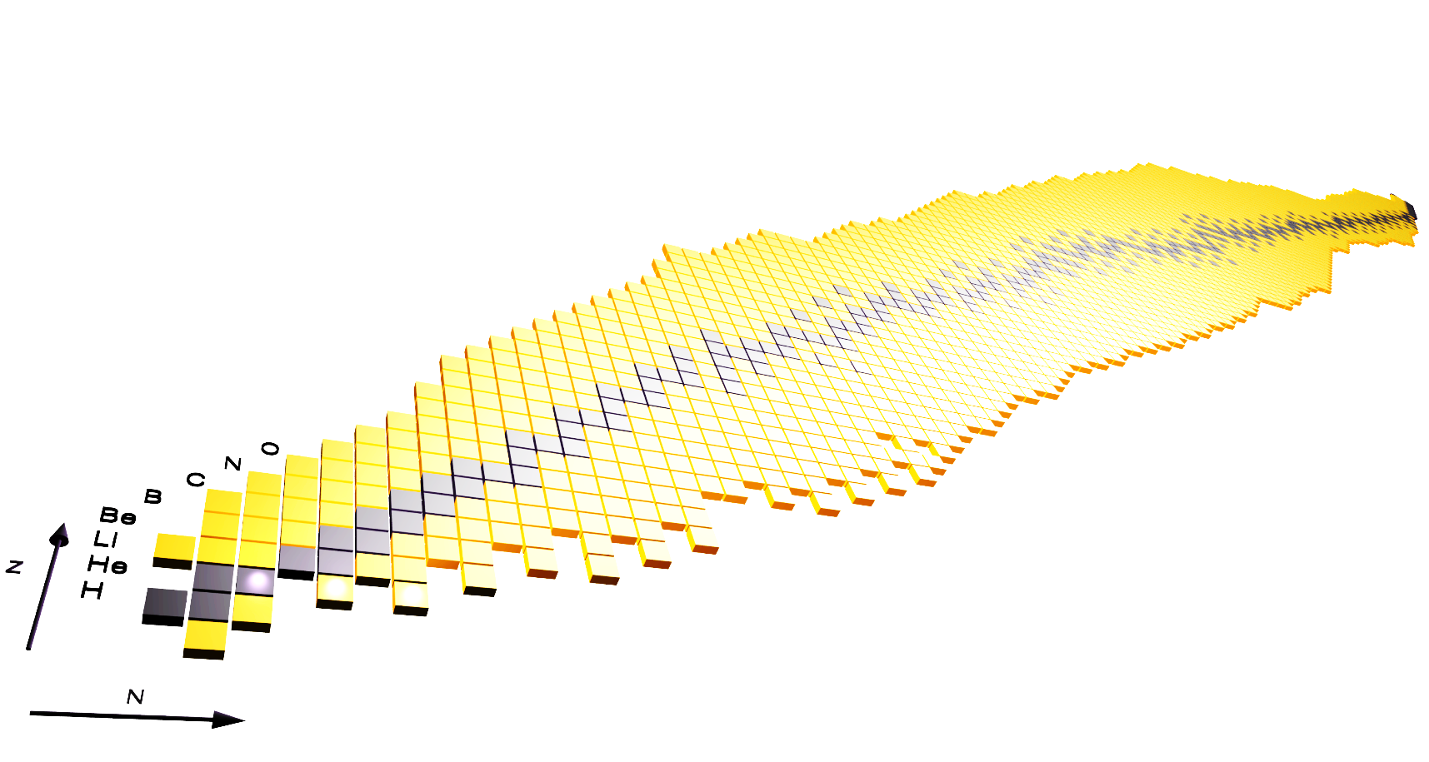
Overview on recent fission studies and related topics
Heloise Goutte
SPhN division
CEA Saclay
CEA-Saclay/DSM/Irfu Service de Physique Nucléaire ARIS

Slide 2
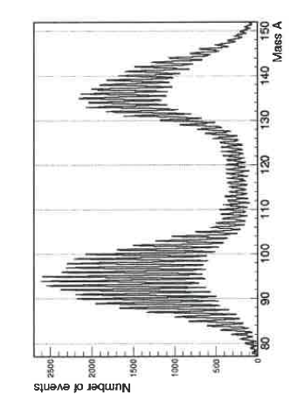
Main characteristics of the fission process
Fission yields
Preliminary results from SOFIA@GSI
A very complex process
Associated to a rich variety of observables
Prompt :
- Kinetic energy of the fission fragments: ~170 MeV
- Kinetic energy of prompt neutrons ~ 5 MeV
- Prompt gammas ~ 7 MeV
- Beta decay:
- Antineutrinos: ~9 MeV
- Delayed electrons: ~ 7 MeV
- Delayed neutrons : ~0.01 MeV
- Delayed gammas: ~7 MeV
²³⁵U*
Number of events
Pellereau et al.
EPJ Web of conf 62 06005(2013)
Beta decay

Slide 3
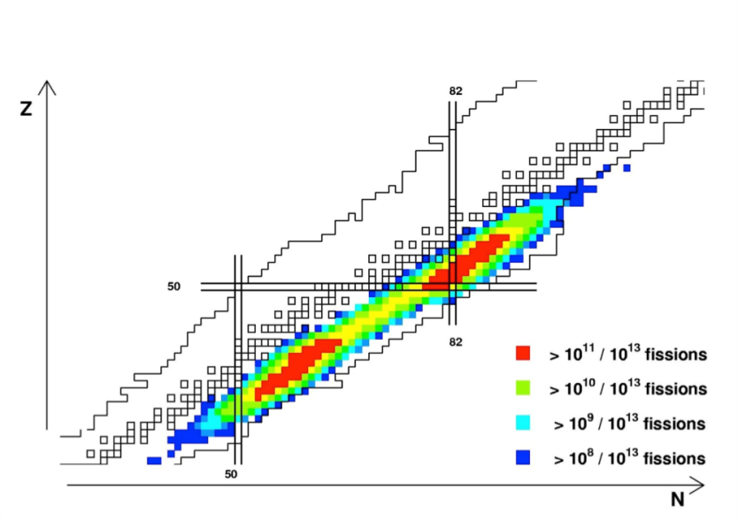
What makes fission so particular ?
Fission is at the same time:
- exceedingly complex mechanism linked to basic questions of many-body dynamics
a tool for societal applications (various and numerous)
a tool for the production of elements of interest (exotic nuclei, neutrinos)
Questions we are asking should be different
depending our interest in fission.
-- > different approaches needed (both exp. and theo.)
- approaches focused on a precise case
- systematics
(to challenge a theory, search for systematic effects, look at evolutions …)
Expected SPIRAL2 production

Slide 4
Fundamental questions
related to
the fission process

Slide 5
Fundamental questions
What is driving the fission process ?
How a quantum many-body system can break apart in fragments ?
How do shell effects manifest ?
Why do individual degrees of freedom play such a big role ? And how ?
²⁵⁷Fm : α decay
T_{1/2α} = 8.7 10⁶ s
²⁵⁸Fm : spontaneous fission
T_{1/2sf} = 3.8 10⁻⁴ s
K-H Schmidt et al., NPA 665 (2000) 221

Slide 6
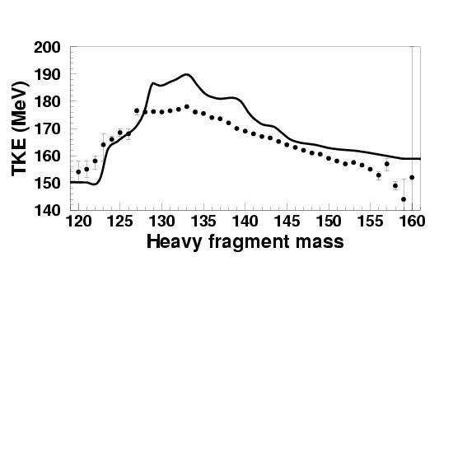
What are the observables available to answer these questions ?
Mass and charge distributions of the fragments
→ test of the shell effects (… and of the effective interaction)
Kinetic energy of the fragments
Prompt neutrons
→ test of the configurations at scission
→ deformation of the fragments at scission
Prompt Gammas
→ Excitation energy of the fragments
Lifetime, cross sections
→ Fission barriers (pairing, …)
²³⁸U
Kinetic energy (MeV)
Mass of the heavy fragment
H. Goutte,et al.
PRC 71, 024316 (2005)

Slide 7
Some new results/developments
(a non exhaustive and subjective list)

Slide 8
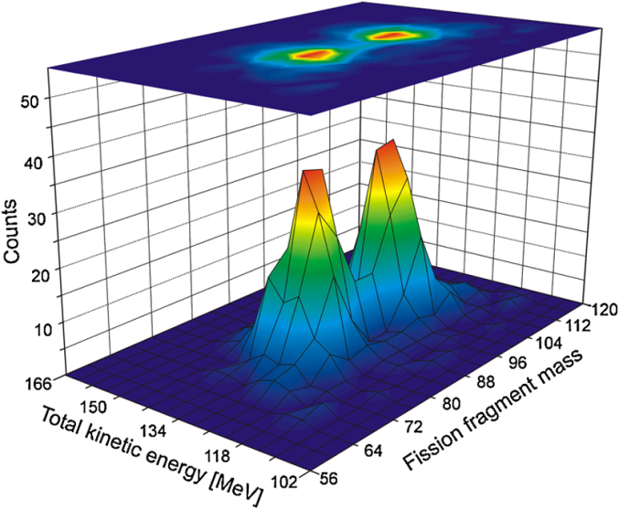
Unexpected shell effects: asymmetric fission of ¹⁸⁰Hg
Experimental discovery @ ISOLDE:
Fission fragment mass distribution of ¹⁸⁰Hg is asymmetric (for E* ~ 10 MeV)
A. N. Andreyev et al., Phys. Rev. Lett. 105, 252502 (2010)
A symmetric fragmentation was expected before
with 2 magic nuclei with N=50, Z=40 :
Has triggered a lot of fission studies
Questions are:
Is this asymmetric fragmentation due to the structure properties of the
fragments at scission?
Is this due to dynamical effects ?
Is it strongly depending on the excitation energy of the fissioning system ?

Slide 9
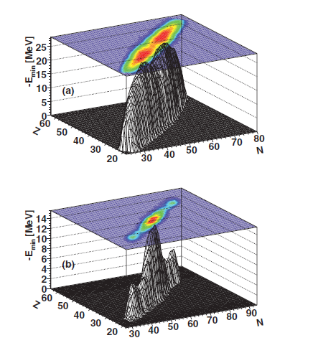
Some theoretical results : scission point approaches
Scission-point model SPY:
S. Panebianco et al. PRC86, 064601 (2012)
(using structure properties at scission obtained
from HFB calculations and the Gogny force):
-> can explain asymmetric splitting of ¹⁸⁰Hg
and symmetric splitting of ¹⁹⁸Hg
-> highlight the importance of the shell effects of the
fragments (spherical and deformed ones)
Micro-macro scission-point model A.V. Andreev et al., PRC88, 047604, (2013):
-> predict evolution from symmetric distribution in ¹⁷⁴Hg to asymmetric around ¹⁸⁰Hg
and more symmetric for ¹⁹²⁻¹⁹⁶Hg.
-> the influence of the excitation energy on the shape of the mass distribution is
found to be rather weak

Slide 10
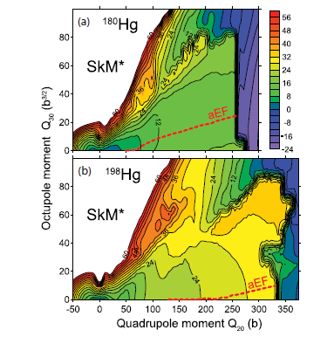
Some theoretical results based on potential energy surfaces
Microscopic HFB approach with Gogny and Skyrme interactions
M. Warda et al. PRC86, 024601 (2012)
→ In ¹⁸⁰Hg, both functionals lead to ¹⁰⁰Ru/⁸⁰Kr as the most probable
→ The most likely split predicted for ¹⁹⁸Hg is ¹⁰⁸Ru/⁹⁰Kr in HFB-D1S and ¹¹⁰Ru/⁸⁸Kr in HFB-SkM∗.
Browian metropolis shape-motion treament based on 5D micro-macro PES:
P. Moller et al. PRC85, 024306 (2012)
For ¹⁷⁴Hg the symmetric yield increases strongly with decreasing energy, an unusual feature, which would be interesting to verify experimentally.

Slide 11
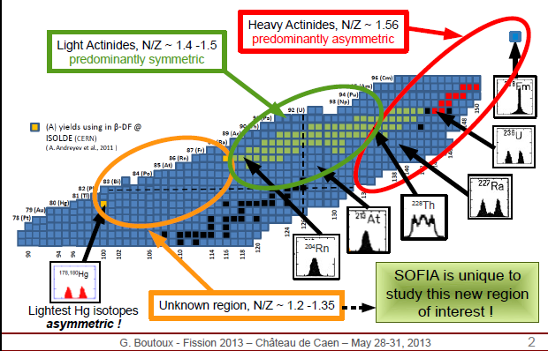
What is needed then ? (Personal view 1/2)
Systematics: To look at global evolutions (as function of E*, N, Z of the fissioning system…)
Example: almost 70 nuclei studied in SOFIA
Pellereau et al. EPJ Web of conf 62 06005(2013)
On Friday Parallel session 4C talks :
K. Nishio, Mass Asymmetric fission of Iridium Nucleus
L. Ghys, Multimodal fission identified in beta-delayed fission of At and Fr at ISOLDE
Systematic calculations
Such as J. Randrup and P. Moller, PRC88, 064606 (2013)
S. Goriely et al. PRL111, 242502 (2013).
11

Slide 12
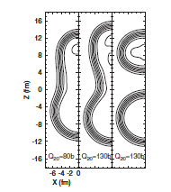
What is needed then ? (Personal view 2/2)
Theoretical improvements :
Quality inputs of the functionals:
Gogny D1M, UNEDF1
Introduce excitation energy/temperature in HFB calculations
J.D. McDonnell et al. (2013/2014) work in progress
Better define the fission fragments at scission
(projection on good particle numbers in the fragments,
quantum localization …) W. Younes, D. Gogny, PRL 107, 132501 (2011).
Enrich the dynamical approaches
(effect of inertia, dissipation, pairing correlations…
J. Sadhukhan et al., PRC88 064314 (2013) importance of the inertia
R. Bernard et al. PRC84, 044308 (2011) TDGCM (+GOA) based HFB + qp
C. Simenel, A.S. Umar, PRC89, 031601(R)(2014) TDHF
Y. Aritomo et al., PRC85, 044614 (2012) Langevin equations
S.A. Giuliani and
L.M. Robledo,
PRC88, 054325 (2013).

Slide 13
A few example of applications
related to
the fission process:
- nuclear energy
- abundances and r-process
- existence of a 4-th neutrino ?
Non exhaustive

Slide 14
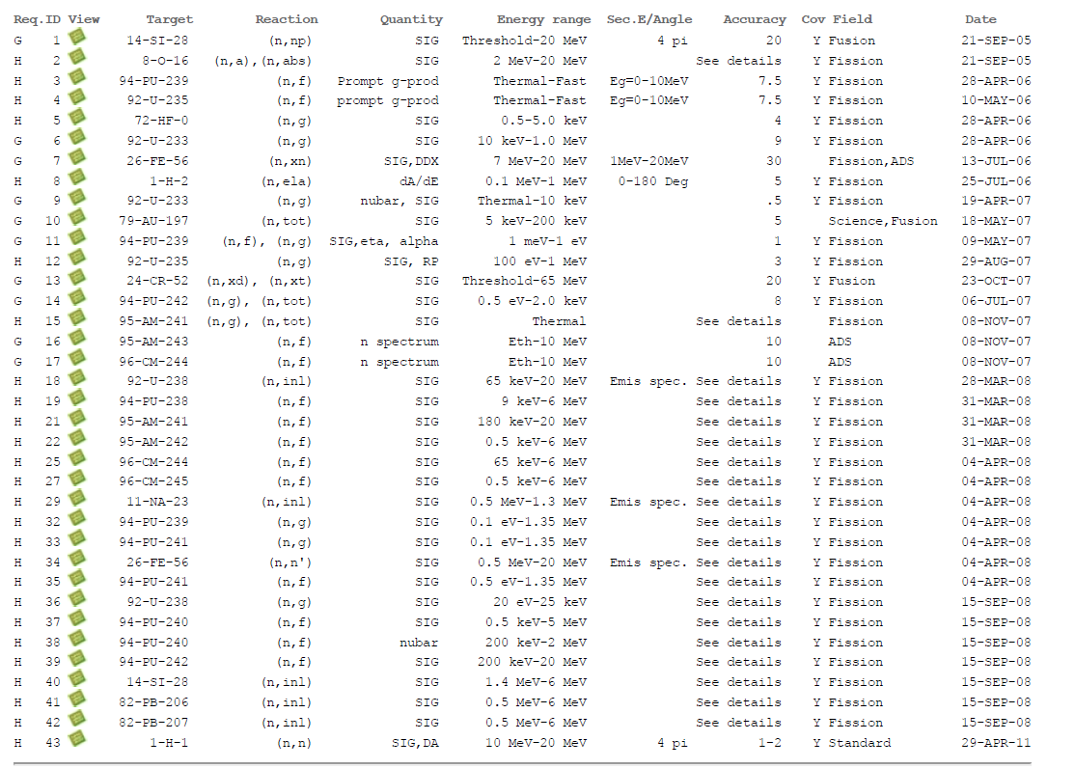
OECD NEA: nuclear Data High Priority List
http://www.oecd-nea.org/dbdata/hprl/search.pl

Slide 15
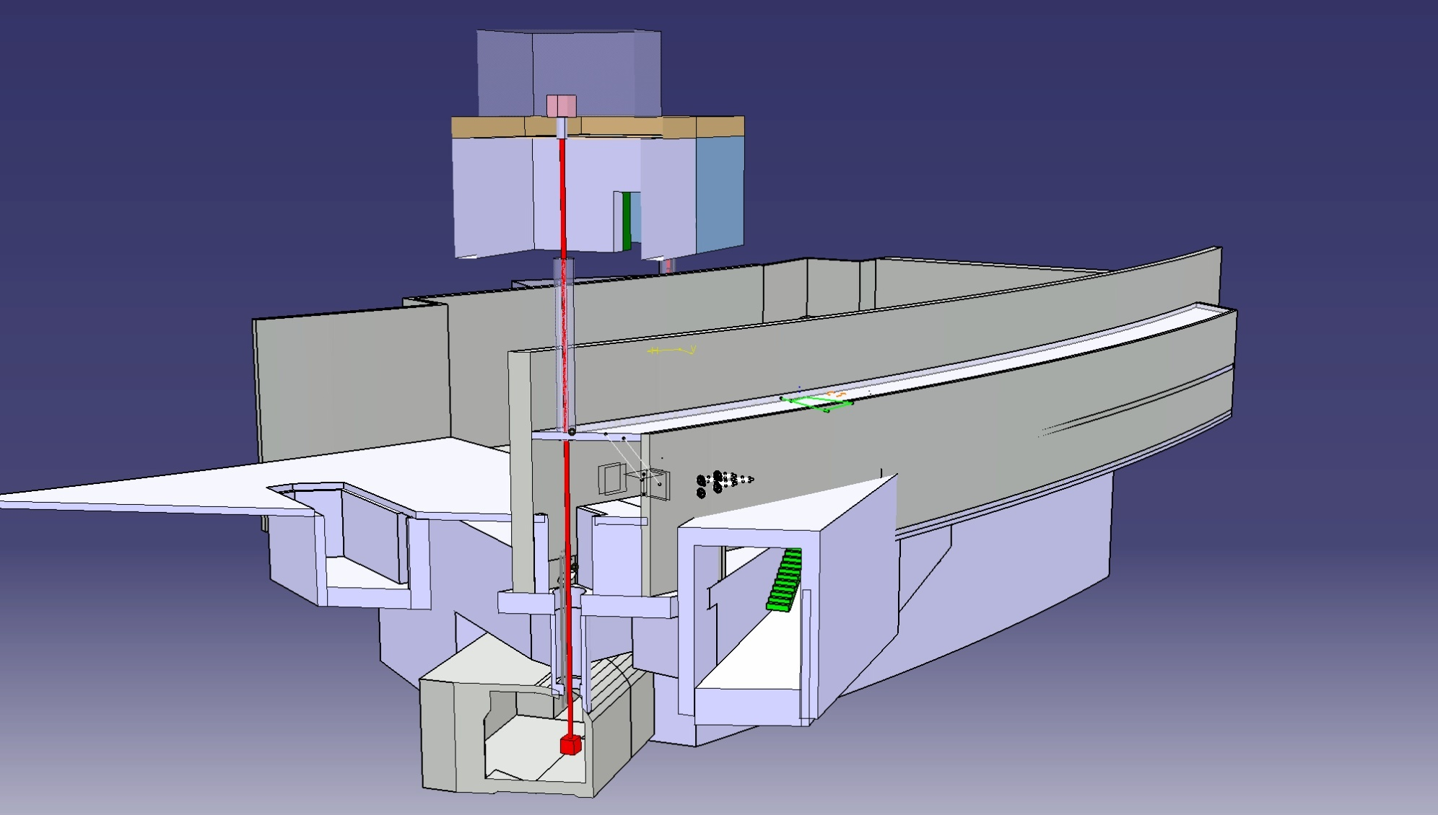
Nuclear Data High Priority List
Efforts to clean up the HPRL ; only documented requests now
43 requests
13 related n-induced fission reactions
Demands related to existing reactors
Nuclei of interest: actinides ²³⁹⁻²⁴²Pu, ²³⁵U, ²⁴¹⁻²⁴⁴Am, ²⁴⁴⁻²⁴⁵Cm
Observables are: cross sections (mainly),
number of emitted neutrons, neutron spectrum, prompt gammas,
capture over fission ratio
Large energy range: from thermal to a few MeV
The main question is the accuracy and the control of the uncertainties
and covariances (both theoretically, experimentally and in the evaluations)
K.H. Schmitt et al; NEA report (2014)
n_TOF
EAR2
To be built
Existing hole

Slide 16
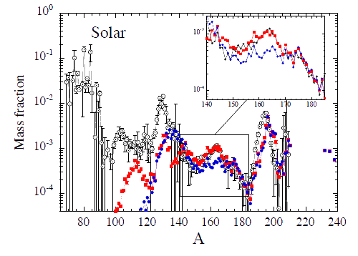
Fission in the heart of the nucleosynthesis (1/2)
None of the existing model of nucleosynthesis is able to explain the abundances
of rare earth nuclei. Are the neutron stars good sites for the formation of these
heavy elements ?
Need of the modelisation of the fission of a huge number of nuclei (2000),
including drip-line nuclei
→ Use of SPY the HFB-based scission point model
S. Goriely, et al., PRL 111, 242502 (2013)
White : Solar r-abundance distribution
Red : fission yields from SPY
Blue : fission yields from phenomenological fission model (GEF)

Slide 17
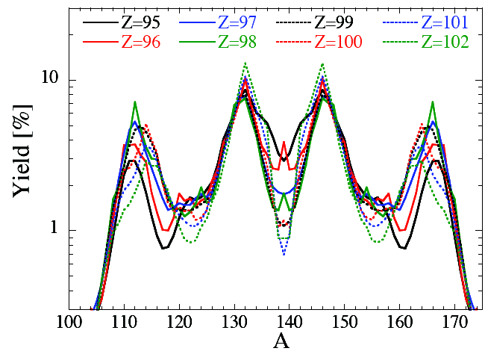
Fission in the heart of the nucleosynthesis (2/2)
Nuclei with mass A=165 are predicted to come from the fission of A=278 nuclei
Fission mass distributions of these nuclei are predicted to be 4-bump distributions: unexpected and never observed experimentally confirmed by HFB calculations of potential energy surfaces
SPY - Isobares A=278
S. Goriely, et al., PRL 111, 242502 (2013)

Slide 18
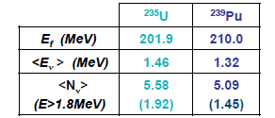
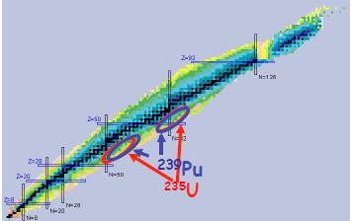
Fission : a source of antineutrinos
Most of fission products are neutron rich nuclei undergoing β-decay.
Power reactors are copious antineutrino emitters:
Use the difference between ν flux and energies
from Pu and U isotopes to infer reactor fuel isotopic
composition
→ reactor monitoring, non-proliferation
Example: Nucifer experiment@OSIRIS (France), …
Neutrino physics:
Oscillation parameter search θ₁₃.
Double Chooz, Daya-Bay and Reno exp.
Y. Abe et al. PRL108, 131801 (2012)
F.P. An et al. PRL108, 171803 (2012)
J.K. Ahn, et al. PRL108, 191802 (2012)
→ search for sterile neutrinos
From M. Fallot, Fission 2013 conference, EPJ Web of science 62 (2013)

Slide 19
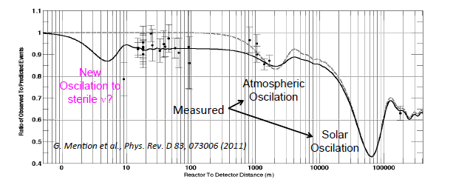
4th neutrino hypothesis
The reevaluation of the anti-neutrino spectrum associated to fission fragments has recently shown a significant deviation that could sign the existence of sterile neutrinos.
Th. A. Mueller et al. PRC83, 054615 (2011)
This result on fission spectra has triggered a lot experiments:
Reactor exp.: Nucifer (Fr.), STEREO (France), …
And mega Curie sources experiments such as CESOX …

Slide 20
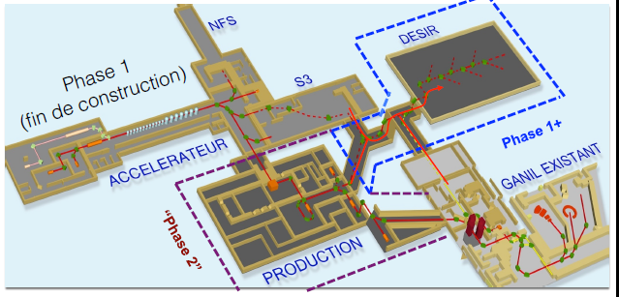
Conclusion
Very active field
Many other examples of fission studies not discussed in this talk;
Superheavies, odd-even effects, spontaneous fission ….
J. Erler et al. PRC85 025802 (2012)
I. Petermann et al., EPJA 48 (2012)
Start of NFS soon (2015) @ SPIRAL2
FALSTAFF
D. Dore et al.
EPJ Web of conf 62 06005(2013)

