Slide 1
2nd Conference “Advance in Radioactive Isotope Science
At the End of the Nuclear Map
Yuri Oganessian
Flerov Laboratory of Nuclear Reactions,
Joint Institute for Nuclear Research,
141980 Dubna, Moscow region, Russia
ARIS 2014 June 1-6, 2014 in Tokyo, Japan

Slide 2
Chart of nuclides
Chart of nuclides
Macroscopic theory (Liquid Drop Model)
about 50 years ago…
T_{SF} = 2·10⁻⁷ y
₁₀₂No / T_{α} ≈ 2 s
Nuclear instability against spontaneous fission
Th
Bi
₉₂U / T_{α} = 4.5·10⁹ y
T_{SF} = 10¹⁶ y
₈₂Pb / stable
Yuri Oganessian. ARIS 2014, June 5, 2014 in Tokyo, Japan
Notes:
2

Slide 3
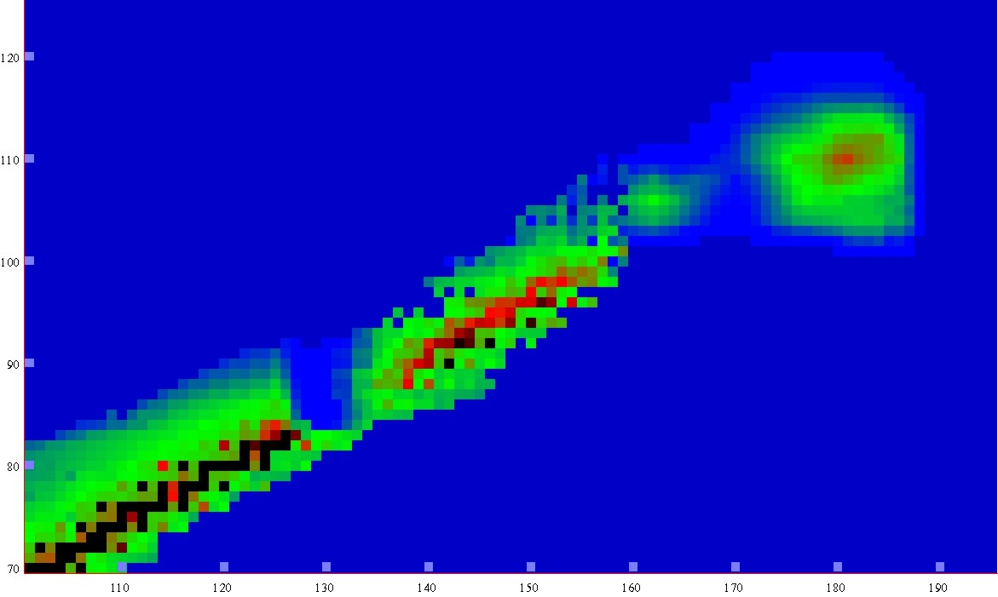
New lands
New lands
Macro-microscopic theory
New lands
A. Sobiczewski et al (2003)
New lands
-5
0
5
10
15
LogT_{1/2} s
about 40 years ago…
1µs
1s
1h
1y
1My
Island of
Stability
120
Island of
Stability
r
e
b
m
Shoal
u
110
shoal
n
n
o
t
o
Peninsula
r
peninsula
P
100
90
Continent
continent
Sea of Instability
80
70
100
110
120
130
140
150
160
170
180
190
Neutron number
Notes:
3

Slide 4
Reactions of Synthesis
Reactions of Synthesis
A. Sobiczewski, K. Pomorski, PPNP 58, 292, 2007
LDM + Shell Corrections
SHE
(10y) 6 elem.
1989 - 2010
protons →
Cold fusion
Cold fusion
Act. + ⁴⁸Ca
(38y) 6 elem.
1974 - 2012
Act. + ⁴⁸Ca
Hot
fusion
Hot
fusion
1955 - 1975
(20y) 6 elem.
Neutron capture
Neutron capture
1940 - 1955
(15y) 8 elem.
Historical background:
After discovery of nuclear fission 75 - years ago - 26 new chemical elements heavier than uranium was synthesized
Pb
neutrons →
Yuri Oganessian. ARIS 2014, June 5, 2014 in Tokyo, Japan
Notes:
4

Slide 5

P. Moller et al., PR., C79, 064304 (2009)
hot fusion
⁴⁸Ca-induced reactions
E_{x} = 35 - 45 MeV
х = 3 – 4
SHE
118
116
117
115
113
113
114
112
112
110
106
108
Fission barrier
heights in MeV
104
cold fusion
²⁰⁸Pb, ²⁰⁹Bi + ⁵⁰Ti,……⁷⁰Zn
E_{x} = 12 - 15 MeV
х = 1
10⁻³²
Rf
Sg
⁴⁸Ca
10⁻³⁴
Hs
Total EVRs cross sections (cm²)
Hs
Fl
Lv
Ds
Cn
Fl
10⁻³⁶
Cn
Island
113
10⁻³⁸
155
160
165
170
175
180
185
190
CN neutron number

Slide 6
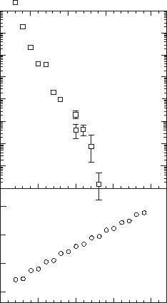
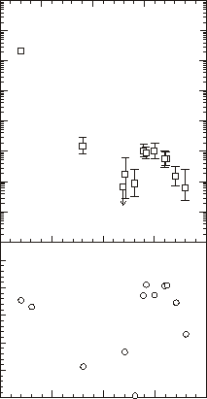
10⁶
10⁶
Cold fusion
E_{x}=12-15 MeV
Hot fusion
E_{x}≈ 40 MeV
10⁴
10⁴
Total EVR’s cross sections (pb)
Total EVR’s cross sections (pb)
SHE
10²
10²
10⁰
10⁰
SHE
10⁻²
10⁻²
300
0.5
0.0
250
Z₁·Z₂/(A₁^{1/3}+A₂^{1/3})
-0.5
B_{n} – B_{f} (MeV)
200
-1.0
Limitation of fusion
-1.5
CN survival ~ exp(B_{n}-B_{f})
150
-2.0
100
105
110
115
120
100
105
110
115
120
Atomic number
Atomic number
K. Siwek-Wilczy´nska et al.,
PR C86, 014611 (2012)
Yuri Oganessian. ARIS 2014, June 5, 2014 in Tokyo, Japan

Slide 7
1998 - 2007
Experimental technique
Dubna Gas-Filled Recoil Separator
Dubna Gas-Filled Recoil Separator
Transmission for:
EVR 35-40%
target-like 10⁻⁴-10⁻⁷
projectile-like 10⁻¹⁵-10⁻¹⁷
Registration efficiency:
for α-particles 87%
for SF
single fragment 100%
two fragments ≈ 40%
beam
⁴⁸Ca
target
Notes:
7

Slide 8
low-background detection scheme
²⁴⁹Bk
target
separator
focal plane
detector array
Yu. Oganessian 2010
⁴⁸Ca
9.96 MeV
293
22.04 mm
117
E_{R}=7–15 MeV
y=y₀
α
10.91 MeV
1
10.7–11.4 MeV
53.01 ms
289
≤ 132 ms
22.16 mm
115
Δy=y₁-y₀ ≤ 2.2 mm
α
2
10.25 MeV
285
0.51s
22.20 mm
113
α
9.79 MeV
3
0.24 s
281
22.09 mm
111
SF
189.4 MeV
31.66 s
22.01 mm
the beam was switched off

Slide 9
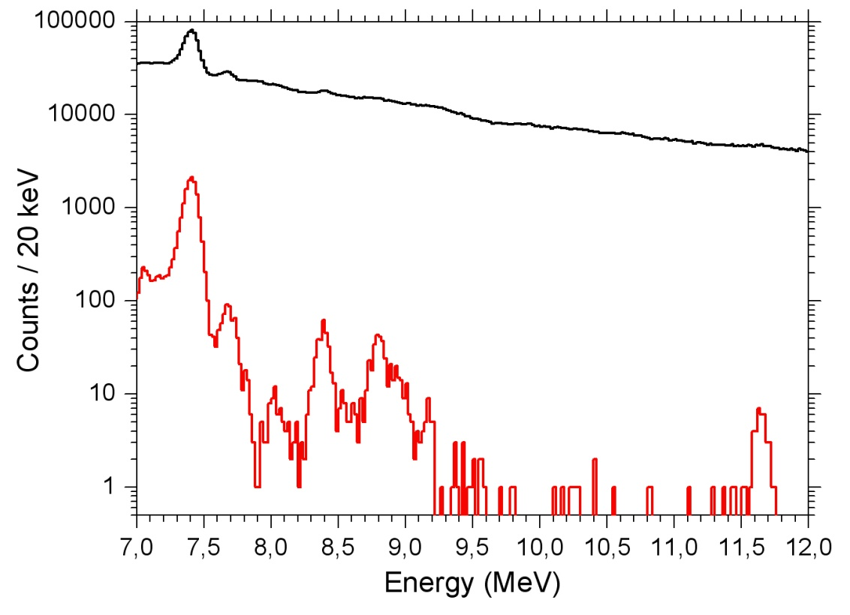
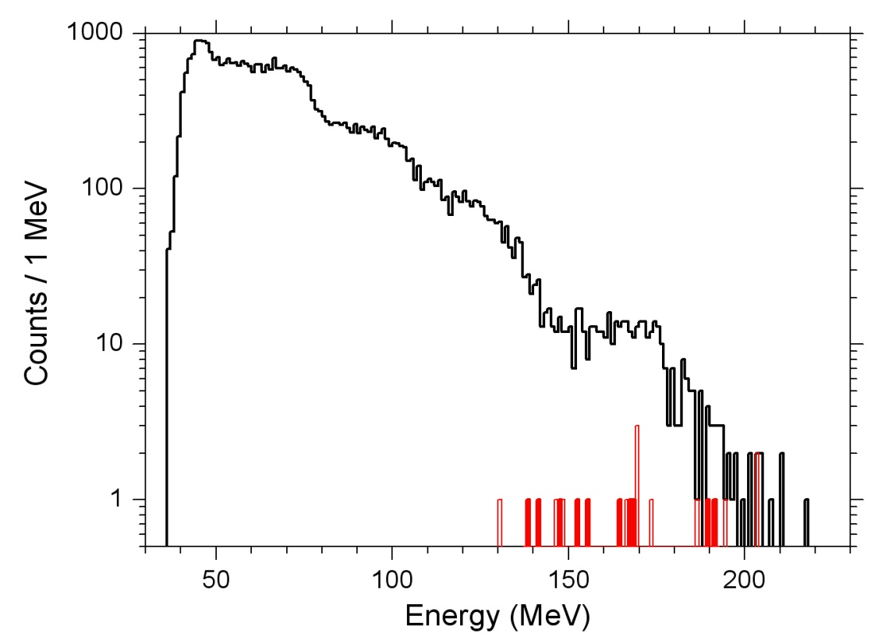
Spectra of the α-like signals
Spectra of fission-like signals
117
α₁
Yu. Oganessian 2010
beam-on
1680 h
beam-on
²¹¹Po
1680 h
²¹⁴Po
²¹³Po
²¹²Po
(α+e⁻)
(α+e⁻)
SF
113
115
111
α₃
α₂
²¹²Po
beam-off
^{252,254}Cf
80 h
80 h
beam-off
10⁻³/s
7·10⁻⁵/s
per strip / position
2·10⁻⁶/s
1.5·10⁻⁷/s
Expected numbers of random sequences ≤ 5·10⁻¹⁰
Yuri Oganessian / Seminar at Tokyo Institute of Technology, June 04, 2014 , Tokyo, Japan

Slide 10
Decay Properties of SHN

Slide 11
Even-Z Nuclei
3n
²⁴⁵Cm + ⁴⁸Ca
2n
²⁴²Pu + ⁴⁸Ca
4n
²³⁸U + ⁴⁸Ca
3n
2n
4n
3n
²⁴⁴Pu + ⁴⁸Ca
4n
3n
Z=118
3n
²⁴⁹Cf + ⁴⁸Ca
²⁴⁴Pu + ⁴⁸Ca
5n
4n
3n
116
114
112
110
19
N=26
26
10
108
106
Decay chains
104
3

Slide 12
Even Z Nuclei
1999 - 2005
Energy spectra of alpha particles
²⁴⁹Cf + ⁴⁸Ca
²⁴²Pu+ ⁴⁸Ca
²⁴⁴Pu+ ⁴⁸Ca
Yuri Oganessian. ARIS 2014, June 5, 2014 in Tokyo, Japan

Slide 13
Alpha - decay
Theory I. Muntian, Z. Patyk, and A. Sobiczewski
Phys. At. Nucl. 66, (2003)
Z-even
Exp.
Z-even

Slide 14
Spontaneous fission
even-even isotopes
R. Smolańczuk, PR. C 56 (1997) 812
SHN
SF critical
zone
Yuri Oganessian. ARIS 2014, June 5, 2014 in Tokyo, Japan

Slide 15
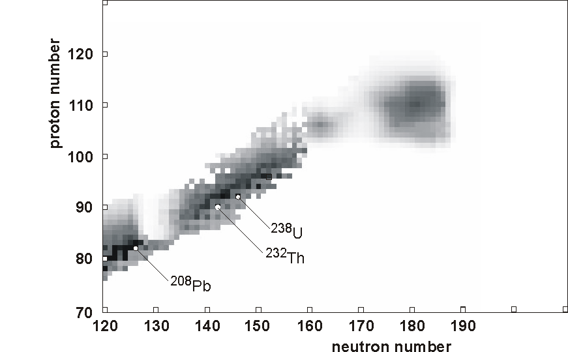
130
Congress of IUPAC-2011
^{Fl}
β-stability line
^{Lv}
SHE
200
210
Yuri Oganessian. ARIS 2014, June 5, 2014 in Tokyo, Japan

Slide 16
Odd-Z Nuclei
February, 2012
GARIS
DGFRS
2n[4]
4n[10]
[2]
[2]
[1]
[31]
[3]
Yuri Oganessian. ARIS 2014, June 5, 2014 in Tokyo, Japan

Slide 17
June, 2013
GARIS
DGFRS + TASCA
2n[4]
4n[16]
[3]
[2]
[3]
[73]
[6]
K. Morita
this session

Slide 18
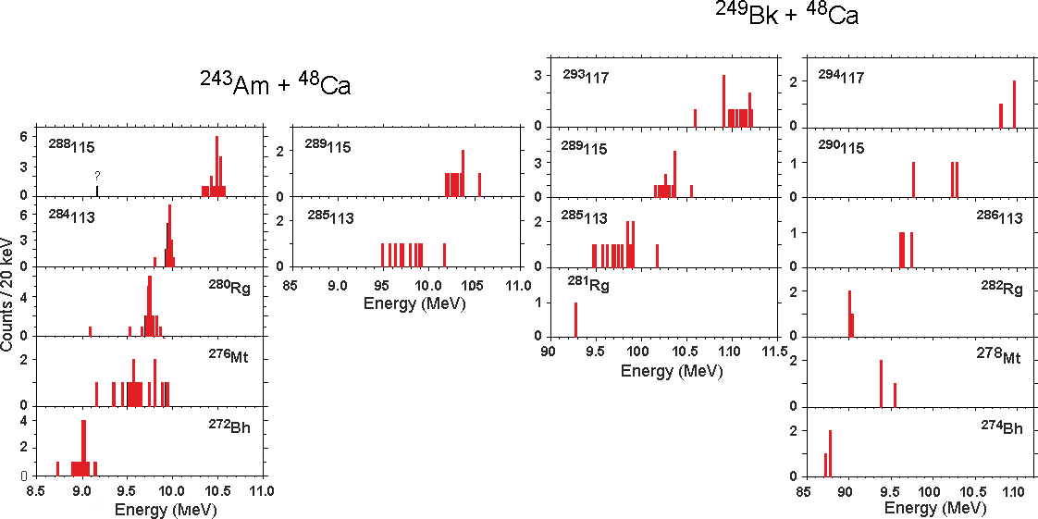
Odd Z Nuclei
2003 - 2012
An excellent case for
spectroscopic studies of the SHN
in <α-γ> coincidence experiments
D. Rudolf at this session
Yuri Oganessian. ARIS 2014, June 5, 2014 in Tokyo, Japan

Slide 19
Confirmations of DGFRS data 2007 - 2014
A/Z | Setup | Laboratory | Publications
²⁸³112 | SHIP | GSI Darmstadt | Eur. Phys. J. A32, 251 (2007)
²⁸³112 | COLD | PSI-FLNR (JINR) | NATURE 447, 72 (2007)
^{286, 287}114 | BGS | LBNL (Berkeley) | P.R. Lett. 103, 132502 (2009)
^{288, 289}114 ^{292, 293}116 | TASCA SHIP | GSI – Mainz GSI Darmstadt | P.R. Lett. 104, 252701 (2010) Eur. Phys. J. A48, 62 (2012)
^{287, 288}115 ^{293, 294}117 | TASCA TASCA | GSI – Mainz GSI – Mainz | P.R. Lett. 111, 112502 (2013) P.R. Lett. 112, 172501 (2014)
^{292, 293}116 | GARIS | RIKEN Tokyo | Accelerator Progress Rep. (2013)

Slide 20
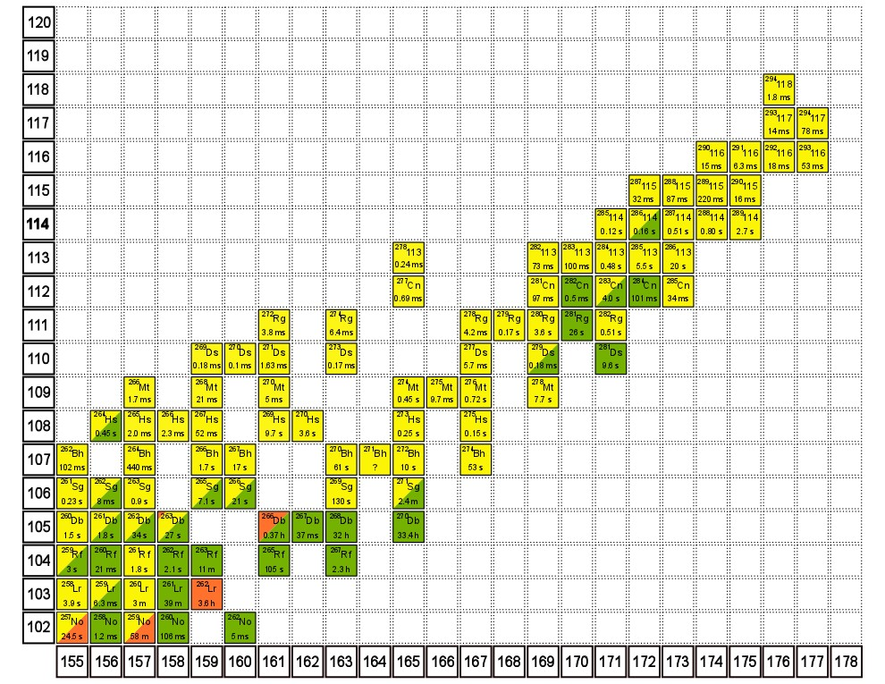
Island of over 50 nuclei
produced in Act.+⁴⁸Ca
reactions
~1 pb
~ 0.02 pb
~10 pb
Nuclear Mainland
29 s
²⁷¹Hs
4 s
²⁷⁷Hs
3 ms
2 s
²⁶⁷Sg
2min
~1 h
1.1h
Fission is terminating
the decay chains at the Island
1.1h
²⁶⁶Lr
11 h

Slide 21

How to build a bridge between heavy and super-heavy nuclei
118
117
116
115
Island
114
113
112
112
110
108
Z=106
Mainland

Slide 22
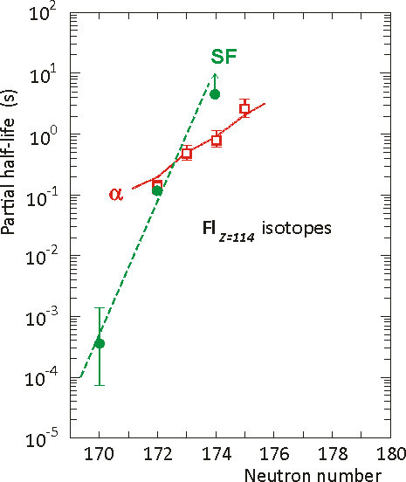
How to build a bridge between heavy and super-heavy nuclei
K. Rykaczewski tomorrow
118
²³⁹Pu(⁴⁸Ca,3n)
One decay was
detected only
t_{SF} = 0.5 ms
σ ≈ 0.25 pb
protons
116
115
114
284
Island
114
²³³U(⁴⁸Ca,3n)
113
4n
No decays was observed
278
112
²⁴⁴Pu+⁴⁸Ca
t_{SF} > 5 s
σ ≈ 6-7 pb
111
Mainland
110
109
108
107
106
105
104
neutrons
Notes:
22
It is questionable that “filling in empty spaces” would give us any new information about nuclear structure of super heavy elements.

Slide 23
The discovery of SHE raised a questions:

Slide 24
Where is the end of
the nuclear landscape?
Are SH atoms and nuclei
different from lighter species?
SHN
…and what are the shapes
and density of nuclei
at the mass limit?
HN
β⁻
β⁻
Pb
β⁻
Uranium
Are SHN produced
in stellar explosions?
waiting
point
Yuri Oganessian. ARIS 2014, June 5, 2014 in Tokyo, Japan

Slide 25
⁵⁰Ti,⁵⁴Cr,⁵⁸Fe
STRATEGY
σ≤0.12pb
Search for new elements
σ≤0.07pb
Fusion of ²⁰⁸Pb and ²⁰⁹Bi with
projectiles A > 50
Act + ⁴⁸Ca
σ≈10 pb
0.3 pb
proton number
low intensity of RIB
Expanded studies
Fusion reaction of Actinide-target
nuclei with ⁴⁸Ca projectiles
Neutron number
Yuri Oganessian. ARIS 2014, June 5, 2014 in Tokyo, Japan

Slide 26
Obviously...
the field of the research is limited
by the production of super heavy nuclei

Slide 27
Everything we know about SH-nuclei produced
in ⁴⁸Ca-induced reactions:
…allow us to think about a SHE-Factory
with production rate about 100 times higher
than what we currently have
Reaction of synthesis (CN and neutron evaporation)
Production cross sections (excitation functions)
Competing channels (background)
Decay chains (principal decay modes)
- Half-lives of the SHN (and its α-decay products)
and
All achievements obtained in last decade:
- in experimental technique,
- in accelerator and plasma physics,
- in detectors,
- in target technologies, etc.

Slide 28
Factory of SHE

Slide 29
SHE-Factory
Isotope production:
Cm-248
Bk-249
Cf-251
New accelerator
High beam
dose of : Ca-48
Ti-50
Ni-64
To be increased
10 times
SC- separator
& sophisticated
detectors
Factor 10-20
Depend of
target durability
Factor 3-5
is closely linked
to the intellect
Yuri Oganessian. ARIS 2014, June 5, 2014 in Tokyo, Japan

Slide 30
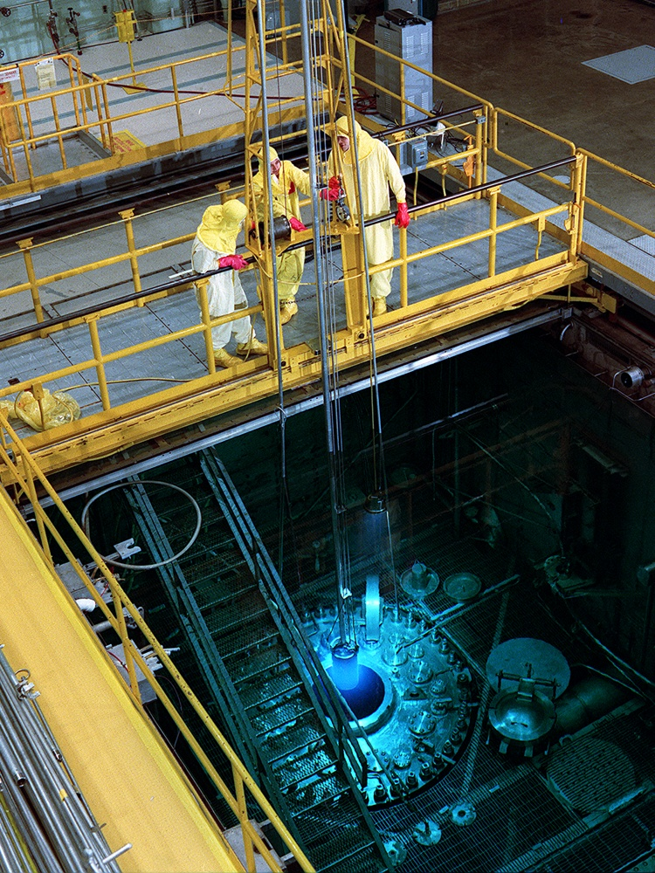
High Flux Isotope
Reactor at Oak- Ridge
Yu. Oganessian 2010
Cf
251
98
Cf249
α, (n,f)
Cf250
α
251
α, (n,f)
new mode gave
by now factor: 6.5
Cf251
Cf252
α, SF
Cf
Cf
Z
97
Bk
249
Bk250
β⁻
Bk
96
Cm
Cm242
α
Cm243
α, (n,f)
Cm244
α
Cm245
α, (n,f)
Cm246
α
Cm247
α, (n,f)
Cm248
α, SF
248
start
Cm
95
Am
Am241
α
Am242
β⁻,EC,(n,f)
Am243
α
Am244
β⁻
Am245
β⁻
Am246
β⁻
Isolation from the
“Old ²⁵²Cf sources”
& mass separation
94
Pu
Pu240
α
Pu241
β⁻, (n,f)
Pu242
α
Pu243
β⁻
Pu244
α
Pu245
β⁻
Pu246
β⁻
start
146
148
150
152
N

Slide 31
HEAVIEST NUCLEI
293
294
295
296
α
118
118
118
118
α
α
3n and 4n
evaporation
channels
289
290
291
292
293
0.42/0.22/0.36
α
Lv
Lv
Lv
Lv
Lv
48
+
249
250
251
,
Ca
Cf
Cf
Cf
285
286
287
288
289
Fl
Fl
Fl
Fl
Fl
Cf - mixed target
made in ORNL
281
282
283
284
285
Cn
Cn
Cn
Cn
Cn
new:
α
277
279
281
Ds
Ds
Ds
273
275
277
Hs
Hs
Hs
269
271
Search for new isotopes of Lv and element 118
Sg
Sg
265
267
Rf
Rf
Yuri Oganessian. ARIS 2014, June 5, 2014 in Tokyo, Japan

Slide 32
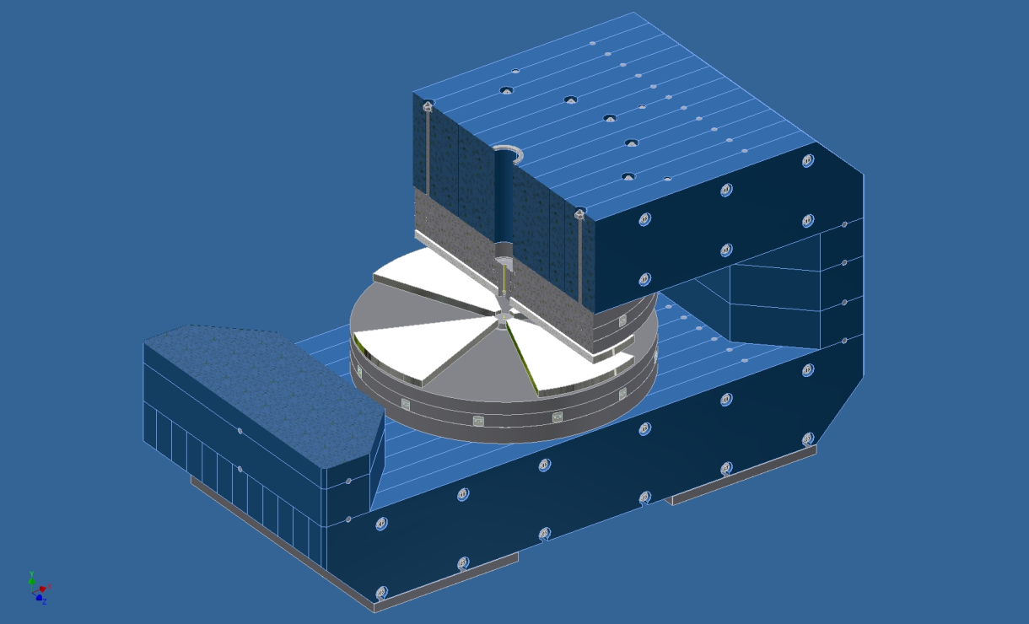
New accelerator and new Lab. at Dubna
Production
Production
today: ~ 5·10¹⁹/y
with Factory: 1.0·10²¹/y
factor: 20
Increase a beam dose
 |  | Beam intensity |  | & | Beam time
 | New accelerator |  |  |  | Factory
 |  |  | 10-20 pµA |  | ~ 7000 h/year
New cyclotron
From ECR
10-20 pµA
Yuri Oganessian. ARIS 2014, June 5, 2014 in Tokyo, Japan

Slide 33
Scheme of the production and delivery SH-atoms to the detectors
Mass analyzer
EVR’s transport
interface
analyzer
Actinides
beam
SHE
target
station
Gas catcher
⁴⁸Ca
Focal plane
detector array
Z, A
Large acceptance
SC-gas filled recoil
separator
Present
acceleration
if necessary
factor: 5-10
Detectors
Yuri Oganessian. ARIS 2014, June 5, 2014 in Tokyo, Japan

Slide 34
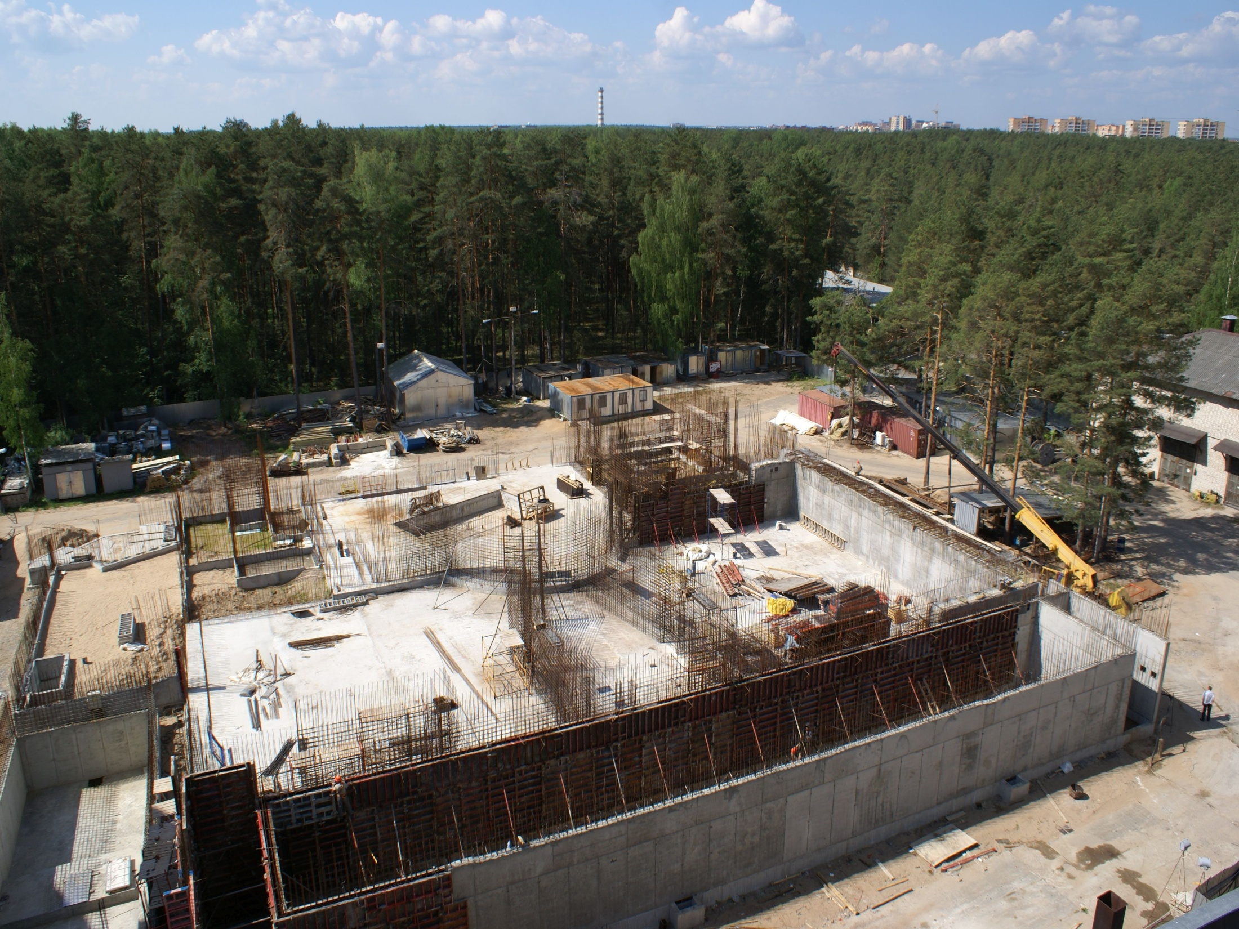
Dubna, May 22, 2014

Slide 35
Collaboration
Thank you
FLNR, JINR (Dubna)
ORNL (Oak-Ridge, USA)
LLNL (Livermore, USA)
ANL (Argonne, USA)
GSI (Darmstadt, Germany)
TAMU Cyclotron Institute (Texas, USA)
GANIL (Caen, France)
RIAR (Dimitrovgrad, Russia)
Vanderbilt University (Nashville, USA)
Yuri Oganessian. ARIS 2014, June 5, 2014 in Tokyo, Japan

