Slide 1

Reaction dynamics of light nuclei around the Coulomb barrier
Alessia Di Pietro
INFN-Laboratori Nazionali del Sud

Slide 2
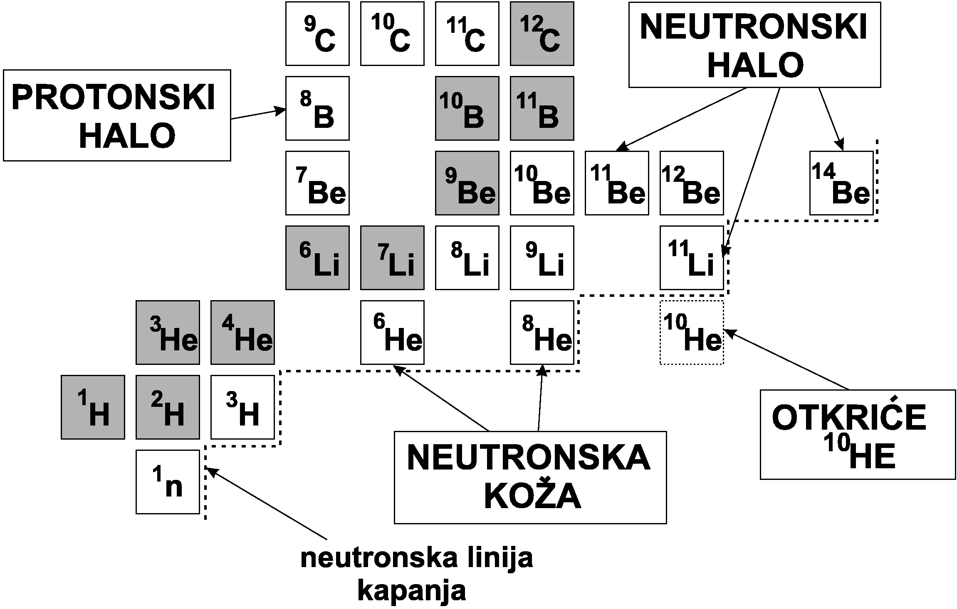
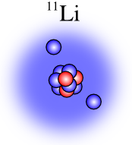
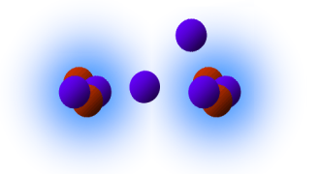
Light Nuclei
neutron
halo
proton
halo
Cluster
configuration
¹⁰Be
¹⁰He
neutron
skin
neutron drip line
Quantum mechanics plays a role in creating peculiar structures in ground states of light nuclei namely: nuclear clusters, nuclear skins and/or nuclear halos.
We are going to discuss the effects of such structures on different reaction mechanisms:
  Elastic scattering
  Direct reactions
  Fusion
ECT*, April 23rd 2013
Alessia Di Pietro,INFN

Slide 3
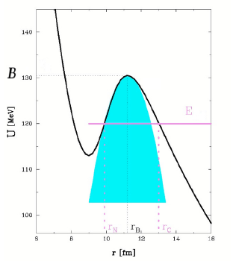
Collisions induced by light weakly bound or halo nuclei
Characteristics of the projectiles:
Low break-up thresholds, diffuse tails
Continuum lies close to ground state → coupling to continuum expected to be important in all channels (elastic scattering and reactions)
⇓
    Direct mechanisms (e.g. break-up, transfer) could be favored
    What do we expect for fusion reactions ?
a)Static effects:
diffuse tail affects the shape of potential
b) Dynamic effects:
Coupling not only to resonant states but also to continuum
For such type of studies, light stable weakly bound beam as well as radioactive beams are used.

Slide 4
Elastic scattering and direct processes

Slide 5
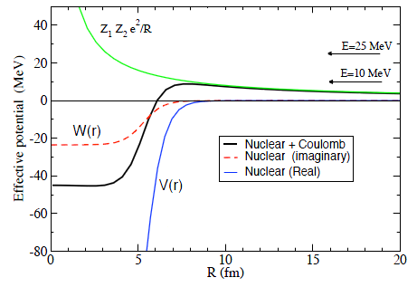
Theoretical ‘tools’ for data interpretation
Optical model
Elastic scattering A.D. can be reproduced using
O.M. with potentials: U(r)= Vc(R)+V(r)+iW(r)
Hamiltonian: H = T(r )+ U(r)
The inclusion of a DPP ΔV(r) potential to simulate
coupling effects.
CDCC
Hamiltonian: H= h+T(r)+U(r) h= intrinsic Hamiltonian
Coupling to continuum treated discretizing it into a finite number of bins from the BU threshold to a certain ε_{max}.
εmax
T
h
B.U. Threshold
C
gs

Slide 6
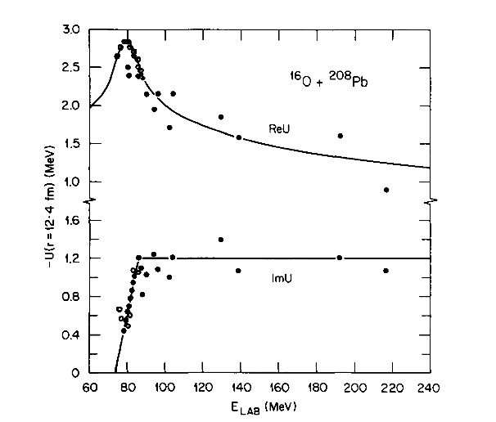
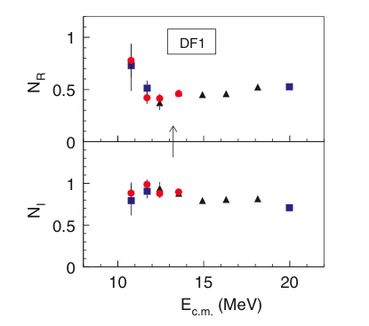
Collisions around the barrier induced
by the stable weakly bound nuclei.
Question: effects of weakly bound cluster structure?
Stable beams ⇒ better data quality.
The threshold anomaly is the energy behavior of O.P. at low energy around the barrier.
Is usual threshold anomaly in O.P. present in collisions involving weakly bound nuclei?
¹⁶O+²⁰⁸Pb
⁶Li+⁶⁴Zn
R.G. Satchler Phys. Rep. 199,147,(1991)
M.Zadro et al., PRC 80,064610, (2009)

Slide 7
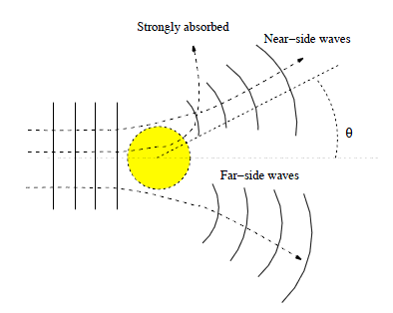
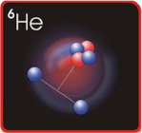
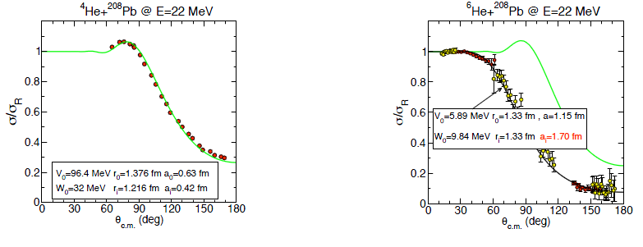
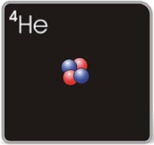
Elastic scattering: Normal versus halo nuclei
How does the halo structure affect the elastic scattering?
Low energy and heavy targets
Coulomb strong (η>>1)
’Illuminated’ region→ interference pattern.
’Shadow’ region →strong absorption.
A.M.Moro lectures at TRIUMF summer school
● ⁶He+²⁰⁸Pb requires a large imaginary diffuseness ! long-range absorption

Slide 8
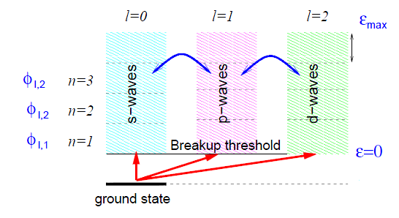
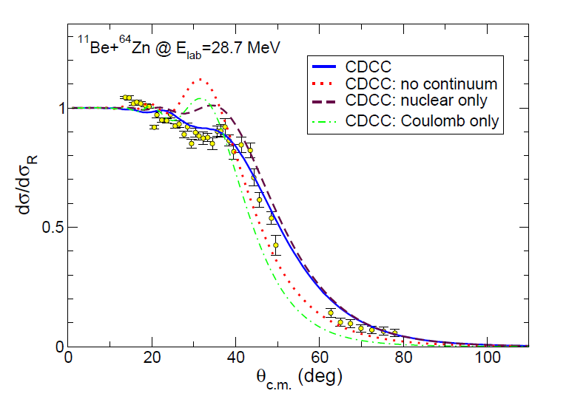
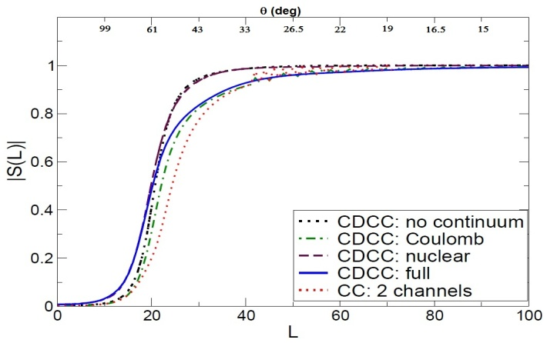
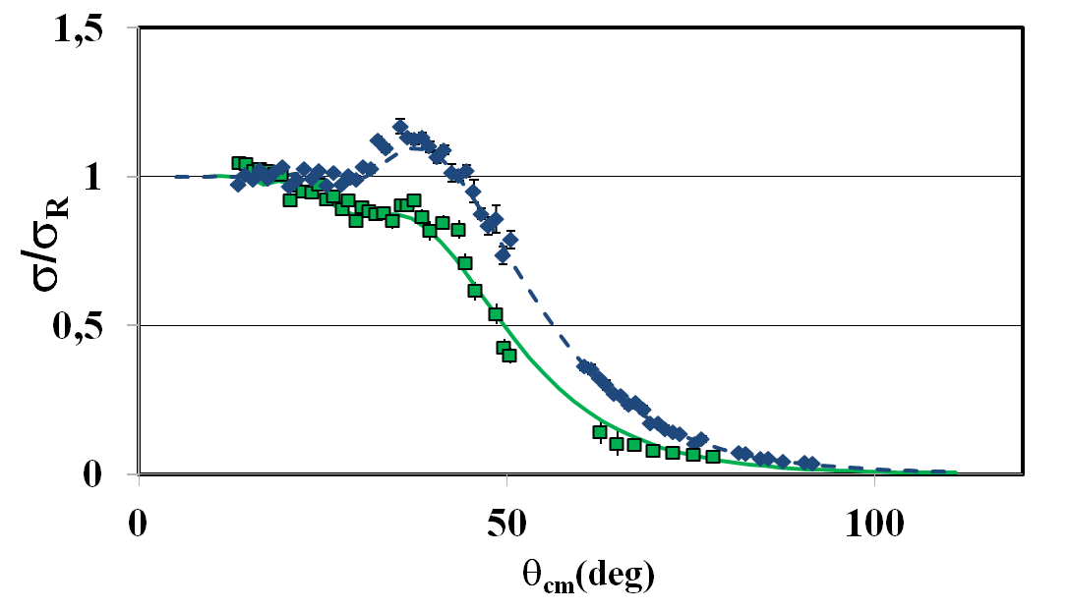
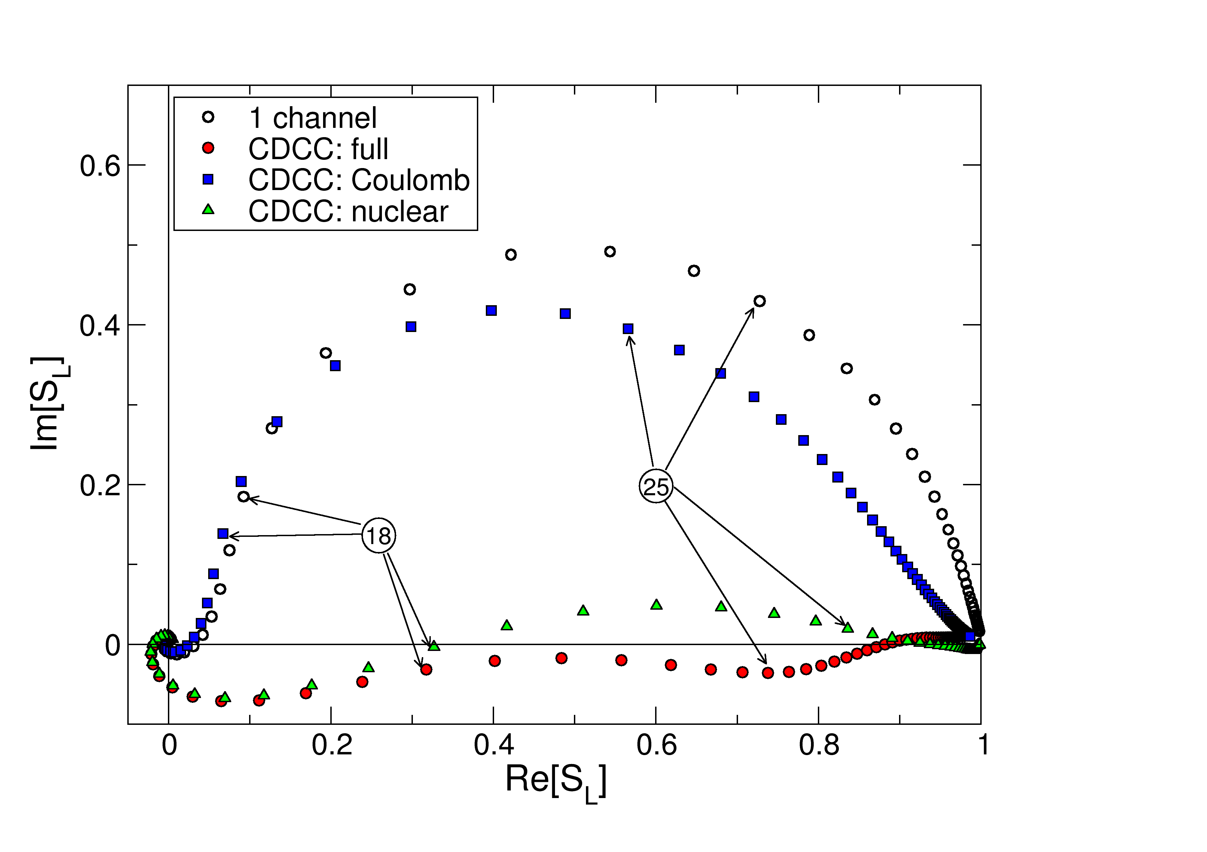
Elastic scattering angular distribution ¹¹Be+⁶⁴Zn @ 29 MeV
Standard CDCC calculations
¹⁰Be+⁶⁴Zn
¹¹Be+⁶⁴Zn
A. Di Pietro et al. Phys. Rev. Lett. 105,022701(2010)
A. Di Pietro, V. Scuderi, A.M. Moro et al.
Phys. Rev. C 85, 054607 (2012)

Slide 9
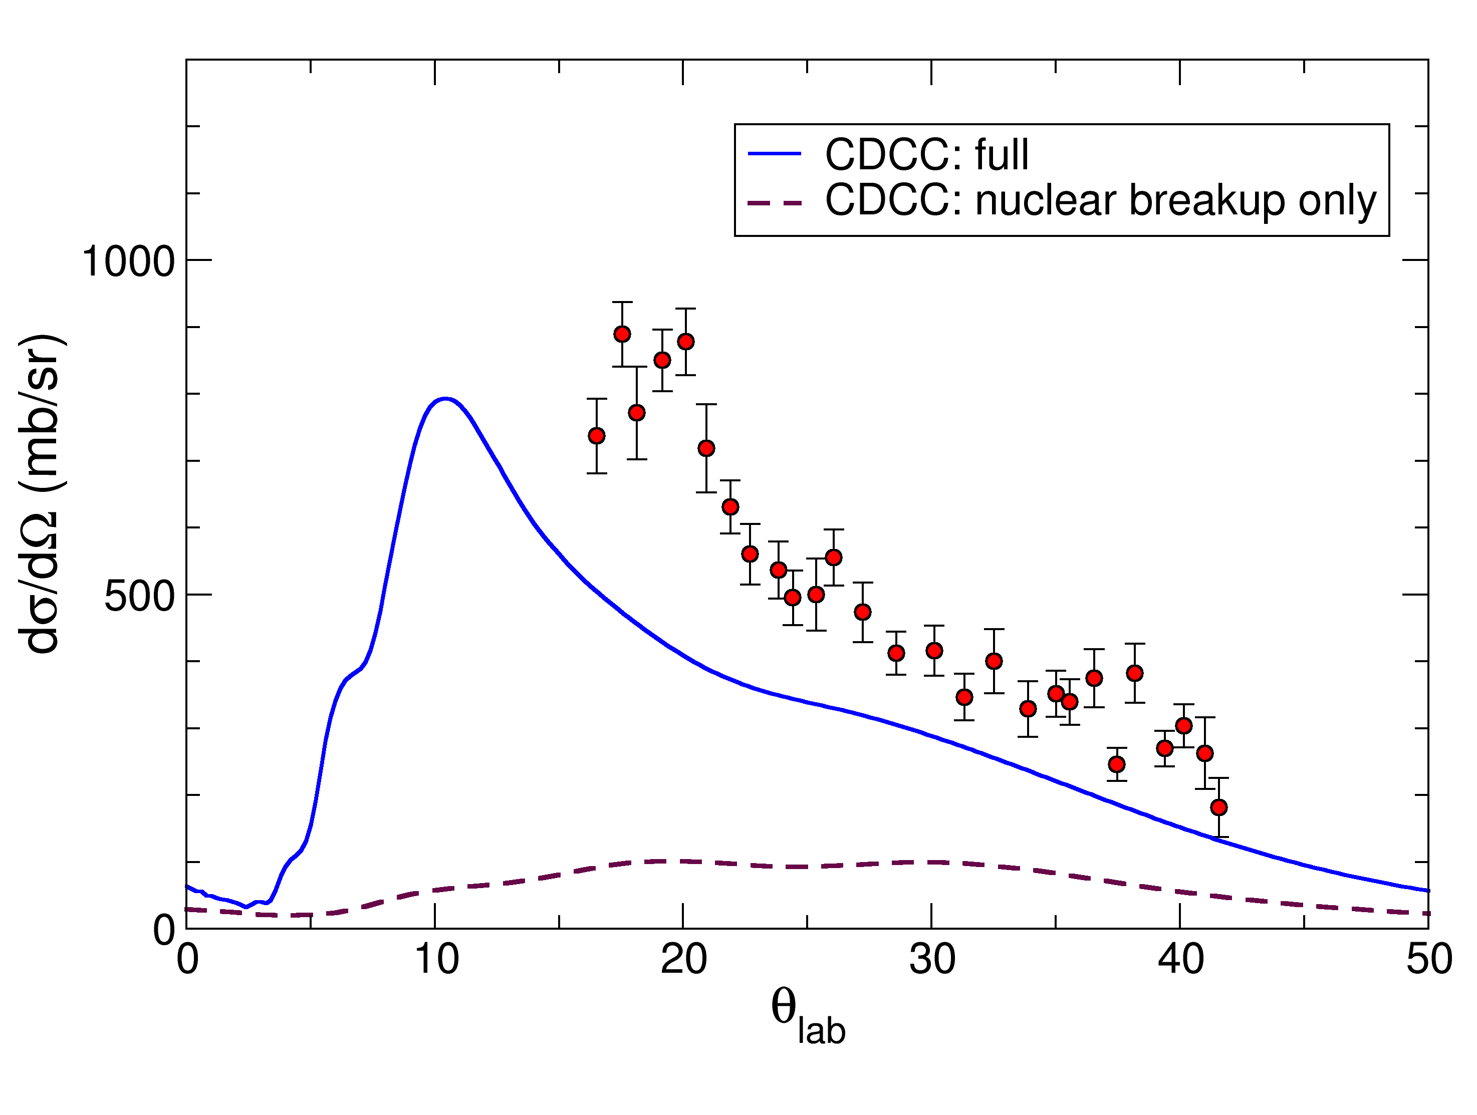
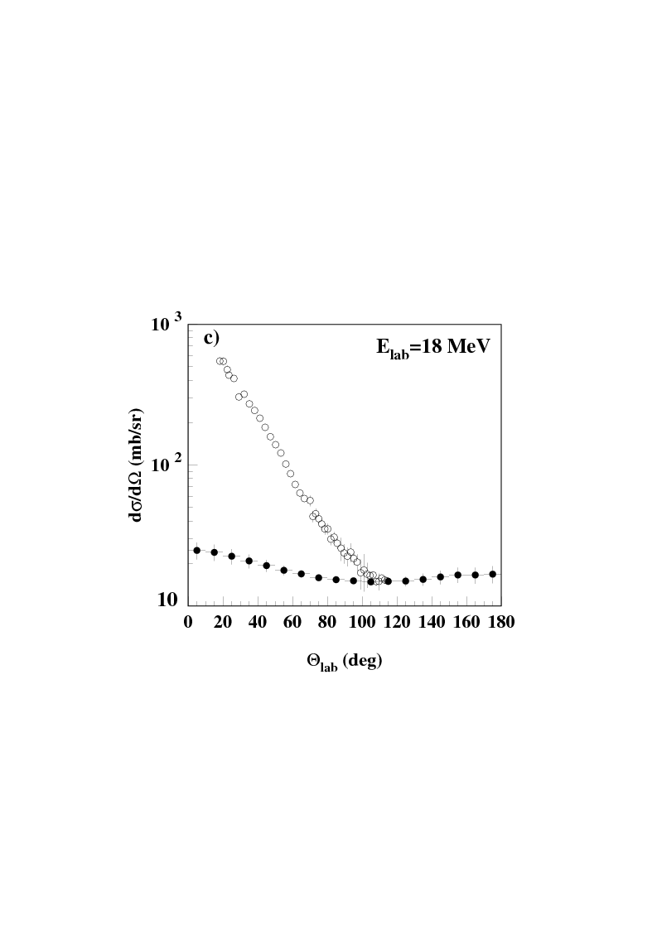
Where is the missing elastic cross-section going?
C
C
H
P
T
P
T
T+n
Break-up
Transfer
¹⁰Be angular distribution
α-particles angular distribution
⁶He+⁶⁴Zn
¹¹Be+⁶⁴Zn
α- experiment
α- calculations
fus. evap. process
σ_{BU/TRANSF}≈ 0.4 σ_{reac}
σ_{BU/TRANSF}≈ 0.8 σ_{reac}
A. Di Pietro, V. Scuderi, A.M. Moro et al.
Phys. Rev. C 85, 054607 (2012)
V.Scuderi et al.
Phys. Rev. C 84, 064604(2011)

Slide 10
Fusion

Slide 11
How does halo affect fusion ?
Possibilities: Static effect
r₀ A^{1/3}
Radius ≠ r₀ A^{1/3}
V
Halo
D
Dynamic effect
Effect?
Breakup
Like any other
coupling process
Decreases Flux
Increased sub barrier fusion
Decreased sub barrier fusion
G.S.

Slide 12
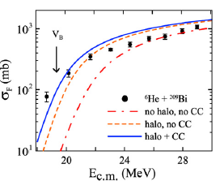
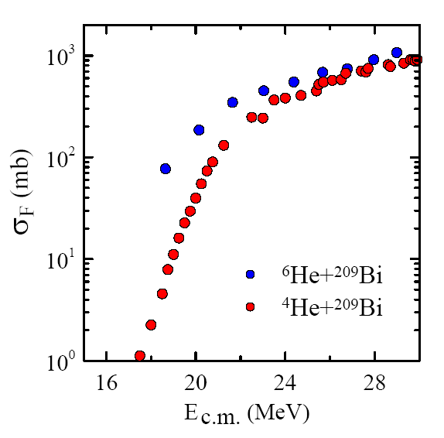
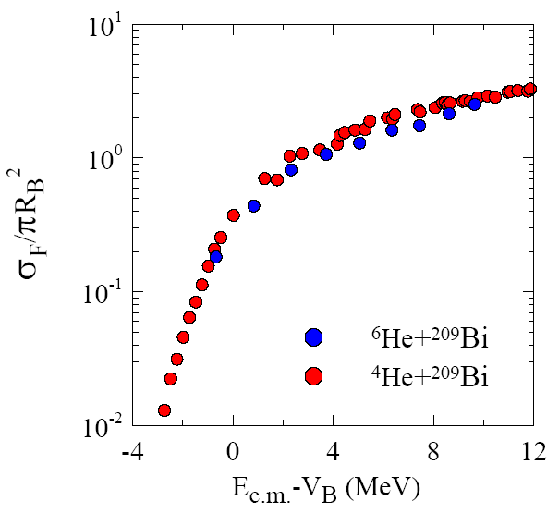
Fusion with n-halo nuclei
E.g^{. 6}He+²⁰⁹Bi
Comparison with calculations
Comparison ⁴He,⁶He+²⁰⁹Bi data
Enhancement seems due to static effects
Data: J.J. Kolata et al PRL 81,4580,(1998) Figures: L.F.Canto et al NPA 821, 51, (2009)

Slide 13
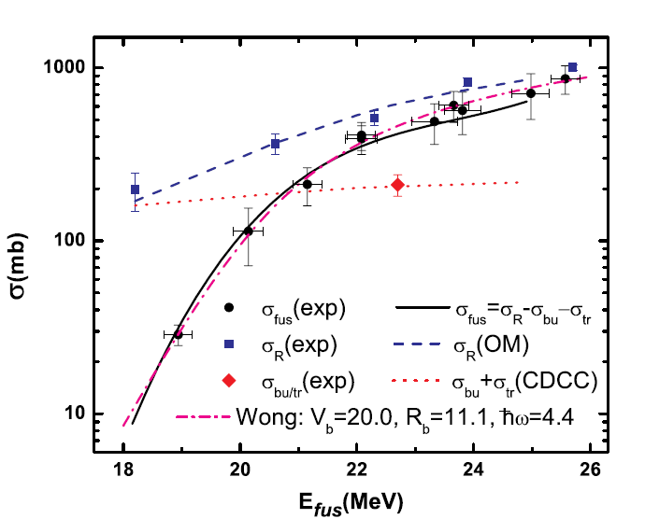
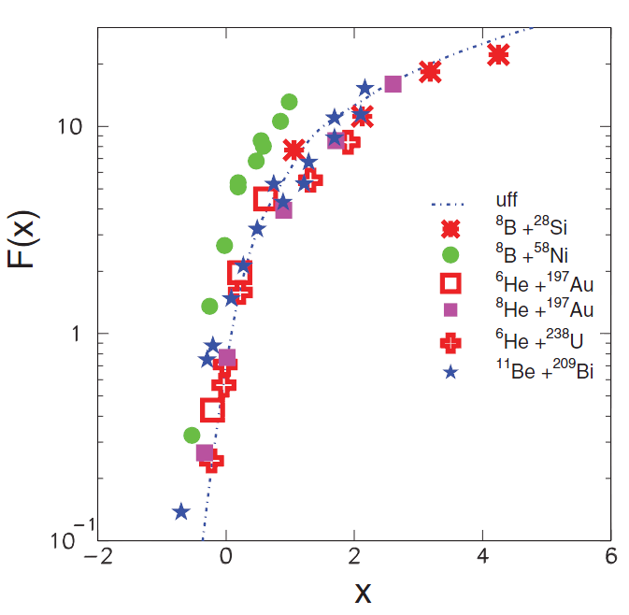
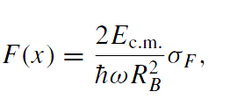

Fusion reaction with p-halo nuclei
⁸B+⁵⁸Ni
⁸B+²⁸Si @ Exotic
E. F. Aguilera PRL 107, 092701 (2011)
A.PAKOU et al. PRC 87, 014619 (2013)
No-enhancement of fusion cross-section
Enhancement of fusion cross-section

Slide 14
Fusion of weakly bound nuclei with no halo structure
Systematic on heavy targets
L .F. Canto , Nucl. Phys. A 821 (2009) 51

Slide 15
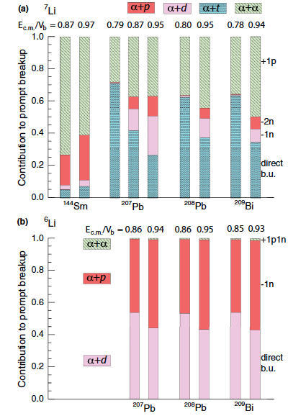
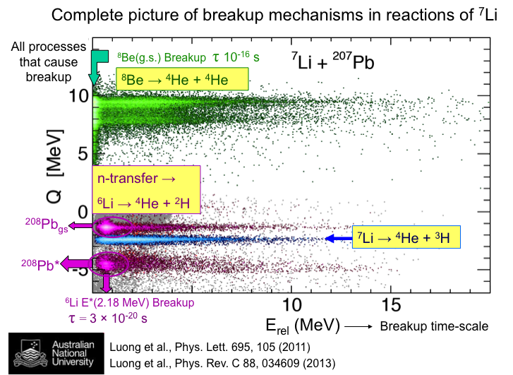
Break-up dynamics in ^{6,7}Li+¹⁴⁴Sm, ²⁰⁷Pb and ²⁰⁹Bi
Break-up is triggered predominantly by nucleon transfer. From the relative energy of break-up fragments the time-scale of break-up was deduced and prompt break-up was separated by asymptotic break-up.

Slide 16
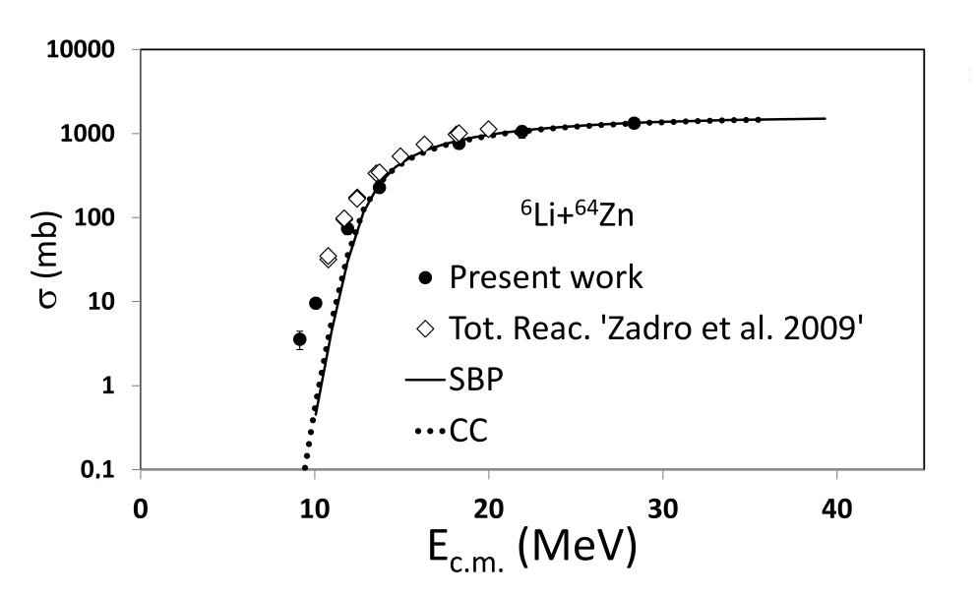
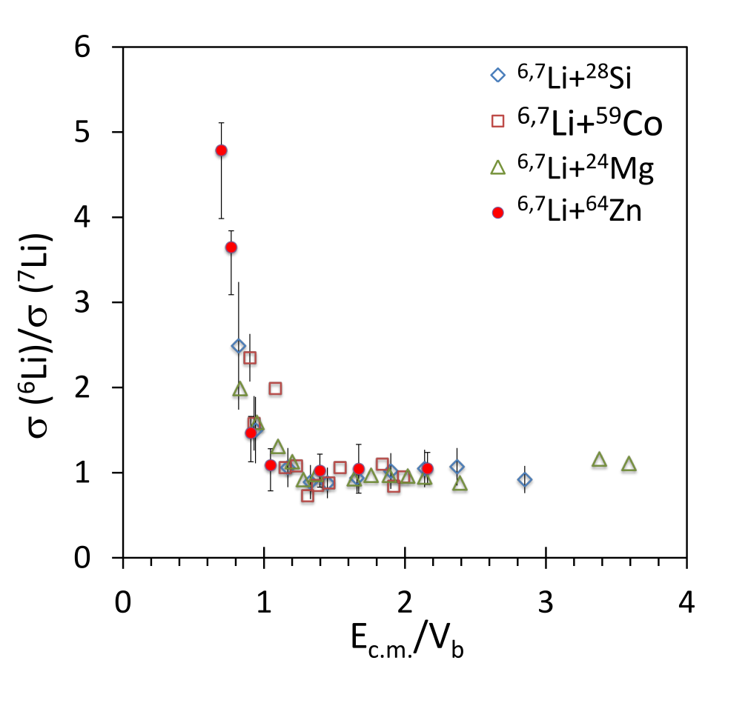
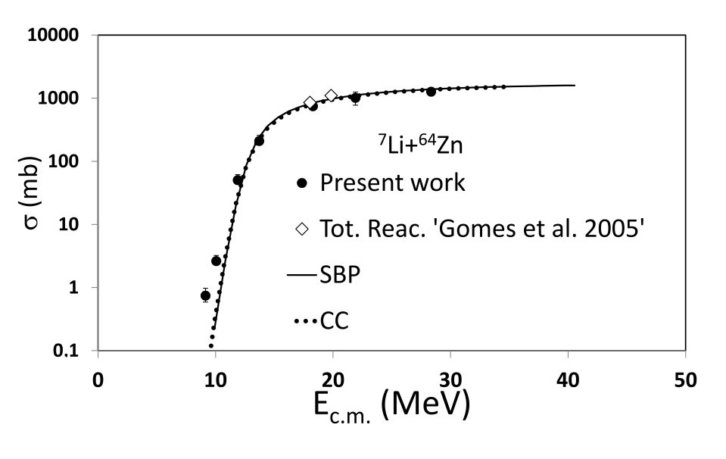
^{6,7}Li+⁶⁴Zn Heavy Residue excitation function
Ratio of H.R. cross-section
A. Di Pietro et al. PHYS. REV. C 87, 064614 (2013)

Slide 17
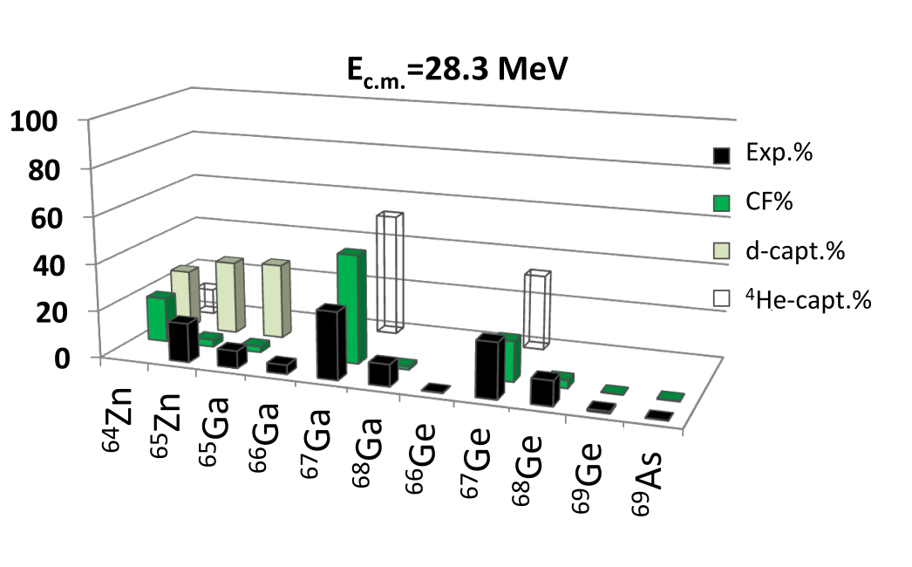
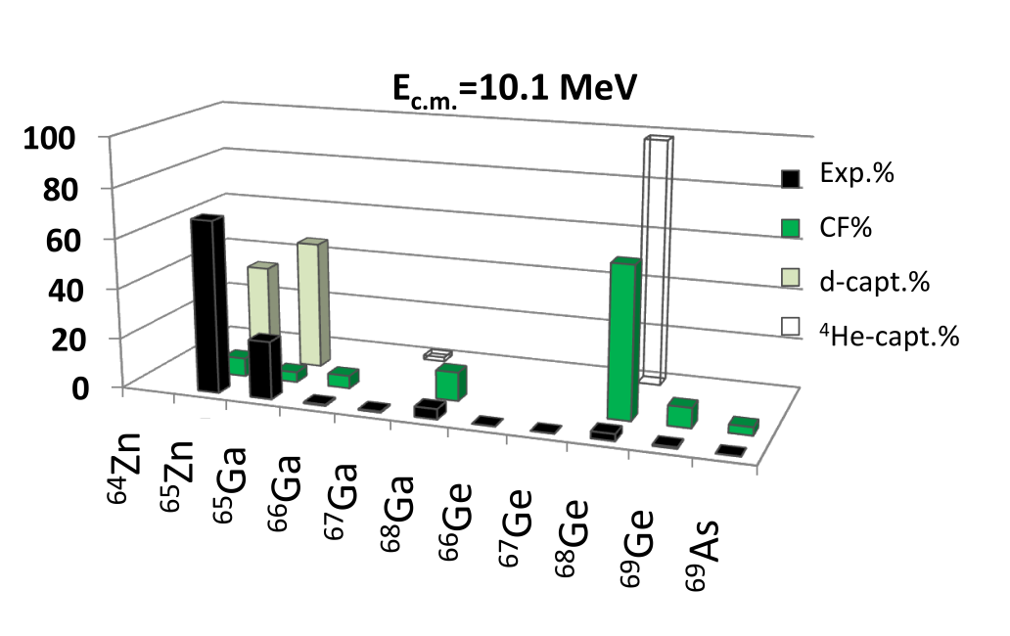
Heavy Residue relative yields (σ _{H.R.} /σ _{tot})
Is d or α capture from ⁶Li important ?
● ICF E* ∼ ( E_{cm} - S_{α})x(m_{clu}/m_{proj}) + Q_{(Clu+64Zn)}
● Cluster transfer E* ∼ Q_{gg} – Q_{opt}
Experiment
Complete Fusion calculations
d-capture calculations
α-capture calculations
1n or 1p transfer leading to ⁶⁵Zn and ⁶⁵Ga can also contribute
Above barrier CF dominates
Below the barrier different processes dominate
A.Di Pietro et al. Phys. Rev. C 87, 064614, (2013)

Slide 18
Summary and conclusions
Reaction studies with halo and weakly bound beams have shown many peculiarities due to the low binding and extended wave function :
Damping of elastic cross-section at large impact parameters due to the coupling to the continuum. Both Coulomb and nuclear coupling contribute to the effect.
Large total reaction cross-sections.
Large cross-section for transfer and breakup events.
Fusion induced by n-halo nuclei seems to be enhanced below the barrier due to static effects. Need for precise data at lower energies to investigate possible dynamic effects.
The reaction dynamics for p-halo nuclei is expected to be different due to the presence of Coulomb interaction with the halo. Discrepancy have been observed from the only two existing fusion measurement.
With weakly bound nuclei the suppression of above barrier complete fusion could be due to break-up triggered by nucleon transfer. With lighter masses the observed enhancement below the barrier seem to be due to other processes contributing to the measured cross-section.

Slide 19











RBI Zagreb

