Slide 1
Nuclear Moments and Structure of Unstable Nuclei
UENO, Hideki
RIKEN Nishina Center
ARIS2014, Tokyo, Jun 2-6, 2014

Slide 2
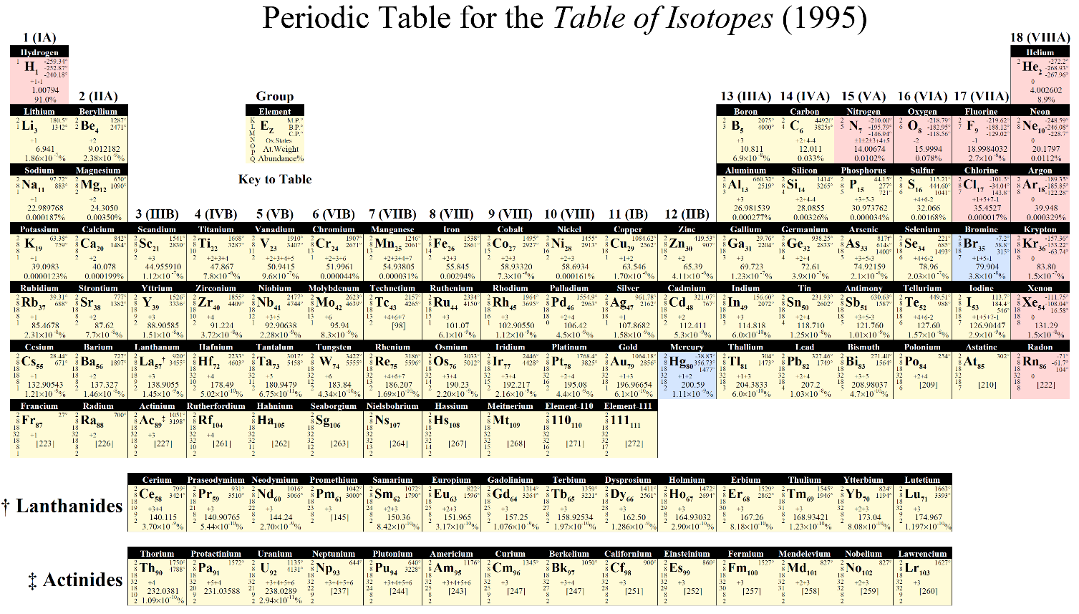
Nuclear-moment measurements of unstable nuclei
Laser-based techniques
ISOLDE
Ground state μ & Q
⁴⁹K and ⁵¹K: J. Papuga et al., Phys. Rev. Lett. 110, 172503 (2013)
⁷²⁻⁷⁸Ga: E.Mane et al., Phys. Rev. C 84, 024303 (2011)
⁵⁸⁻⁶²Cu: P. Vingerhoets et al., Phys.Lett. B 703, 34 (2011)
⁶⁷⁻⁸¹Ga: B.Cheal et al., Phys. Rev. Lett. 104, 252502 (2010)

Slide 3
Nuclear-moment measurements of unstable nuclei
Laser-based techniques
ISOLDE
Ground state μ & Q
⁴⁹K and ⁵¹K: J. Papuga et al., Phys. Rev. Lett. 110, 172503 (2013)
⁷²⁻⁷⁸Ga: E.Mane et al., Phys. Rev. C 84, 024303 (2011)
⁵⁸⁻⁶²Cu: P. Vingerhoets et al., Phys.Lett. B 703, 34 (2011)
⁶⁷⁻⁸¹Ga: B.Cheal et al., Phys. Rev. Lett. 104, 252502 (2010)
Fragmentation-induced spin orientation
Spin-aligned RIBs
Isomeric state μ & Q
GANIL
GSI (gRISING)
RIBF (BigRIPS, E/A ~ 270 MeV)
Spin-polarized RIBs
Ground state μ & Q
MSU
GANIL
RIBF (RIPS, E/A ~ 70 MeV)
…

Slide 4
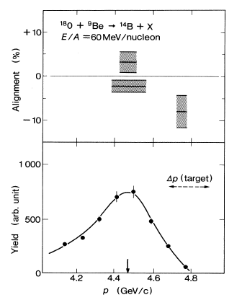
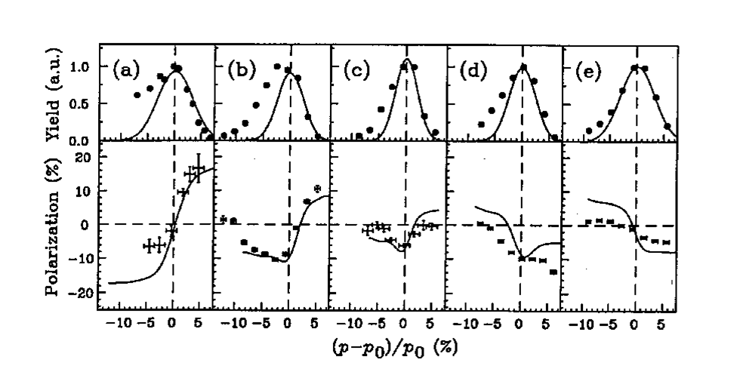
Fragment-induced spin orientation
projectile
fragment
Sum of the lost Fermi momenta
P
R
Position vector of the participant portion
-P
Angular momentum left in the fragment part
target
L_{F}=-RxP
K.Asahi et al., PLB 251, 499 (1990)
Spin polarization
¹⁴⁽¹⁵⁾N+X→¹²⁽¹³⁾B polarization
Spin alignment
near-side
trajectory
Detector
far-side
trajectory
Detector
near-side
trajectory
Large-Z target
Au
Au
Nb
Nb
Al
Detector
Fragments scattered at 0◦
High energies are suitable because of
production of RIBs
population of isomeric states
production of spin alignment
far-side
trajectory
40A MeV
70
110
70
70
Small-Z target
K. Asahi et al., Phys. Rev. C 43, 456 (1991)
H. Okuno et al., PL B335,29 (1994)
Notes:
This figure shows the basic idea of the mechanism of fragment-inducded polarization.
In the PF reaction, a fragment part shows the Goldhaber momentum distribution, which is sum of the lost Fermi momenta.
Because of the properties of peripheral reaction, position vector of the participant portion in the projectile rest frame can be defined as shown here.
Then, in this picture, angular momentum, defined by RxP, is left in the fragment part.

Slide 5
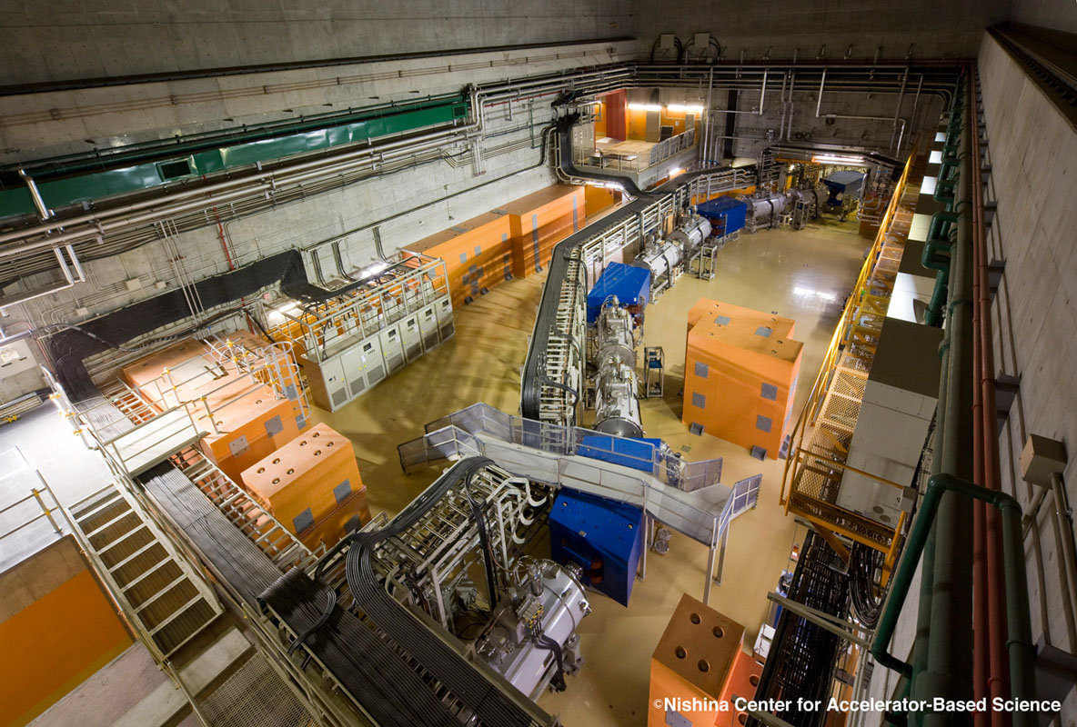
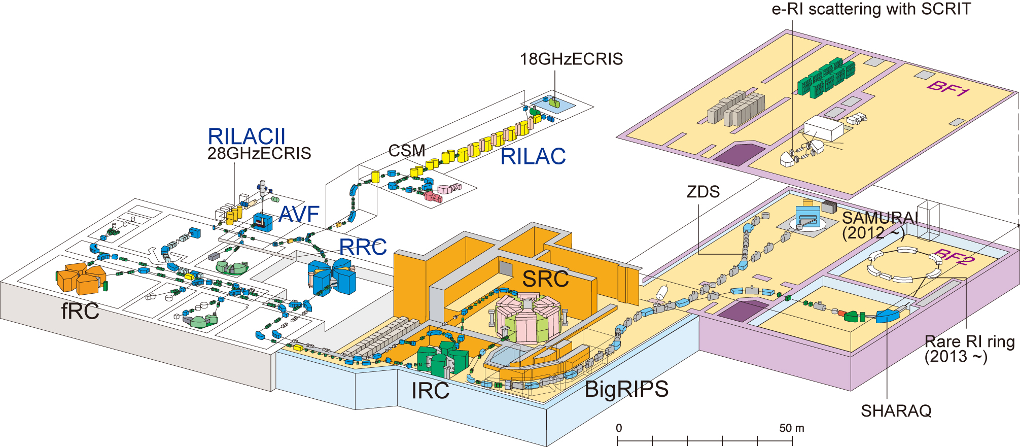
BigRIPS – superconducting in-flight RI separator

Slide 6
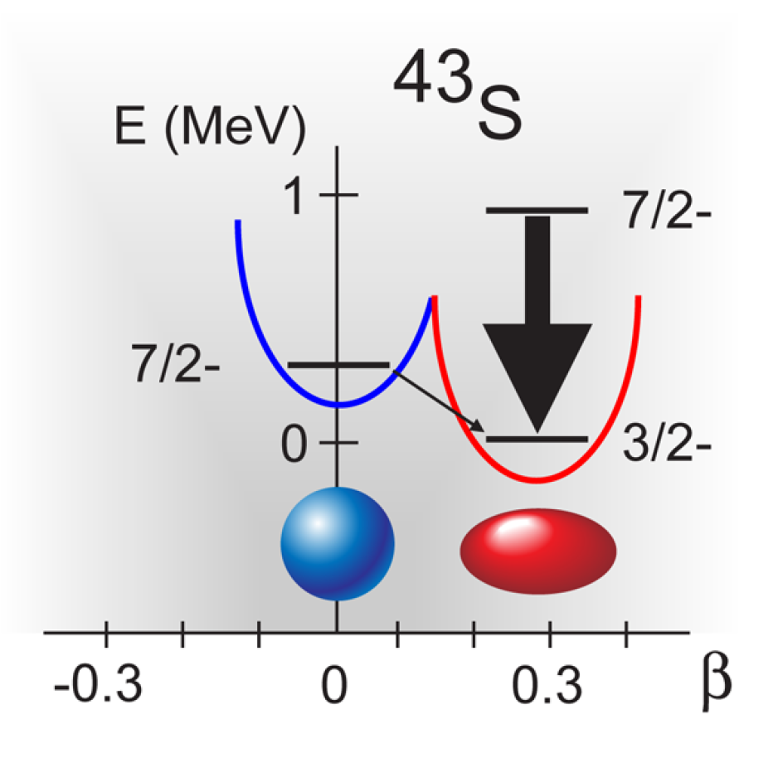
μ & Q of ⁴³S
P. Mantica, Physics 2 18, (2009)
weakening the N = 28 shell gap
from experiments
⁴³S (N=27)
For the 320-keV isomeric state:
μ_{exp} = –0.317(4) μ_{N}
Q_{exp} = ?
L. Gaudefroy et al., Phys. Rev. Lett. 102, 092501 (2009).

Slide 7
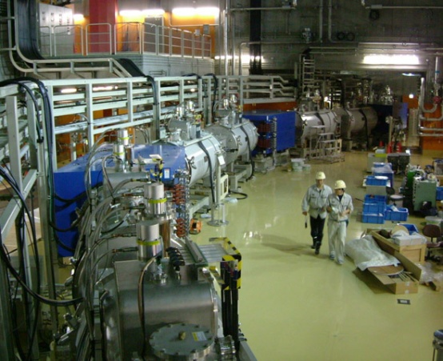
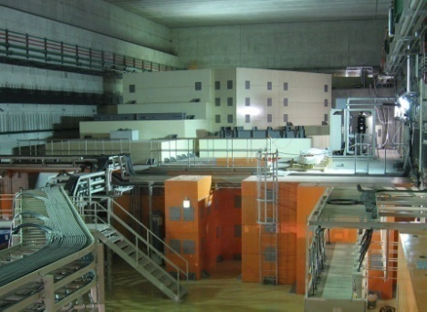
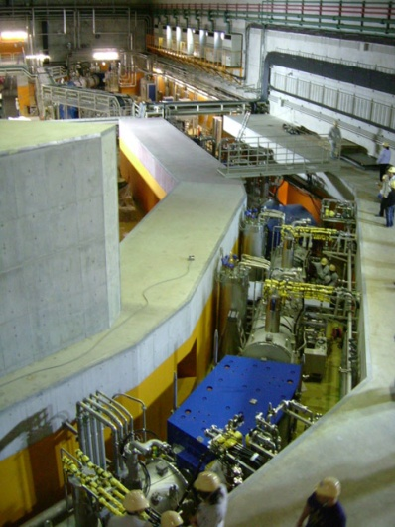
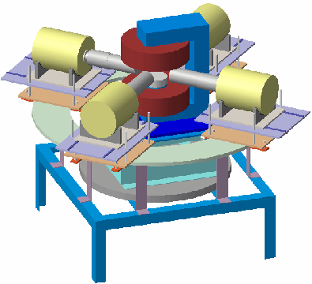
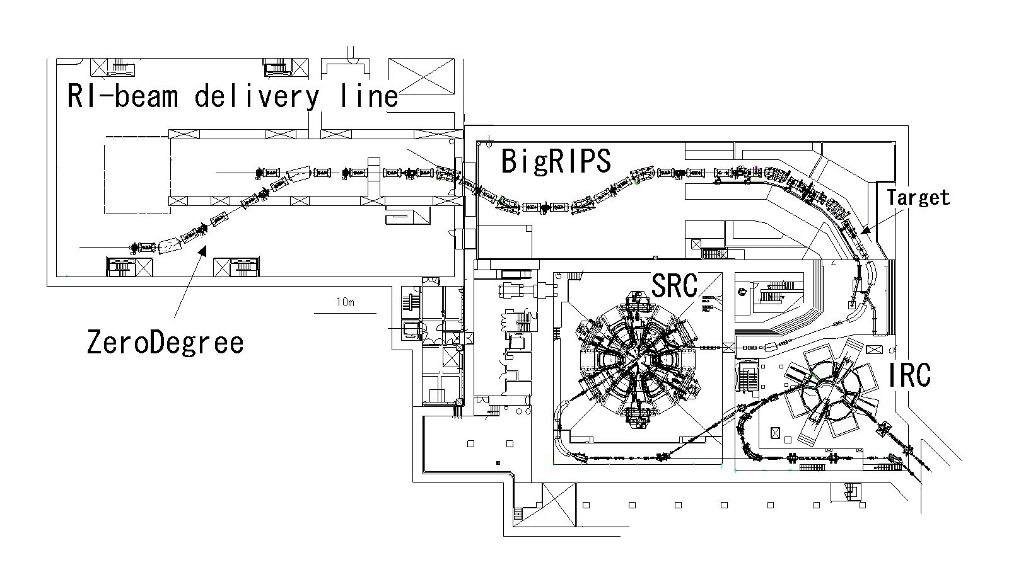
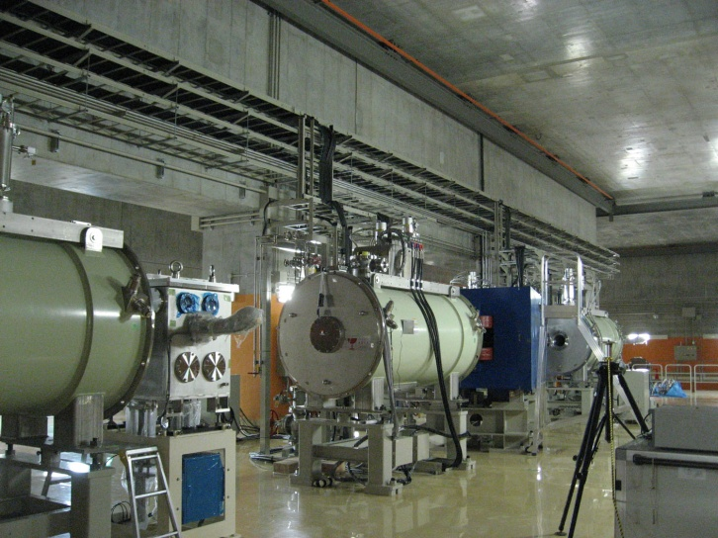
BigRIPS Layout for the present experiment
TDPAD apparatus
Target
Experimental set-ups
ZeroDegree: Zero-degree forward Spectrometer
T. Kubo, Nucl. Instr. Meth. B204, 97 (2003).
T. Kubo et al., IEEE Transactions on Applied Superconductivity, 17, 1069 (2007)

Slide 8
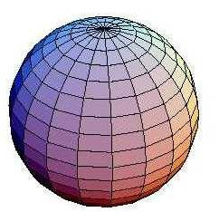
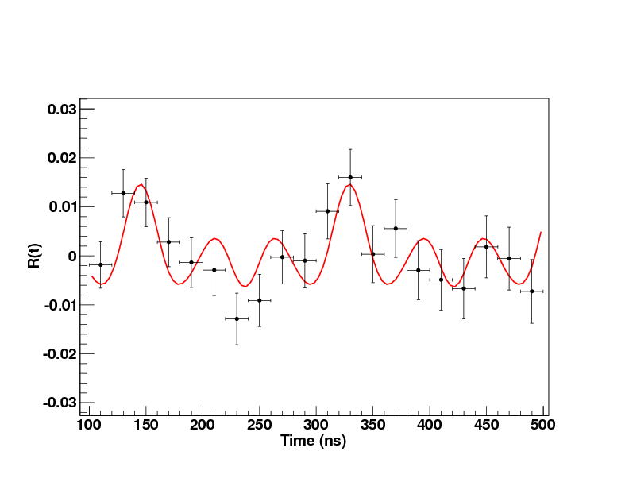
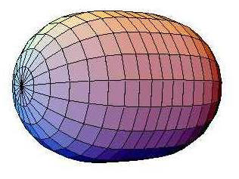
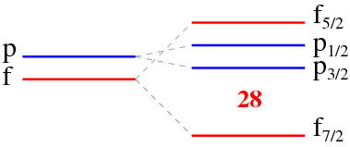
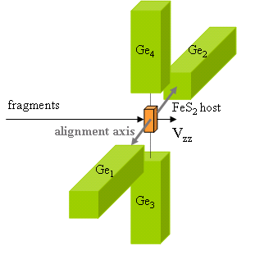


Q(^{43m}S) measurement @BigRIPS (Spokesperson: J.M. Daugas)
Fragmentation-induced spin-alignment
⁴⁸Ca + ⁹Be → ^{43m}S + X
(conventional single step fragmentation
involving just 5-nucleon removal）
Rather spherical
7/2⁻
415(5) ns
320.5(5) keV
3/2⁻
F. Sarazin et al., PRL 84, 5062 (2000)
|Q_{s}|=23(3) efm²
Prolate deformed
crystal : pyrite FeS₂
V_{zz}=14*10¹⁷ V/cm² (err. ~10%)
(solide state physics calculations)
Configuration inversion between and
Shape coexistence
R. Chevrier et al., Phys. Rev. Lett. 108, 162501 (2012)

Slide 9
Problem: spin orientation reduction
D. Nagae et al., Phys. Rev. C 79, 027301 (2009)
M. De Rydt et al., Phys. Lett. B678, 344-349 (2009)
40Ar → 31Al
(9-nucleon removal)
P ～ 0.3%
36S → 31Al
(5-nucleon removal)
P ～ 3%

Slide 10
Problem
L_{F} = – RxP
Angular momentum left in the fragment part
Beam
Fragment
Sum of the lost Fermi momenta
P
R
-P
Position vector of the participant portion
Target
When a large nucleon removal is involved
L_{F} ≈ 0xP = 0
Beam
Fragment
P
R
–P
Position vector
can not be defined
Target
No spin orientation
due to the nature of central collision
Notes:
This figure shows the basic idea of the mechanism of fragment-inducded polarization.
In the PF reaction, a fragment part shows the Goldhaber momentum distribution, which is sum of the lost Fermi momenta.
Because of the properties of peripheral reaction, position vector of the participant portion in the projectile rest frame can be defined as shown here.
Then, in this picture, angular momentum, defined by RxP, is left in the fragment part.

Slide 11
New method: dispersion-matched two-step PF
Conventional single step PF
Y ield (Hign)
A_{Beam}
A_{RI}
momentum
A lignment（Low）
Target
Slit
Simple two-step PF
~ 1/1000
Y(Low)
A_{Beam}
A_{RI}+1
A_{RI}
P
色消しプリズム
(分散整合）
A（Hign）
1st Target
2nd Target
Slit
Slit

Slide 12

Smearing out of A due to target thickness
A_{Beam}
A_{RI}+1
A_{RI}
Target
Yield
Alignment
Momentum
Slit
Slit
No spin alignment

Slide 13
Conventional single step PF
Y(High)
A_{Beam}
A_{RI}
mom.
A（Low）
Target
Slit
Simple two-step PF
Y(L)
~ 1/1000
A_{Beam}
A_{RI}+1
A_{RI}
色消しプリズム
(分散整合）
mom.
1st Target
2nd Target
Slit
A（H）
Slit
Dispersion-matching two-step PF
A_{Beam}
A_{RI}+1
~ 1/50
Y(M~H)
A_{RI}
no slit
mom.
1st Target
2nd Target
Slit
A（H）
dispersion-matching
Achromatic prism

Slide 14
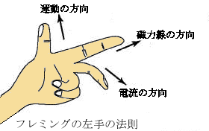
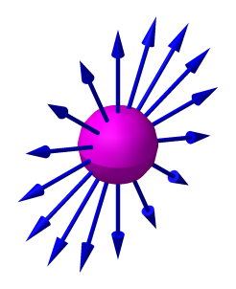
Dispersion matching for spin-aligned RIBs
A_{RI}+1
A_{RI}
Target
Yield
p small
Alignment
mom.
p large
Slit
Slit
Tertiary
RI beam
magnetic field
... can extract the same spin-alignment component

Slide 15
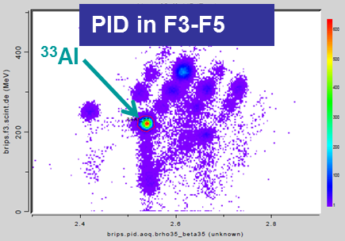
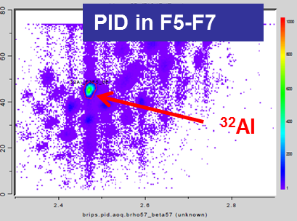
BigRIPS Layout for the present experiment
TDPAD apparatus
1st Target
2nd Target
Experimental set-ups
ZeroDegree: Zero-degree forward Spectrometer
T. Kubo, Nucl. Instr. Meth. B204, 97 (2003).
T. Kubo et al., IEEE Transactions on Applied Superconductivity, 17, 1069 (2007)

Slide 16
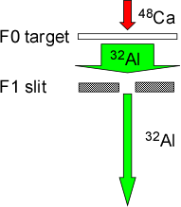
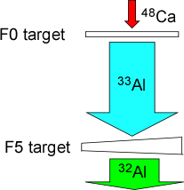
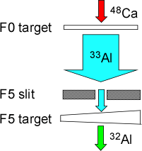
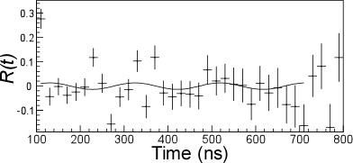
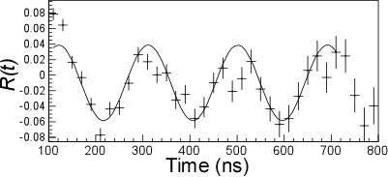
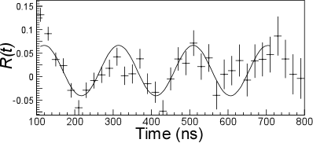
Result
Measurement 1
Measurement 2
Measurement 3
One-step PF
Two-step PF
w/ Disp. Matcing.
Two-step PF
w/o Disp. Matcing.
A < 0.8 %
A = 8(1) %
(~30% of theo. max.)
A = 9(2) %
large Y but quite small A
large Y and large A
large A but quite small Y
Y. Ichikawa, H. Ueno et al., Nature Physics, published online (2012)

Slide 17

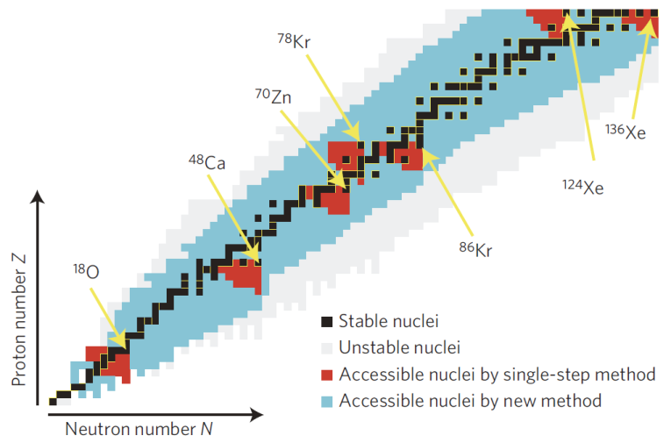
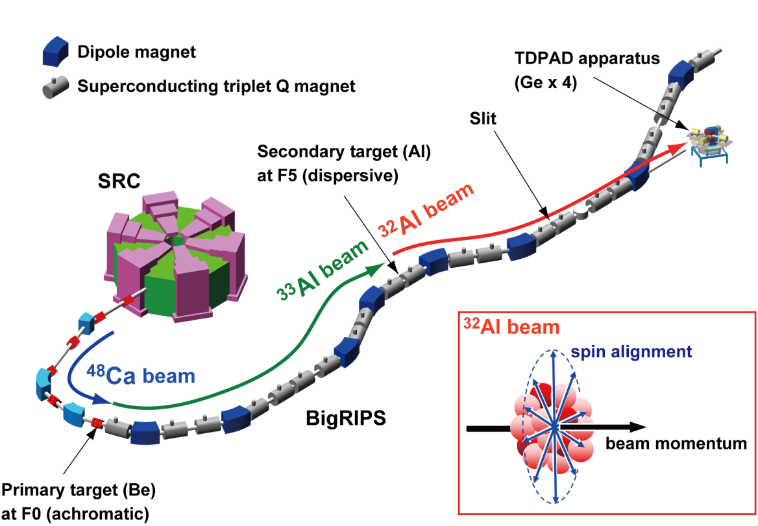
Key 1:
Two step PF
→ Maximize spin alignment
Key 2:
Dispersion matching
→ Maximize yield of two-step PF

Slide 18
RIKEN RI Beam Factory (RIBF)
Self Confining RI Ion Target
RIBF Layout
150 MeV e-Microtron
700 MeV e-Storage ring
Notes:
RIBF now can provide all ions at 345 MeV/u.
And RI beams are produced by In-flight Uranium fission or projectile fragmentation.
Take U-fission for instance, Uranium beam is pre-accelerated by this newly operational RILAC two, and injected into RRC. The energy of RRC beam is boosted up to 345 MeV/u by fRC, IRC , and finally by this superconducting ring cyclotron, SRC. 345 MeV/u Uranium beam goes to the production target, here and fission fragments are isotopically selected and collected by this large-acceptance superconducting BigRIPS.
Now, superconducting Zero Degree Spectrometer and SHARAQ spectrometer are used for the experiments, and This large-acceptance superconducting SAMURAI spectrometer will be operational early next year. This unique electron-RI scattering ring with Self-Confining RI target for precision measurement of charge distribution in unstable nuclei will start RI experiment next year. This Rare-RI ring for the precision mass measurement will be completed in next fiscal year.

Slide 19
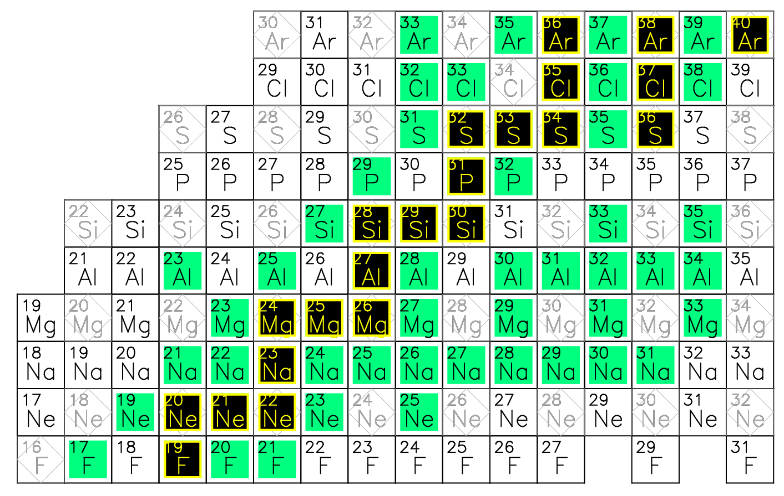
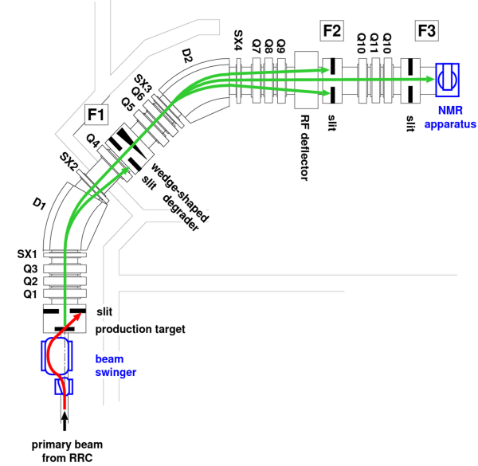
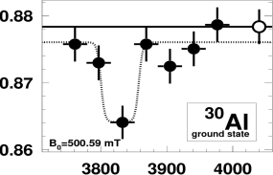
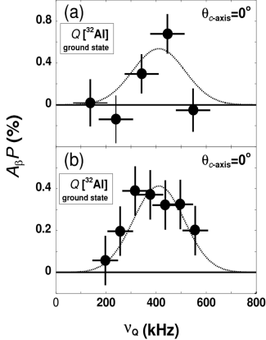
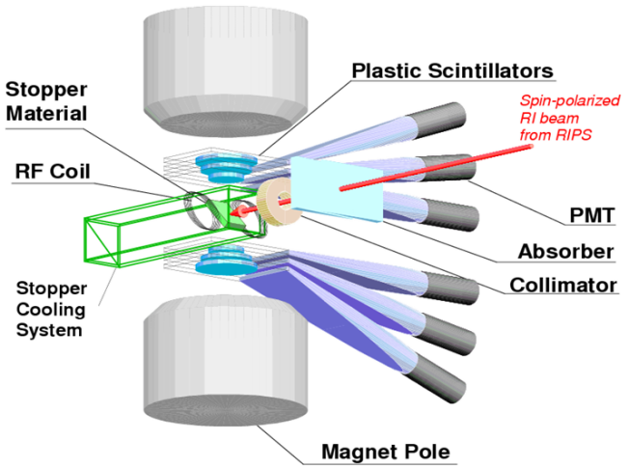
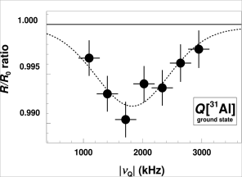
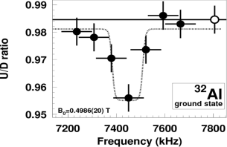
μ &Q (Al_{G.S.}) measurements @RIKEN
Method:
Polarized RI beam
+ β-NMR spectroscopy
Measured:
stable isotopes
N=20
μ and/or Q known
RIPS
Island of inversion
μ [³⁰Al]
Q [³¹Al]
Q [³²Al]
β-NMR apparatus
μ [³²Al]
|eqQ/h| (kHz)
|eqQ/h| (kHz)
H. Ueno et al.,
PLB 615, 186 (2005)
D. Nagae et al.,
PRC 79 027301 (2009).
D. Kameda et al.,
PLB 647, 93 (2007)

Slide 20
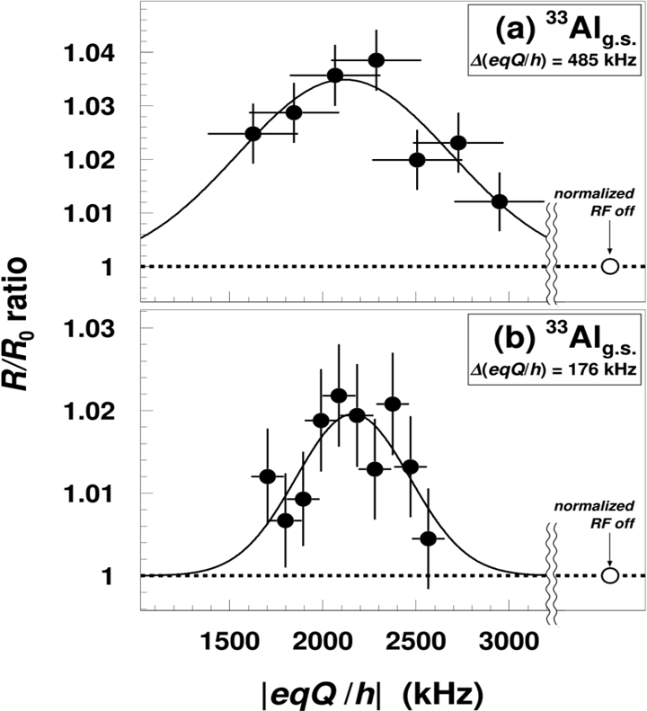
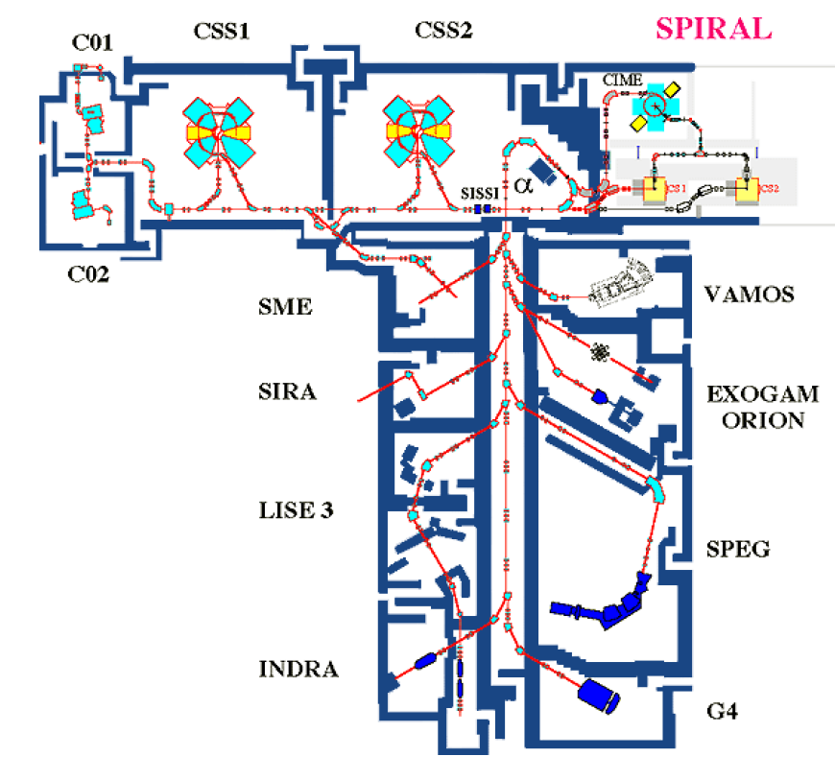
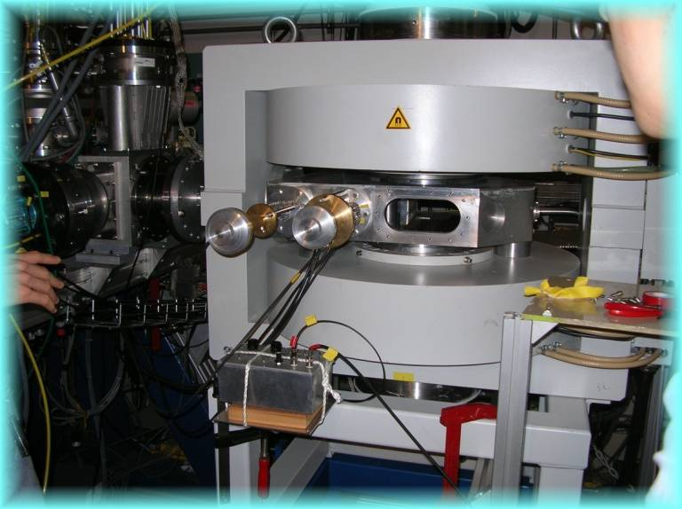
Q (³³Al) measurement @GANIL
Reaction:
³⁶S¹⁶⁺ (E=77.5A MeV, I～130pnA) +Be (224mg/cm²)
→ ³³Al ( θ_{Lab}=2±1◦, p=(1.026-1.041)∙p_{beam}, purity 83%,
  I [³³Al]～1.4k pps )
NQR spectra
β-NMR apparatus
³³Al
|Q_{exp}(³³Al) | = 132 (18) e mb
K. Shimada et al., Phys. Lett. B714, 246-250 (2012)
³³Al
beam
precision |Q_{exp}| measurement
M. De Rydt al., to be submitted soon

Slide 21
μ & Q of ⁴³S
P. Mantica, Physics 2 18, (2009)
weakening the N = 28 shell gap
from experiments
⁴³S (N=27)
For the 320-keV isomeric state:
μ_{exp} = –0.317(4) μ_{N}
Q_{exp} = 23(3) efm²
→ spherical 7/2–
L. Gaudefroy et al., Phys. Rev. Lett. 102, 092501 (2009).
R. Chevrier et al., Phys. Rev. Lett. 108, 162501 (2012)
No direct experimental evidence
for the deformed GS
Purpose:
μ & Q measurements for ⁴³S_{G.S.}
same observation for ⁴⁵S_{G.S.}
3/2– GS predicted
by a process of elimination
(based on SM)

Slide 22
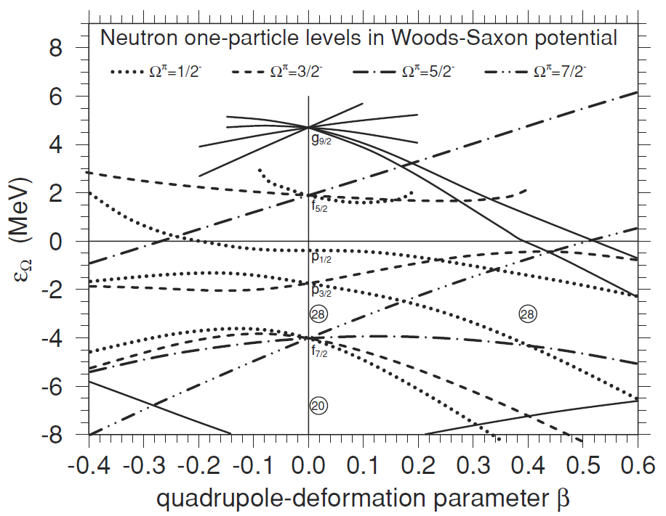
One particle in the deformed WS potentinal
⁴⁵S₂₉: 3/2–
⁴³S₂₇: 1/2–, 5/2–
I. Hamamoto, J. Phys. G: Nucl. Part. Phys. 37 055102, (2010).

Slide 23
Status
(1) Production of spin-polarized RI beams and/or crystal studies
  ^{41, 43}S: PF-induced spin polarization
  ⁴⁵S: PF+ neutron pickup reaction
Spin-polarization of 41S（←48Ca) has been confirmed
(2) Resonance scans through β-NMR spectroscopy
production (reaction) and preservation (crystal stopper) of spin polarization
resonance scan
β-ray angular distribution
W_{β} (θ)=1+A_{β}P cosθ
    A_{β} : Asymmetry parameter
    P : spin polarization
(1–A_{β}P )
(1+A_{β}P)
(U/D) =

Slide 24
Beta-delayed γ & n spectroscopy with stopped pol. RI
Beta-delayed neutron spectroscopyfor the study of neutron-rich nuclei
  R. Harkewicz et al., PRC 44, 2365 (1991)
  J.L. Lou et al., PRC 75, 057302 (2007) and references therein.
  ¹⁷B: G. Raimann et al., PR C 53, 453 (1996)
AP ^{i}
β-ray asymmetry
AP ^{j}
n
β
AP ^{k}
γ
Beta-delayed neutron spectroscopy from spin-polarized RI
  ¹⁵B↑: H. Miyatake et al., PRC 67, 014306 (2003) …RIPS
  ¹¹Li↑: Y. Hirayama et al., PL B611, 239 (2005) …TRIUMF
  ¹⁷B↑: present

Slide 25
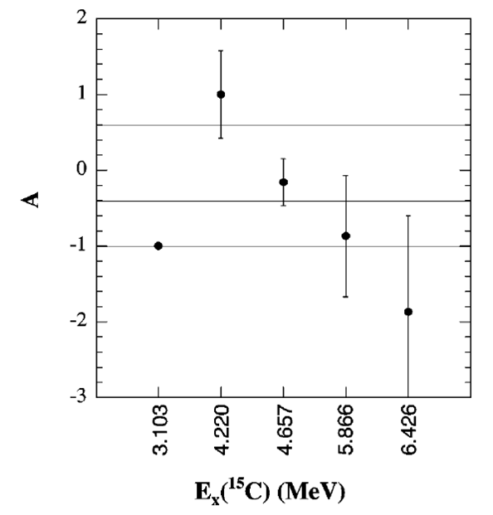
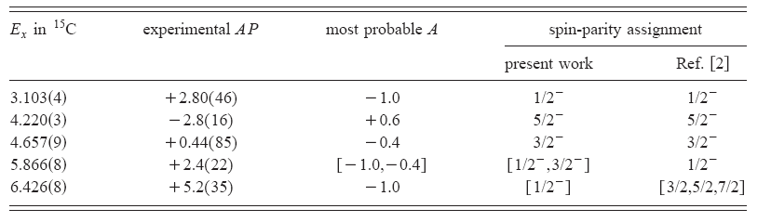
I^{π} assignment of the ¹⁵C levels
logft = 4.34-5.39
→ GT transition
R. Harkewicz et al., PRC 44, 2365 (1991)
A(¹⁵B→¹⁵C)
=
–1 for ¹⁵C(1/2–)
–0.4 for ¹⁵C(3/2–)
+0.6 for ¹⁵C(5/2–)
H. Miyatake et al.,
PRC 67, 014306 (2003)

Slide 26
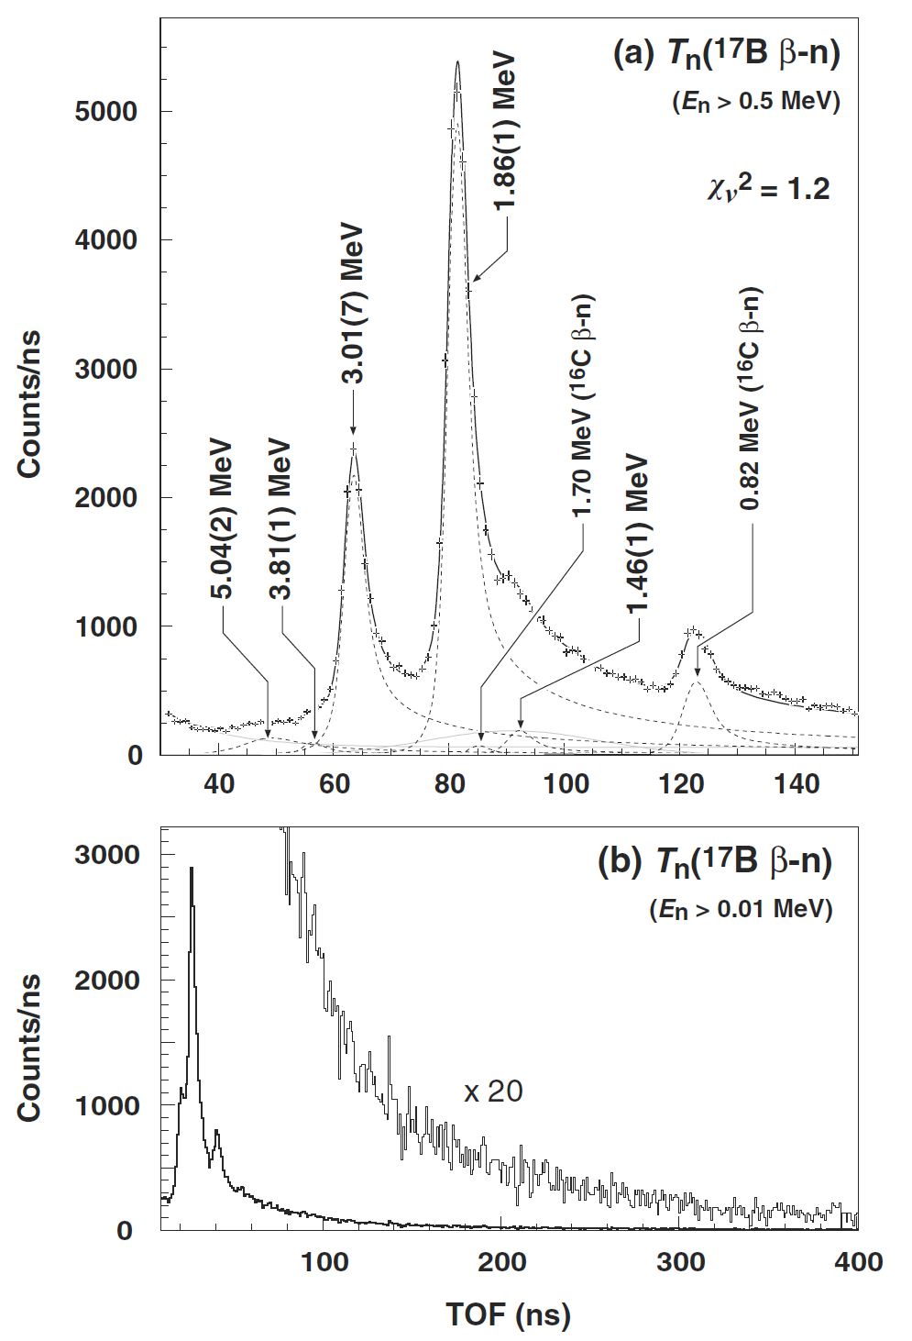
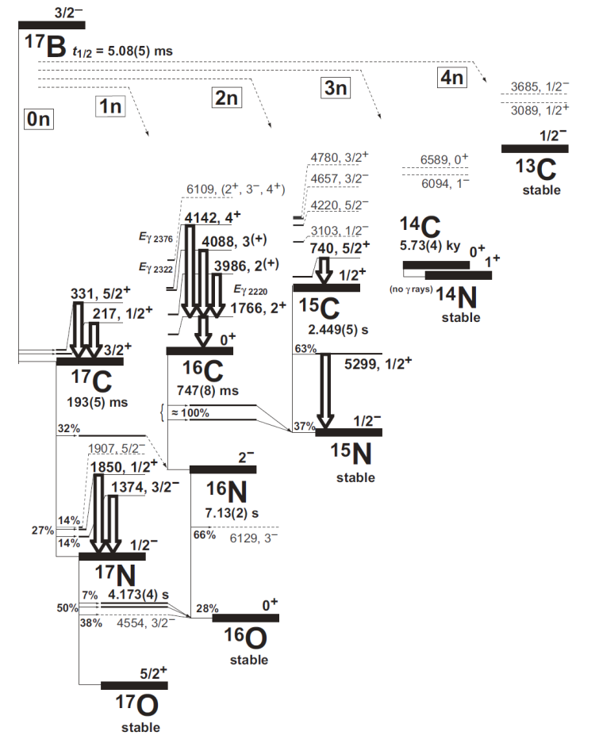
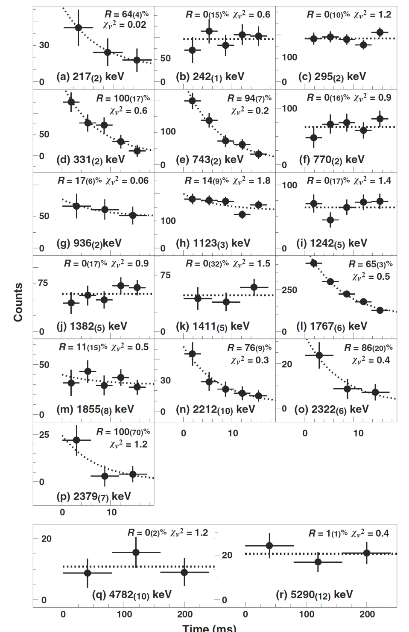
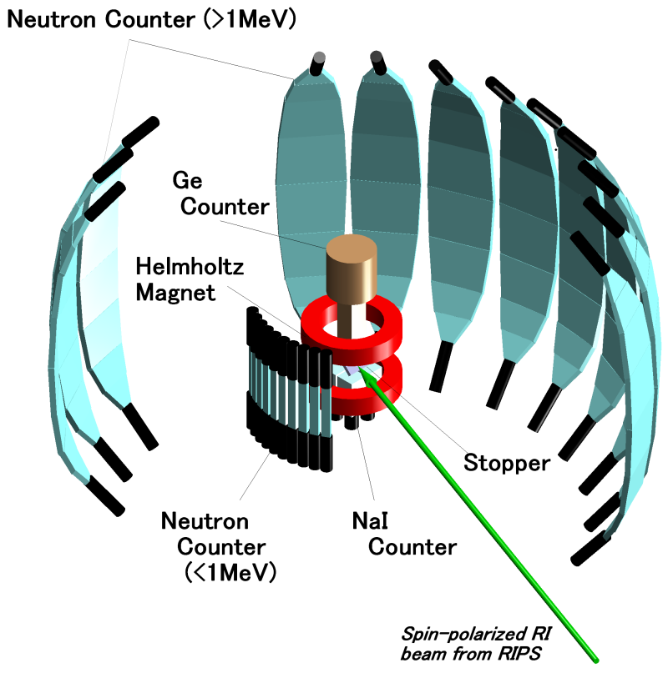
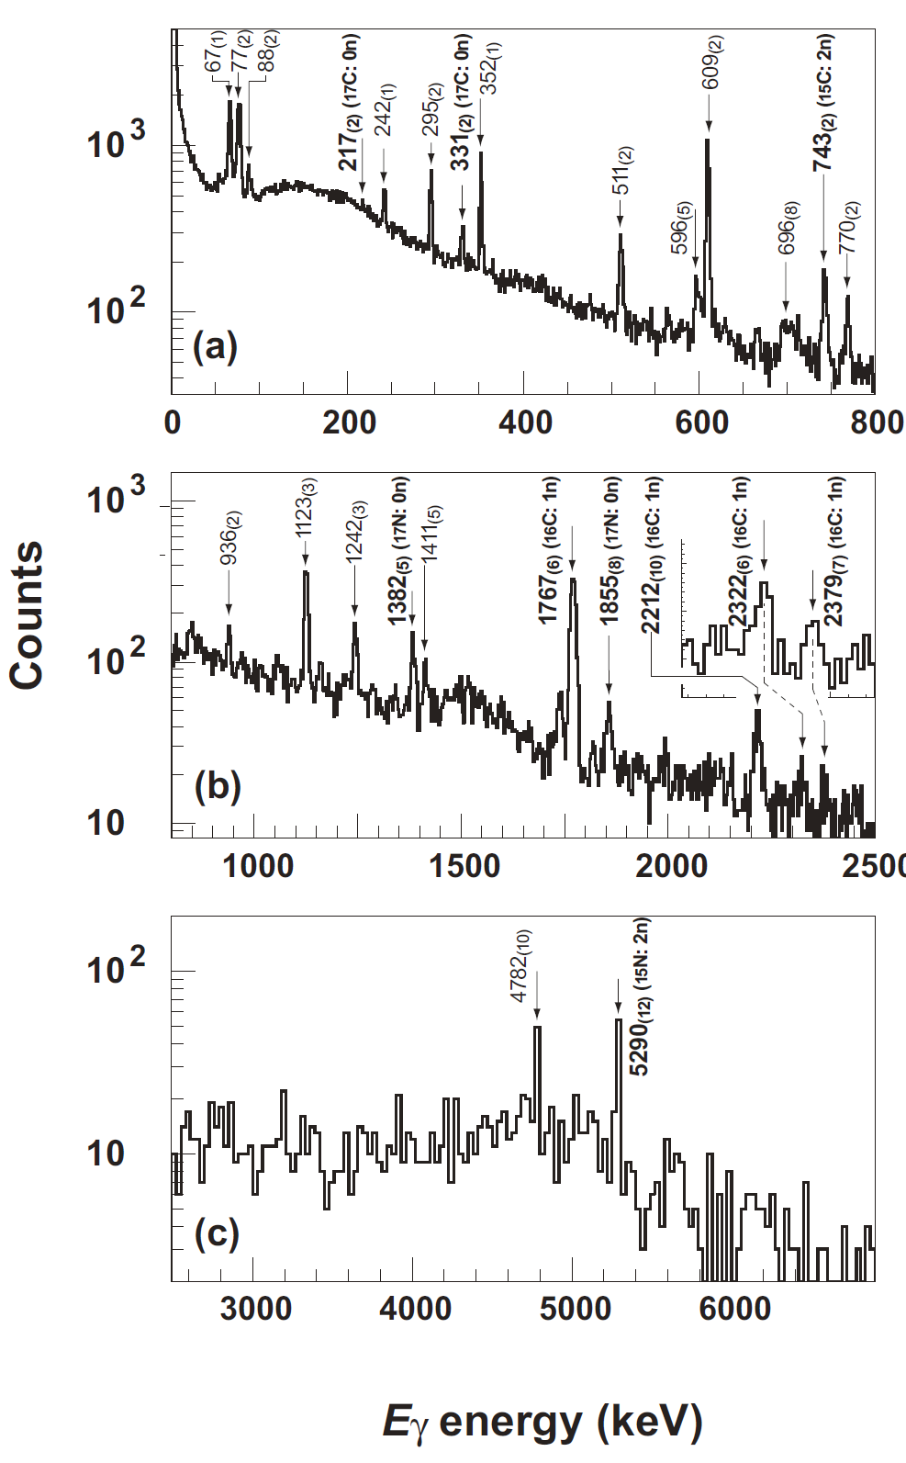
β-neutron-γ spectroscopy with ¹⁷B↑

Slide 27
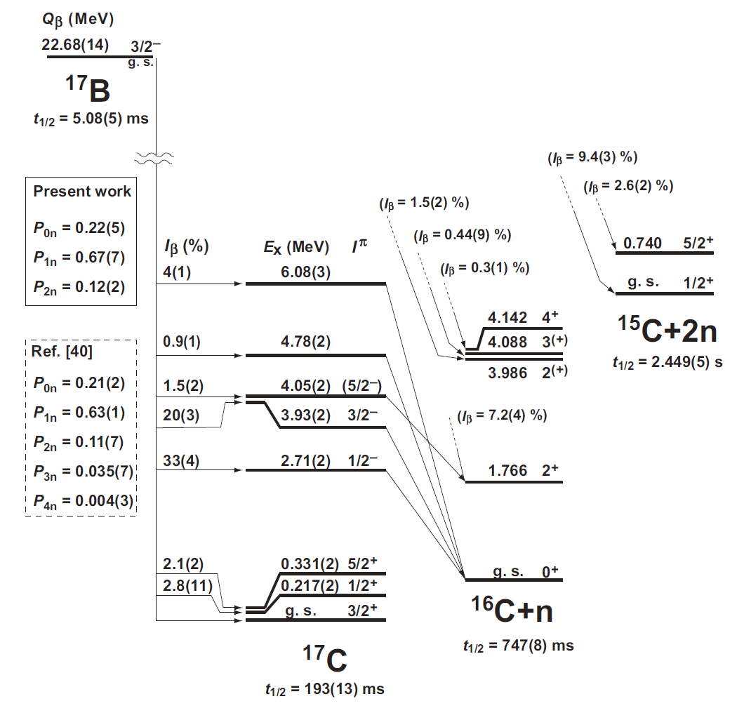
Decay scheme of 17B
H. Ueno et al., Phys. Rev. C 87, 034316 (2013)

Slide 28
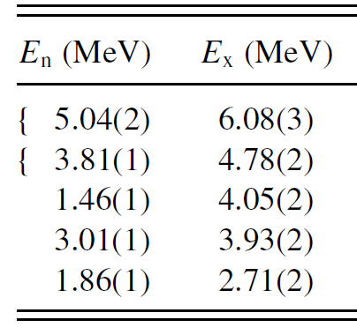
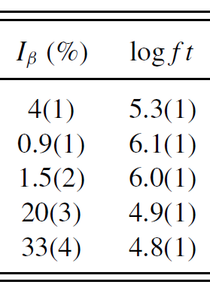






I^{π} assignment of the ¹⁷C levels
No reference I^{π}_{f} is known
all possible combinations of I^{π}_{f} =1/2–, 3/2–, and 5/2– were examined
( 3 x 3 x 3 = 27 set)
→ calculated reduced χ²
(≡ consistency check)
A(¹⁷B→¹⁷C)
=
–1 for ¹⁷C(1/2–)
–0.4 for ¹⁷C(3/2–)
+0.6 for ¹⁷C(5/2–)

Slide 29




1/2– state
3/2– state
Cannot decay into single particle/hole states
→ no concentration of the strength
5/2– state

Slide 30
RIKEN RI Beam Factory (RIBF)
Self Confining RI Ion Target
RIBF Layout
150 MeV e-Microtron
700 MeV e-Storage ring
Notes:
RIBF now can provide all ions at 345 MeV/u.
And RI beams are produced by In-flight Uranium fission or projectile fragmentation.
Take U-fission for instance, Uranium beam is pre-accelerated by this newly operational RILAC two, and injected into RRC. The energy of RRC beam is boosted up to 345 MeV/u by fRC, IRC , and finally by this superconducting ring cyclotron, SRC. 345 MeV/u Uranium beam goes to the production target, here and fission fragments are isotopically selected and collected by this large-acceptance superconducting BigRIPS.
Now, superconducting Zero Degree Spectrometer and SHARAQ spectrometer are used for the experiments, and This large-acceptance superconducting SAMURAI spectrometer will be operational early next year. This unique electron-RI scattering ring with Self-Confining RI target for precision measurement of charge distribution in unstable nuclei will start RI experiment next year. This Rare-RI ring for the precision mass measurement will be completed in next fiscal year.

Slide 31

SLOWRI facility
Slow beam production
based on the rf ion guide method
M. Wada et al.
“Super ISOLDE”
1. Wide Range of Nuclides
No Chemical Processes in Production & Separation
2. High Purity
No Isobar No Isotone Contamination
3. Small Emittance
4. Variable Beam Energy
1-50 keV Slow Beam, <1eV Trapped RI, 1MeV/u (future option)
5. Human Accesibility during On-line Exp.
ISOL
Ion Trap
RF Ion guide gas cell
Collinear Laser Exp.
Degrader
MR-TOF-MS
HEBT(DQQ)
from BigRIPS
Decay studies

Slide 32
Summary
Activities of μ & Q at RIBF
Excited (isomeric) states – BigRIPS
  Q(^{43m}S)
  A new scheme to produce surely spin-aligned RIBs
  (two-step PF combined with disp. matching)
    → ^{32m}Al
    → a new proposal submitted to RIBF
  Spin alignment via the ²³⁸U in-flight fission
2. Ground states – RIPS
  Al
  ⁴¹⁻⁴⁵S
  Application to delayed particle spectroscopy
  New devices: SLOWRI

Slide 33

Spin-parity assignment of the ^{32m}Al state at E_{x}=957 keV
Experimental g_{exp}(^{32m}Al) = 1.32(1)
(preliminary)
Theoretical g-factors
 | 4⁺ | 2⁺
USD | 1.327 | 1.548
USDA | 1.323 | 1.563
USDB | 1.322 | 1.531
π(d_{5/2})^{–1} ⊗ν(d_{3/2}) ^{–1} | 1.485 | 1.821
eff. g’s
1.432
1.776
0.256 (Ip=4-)
Spin-parity of ^{32m}Al has been assigned to 4⁺

Slide 34



Ordering of 2⁺ and 4⁺ in ³²Al
The inversion of 2⁺ & 4⁺ levels of ³²Al
from USD is associated with island of inversion phenomena
Robinson et al., Phys. Rev. C 53, R1465 (1996)
Assuming
|³⁰Al⟩^{Iπ=1,2,3,4+} = |π(d_{5/2})⁻¹ ⊗ ν(d_{3/2}) ⟩ ^{Iπ=1,2,3,4+}
|³²Al⟩^{Iπ=1,2,3,4+} = |π(d_{5/2})⁻¹ ⊗ ν(d_{3/2})⁻¹ ⟩ ^{Iπ=1,2,3,4+}
low-lying I^{π}=1,2,3,4⁺ levels of ³²Al can be estimated with
I^{π} = 4⁺
from g_{exp}
4⁺
The 2⁺ & 4⁺ ordering
could be explained from ³⁰Al
→ ^{32m}Al is normal
R.F. Casten, “Nuclear Structure from a simple perspective”
(assumed 4⁺)
³⁰Al exp.
³²Al (←³⁰Al)
³²Al exp.
USD

Slide 35



SLOWRI - a universal low-energy RI-beam facility
with RF-carpet Gas Cell & PALIS Gas Cell
M. Wada et al.
Daily Work：Parasitic RI beam for experiments, tuning, adventure
Main Beam Time (a few/ y)：Experiments for very rare, or difficult elements.
Detectors, Exp Apparatus: Shared with two RI-beams
Main RF Gas Cell
Z: ≈100%
Text: ≈10 ms
effi: ≈10%
Parasitic LIS Gas Cell
Z: ≈70%
Text: 0.1~1 s
effi: ≈1%

Slide 36
“OROCHI” method
-a new nuclear laser spectroscopy-
T. Furukawa (Tokyo Metropolitan University), Y. Matsuo (Hosei Univ. / RIKEN)
Optical RI-atom Observation in Condensed Helium as Ion-catcher
separator
Advantageous
for the study of
low yield and
short-lived
unstable nuclei
Ion beam
RI atoms
target
(radioisotope atoms)
Accelerator
RI beam
Laser
He II
aiming at ~10 pps,
~ 50 ms
He stopper of RI beam
+
Laser spectroscopy
LIF
For the systematic determination of nuclear spins and moments
by measuring atomic Zeeman and hyperfine splittings

Slide 37

Probe nucleus
exp
Probe nucleus: ³²Al
Isomer state found @ GANIL
I^{π} & g-factor unknown
# of nucleon removal from 48Ca
= 16 (≡ 16/48 = 33%)
isomer
⁴⁸Ca → ³³Al→ ^{32m}Al
M. Robinson et al.,
Phys. Rev. C 53, R1465 (1996)

Slide 38





RIKEN RI Beam Factory (RIBF)
SRC: 345 MeV/u
BigRIPS: RI beams via In-flight U Fission or P. F.
Self Confining RI Ion Target
RIBF Layout
150 MeV e-Microtron
700 MeV e-Storage ring
fRC
SRC
BigRIPS
IRC
Notes:
RIBF now can provide all ions at 345 MeV/u.
And RI beams are produced by In-flight Uranium fission or projectile fragmentation.
Take U-fission for instance, Uranium beam is pre-accelerated by this newly operational RILAC two, and injected into RRC. The energy of RRC beam is boosted up to 345 MeV/u by fRC, IRC , and finally by this superconducting ring cyclotron, SRC. 345 MeV/u Uranium beam goes to the production target, here and fission fragments are isotopically selected and collected by this large-acceptance superconducting BigRIPS.
Now, superconducting Zero Degree Spectrometer and SHARAQ spectrometer are used for the experiments, and This large-acceptance superconducting SAMURAI spectrometer will be operational early next year. This unique electron-RI scattering ring with Self-Confining RI target for precision measurement of charge distribution in unstable nuclei will start RI experiment next year. This Rare-RI ring for the precision mass measurement will be completed in next fiscal year.

Slide 39
BigRIPS Layout for the present experiment
TDPAD apparatus
1st Target
2nd Target
Experimental set-ups
ZeroDegree: Zero-degree forward Spectrometer
T. Kubo, Nucl. Instr. Meth. B204, 97 (2003).
T. Kubo et al., IEEE Transactions on Applied Superconductivity, 17, 1069 (2007)

Slide 40




Time Differential Perturbed Angular Distribution (TDPAD)
Implantation into
a Cu crystal
222 keV
734 keV
^{32m}Al beam
from BigRIPS

Slide 41
Mesurements
Measurement 1
Measurement 2
Measurement 3
Two-step PF
w/o Disp. Matcing.
Two-step PF
w/ Disp. Matcing.
One-step PF
F0 target : Be 10mm
F1slit : ±3%
F5 target : Al 10mm (Wedge)
(Goldhaber width = 0.4%)
F5 slit : ±0.5%
F7 slit : center±0.15%
F0 target : Be 10mm
F1 slit : ±3%
F5 target : Al 10mm (Wedge)
(Goldhaber width = 0.4%)
F5 slit : ±3%
F7 slit : center±0.15%
F0 target : Be 4mm
(Energy loss = 3%
Goldhaber width = 4%)
F1 slit : ±0.5%

Slide 42


Result 1 : dispersion matching
Measurement 1
Measurement 2
w/o dispersion matching
w/ dispersion matching
p @F3
p_{cut} @F3
p @F5-F7
A₂ : Asymmetry param. (0.447 for E2)
B₂ : rank2 tensor
B₂ = 1.15*A (A:spin alignment)
vs.
x@F7
preliminary
preliminary
A ～ 9(2)%
A ～ 8(1)%
Same A values: dispersion matching works well

Slide 43
Result 2 : two-step vs one-step
Measurement 3
Measurement 2
One-step PF
w/ dispersion matching
preliminary
p @F3
p_{cut} @F3
p @F5-F7
vs.
x@F7
A < 0.8 %
Yield(^{32m}Al) ～ 0.9 kcps
(Att. 1/100)
9.3h measurement
preliminary
A ～ 8(1)%
Figure of Merit (～Y・A²) > 50

Slide 44
Spin-parity assignment of the ^{32m}Al state at E_{x}=957 keV
Experimental g_{exp}(^{32m}Al) = 1.32(1)
(preliminary)
Theoretical g-factors
 | 4⁺ | 2⁺
USD | 1.327 | 1.548
USDA | 1.323 | 1.563
USDB | 1.322 | 1.531
π(d_{5/2})^{–1} ⊗ν(d_{3/2}) ^{–1} | 1.485 | 1.821
eff. g’s
1.432
1.776
0.256 (Ip=4-)
Spin-parity of ^{32m}Al has been assigned to be 4⁺

Slide 45
Ordering of 2⁺ and 4⁺ in ³²Al
The inversion of 2⁺ & 4⁺ levels of ³²Al
from USD is associated with island of inversion phenomena
Robinson et al., Phys. Rev. C 53, R1465 (1996)
Assuming
|³⁰Al⟩^{Iπ=1,2,3,4+} = |π(d_{5/2})⁻¹ ⊗ ν(d_{3/2}) ⟩ ^{Iπ=1,2,3,4+}
|³²Al⟩^{Iπ=1,2,3,4+} = |π(d_{5/2})⁻¹ ⊗ ν(d_{3/2})⁻¹ ⟩ ^{Iπ=1,2,3,4+}
low-lying I^{π}=1,2,3,4⁺ levels of ³²Al can be estimated with
I^{π} = 4⁺
from g_{exp}
4⁺
The 2⁺ & 4⁺ ordering
could be explained from ³⁰Al
→ ^{32m}Al is normal
R.F. Casten, “Nuclear Structure from a simple perspective”
(assumed 4⁺)
³⁰Al exp.
³²Al (←³⁰Al)
³²Al exp.
USD

Slide 46

Ordering of 2⁺ and 4⁺ in ³²Al: Shell model predictions

Slide 47
Two-step PF scheme: Results
The same A values are obtained with simple & disp.-matched two-step P. F. reactions
  Same A components were extracted from the wide-spread momentum distribution as designed
A large A value (～8(1) %) and FoM (＞50) were obtained for two step P. F.
  promising scheme for large spin alignment
  → in-flight U fission + fragmentation
g(^{32m}Al) =1.32(1) has been determined.
  The first application of this technique → feasibility

Slide 48
Experiment: Method
(1) Production of spin-polarized RI beams and/or crystal studies
  ^{41, 43}S: PF-induced spin polarization
  ⁴⁵S: PF+ neutron pickup reaction
(2) Resonance scans through β-NMR spectroscopy
production (reaction) and preservation (crystal stopper) of spin polarization
resonance scan
β-ray angular distribution
W_{β} (θ)=1+A_{β}P cosθ
    A_{β} : Asymmetry parameter
    P : spin polarization
(1–A_{β}P )
(1+A_{β}P)
(U/D) =

Slide 49

(1+A_{β}P )
(1–A_{β}P)
C_{U}
C_{D}
C_{U(B0↑ or ↓)}
C_{D(B0↑ or ↓)}
(U/D) =
β-NMR: Double Ratio
β-AFR: 4-fold Ratio

Slide 50
41,43S spin
direction
(1+A_{β}P )
(1–A_{β}P)
C_{U(B0↑)}
C_{D(B0↑)}
(1+A_{β}P )
(1–A_{β}P)
C_{U(B0↓)}
C_{D(B0↓)}
(1–A_{β}P )
(1+A_{β}P)
C_{U(B0↓)}
C_{D(B0↓)}
(1–A_{β}P )
(1+A_{β}P)
C_{U(B0↑)}
C_{D(B0↑)}

Slide 51
NMR for Q-moment determination (β-NQR)
β-NMR spectroscopy
under the combined Zeeman and quadrupole interactions (β-NQR)
Zeeman
eqQ
⁴³S
(3/2–)
⁴³S (I^{π} = 3/2– ?)

Slide 52



ν_{Q} scan
①
①
⁴³S
(3/2–)
②
②
③
③
m = (–3
–1
+1
+3 ) / 2

Slide 53



RF system for μ- & Q-moment measurements
1Ω
Oscilloscope
63ms
RF power
amplifier
(1kW)
waveform resolution:
32M points x 8bit AM modulation
Zeeman
RF sweeps for One Q-moment data point
Arbitrary waveform generator
(AWG615)
eqQ
RF trigger
to the beam pulsing
count gate
I=5/2
case
NIM
Programmable
Sequence
Generator (PSG)
Notes:
This is the most conservative way.

