Slide 1
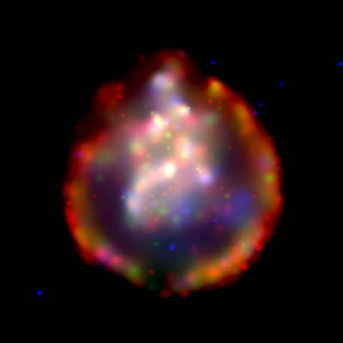
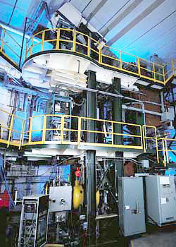
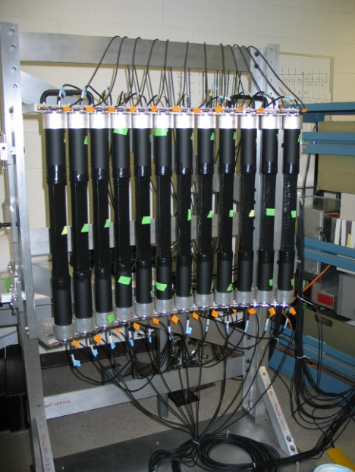
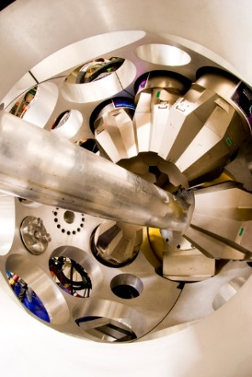
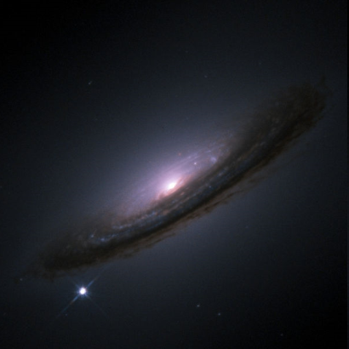






Charge-Exchange Reactions and
Weak Reaction Rates for Astrophysics
Remco G.T. Zegers
For the NSCL Charge-Exchange group and Collaborators

Slide 2
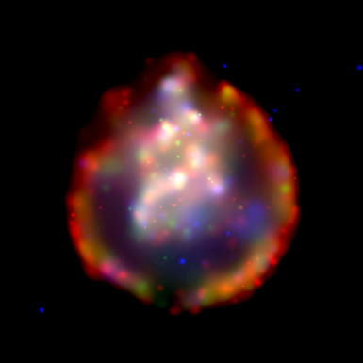
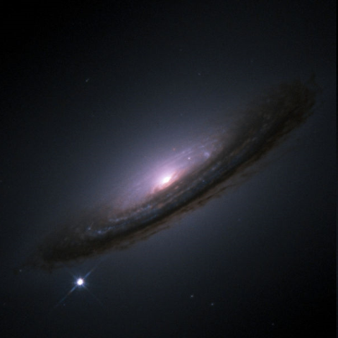
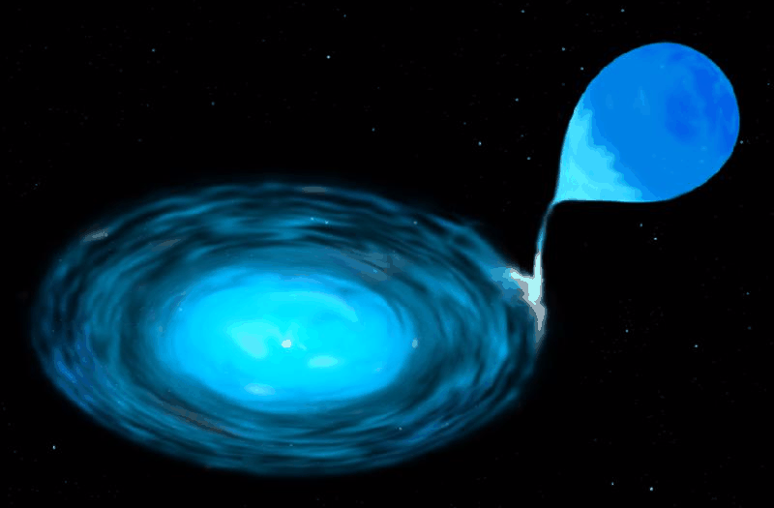
Weak reaction rates in astrophysical phenomena
Core-collapse (Type II) Supernovae
Thermonuclear (Type Ia) Supernovae
Crustal processes in accreting neutron stars
SNR 0103-72.6 Chandra observatory
SN 1994D ESA/Hubble
s-process
r-process
neutrino interactions
neutrino detectors
(neutrinoless) double β decay
…
Today’s focus: electron captures (EC) on pf shell nuclei
A comprehensive description of weak transition rates in nuclei over large portions of the nuclear chart (including unstable nuclei) is critical
K. Langanke and G. Martinez-Pinedo, RMP 75, 819 (2003).

Slide 3
electron captures in supernovae
on groundstate
Dominated by allowed (Gamow-Teller) weak transitions between states in the initial and final nucleus:
No transfer of orbital angular momentum (ΔL=0)
Transfer of spin (ΔS=1)
Transfer of isospin (ΔT=1)
EC
on exited state
β
from groundstate
Due to finite temperature in star, Gamow-Teller transitions from excited states in the mother nucleus can occur
E_{x}
Direct empirical information on strength of transitions [B(GT)] is limited to low-lying excited states e.g. from the inverse (β-decay) transitions, if at all
groundstate
Q
groundstate
Daughter (Z,A)
Mother (Z+1,A)

Slide 4

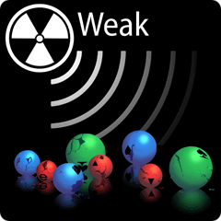
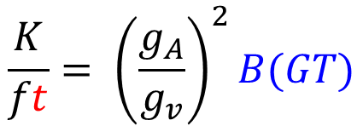
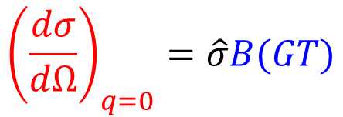
Charge-exchange reactions & β/EC-decay
$${\left(\frac{dσ}{dΩ}\right)}_{q=0}=\hat{σ}B(GT)$$
A,Z+1
(p,n)
(³He,t)
HICE
E/A~100 MeV
(n,p)
(t,³He)
(d,²He)
HICE
β⁻
A,Z
A,Z-1
e-capture/β⁺
$$\frac{K}{ft}= {\left(\frac{g_{A}}{g_{v}}\right)}^{2}B(GT)$$
Y. Fujita et al., PRL 95 (2005), 212501
Y. Fujita, B. Rubio, W. Gelletly, Prog. Part. Nucl. Phys. 66, 549 (2011)
The unit cross section is calibrated against transitions for which β-decay data are available

Slide 5
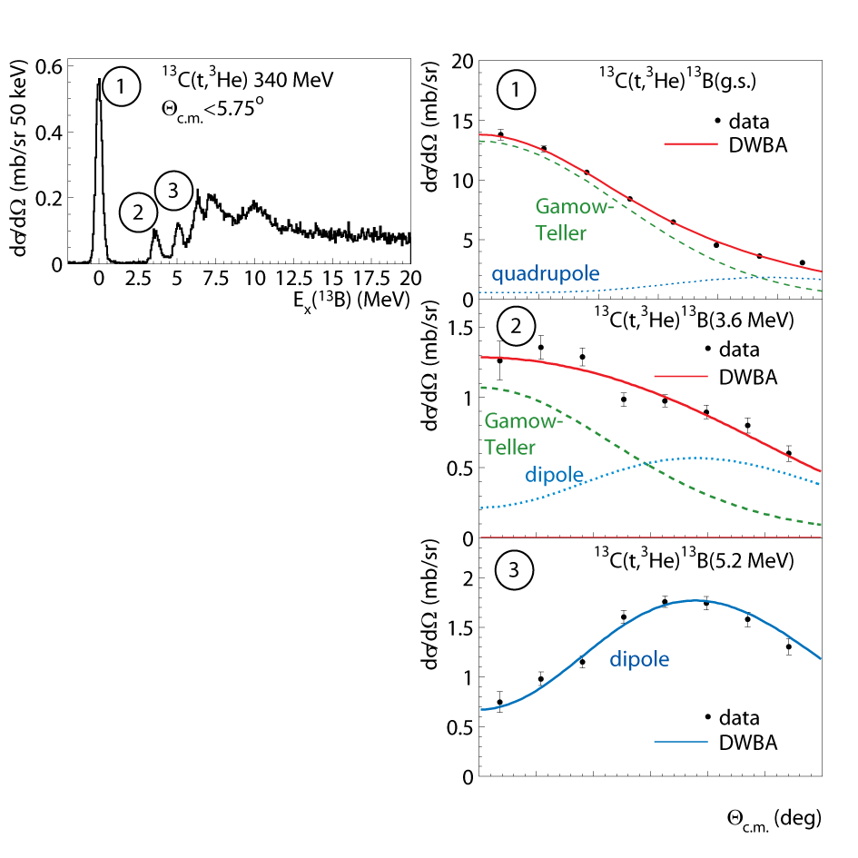
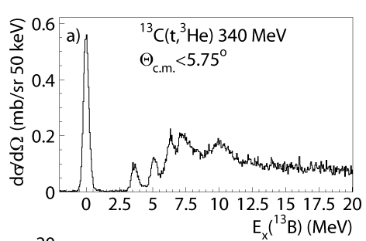
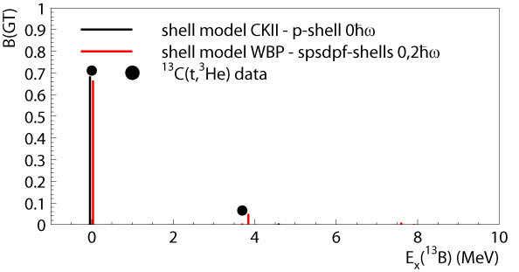

Multipole decomposition
1
Multipole
Decomposition
Analysis
3
2
0 1 2 3 4 5
C. Guess et al., Phys. Rev. C 80, 024305 (2009)

Slide 6
Charge-exchange experiments at intermediate energies
IUCF, TRIUMF, KVI, RCNP, Texas A&M, GANIL, RIBF, GSI, NSCL…
(n,p)-type experiments
(n,p) (d,²He) (t,³He) (⁷Li,⁷Be) HICE, (π⁺,π⁰)…
(p,n)-type experiments
(p,n), (³He,t), HICE,(π⁻,π⁰)…
Experiments successfully performed in inverse kinematics with rare isotope beams
Rare isotope beams serve as probes
Charge-exchange experiments are motivated by a wide variety of scientific questions

Slide 7
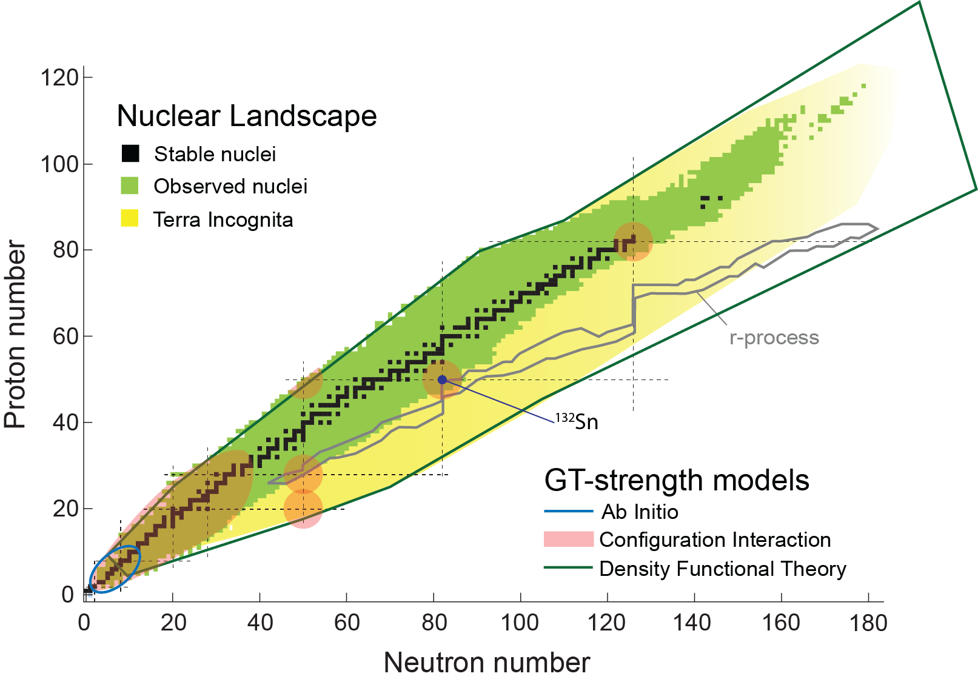

Slide 8
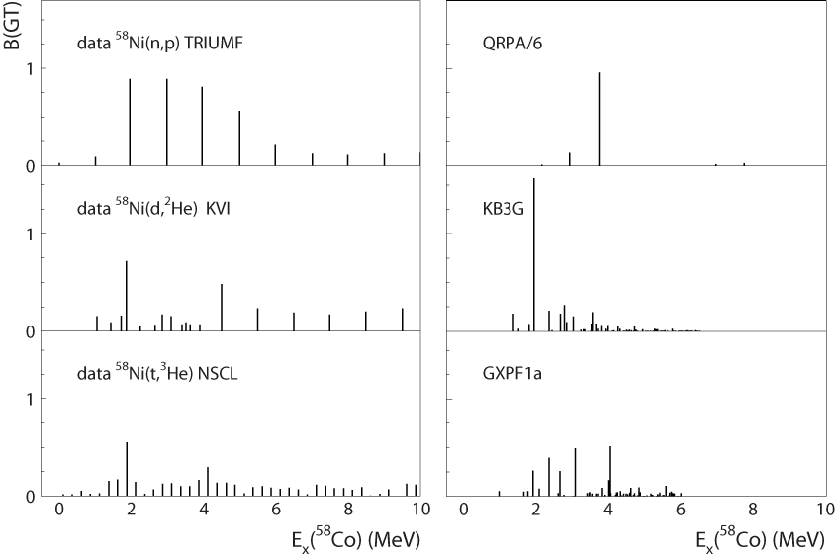
Example ⁵⁸Ni→⁵⁸Co
Frequently used in astrophysical simulations
experiment
theory
S. El-Kateb et al.,
PRC 49, 3128 (1994).
P. Moller and J. Randrup,
NPA514, 1 (1990).
S. Gupta
M. Hagemann et al.,
PLB579, 251 (2004)
A. Poves et al.,
NPA694, 157 (2001).
L. Cole et al.,
PRC 74, 034333 (2006)
M. Honma et al.
PRC 65, 061301(R) (2002)

Slide 9
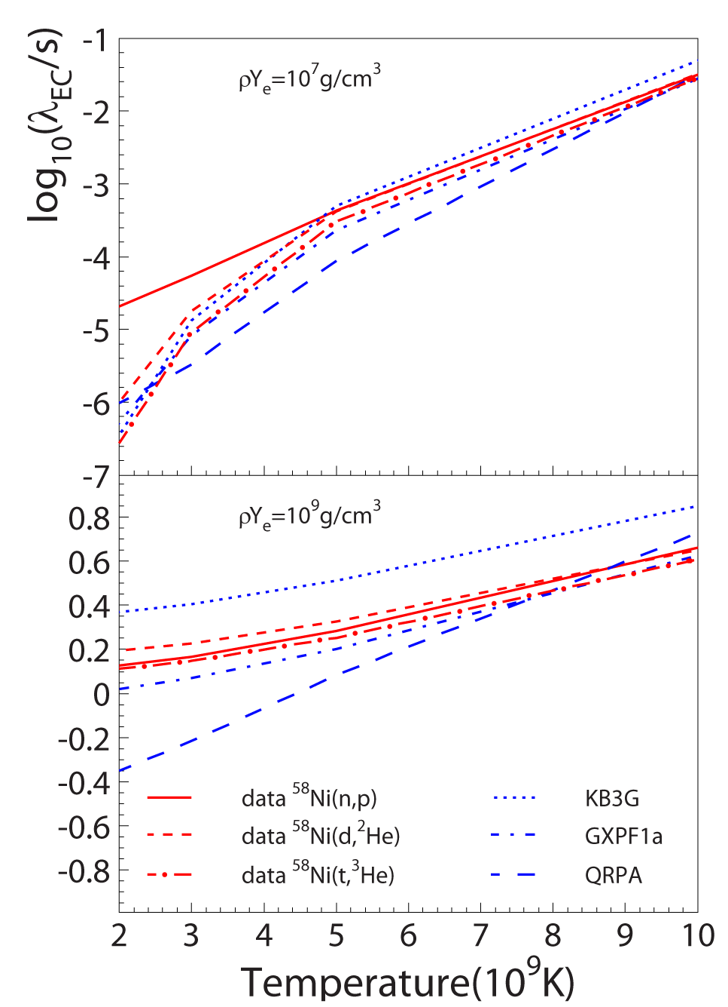
Derived EC rates from experimental and theoretical strength distributions
Calculated at stellar densities and temperatures for different astrophysical scenarios
Combine results for different nuclei to assess the ability of theory to provide accurate input for astrophysical simulations
Pick specific cases that allow one to discriminate between different models
pre-supernova
collapse stage
A.L. Cole et al., Phys. Rev. C 86, 015809 (2012)

Slide 10
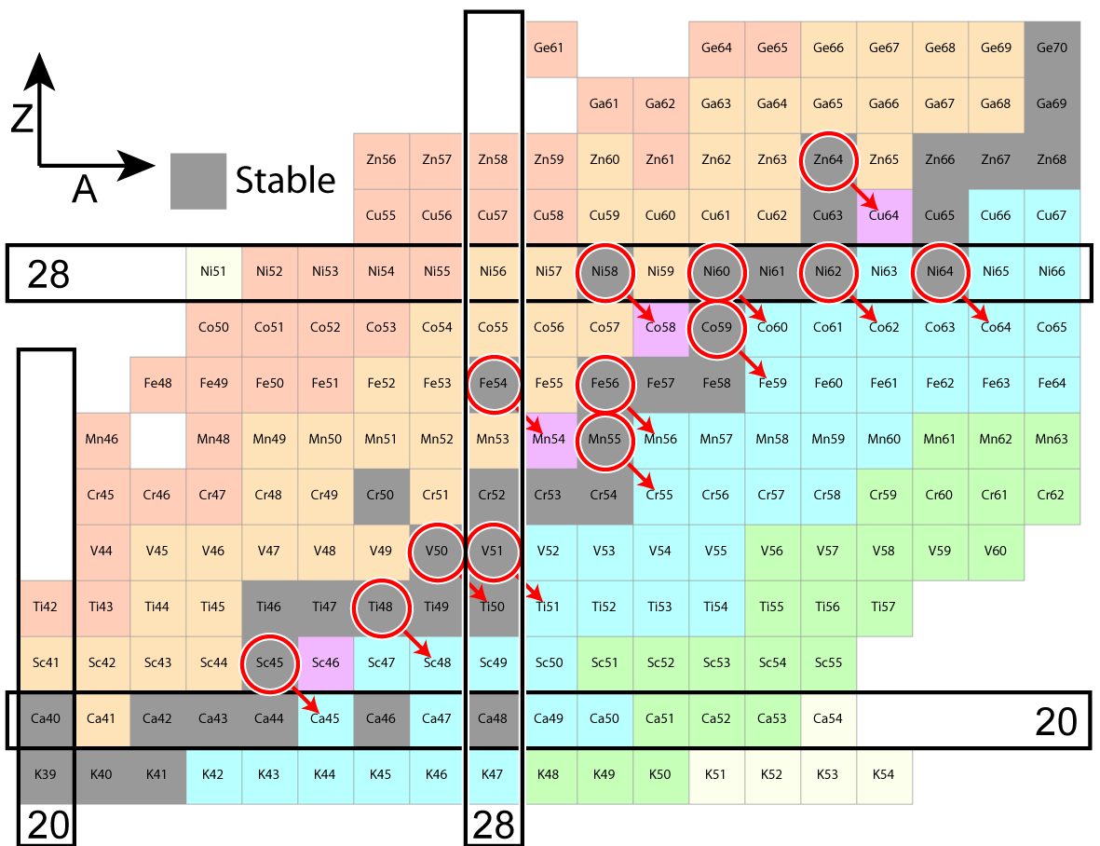
A.L. Cole et al., Phys. Rev. C 86, 015809 (2012)
Studied in CE study
(n,p), (d,²He), (t,³He)…
Data from
TRIUMF, KVI, RCNP, NSCL…

Slide 11
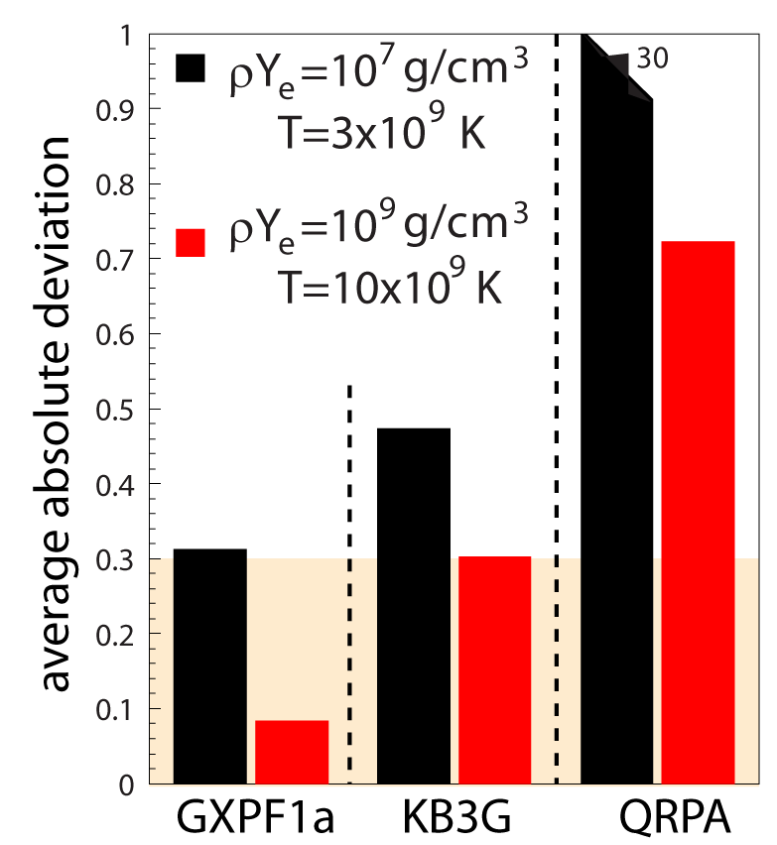
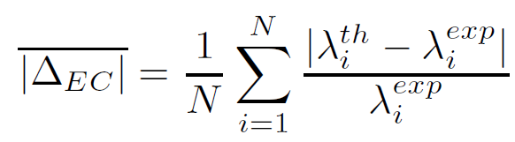
Summary of EC rate study
EC rates based on strengths from shell-model calculations with GXPF1a and KB3G deviate by less than 50%.
EC rates based on QRPA calculations deviate significantly more, especially at low densities/temperatures where transitions to low-lying states are dominant.
Honma et al.
Poves et al.
Möller et al.
A.L. Cole et al., Phys. Rev. C 86, 015809 (2012)

Slide 12
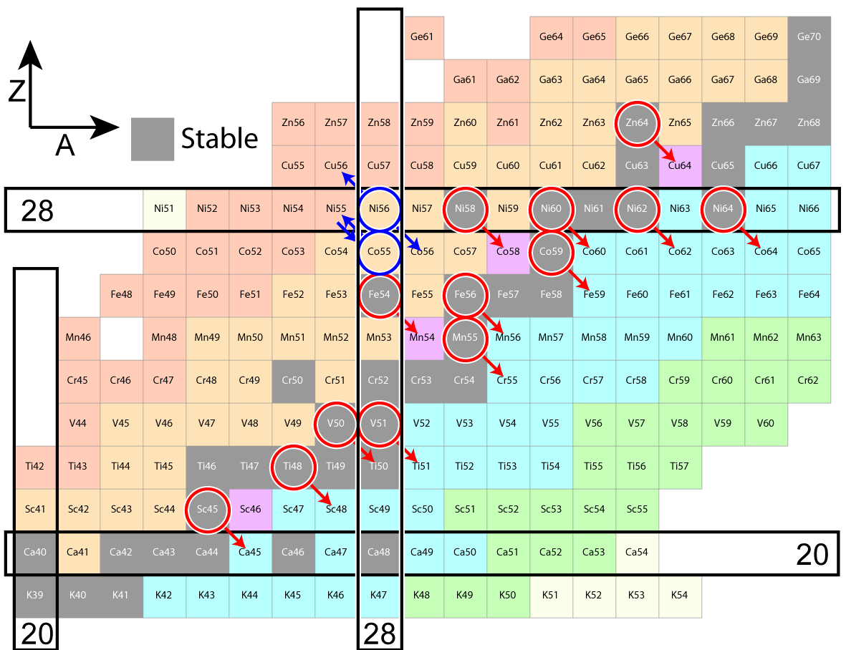
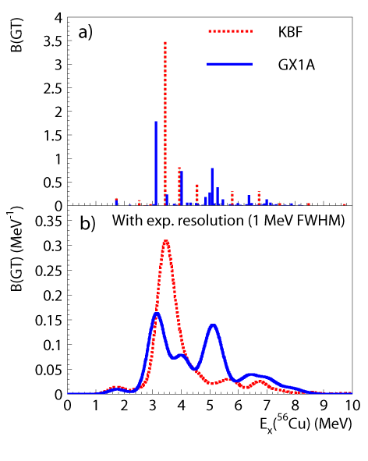
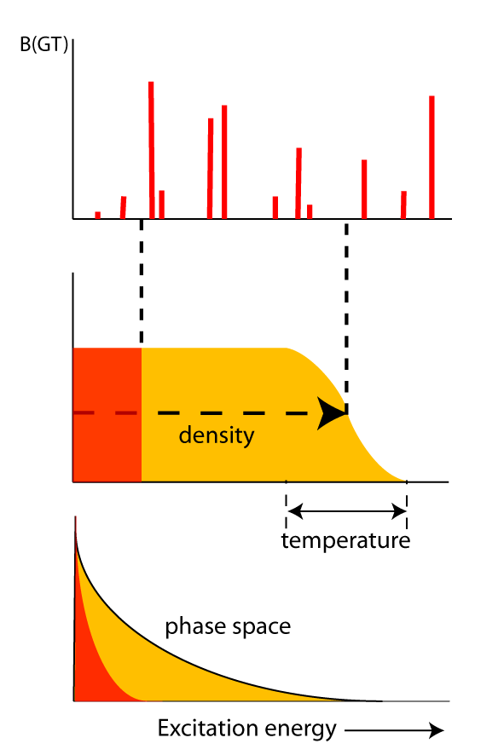
!!!
??
⁴⁵Sc(n,p) - W. P. Alford et al., NPA531, 97 (1991)
⁴⁶Ti(³He,t) -T. Adachi et al., PRC 73, 024311 (2006)
intruder states from sd-shell at low E_{x}?

Slide 13
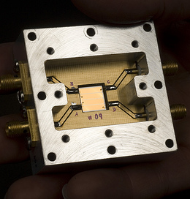
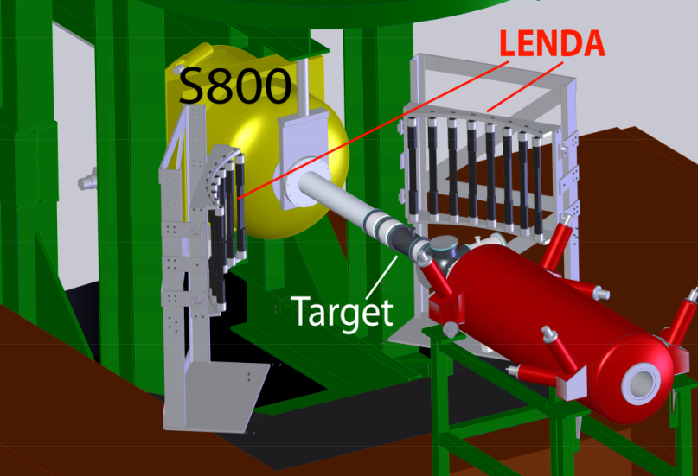
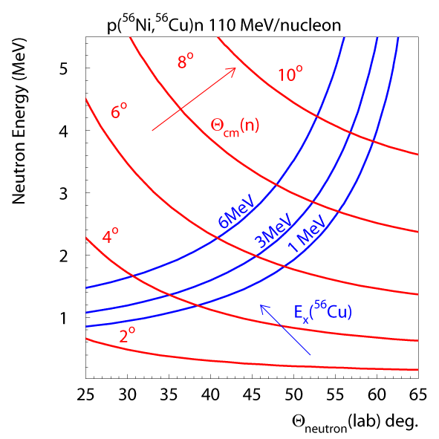
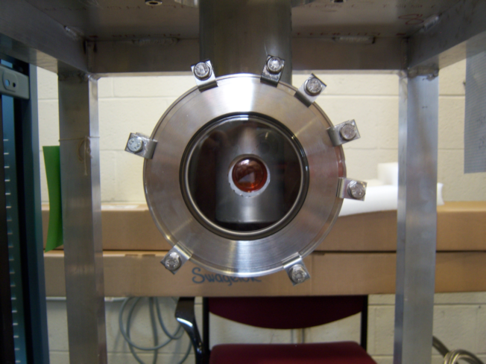
⁵⁶Ni(p,n) in inverse kinematics
S800 spectrometer
Heavy residue collection
Bρ< 4 Tm /130º bend
Particle identification
Diamond detector
Beam particle timing
30 cm
Low Energy Neutron
Detector Array (LENDA)
neutron detection
Plastic scintillator
24 bars 2.5x4.5x30cm
150 keV < E_{n} < 10 MeV
ΔE_{n} ~ 5% Δθ_{n} < 2º
efficiency 15-40%
n
RI beam
Liquid Hydrogen target
“proton” target
65 mg/cm² (~7 mm)
~3.5 cm diameter
T=20 K ~1 atm

Slide 14
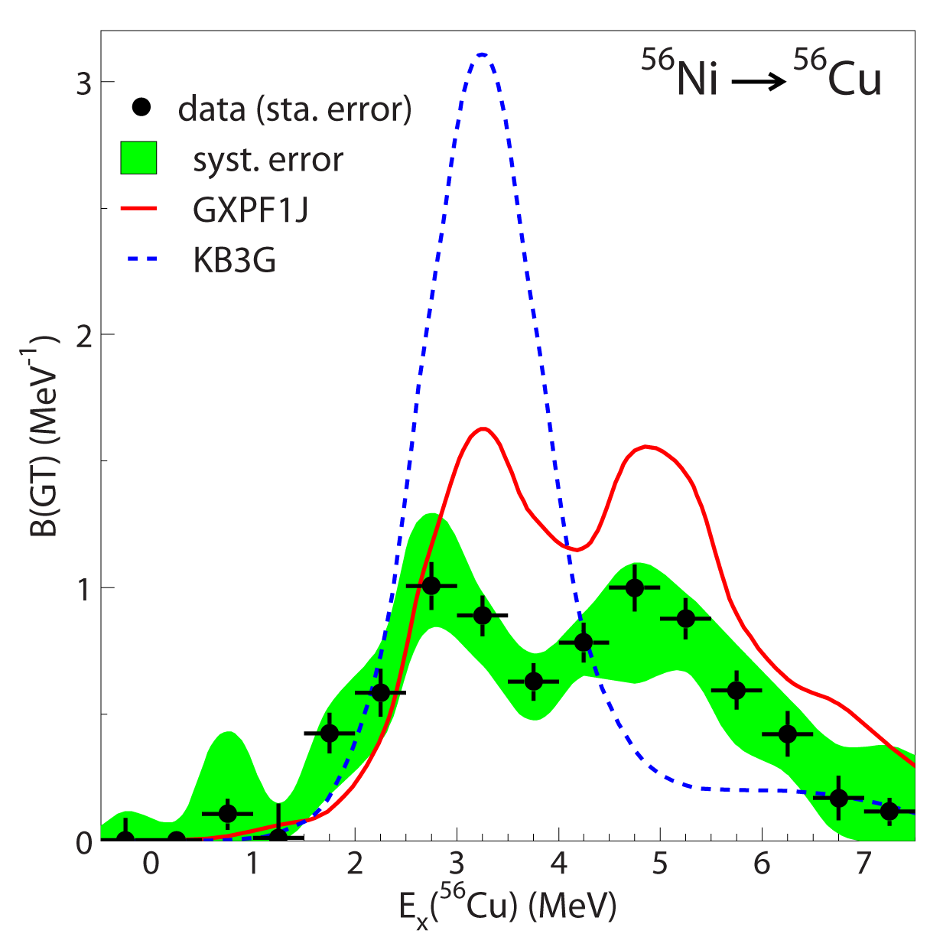
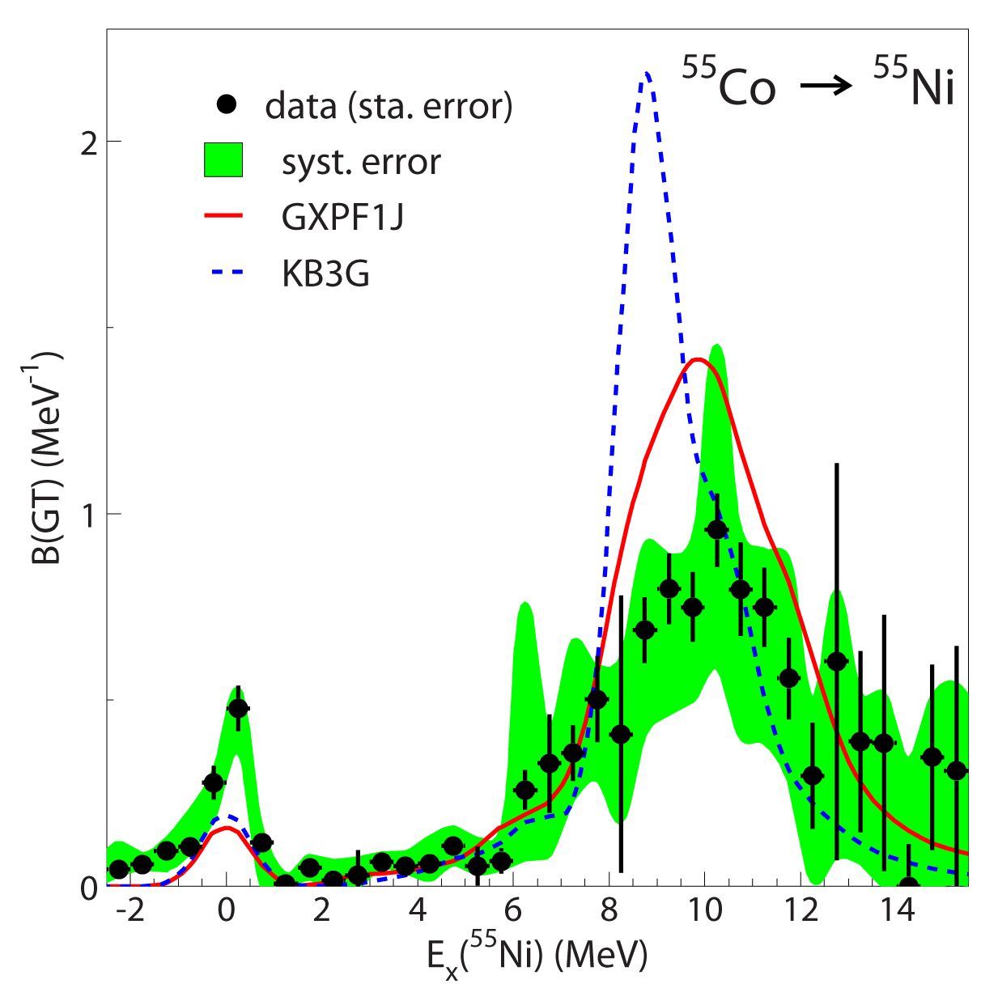
Gamow-Teller strengths
Isospin symmetry:
B(GT)[⁵⁶Ni→⁵⁶Cu]
    =
B(GT)[⁵⁶Ni→⁵⁶Co]
and
B(GT)[⁵⁵Co→⁵⁵Ni]
  =
B(GT)[⁵⁵Ni→⁵⁵Co]
GT strengths from GXPF1A/J provide better results than from KB3G for ⁵⁶Ni (⁵⁵Co)
Difference between KB3G and GXPF1A:
KB3G weaker spin-orbit and pn-residual interactions→GT strength resides at lower E_{x}
KB3G lower level density→GT strength less spread
M. Sasano et al., Phys. Rev. Lett. 107, 202501 (2011),Phys. Rev. C 86, 034324 (2012)
K. Langangke, Physics 4, 91 (2011)

Slide 15

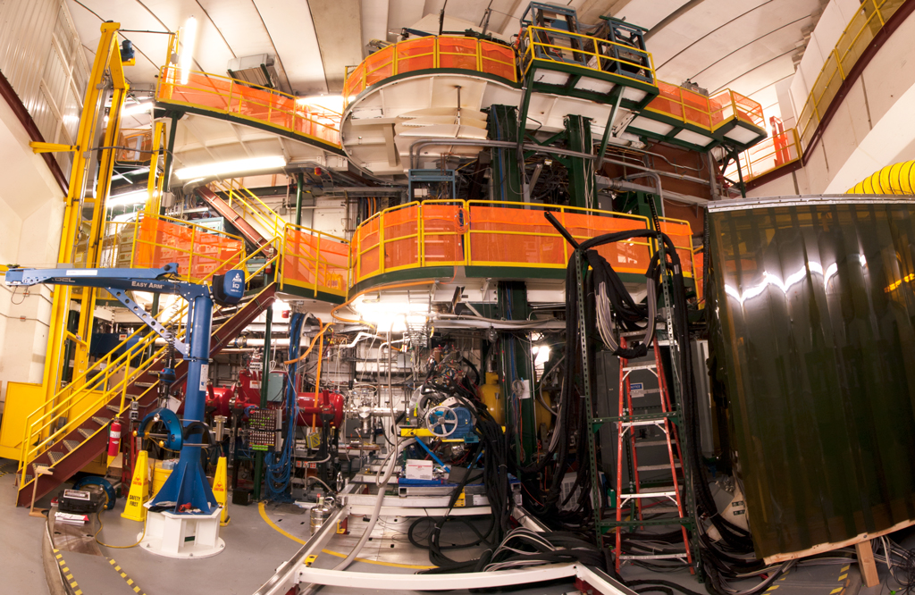

⁴⁵Sc,⁴⁶Ti(t,³He+γ)
S800 Spectrograph+Gretina
S. Noji et al., PRL accepted
Gretina
γ-detection
Gamma-Ray Energy Tracking
In-beam Nuclear Array
³He ejectiles
S800
³H (100 MeV/u)
~10M pps
target (~10 mg/cm²)

Slide 16
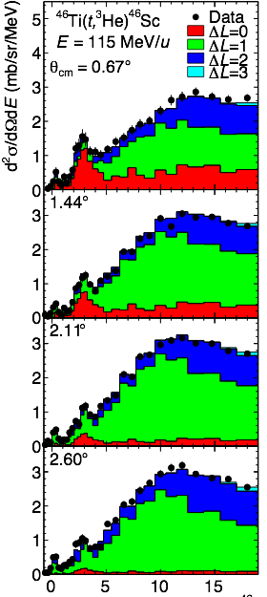
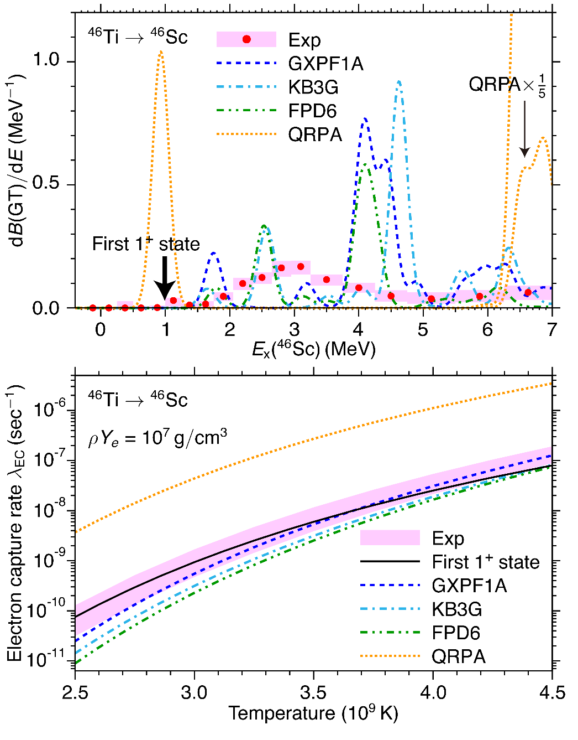
Strength extraction
Low-lying strength distribution is particularly important for type-II presupernova stage
Theoretical models fail to reproduce experiment
  Admixtures between sd and pf shells
Strength of transition to known 1⁺ state at 991 keV??
Achievable resolution ~ 250-300 keV
Limited resolution will also affect future CE experiments in inverse kinematics
E_{x}(⁴⁶Sc) (MeV)

Slide 17


Gretina
Gamma-Ray Energy Tracking In-beam Nuclear Array
S. Paschalis et al., NIMA 709 (2013) 44
Installed at S800 target position (2012-2013)
7 HPGe modules
For (t,³He) experiment: γ-rays from target, produced at rest
Future: CE experiments in inverse kinematics with rare isotope beams: decay-in-flight γ-rays

Slide 18
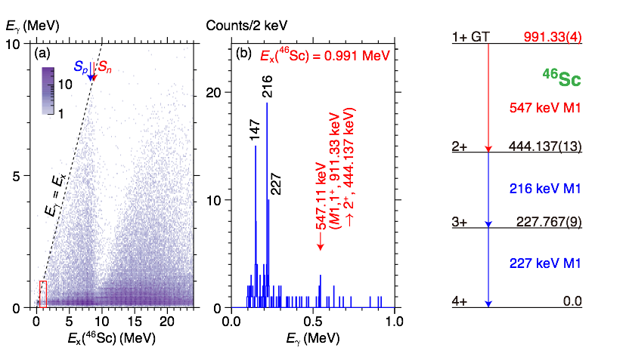
Low-lying GT strength
B(GT)_{0.991}=0.009 ± 0.005(experimental) ± 0.003 (systematic)

Slide 19
Electron-capture rate in pre-supernovae star

Slide 20
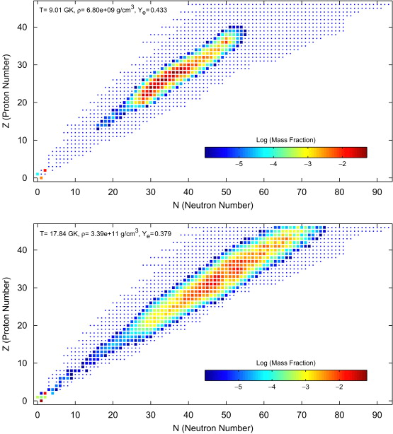
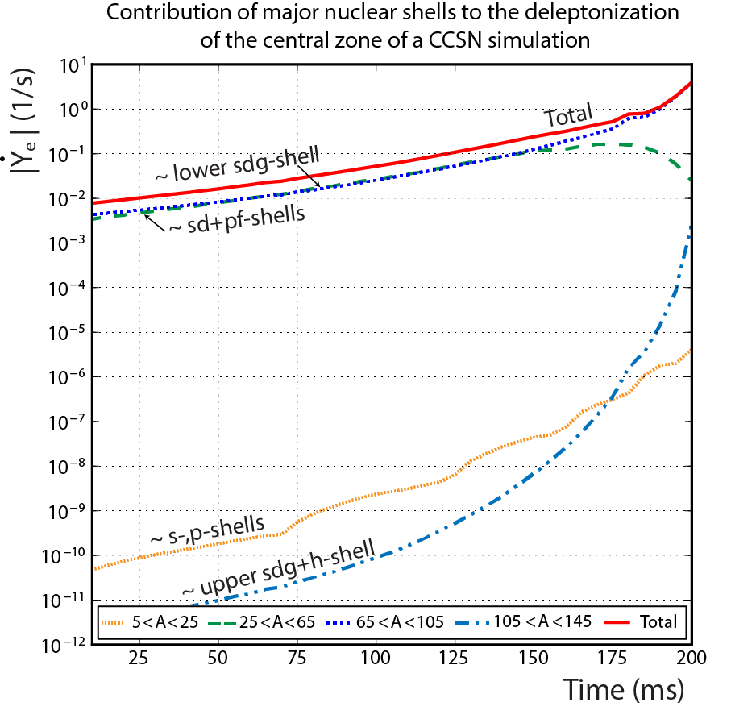
Beyond near-stable pf-shell nuclei
Z (proton number)
T=9 GK
ρ=6.8e+9 g/cm³
T=18 GK
ρ=3.4e+11 g/cm³
N (neutron number)
W.R. Hix et al. 2003
Detailed sensitivity studies in progress
Evan O’Connor (CITA) Chris Sullivan (NSCL/MSU)
GR1D – stellar evolution code
Weak reaction rate sets are required

Slide 21
Future prospects
To achieve a comprehensive description of weak reaction strengths/rates for astrophysical simulations (and others):
Combined analysis of (p,n)-type and (n,p)-type experimental data?
  Charge-exchange experiments
  β-decay experiments
Continued development of theoretical models including comparison with data
Sensitivity studies in astrophysical simulations to provide focus for experiment and theory
Sustained program with existing experimental tools and continued development of novel tools to obtain high-precision GT strengths from unstable nuclei that can be produced at high rates at present and future rare-isotope beam facilities
Database for experimental and theoretical GT strengths and reaction rates!!

Slide 22
The NSCL Charge-Exchange Club*
Graduate students
Jared Doster
Sam Lipschutz
Amanda Prinke
Michael Scott
Chris Sullivan
LeShawna Valdez
Rhiannon Meharchand
Jenna Deaven
Carol Guess
Wes Hitt
Meredith Howard
Postdocs
Shumpei Noji
Masaki Sasano
George Perdikakis
Arthur Cole
Cedric Simenel
Yoshihiro Shimbara
Other group members
Sam Austin
Daniel Bazin
Jorge Pereira
*Current members in italics
…and our local and outside collaborators, in particular Alex Brown, the NSCL gamma group (Alexandra Gade, Dirk Weisshaar), Ed Brown, Sean Liddick, Andreas Stolz, Yoshi Fujita (Osaka U.), Dieter Frekers (U. Muenster), Sanjib Gupta (IITR), Hide Sakai (RIKEN), T. Uesaka (RIBF), Elena Litvinova (WMU), K. Langanke (GSI), G. Martinez-Pinedo (TU Darmstadt), Lew Riley (Ursinus), G. Colò (Milano), Gretina collaboration, A1900 and CCF staff, and many others!
This work was supported by the US NSF grant PHY-08-22648 (Joint Institute for Nuclear Astrophysics). GRETINA was funded by the US DOE Office of Science. Operation of the array at NSCL is supported by NSF under Cooperative Agreement PHY-11-02511 (NSCL) and DOE under grant DE-AC02-05CH11231 (LBNL)

Slide 23
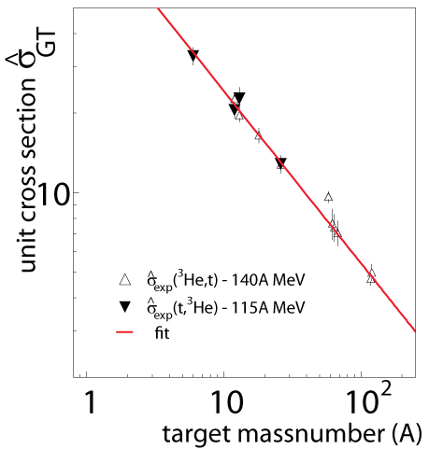
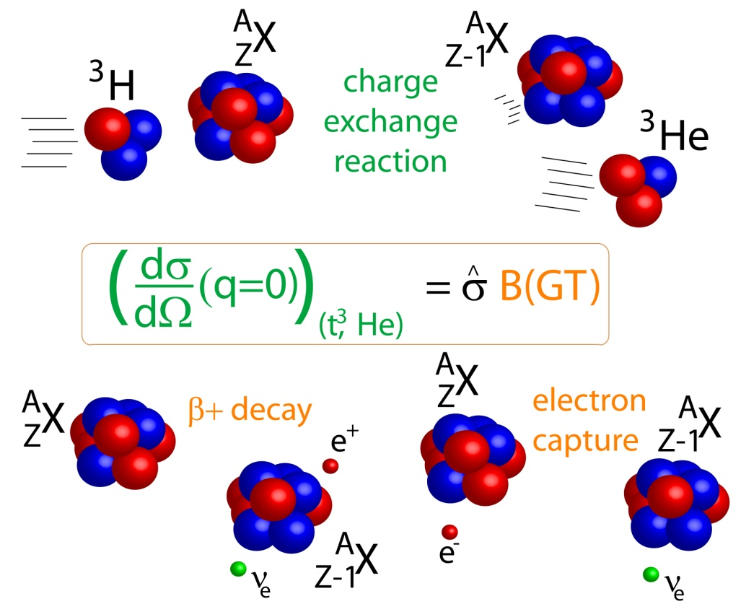
calibrating the proportionality
The unit cross section is conveniently calibrated using transitions for which the Gamow-Teller strength is known from β-decay.
The unit cross section depends on beam energy, charge exchange probe and target mass number: empirically, a simple mass-dependent relationship is found for given probe
CE
β-decay
A,Z
A,Z±1
Once calibrated, Gamow-Teller strengths can be extracted model-independently.
R.Z. et al., Phys. Rev. Lett. 99, 202501 (2007)
G. Perdikakis et al., Phys. Rev. C 83, 054614 (2011)

Slide 24
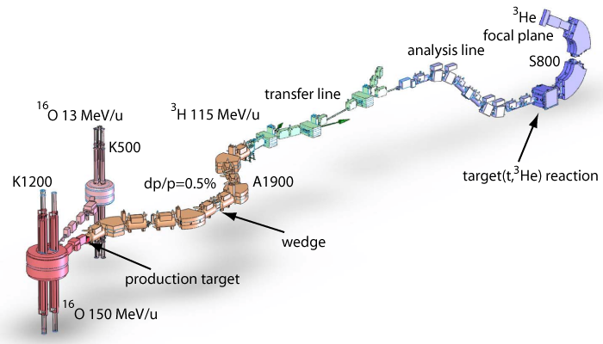
Producing a triton beam for (t,³He) experiments
Primary ¹⁶O beam 150 MeV/n
  rate @ A1900 FP 1.2x10⁷pps @ 130 pnA ¹⁶O
  transmission to S800 spectrometer ~70%
  ³H rate at S800: up to 2x10⁷ pps
S800 spectrometer
Reconstruct momentum
and angle of ³He particle
Extract excitation-energy and center-of-mass scattering angle from two-body kinematics
Without wedge
Thin wedge is needed to remove ⁶He (⁹Li)
Background channel ⁶He->³He + 3n
G.W. Hitt Nucl. Instr. and Meth. A 566 (2006), 264.

