Slide 1
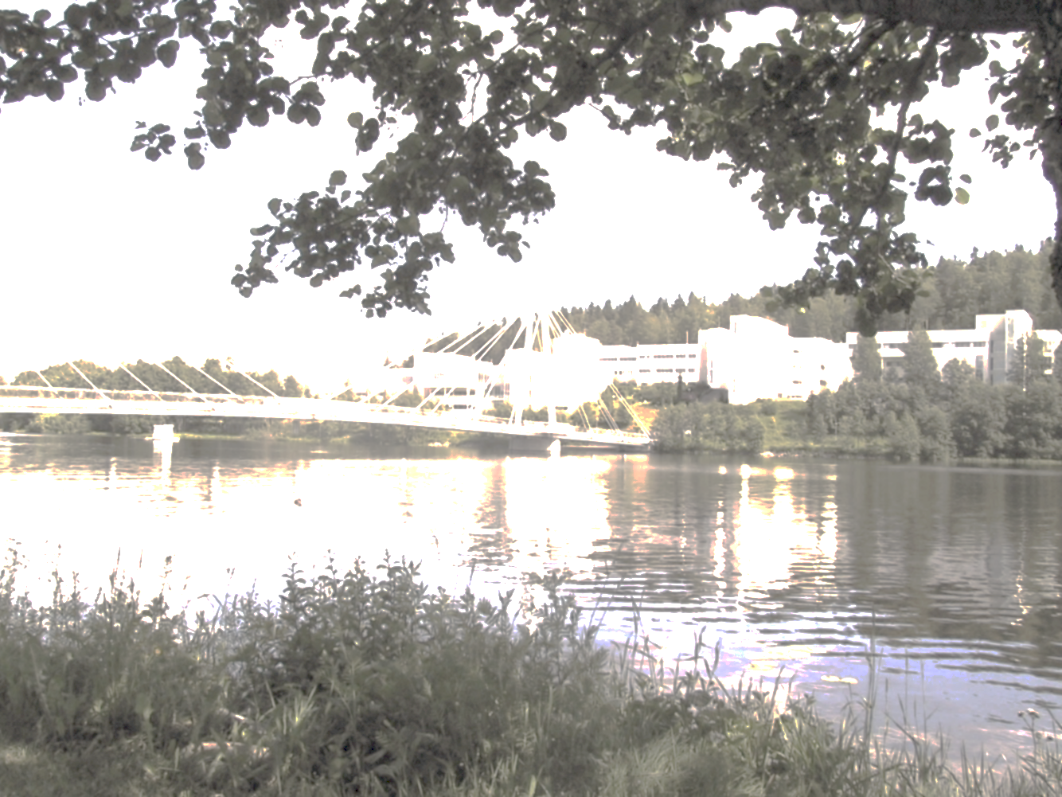

Current status of laser ionization at IGISOL and future concepts for the MARA recoil separator
Iain Moore
Department of Physics, University of Jyväskylä, Finland
ARIS 2014, Advances in Radioactive Isotope Science, Tokyo, June1-6, 2014

Slide 2

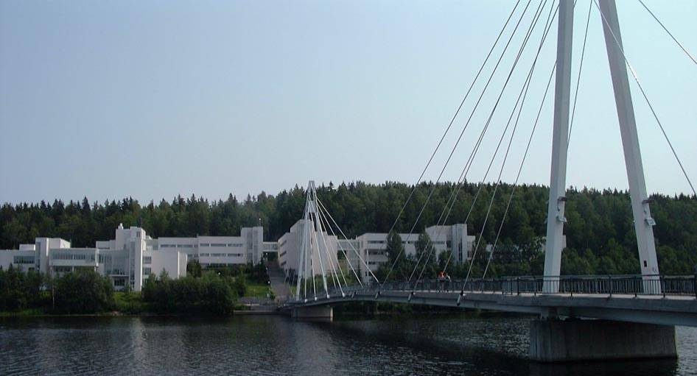
Outline of talk
The ion guide technique
- towards a more element-selective approach
Recent laser-related highlights (2013 – to date)
MARA – a vacuum-mode recoil mass separator
New concepts – a low-energy RIB facility at MARA
ARIS 2014, Advances in Radioactive Isotope Science, Tokyo, June1-6, 2014

Slide 3
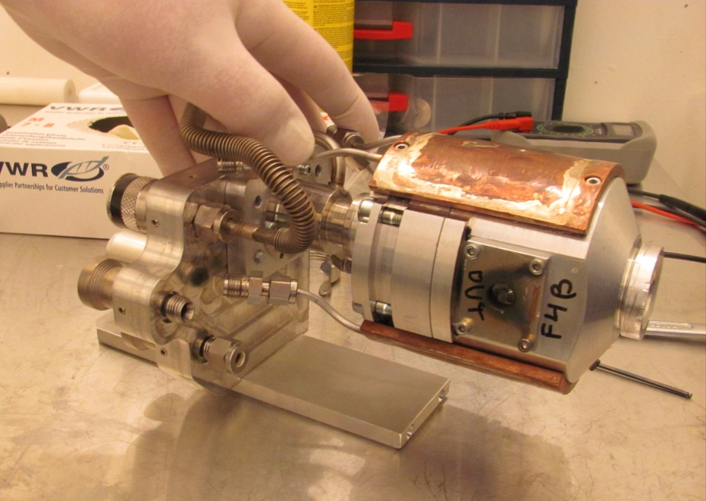
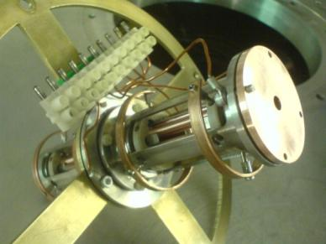
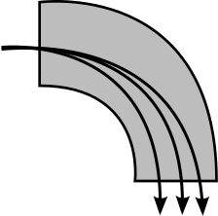
The ion guide method
An ISOL system for ALL elements
Fast extraction (~ms)
Relatively low efficiency
Poor selectivity
Projectile source
Thin target
Ion guidance through
rf sextupole
Mass separator
Ion survival → ion guide method (non-selective)
Neutralization → laser re-ionization (Z selectivity)
ARIS 2014, Advances in Radioactive Isotope Science, Tokyo, June1-6, 2014
Notes:
Universal, but for IGISOL we have a lot of isobaric contamination.
Low yields due to thin target.

Slide 4
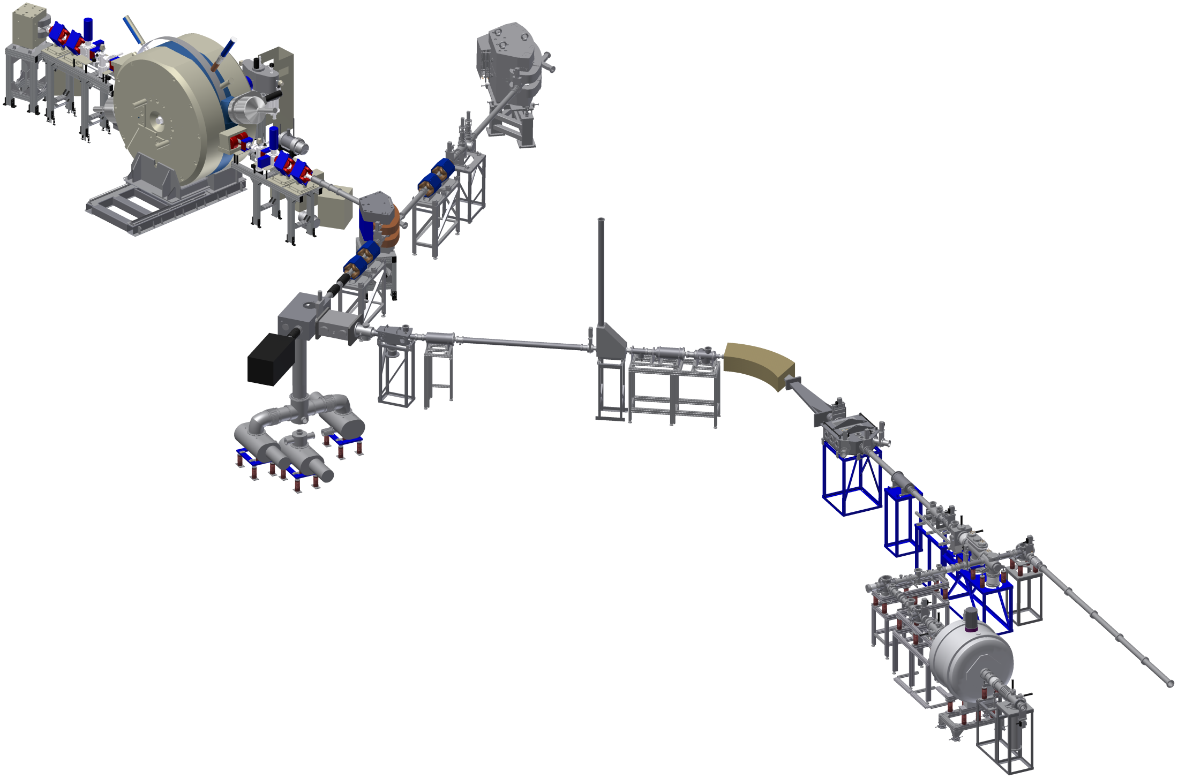
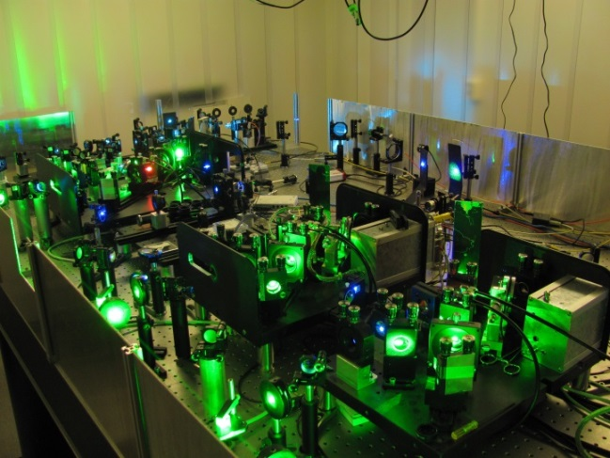
from K=130 MeV
cyclotron
IGISOL-4 – since 2013
https://www.jyu.fi/fysiikka/en/research/accelerator/igisol
Off-line ion sources:
(discharge, carbon cluster…)
K=30 MeV
cyclotron
Laser transport
for optical
manipulation/IRIS
Laser ionization in-source/in-jet
Collinear laser
spectroscopy
Decay spectroscopy
(beam line not shown)
Mass spectrometry
& post-trap spectroscopy
M. Reponen, Poster # PS1-C016
A. Jokinen, Plenary, Tuesday
ARIS 2014, Advances in Radioactive Isotope Science, Tokyo, June1-6, 2014

Slide 5
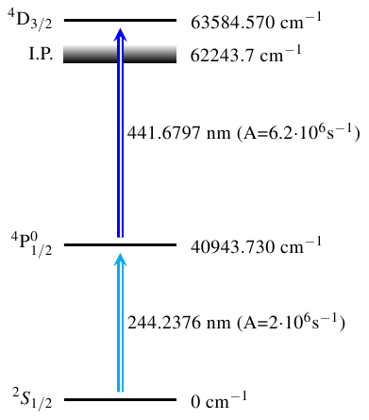
A more element-selective approach
First on-line in-gas-cell laser ionization (2013):
⁵⁸Ni(p,n)⁵⁸Cu (τ_{1/2}=3.2 s)
Dual-chamber gas cell
Mass separator A=58
Lasers on/off 1 hour
Total efficiency ~1%
ARIS 2014, Advances in Radioactive Isotope Science, Tokyo, June1-6, 2014

Slide 6
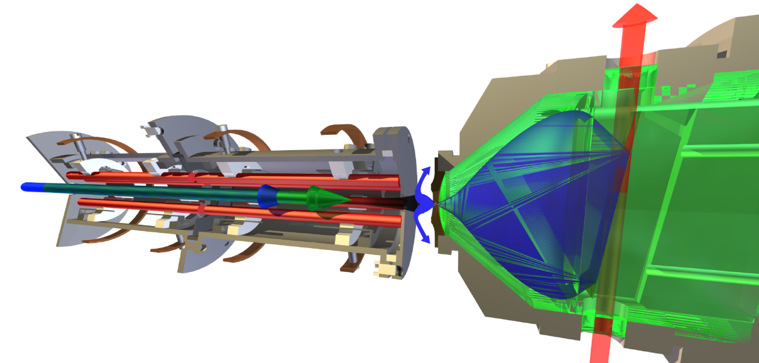

Gas jet laser ionization – how and why?
a quest for PURE radioactive ion beams
→ (the Laser Ion Source ``Trap´´)
I.D. Moore et al., AIP Conf. Proc. 831 (2006) 511
Yu. Kudryavtsev et al., NIMB 297 (2013) 7
an optimal environment for spectroscopy
(reduced temperature and pressure)
N
²P_{3/2}
F_{j}
²P_{1/2}
S
²S_{1/2}
F_{i}
F=J+I
ARIS 2014, Advances in Radioactive Isotope Science, Tokyo, June1-6, 2014
Notes:
Variation of LIST but using gas jet. Spectroscopy in jet.

Slide 7
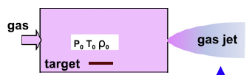
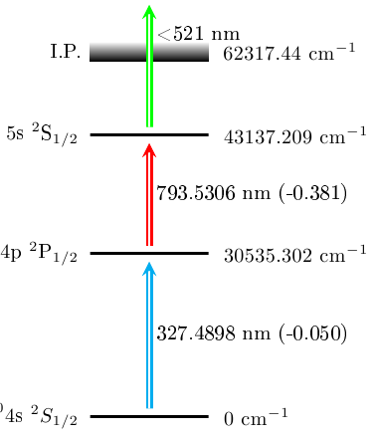
Free jet laser ionization in LIST geometry
FWHM = 1.8 GHz
⁶³Cu
FWHM = 6.7 GHz
He, 180 mbar
V_{jet} ~1040 m/s
FWHM = 3.9 GHz
Employ special nozzles
M. Reponen et al., NIMA 635 (2011) 24
Laser linewidth dominated
I.D. Moore et al., NIMB 317 (2013) 208
ARIS 2014, Advances in Radioactive Isotope Science, Tokyo, June1-6, 2014
Notes:
CoG difference from ref cell to jet is about 3 GHz which translates into a jet velocity of 1040 m/s.

Slide 8
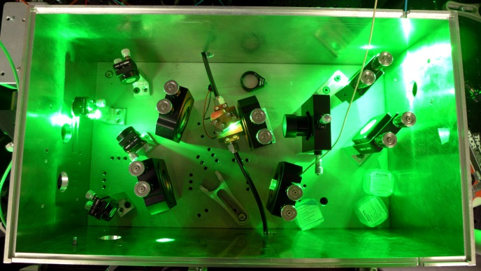
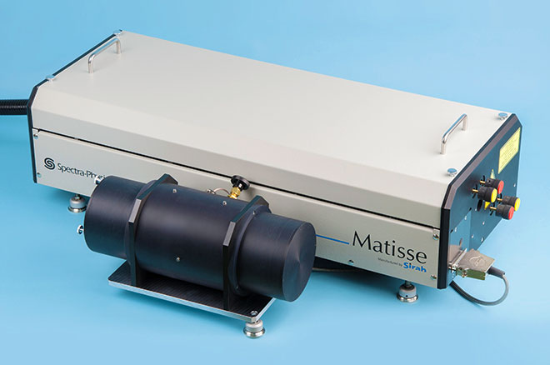
Development of narrowband pulsed
Ti:sapphire laser for gas-jet spectroscopy
Lock-in Amplifier
(TEM Laselock)
Output
pulsed, 30 ns width
2-5 W average power
20 MHz linewidth
HV
out
PSD
Fast piezo mirror
Input:
CW seed laser
1-100mW
Matisse TS Ti:sa
(100 kHz linewidth)
d = n λ_{cw}
Fast-switched
photodiode
amplifier
pump laser
10-20 W, 10 kHz
Ti:sapphire crystal
V. Sonnenschein, Poster # PS2-C018
ARIS 2014, Advances in Radioactive Isotope Science, Tokyo, June1-6, 2014
Notes:
(hyperfine structure, isotope shifts) CW Ti:Sa seed enables a wide wavelength range

Slide 9


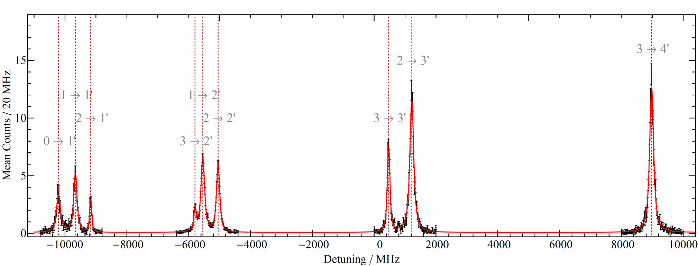
First spectroscopy with the narrowband laser
Tested in Mainz to measure HFS of ²²⁷Ac (τ_{1/2}=22 y)
Same transition applied by LISOL team, May 2014,
on ²¹²⁻²¹⁵Ac (see results in plenary talk, M. Huyse)
AI 46347.0 cm⁻¹
IP
424.7 nm
J=5/2
22 801.1 cm⁻¹
438.58 nm
J₀=3/2
0 cm⁻¹, 6d7s²
Future: measure ²³⁶⁻²⁴⁴Pu via in-jet RIS followed by high resolution
collinear laser spectroscopy (Mainz, Leuven, Manchester and Liverpool)
In-jet RIS in the search for ^{229m}Th (new EU Horizon 2020 application)
ARIS 2014, Advances in Radioactive Isotope Science, Tokyo, June1-6, 2014

Slide 10
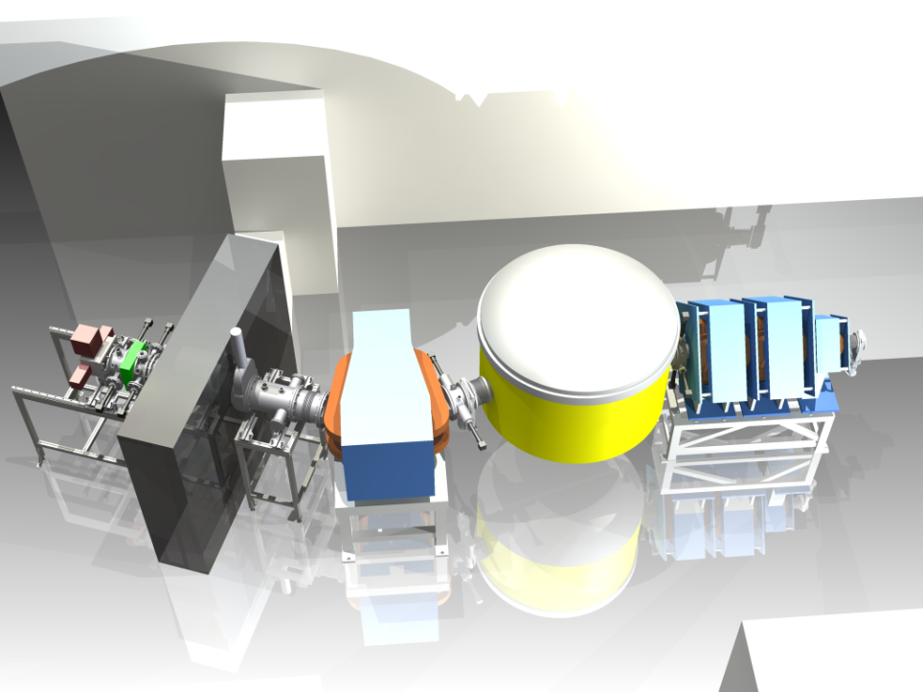
MARA: “Mass Analysing Recoil Apparatus”
A new vacuum mode recoil separator
Electrostatic deflector
Quadrupole triplet
Focal plane
Magnetic dipole
Beam
QQQED configuration
1st order resolving power ~260
Angular acceptance 10 msr
Advanced mass slit system
J. Uusitalo, Poster # PS2-C006
J. Sarén, PhD thesis, University of Jyväskylä (2011)
ARIS 2014, Advances in Radioactive Isotope Science, Tokyo, June1-6, 2014
Notes:
The combination of the ED and MD provides a fixed energy focus, the use of the QQQ results in the angular focus being at the same position as the energy focus. Focal plane may include a gas counter/Si detector. Almost all vacuum components have arrived, 6 month delay on the ED. Focal plane outside the cave to have access when beam is on target.
Two charge states delivered to focal plane

Slide 11
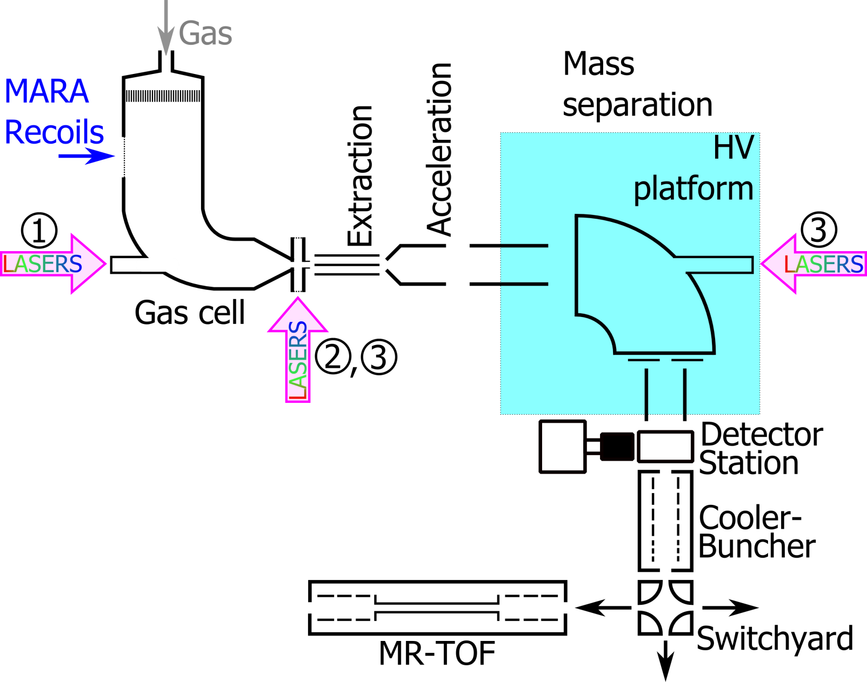
A low-energy RIB facility at MARA
²⁴Mg(⁵⁸Ni,2n)⁸⁰Zr
Cross section 10 µb (C.J. Lister, 1987)
Total fusion-evap. ~500 mb
200 pnA, two charge states,
40 ⁸⁰Zr ions/s @ focal plane
Expect few atoms/s for in-jet RIS,
~10 ions/s at the MR-TOF-MS.
MR-TOF-MS funded and under design at IGISOL (T. Eronen)
ARIS 2014, Advances in Radioactive Isotope Science, Tokyo, June1-6, 2014

Slide 12
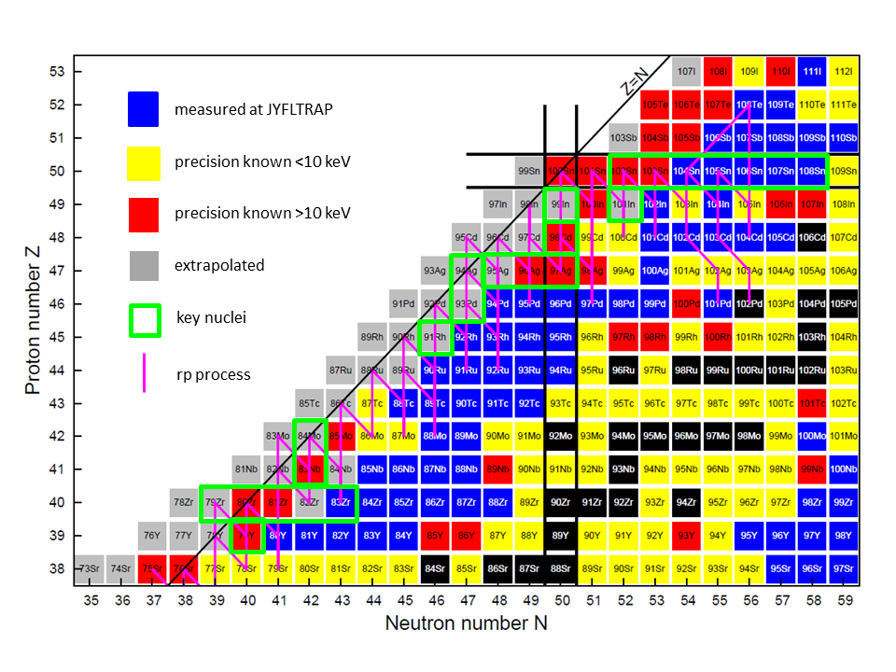
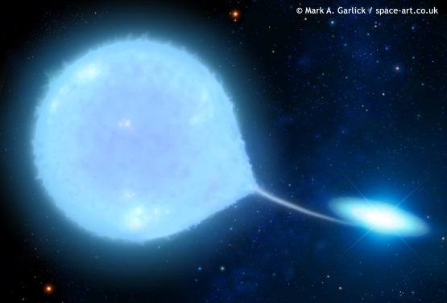
“Day 1” experiments – heavy N~Z nuclei for the rp-process
Mass measurements &
laser spectroscopy:
Region of N~Z ⁸⁰Zr
Reion of N~Z ⁹⁴Ag
Region of N~Z ¹⁰⁰Sn
Combining experts from the IGISOL and nuclear spectroscopy groups, with external
support from Leuven. Providing a platform for testing novel devices for S³ at SPIRAL-2
ARIS 2014, Advances in Radioactive Isotope Science, Tokyo, June1-6, 2014

Slide 13
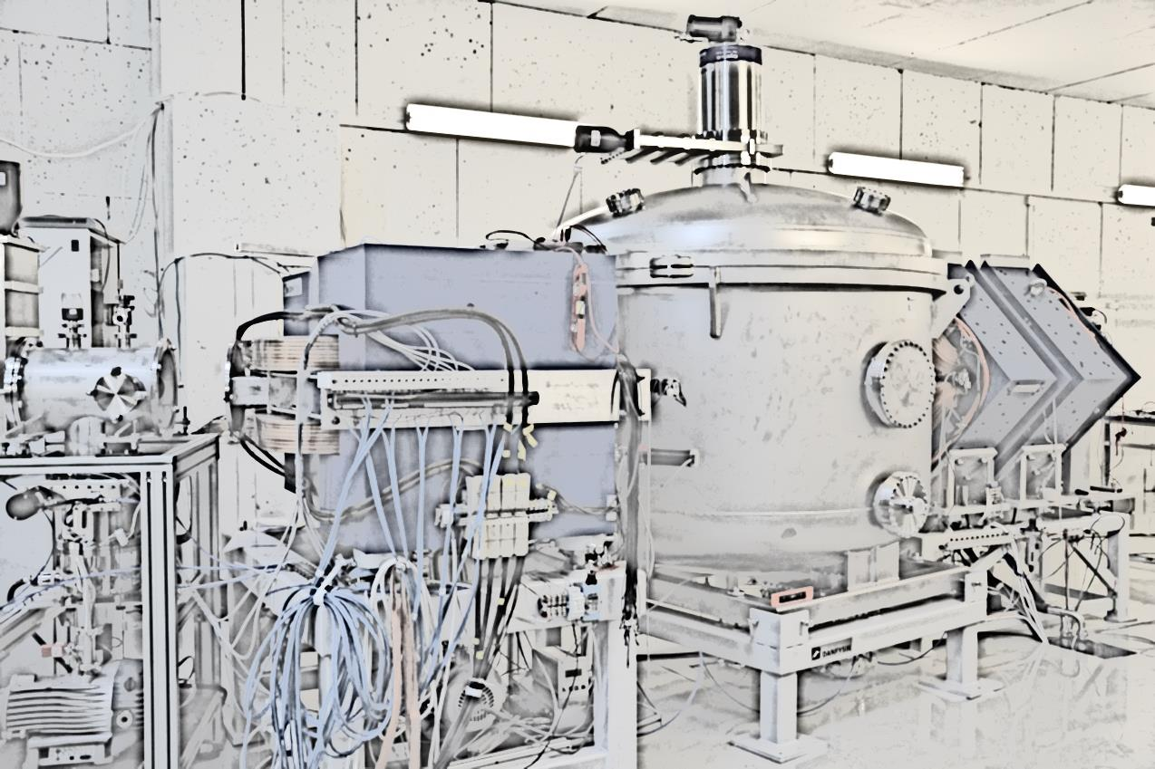
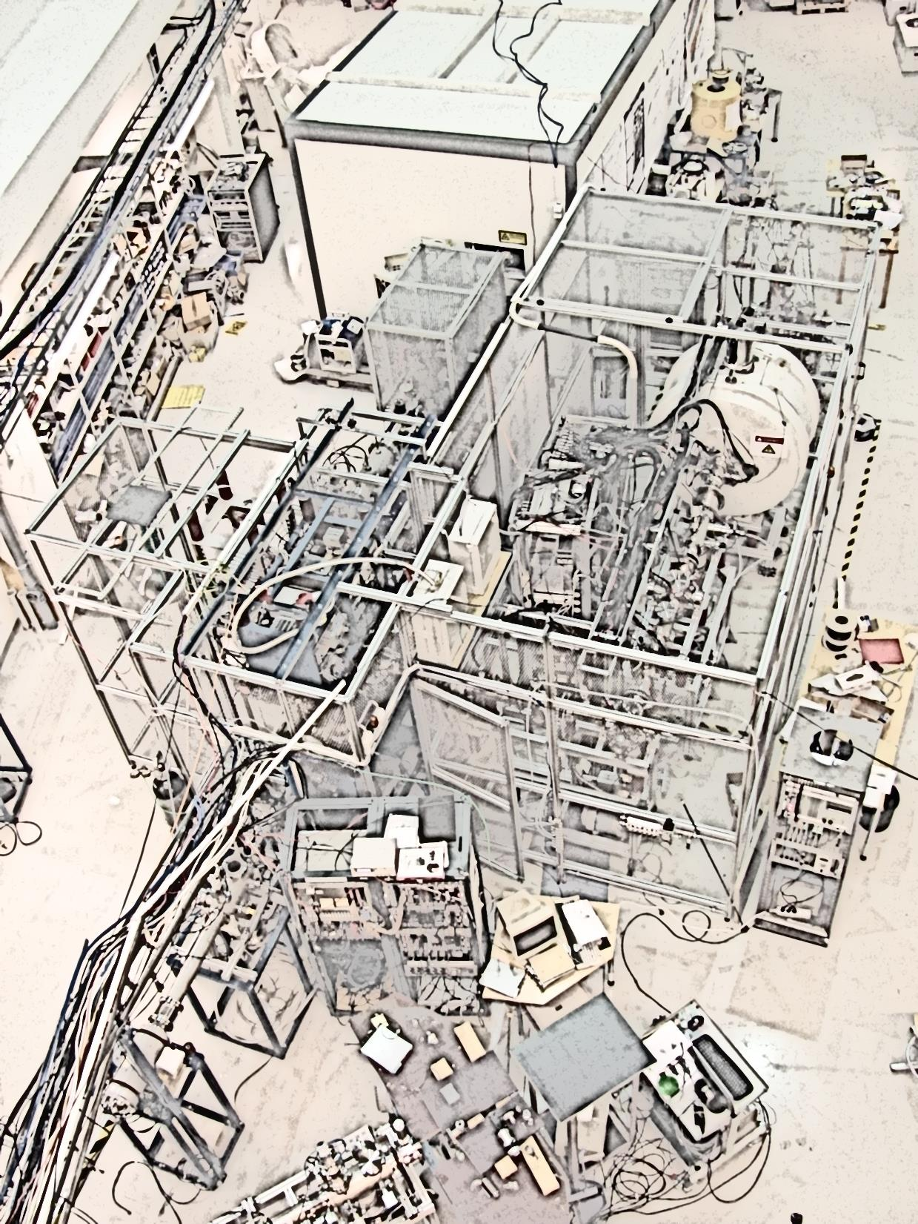
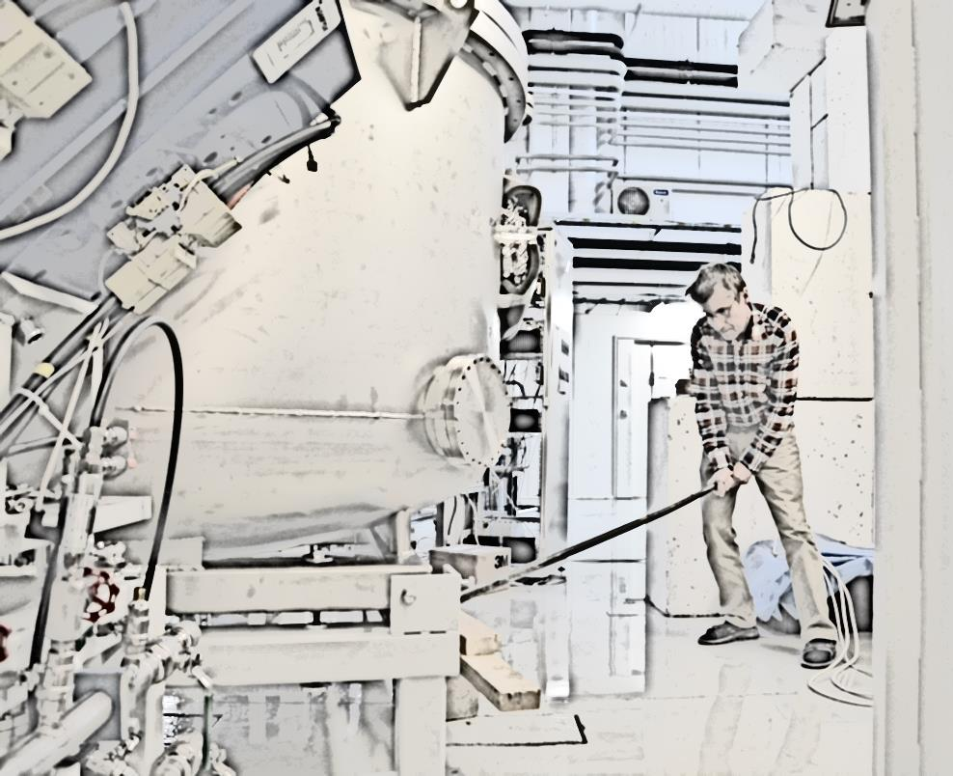
IGISOL-laser team:
I. Pohjalainen, M. Reponen, V. Sonnenschein, A. Voss + IGISOL
MARA team
J. Uusitalo, J. Sarén, J. Partanen
Thank you

Slide 14
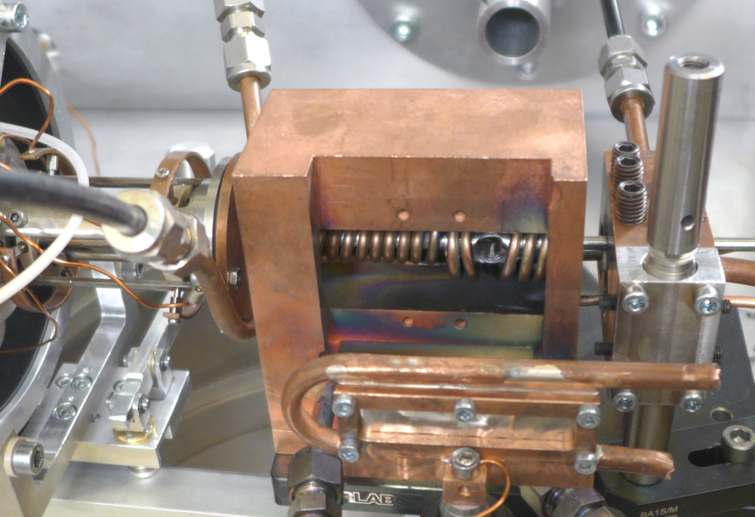
Inductively-heated hot cavity catcher (2014)
Development program towards production of N=Z ⁹⁴Ag
Heating coil
Variable Ni degrader foil
SPIG
Mo crucible
Primary beam
487 MeV ¹⁰⁷Ag²¹⁺
Variable Ni degrader foil
Pulse cyclotron,
measure extraction time
ARIS 2014, Advances in Radioactive Isotope Science, Tokyo, June1-6, 2014

