Slide 1
Shapes and collectivity in the neutron-deficient even mass ¹⁸⁸⁻¹⁹⁸Pb isotopes
probed with radioactive beams at REX-ISOLDE
Janne Pakarinen
– on behalf of the IS494 collaboration –
University of Jyväskylä
ARIS 2014
Tokyo, Japan

Slide 2
Outline
Physics case
Experimental technique
Results
Summary

Slide 3
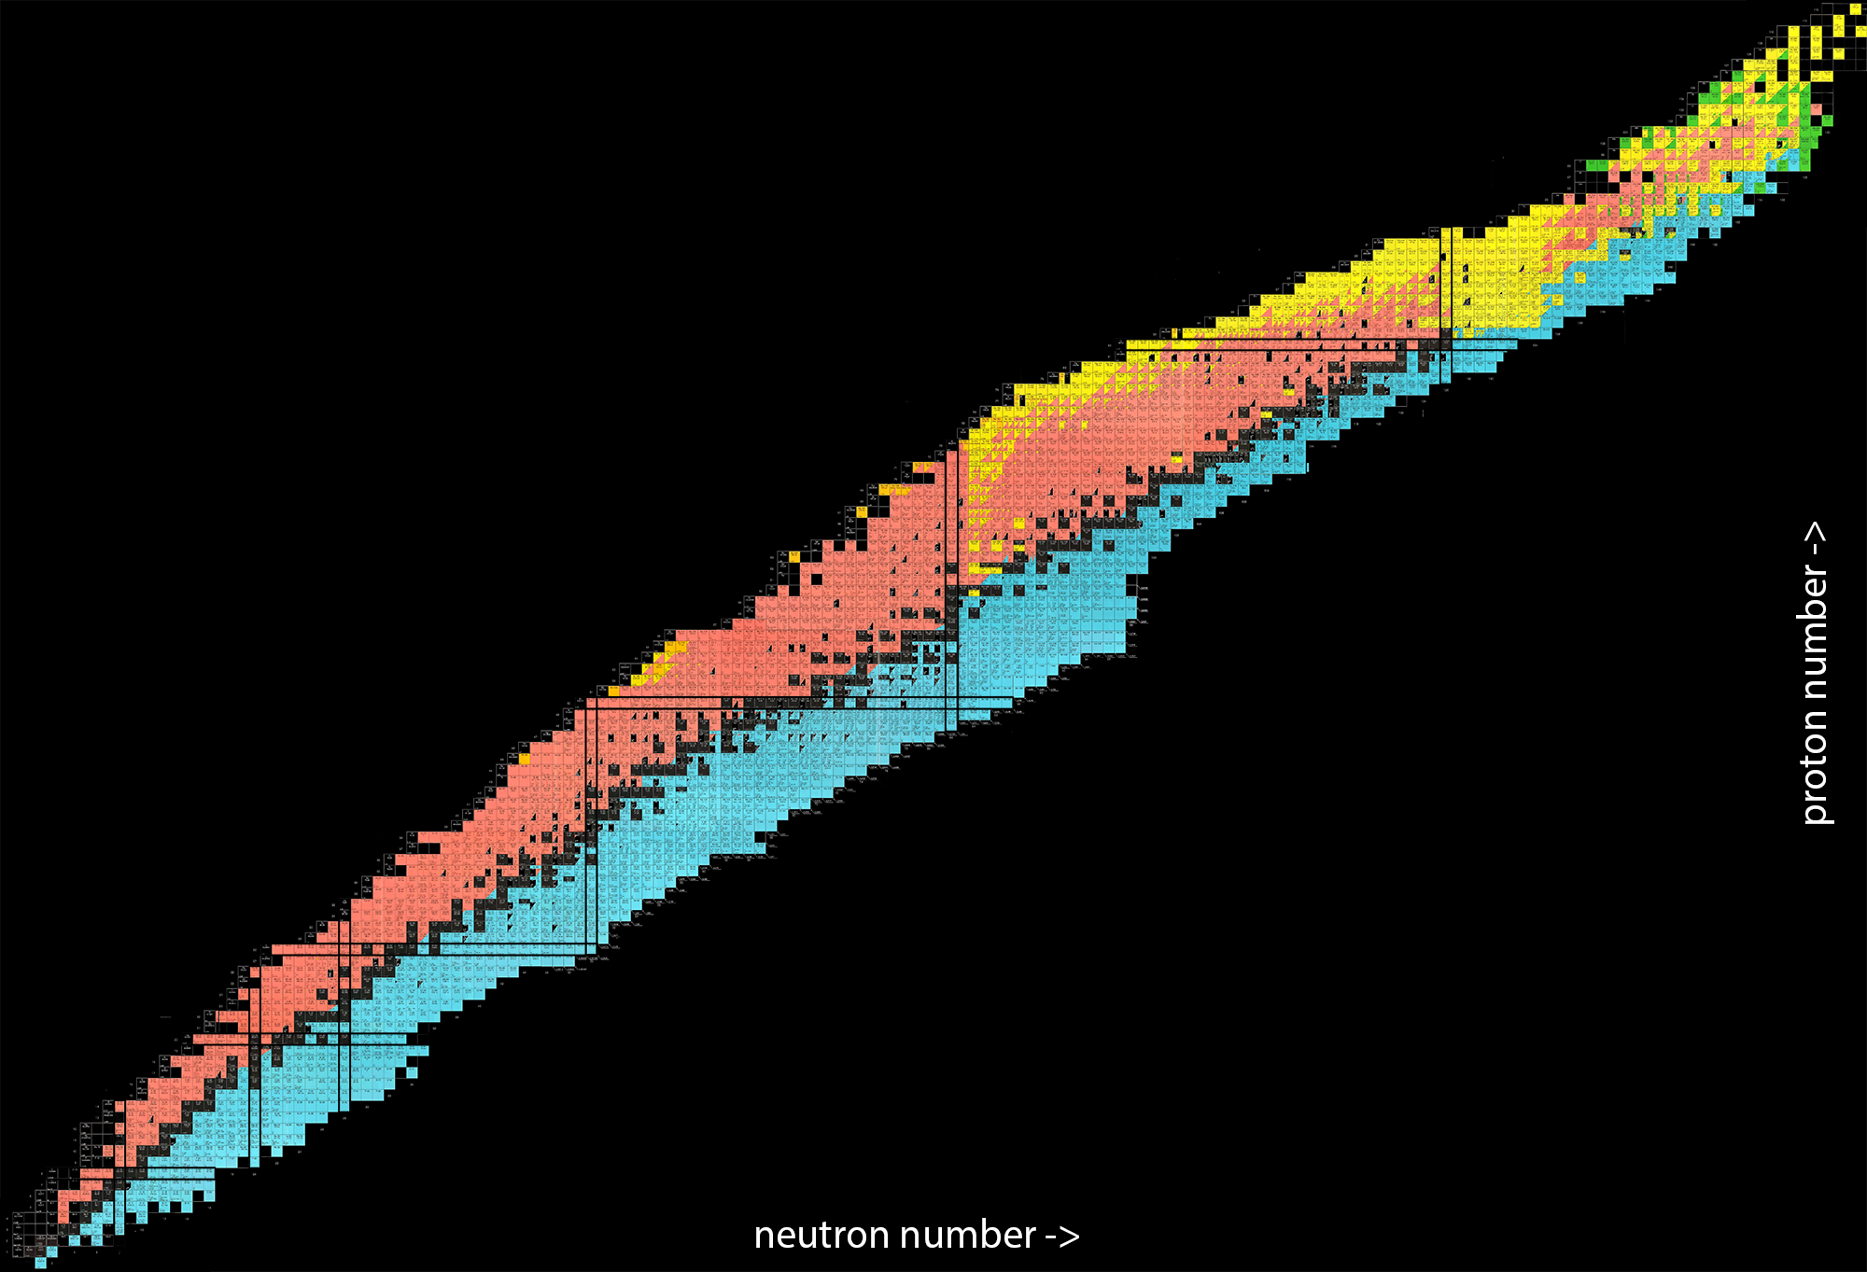
Chart of nuclei

Slide 4
Chart of nuclei

Slide 5
Chart of nuclei

Slide 6
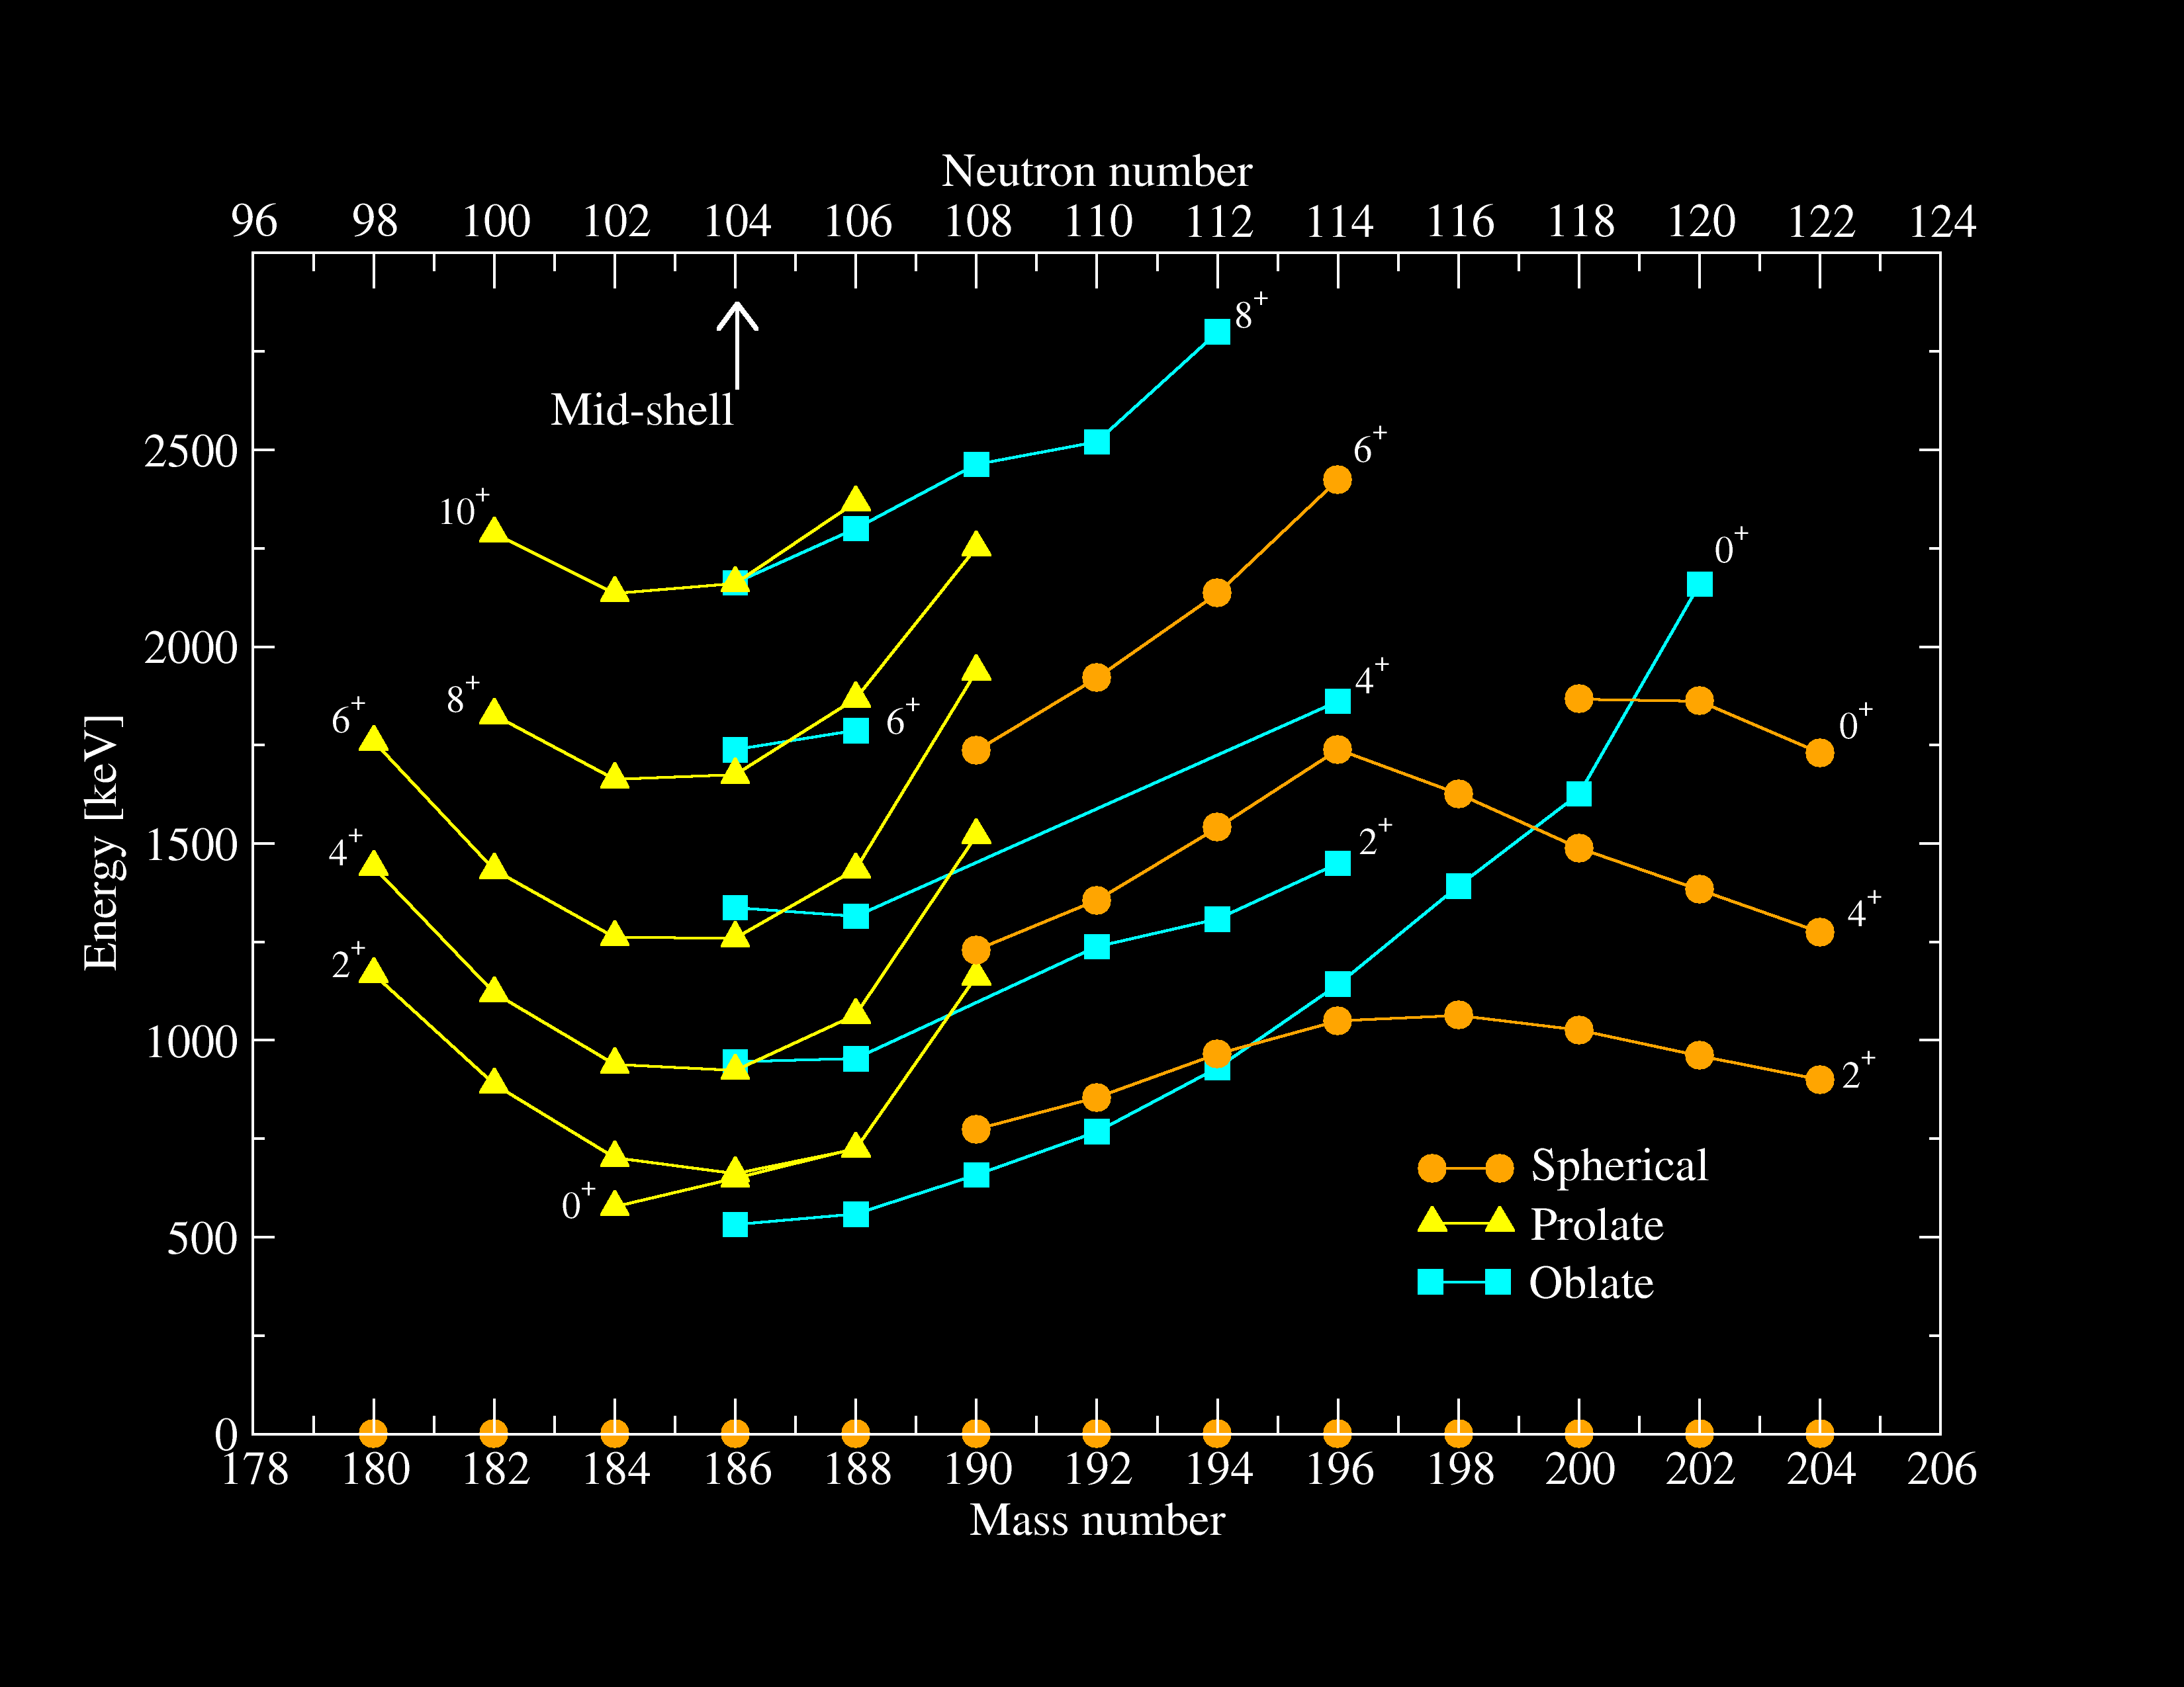
Shape coexistence in Pb isotopes

Slide 7
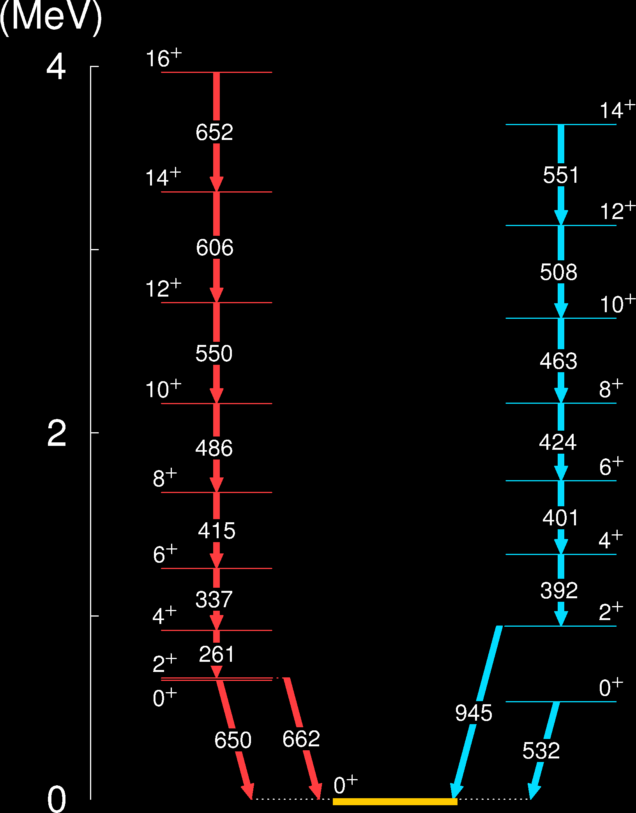
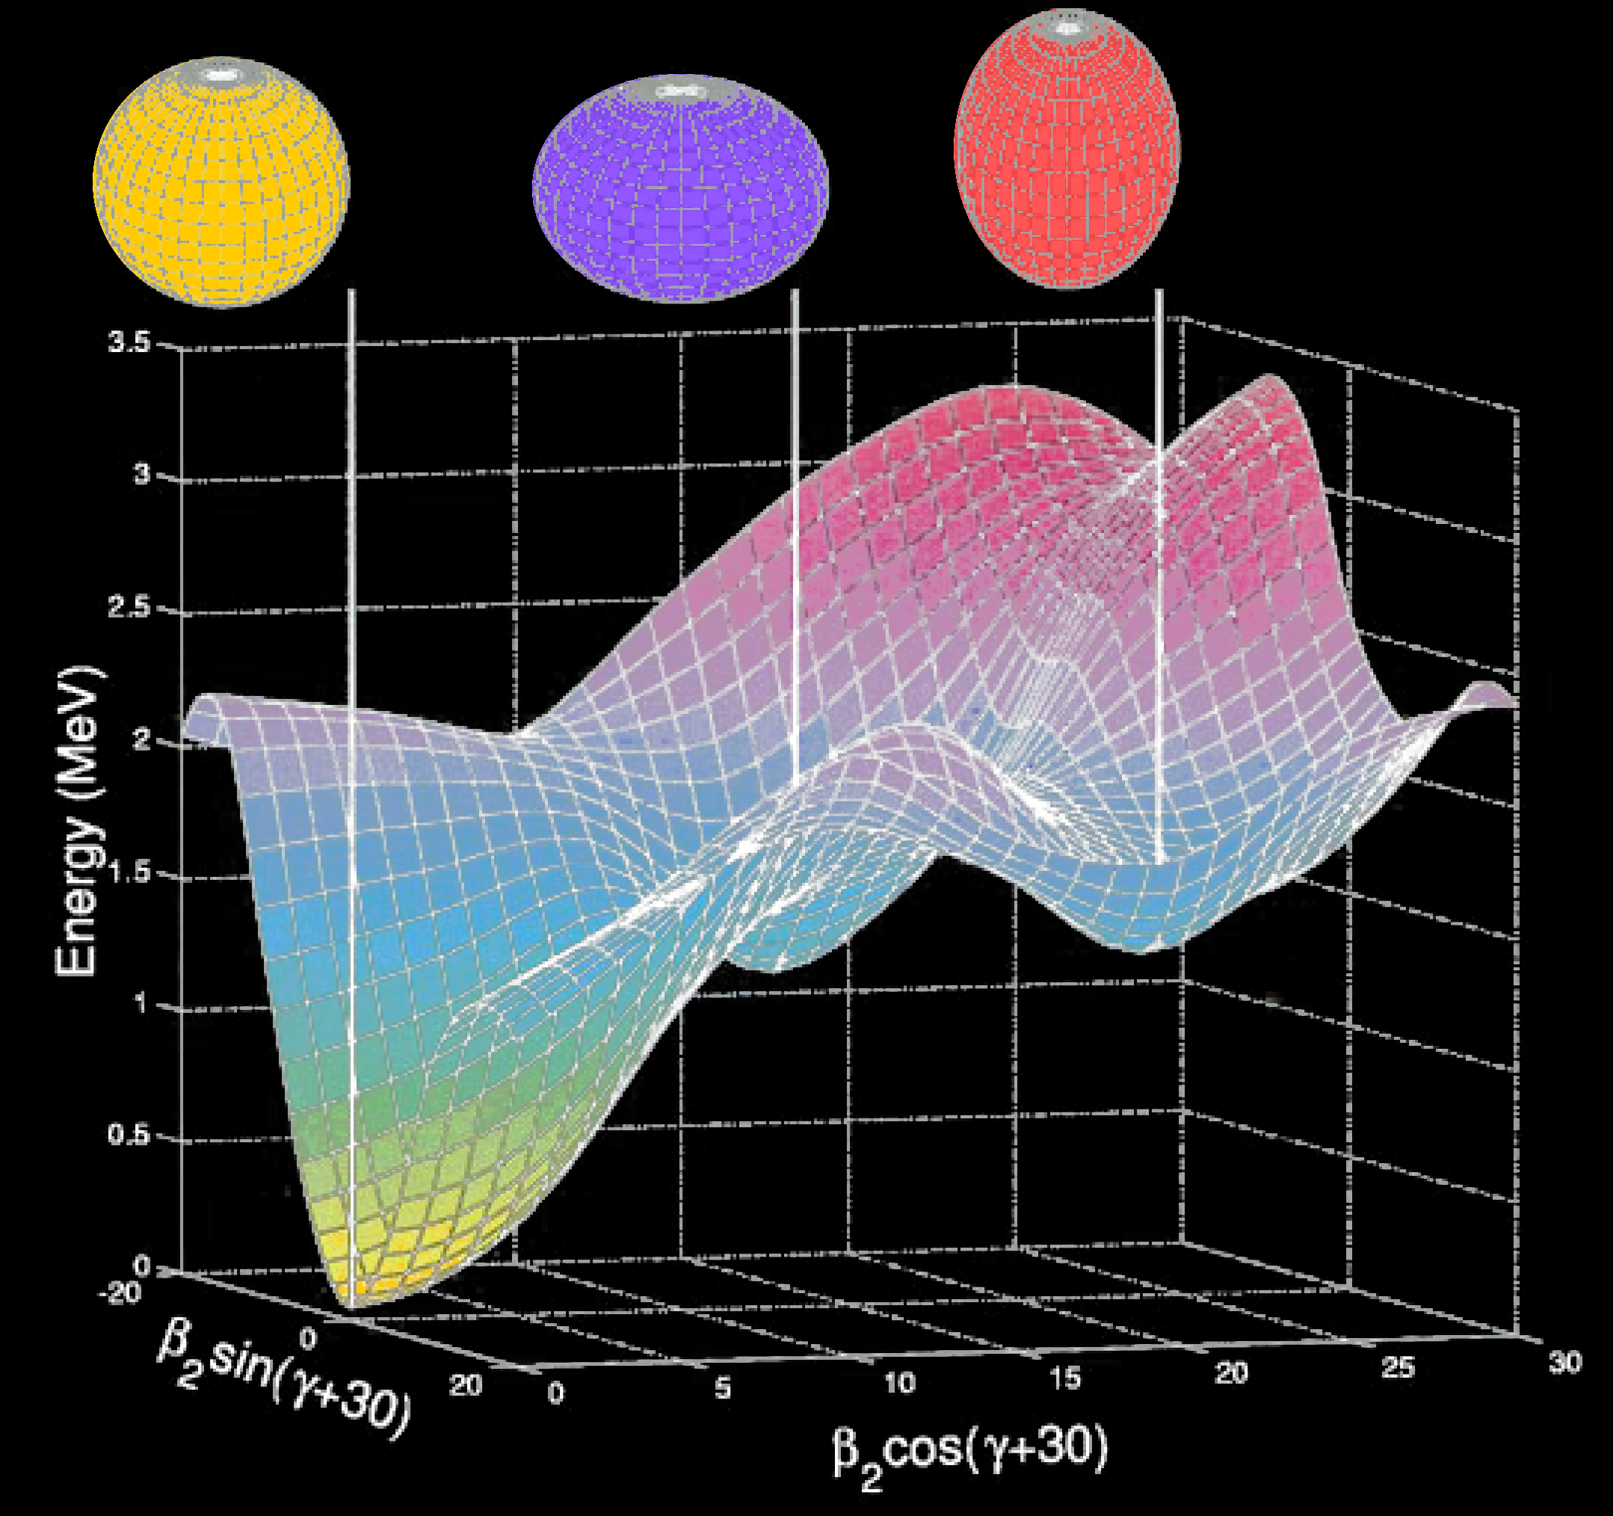
The triplet of 0⁺ states in ¹⁸⁶Pb
A. N. Andreyev et al., Nature 405, 430 (2000)
J. Pakarinen et al., Phys. Rev. C 72 011304(R) (2005)

Slide 8
Shape coexistence
Competing structures near the N=104 midshell
Mixing of different configurations
Low-lying 0⁺ states and enhanced E0 components

Slide 9
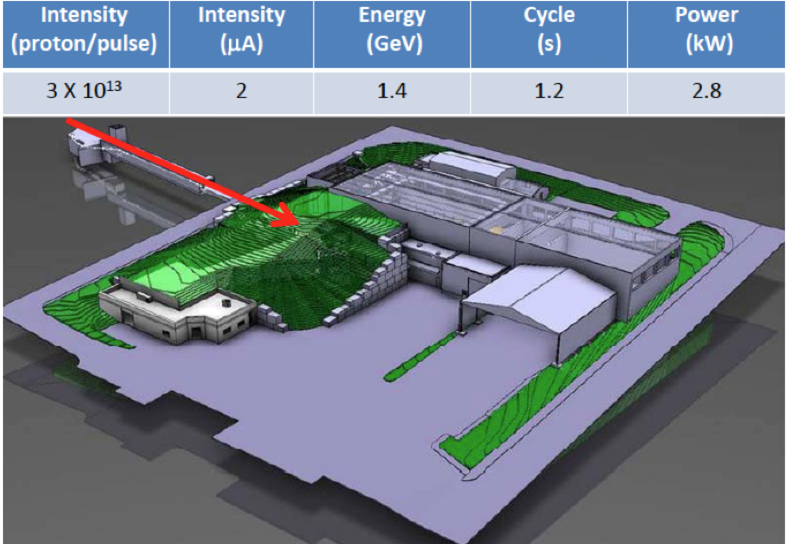
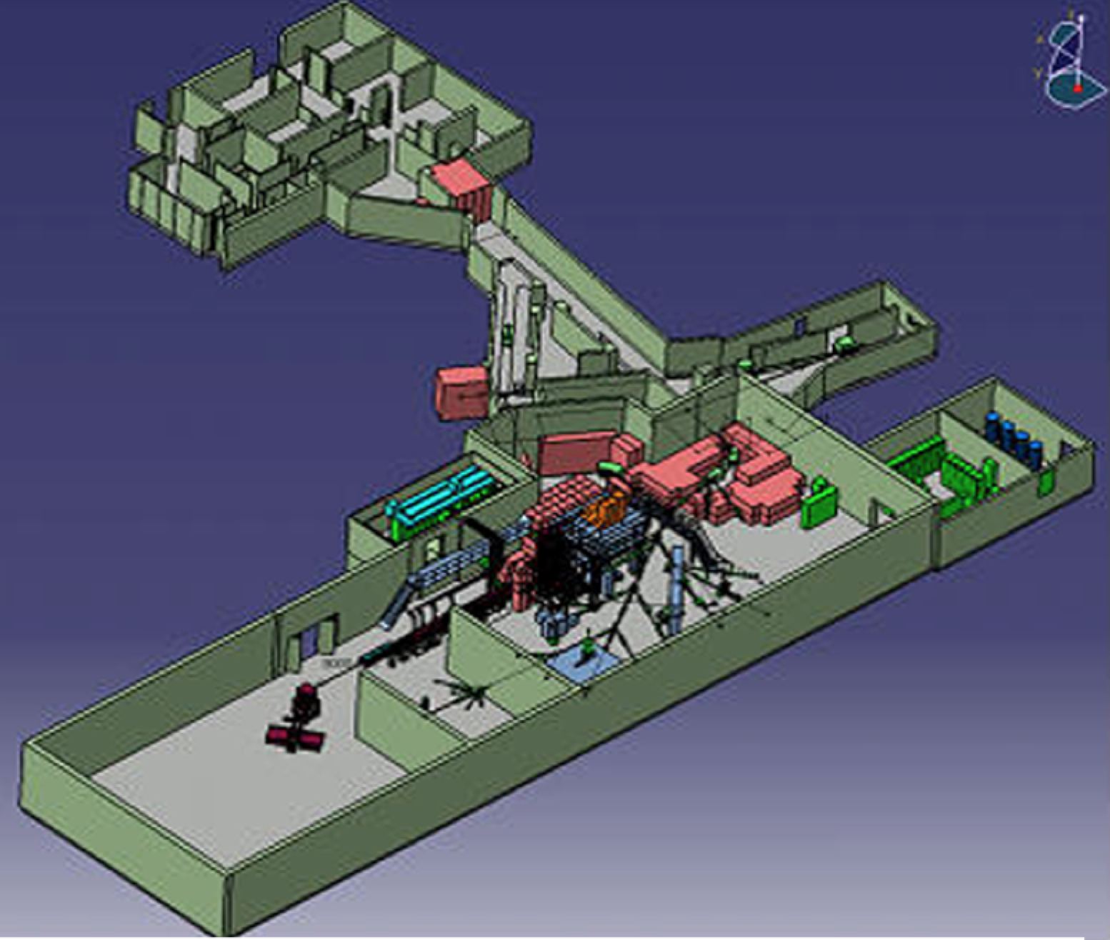
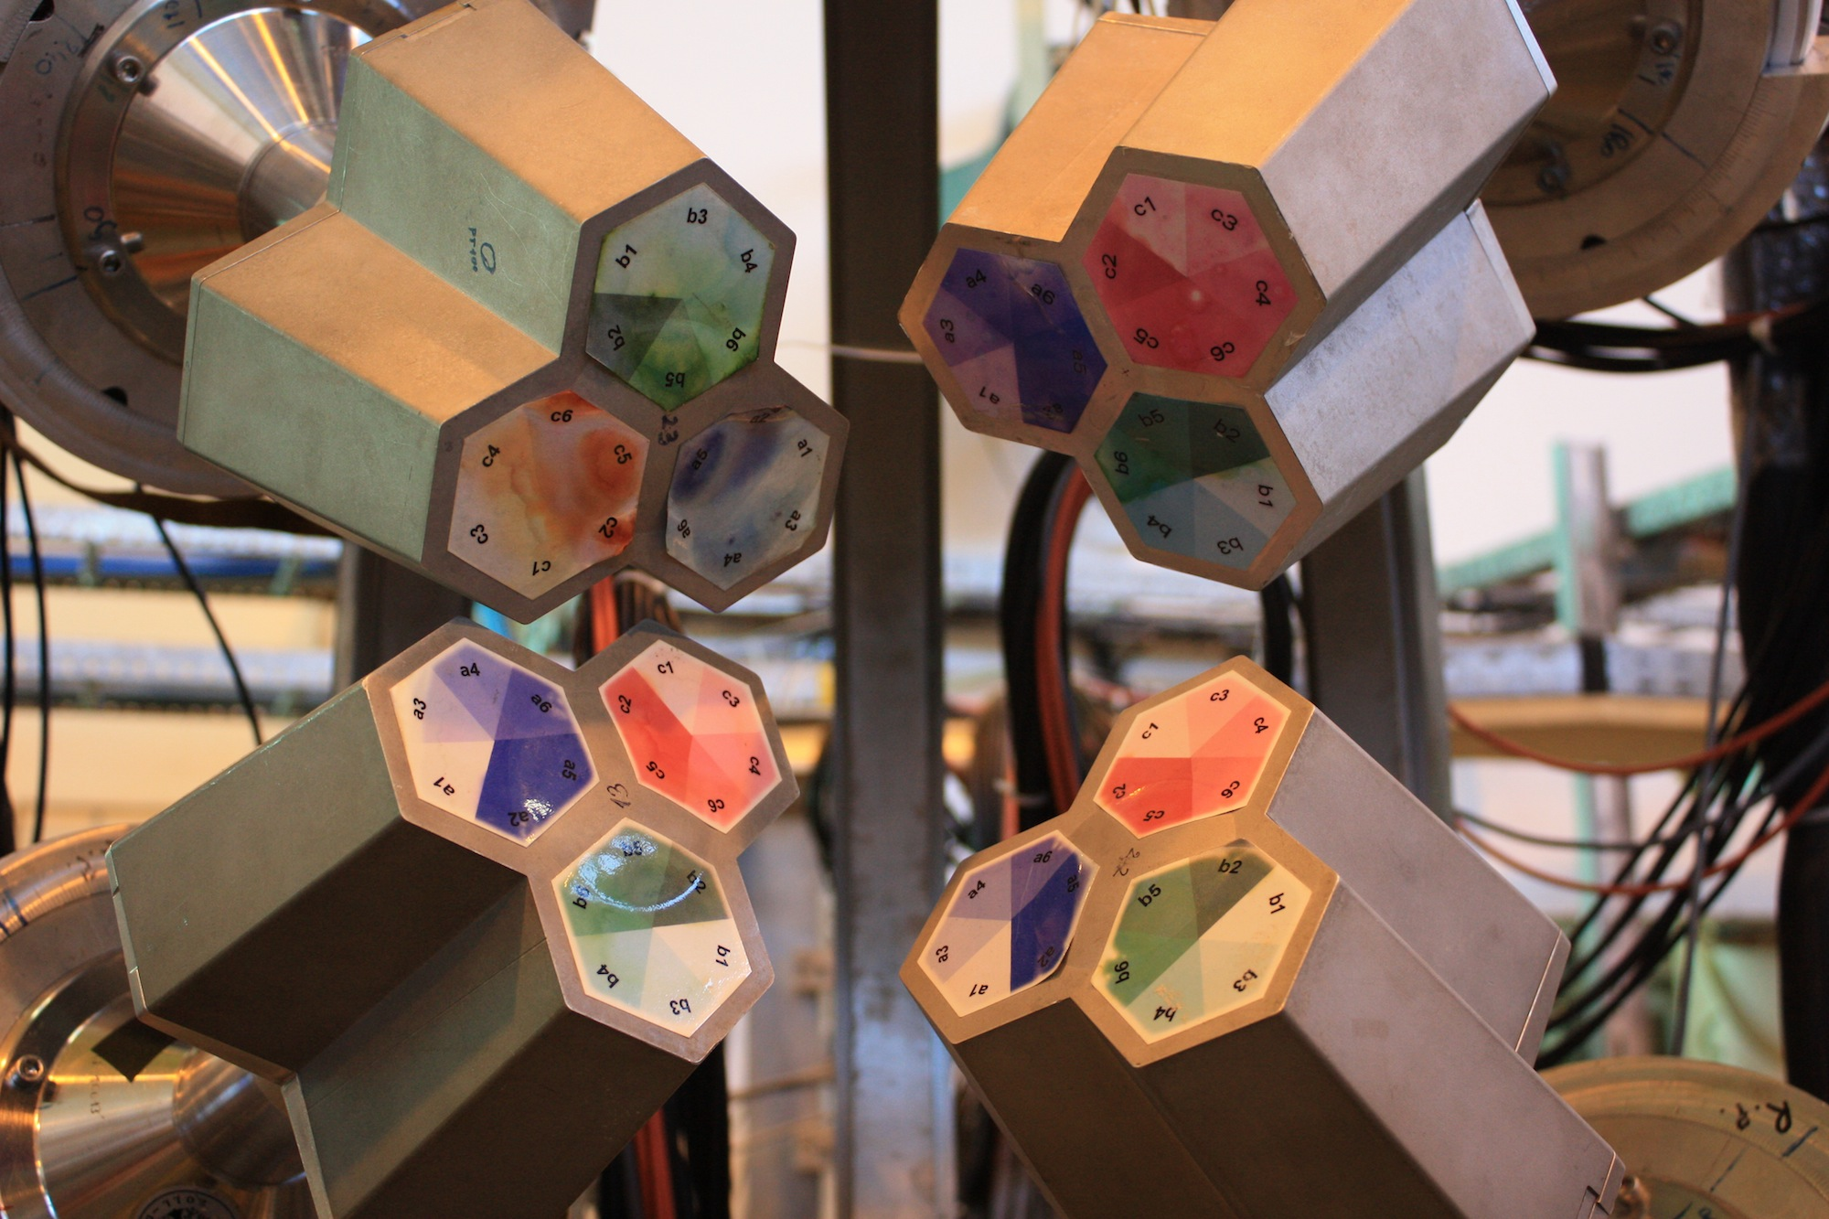
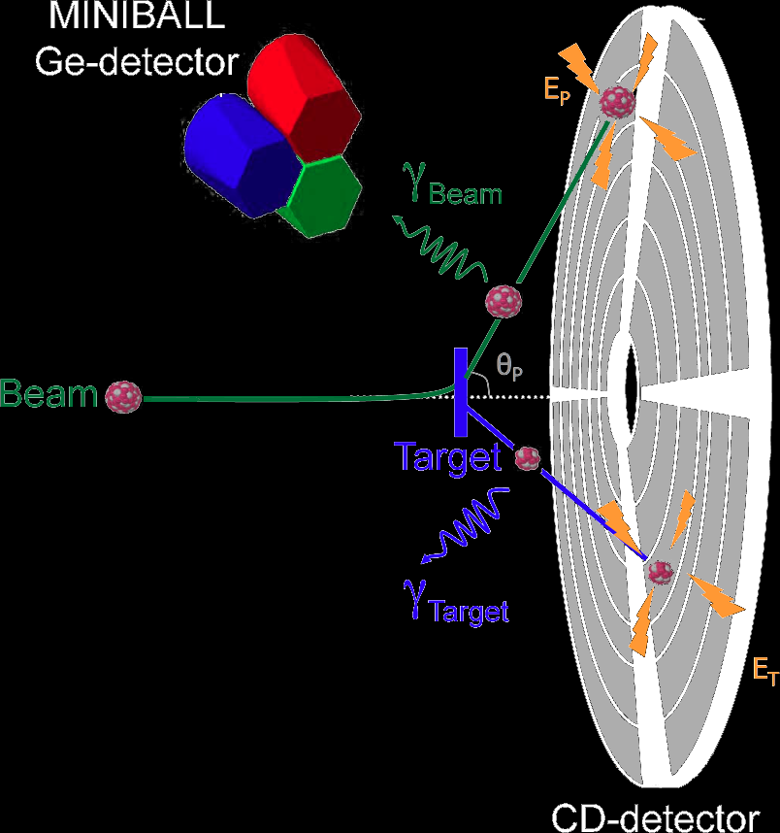
Experimental technique
Radioactive beams from REX-ISOLDE
Beam delivered to the MINIBALL set-up
The MINIBALL array consists of 8 triple cluster Ge-detectors
E_{beam} ~3 MeV/u, I_{beam} < 2×10⁶ pps
Differential cross section for Coulomb excitation depends on both transitional AND diagonal matrix elements

Slide 10
Beams delivered
Isotope | E_{beam} [MeV/u] | Total Yield [Hz] | Purity [%] | Pb dose
¹⁸⁸Pb | 2.82 | 3.2E+05 | 50.9 | 2.05E+10
¹⁹⁰Pb | 2.82 | 2.2E+05 | 90.4 | 2.37E+10
¹⁹²Pb | 2.84 | 5.0E+05 | 97.2 | 6.13E+10
¹⁹⁴Pb | 2.82 | 7.8E+05 | 95.0 | 9.64E+10
¹⁹⁶Pb | 2.82 | 5.0E+05 | 99.0 | 6.19E+10
¹⁹⁸Pb | 2.82 | 2.5E+05 | 98.9 | 3.09E+10
UCx target, Ta transfer line, laser ionisation
Secondary target: ¹¹²Cd, 2mg/cm²
Inverse kinematics

Slide 11
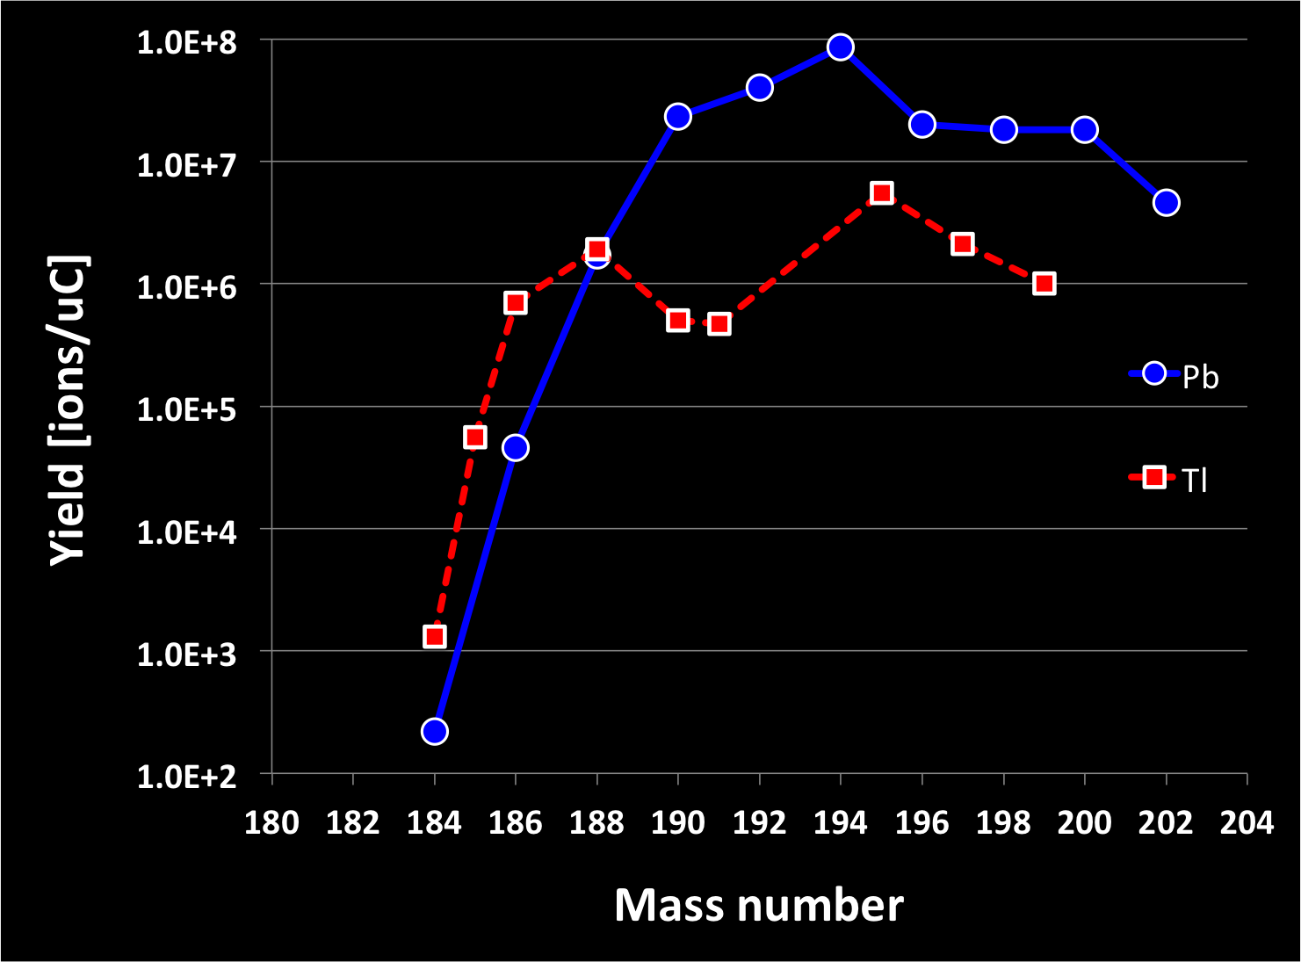
ISOLDE yields

Slide 12
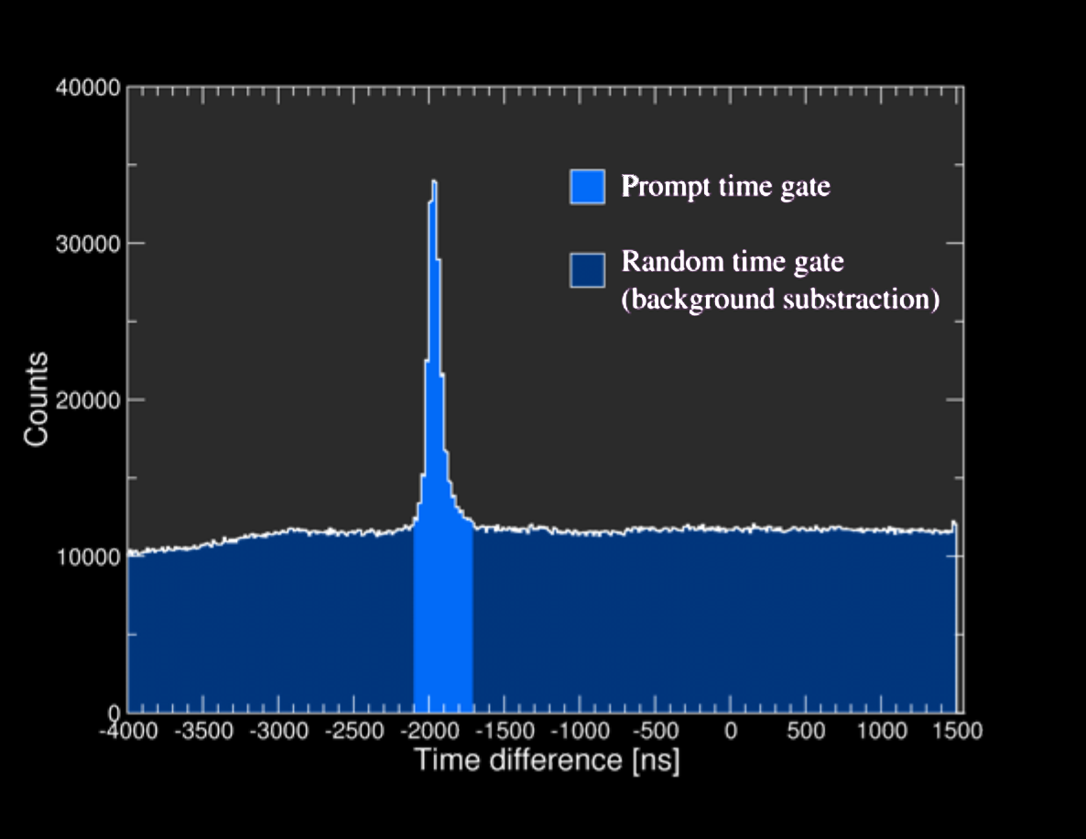
Particle-gamma time difference

Slide 13
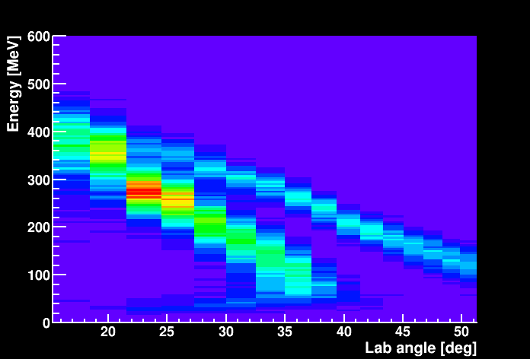
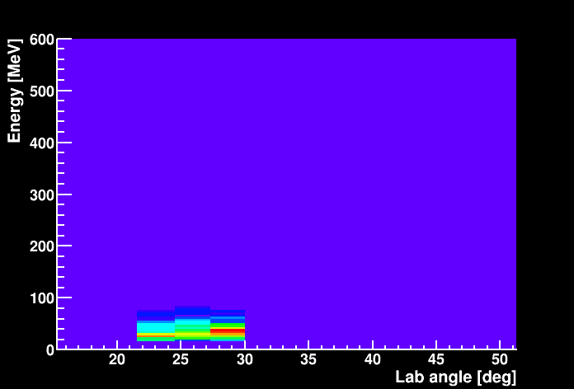
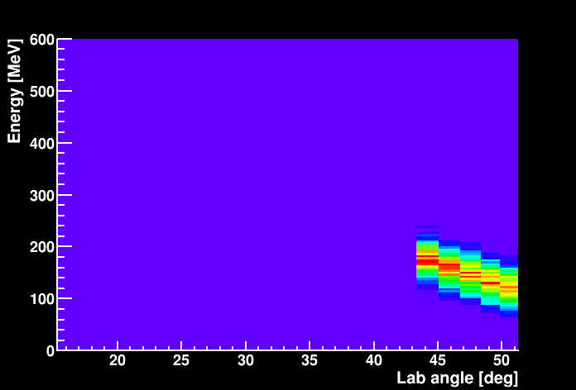
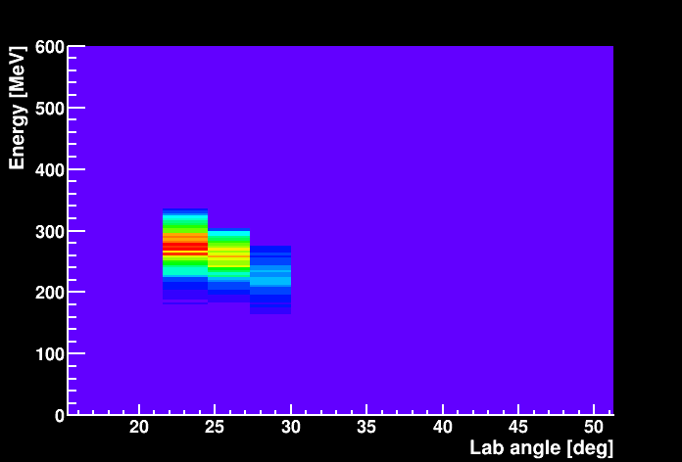
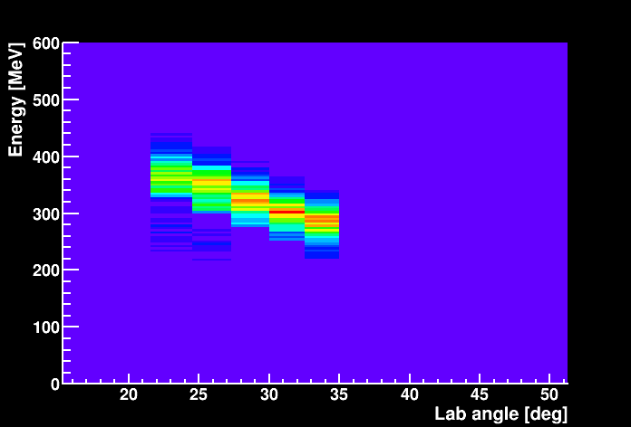
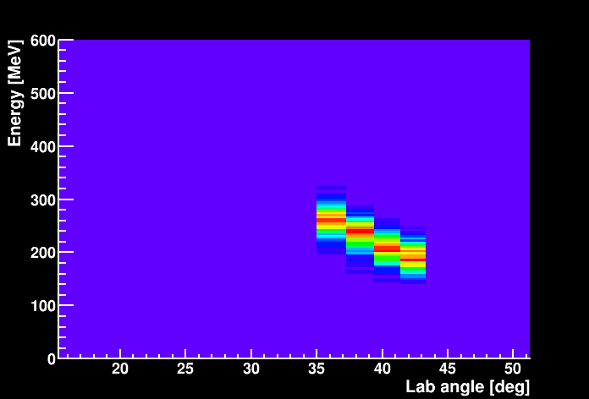
Chosen angular ranges – ¹⁸⁸Pb
All particles
Projectiles – low CoM
Projectiles – high CoM
Target – high CoM
Target – mid CoM
Target – low CoM

Slide 14
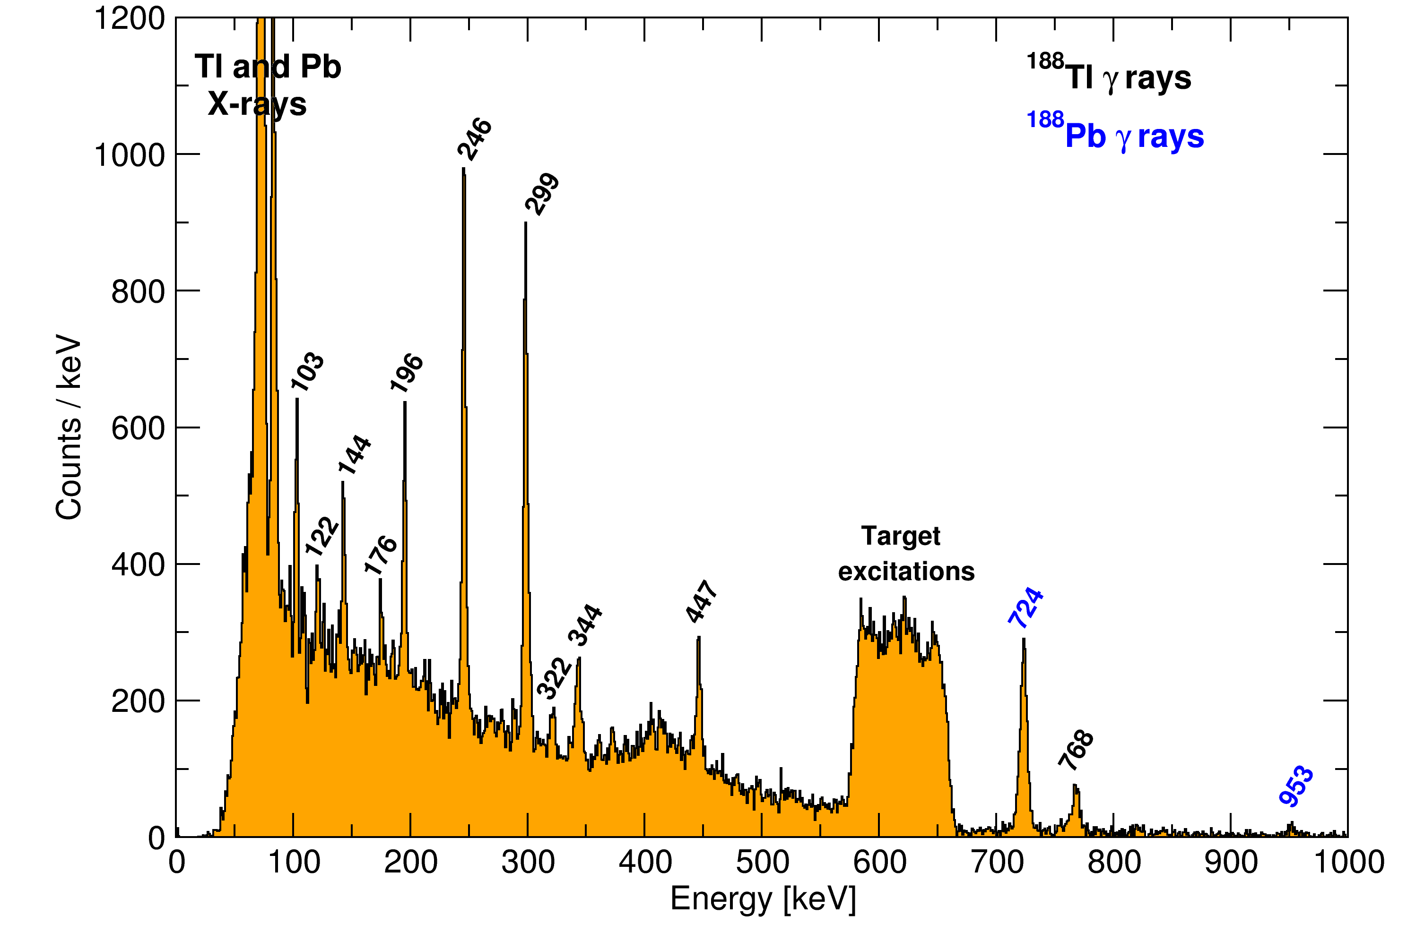
γ-rays in coincidence with ¹⁸⁸Pb detected in low CoM angles

Slide 15
Data treatment in a nutshell
Isotope | States populated | GOSIA version | Known data
¹⁸⁸Pb | 2⁺₁, 2⁺₂, (4⁺₁) | 1 | Yrast lifetimes, 2⁺₂ branching ratios
¹⁹⁰Pb | 2⁺₁ | 2 | -
¹⁹²Pb | 2⁺₁, 2⁺₂ | 1 | 2⁺₂ branching ratios (upper limit)
¹⁹⁴Pb | 2⁺₁ | 2 | -
¹⁹⁶Pb | 2⁺₁ | 2 | -
¹⁹⁸Pb | 2⁺₁ | 2 | -

Slide 16
Level schemes of the proposed isotopes
Enhanced E0 strengths between intruder configurations => complications to data analysis

Slide 17
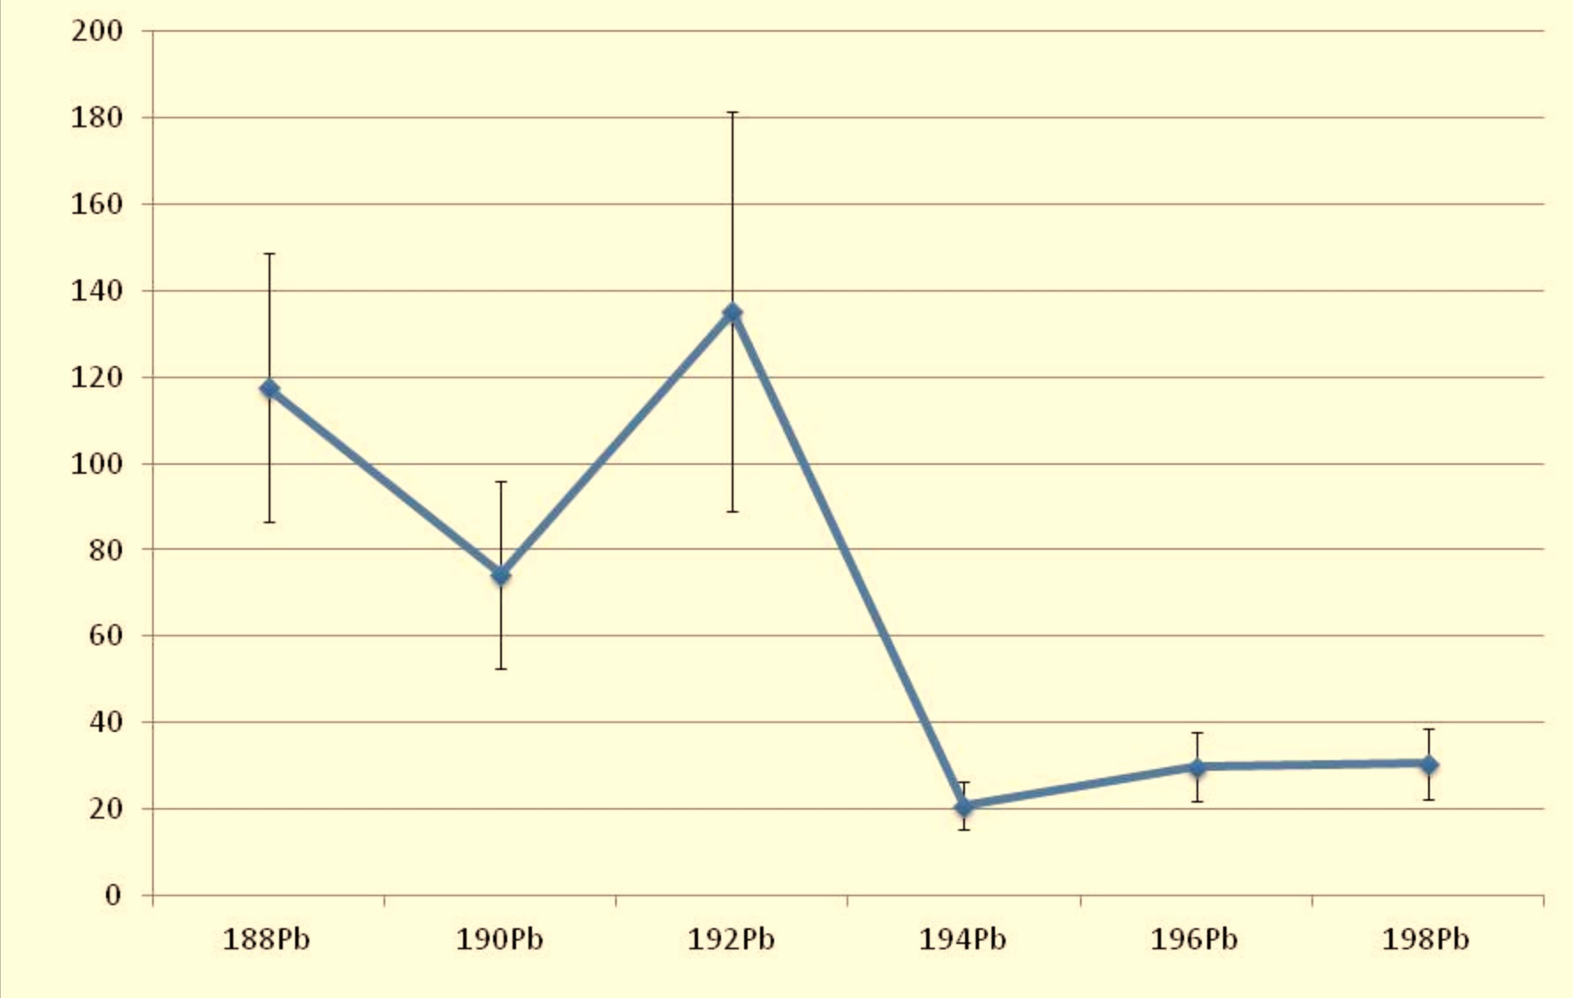
observed/expected beam induced X-rays
N. Bree et al. To be submitted to NIMB

Slide 18
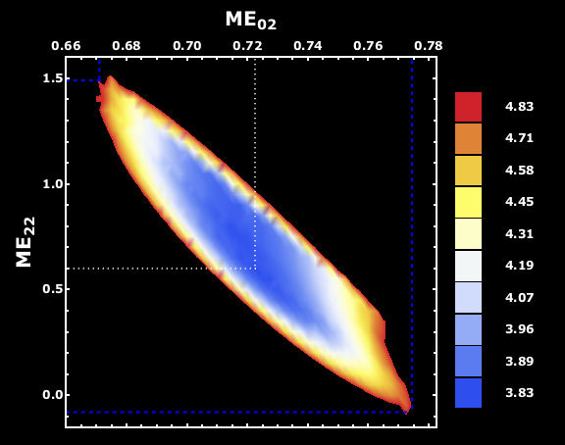
Matrix elements for the 2₁⁺ state in ¹⁹⁰Pb 1σ contour of the χ² surface
B(E2) = 16(3) W.u Q_{sp} = + 0.5(6) eb

Slide 19
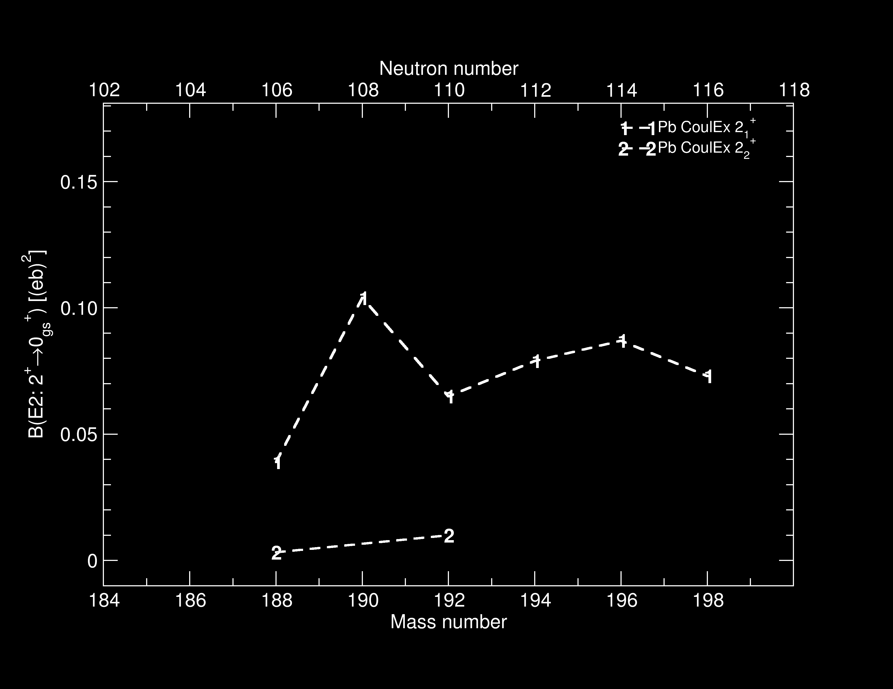
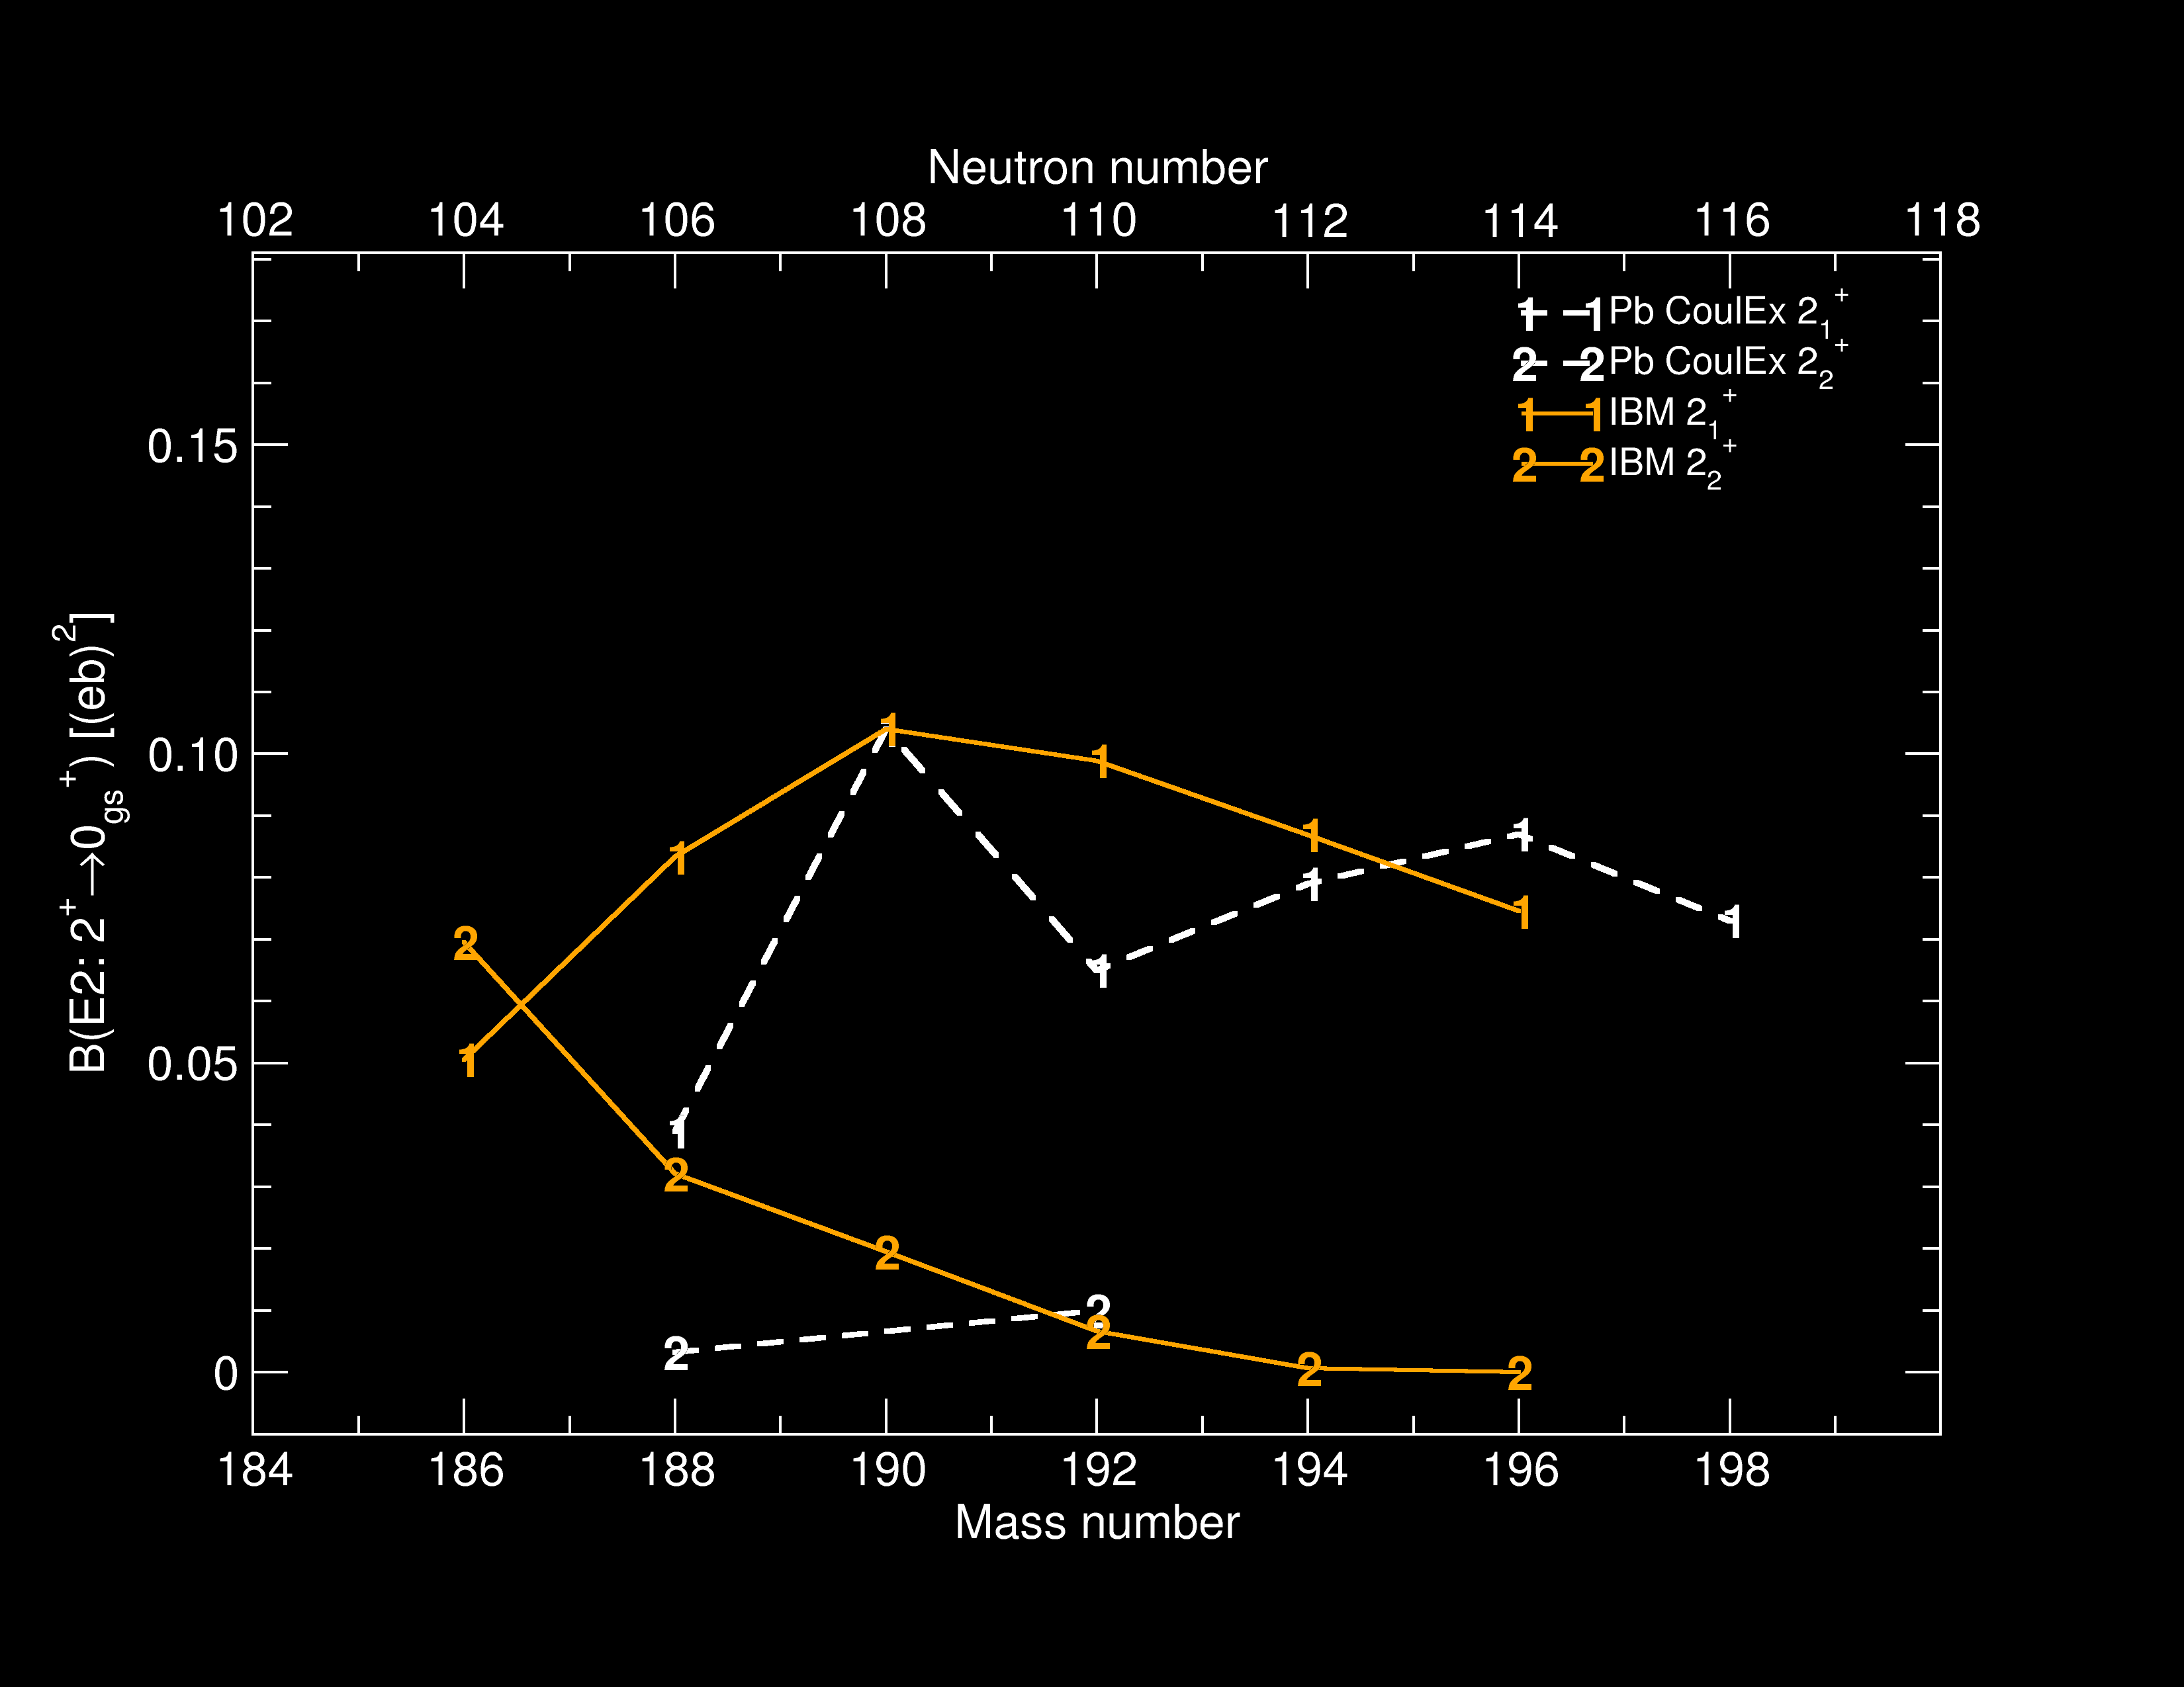
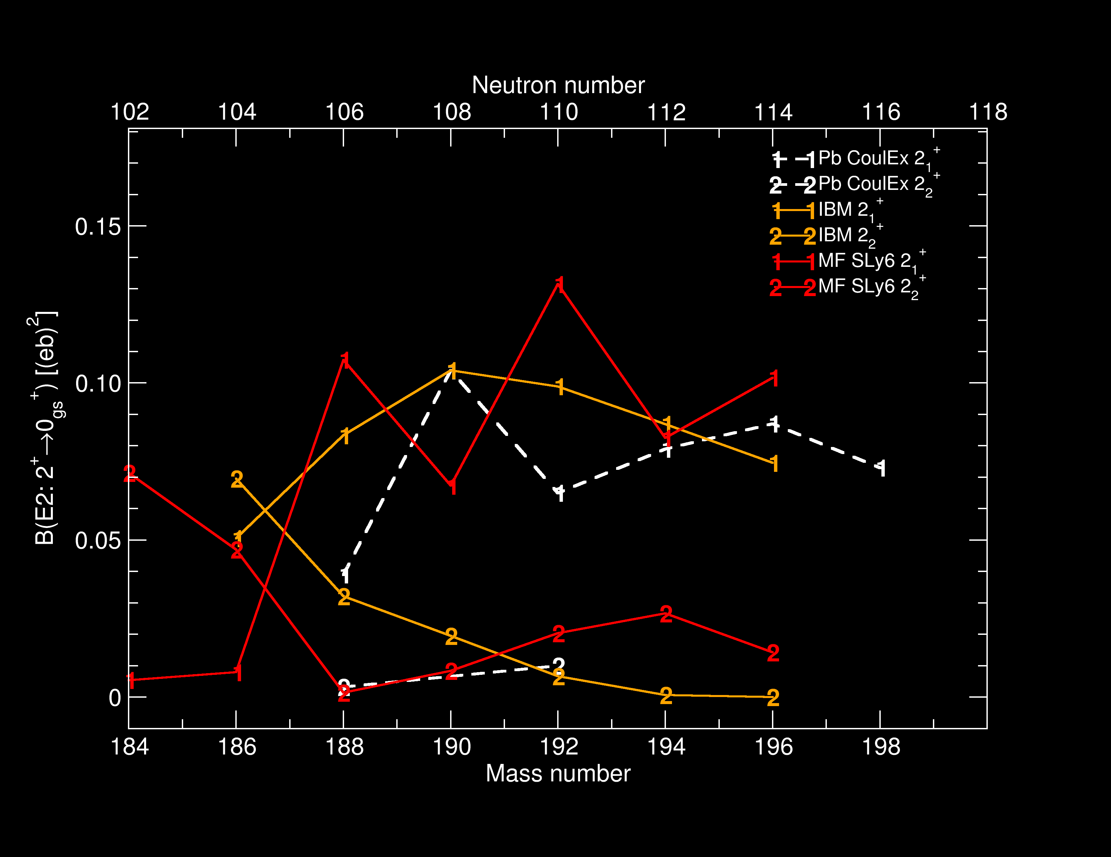
B(E2) values of the 2⁺ states in Pb isotopes
This work
V. Hellemans et al. PRC 77, 064324 (2008)
M. Bender et al. PRC 69, 064303 (2004) and private communication

Slide 20
SPEDE – γe⁻ spectroscopy with radioactive beams
γ-rays carry out only partial information of de-excitation processes
Internal conversion the only decay mode for an E0 transition
Essential information for analysis of Coulomb excitation data
To be combined with the MINIBALL array for HIE-ISOLDE

Slide 21
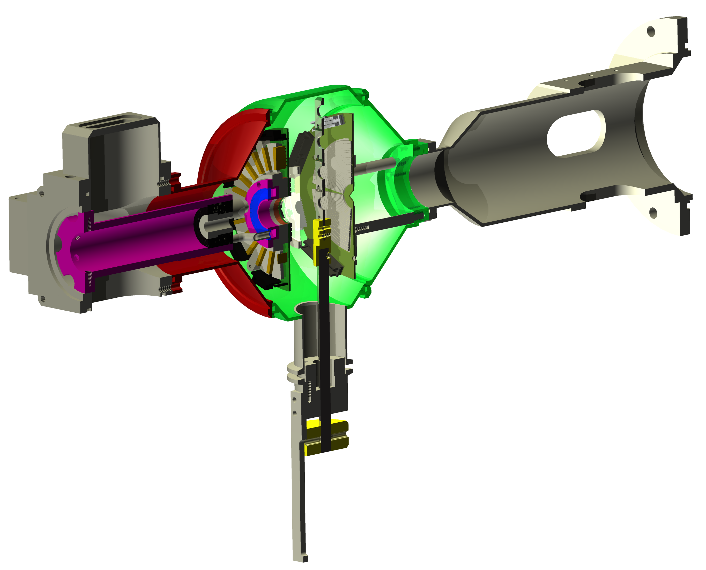
SPEDE – combined γ-ray—electron spectroscopy
For more information see poster #382 by P. Papadakis https://www.jyu.fi/fysiikka/en/research/accelerator/nucspec/spede

Slide 22
Summary
Transition strengths obtained for the yrast 2⁺ states in even mass ¹⁸⁸⁻¹⁹⁸Pb isotopes, first measurement for ¹⁹⁰⁻¹⁹⁸Pb
First measurement of the transition strengths of the non-yrast 2⁺ states in ^{188,192}Pb isotopes
Spectroscopic quadrupole moment determined for the yrast 2+ state in ¹⁹⁰Pb
Direct measurement of the shape, deformation and collectivity

Slide 23
Acknowledgements

Slide 24
Future prospects
Continue the Coulex program at HIE-ISOLDE and complementary experiments at JYFL
Combined in-beam conversion electron γ-ray spectroscopy
Odd nuclei => more fragmented level schema, need more stats ie. more intense, energetic and pure beams
Shape evolution towards the proton dripline (challenging to push limits via fusion-evaporation reactions employing stable beam-target combinations)
Multinucleon transfer => probing multi-particle—multi-hole configurations

Slide 25
Open questions
Confirmation of three different shapes in one nucleus
What is the intrinsic configuration of the intruding structures
Systematic behaviour of mixing between different shape coexisting structures
Why is the collectivity of prolate yrast bands in Pb higher than that of the identical bands in Hg and Pt isotopes
Explanation for identical structures observed in nuclei differing by an α-particle – role of F-spin symmetry

Slide 26
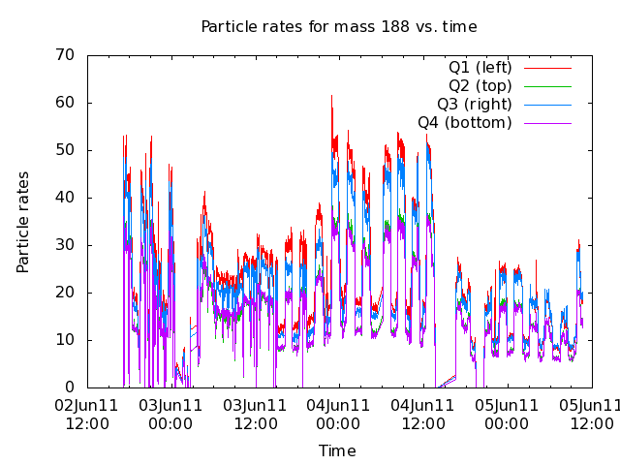
Laser on/off runs for ¹⁸⁸Pb

