Slide 1
Shell evolution towards ¹⁰⁰Sn
Anna Corsi
CEA Saclay/IRFU/SPhN

Slide 2
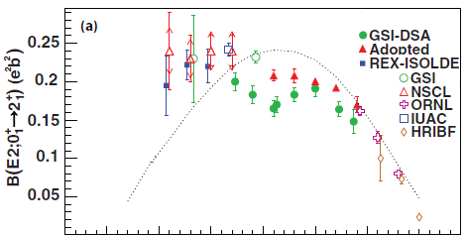
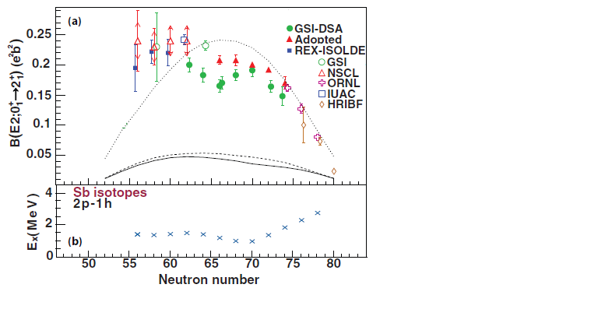
Collectivity along Sn isotopic chain
Experimental B(E2) deviate from predictions (SM, seniority scheme)
A. Banu, et al., Phys. Rev. C 72, 061305 (2005). A. Ekstrom, et al., Phys. Rev. Lett. 101, 012502 (2008).
J. Cederkall, et al., Phys. Rev. Lett. 98, 172501 (2007). C. Vaman, et al., Phys. Rev. Lett. 99, 162501 (2007).
P.Doornenbal et al., Phys. Rev. C 78, 031303 (2008). R.Kumar et al., Phys Rev. C 81, 024306 (2010)
Adapted from V.Bader et al. PRC 88 051301(R) (2013)
Magicity of ¹⁰⁰Sn confirmed by Gamow-Teller resonance measurement
C.B.Hinke, et al., Nature 486, 341 (2012).
Which is the origin of light Sn collectivity?

Slide 3
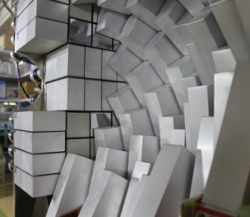
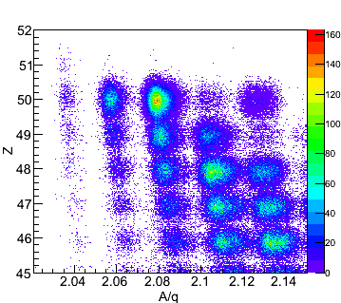
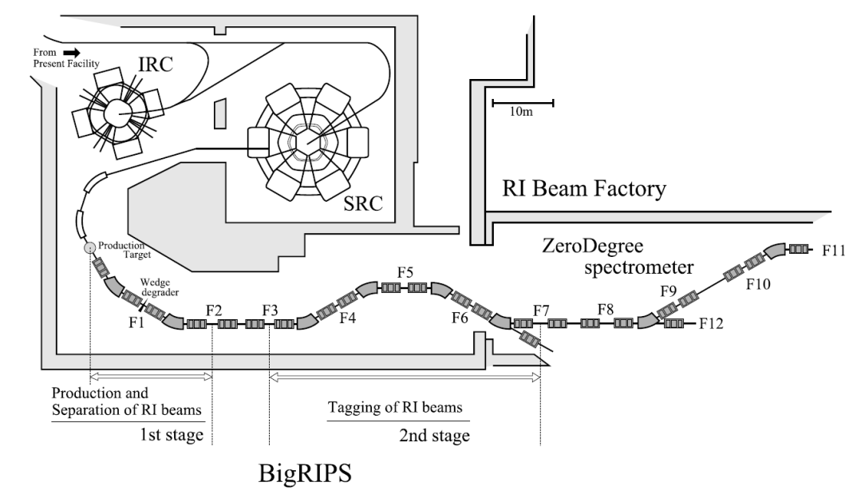
Spectroscopy around ¹⁰⁴Sn at RIBF
RIBF74 experiment, Spokespersons: P.Doornenbal, A.Obertelli
Complementary reaction probes:
-Coulomb excitation
P. Doornenbal et al., arXiv:1305.2877
-Inelastic scattering
A.Corsi et al., in preparation
-Neutron removal
L.Audirac et al., PRC 88, 041602(R) (2013)
PID in ZeroDegree
Spectrometer, incoming ¹⁰⁴Sn
DALI2
¹⁰²Sn ¹⁰³Sn ¹⁰⁴Sn
Primary beam:
  ¹²⁴Xe 10 pnA
Secondary beam:
  ¹¹²Sn (reference)
  ¹⁰⁴Sn 350 pps, 25%

Slide 4
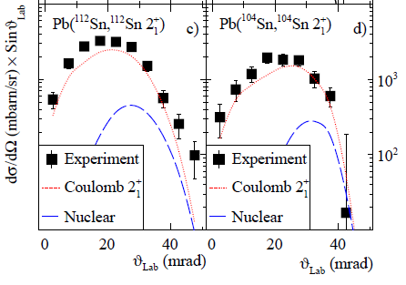
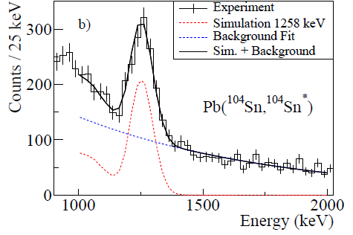
Proton collectivity in light Sn
²⁰⁸Pb(¹¹²Sn,¹¹²Sn’): reference
²⁰⁸Pb(¹⁰⁴Sn,¹⁰⁴Sn’): measurement
METHOD:
1) σ₂₊=σ_{em} +σ_{nucl}+σ_{feeding}
2) σ_{nucl} on C target for ^{104,112}Sn, benchmark
3) σ_{feeding}=σ₂₊−(σ_{em} +σ_{nucl}) for ¹¹²Sn
σ_{em} =298(30) mb for ¹⁰⁴Sn
absolute cross section
P. Doornenbal et al., arXiv:1305.2877

Slide 5
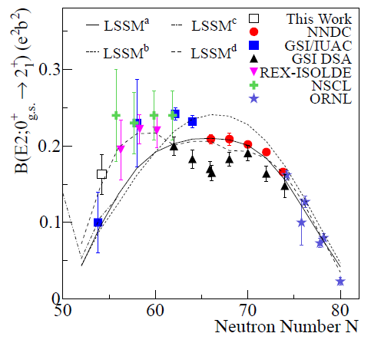
Proton collectivity in light Sn
¹⁰⁴Sn
GSI
G.Guastalla et al., PRL 110 172501 (2013)
B(E2)=0.10(4)e²b²
RIKEN, this exp.
P. Doornenbal et al., arXiv:1305.2877
B(E2)=0.163(26)e²b²
NSCL
V.Bader et al. PRC 88 051301(R) (2013)
B(E2)=0.180(37)e²b²
collectivity starts to decrease with ¹⁰⁴Sn
extra collectivity wrt SM calculations due to excitations outside gds model space
solutions: isospin-dependent effective charges, larger model space

Slide 6
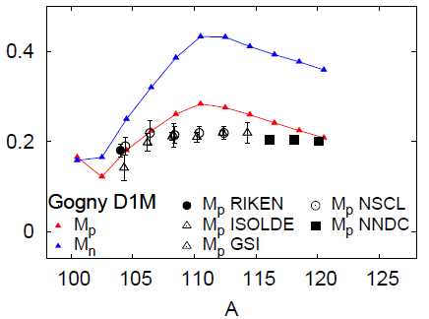
Proton and neutron collectivity in light Sn
HFB+QRPA with Gogny D1M interaction, no model space limitation
M.Martini, S.Peru and M.Dupuis, PRC 83, 034309 (2011)
M_{p} M_{n}
Asymmetric M_{p} curve as in Ansari and Ring, PRC 74, 054313 (2006)
neutron contribution dominant

Slide 7
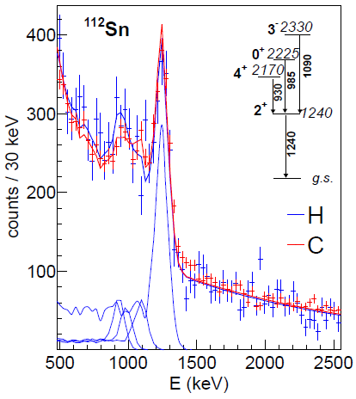
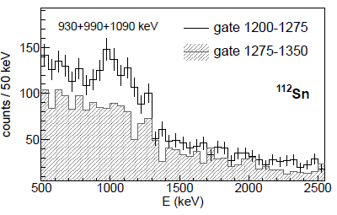
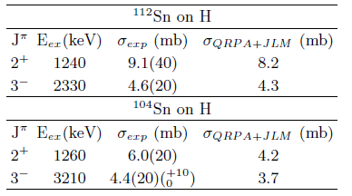
Proton and neutron collectivity in light Sn
Reference case
σ_{p,p’} well reproduced by Coupled Channel calculations with
  HFB+QRPA density with Gogny D1M interaction
  potential from JLM interaction
  M.Dupuis, F.Lechaftois, M.Martini, S.Péru CEA/DAM/DIF
Notes:
microscopic description of the target states based on
RPA calculations implemented with the D1S force

Slide 8
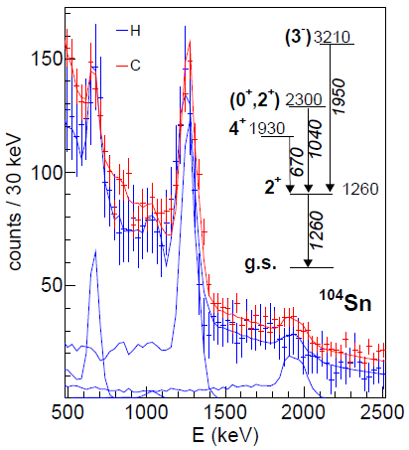
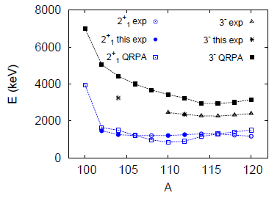
Proton and neutron collectivity in light Sn
Transition at 1950 keV tentatively assigned as 3⁻ → 2⁺ decay from
1) energy systematics
2) strong population of 3⁻ via (p,p’) in semi-magic nuclei
Increase of 3⁻ energy predicted by HFB+QRPA with Gogny D1M
Notes:
microscopic description of the target states based on
RPA calculations implemented with the D1S force

Slide 9
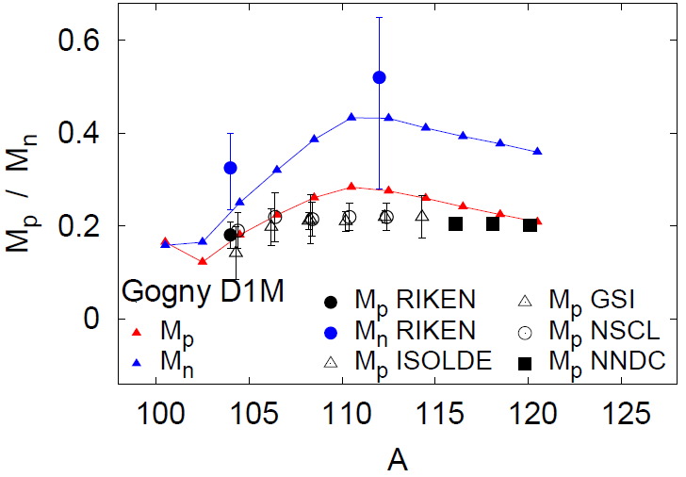
Proton and neutron collectivity in light Sn
HFB+QRPA with Gogny D1M interaction, no model space limitation
M.Martini, S.Peru and M.Dupuis, PRC 83, 034309 (2011)
M_{p} M_{n}
Asymmetric M_{p} curve as in Ansari and Ring, PRC 74, 054313 (2006)
(p,p’) cross section dominated by neutron contribution
+20-30% in M_{n} to reproduce experimental (p,p’) cross section

Slide 10
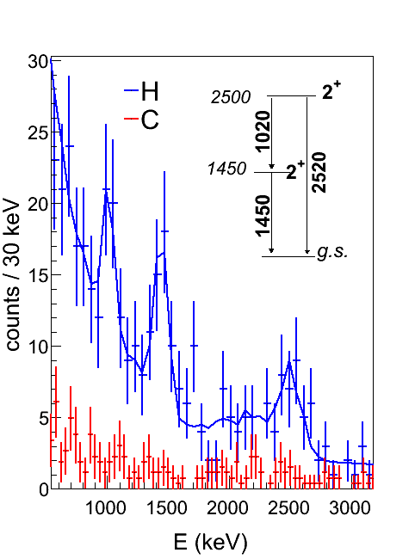
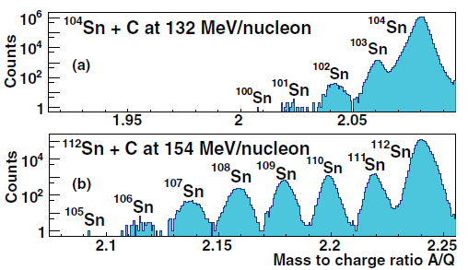
Towards ¹⁰⁰Sn spectroscopy
Inclusive knockout cross section on C and H
L.Audirac et al., PRC 88, 041602(R) (2013)
¹⁰²Sn
Exclusive (p,p2n) cross sections on H:
2⁺₁: 0.6 (4) mb
2⁺₂: 2.1 (6) mb (newly assigned)
Structure change btw ¹⁰⁴Sn and ¹⁰²Sn?
A.Corsi et al., in preparation
Based on measured cross section ¹⁰⁴Sn(p,p2n)¹⁰²Sn(2⁺) :
50 pps ¹⁰²Sn* × 5 cm LH₂ × 0.6 mb × 5% ε_{γ} × 60% ε_{trans} × 6 d = 100 γ
^{→100}Sn spectroscopy feasible at RIBF within 10 days beam time
*primary beam 100 pnA, total secondary beam10⁵ pps, cross section from H.Suzuki et al., NIM B 317, 756(2013)
Notes:
1.5 per 1 pnA 124Xe; same xsec (different structure of 2+ in 100Sn)

Slide 11
Conclusions and perspectives
Coulomb excitation: B(E2) =0.163(26)e²b², decrease less pronounced wrt GSI exp.
Shell model calculations fail to reproduce exp. values, calculations
within a larger valence space demanded
Beyond-mean-field calculations (HFB+QRPA with Gogny D1M) predictive for light Sn
Inelastic scattering: large neutron component in 2⁺ excitation
New 3⁻ at 3210 keV; increasing 3⁻ energy
→ neutron collectivity reduced close to ¹⁰⁰Sn
¹⁰⁴Sn(p,2n)¹⁰²Sn cross sections measured
^{→ 100}Sn spectroscopy from (p,p2n) feasible at RIBF with LH₂ thick target when ¹²⁴Xe at 100 pnA available
Notes:
Factor 4 reduction going 1 step towards drip line =>0.1 mb

Slide 12
Local team (RIKEN, CNS, RCNP)
P.Doornenbal, M.Matsushita, D.Steppenbeck, S.Takeuchi, H.Wang, N.Aoi, H.Baba, K.Matsui, T.Motobayashi, D.Nishimura, S.Ota, H.Sakurai, H Shiga, R. Taniuchi
CEA-Saclay team
A. Corsi. A.Obertelli, L.Audirac, S.Boissinot, A.Gillibert, V.Lapoux, E.Pollacco, C.Santamaria
Theoretical support, CEA/DAM/DIF Arpajon, France
M.Dupuis, F.Lechaftois, M.Martini, S.Péru

Slide 13
Backup slides

Slide 14
Inelastic scattering cross sections
Ingredients:
HFB+QRPA density with Gogny D1M interaction
JLM potential (Semi-microscopic optical )
M.Dupuis, CEA/DAM/DIF

Slide 15
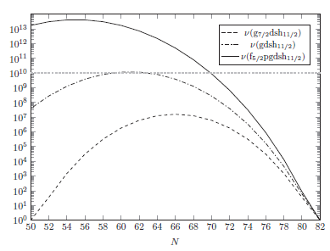
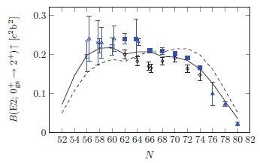
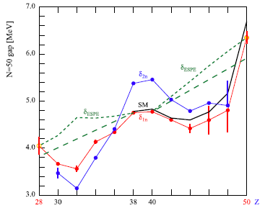

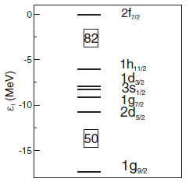
Shell model
T.Back, PRC 87, 031306 (2013)
T.Faestermann, PPNP 69, 85 (2013)
HF sp levels, ¹⁰⁴Sn

Slide 16
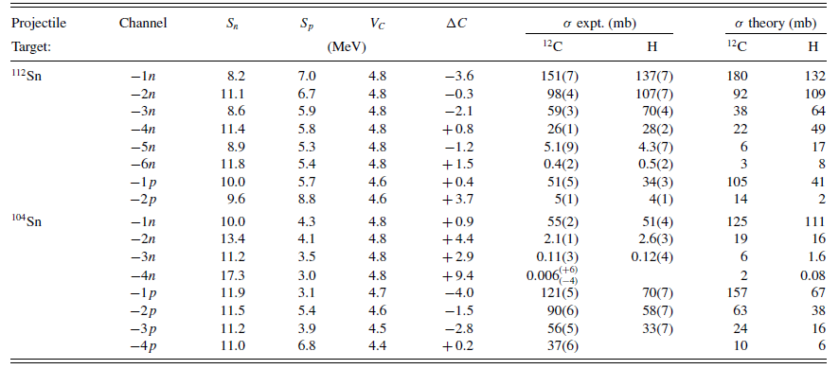
Nucleon removal cross section
L.Audirac et al., PRC 88, 041602(R) (2013)

