Slide 1
Constraining the astrophysical
S-factor of the ³He(α,γ)⁷Be reaction
Mariano Carmona Gallardo
Instituto de Estructura de la Materia-CSIC (Madrid)
“Advances in Radioactive Isotope Science”
Tokio, 2nd June 2014
QUESTIONS TO ADDRESS!
1.- Motivation: Why to study the ³He(α,γ)⁷Be reaction
2.- Reaction and Techniques: How to determine the cross section
3.- Our experiments: How we measured the reaction cross section
4.- Conclusions: What are our results and what is the impact

Slide 2
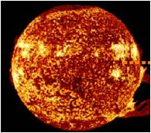
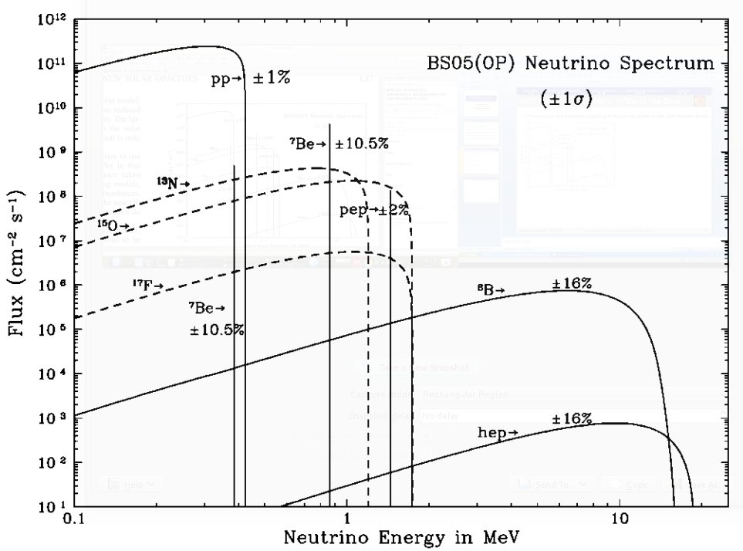
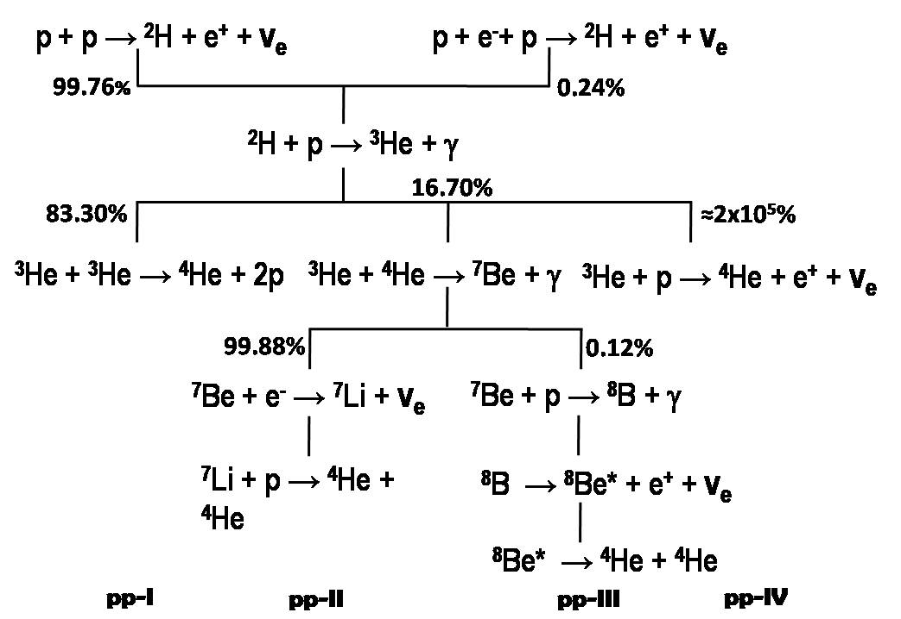
Motivation
Reaction and Techniques
Activation Experiment
Direct Counting Experiment
Conclusion
MOTIVATION: The ³He(α,γ)⁷Be in the Sun
The evolution and processes are studied by the Standard Solar Model
Input parameters:
Opacities
Equation of Stage
….
Nuclear Reactions Cross Sections
Astrophysical S-factor
Nuclear Part of the
Cross Section
Coulomb Contirubtion
Easier extrapolations.
High uncertainty in the neutrino flux from ⁸B decay
Φ_{ν}(⁸B)≈ S₃₄(0)^{0.81}
M. Carmona-Gallardo - ARIS 2014 Constraining the S-factor of the ³He(α,γ)⁷Be reaction

Slide 3
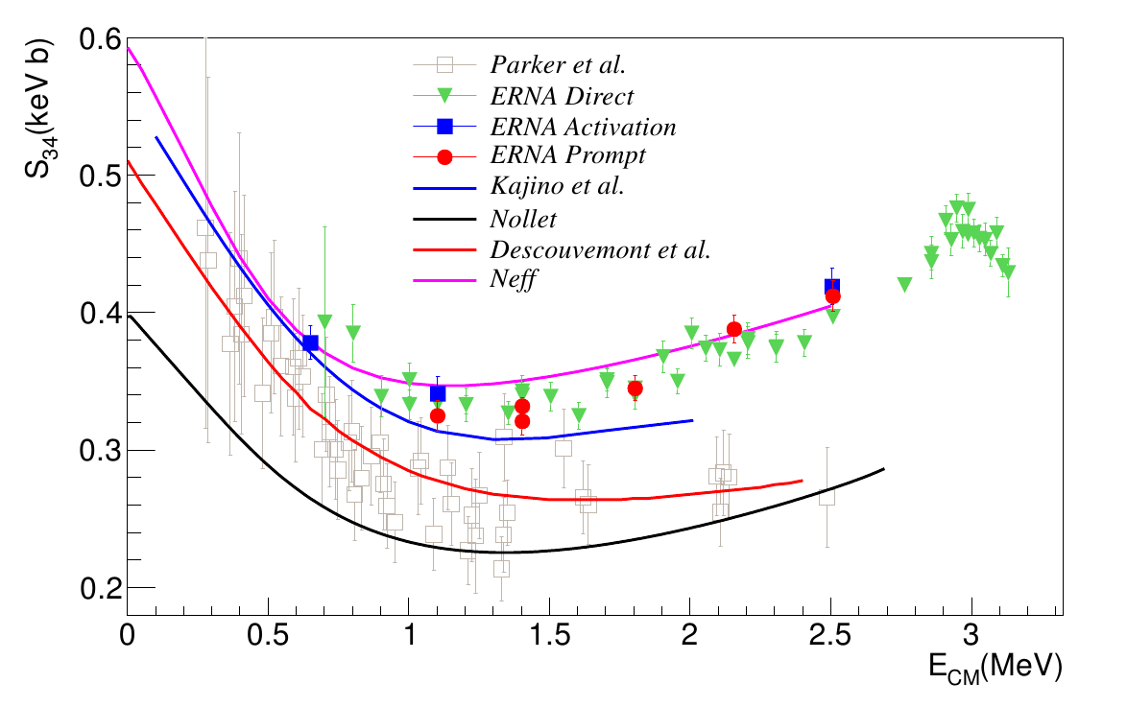
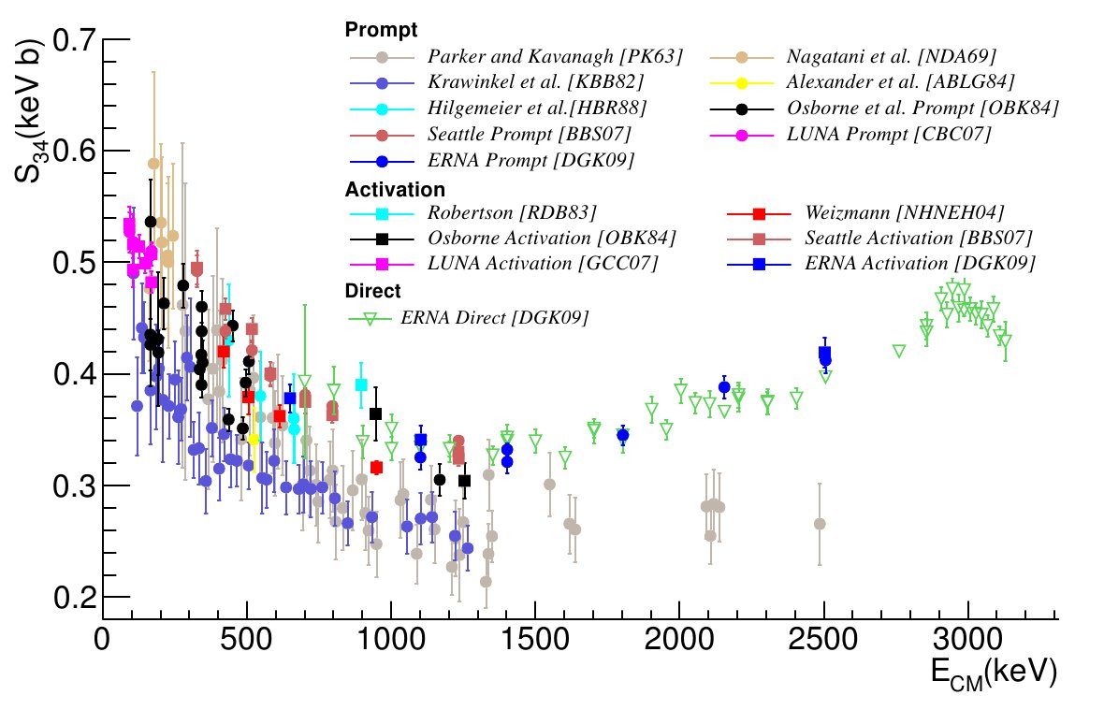
Conclusion
Activation Experiment
Conclusion
Activation Experiment
Direct Counting Experiment
Motivation
Direct Counting Experiment
Motivation
Reaction and Techniques
Reaction and Techniques
MOTIVATION: Previous Data
High discrepancy among data sets
Specially high in the medium high energy region: E_{CM}=1-3 MeV
Theoretical differences in the energy dependence of the S₃₄ factor and thus on ≈ S₃₄(0)
Values at 1-3 MeV constrains the underlying physics and the extrapolations down to zero energy
Mariano Carmona-Gallardo
PhD. Thesis
M. Carmona-Gallardo - ARIS 2014 Constraining the S-factor of the ³He(α,γ)⁷Be reaction

Slide 4
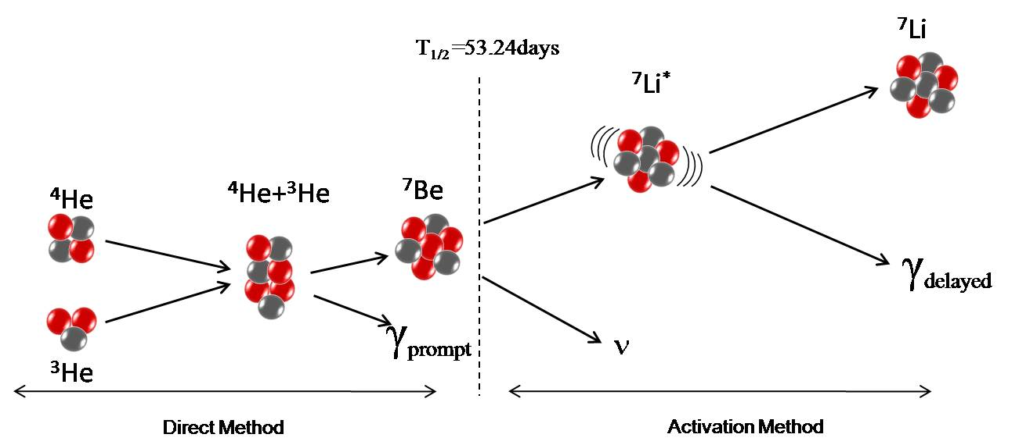
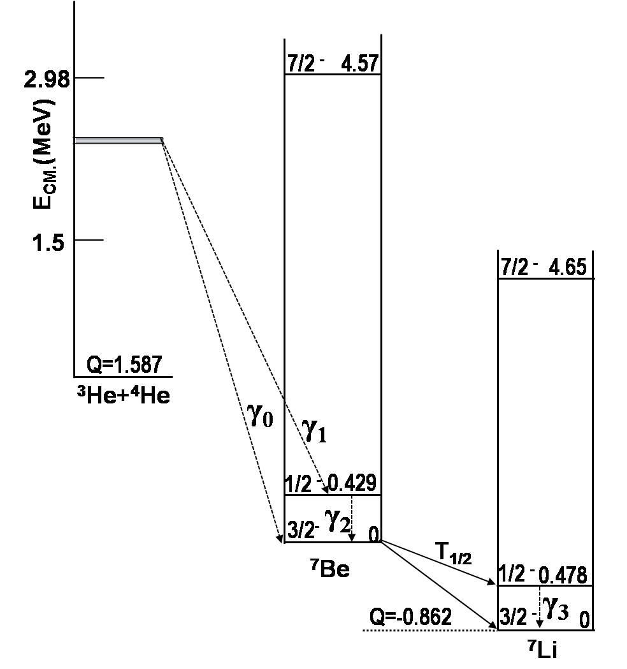
Conclusion
Activation Experiment
Conclusion
Activation Experiment
Direct Counting Experiment
Motivation
Direct Counting Experiment
Motivation
Reaction and Techniques
Reaction and Techniques
Reaction and Techniques
Proton
Neutron
ν
⁴He
⁷Be
⁷Li
³He
RADIATIVE CAPTURE REACTION
ELECTROMAGNETIC TRANSITION
DIRECT ONE STEP PROCESS
DIRECT COUNTING DETECTION METHOD
PROMPT γ-DETECTION METHOD
ACTIVATION METHOD: γ-DELAYED DETECTION
⁷Be
T_{1/2}=53.24(4) days
B.R.=10.44%
M. Carmona-Gallardo - ARIS 2014 Constraining the S-factor of the ³He(α,γ)⁷Be reaction

Slide 5
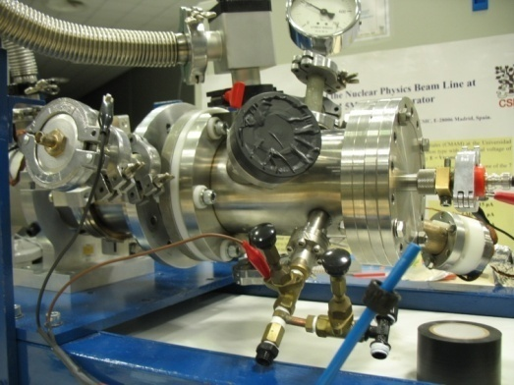
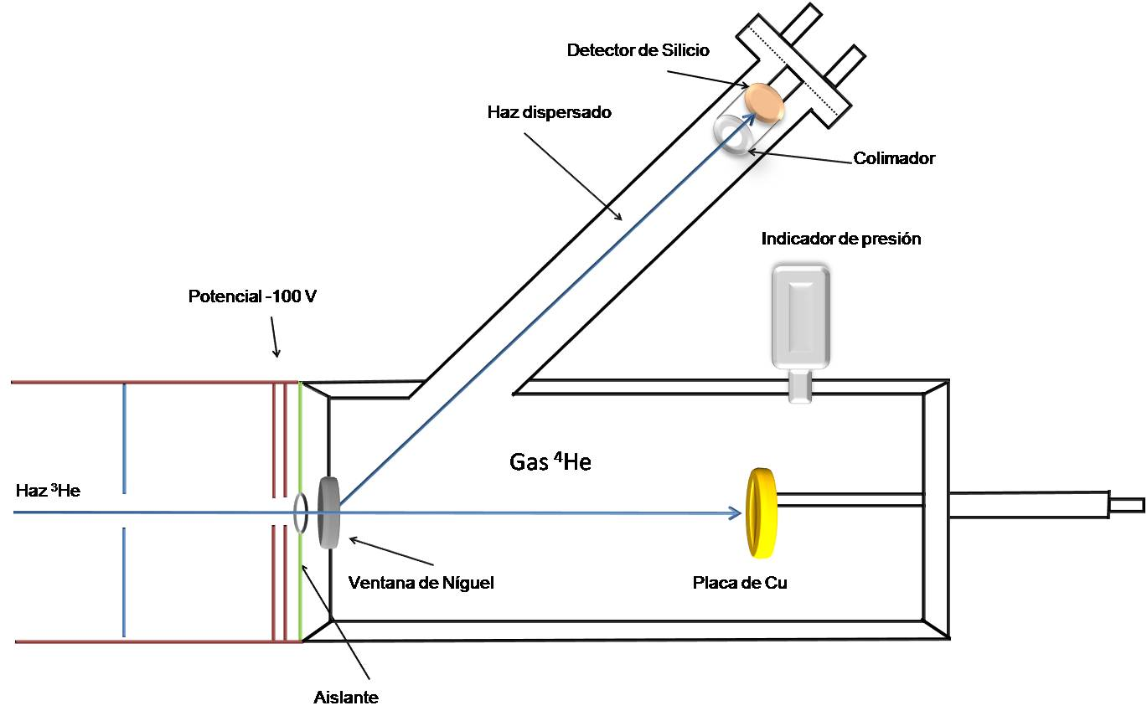
Conclusion
Activation Experiment
Conclusion
Activation Experiment
Direct Counting Experiment
Motivation
Direct Counting Experiment
Motivation
Reaction and Techniques
Reaction and Techniques
ACTIVATION METHOD EXPERIMENT
Silicon detector
Scattered beam
Collimator
Pressure gauge
-200 V suppressor
⁴He Gas
³He beam
Ni foil
Cu catcher
Insulator
M. Carmona-Gallardo et al. Phys. Rev C 86, 032801 (R) 2012
M. Carmona-Gallardo - ARIS 2014 Constraining the S-factor of the ³He(α,γ)⁷Be reaction

Slide 6
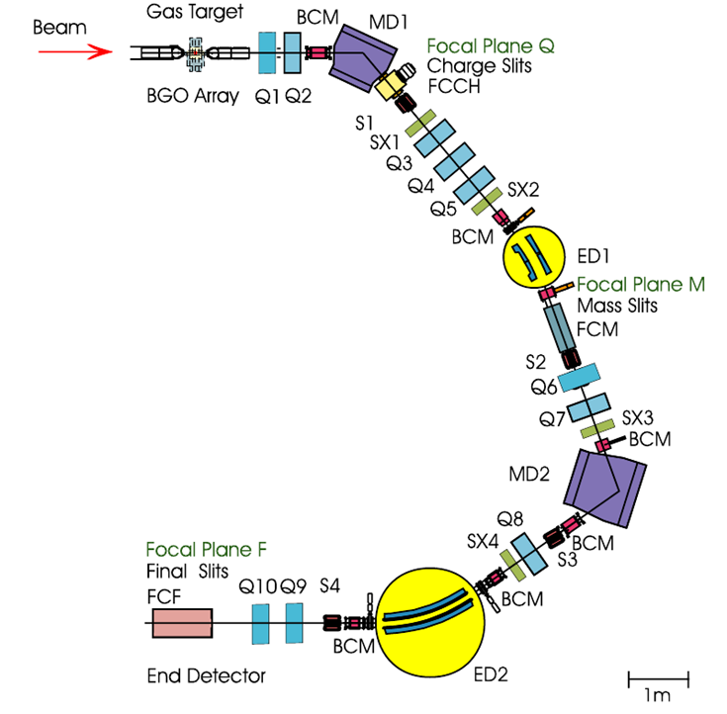
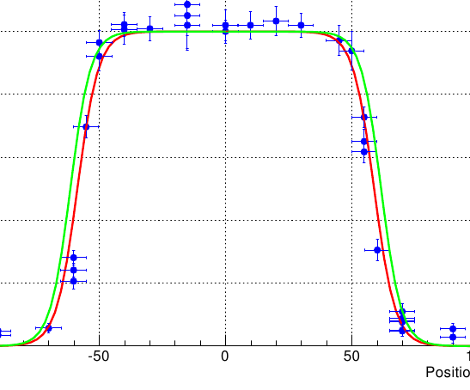
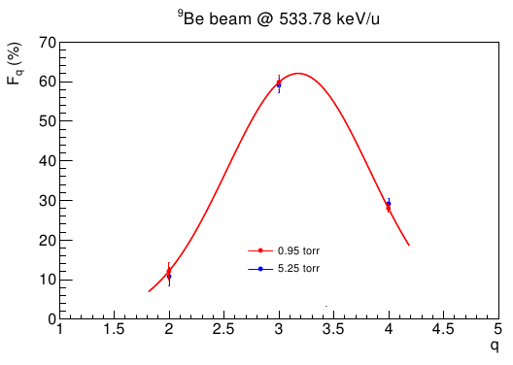
Conclusion
Activation Experiment
Conclusion
Activation Experiment
Direct Counting Experiment
Motivation
Direct Counting Experiment
Motivation
Reaction and Techniques
Reaction and Techniques
Direct Recoil Counting Experiment
⁷Be²⁺
DRAGON RECOIL SEPARATOR AT TRIUMF
³He gas and ⁴He beam
TWO EFFECTS TO BE CONSIDERED:
⁷Be³⁺
TRANSMISSION: loss of ⁷Be
¹²C(³He,γ¹⁴N)p TDP
GEANT SIMULATIONS
CHARGE STATE DISTRIBUTION
⁹Be beam onto ³He gas
Mariano Carmona-Gallardo
PhD. Thesis
M. Carmona-Gallardo - ARIS 2014 Constraining the S-factor of the ³He(α,γ)⁷Be reaction

Slide 7
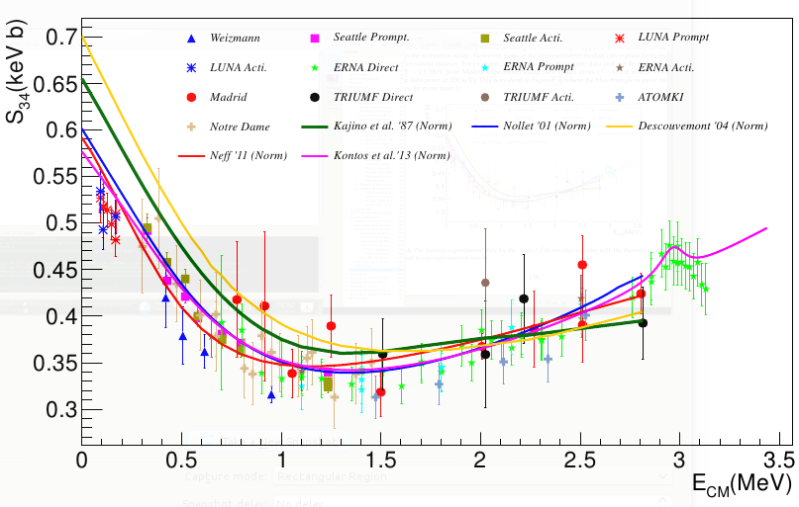
Conclusion
Activation Experiment
Conclusion
Activation Experiment
Direct Counting Experiment
Motivation
Direct Counting Experiment
Motivation
Reaction and Techniques
Reaction and Techniques
CONCLUSIONS
Mariano Carmona-Gallardo
PhD. Thesis
Direct implications in astrophysics:
5.05 % increase in φ_{ν}(⁷Be)
4.75 % increase in φ_{ν}(⁸B)
Discard the Parker Data
Energy dependence of the S-factor have been investigated by using χ² method
The low energy data of LUNA constrain also the energy dependence
Two theoretical models fit both our data and low energy data. R-matrix fit by Kontos et al. and ab-initio calculation by Neff.
Ab-initio calculation reproduce the data without any normalization factor
Therefore we suggest a S₃₄(0)=0.593 keV·b as given by Neff.
M. Carmona-Gallardo - ARIS 2014 Constraining the S-factor of the ³He(α,γ)⁷Be reaction

Slide 8
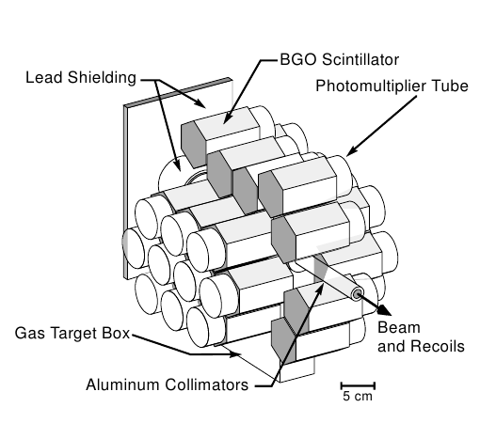
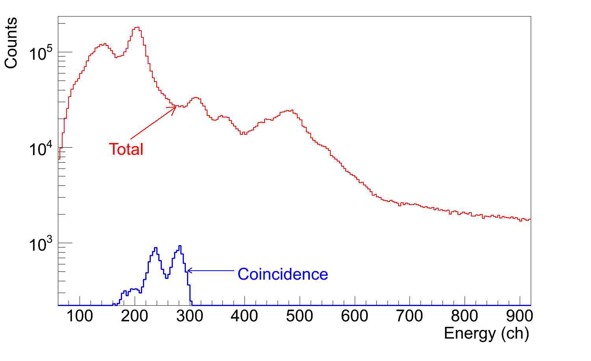
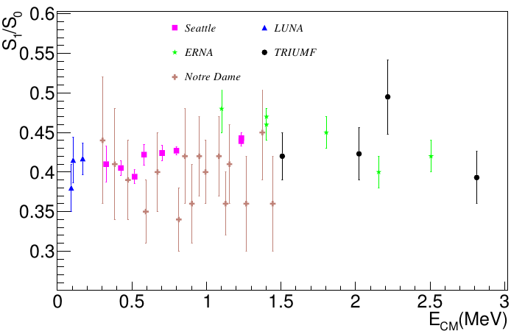
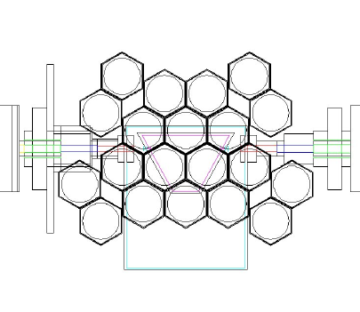
Conclusion
Activation Experiment
Conclusion
Activation Experiment
Direct Counting Experiment
Motivation
Direct Counting Experiment
Motivation
Reaction and Techniques
Reaction and Techniques
Direct Recoil Counting Experiment
Prompt-γ detected in the BGO array
A. Rojas, M.Carmona-Gallardo et al. under preparation
M. Carmona-Gallardo - ARIS 2014 Constraining the S-factor of the ³He(α,γ)⁷Be reaction

Slide 9
Conclusion
Activation Experiment
Conclusion
Activation Experiment
Direct Counting Experiment
Motivation
Direct Counting Experiment
Motivation
Reaction and Techniques
Reaction and Techniques
THANK YOU!
S34 CMAM-Madrid
CSIC-Madrid: M. Carmona-Gallardo, O. Tengblad, M.J.G. Borge, J.A. Briz, M. Cubero, E. Nácher, A. Perea, V. Pesudo, G.Ribeiro, J. Sánchez del Rio
University of York: B.S. Nara Singh, B.R. Fulton, J. McGrawth
The Weizmann Institute: M. Hass, V. Kumar
Soreq Research Center: G. Haquin, Y. Nier-El, R. Yaniv, Z. Yungreis
Aarhus University: H. Fynbo
CMAM-Madrid: A. Munoz-Martín, A. Maira, N. Gordillo
S34 TRIUMF
CSIC-Madrid: M.Carmona-Gallardo, O.Tengblad, M.J.G Borge
TRIUMF: A. Rojas, S.K.L Sjue, B. Davids, C. Ruiz, J. Fallis, A. Shotter, D. Ottowell, D.A. Hutcheon, G. Ruprecht, L. Buchmann, U. Hager
University of York: B.S. Nara Singh, B. R. Fulton, A.M. Laird, S. Fox
The Weizmann Institute: M. Hass
Simon Fraser University: S. Reeve, D. Howell, N. Galinski
NSCL: R. H. Cyburt
Bibliography
[PK63] P.D. Parker and R.W. Kavanagh, Phys. Rew.131 nº 6 2578 (1963)
[NDA69] K. Nagatani et al., Nucl. Phys. A 128, 325 (1969)
[KBB82] H. Kräwinkel et al., Zeit. Fur Phys. A 304, 307 (1982)
[RDB83] R.G.H. Robertson et al. Phys. Rev. C 27 nº 1, 11(1983)
[ABLG84] T. K. Alexander et al. Nucl. Phys. A 427, 526 (1984)
[OBK84] J. L. Osborne et al. Nucl. Phys. A 115 (1984)
[HBR88] M. Hilgemeier et al., Zeit. Fur Phys. A 304, 307 (1982)
[NHNEH04] B.S. Nara Singh et al. Phys. Rev. Lett . 93, 262503 (2004)
[BBS07] T. Brown et al. Phys. Rew C 76, 055801 (2007)
[GCC07] Gy. Gyürky et al. Phys. Rew. C 75, 034805 (2007)
[DGK09] A. Di Leva et al. Phys. Rev Lett. 102, 232502 (2009)
[KTA87] T. Kajino et al. The Astroph. Journal 319, 531 (1987)
[Nol01] Kenneth Nollet, Phys. Rev. C 63 nº 5, 1 (2001)
[Desc04] P. Descouvemont et al. Atom .Data Nucl. Data 88 nº 1, 203 (2004)
[Neff01] T. Neff Phys. Rev. Lett. 106, n’ 4, (2011)
M. Carmona-Gallardo - ARIS 2014 Constraining the S-factor of the ³He(α,γ)⁷Be reaction

Slide 10
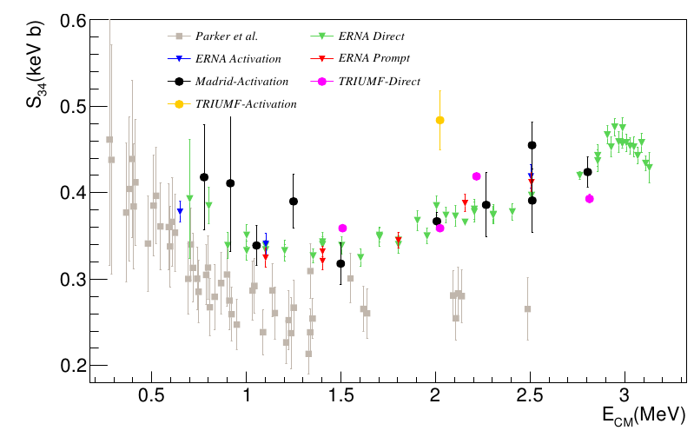
Motivation
Reaction and Techniques
Activation Experiment
Direct Counting Experiment
Conclusion
Direct Recoil Counting Experiment
⁷Be recoils counted in the DSSSD
Low statistical errors
M. Carmona-Gallardo - ARIS 2014 Constraining the S-factor of the ³He(α,γ)⁷Be reaction

Slide 11
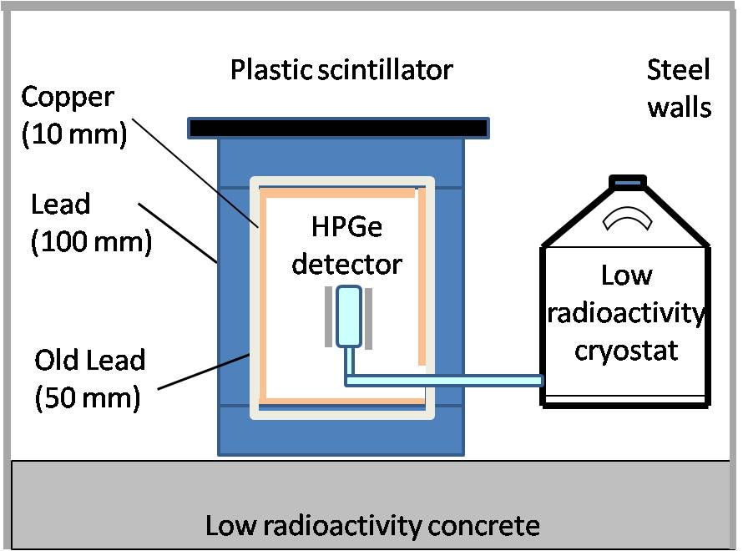
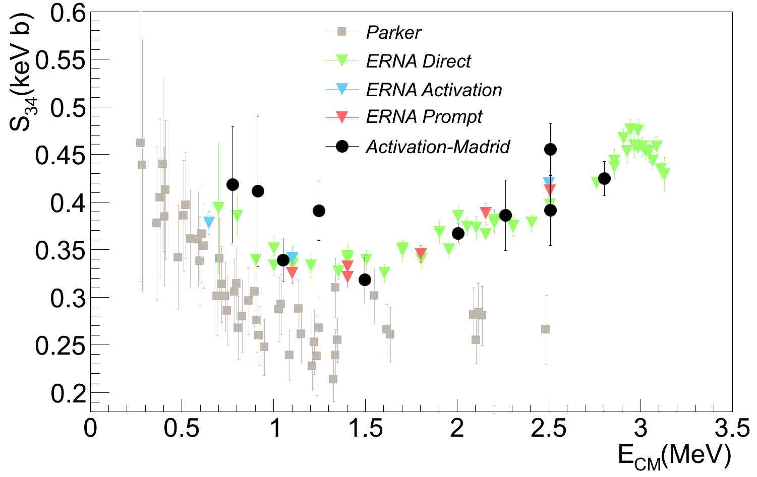
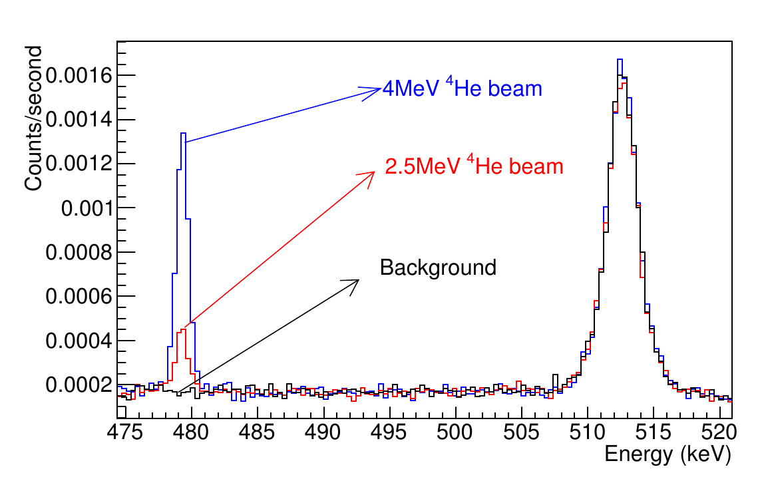
Motivation
Reaction and Techniques
Activation Experiment
Direct Counting Experiment
Conclusion
ACTIVATION METHOD EXPERIMENT
M.Carmona-Gallardo et al. PRC (R )
M. Carmona-Gallardo - ARIS 2014 Constraining the S-factor of the ³He(α,γ)⁷Be reaction

Slide 12
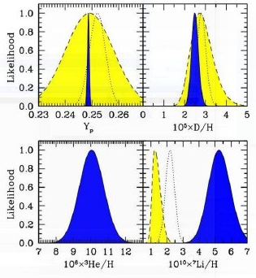
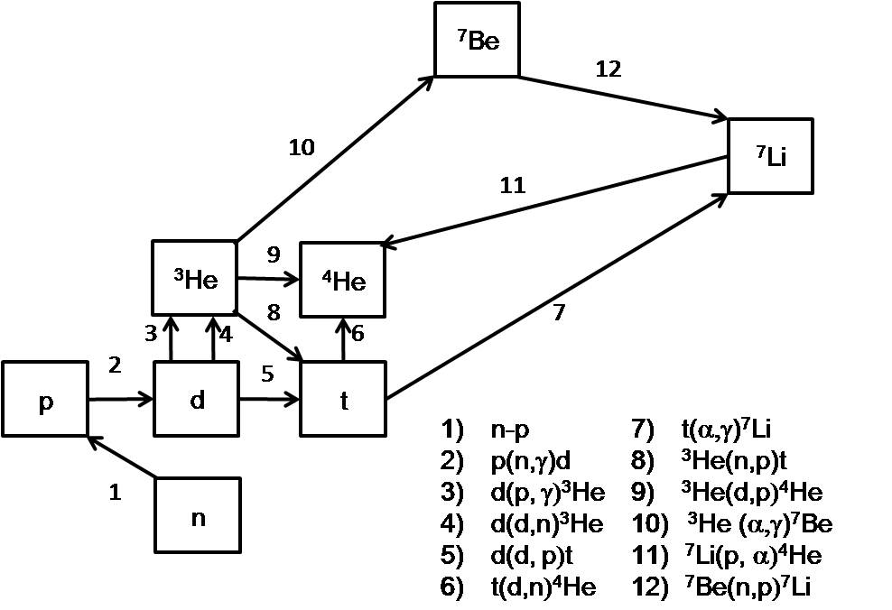
Motivation
Reaction and Techniques
Activation Experiment
Direct Counting Experiment
Conclusion
MOTIVATION: The ³He(α,γ)⁷Be in the ⁷Li problem
The Standard Big Bang Nucleosynthesis predicts the primordial abundances
Different solutions have been suggested including physics beyond the standard model.
SBBN input parameters
Baryon density/Neutrino Lifetime/flavors
Nuclear Reactions Cross Sections
A factor ≈3 between the SBBN predications and the direct observations
⁷Li≈ S₃₄^{0.96}
M. Carmona-Gallardo - ARIS 2014 Constraining the S-factor of the ³He(α,γ)⁷Be reaction

