Slide 1
Reaction cross sections of ¹⁴B and ⁸He on proton target for the separation of proton and neutron density distributions
M. Tanaka, Osaka Univ., Japan
Osaka Univ.
M. Fukuda, K. Matsuta, M. Mihara,
Y. Morita, Y. Kamisho, J. Oono,
R. Kanbe, S. Yamaoka, K. Watanabe
Tokyo Univ. Sci.
D. Nisimura, S. Kinno, Y. Taguchi
Niigata Univ.
M. Takechi, T. Ohtsubo, T. Izumikawa,
A. Honma, D. Murooka
National Institute of Radiological Science (NIRS)
S. Suzuki, A. Kitagawa, M. Fukuda,
S. Sato
Saitama Univ.
T. Suzuki, T. Yamaguchi, J. Kouno,
S. Yamaki, S. Matsunaga

Slide 2
σ_{R} on proton target
σ_{NN} has high sensitivity to the surface structure of nucleus
at Intermediate energy region.
Nucleon-nucleon total cross section σ_{NN} (＊)
σ_{pn}＞σ_{pp(nn)}
p-n asymmetry
〜3 times
Proton
Proton
＊(http://pdg.lbl.gov/2010/hadronic-xsections/hadron.html)
Proton target
(Largest p-n asymmetry)
Sensitive to
the composition of surface

Slide 3


Neutron rich nucleus ¹⁴B
Magnetic moment [1]
Q moment [2]
1n removal reaction [3,4]
(¹⁴B→¹³B+n)
1d_{5/2}
2s_{1/2}
2s_{1/2}
1d_{5/2}
1p_{1/2}
1p_{1/2}
1p_{3/2}
These data point out
large contribution
of 2s_{1/2} orbit.
1p_{3/2}
1s_{1/2}
1s_{1/2}
Proton
Proton
Neutron
Neutron
¹⁴B
S_{1n}= 0.970(21)MeV [5]
so small
[1] H. Okuno et al., Phys. Lett. B354, 41 (1995).
[2] H. Izumi et al., Phys. Lett. B366, 51 (1996).
[3] D. Bazin et al., Phys. Rev. C57, 2156 (1998).
[4] V. Guimarães et al., Phys. Rev. C61, 064609 (2000).
[5] G. Audi and A. H. Wapstra, Nucl. Phys. A 565 (1993).
Halo nucleus

Slide 4
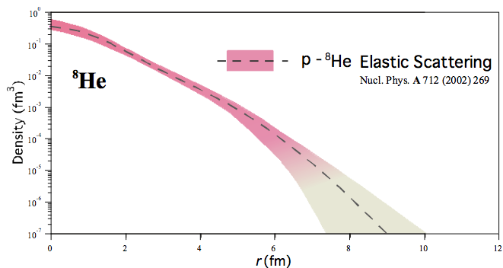
Neutron rich nucleus ⁸He
σ_{I} at high energy [*]
(790MeV/nucleon)
Elastic Scattering [**]
Large neutron radius
Nucleon density distribution of ⁸He
[**]
Structure ?
[*] ] I. Tanihata, et al., Phys. Lett. B 160 (1985) 380-384.
[**] A.A. Korsheninnikov, et al.,Nuclear Phys. A 617 (1997) 45-56.

Slide 5
Purpose of this study
Measurement of the σ_{R} for ⁸He and ¹⁴B
① on nucleus targets
② on proton targets
at intermediate energies
Obtaining the information of
proton and neutron density distributions respectively
from σ_{R} on nucleus and proton targets.

Slide 6

Set up
Production Target(F0)
D1
Degrader
Beam
HIMAC in Chiba (Japan)
SB2 Course
F1PL
Upstream
Slit
D2
¹⁴B 130, 110, 85, 60MeV/nucleon
Primary beam ¹⁸O, ¹⁵N 160AMeV
F0 Target Be 3.0, 0.55g/cm²
Slit
At F3 Focal Plane
Go to F3 focal plane
⁸He 125, 110, 80, 65MeV/nucleon
Primary beam ¹¹B 160AMeV
F0 Target Be 3.7, 9.2g/cm²
Bρ − TOF − ΔE
ΔE
ΔE − E
TOF
ΔE
Measurement of σ_{R}
Transmission method
F1PL
F3PL
CsI(Tl)
E
VETO
Si
NaI(Tl)
Reaction target: Be, C, Al, CH₂
Proton=(CH₂ − C)/2
Reaction Target
PPAC

Slide 7
Glauber calculation
Obtain this information
Nucleon-Nucleon
total cross section (＊)
Density distribution
of projectile nucleus.
(Model density)
Density distribution
of target nucleus
Nucleon-nucleon total cross section σ_{NN} (＊)
Nucleus target
Proton target
ρ_{Ν} of ¹⁴B, ⁸He
ρ_{n}, ρ_{p} of ¹⁴B, ⁸He
with
Modified Optical Limit approximation.
＊(http://pdg.lbl.gov/2010/hadronic-xsections/hadron.html)

Slide 8
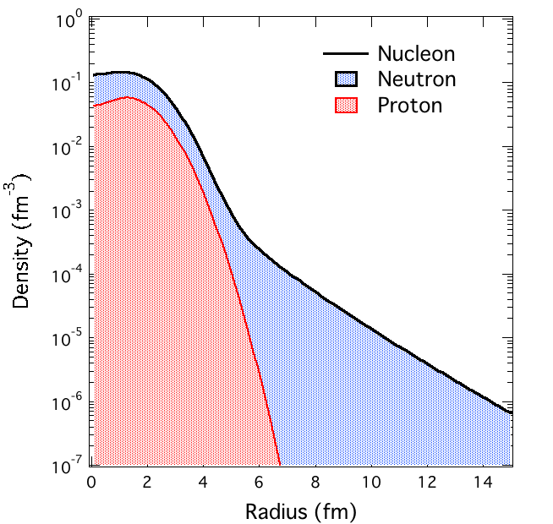
Derivation of proton and neutron density distributions ρ_{p}, ρ_{n}
χ² fitting with the width of ρ_{p} as a free parameter.
ρ_{Nucleon}
From
σ_{R} on nucleus target
ρ_{n} is deduced by subtraction.
ρ_{n}=ρ_{N}− ρ_{p}

Slide 9
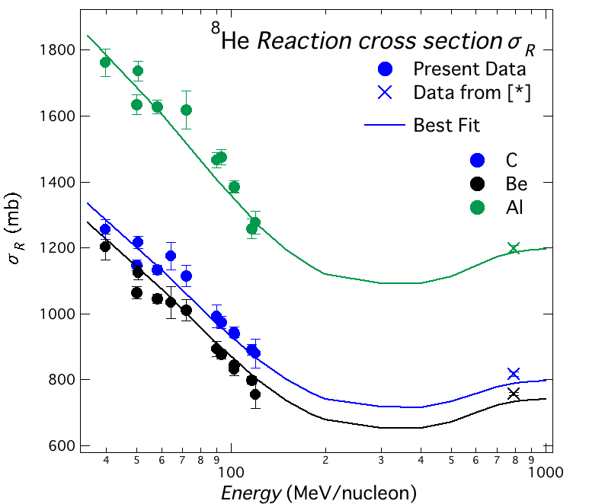
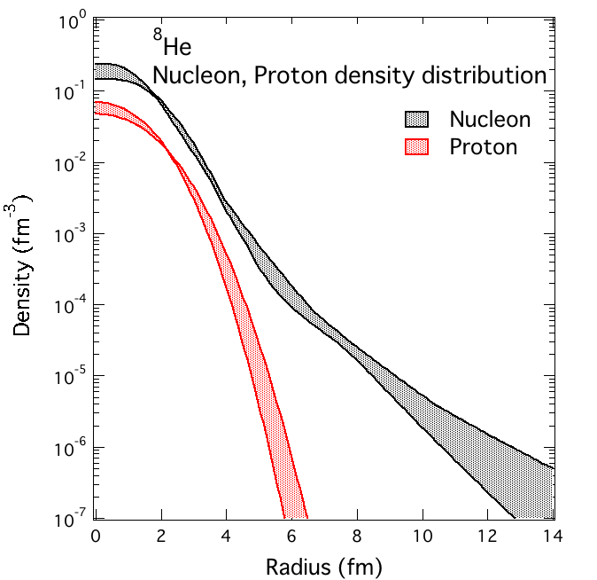
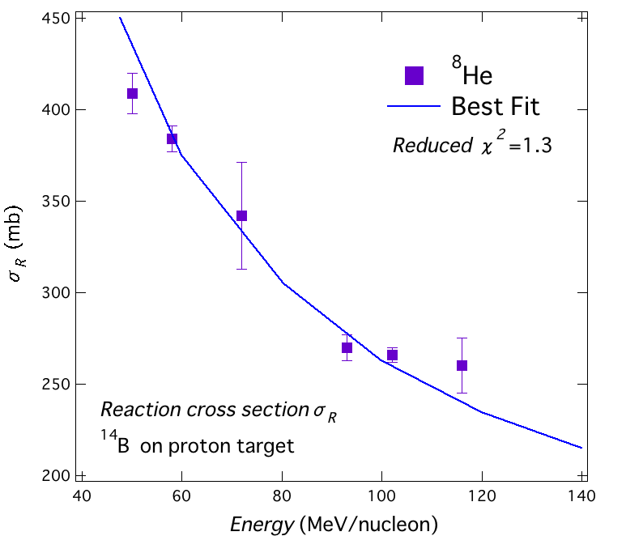
ρ_{p} and ρ_{n} of ⁸He
σ_{R}(E) on nucleus target
ρ_{p}(R) and ρ_{N}(R)
σ_{I} @ LBL [*]
σ_{R}(E) on proton target
[*] I. Tanihata, et al., Phys. Lett. B 160 (1985) 380-384

Slide 10
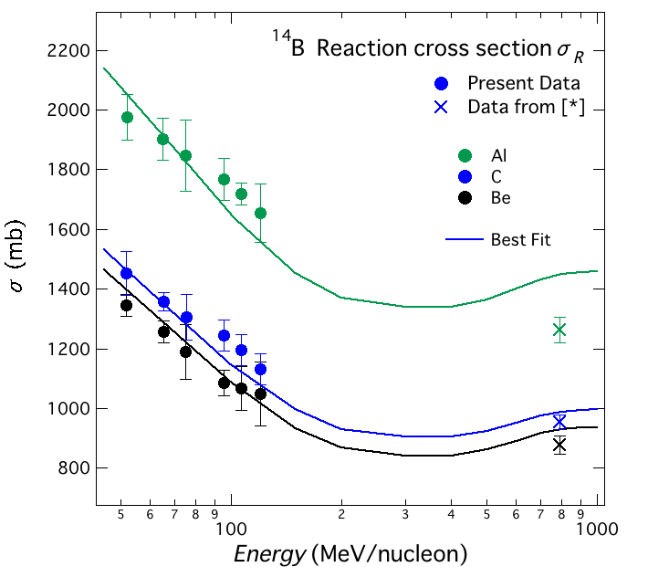
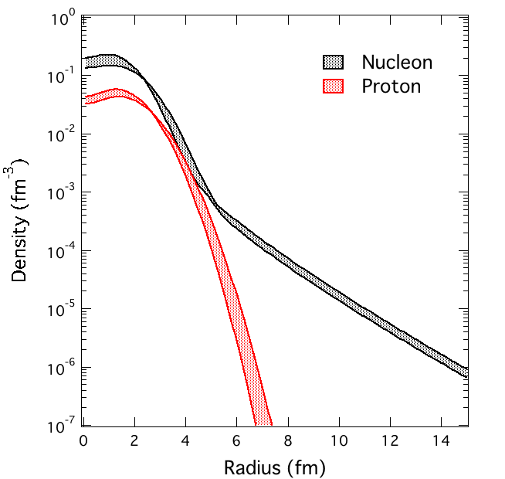
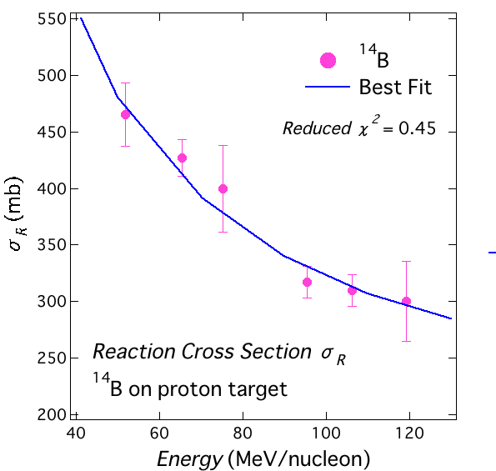
ρ_{p} and ρ_{n} of ¹⁴B
σ_{R}(E) on nucleus target
ρ_{p}(R) and ρ_{N}(R)
σ_{I} @ LBL [*]
Neutron tail
σ_{R}(E) on proton target
[*] I. Tanihata, et al., Phys. Lett. B 206 (1988) 592-596

Slide 11
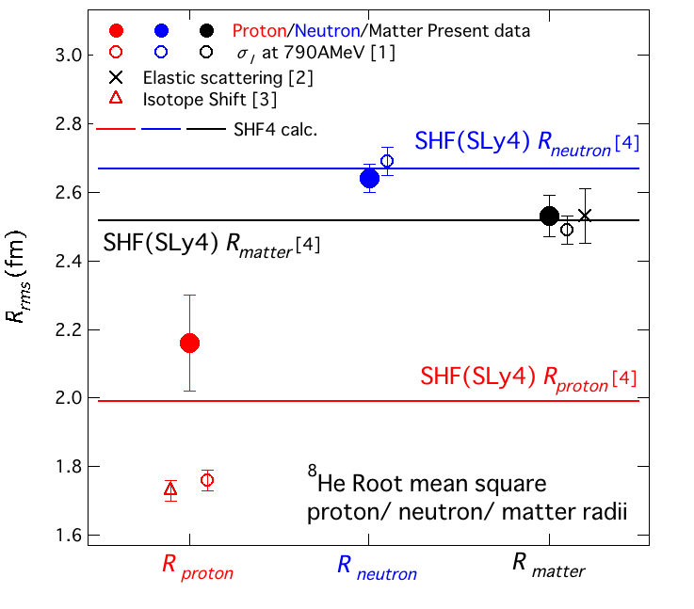
⁸He root mean square radii
R_{proton}, R_{neutron}, R_{matter}
[1] I. Tanihata et al., Phys. Lett. B 289, (1992) 261-266.
[2] G. D. Alkhazov et al., Nucl. Phys. A. 712, (2002) 269-299
[3] M. Puchalski et al., Hyperfine Interact (2010) 196:35-42
[4] R. Baldik et al., Phys. of Atomic Nuclei (2010) Vol. 73, No. 1 74-80

Slide 12
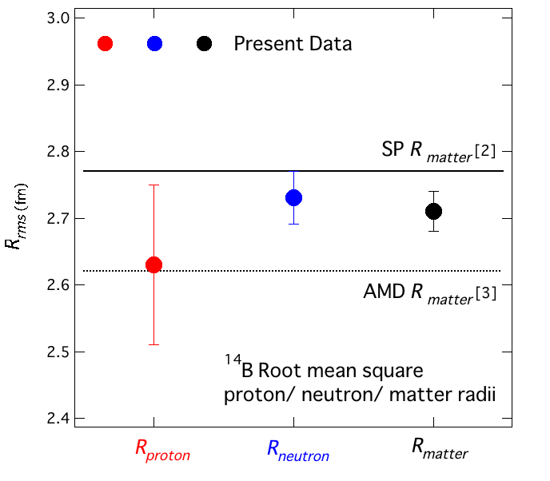
¹⁴B root mean square radii
R_{proton}, R_{neutron}, R_{matter}
Preliminary
[2] A. Bhagwat et al., Eur. Phys. J. A. 8, 511-520 (2000)
[3] H. Takemoto et al. Phys. Rev. C. 63. 034615
Notes:
proton=5%, neutron, matter=1.5%

Slide 13
Summary
We measured σ_{R} for ⁸He and ¹⁴B on nucleus and proton targets at the HIMAC heavy ion synchrotron facility.
ρ_{p} and ρ_{n} were separated successfully through the χ² fitting procedure with the modified Glauber calculation.
R_{p}, R_{n}, R_{matter} were derived from ρ_{p}, ρ_{n} and ρ_{N}.
As a future prospect, we will finalize the data analysis. And we deduce more accurate ρ_{p}, ρ_{n} of ⁸He and ¹⁴B, then make a detailed discussion on their structures.

Slide 14
Sub

Slide 15
Relation between Reaction cross section(σ_{R}) and density distribution
Energy dependence of σ_{R}
on Nucleus target
Nucleon density distribution ρ_{N}
p-n symmetric target
σ_{R}
It is impossible to clarify
a composition of the surface
by means of σ_{R}
on p-n symmetric target.
High energy →The inner part of nucleus
Low energy →The outer part of nucleus

Slide 16
Measurement of σ_{R}
〜Transmission method〜
Detector１
Reaction
target
Detector２
Incident particles
Non-reacted particles
N₁^{in}
N₂^{in}
Target thickness
t
Reation target out
Detector１
Detector２
Incident partices
Non-reacted particles
N₁^{out}
N₂^{out}
Correction for reactions in the detector.

Slide 17

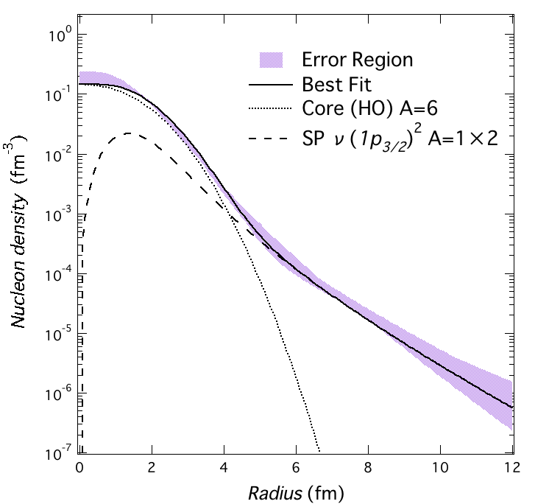
ρ_{N} of ⁸He
The core is not a “bare” ⁶He.
(⁶He is a halo nucleus.)
Best Fit
Core: Z=2, N=4
Tail: 2nucleons (1p_{3/2} orbit)
S_{2n}=2.14MeV
Best Fit is 1p3/2 2nucleon
with B.E= 3MeV

Slide 18
Single particle density calculation
Calculate SP density with adjusting
the potential depth to reproduce
Binding energy.
Binding Energy
Best Fit Results
¹⁴B
2s_{1/2} orbit with B.E=0.97MeV
(consistent with S_{1n}=0.97MeV)
⁸He
1p_{3/2} orbit with B.E=3MeV
(inconsistent with S_{1n}=3MeV)
Woods-Saxon
Coulomb
Centrifugal Potential

Slide 19
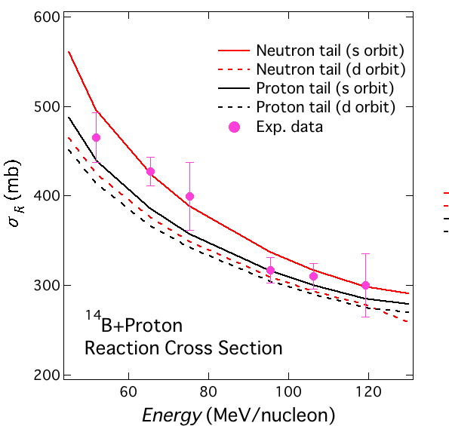
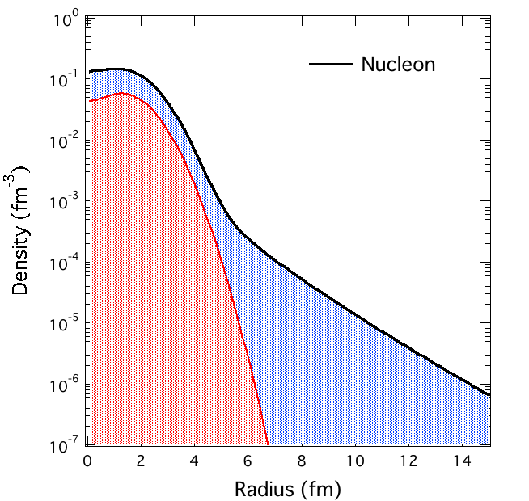
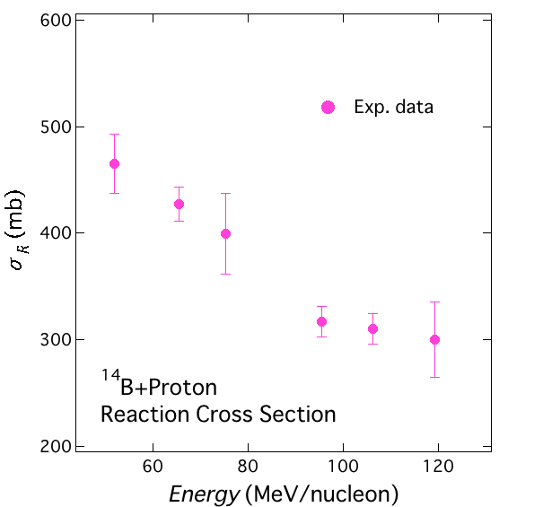
¹⁴B
Comparison between Exp. and Calc. value
Tail
Neutron or Proton
Orbit
2s_{1/2} or 1d_{5/2}
Tail
Neutron or Proton
Orbit
2s_{1/2} or 1d_{5/2}
Notes:
5,4,8,4,4,11%

Slide 20
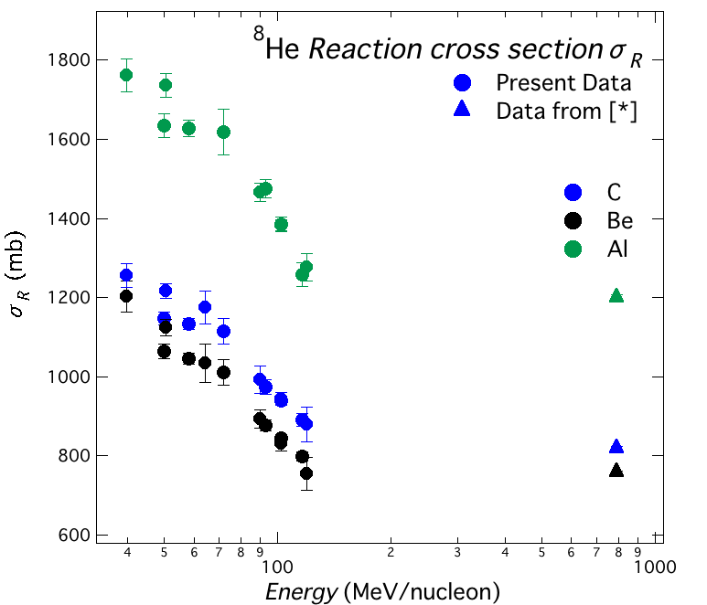
σ_{R} for ⁸He on nucleus targets
σ_{I} @ LBL
(Tanihata et al.)
Preliminary
[*] I. Tanihata, et al., Phys. Lett. B 160 (1985) 380-384.

Slide 21
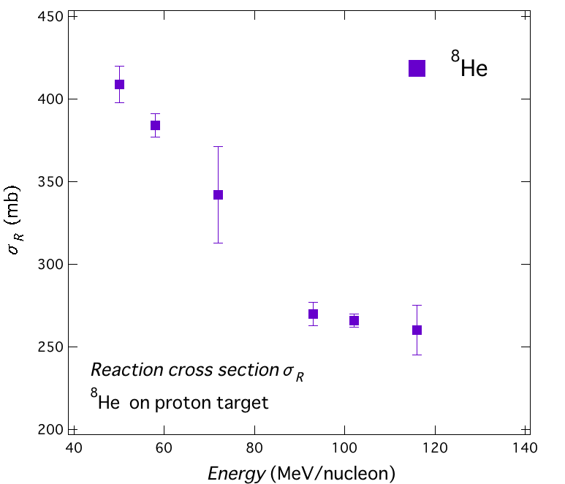
σ_{R} for ⁸He on proton targets
σ_{R}^{H}=(σ_{I}^{CH2}−σ_{I}^{C})/2

Slide 22
σ_{R} on proton target
Determined by subtracting the σ_{I}^{C} from σ_{I}^{CH2}.
CH₂ : Polyethylene
Measurement of
interaction cross section σ_{I}
on C, CH₂ targets.
Notes:
相互作用断面積の引き算では相互作用断面積が導出されるが、陽子標的は安定で壊れにくいため、

Slide 23
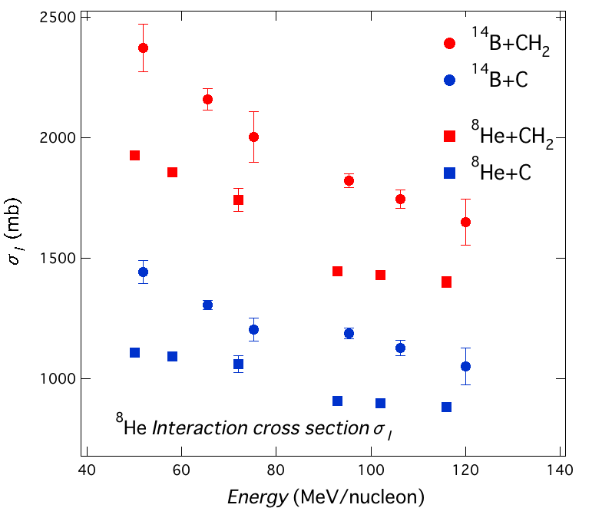
σ_{I} for ¹⁴B, ⁸He on C, CH₂ targets.

