Slide 1
Ground-State Properties of Mg Isotopes in and beyond the Island of Inversion through Reaction Cross Sections
S. Watanabe
^{A}K. Minomo, M. Shimada, S. Tagami, ^{B}M. Kimura,
^{C}M. Takechi, ^{D}M. Fukuda, ^{E}D. Nishimura, ^{F}T. Suzuki,
T. Matsumoto, Y. R. Shimizu, and M. Yahiro
Kyushu Univ., ^{A}RCNP, ^{B}Hokkaido Univ., ^{C}Nigata Univ.,
^{D}Osaka Univ., ^{E}Tokyo Univ. of Sci., ^{F}Saitama Univ.
2/June/2014
Advances in Radioactive Isotope Science (ARIS2014)
the University of Tokyo

Slide 2
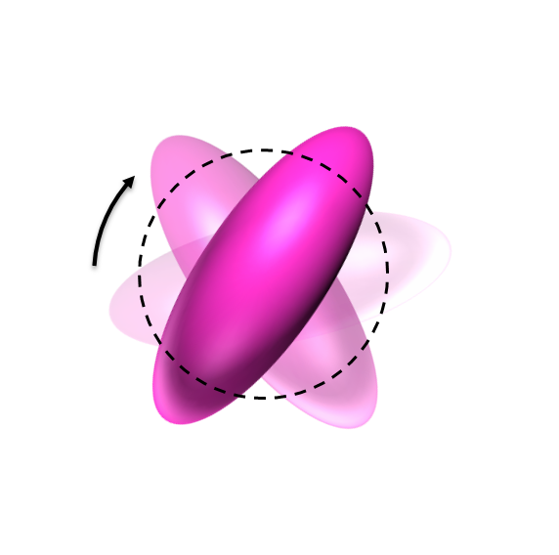
Nuclear deformation
1/12
Usually, the deformation strength $\left|β_{2}\right|$ is determined from transition probabilities.
$$4_{1}^{+}$$
rotation
$$2_{1}^{+}$$
E2
$$0_{gs}^{+}$$
Measurements for unstable nuclei are not easy.
$E(2+)$
$E(4+)$
$R_{4/2}=E(4+)/E\left(2+\right)$

Slide 3
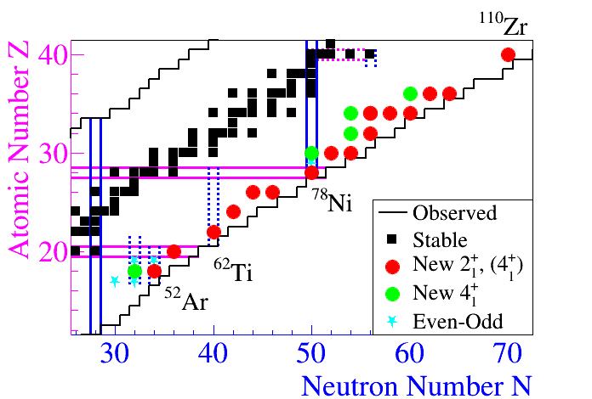
Systematic measurement
2/12
E(2+) and E(4+) were measured, for example, for Mg isotopes.
P. Doornenbal et al., PRL111, 212502 (2013).
Systematic measurements for E(2+), E(4+) are quite important
to clarify the structure of unstable nuclei such as magicity.
for example
SEASTAR project
Shell Evolution And Search for Two-plus energies At RIBF
http://www.nishina.riken.jp/collaboration/SUNFLOWER/experiment/seastar/index.html
Systematic measurements of σ_{R} in addition to E(2+) and E(4+)

Slide 4
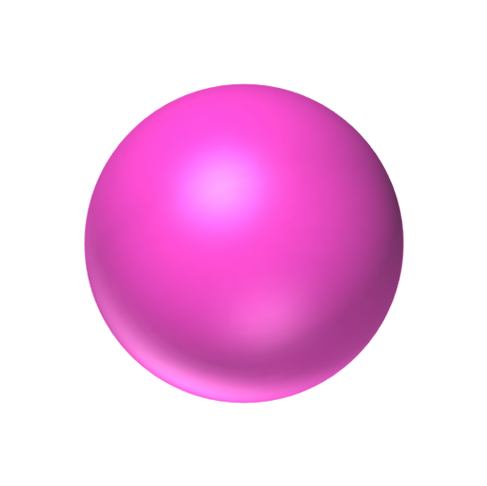
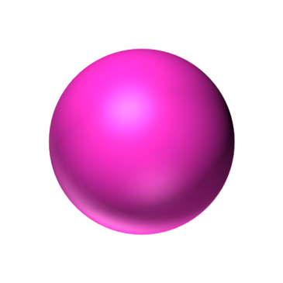
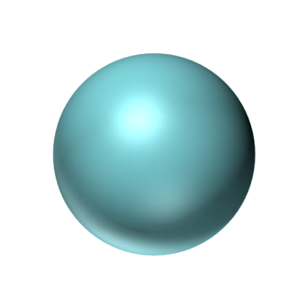
Deformation and σ_{R}
3/12
Nuclear deformation can be determined from σ_{R}.
cf. Angular Momentum Projection
$$σ_{R}≒π{\left(R_{P}+R_{T}\right)}^{2}$$
$$R_{P}$$
$$R_{T}$$
Projectile
（Spherical）
Projectile
(Deformed)
Target（¹²C）
Deformation enhances σ_{R}.

Slide 5
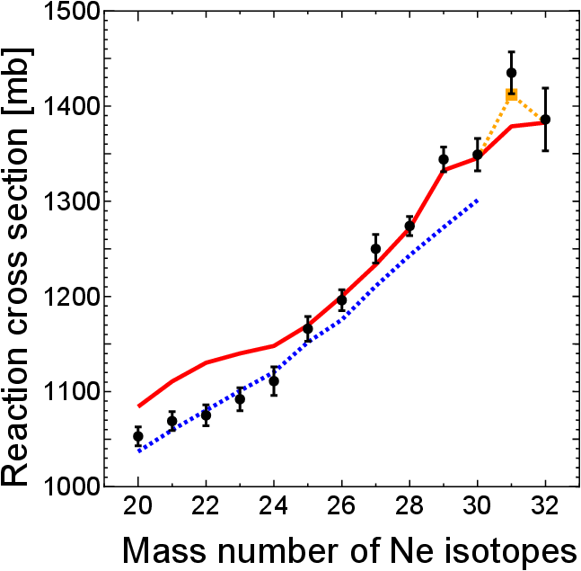
Recent studies for ₁₀Ne isotopes
4/12
Experiment
σ_{I} for ²⁰⁻³²Ne were measured systematically.
M. Takechi et al., PLB 707, 357 (2012).
²⁰⁻³²Ne + ¹²C at 240MeV/nucleon
Theory
σ_{I} were analyzed theoretically.
AMD-RGM
AMD + Double Folding Model
island of inversion
K. Minomo et al., PRL 108, 052503 (2012).
Skyrme-HF + Glauber
AMD
W. Horiuchi et al., PRC 86, 024614 (2012).
W. Horiuchi, PS1-B008 (June 3)
spherical-HF
Particle Rotor Model + Glauber
Y. Urata et al., PRC 86, 044613 (2012).
$$β_{2}∼0.2$$
$$β_{2}∼0.4$$
²⁹⁻³²Ne: Large deformation
³¹Ne: Deformed halo
Exp. M. Takechi et al., PLB 707, 357 (2012).

Slide 6
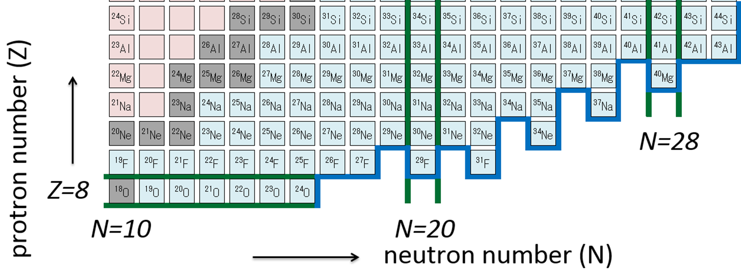
Motivation 1 (by measurements)
5/12
In this talk, I analyze Mg isotopes from 24 to 40 with the microscopic framework.
Since, in the isotopes, precise measurements were recently made not only for σ_{R} but also for E(2+) and E(4+).
M. Takechi et al., EPJ Web of Conferences 66, 02101 (2014).
P. Doornenbal et al., PRL111, 212502 (2013).
²⁴⁻⁴⁰Mg

Slide 7
Motivation 2 (theoretical points)
6/12
Microscopic framework
AMD
Double Folding Model
Measurements
σ_{R}
E(2+) and E(4+)
N=20 magicity?
N=28 magicity?
²⁴⁻⁴⁰Mg
Island of Inversion

Slide 8
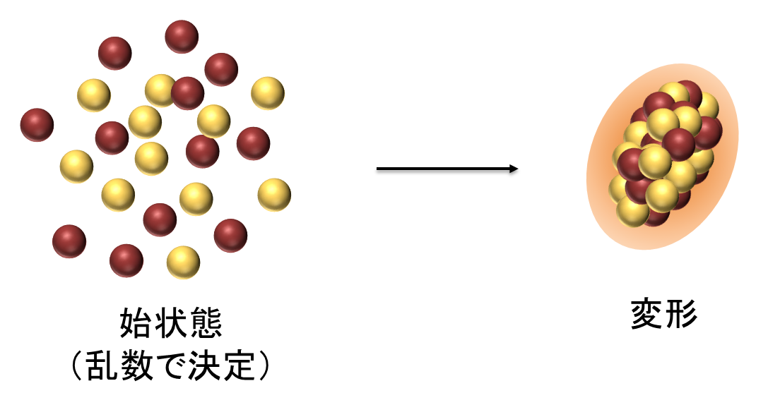
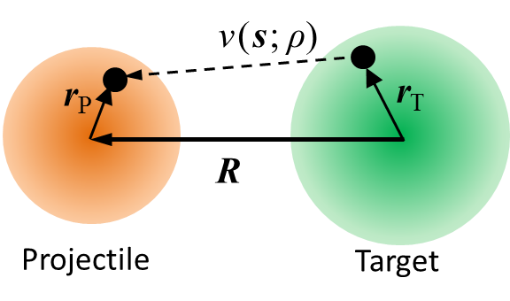
Microscopic framework
7/12
AMD
(Antysimmetrized Molecular Dynamics)
DFM
(Double Folding Model)
Projectile densities
Optical potentials
Energy
variation
Initial state
Deformed density
Projectile
Target (¹²C)
Gogny D1S
Angular Momentum Projection
Generator Coordinate Method
Melbourne g-matrix
$$U\left(R\right)=\int{ρ_{P}\left(r_{P}\right)ρ_{T}\left(r_{T}\right)v\text{(}\text{s}\text{;} ρ\text{)} {dr}_{P}{dr}_{T}}$$
Masaaki Kimura, (Next speaker)
Shape Coexistence in the vicinity of ⁴⁴S
We calculate various observables microscopically.

Slide 9
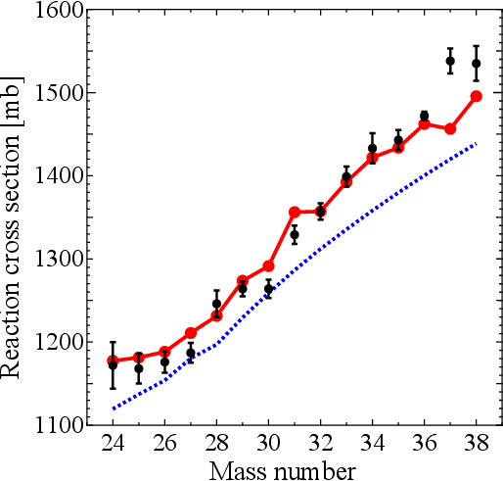
Results: σ_{R} for Mg (Z=12)
8/12
^{A}Mg+¹²C, E_{lab}=240MeV/nucleon
Deformation effect is significant for σ_{R}.
³⁷Mg?
due to
deformation
AMD well reproduces the measured σ_{R}.
AMD
(w/ deformation)
For ³⁷Mg, AMD underestimates the experimental data.
spherical-HF
(w/o deformation)
“Deformed halo”?
Maya Takechi, PS2-A017
in Poster Session 2 (June 5)
Exp. M. Takechi, EPJ Web of Conferences 66, 02101 (2014).

Slide 10
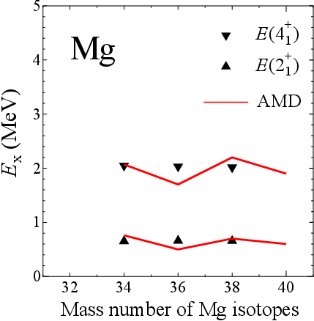
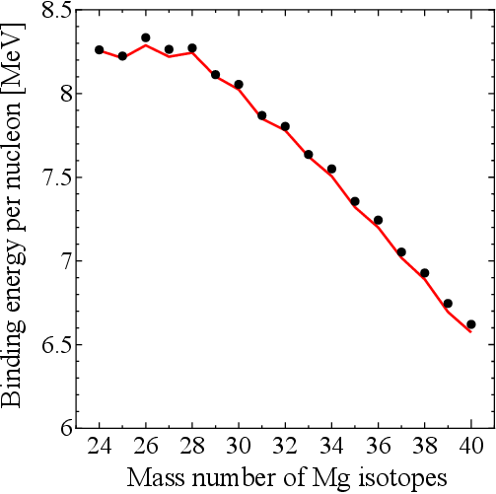
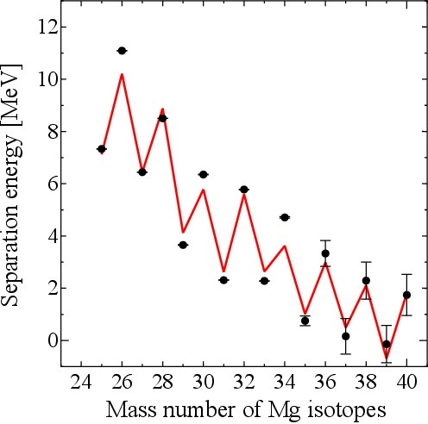
AMD results for Mg isotopes
9/12
AMD is applied to calculate E(2+), E(4+), B.E./nucleon, and S_{n}.
preliminary
E(4+)
B.E./nucleon
E(2+)
Exp. P. Doornenbal et al., PRL111, 212502 (2013).
S_{n}
AMD is highly reliable particularly for β₂.
Exp. G. Audi et al., Chin. Phys. C 36, 1157 (2012).

Slide 11
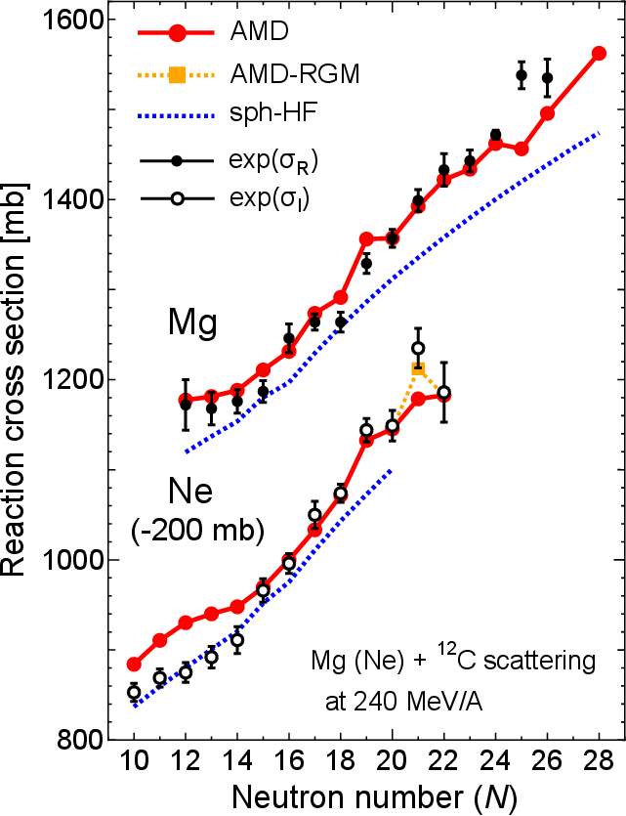
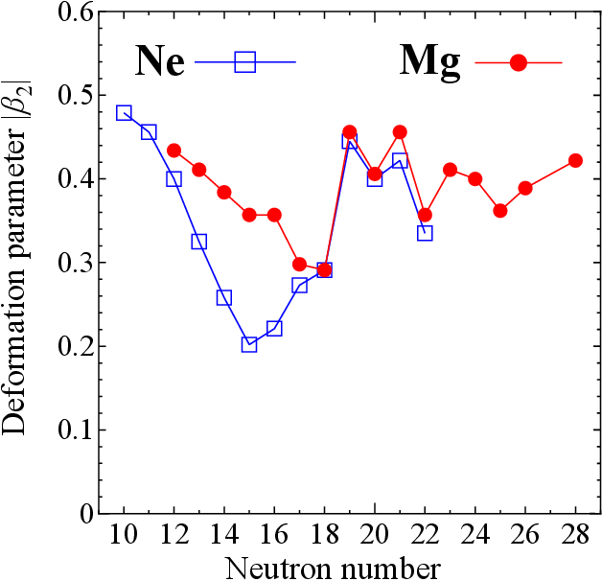
β₂ for Ne and Mg isotopes
10/12
N=20
N=28
N=20
N=28
Peninsula of
large deformation
12
Deformation by AMD
10
Big jump of σ_{R} from N=18 to 19
From big jump of β₂
Entrance of the island of inversion
Deformation keeps large upto N=28.
Consistent with E(4+)/E(2+)〜3.1
P. Doornenbal et al., PRL111, 212502 (2013).
Exp. M. Takechi, EPJ Web of Conferences 66, 02101 (2014).
“Peninsula of large deformation”
M. Takechi et al., PLB 707, 357 (2012).

Slide 12
Peninsula of large deformation
11/12
N=20 magicity?
N=28 magicity?
Peninsula of
large deformation
N=20 and N=28 magicities may disappear.

Slide 13
Summary
12/12
We have analyzed Mg isotopes with the microscopic framework.
As an experimental tool of probing the deformation strength, measurements of σ_{R} are also quite useful in addition to measurements of 2+ and 4+ excitation energies. ​
AMD calculations reproduce experimental data on σ_{R}, E(2+) and E(4+), B.E. and S_{n} systematically. Therefore, AMD is highly reliable.
AMD calculations show that the island of inversion starts with N=19 and there exists a “peninsula of large deformation” between N=19 to 28.

