Slide 1
Collinear Laser Spectroscopy @ ISOLDE
Spins, Moments, and Radii of ¹⁰⁰⁻¹³⁰Cd
by High-Resolution Laser Spectroscopy
D. T. Yordanov¹, D. L. Balabanski², M. L. Bissell³, K. Blaum¹, I. Budinčević³, B. Cheal⁴,
K. T. Flanagan⁴, N. Frömmgen⁵, G. Georgiev⁶, Ch. Geppert^{5,7}, M. Hammen⁵, M. Kowalska⁸,
K. Kreim¹, A. Krieger⁵, R. Neugart⁵, G. Neyens³, W. Nörtershäuser^{5,9},
J. Papuga³, M. M. Rajabali³, R. Sánchez¹⁰, S. Schmidt⁹
¹Max Planck Institute for Nuclear Physics, Saupfercheckweg 1, 69117 Heidelberg, Germany
²INRNE, Bulgarian Academy of Science, BG-1784 Sofia, Bulgaria
³Instituut voor Kern- en Stralingsfysica, KU Leuven, B-3001 Leuven, Belgium
⁴School of Physics and Astronomy, The University of Manchester, Manchester M13 9PL, UK
⁵Institut für Kernchemie, Universität Mainz, D-55099 Mainz, Germany
⁶CSNSM-IN2P3-CNRS, Université de Paris Sud, F-91405 Orsay, France
⁷Helmholtz Institute Mainz, D-55099 Mainz, Germany
⁸Organisation Européenne pour la Recherche Nucléaire, CH-1211 Geneva 23, Switzerland
⁹GSI Helmholtzzentrum für Schwerionenforschung GmbH, D-64291 Darmstadt, Germany

Slide 2
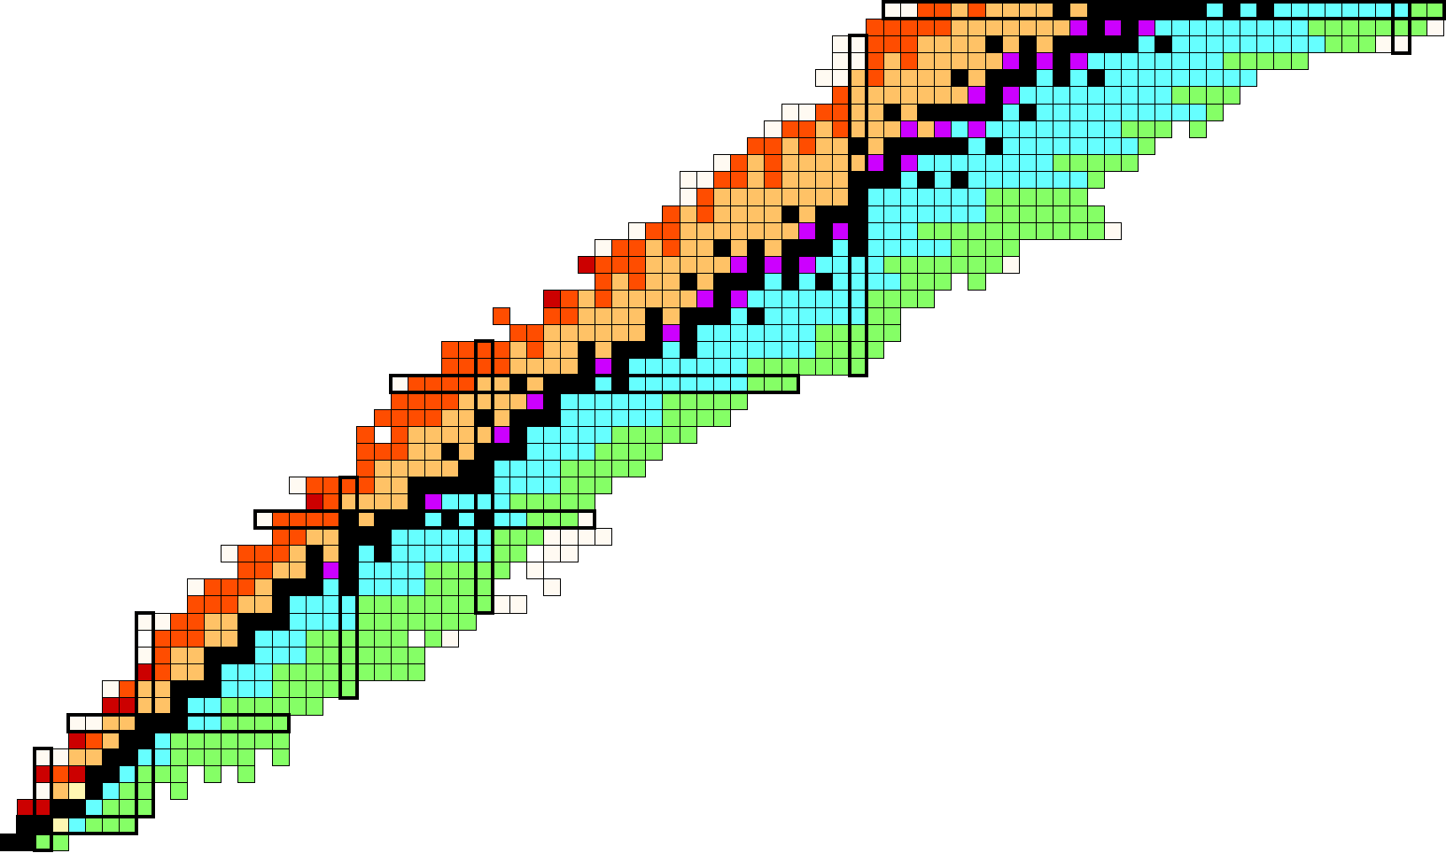
Nuclear chart
50
Cd
82
Spherical Shell Model
Z
28
1h_{9/2}
92
50
N
20
1h
82
28
1h_{11/2}
82
3s
3s_{1/2}
70
8
2d_{3/2}
68
20
2d
2d_{5/2}
64
2
1g_{7/2}
58
8
2
1g
50
1g_{9/2}
50

Slide 3
Collinear Laser Spectroscopy @ ISOLDE
Outline
Physics interest in the Cd isotopes
Laser spectroscopy with bunched beams
Frequency quadrupling
Shell structure from μ and Q moments
Charge radii

Slide 4
Physics case
Perspectives for laser spectroscopy in the Sn region
ground and isomeric state properties of ¹⁰⁰⁻¹³⁰Cd
¹⁰⁰Sn
¹³²Sn
rp process
r process
more accurate theoretical lifetimes of the N=82 isotones below ¹²⁹Ag
shell quenching vs. deformation
shell effect in the radii

Slide 5
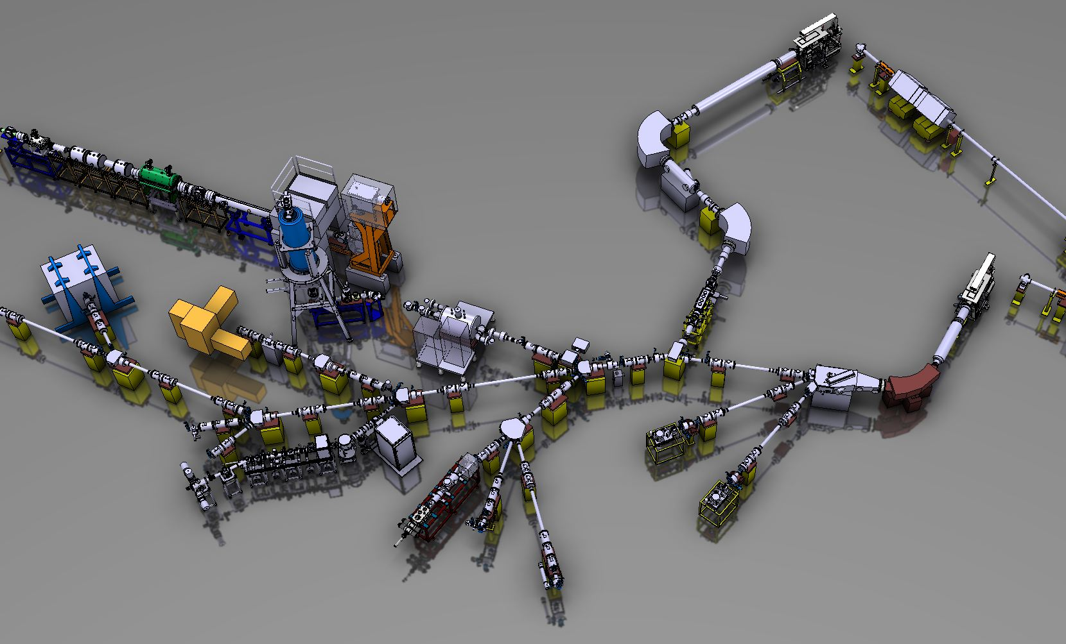
RILIS
HRS
p+
ISCOOL
GPS
COLLAPS
ARIS, Tokyo 2014

Slide 6
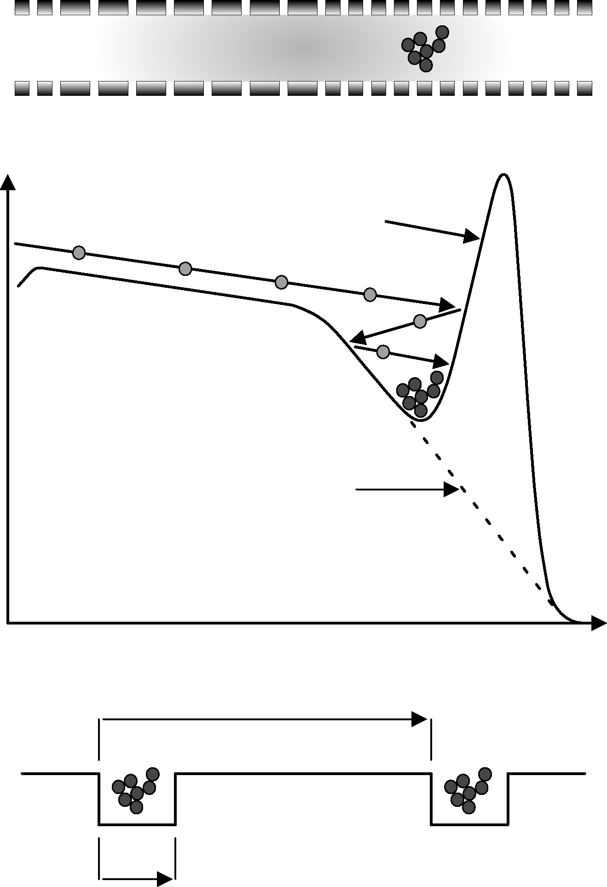
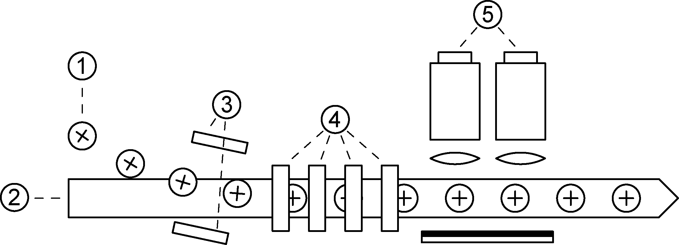
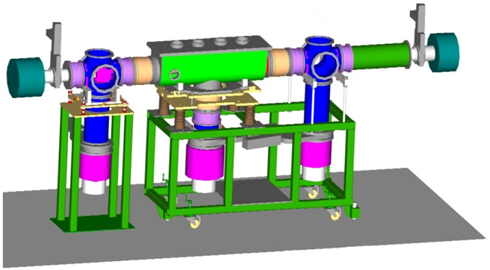
Experimental technique
Bunched-beam fluorescence of ¹⁰⁰⁻¹³⁰Cd
COLLAPS
1.) ion beam;
2.) laser;
3.) deflection plates;
4.) post acceleration;
5.) optical detection
accumulation
release
T₁
ISCOOL - ISOLDE RFQCB
T₂ ≈ T₁ / 10⁴

Slide 7
Experimental technique
Bunched-beam fluorescence of ¹⁰⁰⁻¹³⁰Cd
5p ²P_{3/2}
5p ²P_{1/2}
Cd ion
accumulation
D₁
D₂
215 nm, 2.8×10⁸ s⁻¹
227 nm, 3×10⁸ s⁻¹
release
5s ²S_{1/2}
T₁
ISCOOL - ISOLDE RFQCB
T₂ ≈ T₁ / 10⁴

Slide 8
Laser system for 215nm
215 nm
430 nm
860 nm
ARIS, Tokyo 2014

Slide 9
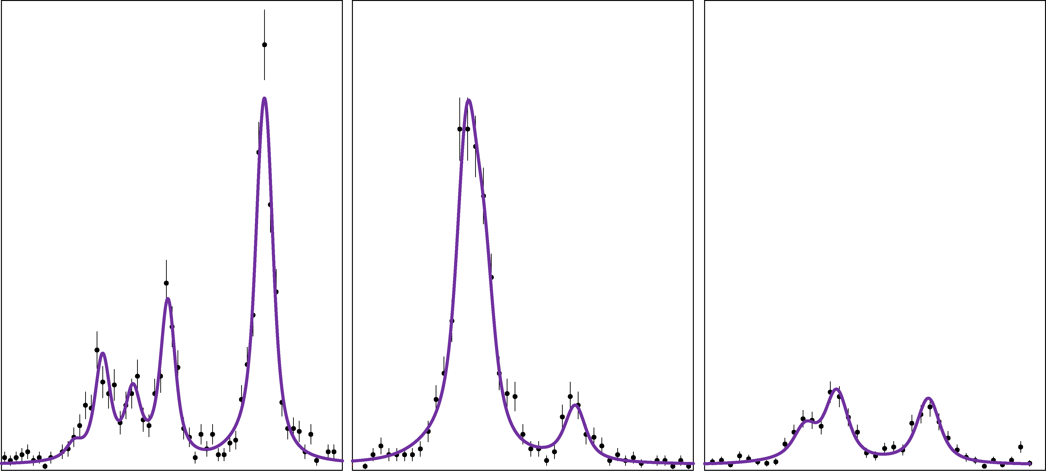
Experimental results
Discovery of a long-lived isomeric state in ¹²⁹Cd
I.
II.
III.
¹²⁹Cd
g.s. + isomer
# counts
Isotope shift relative to ¹¹⁴Cd

Slide 10
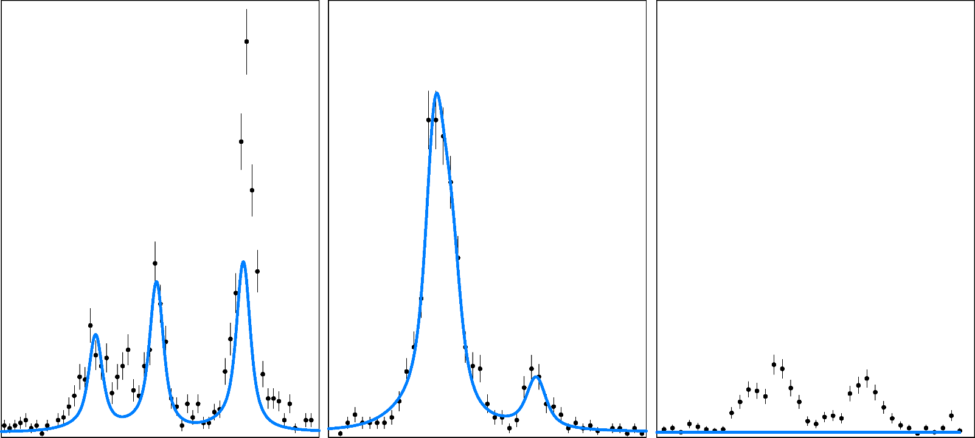
Experimental results
Discovery of a long-lived isomeric state in ¹²⁹Cd
I.
II.
III.
¹²⁹Cd, (11/2 ⁻)
# counts
Isotope shift relative to ¹¹⁴Cd

Slide 11
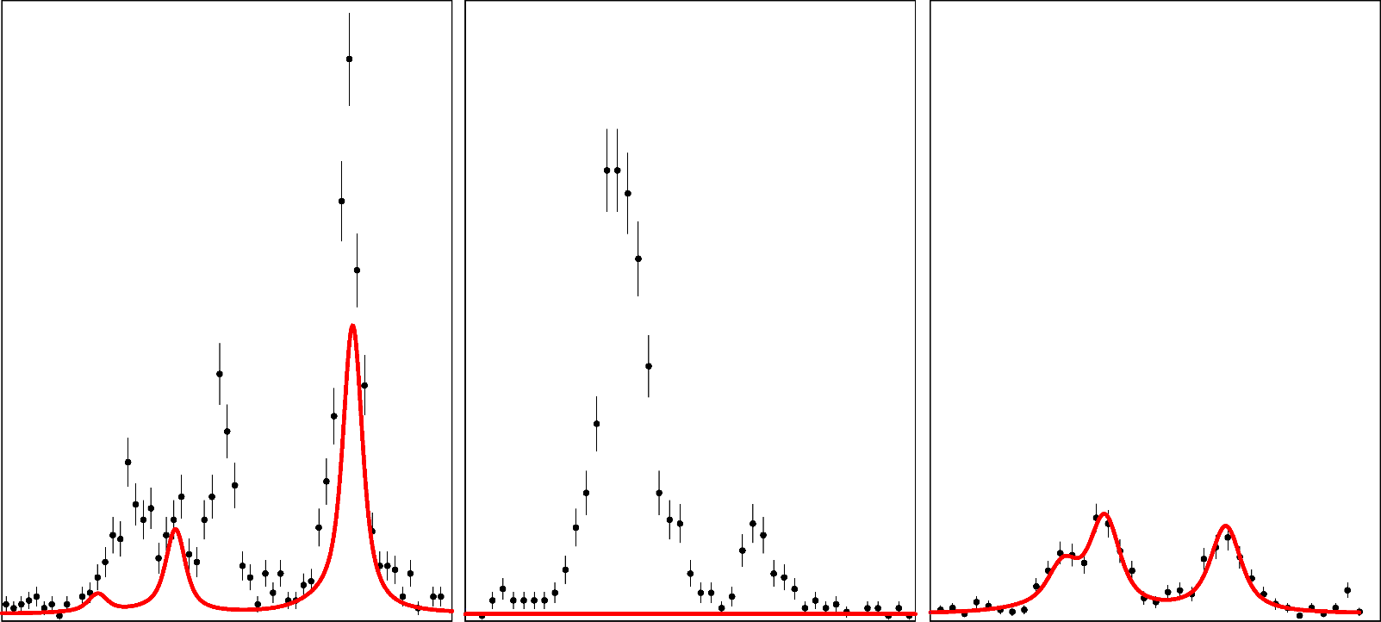
Experimental results
Discovery of a long-lived isomeric state in ¹²⁹Cd
I.
II.
III.
¹²⁹Cd, 3/2 ⁺
# counts
Isotope shift relative to ¹¹⁴Cd

Slide 12
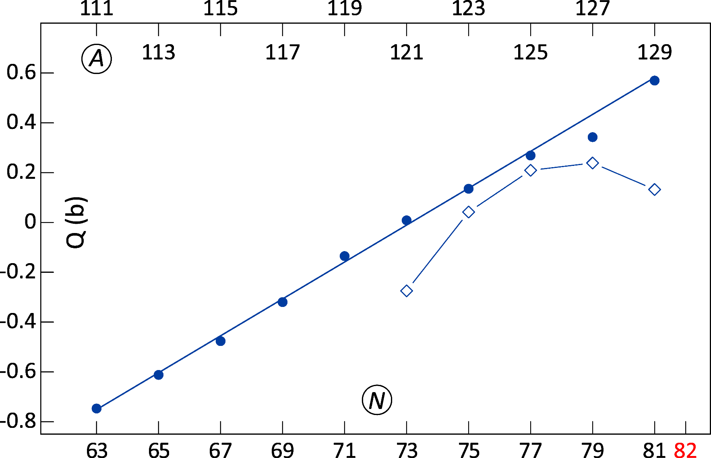
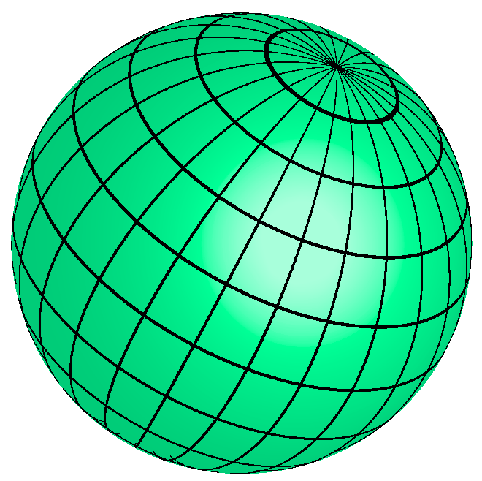
Experimental results
11/2 ⁻ states: extreme shell-model view
2j+1-2n
‹j ^{n}|Q|j ^{n}› = ‹j|Q|j›
2j-1
h_{11/2}
3/2 ⁺
Phys. Rev. Lett., 110, 192501 (2013)

Slide 13
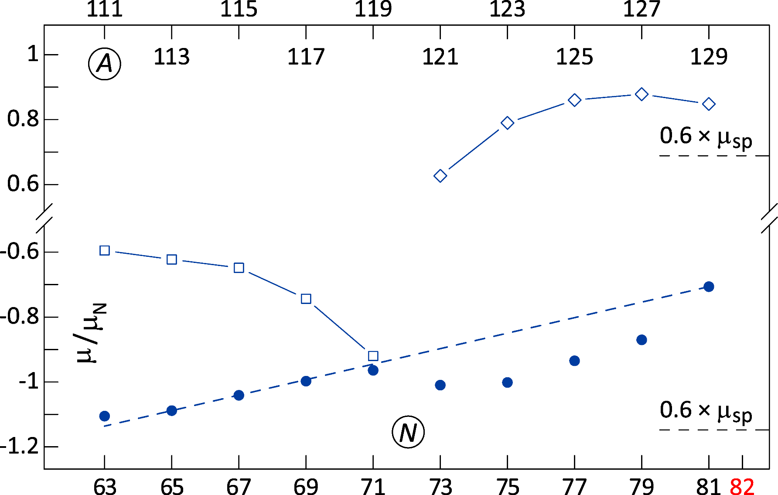
Experimental results
11/2 ⁻ states: extreme shell-model view
3/2 ⁺
1/2 ⁺
h_{11/2}
Phys. Rev. Lett., 110, 192501 (2013)

Slide 14
Collinear Laser Spectroscopy @ ISOLDE
Summary
Measured model independent I, μ, Q and ‹r²› of ¹⁰⁰⁻¹³⁰Cd
First direct observation of long-lived isomers in ^{127, 129}Cd
Linear behavior of the h_{11/2} Q moments in ¹¹¹⁻¹²⁹Cd
core polarization from magnetic moments
IAP

