Slide 1
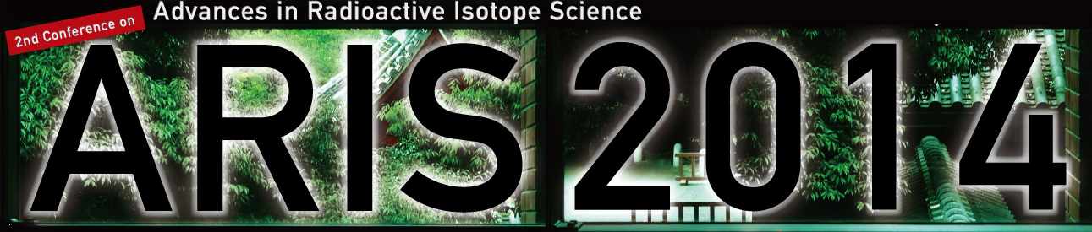
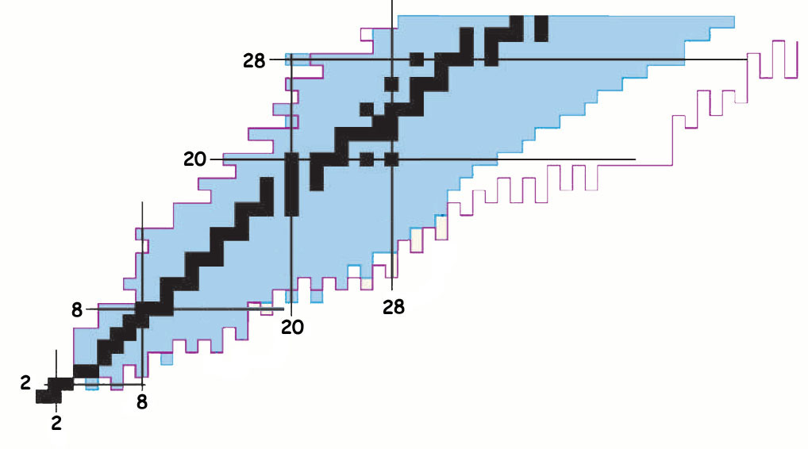
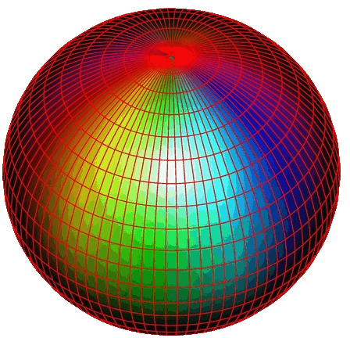
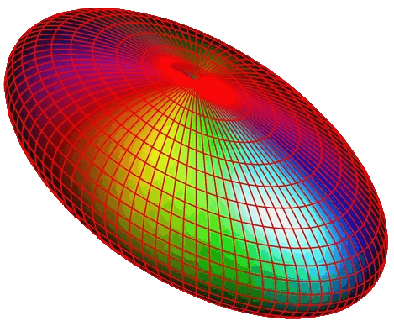


Properties of intruder states in ³⁴Al₂₁ and ³⁴Si₂₀
IFIN - Bucharest GANIL - Caen
CENBG - Bordeaux IPN - Orsay
Atomki - Debrecen FLNR - Dubna
NPI - Rez IPHC - Strasbourg
University of Madrid CEA - Bruyères-le- Châtel
ISOLDE - Geneva INFN - Padova
1- intruder 0⁺₂ state in ³⁴Si GANIL - E594 : beta decay of ³⁴Al
F. Rotaru et al., PRL109(2012)
2- intruder 1⁺ state in ³⁴Al ? ISOLDE - IS530 : beta decay of ³⁴Mg
R. Lica et al., under analysis
Stephane Grévy : grevy@in2p3.fr
June 2, 2014

Slide 2
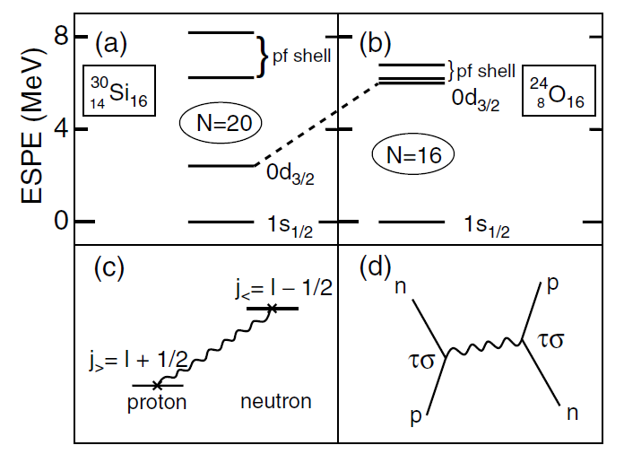
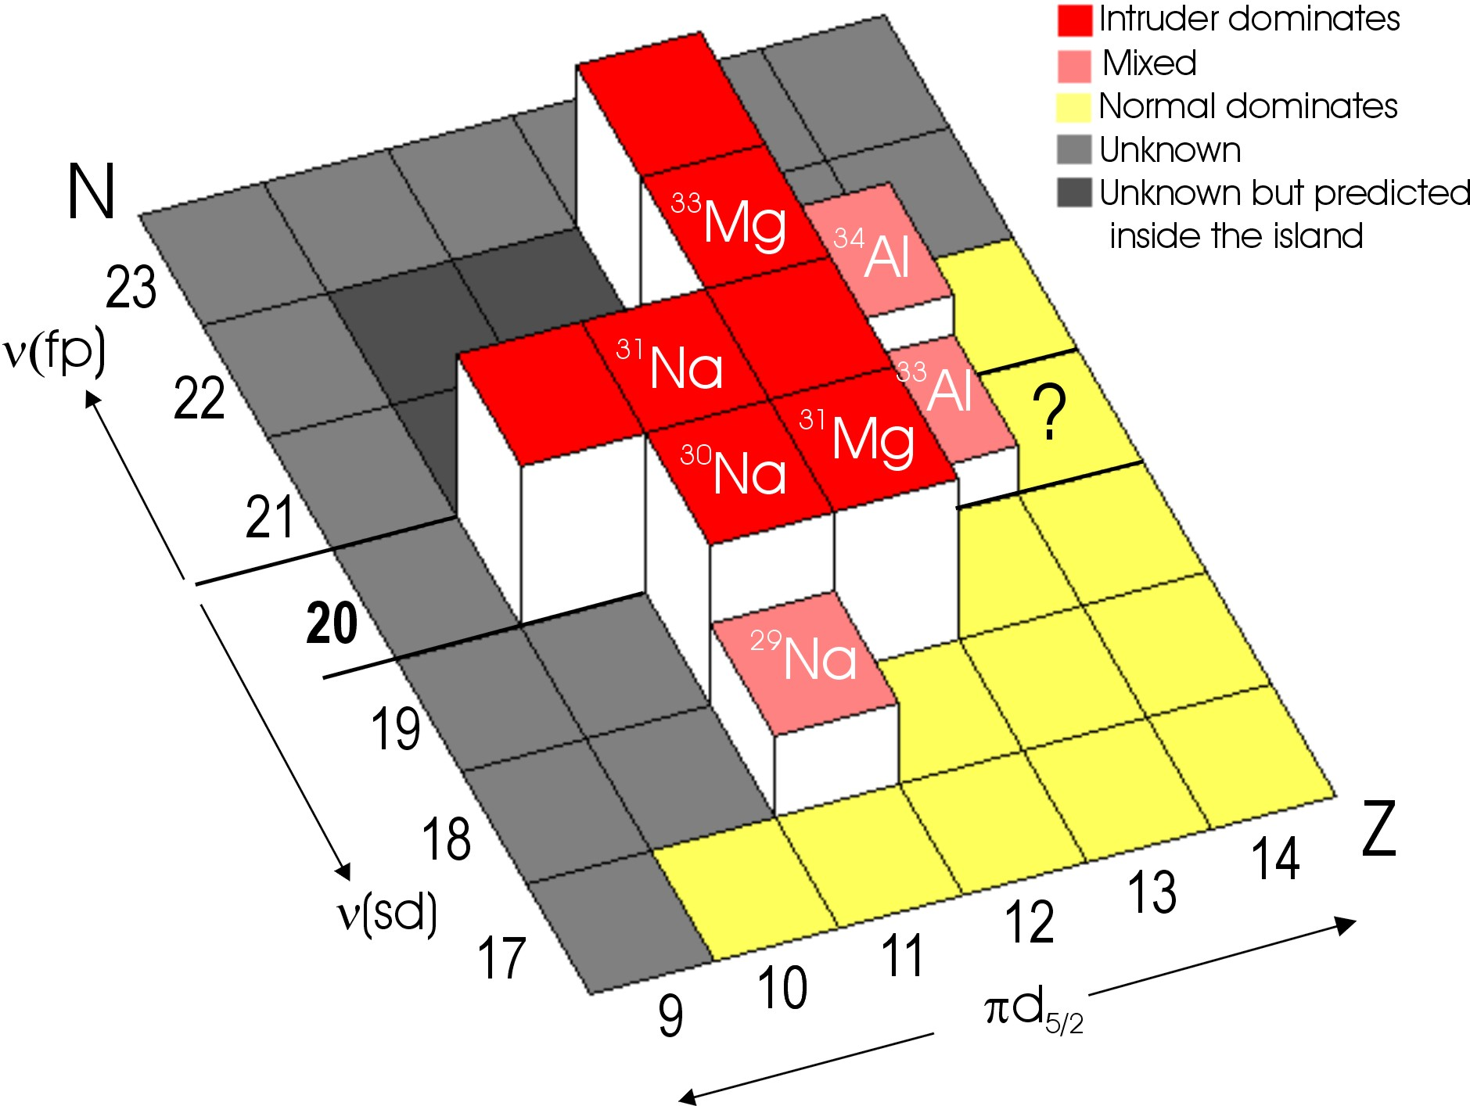
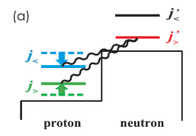
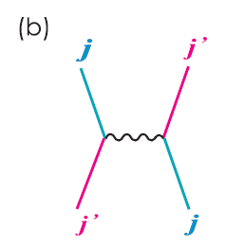
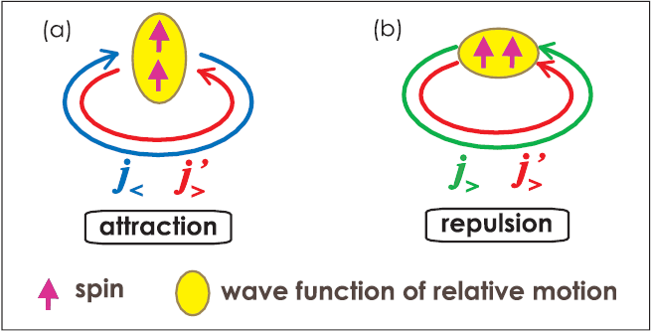
The "island of inversion" around ³²Mg
tensor part
³²Mg
³⁶S
³⁴Si
³⁰Mg
²⁸Mg
+ central part
Follow the evolution of the intruder configurations from the stability towards the Island of Inversion
→ Study the evolution of the excited 0⁺ states
Nħω
O⁺₂(³⁰Mg) :
W. Schwerdtfeger, PRL2009
Nħω
3346
5702
O⁺₂(³²Mg) :
K. Wimmer, PRL2010
?
2ħω
Nħω
1789
0ħω
0ħω
0ħω
1058
0ħω
0ħω
2ħω
²⁸Mg
³⁰Mg
³²Mg
³⁴Si
³⁶S
→ 0⁺₂ state in ³⁴Si : how the intruder configurations develop at N=20

Slide 3
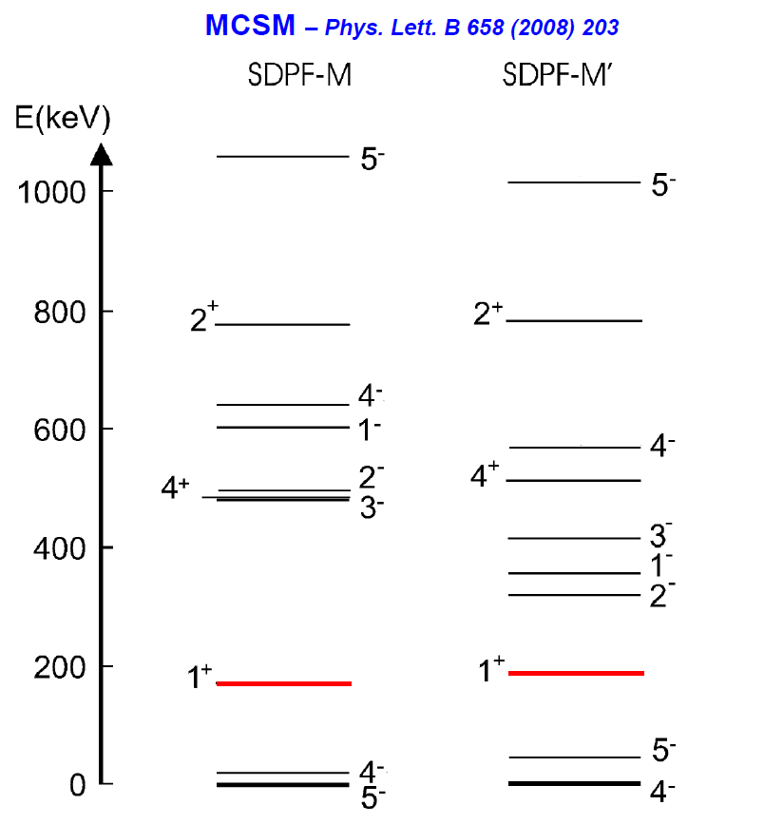
Search for the 0⁺₂ state in ³⁴Si
N=20
All experiments failed in this quest…
    → inelastic scattering, β-decay of ³⁴Al,…
⁴⁰Ca
2ħω
³⁸Ar
³⁴Si : 0⁺₂ deformed state → π(d_{5/2})⁶  ν(d_{3/2})⁻²(f7/2)⁺²
³⁴Si : 0⁺ ground state → π(d_{5/2})⁶  ν(d_{3/2})⁺⁴
³⁶S
³⁴Al : 4⁻ ground state → π(d_{5/2})⁵  ν(d_{3/2})⁺⁴(f7/2)⁺¹
³⁴Al : 1⁺ excited state (E~200 keV) → π(d_{5/2})⁵  ν(d_{3/2})⁻¹(f7/2)⁺²
³⁴Si
hypothesis :
the 0⁺₂ could be directly populated
through the β-decay of a predicted
isomeric 1⁺ state in ³⁴Al.
³⁴Al
³²Mg
Almost all the calculations predict
the 0⁺₂ state to be located below the 2⁺₁
³⁰Ne
decay by :
- internal pair creation
- internal conversion electron
[if E(0⁺₂) <1022 keV - not expected]

Slide 4
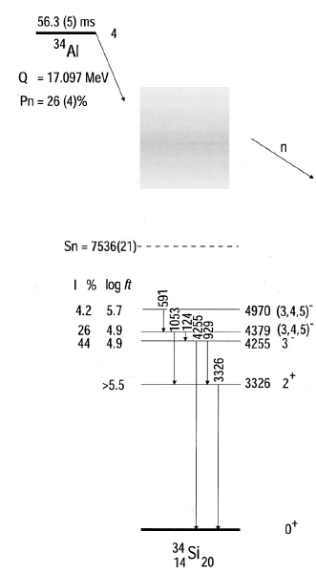
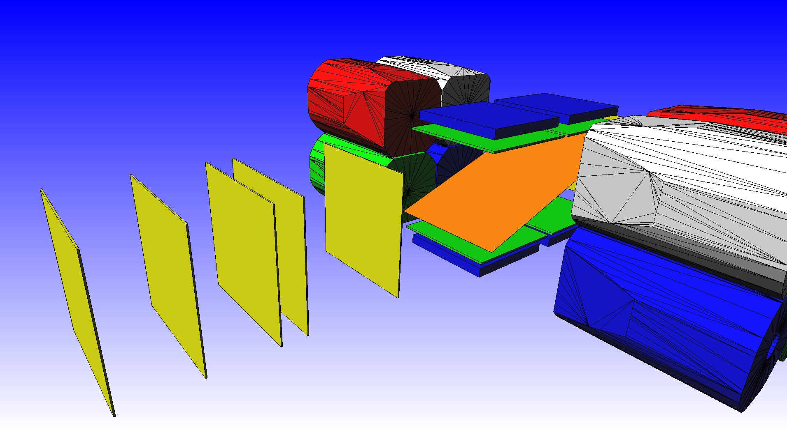
0⁺₂ in ³⁴Si : the experiment
1⁺
Experiment :
production the ³⁴Al in the "predicted" isomeric 1⁺
→ projectile fragmentation @ GANIL/LISE
- implantation in a Kp foil
4⁻
b
trigger on the β-decay from the gs and the isomer and
measurement of the energy of both e⁺ and e⁻ in coincidence
→ 4 Si-SiLi telescopes
β
measurement of the gamma-rays
  → 2 Ge clovers (EXOGAM)
F. Rotaru et al., Phys. Rev. Lett.109 (2012)092503
0⁺₂
e+ e-
Erot1
Edeg1&2
E2XY
E1D6
GANIL/LISE3 Experiment, may 2010

Slide 5
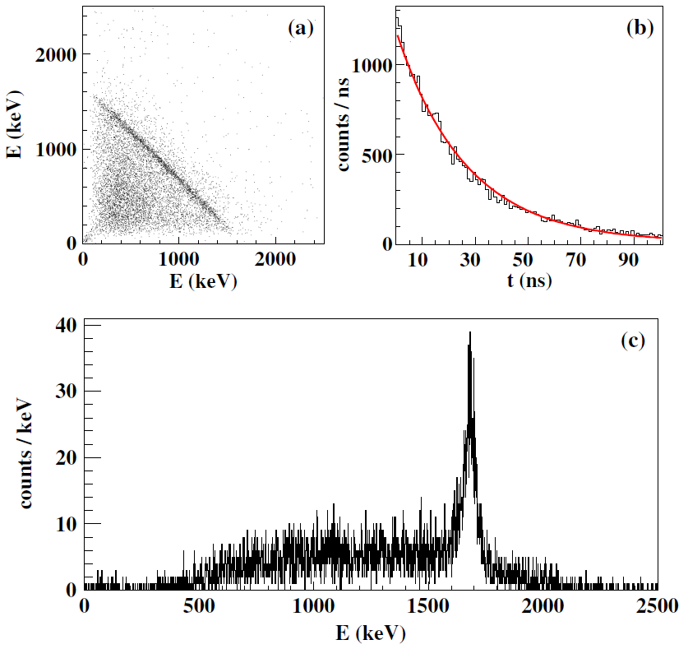
0⁺₂ in ³⁴Si : experimental results 1/3
1⁺
4⁻
4⁻
4⁻
β⁻
e⁺ e⁻
2719(3) 0₂⁺
19.4(7) ns
F. Rotaru et al., Phys. Rev. Lett.109 (2012)092503
E_{e1}+E_{e2} = cst = 1697(3) keV
E(0⁺₂) = 1697 keV
+ 1022 = 2719(3)
T_{1/2}(0⁺₂) = 19.4(7) ns
Electric monopole strength:
ρ²(E0)=(13 ± 0.9)x10⁻³

Slide 6
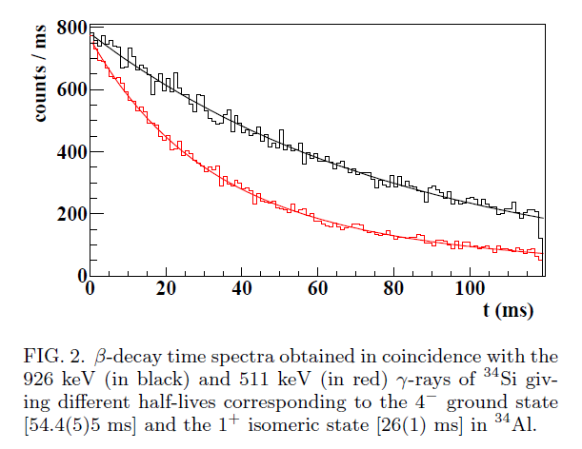
0⁺₂ in ³⁴Si : experimental results 2/3
1⁺
4⁻
26 (1) msec
4⁻
54.4 (5) msec
β⁻
Beta decay time from ³⁴Al :
e⁺ e⁻
19.4(7) ns
2719(3) 0₂⁺
F. Rotaru et al., Phys. Rev. Lett.109 (2012)092503
54.4 (5) msec
26 (1) msec

Slide 7
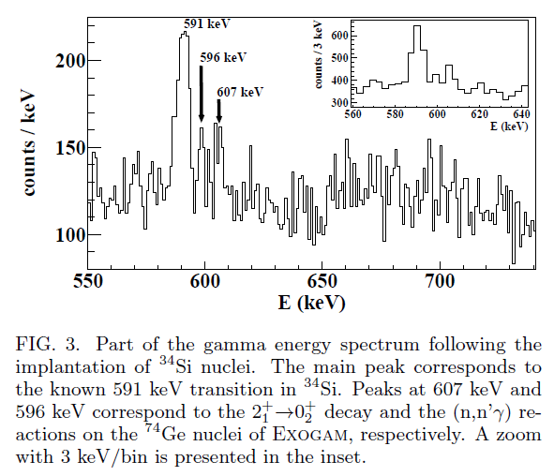
0⁺₂ in ³⁴Si : experimental results 3/3
1⁺ 26 (1) msec
4⁻
4⁻
?
17(7)
19.4(7) ns
2719(3) 0₂⁺
F. Rotaru et al., Phys. Rev. Lett.109 (2012)092503
B(E2:2⁺₁→0⁺₂) from
- B(E2:2⁺₁→0⁺₁) = 17(7) e²fm⁴
Coulex : Ibbotson, PRC80(1998)2081
- Iγ(3326 keV)/Iγ(606 keV) = 1380(717)
B(E2:2⁺₁→0⁺₂) = 61(40) e²fm⁴

Slide 8
0⁺₂ in ³⁴Si : mixing and deformation
1⁺ 26 (1) msec
4⁻
4⁻
17(7)
19.4(7) ns
61(40)
2719(3) 0₂⁺
F. Rotaru et al., Phys. Rev. Lett.109 (2012)092503
ρ²(E0: 0⁺₂→0⁺₁) = 13.0(0.9) mu
B(E2: 2⁺₁→0⁺₂) = 61(40) e²fm⁴
+
B(E2: 2⁺₁→0⁺₁) = 17(7) e²fm⁴
 mixing of the 0⁺ states : cos²θ ~ 0.22
ρ² = (3Z/4p)²cos²θ∗(1−cos²θ)∗(β₁²-β₂²)²
if spherical-deformed configuration → β₂ = 0
 β₂ ~ 0.29

Slide 9
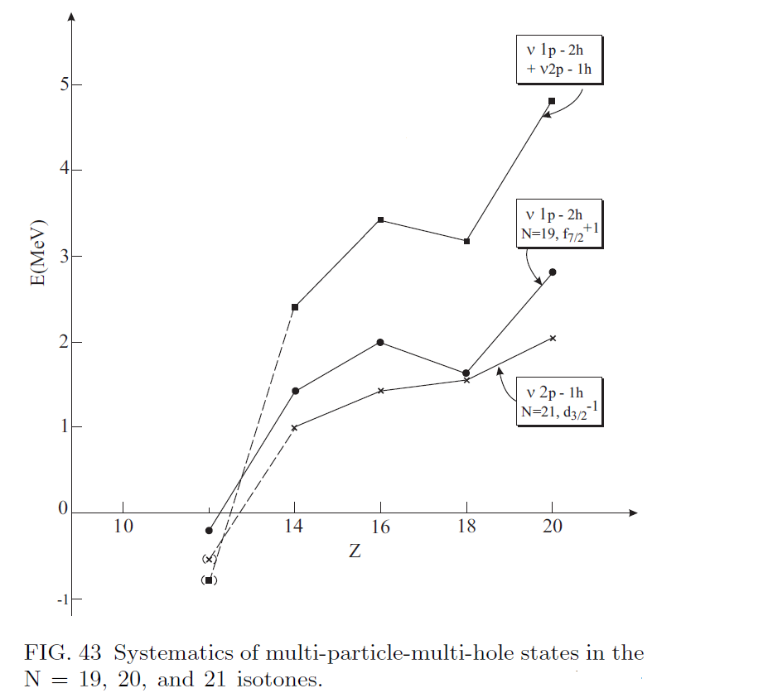
0⁺₂ in ³⁴Si : np-nh excitations
f_{7/2}
d_{3/2}
2ħω
s_{1/2}
ν
d_{5/2}
0⁺₁
f_{7/2}
From Heyde and Wood, Rev. Mod. Phys.
d_{3/2}
7/2⁻
s_{1/2}
ν
d_{5/2}
3/2+
f_{7/2}
d_{3/2}
3/2⁺
s_{1/2}
ν
d_{5/2}
7/2⁻
 The energy of the 0⁺₂ in ³⁴Si is in agreement with a 2p-2h character

Slide 10
0⁺₂ in ³⁴Si : Shell model calculations
Important to have a interaction capable of describing various situations in a unified manner.
In particular, the major pillars to understand the Island of Inversion are the 0⁺_{1,2} states in ³⁰Mg, ³²Mg and ³⁴Si
A good interaction should therefore be able to reproduce :
- addition of two neutrons to ³⁰Mg → 3 MeV shift
0⁺_{def}
1789
-3 MeV
0⁺_{sph}
gs
1058
0⁺_{sph}
gs
0⁺_{def}
³⁰Mg
³²Mg
- removal of two protons from ³⁴Si → 4 MeV shift
0⁺_{def}
2713
-4 MeV
0⁺_{sph}
gs
1058
0⁺_{sph}
gs
0⁺_{def}
³⁴Si
³²Mg

Slide 11
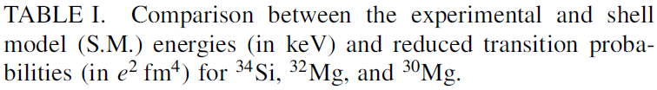
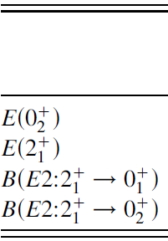



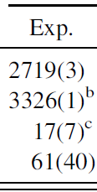

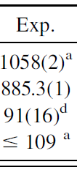

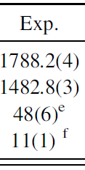

SDPF-U-SI interaction : F. Nowacki and A.Poves, PRC79(2009)014310
valence protons : sd shell
valence neutrons : sd or pf shell → no (sd → pf) neutron excitations
 labeled "0ħω"
not able to describe nuclei in wich neutron
excitations from sd to pf are important
such as, by definition, in the "island of inversion"
20
8
8
8
π
ν
π
ν
To account for (sd → pf) neutron excitations : A. Poves & Strasbourg/Madrid coll.
off diagonal matrix elements
Lee-Kahana-Scott G matrix
scaled as for the description of the SD states
in ⁴⁰Ca (multi p-multi h excitations)
8
8
neutron SPE's for sd-pf shells on a ¹⁶O core
- sd → standard USD
- fp → no experimental guidance
 SDPF-U-SI in case of 0ħω limit
 0⁺₂(³⁰Mg) at the correct energy
→ SDPF-U-MIX interaction
decrease of the 0⁺_{def}
Expt. SM
³⁴Si→³²Mg
3767 3852
³⁰Mg→³²Mg
2846 2999

Slide 12
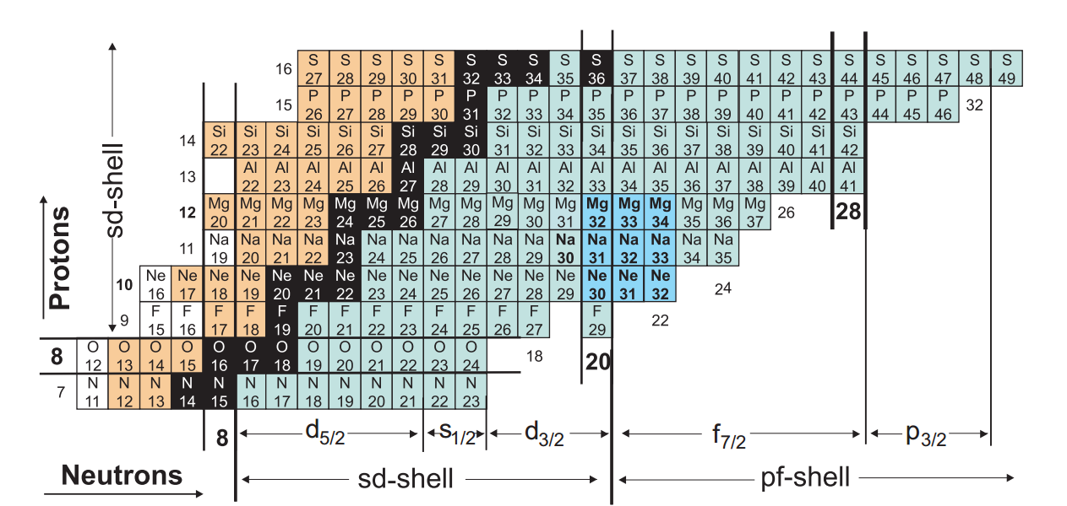
Intruder 1+ state in ³⁴Al : ISOLDE Experiment IS530
0⁺
³⁴Mg
(1⁺)
26(1)ms
³⁴Al : 1⁺ excited state → π(d_{5/2})⁵  ν(d_{3/2})⁻¹(f7/2)⁺²
?
4⁻
³⁴Al
54.4(5)ms
³⁴Al : 4⁻ ground state → π(d_{5/2})⁵  ν(d_{3/2})⁺⁴(f7/2)⁺¹
³⁴Mg beta decay experiment at ISOLDE

Slide 13
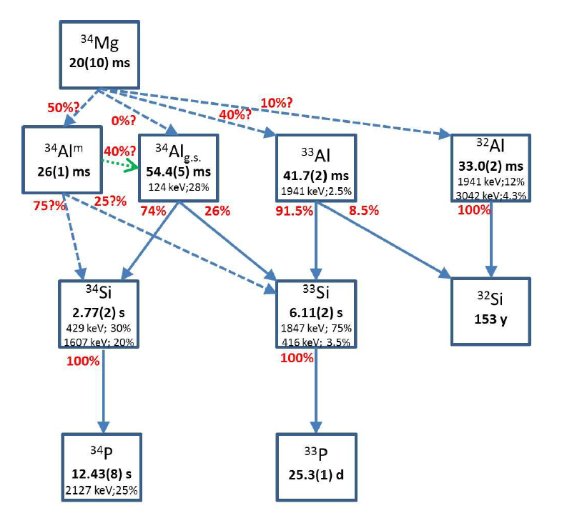
Intruder 1+ state in ³⁴Al : ISOLDE Experiment IS530
  Motivations :
  Measure the excitation energy of the newly observed 1⁺ isomer;
  First time measurement of the gamma rays following the β- decay of ³⁴Mg
  Build the first level scheme for ³⁴Al
  Measure the intensity of the (2⁺ → 0₂⁺) transition in ³⁴Si
  → B(E2 : 0⁺₂→2+)

Slide 14
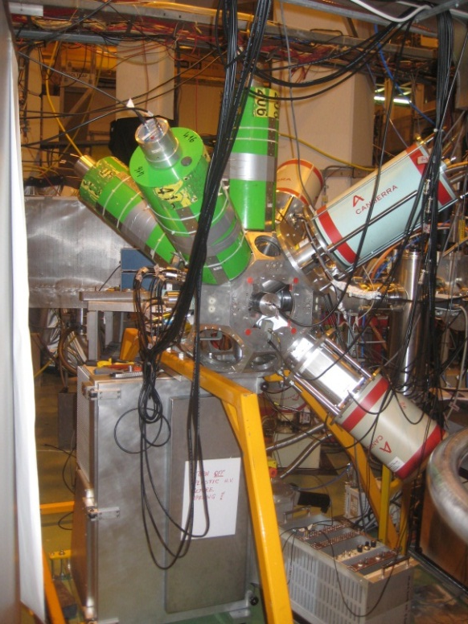
Intruder 1+ state in ³⁴Al : ISOLDE Experiment IS530
september 2012
Structure – based on OSIRIS (Bucharest)
3 CLOVER detectors (Bucharest)
1 HPGe detector (90%) (Strasbourg)
5 LaBr₃ detectors (4 Legnaro, 1 Bucharest)
~4π NE102 plastic scintilator (Bucharest)
3 neutron detectors (NE213 DEMON, Strasbourg)
Tape station (Strasbourg)
Data ACQ (Bucharest)

Slide 15
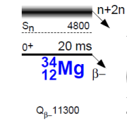
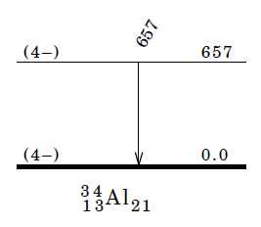
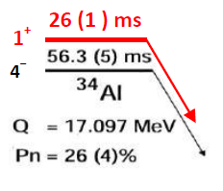
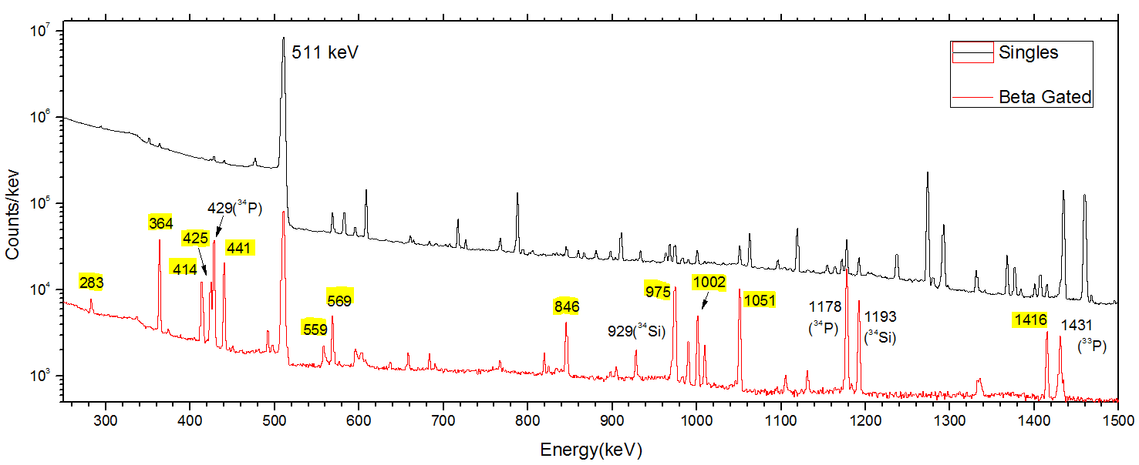
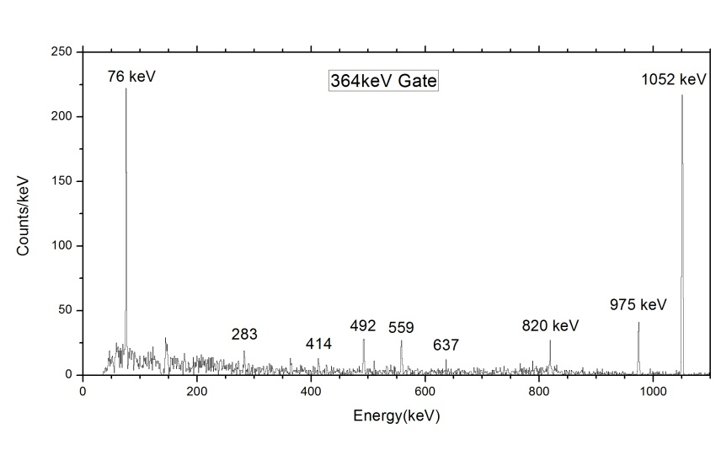
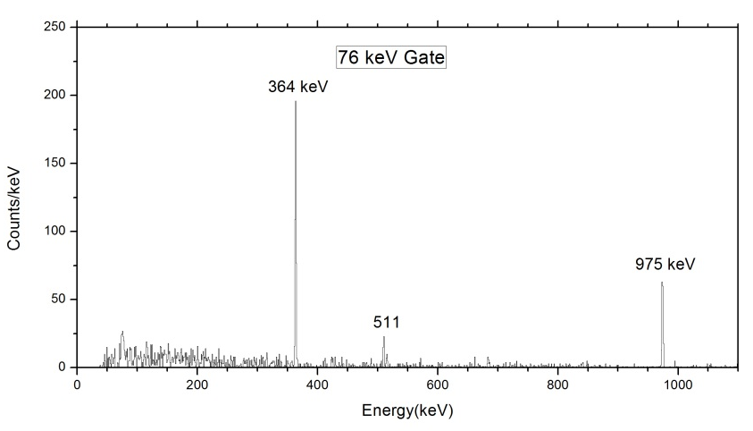
Intruder 1+ state in ³⁴Al : ISOLDE Experiment IS530
Scarce information for ³⁴Al in ENSDF (Coul.Ex.)
Many strong unassigned gammas observed in the beta gated HPGe spectra
ENSDF
F.Rotaru et al., PRL 109, 092503 (2012)
IS530 data

Slide 16
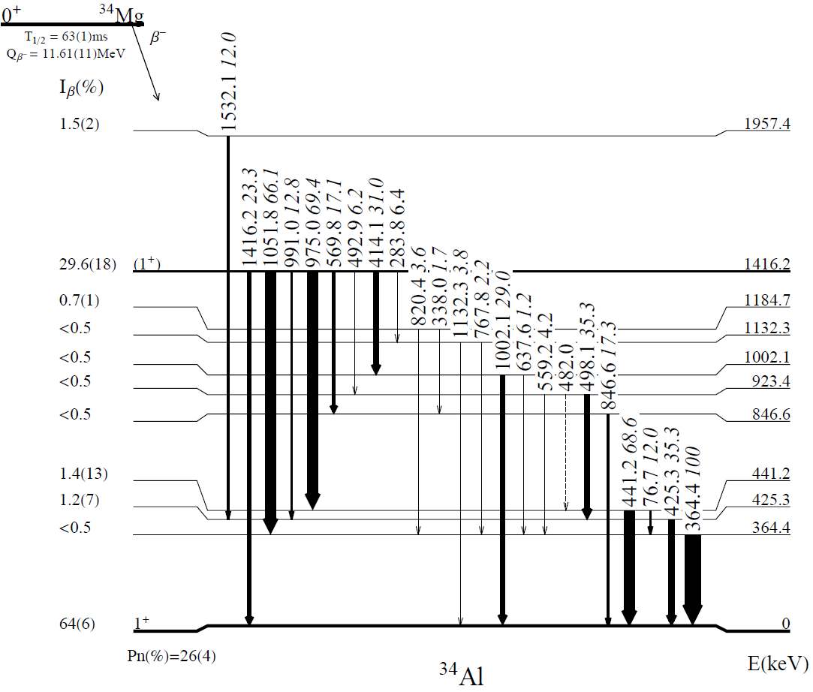
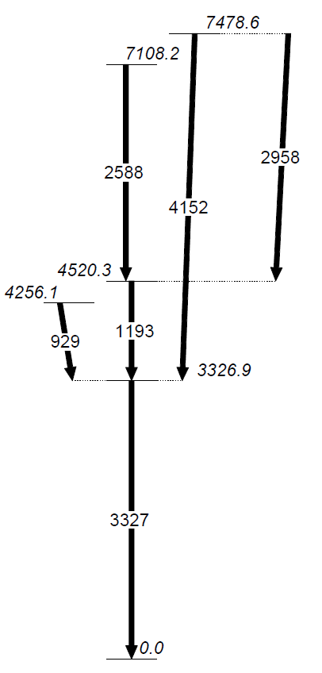
Intruder 1+ state in ³⁴Al : ISOLDE Experiment IS530
  New half-life for ³⁴Mg – 63(1)ms
  First time measurement of the gamma rays following the β- decay of ³⁴Mg
  The first level scheme for ³⁴Al
  Improved level scheme for ³⁴Si
100% feeding of the 1⁺ in ³⁴Mg→³⁴Al
 no information about the
excitation energy of the 1⁺ state
I_{β} (%)
12
5
2₁⁺
0₂⁺
58
e⁻
e⁺
25
0₁⁺
³⁴Si

Slide 17
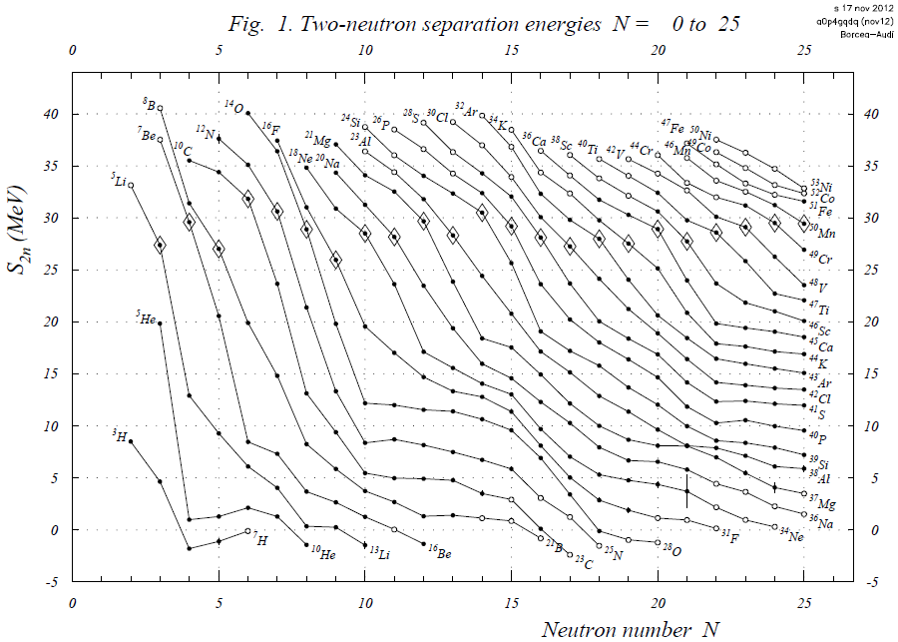
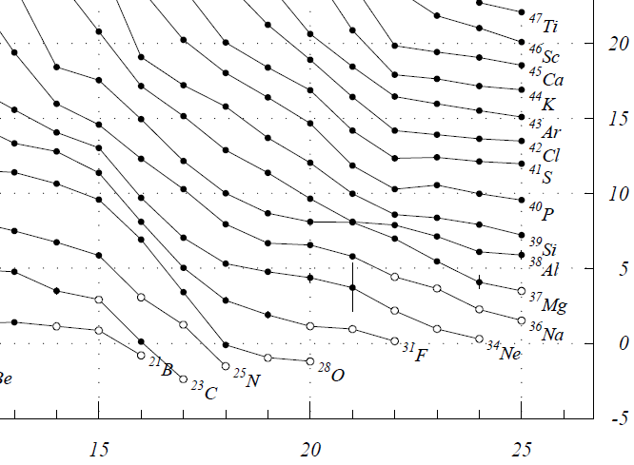
Intruder 1+ state in ³⁴Al : isomer or ground state ?
A. Chaudhuri et al., Phys. Rev. C88(2013)054317 - november 2013
Crossing between ³³Mg and ³⁴Al !
→ unexpeted… (attractive p-n int.)
4⁻ is believed to be the g.s. because it was
observed first using an ISOL technique
→ slow
→ 4⁻ (54ms) could be favored / 1⁺ (26ms)
→ it could be the isomer !
mass measurement of the 1⁺ state
after β-decay of ³⁴Mg
proposal at ISOLTRAP and TITAN

Slide 18
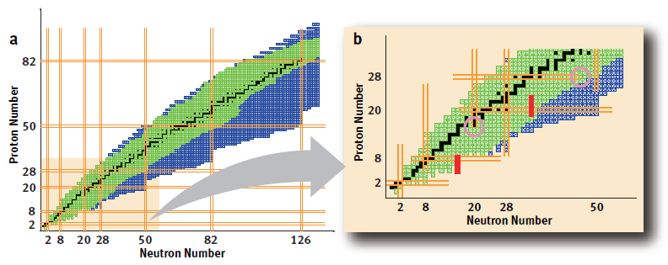
Conclusions
0⁺₂ state in ³⁴Si → better characterization of the shape coexistence at N=20
extention of the the SDFP-U-SI interaction →neutron excitation above N=20
→ SDPF-U-MIX : description of both the N=20 and N=28 regions
first study of the beta-decay of ³⁴Mg
    → new T_{1/2}
    → first level scheme in ³⁴Al (above 1+ state)
Perspectives (from an experimental point of view)
Better characterize the isomer/ground state in ³⁴Al
  → g factor measurement (accepted experiment at GANIL)
  mass measurement (accepted at ISOLDE and TRIUMF)

Slide 19
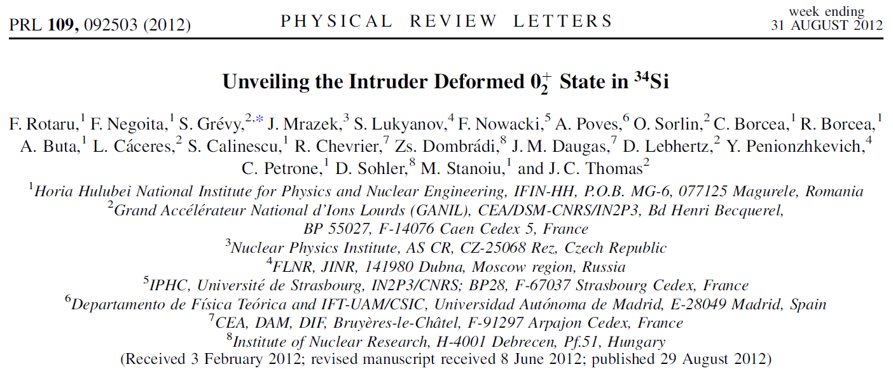
R.Lică¹, F.Negoiță¹, S.Grevy², N.Mărginean¹, Ph.Desagne³, T.Stora⁴, F.Rotaru¹,
C.Borcea¹, R.Borcea¹, S.Călinescu¹, J.M.Daugas⁵, D.Filipescu¹, I.Kuti⁸, L.Fraille⁹, S.Franchoo⁶, I.Gheorghe¹, D.G.Ghiţă¹, R.Mărginean¹, C.Mihai¹, P.Mourface⁶, P.Morel⁵, J.Mrazek⁷, A.Negreț¹, D.Pietreanu¹, T.Sava¹, D.Sohler⁸, M.Stănoiu¹, I.Stefan⁶, R.Șuvăilă¹, S.Toma¹, C.A.Ur^{1,10}
1 IFIN-HH, Bucharest, Romania,
2 CENBG, Bordeaux, France
3 IPHC, Strasbourg, France
4 ISOLDE/CERN, Geneva, Switzerland
5 CEA, DAM, DIF Arpajon, France
6 IPN, Orsay, France
7 NPI, AS CR, Rez, Czech Republic
8 Atomki, Debrecen, Hungary
9 Universidad Complutense, CEI Moncloa, Madrid, Spain
10 INFN - Sezione di Padova, Italy

Slide 21
backup slides

Slide 22
0⁺₂ in ³⁴Si : Shell Model calculations
SDPF-U-MIX
decrease of the 0⁺_{def}
Expt. SM
³⁴Si→³²Mg
3767 3852
³⁰Mg→³²Mg
2846 2999
26(1)ms
1⁺
4⁻
30 ms
0.550 1⁺ 92% 2p-1h
4⁻ 78% 0ħω
54.4(5)ms
59 ms
b
b
b
Excellent agreement
experiment – Shell Model
60%
5⁻
3⁻
4⁻
~5000
30%
3510 2⁺
61(40)
67
2713(3)
0⁺₂
2570
0⁺₂ 86% 2p-2h
17(7)
10%
11
0⁺₁ 89% 0ħω

